Slide 1
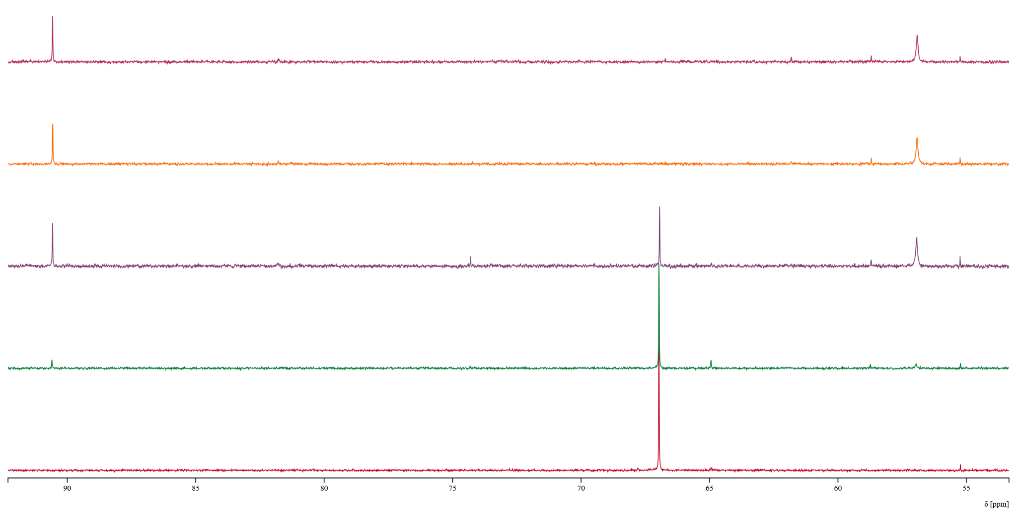
7 h
5 h
3 h
1 h
0 h

