Slide 1
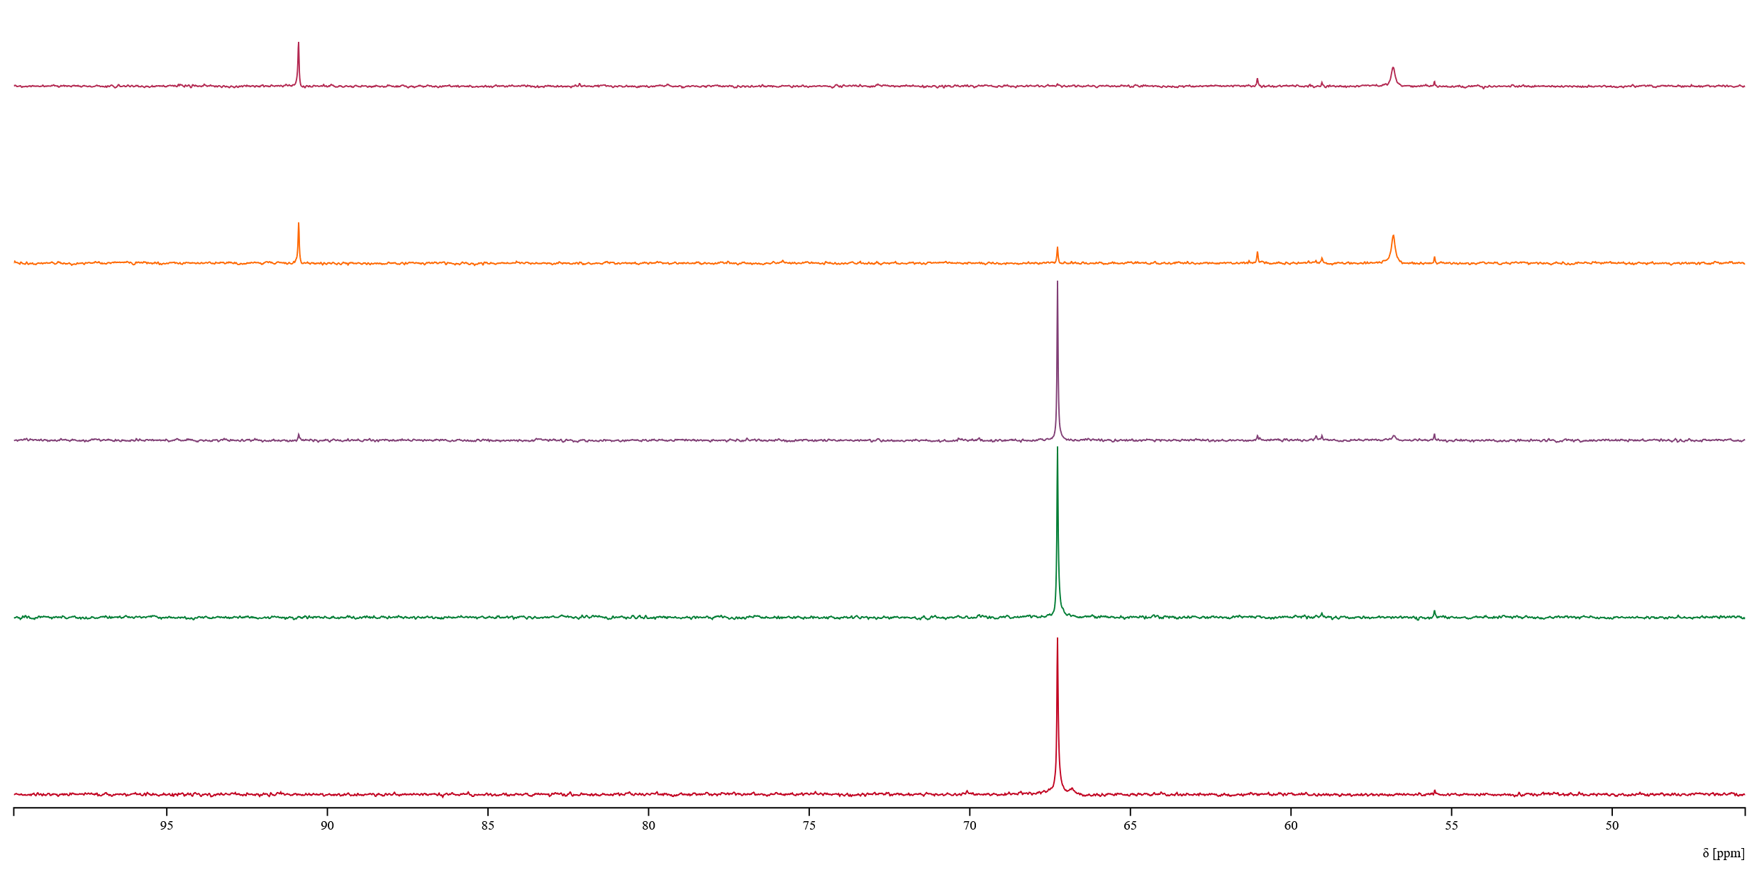
48 h
24 h
4 h
1 h
0 h

