Slide 1
Corporate Stress Testing
GSST
Risk Capital
Run Manager

Slide 2
Description:
Team Members:
5
Tools:
SVN, TeamCity + Jenkins + Sonar
Technologies:
Google protobuf, Guava, EH-Cache, Jetty, Spring, Hibernate, POI, AB Initio, IBM Cognos, Python and Perl …etc.

Slide 3


Corporate Stress Testing Overview
Stress Loss Calculation is done by data providers
Stress packages
> Board Of Directors
> Regional, Consumer, Consolidated
Data Sources
Data Providers
Stress Test Team
> GMR
ICG Trading
Upload Stress Test Results
> From excel file, flat file
> Copy data from other periods
> Modify data copy rules
> Send/Receive iVAST data
Generate Stress Reports
> Run batch reports
> Review and adjust stress reports
> Prepare final stress reports
Analysis
> Consolidated stress data
> Granular data from providers
> Data dump
> NOVA
> GRR
> MCC
> PSE
CVA Trading
FX Unhedged
non-USD
Book Capital
> MANUAL
CST Application
> STORM
> CALYPSO
> OASYS
Retail Macro
Hedges
CST GUI (via CitiRisk Portal)
Retail Credit
Data Maintenance
Process Monitoring
Reports
Analysis
> GCBC
> Data upload utility
> Data copy utility
> Data copy rules
> Risk type substitution rules
> Hierarchy maintenance
> Data upload process
> Batch report process
> iVAST feed process
> Data dump reports
> Single reports
> Batch reports
> Consolidated data
analysis
> Raw feed data
analysis
> GRR
> GCBC
Wholesale
Credit
> ARTEMIS
> CALM
ALM
> FIGARO
CAI
ETL (Ab Initio)
Java Services
Cognos Reports / Cube
> MANUAL
Pension Risk
CST Database
> Assumptions
> Spread Shocks
> Market Levels
> Curve Shifts
> Citi holdings Template
Instructions for
monthly stress
iVAST feed to & from GMR
testing
> Scenario definitions
> Business Unit Hierarchy
> Consolidated Stress Data
> Granular data from feeds
> Rules/Configuration info …

Slide 4
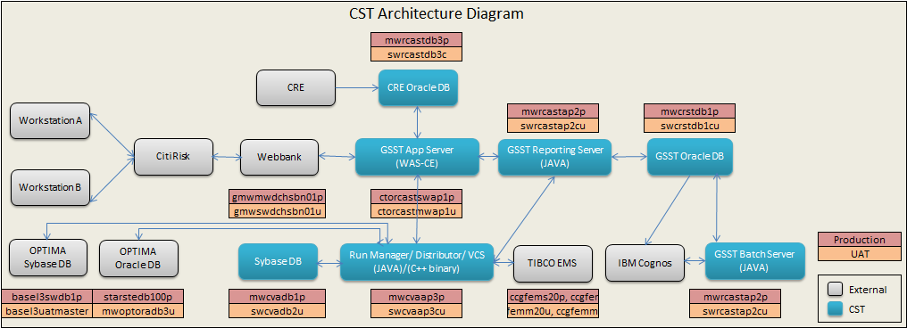
CST Architecture Diagram

Slide 5
Command Definition
Validation Command
Initiation Command
Upload Command
File Converter
Postprocessor
Preprocessor
Preprocessor
Validator
Loader
Postprocessor
Preprocessor
Enricher
Transformer
Aggregator
Loader
Postprocessor
Information Command
Informer
Report Command
Generator
Handler
Render

Slide 6
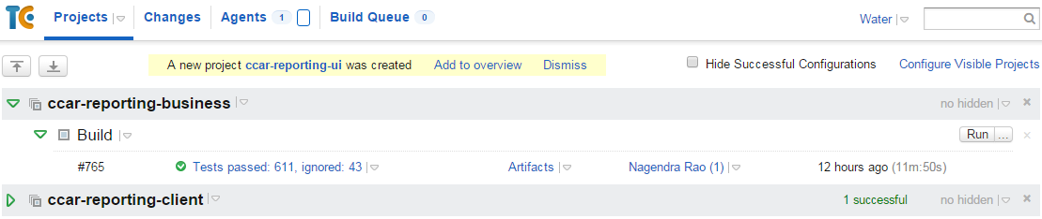
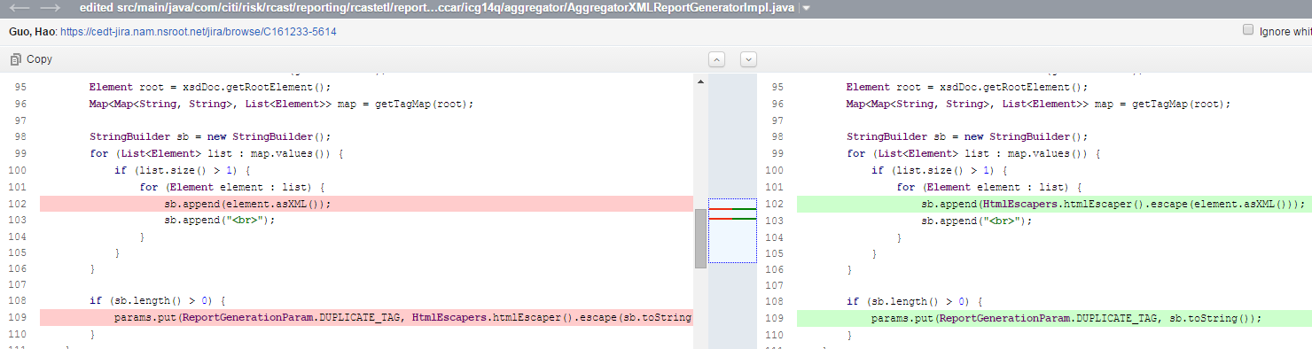
TeamCity
Run your changes without checking-in to SVN
Effective Code Reviews

Slide 7
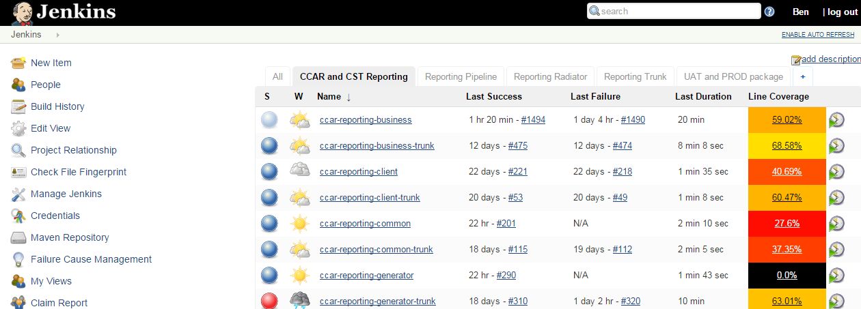
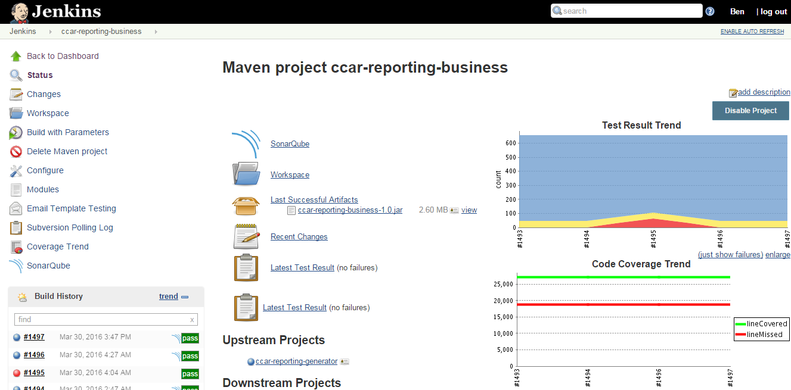
Jenkins
Maven Build Automation
Auto-Deploy for Dev

Slide 8
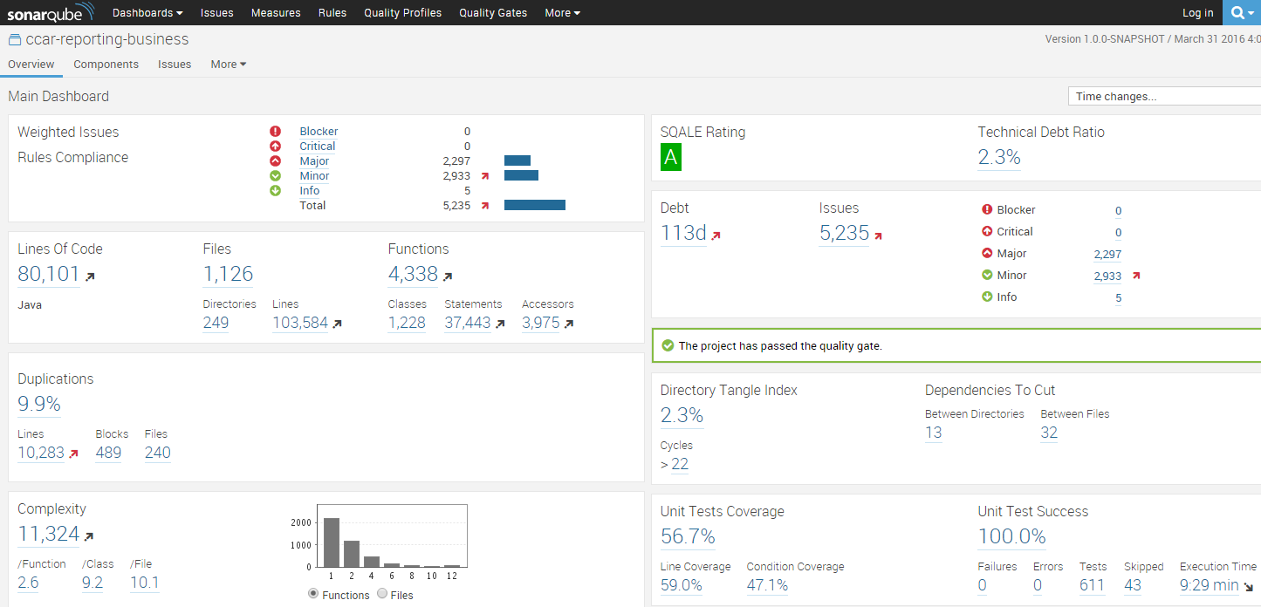
Sonar
View issues/rules compliance
View test case coverage
Improve Code Quality

Slide 9
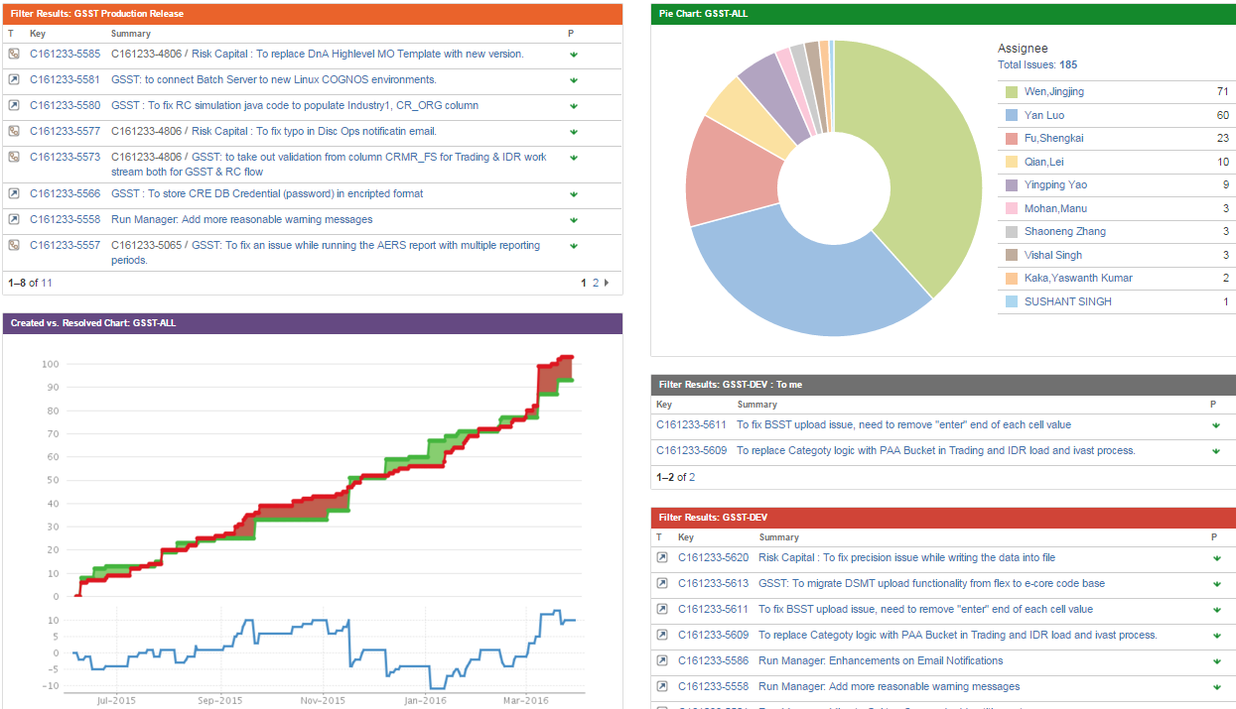
JIRA Dashboard
Task assignment and UAT/Production Release Version Control

Slide 10
Strengths and Weaknesses
Quick Learner
Problem Solver
Solid leadership and Organized skill
Work too hard sometimes
Get nervous when speaking in front of large groups
Speak less and Work more

