Slide 1
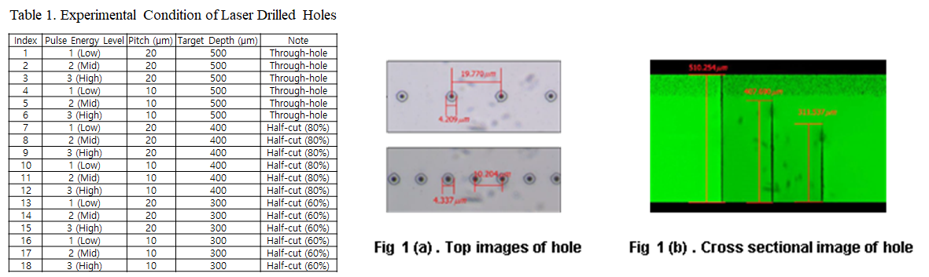
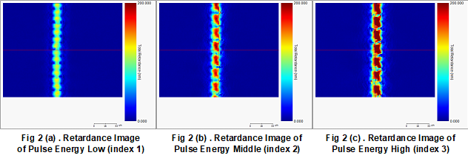
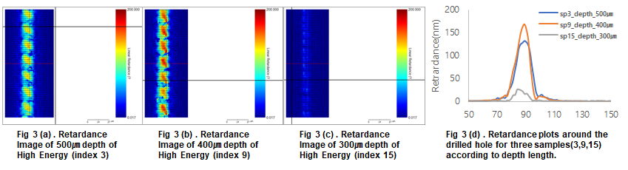
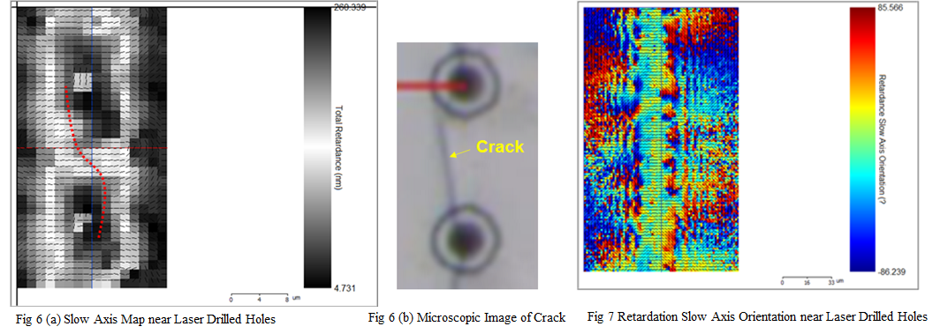
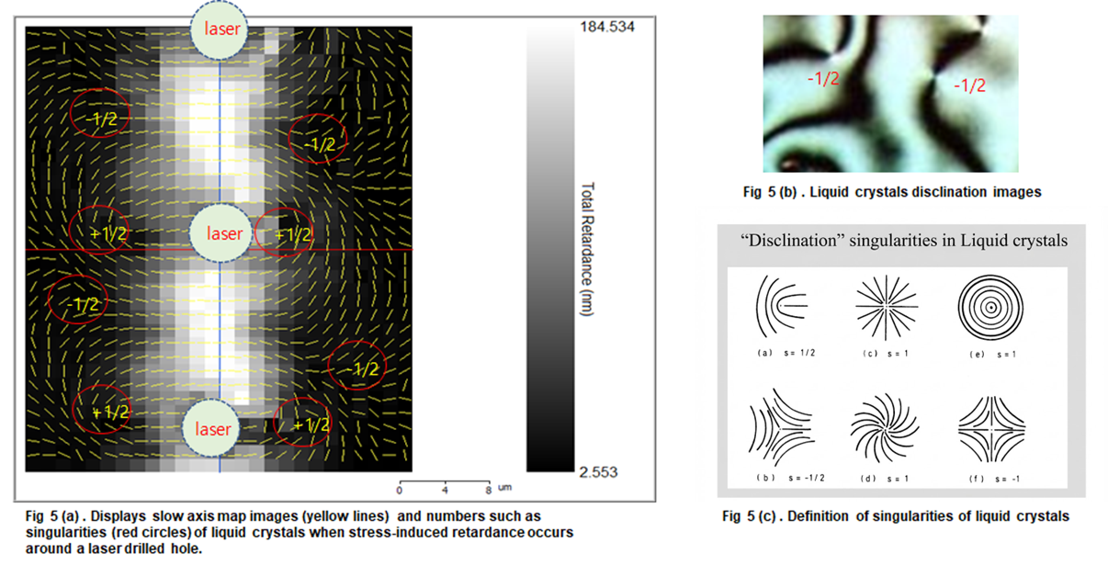
Poster #99
Stress-Induced Birefringence Measurement for Crack Detection in Bessel Beam Laser-Drilled Glass
Nakcho Choi, Jeongiin Park, Seongjun Lee
Mobile Display Division, Samsung Display Co., Ltd., Giheoung-gu, Yongin-City, Gyeonggi-Do, Korea
ABSTRACT
This study presents a non-destructive inspection methodology for detecting latent defects in laser-processed glass used in Under Display Cameras (UDC) and Glass Core Substrates (GCS). Building upon our previous research on microscopic stress-induced retardation in amorphous layers, we apply liquid crystal retardation sensing to visualize stress fields during laser drilling. We demonstrate that peak stress accumulation occurs at partial depths, serving as a precursor to cracks, enabling yield improvement for both advanced displays and semiconductor packaging.
1. INTRODUCTION
2. THEORY
3. METHODS
Objectives: Characterize stress vs. depth, correlate slow axis with crack trajectories
Photoelastic Effect:
Laser Processing:
Display-semiconductor convergence demands glass-based manufacturing for UDC and GCS [1, 2]
High-energy pulsed laser induces complex residual stress fields as micro-crack nucleation sites
Previously demonstrated Microscopic Stress-Induced Retardation in thin-film amorphous materials [3]
This work extends principle to bulk glass substrates subjected to high-energy laser drilling
Mechanical stress induces optical anisotropy in isotropic glass
Picosecond pulsed laser at 1064 nm
Bessel beam configuration
Pulse energy: Low (1), Mid (2), High (3)
Pitch: 10 and 20 μm
Processing depths: 300, 400, 500 μm
Phase Retardation Equation:
R = C × (σ₁ - σ₂) × d
where:
Measurement:
R: Phase retardation (nm)
C: Stress-optical coeff. (~3.5 x 10⁻⁶ mm²/N)
(σ₁ - σ₂): Principal stress difference
d: Optical path length through stressed region
Mueller matrix polarimeter (LC cell equipment)
Multi-wavelength: 450, 550, 650 nm
Outputs: Retardation magnitude & slow axis orientation
Goal: Effective in-line inspection for yield improvement [4, 5]
4. RESULTS: Retardance vs. Pulse Energy
5. RESULTS: Peak Stress at ~75% Depth
⚠️ KEY FINDING
Peak stress occurs at 400 μm (80% depth)
Highest retardance at 400 μm depth, followed by 500 μm and 300 μm. Stress increases gradually during drilling, then decreases after complete perforation through the 500 μm glass.
This "half-cut" stage represents the critical window for maximum crack initiation risk.
6. RESULTS: Slow Axis Predicts Crack Path
Slow Axis Orientation Analysis
Slow axis: Direction of maximum refractive index,
aligned with principal tensile stress (σ₁)
Crack propagation: Cracks propagate preferentially
perpendicular to slow axis vectors to minimize
elastic energy
7. DISCUSSION
The microscopic stress-induced retardation effect, previously characterized in thin-film heterostructures, operates as a dominant failure mechanism in bulk glass laser processing. The identification of the half-cut stress peak represents a paradigm shift: current protocols optimize for clean through-hole perforation, but the transient condition immediately before breakthrough presents the highest crack initiation risk. This necessitates a fundamental reconsideration of process optimization, shifting focus from final hole quality to stress evolution trajectory management.
8. CONCLUSION
Liquid crystal retardation metrology provides a powerful non-destructive method for predicting crack formation in laser-processed glass substrates
Maximum stress accumulation occurs at approximately 75% drilling depth rather than after completion
Slow axis vector analysis successfully forecasts crack propagation trajectories
Enables predictive quality control for UDC manufacturing and GCS fabrication in next-generation display and semiconductor packaging
REFERENCES
[1] Chen H, Park J, Lee S. Under-Display Camera Technology: Challenges and Solutions for Full-Screen Smartphone Displays. SID Symposium Digest of Technical Papers. 55, 234 (2024)
[2] Shorey AB, Cochet M, Bruex E. Glass Substrates for Advanced Packaging: From Interposers to Integrated Fanout. IEEE ECTC, 105 (2023)
[3] Choi NC, Yim T, Yoon Y, Cheong B, Hong M. Microscopic-stress-induced retardation between amorphous silicon nitride and amorphous indium zinc oxide having different stresses. Materials Research Express 6, 045209 (2019)
[4] Yamamoto K, Nakamura T. Photoelastic Measurement of Residual Stress Distribution in Chemically Strengthened Glass. Journal of Applied Physics. 125, 085102 (2022)
[5] Lau JH. Recent Advances and Trends in Advanced Packaging. IEEE Transactions on Components, Packaging and Manufacturing Technology, 12, 228 (2022)
[6] Chandrasekhar S. Liquid Crystals, 2nd ed. Cambridge University Press. 121 (1992)
Acknowledgments: This work was supported by Samsung Display Co., Ltd. | Contact: nakcho.choi@samsung.com | SID Display Week 2026, Los Angeles, CA

