Slide 1
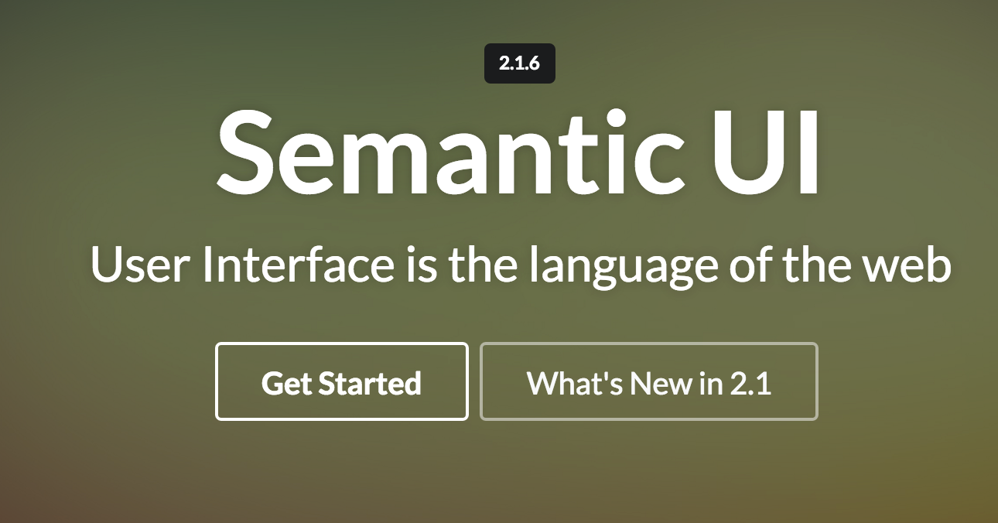
Semantic UI
Grids & Images

Slide 2
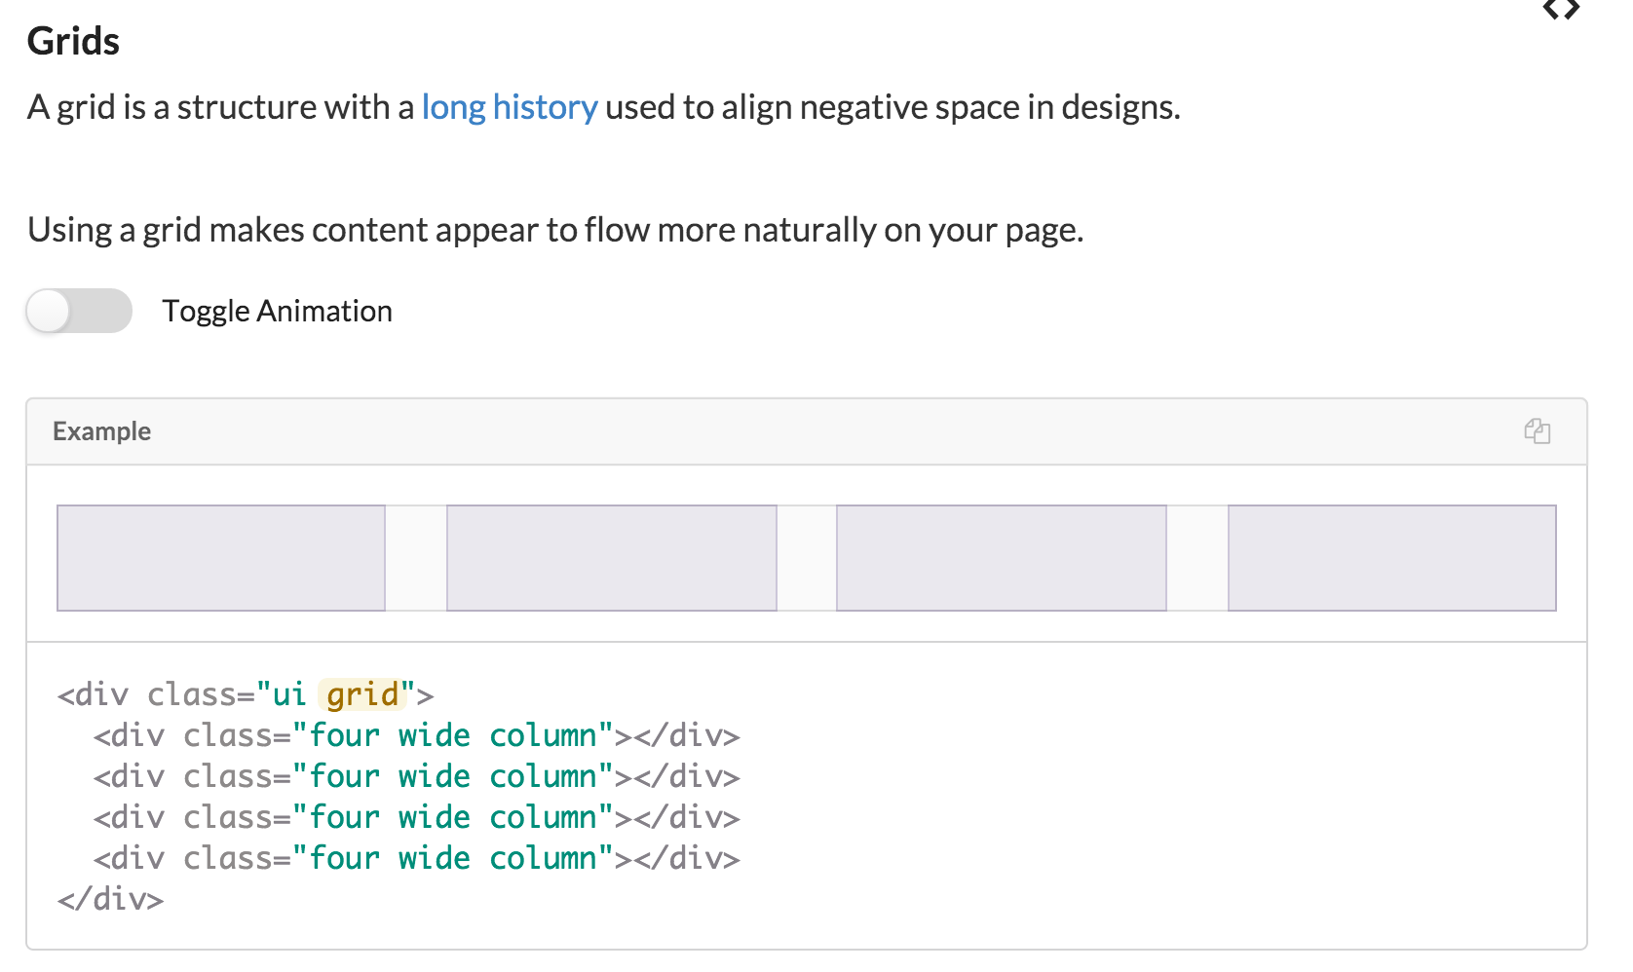
Grids

Slide 3
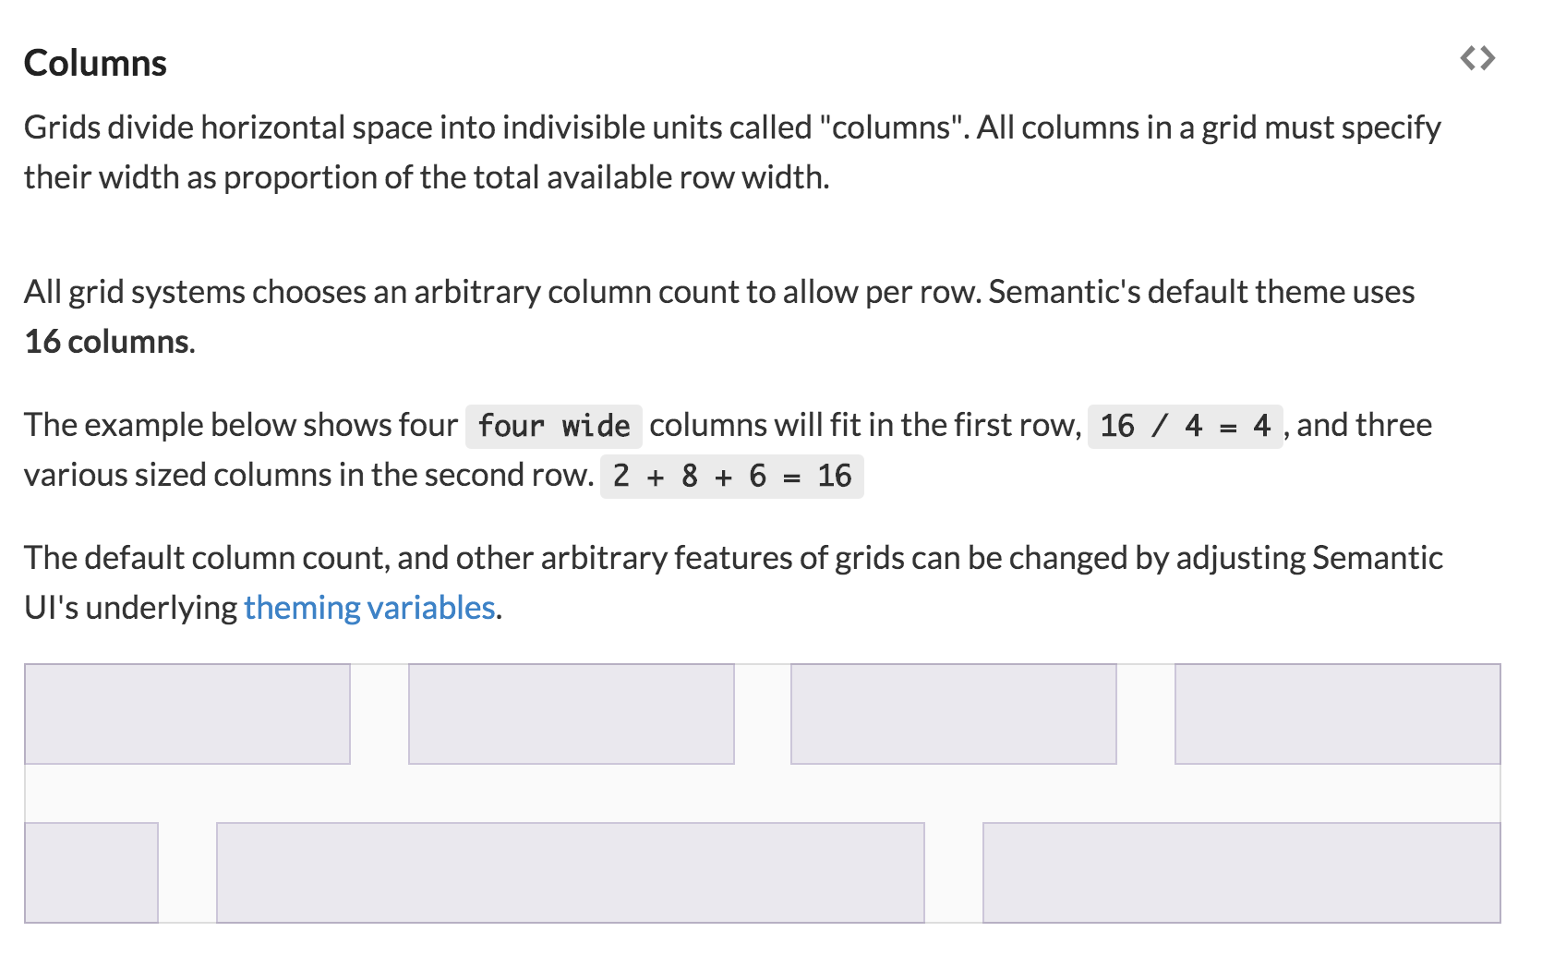

Slide 4
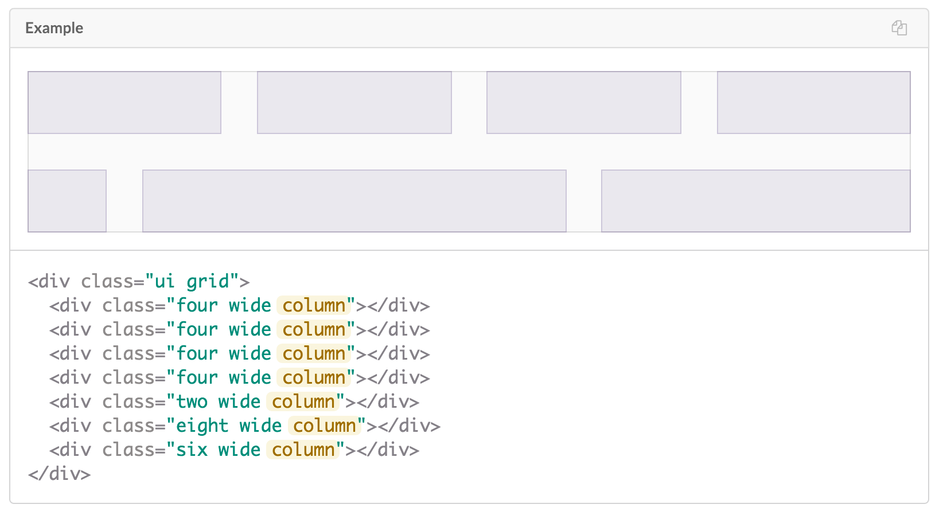

Slide 5
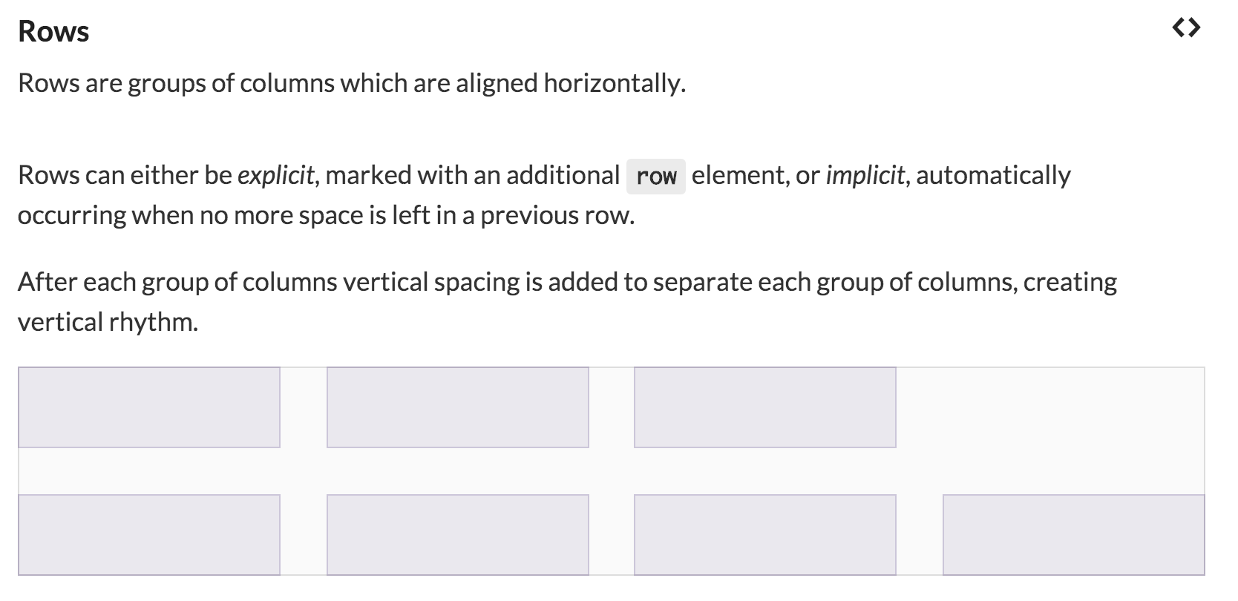

Slide 6
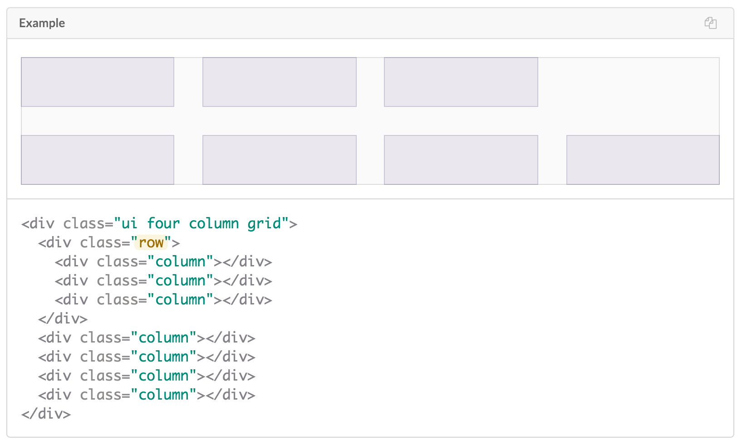

Slide 7



Grids in IoT Site
How to adapt this to render as shown below?

Slide 8

Two Columns

Slide 9

combining grid with segment
+ introducing 2 “ui column” divisions

Slide 10

Centre Alignment + ui image

Slide 11


Middle Alignment

Slide 13

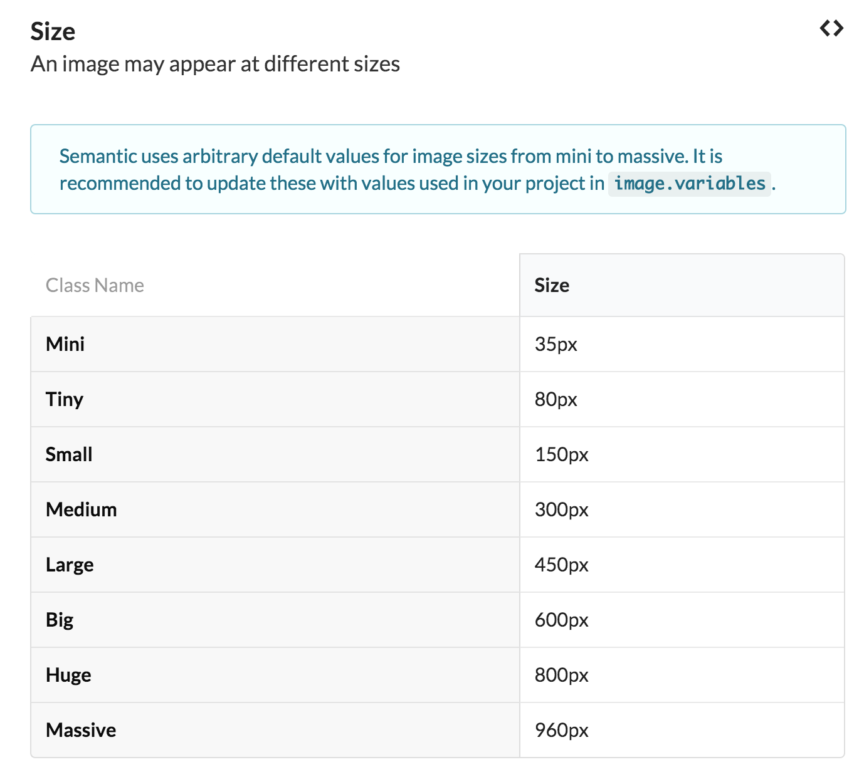
ui image

Slide 14



Slide 15
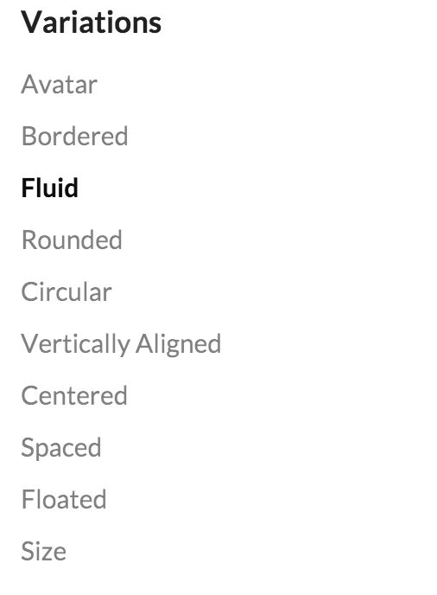
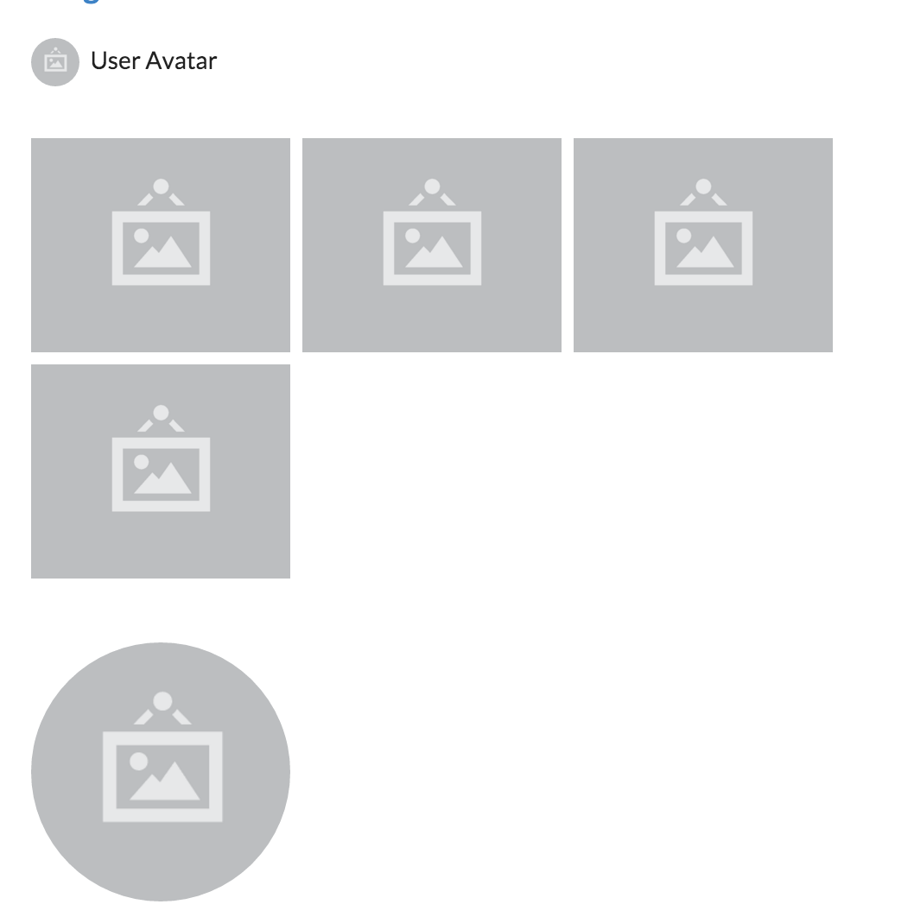
Image Variations

Slide 16


Grids & Image Example - Before

Slide 17

Grids & Image Example - After
Grid - center aligned
Two Rows
Row 1 - single column
Row 2 - 3 columns

Slide 18
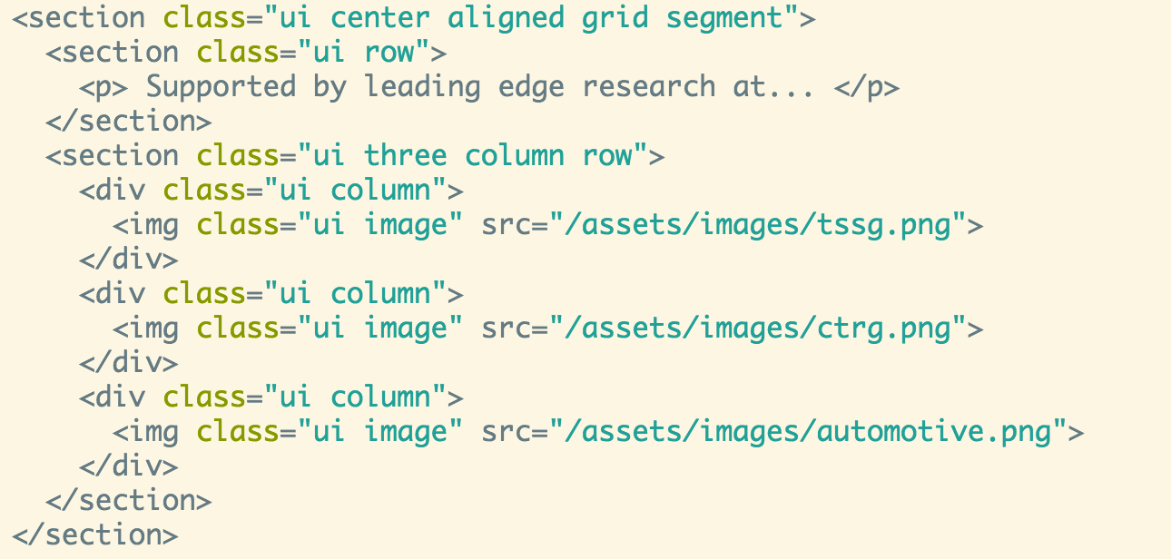
Grids & Image Example - After

Slide 19
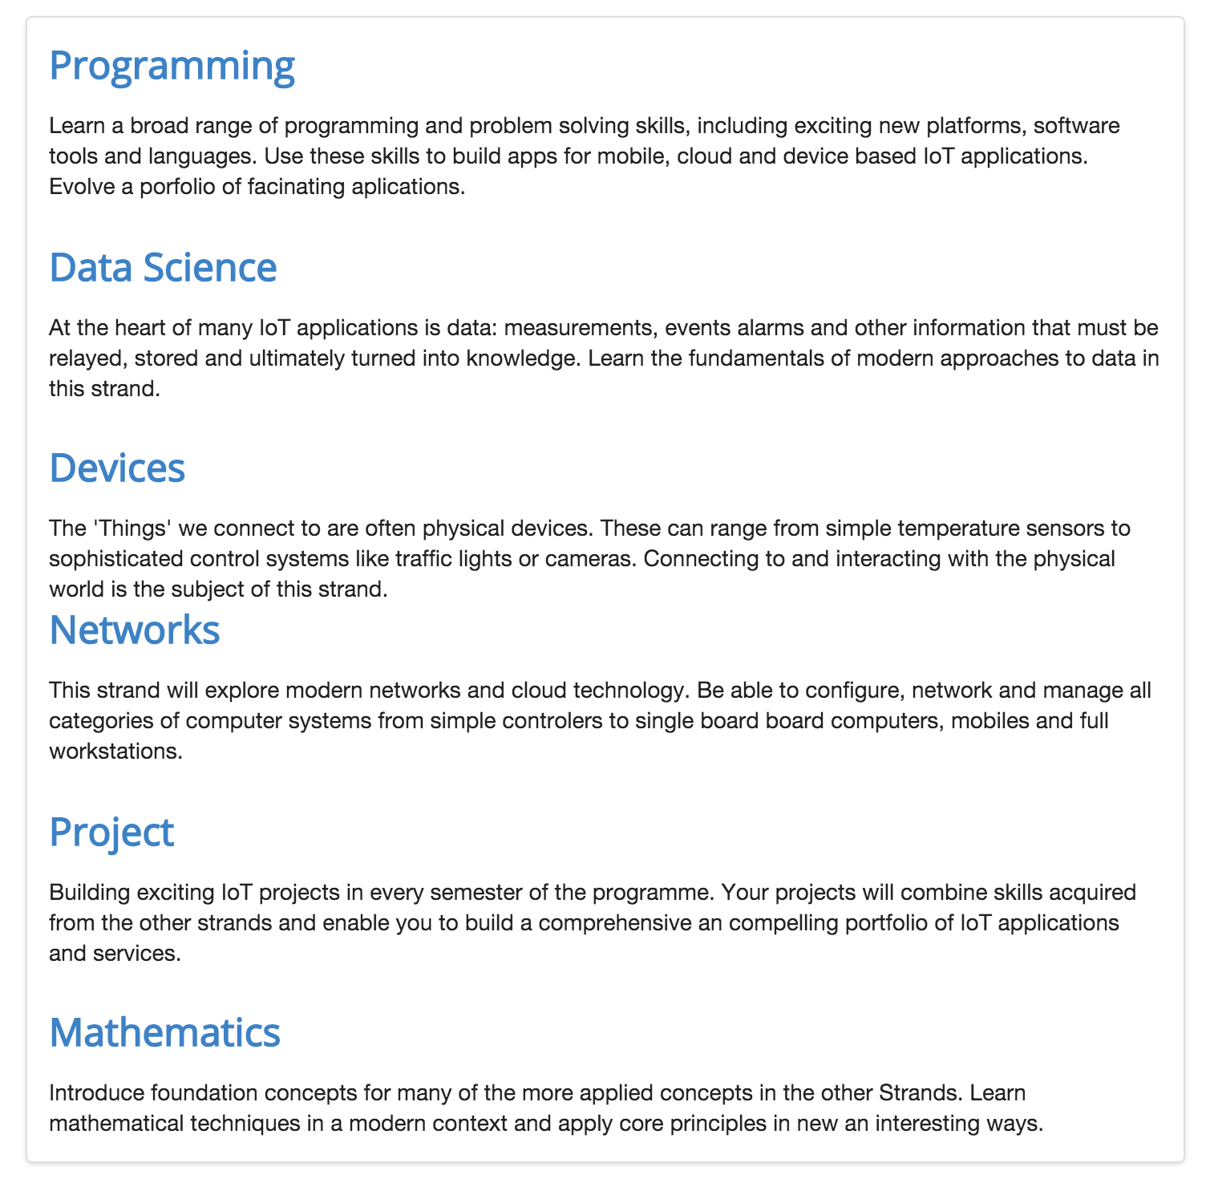
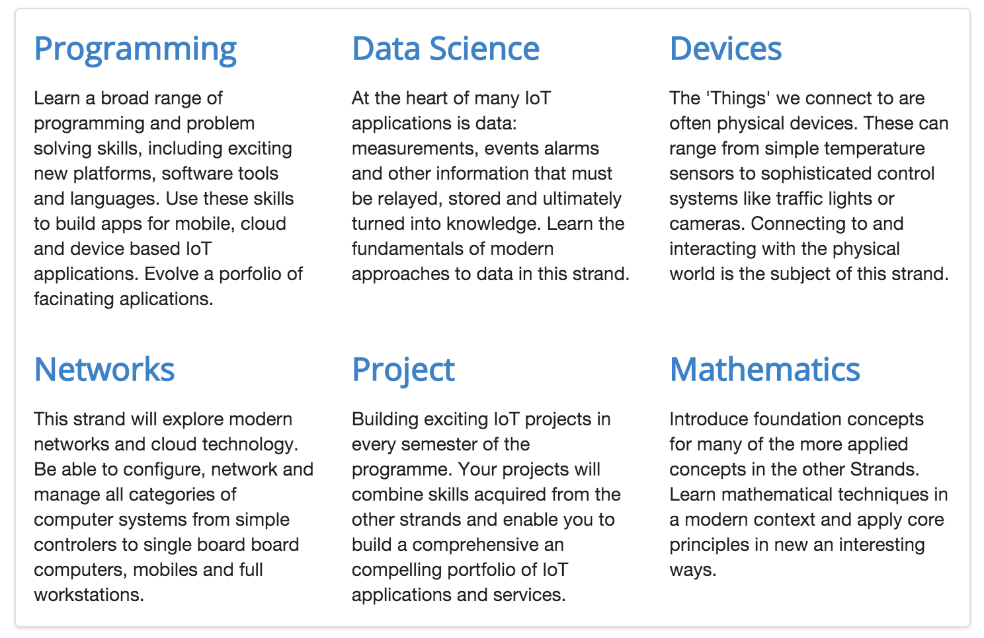
Text Grid Example

Slide 20
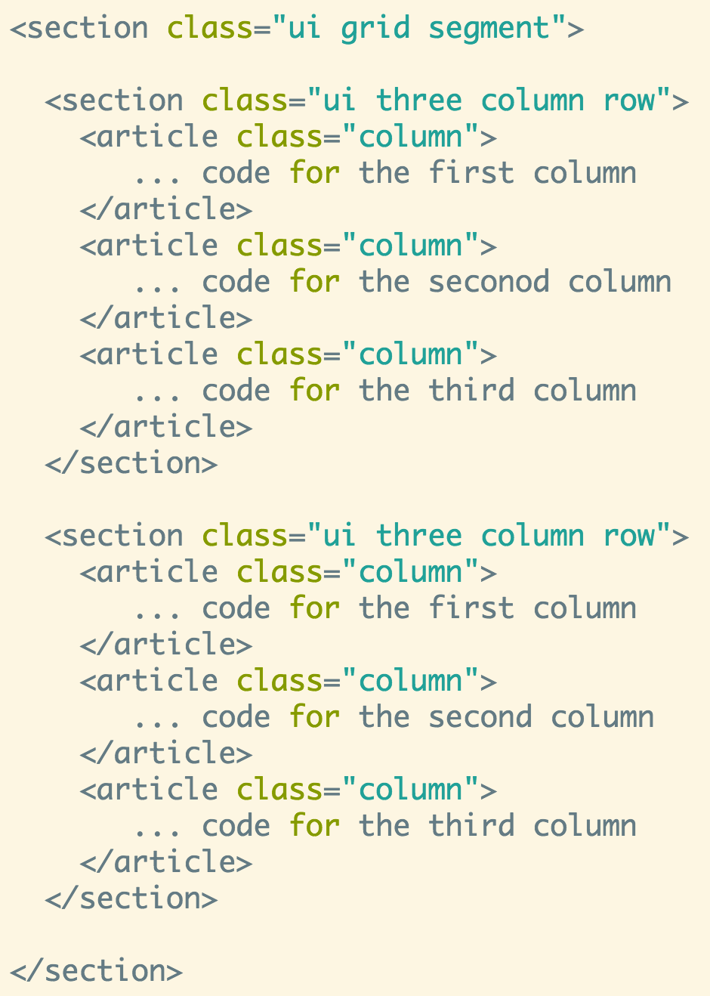
Two Rows
Row 1 - three columns
Row 2 - three columns

