Slide 1
Web Development
Eamonn de Leastar (edeleastar@wit.ie)

Slide 2
CSS: The Box Model
Web Development

Slide 3
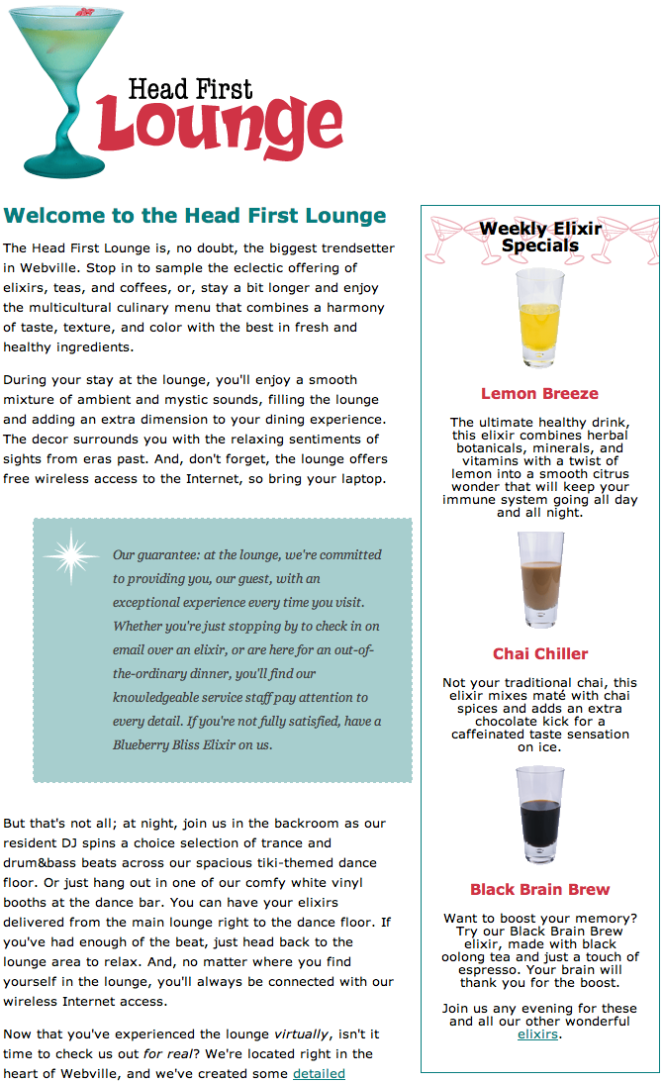
Box Model in Action

Slide 4
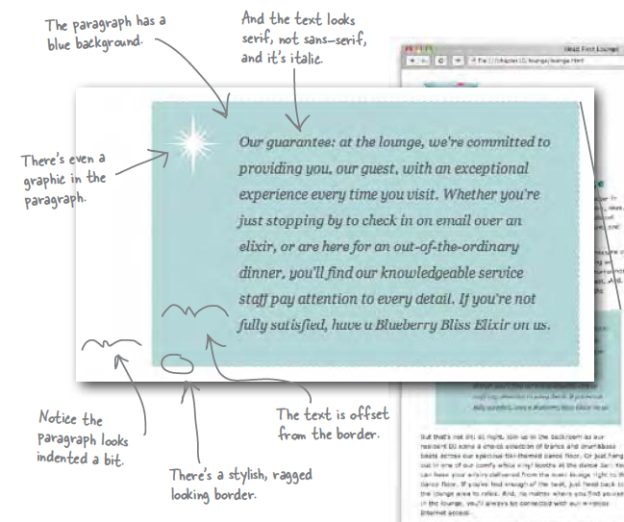
The “Guarantee” box

Slide 5
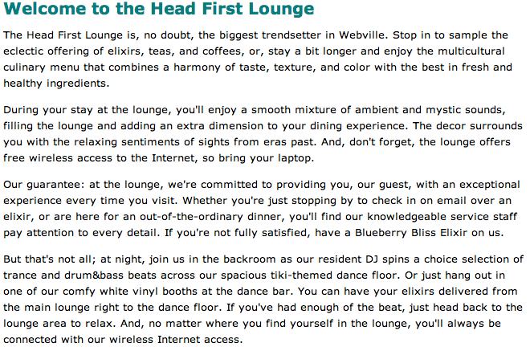
Use class to identify the “guarantee” paragraph
No styling initially
<p class="guarantee">
Our guarantee: at the lounge, we're committed to providing you,
our guest, with an exceptional experience every time you visit.
Whether you're just stopping by to check in on email over an
elixir, or are here for an out-of-the-ordinary dinner, you'll
find our knowledgeable service staff pay attention to every detail.
If you're not fully satisfied, have a Blueberry Bliss Elixir on us.
</p>

Slide 6
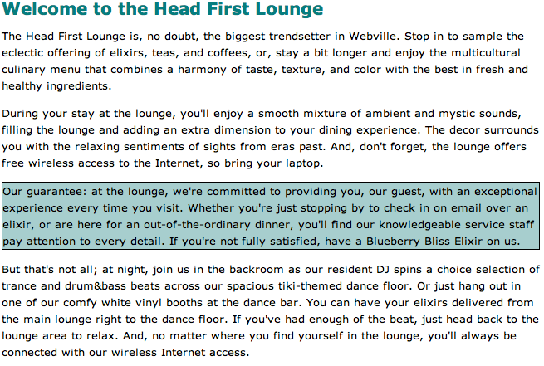
No padding around the content - i.e no space between text and border
No margin left/right
But there seems to be a margin top/bottom? -> Check Default Style Sheet
.guarantee
{
border-color: black;
border-width: 1px;
border-style: solid;
background-color: #a7cece;
}

Slide 7
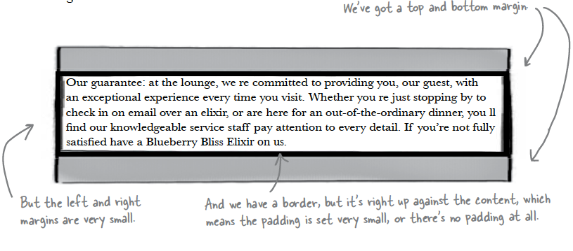
Box Model
Here’s what the paragraph would look like if we drew it as a box model diagram

Slide 8
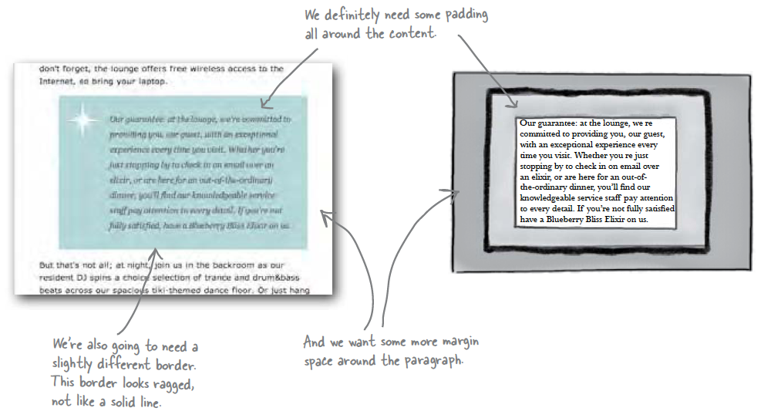
What we want:

Slide 9
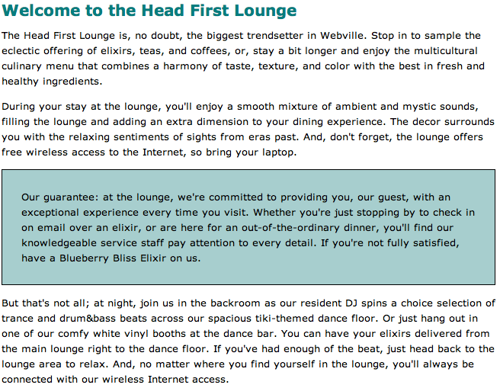
Add Padding
.guarantee
{
border-color: black;
border-width: 1px;
border-style: solid;
background-color: #a7cece;
padding: 25px;
}
Can be either to a number of pixels or a percentage of area inside the border

Slide 10
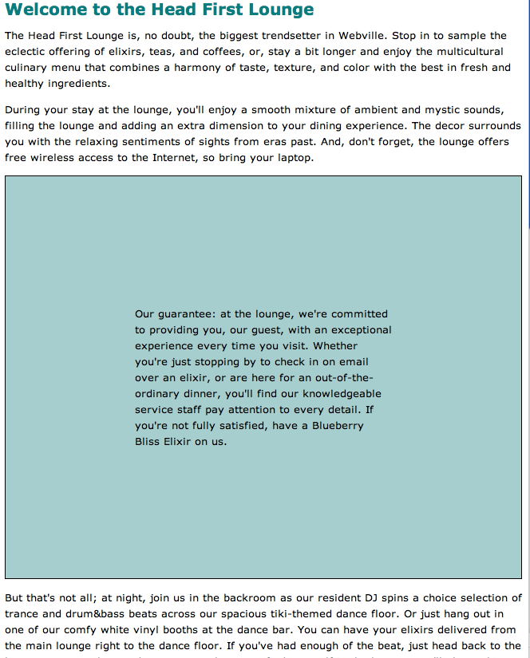
Had we chosen %
.guarantee
{
border-color: black;
border-width: 1px;
border-style: solid;
background-color: #a7cece;
padding: 25%;
}

Slide 11
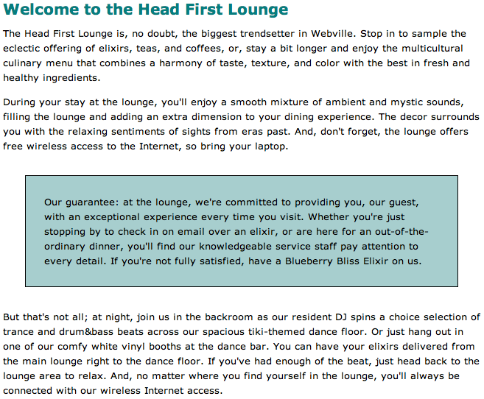
Add Margin
Now we have 25 pixels of margin on all sides.
.guarantee
{
border-color: black;
border-width: 1px;
border-style: solid;
background-color: #a7cece;
padding: 25px;
margin: 30px;
}

Slide 12
Agenda
Box Model
Content, Padding, Border & Margin
Background images
Border Styles, Width, Colour

Slide 13

Add a Background Image
Background.gif
<img> and background images:
An <img> element, on the other hand, is used to include an image that has a more substantial role in the page, like a photo or a logo
A background image is pure presentation, and the only reason you would use a background-image is to improve the attractiveness of an element.
We could have just placed the image inside the paragraph, and we could probably get the same look and feel, but the guarantee star is pure decoration
It has no real meaning on the page and it’s only meant to make the element look better. So, background-image makes more sense.

Slide 14
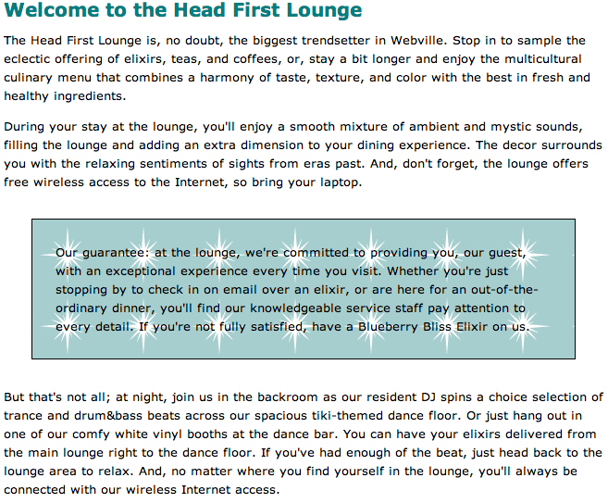
Background Image
.guarantee
{
border-color: black;
border-width: 1px;
border-style: solid;
background-color: #a7cece;
padding: 25px;
margin: 30px;
background-image: url(images/background.gif);
}
Image sits on top of the background color.
Because it has a transparent background, it lets the color show through
The background images, like the background color, only show under the content area and padding, and not outside the border in the margin

Slide 15
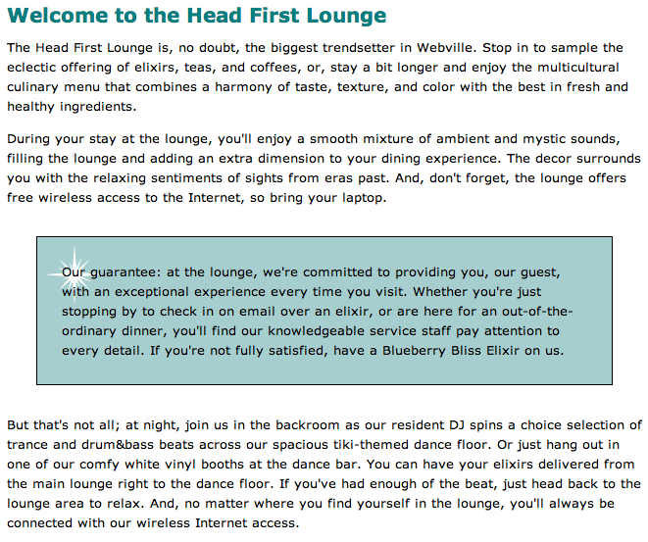
By default, background images are repeated.
The no-repeat value for the background-repeat property turns this off, so we get just one image.
By default, browsers position a background image in the top, left of the element
.guarantee
{
border-color: black;
border-width: 1px;
border-style: solid;
background-color: #a7cece;
padding: 25px;
margin: 30px;
background-image: url(images/background.gif);
background-repeat: no-repeat;
background-position: top left
}

Slide 16
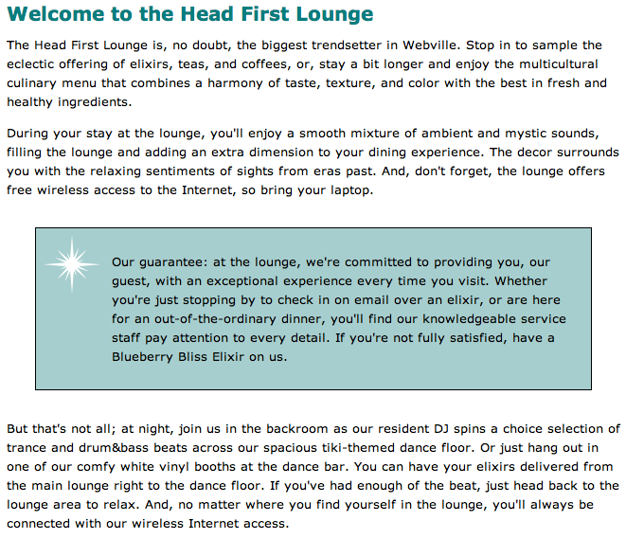
More Padding
For padding, margins, and even borders, CSS has a property for every direction: top, right, bottom, and left.
To add padding on the left side, use the padding-left property
.guarantee
{
border-color: black;
border-width: 1px;
border-style: solid;
background-color: #a7cece;
padding: 25px;
padding-left: 80px;
margin: 30px;
background-image: url(images/background.gif);
background-repeat: no-repeat;
background-position: top left
}

Slide 17
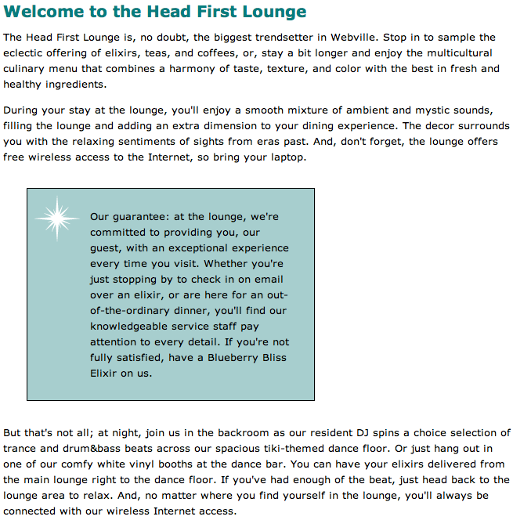
More Margins
.guarantee
{
border-color: black;
border-width: 1px;
border-style: solid;
background-color: #a7cece;
padding: 25px;
padding-left: 80px;
margin: 30px;
margin-right: 250px;
background-image: url(images/background.gif);
background-repeat: no-repeat;
background-position: top left
}

Slide 18
Using DIVs to define sections
Main content
Releases
36
While we have used the box model to specify space within (i.e., padding) and outside (i.e., margin) the border of an element, it can also be employed to specify the position of portions of text on the page
We could, for example, add content related to new releases on the right hand-side and the main content on the left-hand side as illustrated in the next diagram, using a two-column layout

Slide 19
Using Divs to define Regions of a Page
To achieve this we could do the following:
Use DIV elements as containers, one for the main content and one for the left content
Allocate an ID to each of these divs
Create CSS rules for each DIVs so that they are floating to the left and right of the page, respectively
#releases
{
…
float:right;
}
#maincontent
{
…
float:left;
}
<div id = maincontent>
…
</div>
<div id = releases>
…
</div>
37

Slide 20
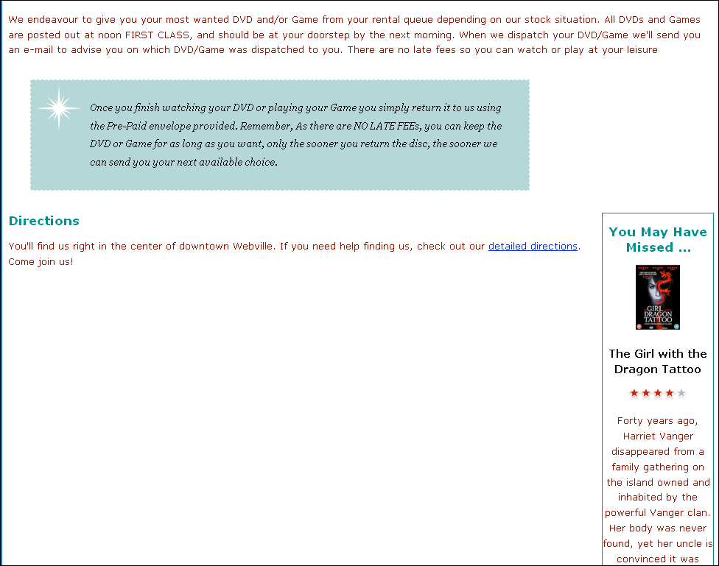
#releases
{
border-width: thin;
border-style: solid;
border-color: #007e7e;
width: 150px;
padding: 0px 20px 30px 10px
margin-left: 20px;
text-align: center;
float:right;
}

Slide 21
#releases
{
border-width: thin;
border-style: solid;
border-color: #007e7e;
width: 150px;
padding: 0px 20px 30px 10px
margin-left: 20px;
text-align: center;
float:right;
}
#maincontent
{
float:left;
width:800px;
}
#maincontent
{
float:left;
width:800px;
}

Slide 22
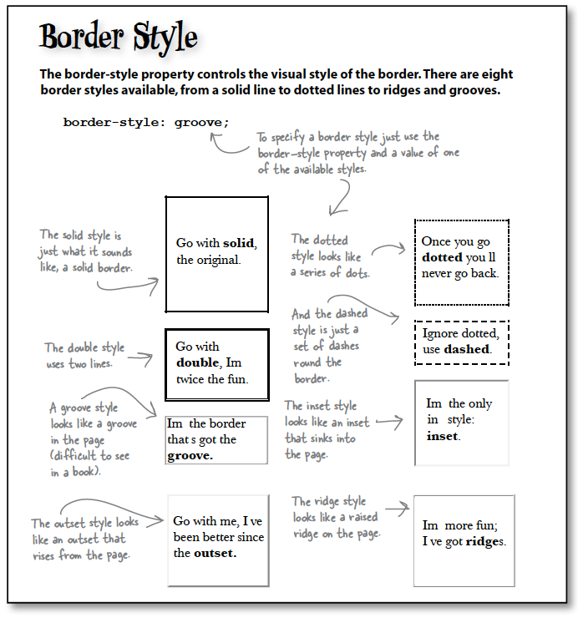

Slide 23
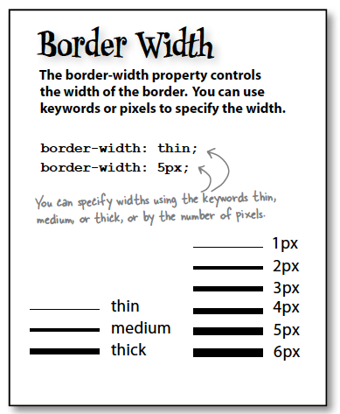
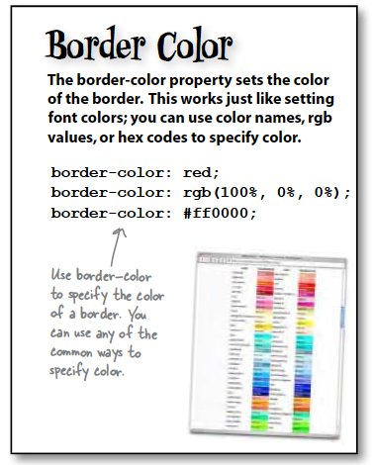

Slide 24
