Slide 1
HTML Basics
Website Development 1

Slide 2
Overview
HTML introduction
Anatomy of a tag
Required tags
Basic formatting tags
Adding an image
Linking pages
HTML Validation
Structure of practical classes

Slide 3
Hyper Text Markup Language
HTML tells your browser about the structure of your document:
where the headings are,
where the paragraphs are,
what text needs emphasis, etc
what text needs to linked,
what images to be displayed.
Given this information, browsers have built-in default rules for how to display each of these elements.
This information is conveyed using tags, these denote the intention of the author regarding the structure and display of the document.

Slide 4
HTML
An HTML document is called a ‘page’.
The starting page of a site is called the ‘homepage’, saved as index.html.
HTML should only be used for the description of the document structure and not to describe the document presentation.
Every HTML document consists of two parts:
Document ‘head’: contains information about the document.
Document ‘body’: contains the content of the document.

Slide 5
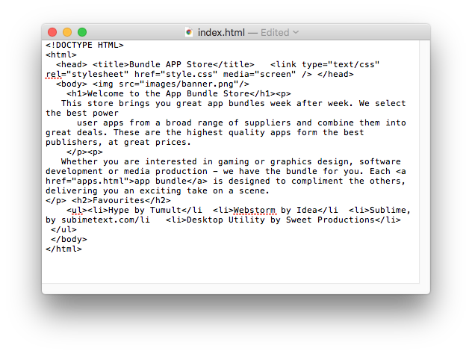
The Code in a Conventional Editor
An actual document text - but poorly structured (indented)

Slide 6
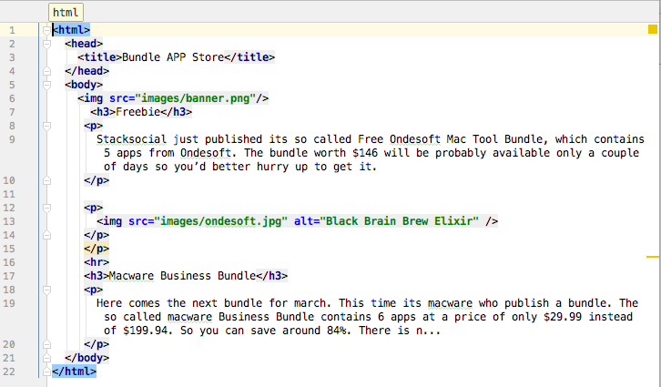
The Code in a Programmer’s Editor
Same document - pleasingly indented and syntax highlighted.
6

Slide 7
Overview
HTML introduction
Anatomy of a tag
Required tags
Basic formatting tags
Adding an image
Linking pages
HTML Validation
Structure of practical classes

Slide 8
HTML Tags (more correctly called Elements)
Grouped by purpose:
Structural
<html>, <head>, <title>, <body>
Text
Heading
<h1>, <h2>
Text
<p>, <b>, <i>
Hypertext
<a>
Image
<img>
Sample Tags for this week
<html>
<head>
<title>
<body>
<h1>
<h2>
<p>
<a>
<img>

Slide 9
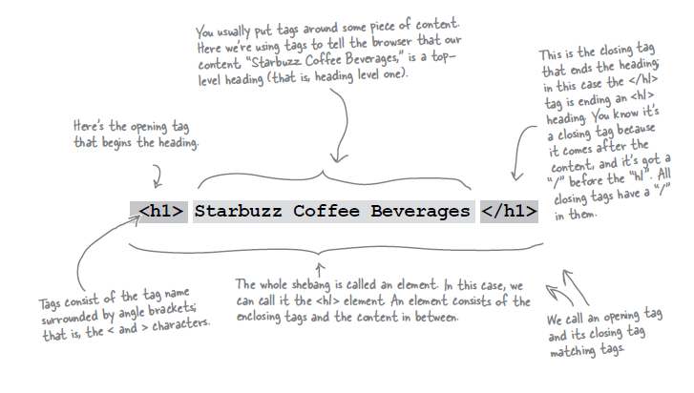
Components of an HTML Element

Slide 10
Components of an HTML Element
<ElementName >
Content
</ElementName>
Start Tag
End Tag

Slide 11
Example: <title>
<title>My App Store</title>
ElementName: <title>
Content: My App Store
ElementName: </title>

Slide 12
Overview
HTML introduction
Anatomy of a tag
Required tags
Basic formatting tags
Adding an image
Linking pages
HTML Validation
Structure of practical classes

Slide 13
<html>
The html element is the outer container for everything that appears in an HTML document.
It can only contain two elements as direct descendants, namely the head element and the body element.
As it is the outermost element in the document, it’s also known as the root element.
This element will have a place on every single web page you ever create. There’s no case in which you would not use this element when crafting a web page.
<html>
<head>
…
</head>
<body>
…
</body>
</html>

Slide 14
<head>
The head element is the wrapper for all the head elements that:
instruct the browser where to find style sheets,
define relationships that the document has to others in the web site,
provide essential meta information,
point to or include scripts that the document will need to apply later on.
<html>
<head>
<title>
…
</title>
...
</head>
<body>
…
</body>
</html>

Slide 15

<title>
The title element displays a title in the browser toolbar or in the task bar (on Windows).
Provides a name for the document that’s used by the browser when you add the page as a favourite or bookmark.
Displays a title of the page when it appears in search engine results.
<html>
<head>
<title>
FAQ
</title>
</head>

Slide 16
<body>
The body element wraps around all of the content that will be displayed on screen.
Usually starts with a heading, followed by paragraphs, images, etc..
<html>
<head>
<title>Page title goes here</title>
<link type="text/css" rel="stylesheet" href="style.css“ media="screen">
</head>
<body
<h1>101 Ways to make a paper aeroplane</h1>
<p>Let's start with the basics …</p>
</body>
</html>

Slide 17
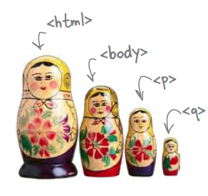
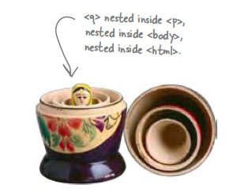
Nesting
When we put one element inside another element, we call that nesting.
We say, the <p>element is nested inside the <body>element.
We put a <body>element inside an <html>element, a <p>element inside a <body>element etc.

Slide 18
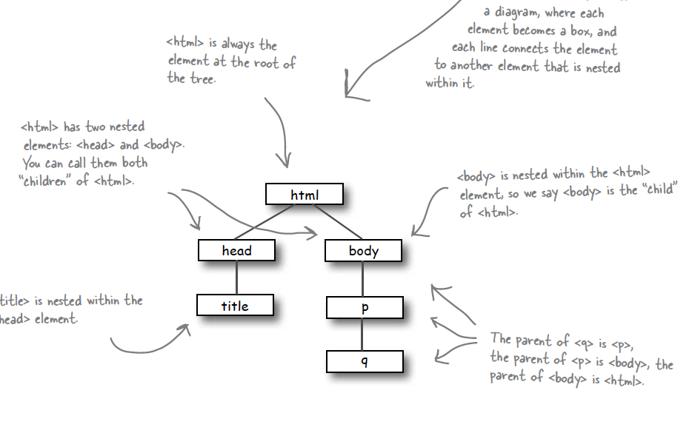
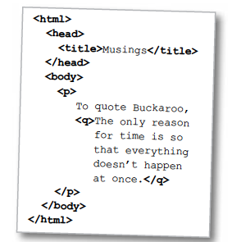
Nesting - Tree Structure

Slide 19
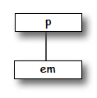
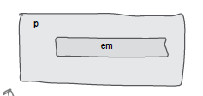
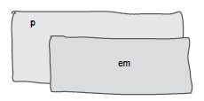
Nesting can be Incorrect!
<p>I’m so going to blog <em>this</em></p>
Good
<p>I’m so going to blog <em>this</p></em>
Bad
?

Slide 20
Overview
HTML introduction
Anatomy of a tag
Required tags
Basic formatting tags
Adding an image
Linking pages
HTML Validation
Structure of practical classes

Slide 21
<p>
One of the most commonly used building blocks of HTML.
When you use the p element to begin a new paragraph in HTML, it automatically creates some space above and below the content.
<p>
We endeavour to give you your most wanted DVD and/or Game from your rental queue depending on our stock situation. All DVDs and
Games are posted out at noon FIRST CLASS, and should be at your doorstep by the next morning.
When we dispatch your DVD/Game we'll send you an e-mail to advise you on which
DVD/Game was dispatched to you. There are no late fees so you can watch or play at your leisure
</p>

Slide 22
<h1-h6>
The h1 element is used to indicate the most important (or highest-level) heading on the page.
There are six heading levels h1 to h6—to add structure to the web page.
A document’s first heading should be an h1, followed by one or more h2 headings; each of these h2 headings can then have a further series of h3 headings below them, and so on.

Slide 23
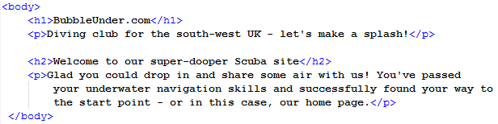
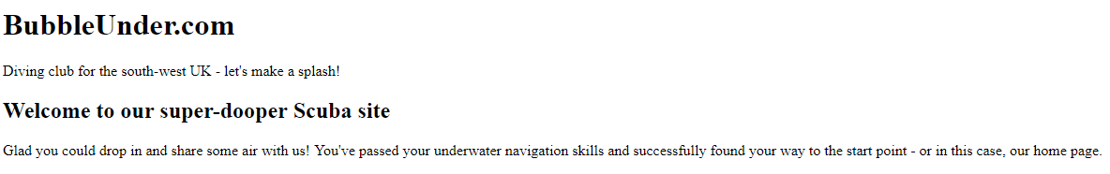
<h1-h6>

Slide 24
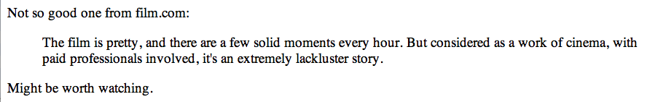
<blockquote>
The blockquote element is a mechanism for marking up a block of text quoted from a person or another document or source.
It may be just a few lines, or it may contain several headings, paragraphs, etc- which must be marked up using nested elements).
<p>Not such a good one from film.com:</p>
<blockquote>
The film is pretty, and there are a few solid moments every hour.
But considered as a work of cinema, with paid professionals involved,
it's an extremely lackluster story.
</blockquote>
<p>Might be worth watching.</p>

Slide 25
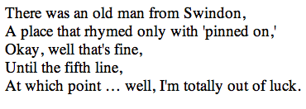
<br>
The br element creates a line break within a block of text, leaving no padding or margins between the two blocks of text created by the line break.
<p>
There was an old man from Swindon,<br>
A place that rhymed only with 'pinned on,'<br>
Okay, well that's fine,<br>
Until the fifth line,<br>
At which point … well, I'm totally out of luck.
</p>

Slide 26


<i> and <b>
The i element is used to italicise text content, and displays in italics in all current browsers.
The b element works in the same way, but displays bold text.

Slide 27
<q>
The q element is used for inline quotations (instead of blockquote, which sets the quotation in its own block).
It is intended that the browser should insert the necessary quotation marks, the style of which should depend on the language of the document or that section of the document, rather than the author adding quotation marks.
<p>
Not so good one from film.com: <q>The film is pretty, and there are a few
solid moments every hour. But considered as a work of cinema, with paid
professionals involved, it's an extremely lackluster story.</q>
</p>

Slide 28
Overview
HTML introduction
Anatomy of a tag
Required tags
Basic formatting tags
Adding an image
Linking pages
HTML Validation
Structure of practical classes

Slide 29

Image & Media Elements - <img>
The img element provides a means for embedding an image in the document.
Has a total of 12 attributes
src provide a link to the image to be displayed,
alt provides text to be displayed if the image cannot be retrieved,
height & width provide (optional) dimensions. Used to help the browser lay out images properly, and should coincide with the actual image dimensions.
<img src="images/robinhood.jpg" alt="Robin Hood">

Slide 30
Overview
HTML introduction
Anatomy of a tag
Required tags
Basic formatting tags
Adding an image
Linking pages
HTML Validation
Structure of practical classes

Slide 31
<a>
The a element is referred to as a link or hyperlink.
Has 7 possible attributes in total, of which we start with just one: href, which defines the document to which the link leads. This may be:
a web page in the same directory,
a page somewhere else on the same server,
a location within the current page,
a web page—or any another kind of document—stored on another server.
<a href="newreleases.html">new releases</a>
<a href="http://www.w3schools.com/html/html5_intro.asp">HTML5 Introduction</a>

Slide 32
Overview
HTML introduction
Anatomy of a tag
Required tags
Basic formatting tags
Adding an image
Linking pages
HTML Validation
Structure of practical classes

Slide 33
W3C Validator
The World Wide Web Consortium (W3C) is an international community that develops open standards to ensure the long-term growth of the Web.
The W3C provide online validation tools that you allow to check whether your HTML code complies with the standard they have set.
You will try out this tool in your practical classes this week.

Slide 34
Overview
HTML introduction
Anatomy of a tag
Required tags
Basic formatting tags
Adding an image
Linking pages
HTML Validation
Structure of practical classes

Slide 35
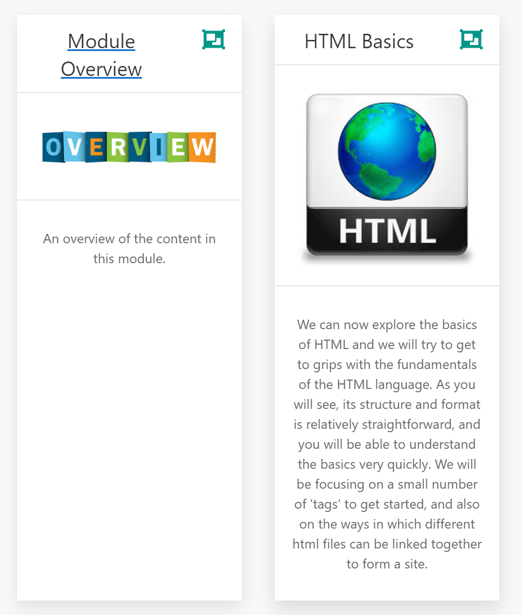
On Moodle: lecture slides
Each topic has lecture(s) and labs.
This week’s lectures: Module Overview and HTML Basics.
Each week there will a new topic.

Slide 36
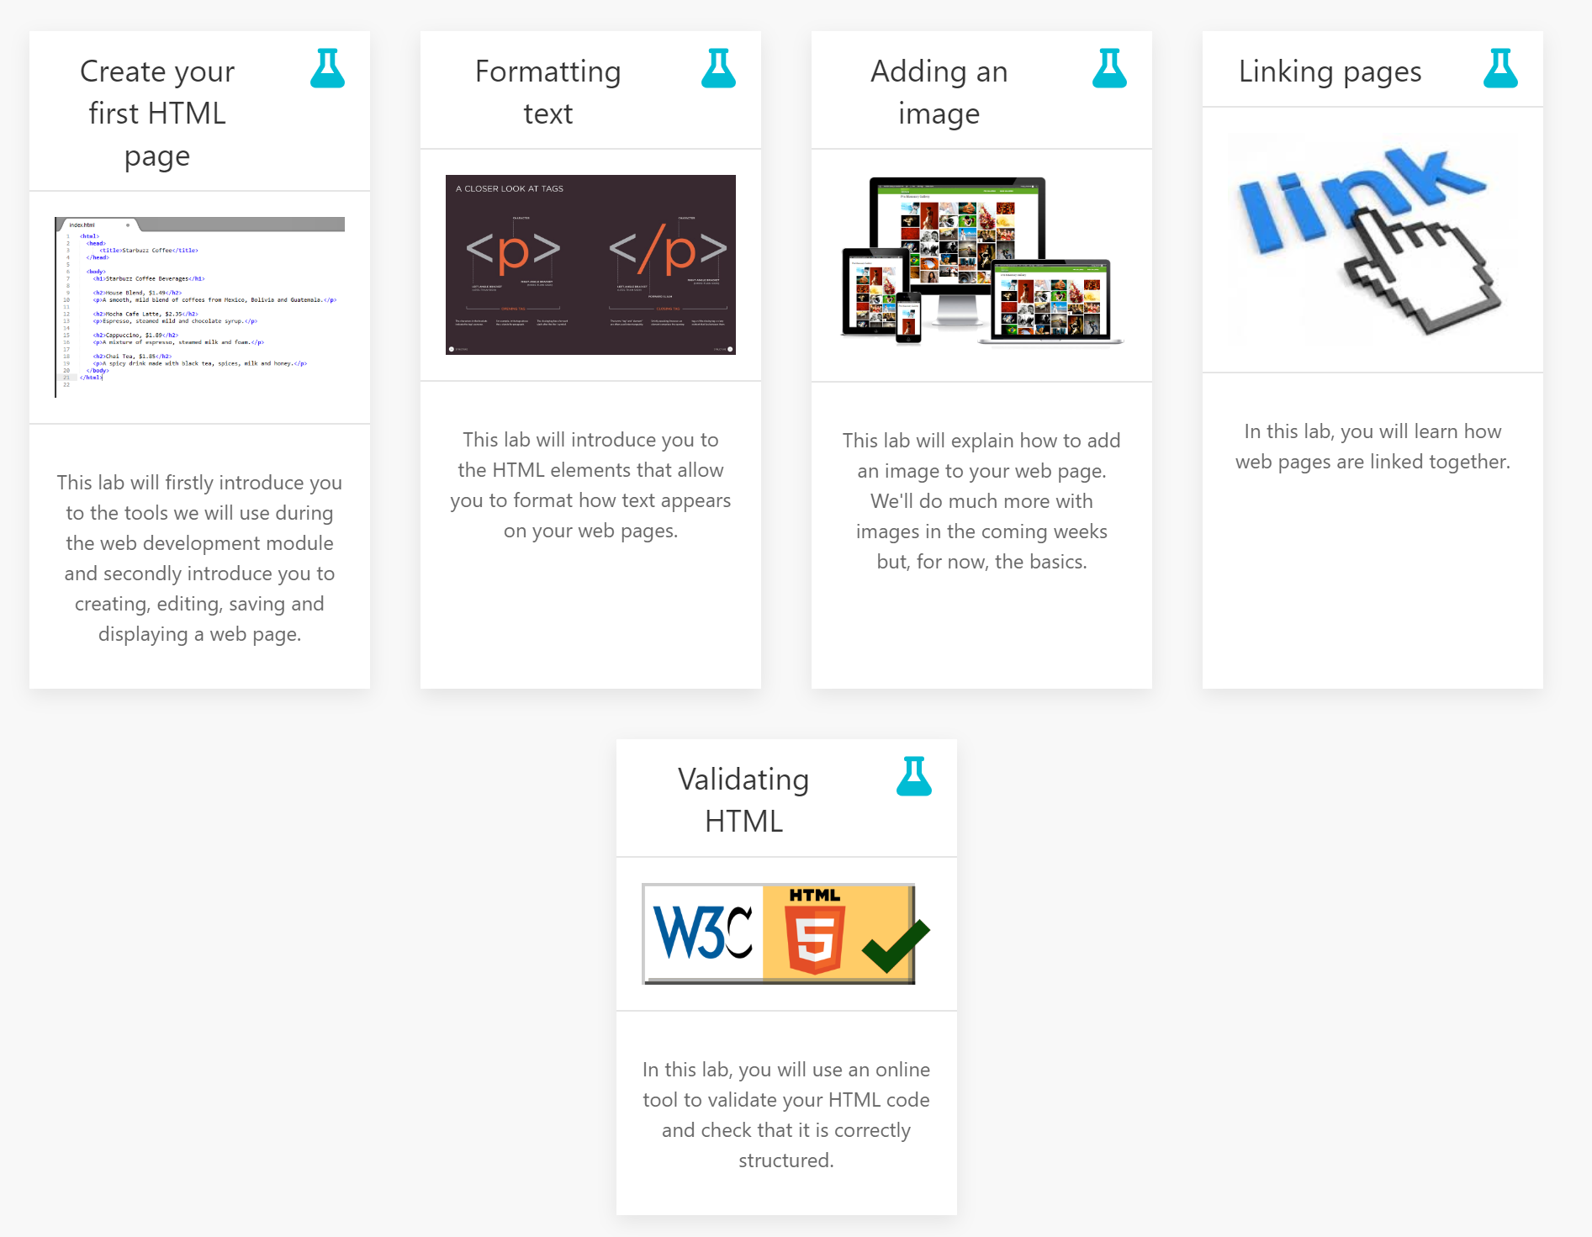
On Moodle: labs
These are the labs this week.

Slide 37
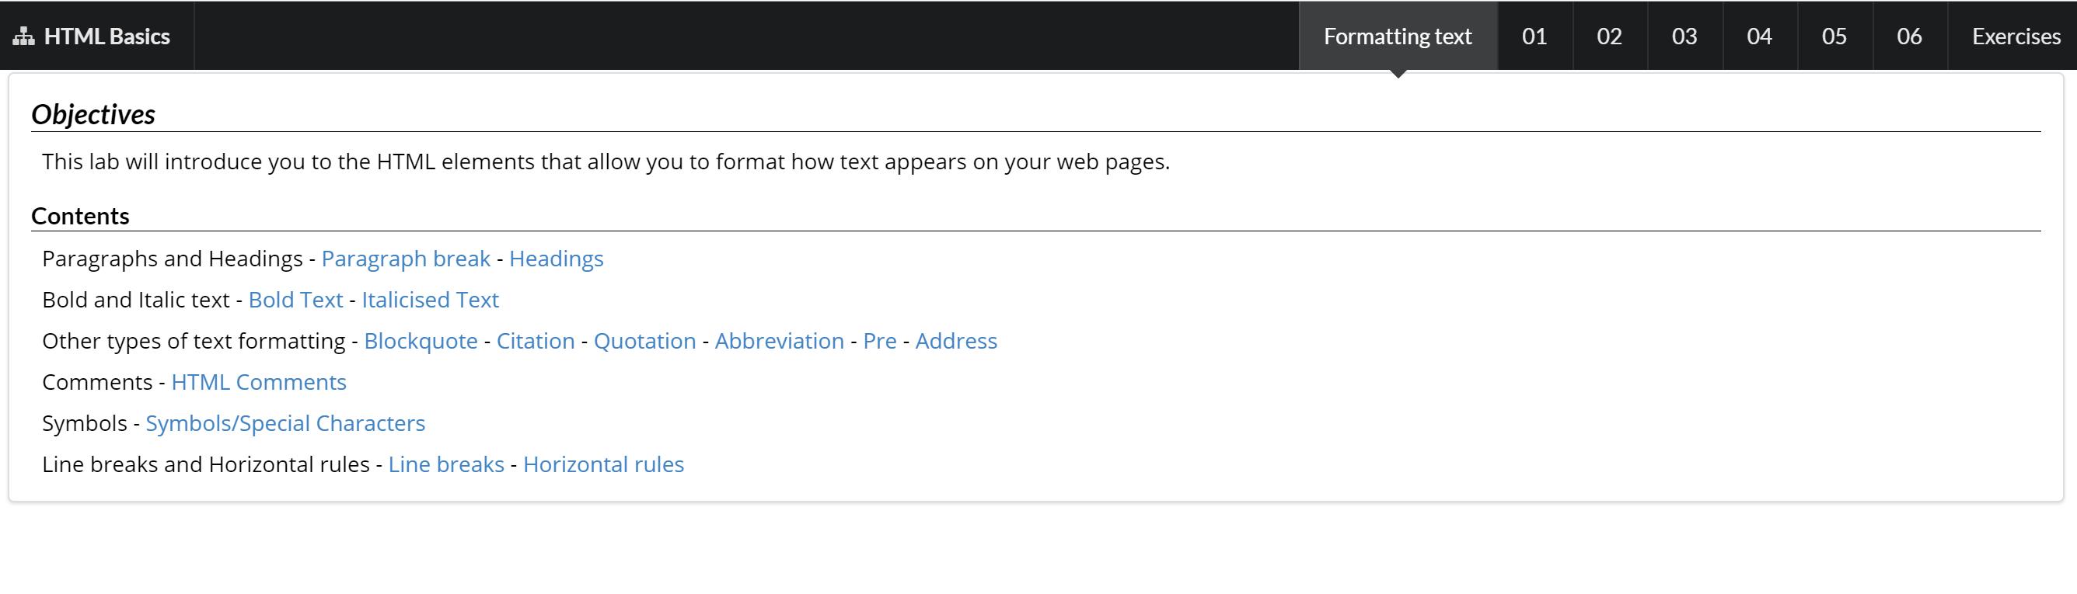
Lab contents
In each lab, you will see a list of the contents.
Use the links to jump to a particular piece of information if you wish.

Slide 38
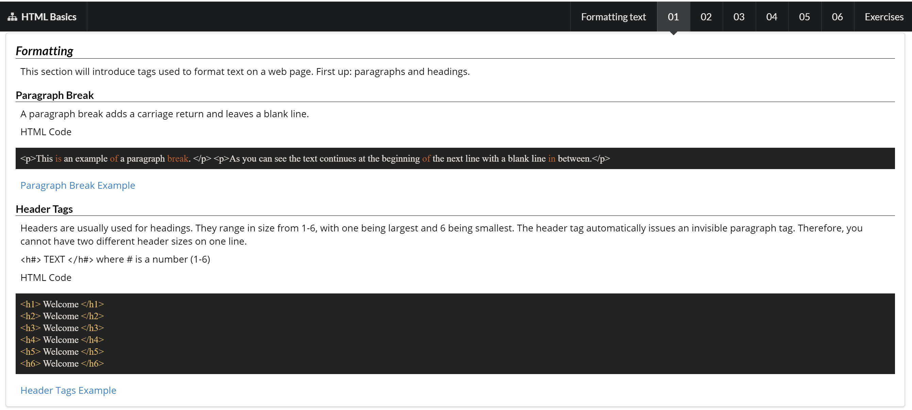
Lab contents
Go through the numbered steps at the top.
Read through the information in each step to refresh your memory from the lecture.
Try out the examples.

Slide 39
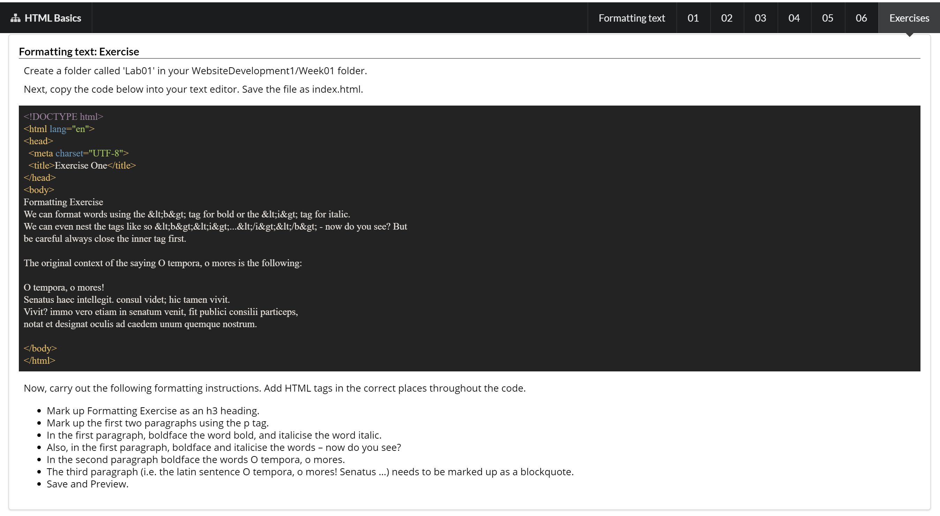
Lab contents
Complete the exercises.
Each week, you should upload your completed exercises to Moodle

