Slide 1
CSS Part One
Website Development 1

Slide 2
Overview
Use of CSS for Styling - Content, Presentation, Behavior
What is CSS?
What can it do?
Rules, Selectors, Declarations, Properties, Values
Linking CSS to HTML
CSS Properties
Styling Links
Grouping Selectors

Slide 3
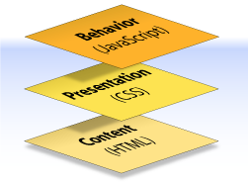
Content, Presentation, Behavior
Content comprises the information the author wishes to convey to his or her audience, and is embedded within HTML markup that defines its structure and semantics.

Slide 4
Content, Presentation, Behavior
Presentation defines how the content will appear to a human being who accesses the document in one way or another, this includes colour, layout, etc..

Slide 5
Content, Presentation, Behavior
Behavior layer involves real-time user interaction with the document.
This task is normally handled by JavaScript.
The interaction can be anything from a trivial validation that ensures a required field is filled in before an order form can be submitted, to sophisticated web applications that work much like ordinary desktop programs.

Slide 6
Overview
Use of CSS for Styling - Content, Presentation, Behavior
What is CSS?
What can it do?
Rules, Selectors, Declarations, Properties, Values
Linking CSS to HTML
CSS Properties
Styling Links
Grouping Selectors

Slide 7
What is CSS?
Cascading Style Sheets is the recommended way to control the presentation layer in a web document.
CSS is a "style sheet language" that lets you style the elements on your page.
CSS is embedded inside/linked to HTML, but it is not HTML itself.
The main advantage of CSS over presentational HTML markup is that the styling can be kept entirely separate from the content.
e.g. it’s possible to store all the presentational styles for a 10,000-page web site in a single CSS file.
CSS also provides far better control over presentation than do presentational element types in HTML.

Slide 8
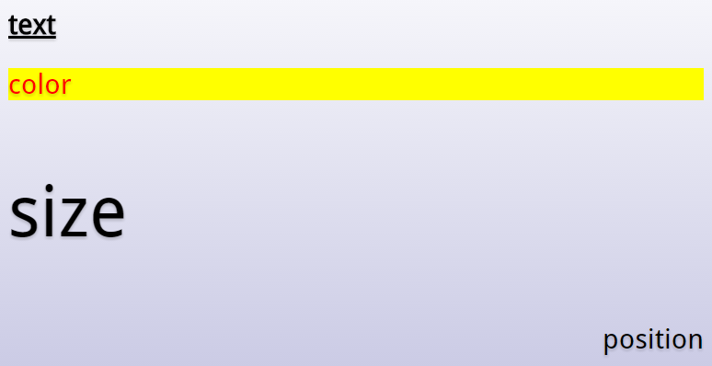
CSS: What can it do?

Slide 9
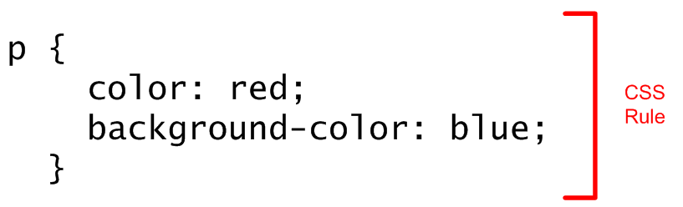
CSS - Rules
CSS consists of "style rules". Each style rule consists of a "selector" and "declarations" of property-value pairs:

Slide 10
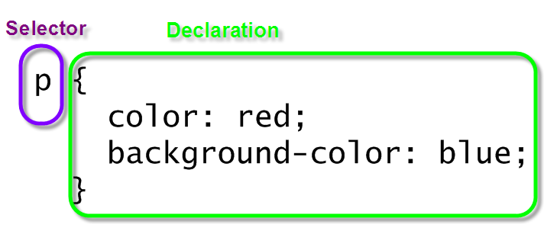
CSS - Selector and Declarations

Slide 11
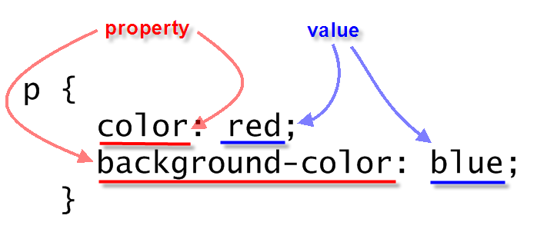
CSS - Properties and Values

Slide 12
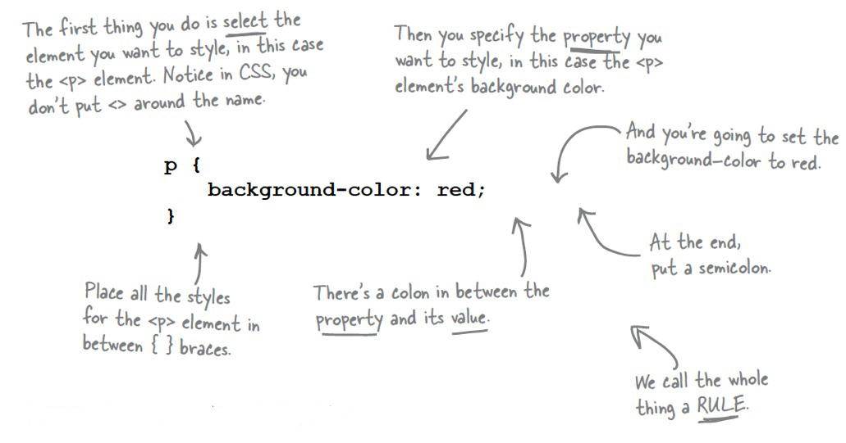
CSS - A Rule

Slide 13
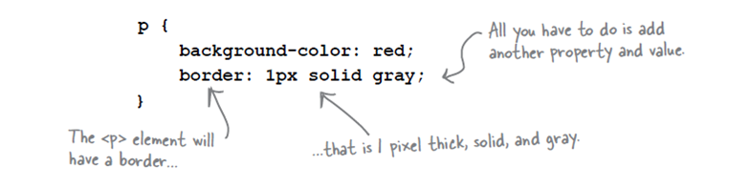
CSS - More than 1 Property
You can add as many properties and values as you like in each CSS rule.
To put a border around your paragraphs:

Slide 14
Overview
Use of CSS for Styling - Content, Presentation, Behavior
What is CSS?
What can it do?
Rules, Selectors, Declarations, Properties, Values
Linking CSS to HTML
CSS Properties
Styling Links
Grouping Selectors

Slide 15
Linking CSS to HTML
CSS contains information about how your markup (HTML) should be presented to the end user. That means that the two languages have to be linked together - the browser needs to know that you want to combine a piece of HTML markup with a piece of CSS code.
This can be done in 3 ways:
Inline CSS through the Style attribute
Document wide CSS through style blocks
Global CSS through external CSS documents

Slide 16
Inline CSS through the Style attribute
Almost every HTML tag can includesi the Style attribute and using this attribute, you can specify CSS directly for the element. This defeats one of the main advantages of CSS, re-usability, since CSS code applied with this technique only applies to a single element and can't be re-used for other elements.
<p style="color:blue; font-style:italic;">Hello CSS</p>

Slide 17
Document wide CSS through style blocks
The second method to apply CSS to elements in your document is through the use of a style block. HTML includes a tag called style, which can contain CSS code. Here, you can define rules which can then be used all across your document.
<style>
p {
color:blue;
font-style:italic;
}
</style>

Slide 18
Global CSS through external CSS documents
So, by using the style block as described above, you can re-use your CSS code all over the document, but you still have to include it on all of the pages of your website, which requires the browser to download it on each request instead of just downloading an external CSS file once and then cache it.
This is a major disadvantage of the style block approach and why you should normally go for the third approach instead: The external CSS file!

Slide 19
Global CSS through external CSS documents
A CSS file is simply a plain text file saved with a .css extension and then referenced in the file(s) where you want to apply the rules. If we re-use our example, we can then move the “p" rule to a new file (without the HTML part) and save it under an appropriate name, e.g. style.css. We will also place it in a CSS sub folder.
We can then reference it in our HTML document, using the link element:
<link rel = "stylesheet" href = "css/style.css">

Slide 20
Overview
Use of CSS for Styling - Content, Presentation, Behavior
What is CSS?
What can it do?
Rules, Selectors, Declarations, Properties, Values
Linking CSS to HTML
CSS Properties
Styling Links
Grouping Selectors

Slide 21
CSS Properties: color
The "color" property changes the text colour. Colours can be set using RGB colour codes (hex or decimal) or by using the colour names.
red Is the same as rgb(255,0,0) Which is the same as rgb(100%,0%,0%) Which is the same as #FF0000 Which is the same as #F00 (shorthand)

Slide 22
CSS Properties: color
The “color" property changes the text color.
body {
color:blue;
}

Slide 23
CSS Properties: background-color
The "background-color" property changes the background colour.
Besides the BODY element, all elements default to a transparent background.
body {
background-color:lightyellow;
}

Slide 24
CSS Properties: font-family
The "font-family" property specifies the font family (or "font face") of the text. You can specify either a specific font name or a generic family name (serif, sans-serif, monospace, cursive, fantasy).
font-family:"Times New Roman", serif;
font-family:Verdana, sans-serif;
font-family:Courier, monospace;
A comma separated list of font families can be specified if you want the browser to prefer one but use the others as backup options.

Slide 25
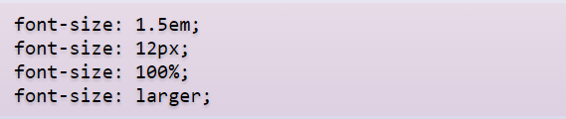
CSS Properties: font-size
The "font-size" property specifies the size of a font. It can be specified as a fixed size in various units, a percentage, or as a predefined keyword
.

Slide 26
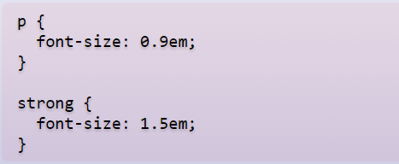
CSS Properties: font-size (em)
The "em" unit lets you set the size of the text relative to the text around it. This makes the page resize nicely in proportion if the user changes their default font-size. The default size is "1em".

Slide 27
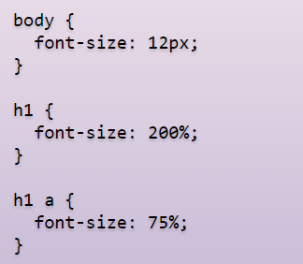
CSS Properties: font-size (%)
The size can also be specified as a percentage, which works similar to "ems", and can be used in conjunction with other units.

Slide 28

CSS Properties: font-size (px)
The "px" unit lets you size font in terms of pixels, which is the unit also used to size images and other elements. It is easier to understand than em, but doesn't work as well when printing or resizing.

Slide 29
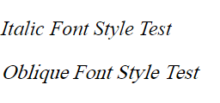
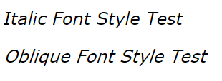
CSS Properties: font-style
The "font-style" property specifies the font style of the text. The style can be "normal" by default or italic or oblique.
Italic forms are generally cursive in nature while oblique faces are typically sloped versions of the regular face. However, if the font being used does not have italic or oblique faces available, in most cases there is little, if any, difference between italic and oblique.
In the screenshots above, the fonts used are Times New Roman and Verdana.

Slide 30
CSS Properties: font-weight
The "font-weight" property specifies the thickness of the font. The default is "normal" and the typical override is "bold". You can also specify "bolder", "lighter", or a number from 100 to 900.
The keyword value normal maps to numeric value 400 and the value bold maps to 700.
blockquote {
font-weight:bold;
}

Slide 31
CSS Properties :text-..
text-decoration: The text-decoration property decorates the text. Values include: underline, overline, line-through, and none.
p {
text-decoration:underline;
}
text-transform: The text-transform property controls the letters in an element. Values include: uppercase, lowercase, capitalize, and none.
p {
text-transform:uppercase;
}

Slide 32
CSS Properties :text-..
text-align: The text-align property aligns the text in an element. Values include: left, right, center, and justify.
p {
text-align:center;
}

Slide 33
Overview
Use of CSS for Styling - Content, Presentation, Behavior
What is CSS?
What can it do?
Rules, Selectors, Declarations, Properties, Values
Linking CSS to HTML
CSS Properties
Styling Links
Grouping Selectors

Slide 34
CSS : Styling links
As we have seen previously, there are different types of links (unvisited, visited, active) that you'll come across on a web page. There's one other state (hover), which occurs when you pass your cursor over the link.
In CSS, you can change the styling of all of these link states using pseudo-classes. The different states are addressed within the CSS through the use of the a element selector, and by applying (with the aid of a colon) the pseudo-classes of link, visited, hover, and active.

Slide 35
CSS : Styling links
a:link {
color:black;
}
a:visited {
color:slategray;
}
a:hover {
text-decoration:none;
}
a:active {
color:red;
}

Slide 36
Overview
Use of CSS for Styling - Content, Presentation, Behavior
What is CSS?
What can it do?
Rules, Selectors, Declarations, Properties, Values
Linking CSS to HTML
CSS Properties
Styling Links
Grouping Selectors

Slide 37
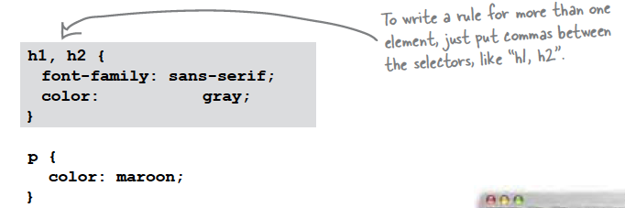
CSS : Grouping selectors
You can group selectors to apply the same style to all of the selectors by separating them with commas.

Slide 38
CSS : Grouping selectors
In the previous example, if we wish the link and visited states to assume the same styling then we can use the following:
a:link, a:visited {
color:slategray;
}

