Slide 1
Tables
Website Development 1

Slide 2
Agenda
What is a Table?
Table syntax
Rows and columns
Grouping Rows
Styling tables using nth-of-type

Slide 3
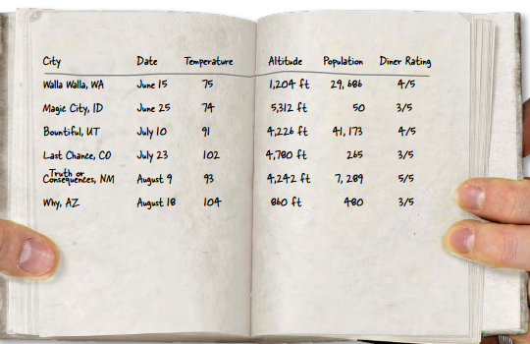
What is a table?
Sometimes you need to present tabular data, perhaps for inventory of products or a catalog of albums.

Slide 4
What is a table?
The <table> element in HTML is used for displaying tabular data. You can think of it as a way to describe and display data that would make sense in spreadsheet software. Essentially: columns and rows.

Slide 5
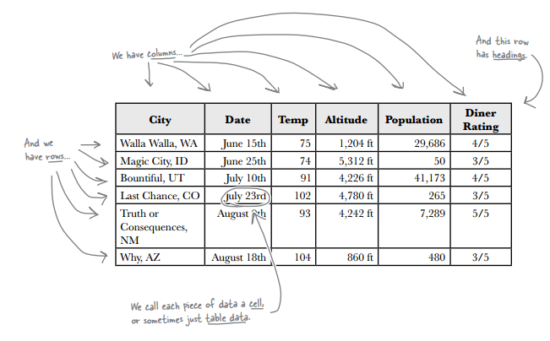
What is a table?

Slide 6
Agenda
What is a Table?
Table syntax
Rows and columns
Grouping Rows
Styling tables using nth-of-type

Slide 7
Table syntax
Tables in HTML are coded as a series of table rows that contain cells (which can contain data or heading information).
The <table>...</table> tags surround the table element.
Rows in the table are surrounded by <tr>...</tr> tags.
Cells in the rows are enclosed in either <td>...</td> tags (for cells containing table data), or <th>...</th>tags (for cells containing heading information).
The <td> and <th> cells have different default formatting, and they make a structural distinction between their contents (either data or heading information).

Slide 8


Table syntax
Here is the HTML code for a simple table, with the resulting table shown below it:

Slide 9


Table syntax
A basic table (like the simple table example) has no border or any styling.
To add a border, we do so through CSS. We add a border to the <table>, <th> and <td> elements.

Slide 10
Table syntax
If you want no space between the cells then you can set the border-collapse property to collapse. Note that the default is separate.
If you do wish to leave space between the cells then set the border-collapse property to separate as stated above and you can also set the border-spacing property to increase or decrease the space (default is 2px).

Slide 11

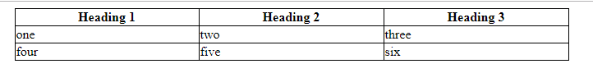
Table syntax
We should also specify a table width property as a table will only take up as much space as the data requires.
To center the table, the table must have a width set, and then you must set the left and right margins of the table to auto.

Slide 12

Table syntax
There is another basic element of the table which is optional. This is the <caption> element.
As you can see the caption is rendered before (top side) the table. To change this to after (bottom side) of the table, we add the caption-side property.

Slide 13
Agenda
What is a Table?
Table syntax
Rows and columns
Grouping Rows
Styling tables using nth-of-type

Slide 14
Rows and columns
You can merge multiple cells together to create cells that span multiple rows or multiple columns.
We can use colspan to make a cell span multiple columns.
We can use rowspan to make a cell span multiple rows.

Slide 15
colspan
To make a cell span multiple columns, add the attribute colspan="n" (where n is the number of columns to span) to the <td> (or <th>) tag of that cell.
The total number of cells has to be the same in all rows, where any cells that span n columns are counted as n cells.

Slide 16
colspan
<table>
<tr> <td>1</td><td>2</td><td>3</td><td>4</td>
</tr>
<tr>
<td colspan="3">under 123</td>
<td>under 4</td>
</tr>
</table>

Slide 17

rowspan
To make a cell span multiple rows, add the attribute rowspan="n" (where n is the number of rows to span) to the <td> (or <th>) tag of that cell.
In the code for above example, there are only two cells specified for row 2. This is because cell three is taking up the space where cell "six" would have been. You have to ensure that the cell count comes out the same for all rows (you include any cell from a previous row that spans into another row as part of that row's cell count).

Slide 18
rowspan
<table>
<tr>
<td>one</td>
<td>two</td>
<td rowspan="2">This cell <br>
spans two rows</td>
</tr>
<tr>
<td>four</td>
<td>five</td>
</tr>
<tr>
<td>six</td>
<td>seven</td>
<td>eight</td>
</tr>
</table>

Slide 19
Controlling Word Wrap Within Cells
A browser may choose to wrap the text in your table cells while it is adjusting the content to fit the column widths. If you find that your text is breaking between words you would rather see stay together, you can prevent the wrapping in a couple ways.
You can put non-breaking spaces between words that you do not want to wrap. This will force the browser to leave the column containing that text content wider, since it won't be able to break those words apart.
You can use the CSS white-space:nowrap declaration applied to a cell or its content (a paragraph or span, for example) to prevent wrapping of that text.

Slide 20
Agenda
What is a Table?
Table syntax
Rows and columns
Grouping Rows
Styling tables using nth-of-type

Slide 21
Grouping Rows
You can group together rows and split a table into a header, footer, and body by organising rows into thead, tfoot, and tbody elements.
Grouping rows can also provide a handy block to latch CSS on to, for example, if you wanted to change the background colour of a block of rows in a table.
You can have more than one tbody elements but only one thead and tfoot elements.

Slide 22
Agenda
What is a Table?
Table syntax
Rows and columns
Grouping Rows
Styling tables using nth-of-type

Slide 23
nth-of-type
The nth-of-type selector finds every nth element of a specific type using either keywords or a formula.
Keywords
:nth-of-type(odd)
:nth-of-type(even)
:first-of-type
:last-of-type
:hover

Slide 24

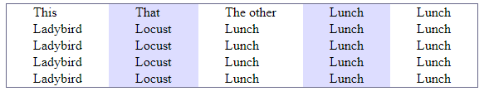
nth-of-type

Slide 25
nth-of-type
Formula
The nth-of-type selector can use formulas instead of keywords. The formula is an + b, where b is the offset, and a is a multiple.
tr:nth-of-type(n) // Each row
tr:nth-of-type(2) // Second row
tr:nth-of-type(2n) // Every second row
tr:nth-of-type(n+2) // Every row starting at the second
tr:nth-of-type(-n+2) // First 2 rows

Slide 26
nth-last-of-type
Formula
tr:nth-last-of-type(2) // Second last row
tr:nth-last-of-type(-n+2) // Last 2 rows

Slide 27

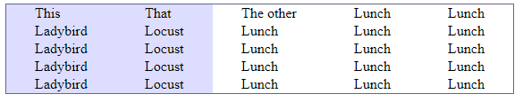
nth-of-type

