Slide 1
Deployment
Website Development 1

Slide 2
Overview
Web Servers
Web Hosting
Domain Names

Slide 3

Remember this? Clients and Servers
Client/Server Computing:
The interaction between two programs when they communicate across a network.
A program at one site sends a request to a program at another site and awaits a response.
The requesting program is called a client; the program satisfying the request is called the server.

Slide 4
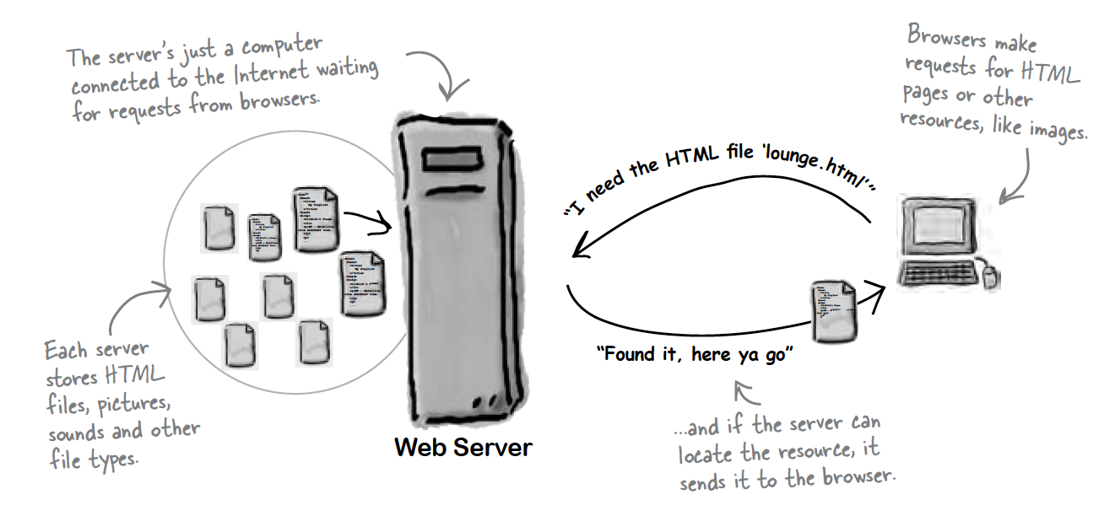
Role of web Server

Slide 5
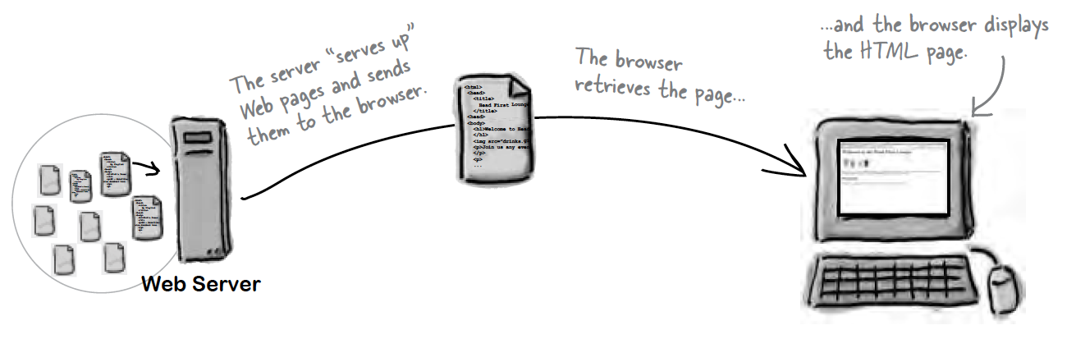
Role of Client

Slide 6
Overview
Web Servers
Web Hosting
Domain Names

Slide 7
Web hosting
Web hosting means storing your web site on a public server.
Web hosting normally includes email services.
Web hosting often includes domain name registration
To get your pages on the Web, you need a server that actually lives on the Web full-time.

Slide 8
Web hosting
For any website to be available online, it has to be stored on some server / computer that is connected to the Internet. That server where you store your website is your host.
The host could be anywhere in the world but it has to have these simple things:
Power
Internet connection
Dedicated IP address

Slide 9
Web hosting
Web hosting companies offer different solutions in relation to the disk space and monthly traffic a website will use
Disk space:
Most websites average around 150 MB, but websites with large amounts of audio/video content or storing large amounts of data will need more.
Monthly traffic (bandwidth):
Most sites use 5GB or less each month; however, sites with a lot of visitors will use more.
https://www.hostingmanual.net/bandwidth-disk-space-need/

Slide 10
Web hosting
Web hosting can be:
Free
Shared
Dedicated
Collocated

Slide 11
Web hosting - free
Some service providers offer free web hosting.
Free web hosting is best suited for small sites with low traffic, like family sites or sites about hobbies. It is not recommended for high traffic or for real business. Technical support is often limited, and technical options are few.
Very often you cannot use your own domain name at a free site. You have to use a name provided by your host like http://www.freesite/users/~yoursite.htm. This is hard to type, hard to remember, and not very professional.
Good: | Bad:
Low cost. It's free. | No domain names.
Good for family, hobby or personal sites. | Few, limited, or no software options.
Free email is often an option. | Limited security options.
 | Limited or no database support.
 | Limited technical support.

Slide 12
Web hosting - shared
Shared hosting is very common, and very cost effective.
With shared hosting, your web site is hosted on a powerful server along with maybe 100 other web sites. On a shared host each web site can have its own domain name.
Shared solutions often offer multiple software solutions like email, database, and many different editing options. Technical support tends to be good.
Good: | Bad:
Low cost. Cost is shared with others. | Reduced security due to many sites on one server.
Good for small business and average traffic. | Restrictions on traffic volume.
Multiple software options. | Restricted database support.
Own domain name. | Restricted software support.
Good support

Slide 13
Web hosting - dedicated
With dedicated hosting your web site is hosted on a dedicated server.
Dedicated hosting is the most expensive form of hosting. The solution is best suited for large web sites with high traffic, and web sites that use special software.
You should expect dedicated hosting to be very powerful and secure, with almost unlimited software solutions.
Good: | Bad:
Good for large business. | Expensive.
Good for high traffic. | Requires higher skills.
Multiple domain names.
Powerful email solutions.
Powerful database support.
Strong (unlimited) software support.

Slide 14
Web hosting - collocated
Collocation means "co-location". It is a solution that lets you place (locate) your own web server on the premises (locations) of a service provider.
This is pretty much the same as running your own server in your own office, only that it is located at a place better designed for it.
Most likely a provider will have dedicated resources like high-security against fire and vandalism, regulated backup power, dedicated Internet connections and more.
Good: | Bad:
High bandwidth. | Expensive.
High up-time. | Requires higher skills.
High security. | Harder to configure and debug.
Unlimited software options.

Slide 15
Overview
Web Servers
Web Hosting
Domain Names

Slide 16
Domain names
A domain name is a unique name for a web site, like w3schools.com.
Domain names must be registered. When domain names are registered they are added to a large domain name register, and information about your site - including your internet IP address - is stored on a DNS server.
DNS stands for Domain Name System. A DNS server is responsible for informing all other computers on the Internet about your domain name and your site address.

Slide 17
Domain names
Registering a Domain
Domains can be registered from domain name registration companies such as https://www.iedr.ie/
These companies provide interfaces to search for available domain names and they offer a variety of domain name extensions that can be registered at the same time.
Domain Name Registration provides registration services for .com .net .org .biz .info .us .nu .ws .cc and .tv domains.

Slide 18
Domain names
Sub Domains
Most people are unaware but they already use sub domains on a daily basis. The famous "www" of the World Wide Web is the most common example of a sub domain.
Common examples of sub domains used on the internet are http://store.apple.com and http://support.microsoft.com.
Sub domains can be requested from your web hosting provider or created by yourself if you manage your own DNS server.

Slide 19
Email accounts
Hosting solutions should include email accounts for each person in your company.
Email addresses should appear something like this:
john@mycompany.com
john.doe@mycompany.com
jdoe@mycompany.com

Slide 20
000webhost
We will deploy a website using 000webhost in our practical labs this week
Free web hosting site that offers:
1GB disk space
10GB bandwidth
Free domain (in the format yourname.000webhostapp.com)

