Slide 1
Layout & images (1)
Website Development 1

Slide 2
Agenda
The Box Model
Background images
More CSS layout properties

Slide 3
CSS Box Model
Boxes consist of:
Content
Padding
Border
Margin
So far, your CSS has focused on changing simple properties of elements, like size, colour, and decorations. For effective layout control, you have got to move on to the box model.
The box model is how CSS sees elements. CSS treats every single element as if it were represented by a box.

Slide 4
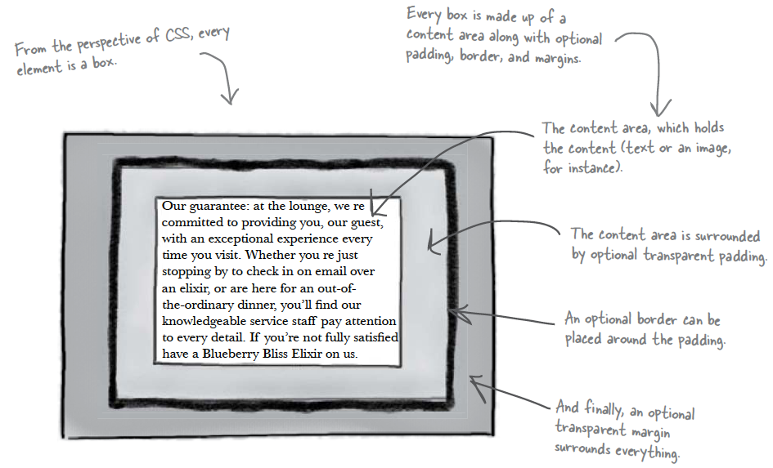
CSS Box Model

Slide 5
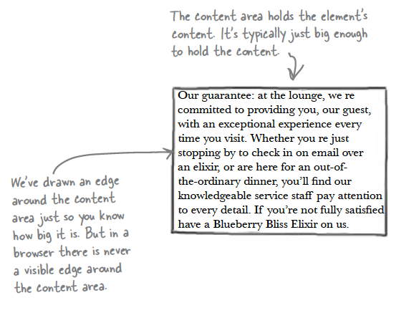
Content Area
Every element starts with some content, like text or an image, and this content is placed inside a box that is just big enough to contain it.
The content area has no whitespace between the content and the edge of the box

Slide 6
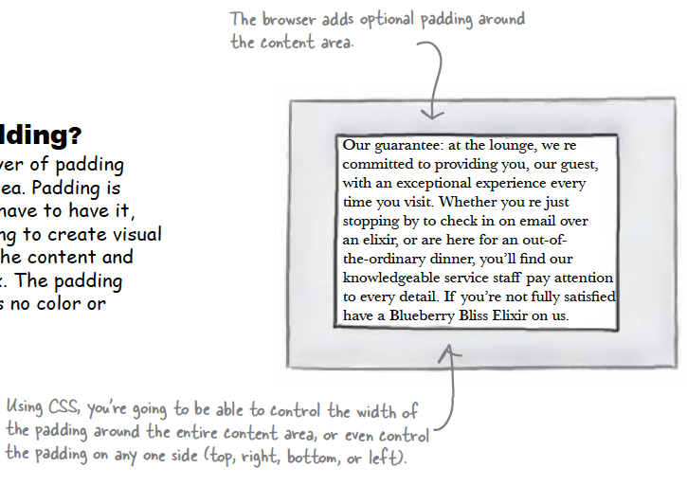
Padding
Any box can have a layer of padding around the content area.
Padding is optional, so you don’t have to have it, but you can use padding to create visual whitespace between the content and the border of the box.
The padding is transparent and has no colour or decoration of its own.

Slide 7
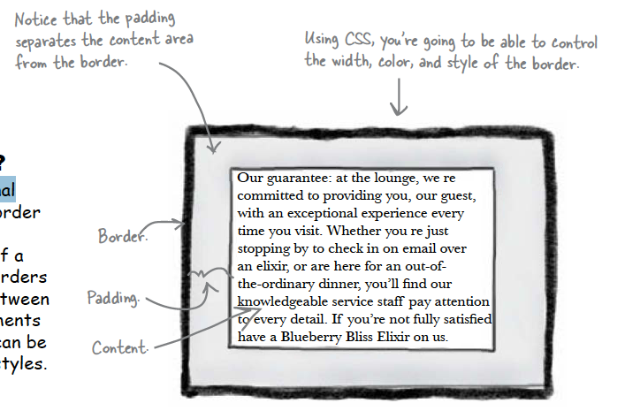
Border
Elements can have an optional border around them
The border surrounds the padding and because it takes the form of a line around the content, borders provide visual separation between content and other elements on the same page
Borders can be various widths, colours and styles

Slide 8
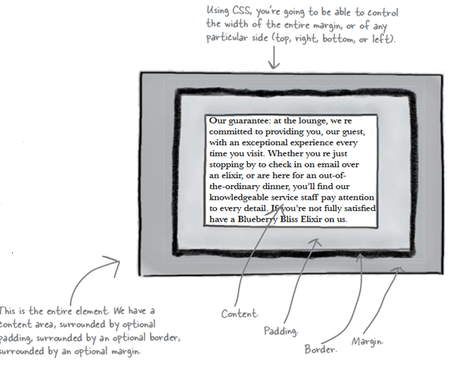
Margin
The margin is also optional and surrounds the border.
The margin gives you a way to add space between your element and other elements on the same page.
If two boxes are next to each other, the margins act as the space in between them.
Like padding, margins are transparent and have no colour or decoration of their own.

Slide 9
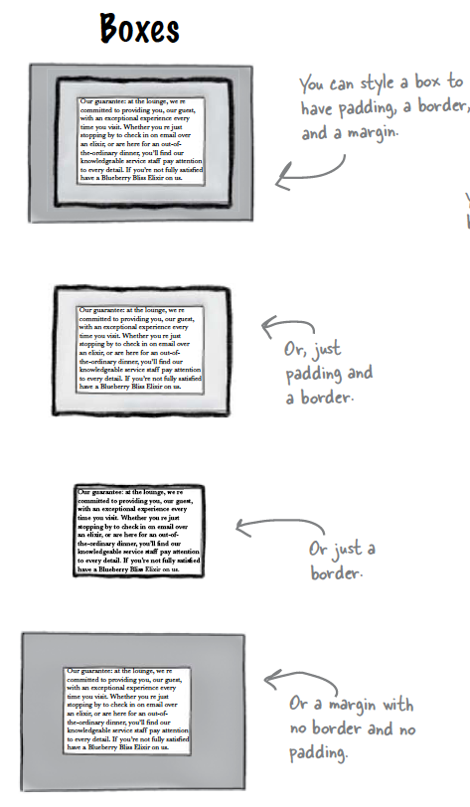
Variations: Boxes
The box model may look simple with just the content, some padding, a border, and margins.
But when you combine these all together there are endless ways you can determine the layout of an element with its internal spacing (padding) and the spacing around it (margins).

Slide 10
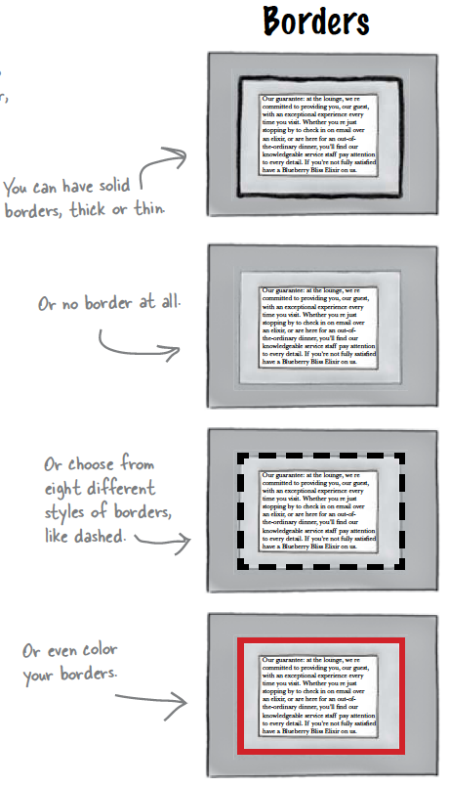
Variations: Borders
Borders can have different properties:
Border width
Border style
Border colour
Or you can specify all three properties using the shorthand “border” property
border: 2px solid navy;

Slide 11
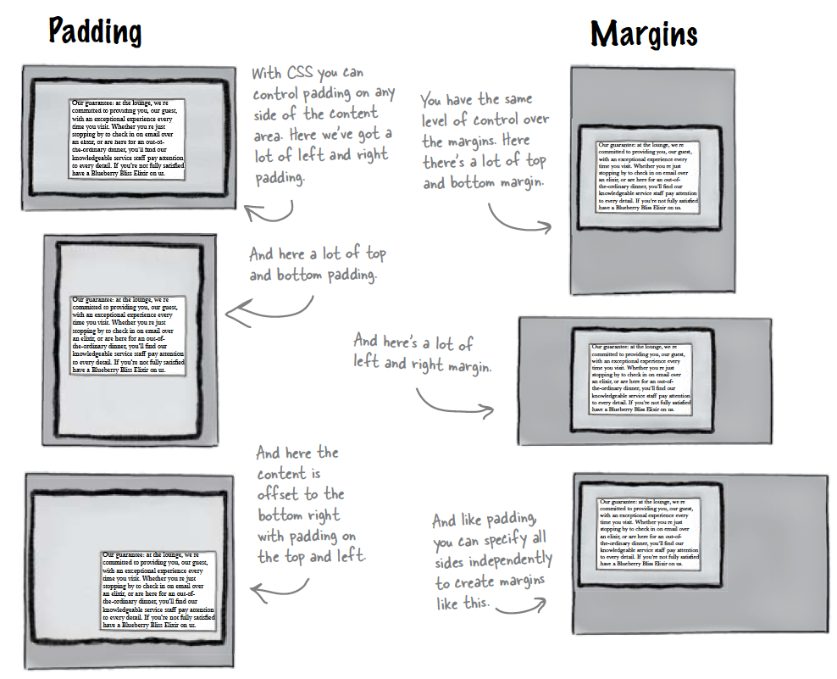
Variations: Padding & Margins
You can vary the padding and margin that is used on the top, bottom, left and right of each box.

Slide 12
Variations: Padding & Margins
Specify all four separately:
padding-top:5px;
padding-right:12px;
padding-bottom:5px;
padding-left:10px;
Use shorthand “padding” property to do all four at once:
padding: 5px 12px 5px 10px;
Specify two values: one for top/bottom, second for left/right
padding: 5px 10px;
The same can be done for margins

Slide 13
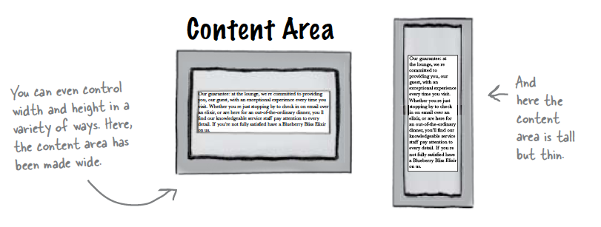
Variations: Content
You can also set the width and height of content areas.
div{
width: 50%;
height: 800px;
}

Slide 14
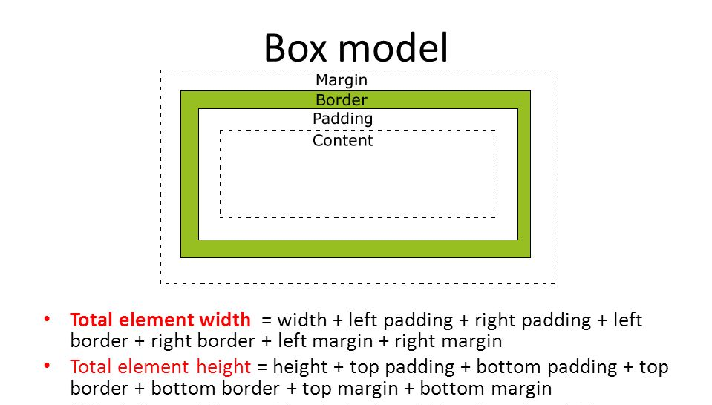
Total width and height
The padding, margins, borders, and content area all combine to give the total width and height of an element.

Slide 15
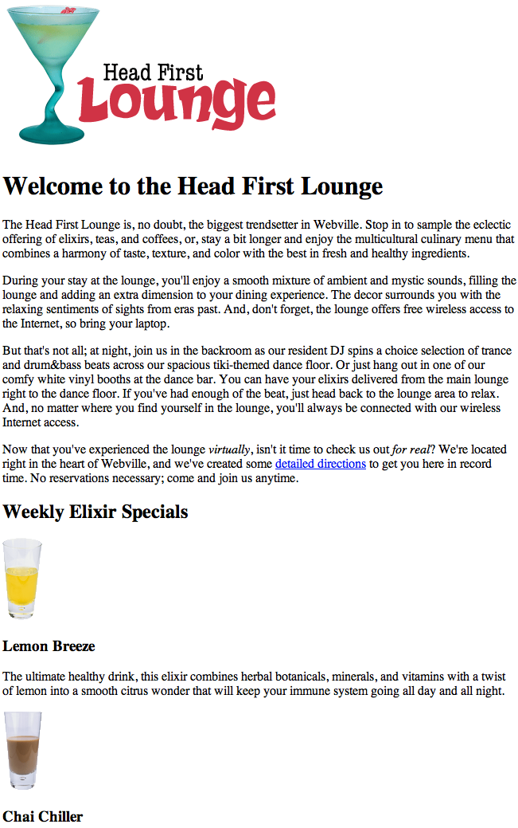
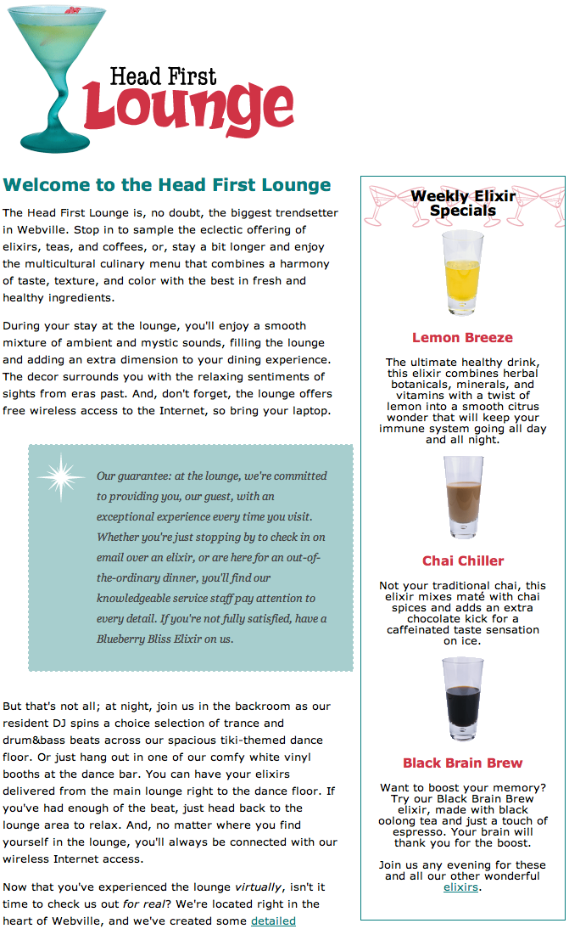
Example: head first lounge

Slide 16
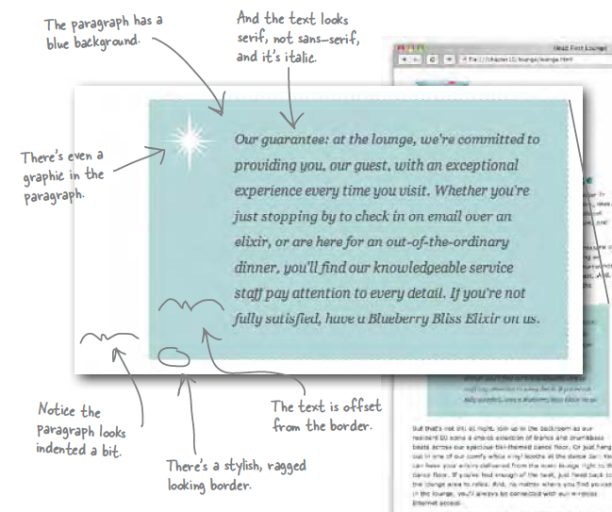
The “Guarantee” box

Slide 17

Guarantee class: CSS
.guarantee
{
border-color: black;
border-width: 1px;
border-style: solid;
background-color: #a7cece;
padding: 25px;
padding-left: 80px;
margin: 30px;
margin-right: 250px;
background-image: url(images/background.gif);
background-repeat: no-repeat;
background-position: top left
}

Slide 18
Agenda
The Box Model
Background images
More CSS layout properties

Slide 19

Add a Background Image
background.gif
We can add a background image using the background-image property in CSS.
<img> vs. background images:
An <img> element is used to include an image that has a more substantial role in the page, like a photo or a logo
A background image is pure presentation, and the only reason you would use a background-image is to improve the attractiveness of an element.
We could have just placed the image inside the paragraph, and we could probably get the same look and feel, but the guarantee star is pure decoration
It has no real meaning on the page and it’s only meant to make the element look better. So, background-image makes more sense.

Slide 20
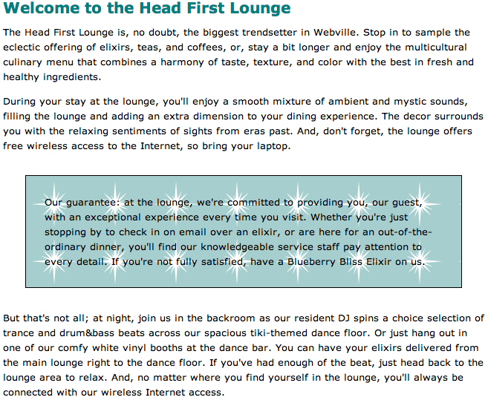
Background Image
In this example, the image sits on top of the background colour.
Because it has a transparent background, it lets the colour show through
The background images, like the background colour, only show under the content area and padding, and not outside the border in the margin
.guarantee
{
border-color: black;
border-width: 1px;
border-style: solid;
background-color: #a7cece;
padding: 25px;
margin: 30px;
background-image: url(images/background.gif);
}

Slide 21
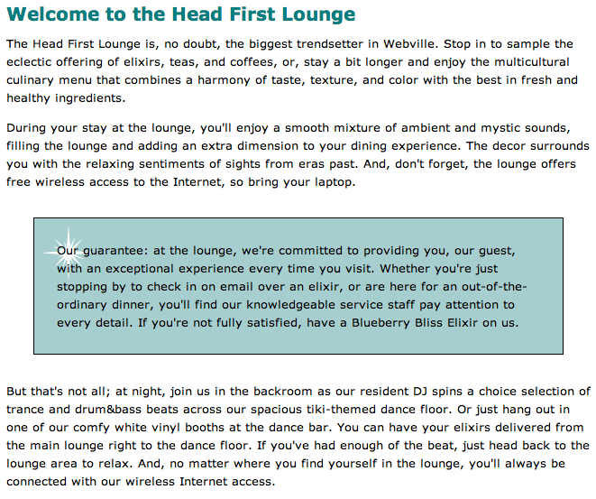
By default, background images are repeated.
The no-repeat value for the background-repeat property turns this off, so we get just one image.
By default, browsers position a background image in the top, left of the element
.guarantee
{
border-color: black;
border-width: 1px;
border-style: solid;
background-color: #a7cece;
padding: 25px;
margin: 30px;
background-image: url(images/background.gif);
background-repeat: no-repeat;
background-position: top left;
}

Slide 22
Agenda
The Box Model
Background images
More CSS layout properties
Display
Position
Float and clear
Overflow

Slide 23
Display property
There are several options for displaying elements:
Block
Inline
Block-inline
None (doesn’t show the element)

Slide 24
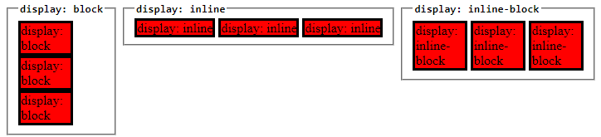
Block, inline, inline-block

Slide 25
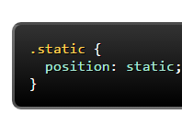
position
Position property often used to make more complex layouts.
Has a range of possible values, and their names can be confusing and difficult to remember.
Static
static is the default value.
An element with position: static; is not positioned in any special way.
A static element is said to be not positioned and an element with its position set to anything else is said to be positioned.

Slide 26
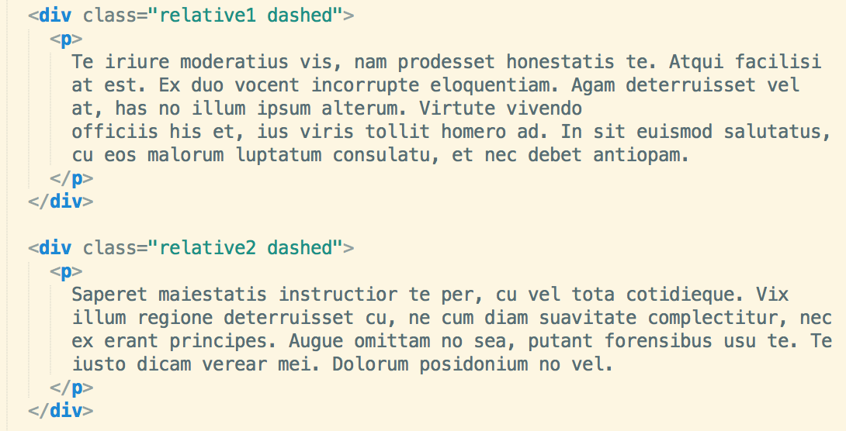
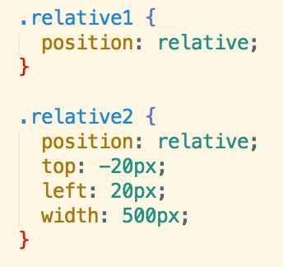
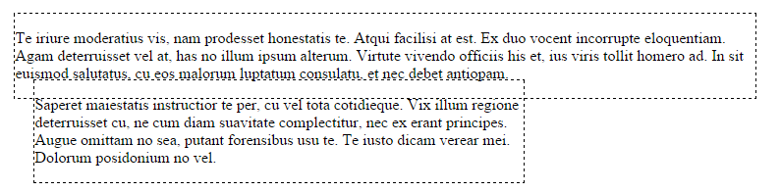
position
Relative
Relative behaves the same was as static unless you add some extra properties to adjust the element away from its normal position.
Other content will not be adjusted to fit into any gap left by that element.

Slide 27
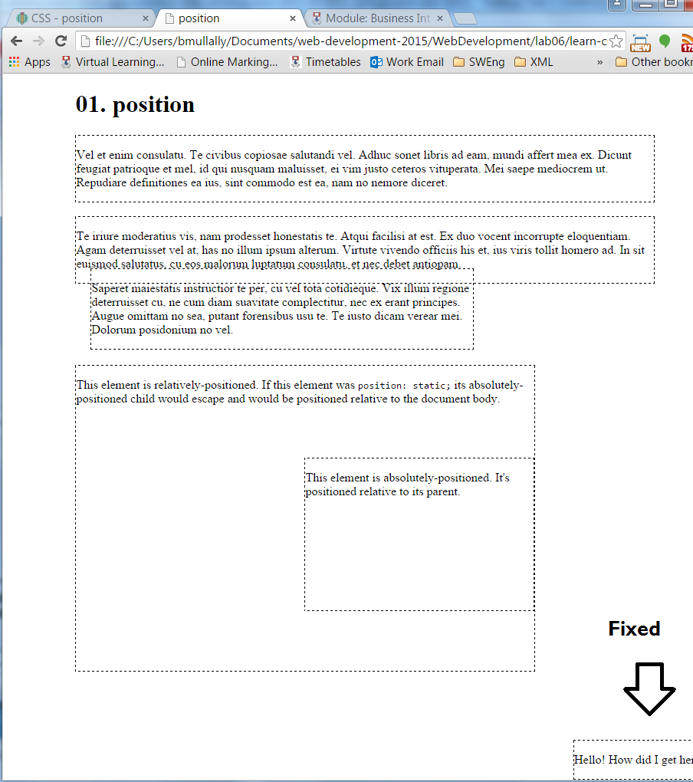
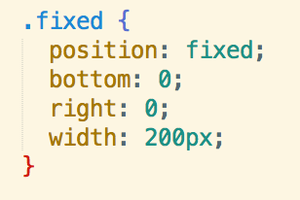
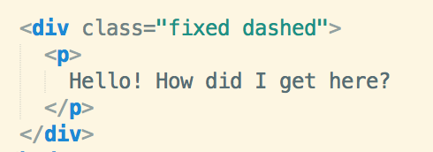
position
Fixed
A fixed element is positioned relative to the viewport, which means it always stays in the same place even if the page is scrolled.
As with relative the top, right, bottom, and left properties are used.
A fixed element does not leave a gap in the page where it would normally have been located.

Slide 28
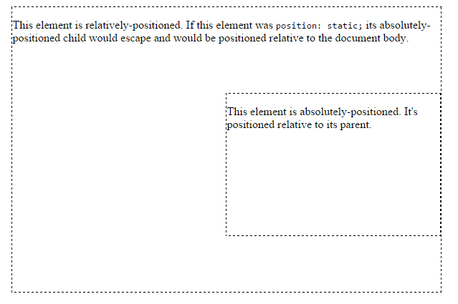
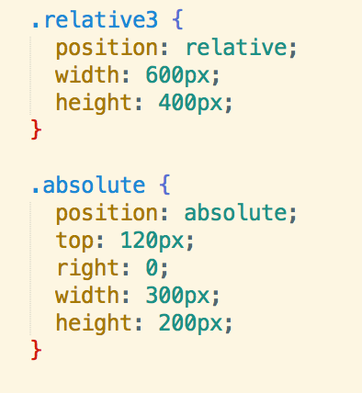
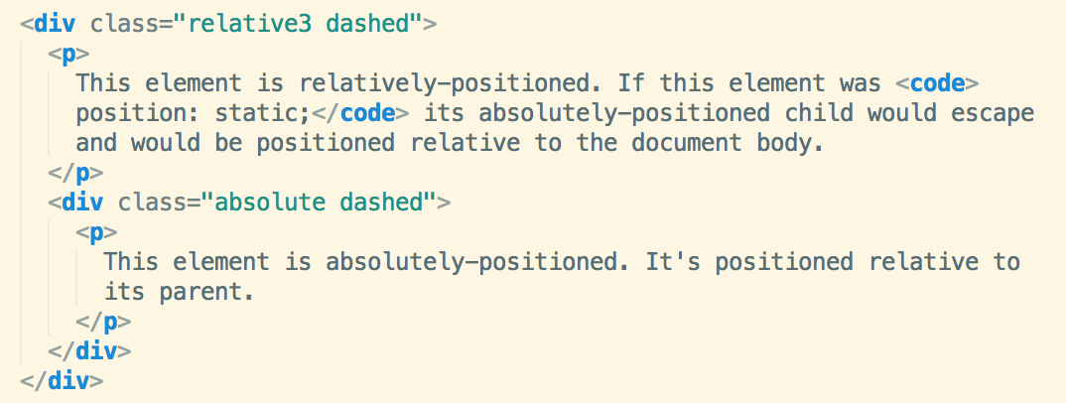
position
Absolute
Absolute behaves like fixed except relative to the nearest positioned ancestor instead of relative to the viewport. If an absolutely positioned element has no positioned ancestors, it uses the document body, and still moves along the page scrolling.
This is tricky, but can be important for creating sophisticated CSS layouts.

Slide 29
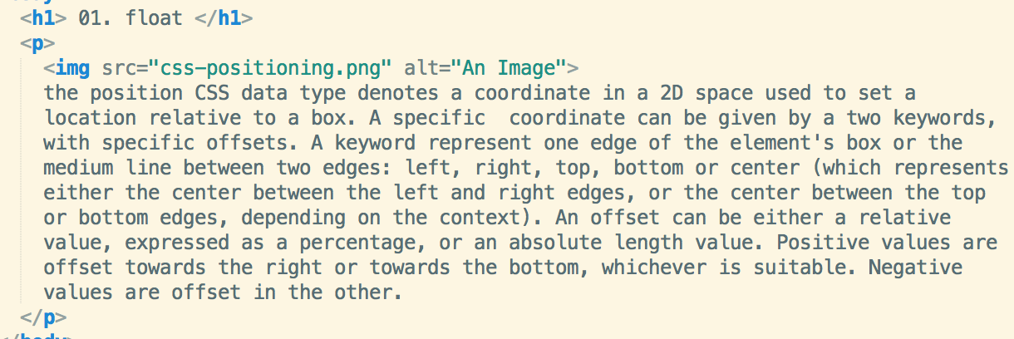
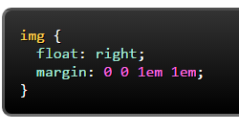
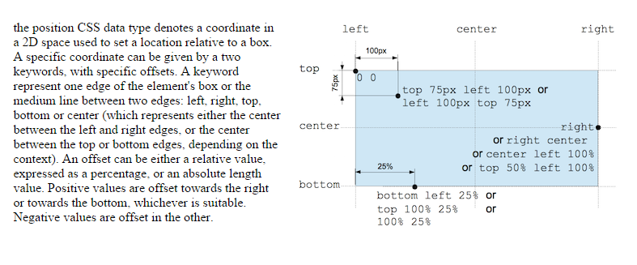
float
Float can be used for wrapping text around images:

Slide 30
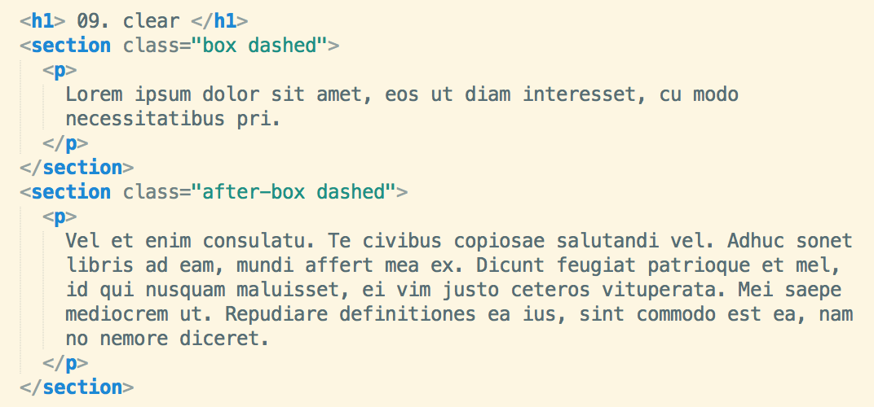
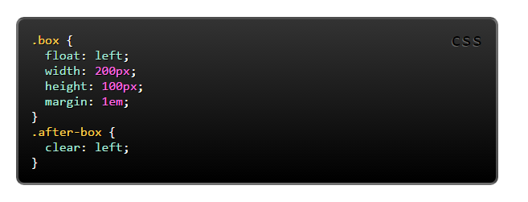
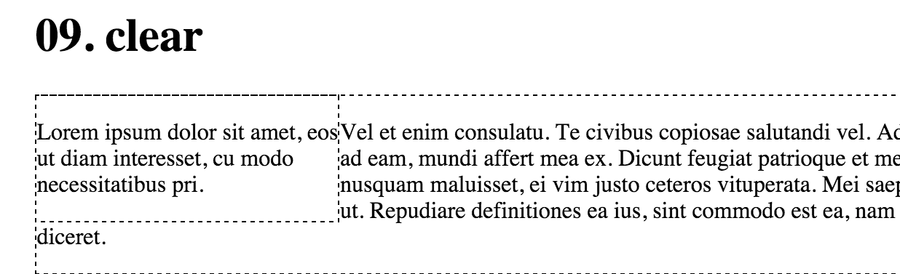
float without clear

Slide 31
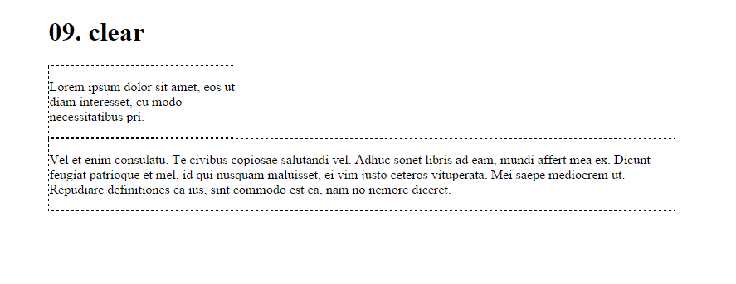
float with clear
The clear property is important for controlling the behaviour of floats.
You use the value left to clear elements floated to the left.
You can also clear right and both.

Slide 32
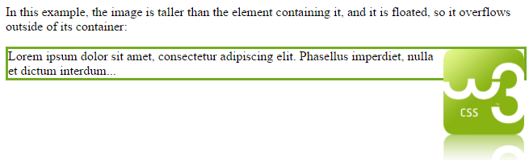
Overflow property
Another problem with using floats is when the content is larger than the containing element – if the content is floated, it is removed from the normal flow of the page, and therefore overflows outside of its container, as seen below:

Slide 33

Overflow property
To prevent this, create a class that uses the overflow:auto property. This automatically adapts the containing div to fit the height of the content.
This is the overflow class, created in the CSS file:

Slide 34
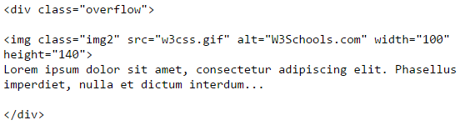
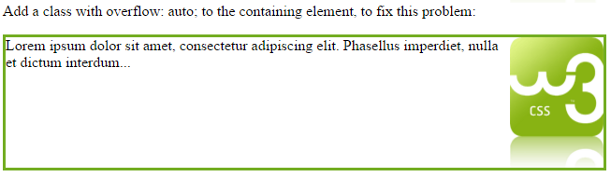
Overflow property
This is the HTML, where you can see the overflow class being applied; the result is shown underneath

