Slide 1
HTML5 Semantic elements
Website Development 1

Slide 2
HTML5 semantic elements
The need for semantic elements
Structural/layout elements
Figures and captions

Slide 3
The Need for Semantic Elements
Give content on the page meaning and structure
Semantics portray the value of content on a page, and are not just its style
Semantic markup can be interpreted by tools for the visually impaired
Search Engines can use semantic markup to better categorise and classify content
Semantic markup can make site maintenance easier as new developers can quickly grasp the site structure
Updating / restyling may by streamlined by using semantic elements

Slide 4
HTML5 semantic elements
The need for semantic elements
Structural/layout elements
Figures and captions

Slide 5
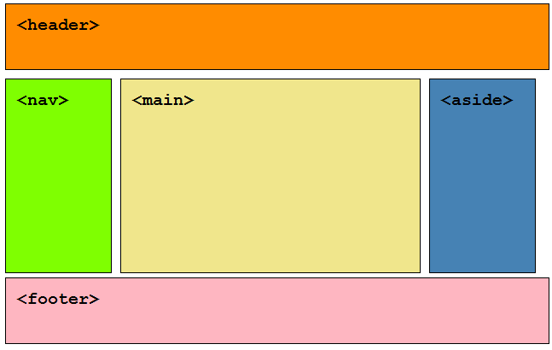
The HTML5 Semantic Elements
<header>
<nav>
<section>
<main>
<article>
<aside>
<figcaption>
<figure>
<footer>

Slide 6
<nav>
<nav>
<h1>Navigation</h1>
<ul>
<li><a href="articles.html">Index of all articles</a></li>
<li><a href="today. html">Things sheeple need to wake up for today</a></li>
<li><a href="successes. html">Sheeple we have managed to wake</a></li>
</ul>
</nav>
The <nav> tag defines a set of navigation links.
Notice that NOT all links of a document should be inside a <nav> element. The <nav> element is intended only for major block of navigation links.

Slide 7
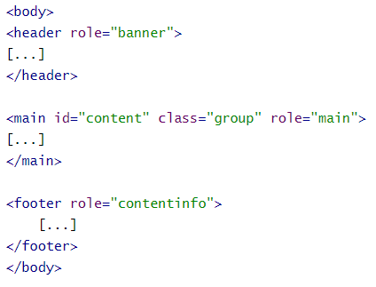
<main>
The <main> tag specifies the main content of a document.
It contains most of the unique content of a given webpage, for example, the video you want to watch, or the main story you're reading, or the map you want to view, or the news headlines, etc. This is the one part of the website that definitely will vary from page to page!
The content inside the <main> element should be unique to the document. It should not contain any content that is repeated across documents such as sidebars, navigation links, copyright information, site logos, and search forms.

Slide 8
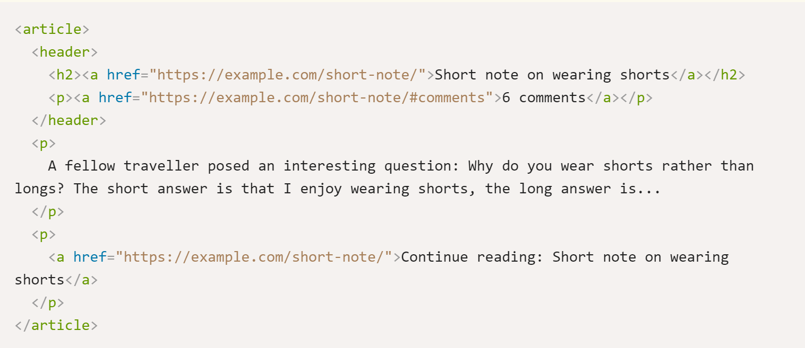
<article>
<article> encloses a block of related content that makes sense on its own without the rest of the page. This could be:
a magazine, newspaper, technical or scholarly article,
an essay or report,
a blog or other social media post.

Slide 9
<section>
<section> is similar to <article>, but it is more for grouping together a single part of the page that constitutes one single piece of functionality (e.g., a mini map, or a set of article headlines and summaries). It's considered best practice to begin each section with a heading; also note that you can break <article>s up into different <section>s, or <section>s up into different <article>s, depending on the context.
<article>
<header>
<h2>Apples</h2>
<p>Tasty, delicious fruit!</p>
</header>
<p>The apple is the pomaceous fruit of the apple tree.</p>
<section>
<h3>Red Delicious</h3>
<p>These bright red apples are the most common found in many
supermarkets.</p>
</section>
<section>
<h3>Granny Smith</h3>
<p>These juicy, green apples make a great filling for apple
pies.</p>
</section>
</article>

Slide 10
<aside>
<aside> contains content that is not directly related to the main content but can provide additional information indirectly related to it (glossary entries, author biography, related links, etc.)
<aside>
<h1>Switzerland</h1>
<p>Switzerland, a land-locked country in the middle of
geographic Europe, has not joined the geopolitical
European Union, though it is a signatory to a number
of European treaties.</p>
</aside>

Slide 11
<header> & <footer>
The <header> element represents introductory content for its nearest ancestor sectioning content or sectioning root element. A header typically contains a group of introductory or navigational aids.
<header>
<p>Welcome to...</p>
<h1>Voidwars!</h1>
</header>
<footer>
<a href="../">Back to index…</a>
</footer>
The <footer> element represents a footer for its nearest ancestor sectioning content or sectioning root element. A footer typically contains information about its section such as who wrote it, links to related documents, copyright data, and the like…

Slide 12
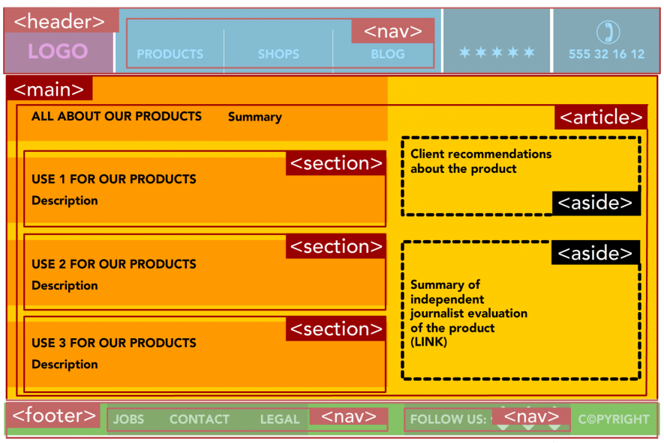
HTML5 semantic elements

Slide 13
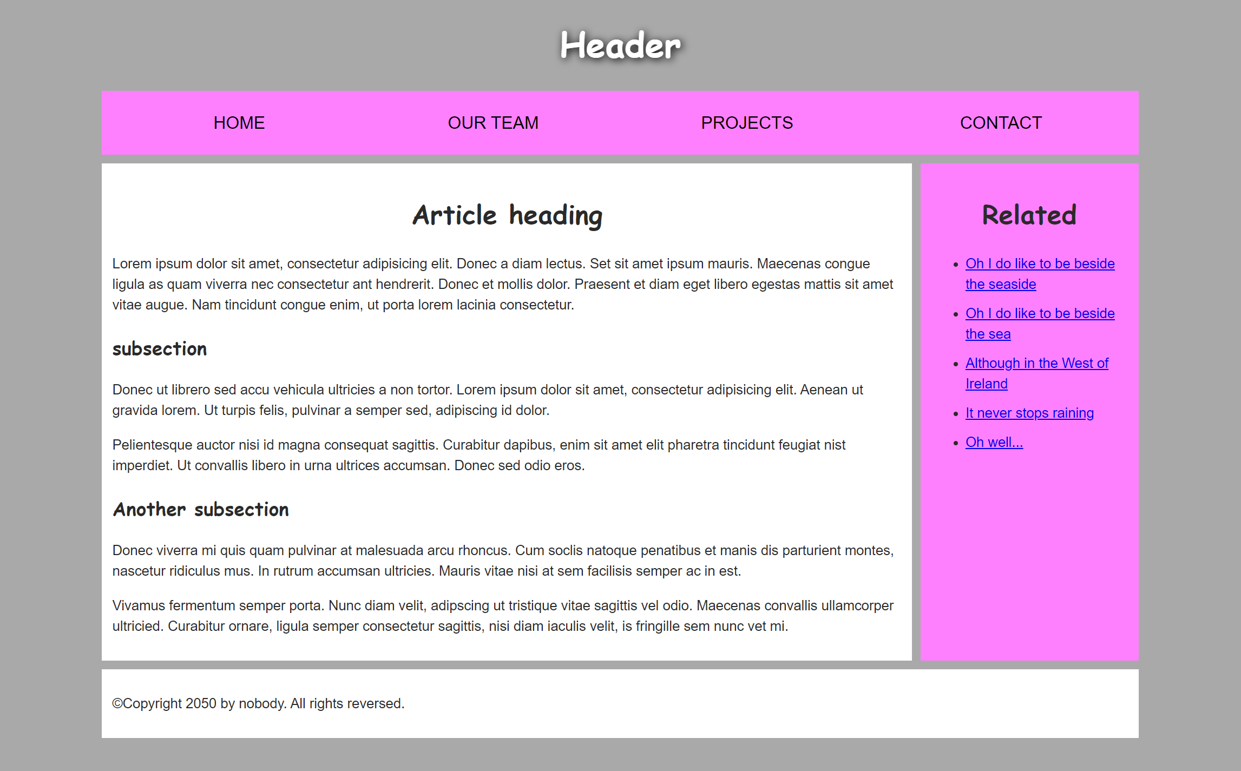
HTML5 semantic elements

Slide 14
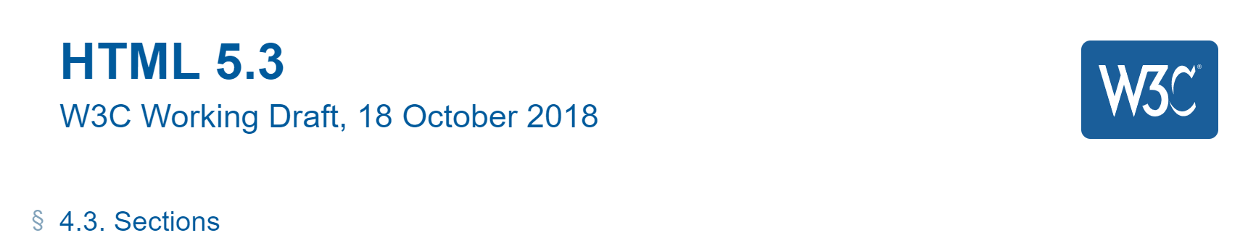
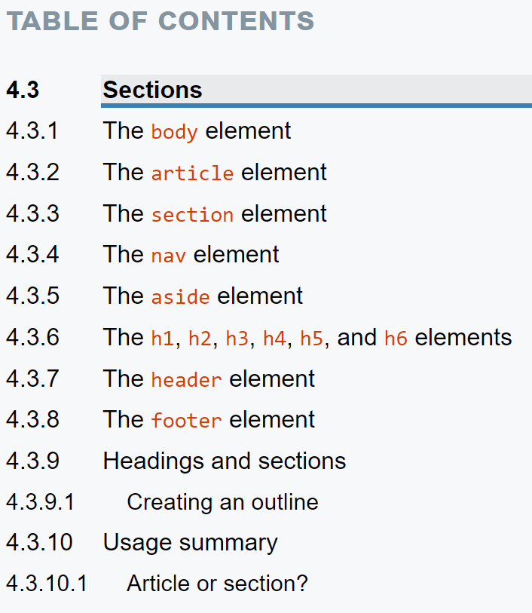
W3C Specifications
Readable and concise
Simple guidance on structuring content

Slide 15
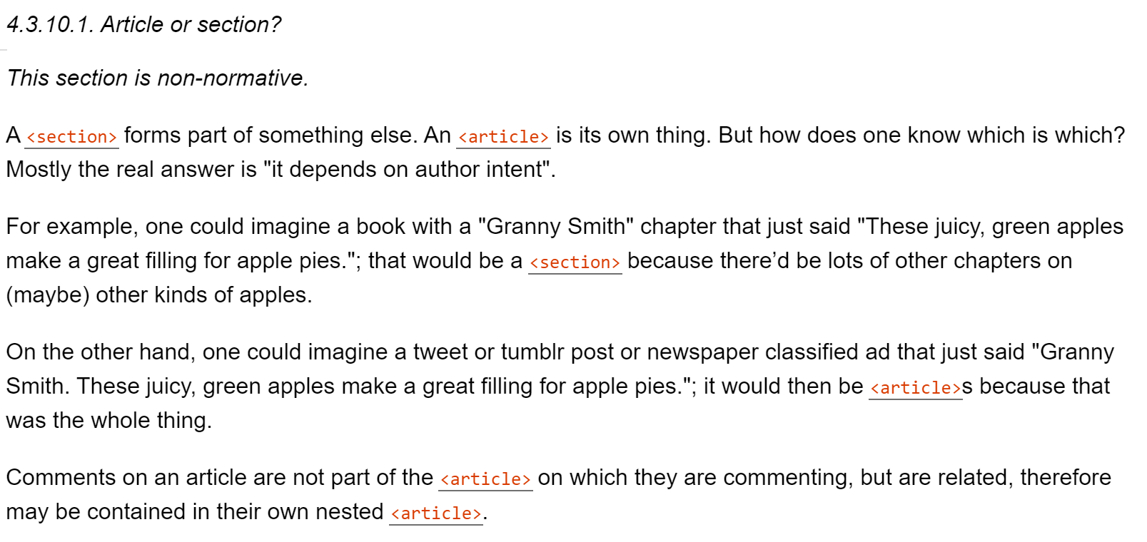
Article or Section - W3C Recommendation

Slide 16
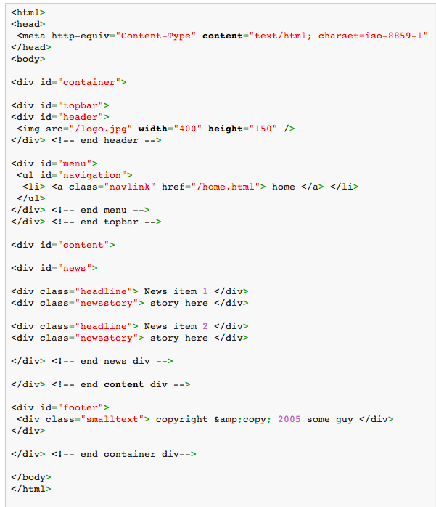
Semantic and Div’itis
Div’itis : the process of using too many nested/unnecessary divs to mark up a page.
Excessive use of DIVs makes page difficult to interpret, both by a human and machine reader

Slide 17
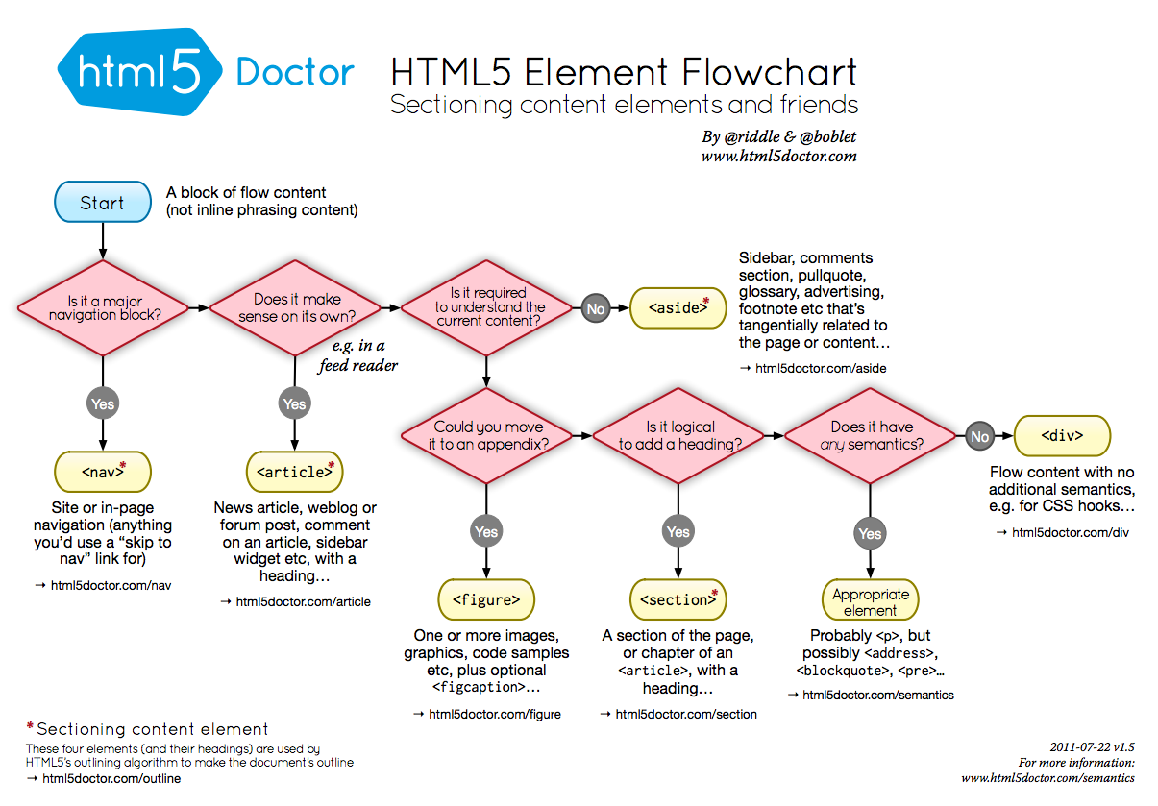

Slide 18
Different Structures and Ordering
<header></header>
<nav></nav>
<main></main>
<aside></aside>
<footer></footer>

Slide 19
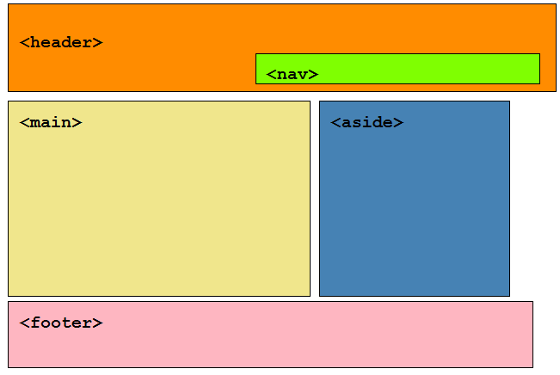
<header>
<nav></nav>
</header>
<main></main>
<aside></aside>
<footer></footer>

Slide 20
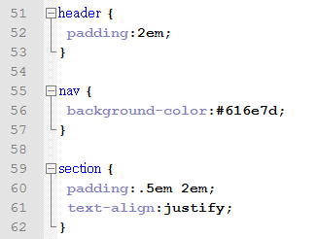
CSS example
All of the semantic structural elements mentioned above can have CSS styles applied to them to control their appearance and position

Slide 21
HTML5 semantic elements
The need for semantic elements
Structural/layout elements
Figures and captions

Slide 22
Figure and figcaption
The <figure> element is intended to be used in conjunction with the <figcaption> element to mark up diagrams, illustrations, photos, and code examples (among other things).
“The figure element represents a unit of content, optionally with a caption, that is self-contained, that is typically referenced as a single unit from the main flow of the document, and that can be moved away from the main flow of the document without affecting the document’s meaning”
“The figcaption element represents a caption or legend for a figure.”

Slide 23
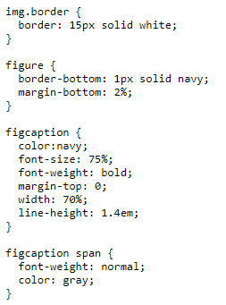
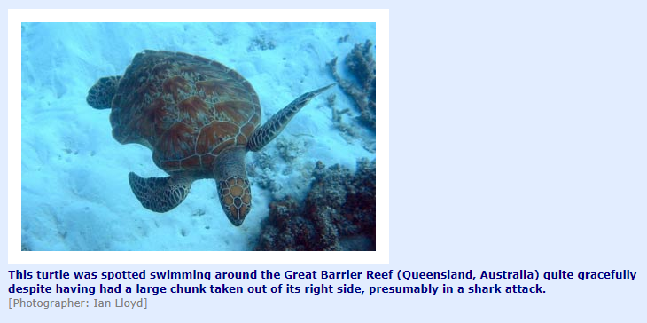
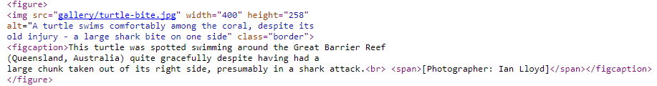
Figure and figcaption

