Slide 1
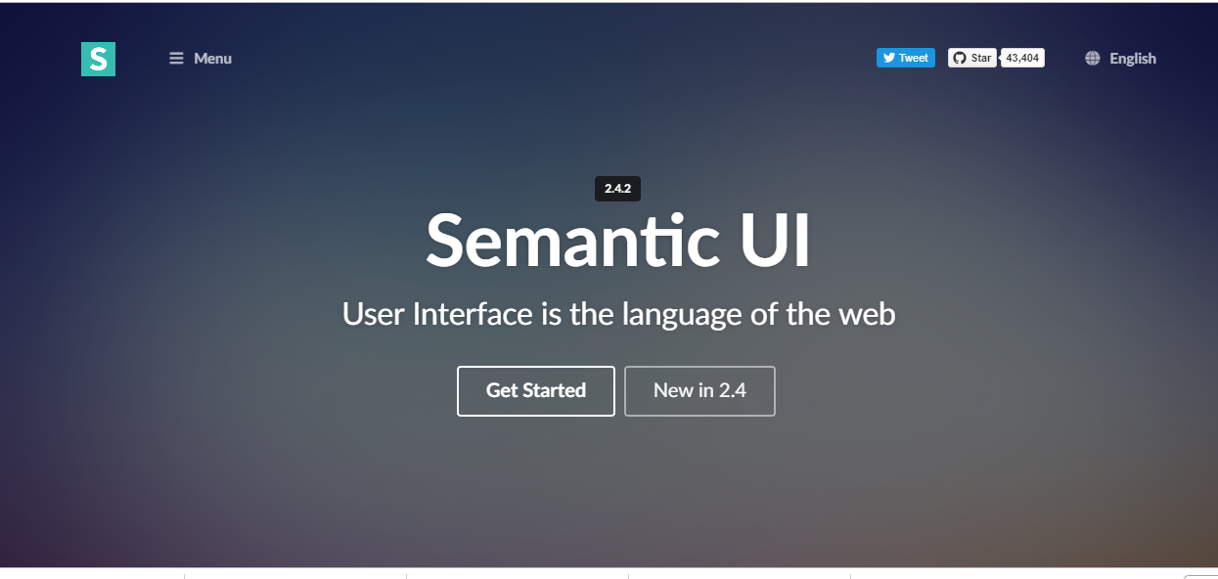
Semantic UI

Slide 2
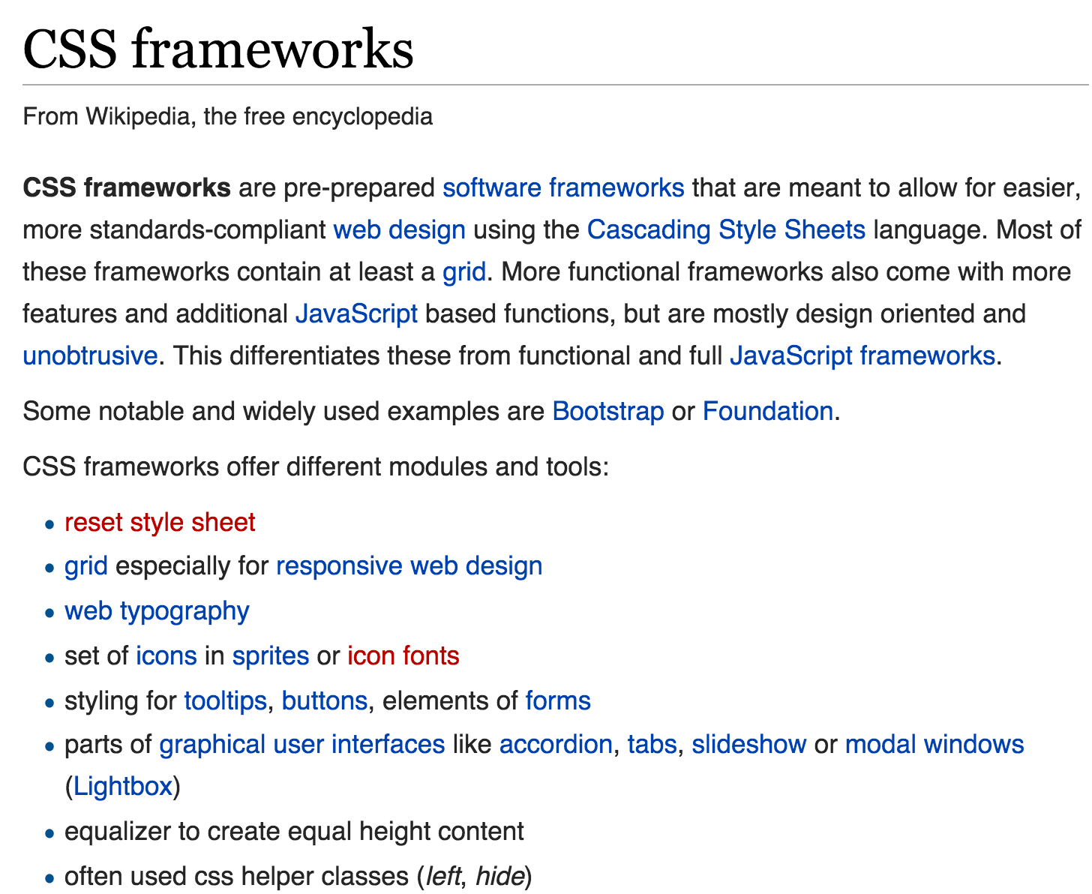


Slide 3
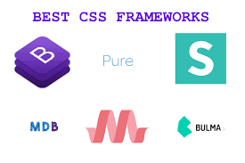
What is a CSS Framework?
“framework is defined as a package made up of a structure of files and folders of standardised code (HTML, CSS, JS etc.) which can be used to support the development of websites, as a basis to start building a site.”
“The aim of frameworks is to provide a common structure so that developers don’t have to redo it from scratch and can reuse the code provided"

Slide 4
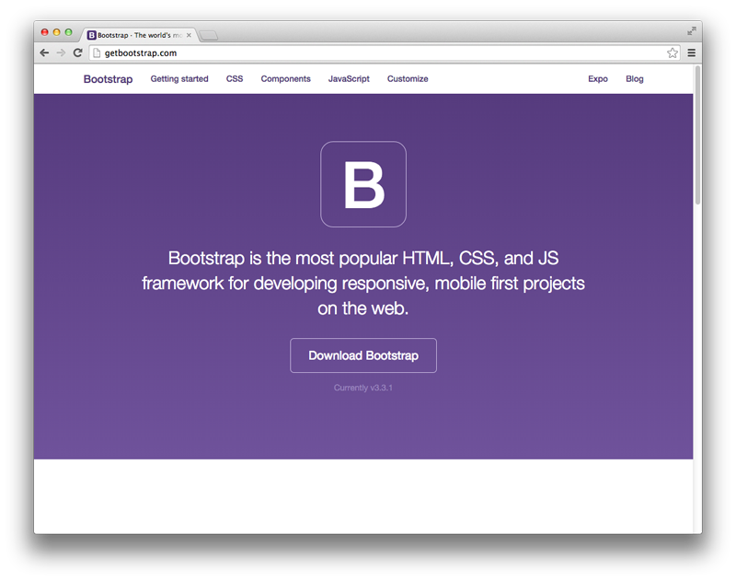
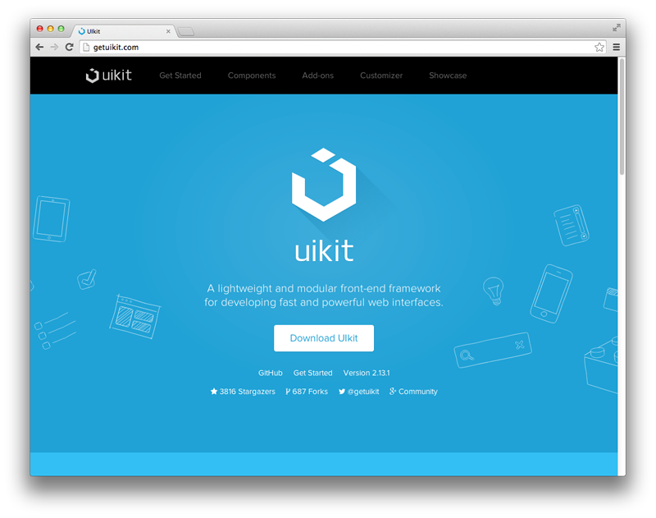
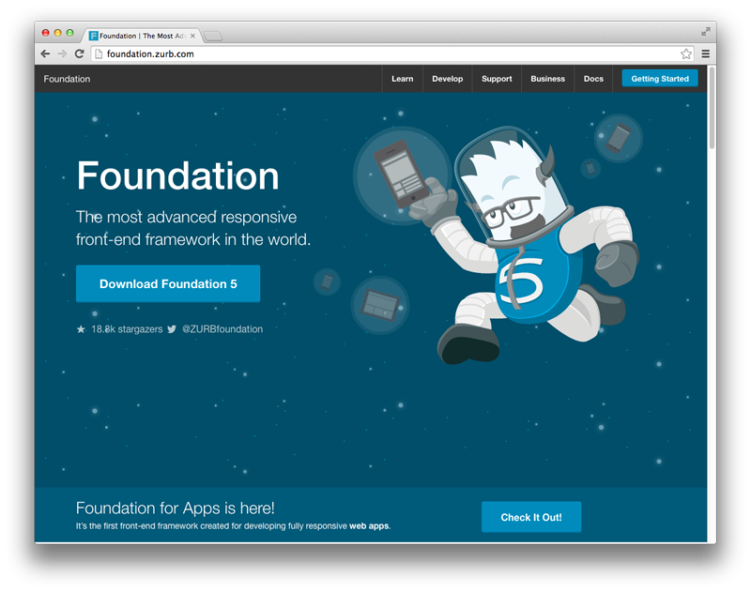
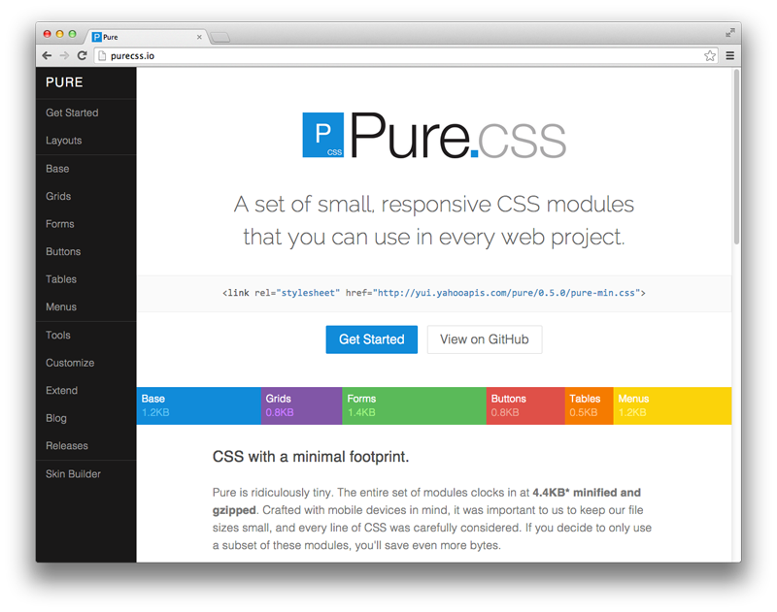
Popular Frameworks

Slide 5
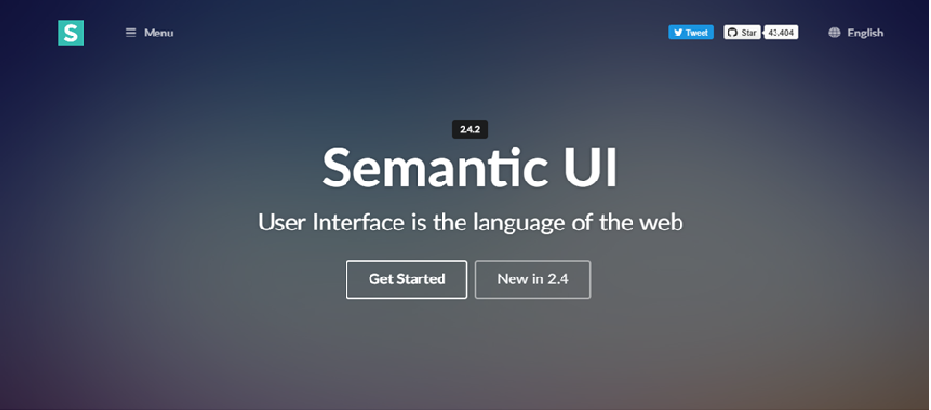
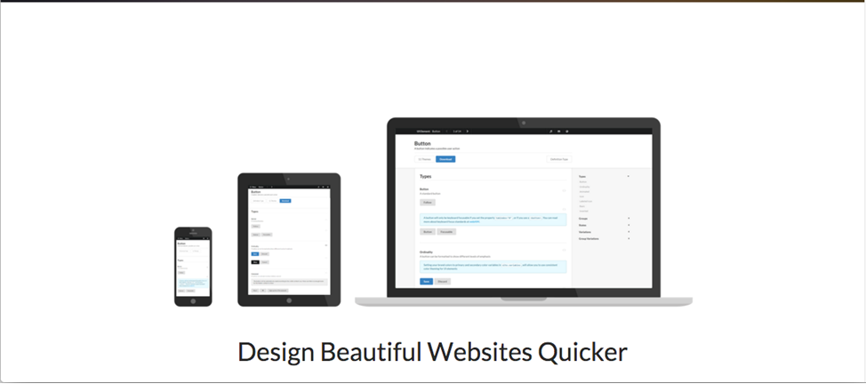

Slide 6
Semantic UI Starter
class = "ui container"
class = "ui segment"
class = "ui header"
class = "ui image"
class = "ui grid"
class = "ui row"
class = "ui column"
Semantic css defines a large number of classes
Your elements take on Semantic-UI styles by adopting specific classes
All classes are preceded by “ui” to mark them as part of the framework

Slide 7
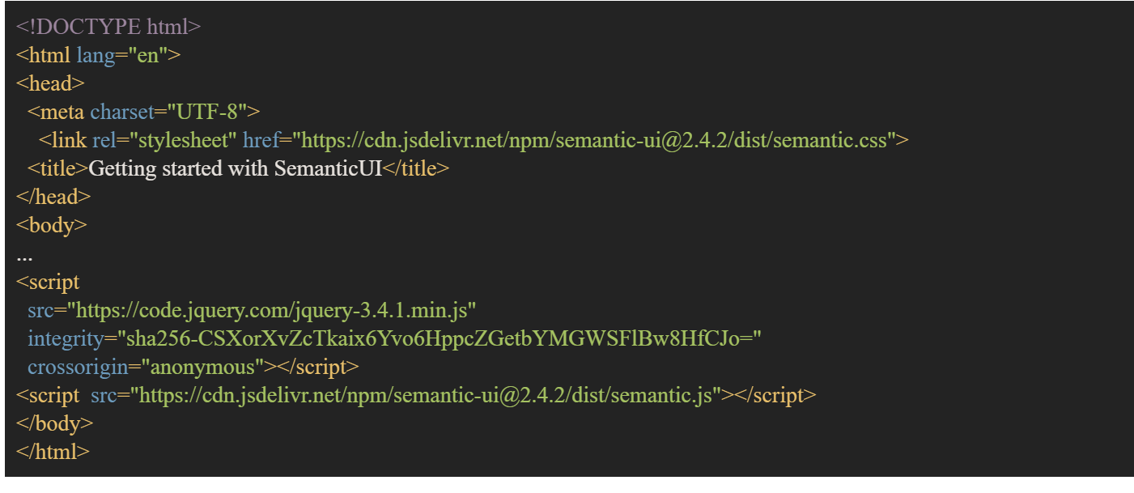
First Steps…
We will link to the required Semantic UI files using Cloud Flare.
Cloud Flare is a Content Delivery Network (CDN).

Slide 8
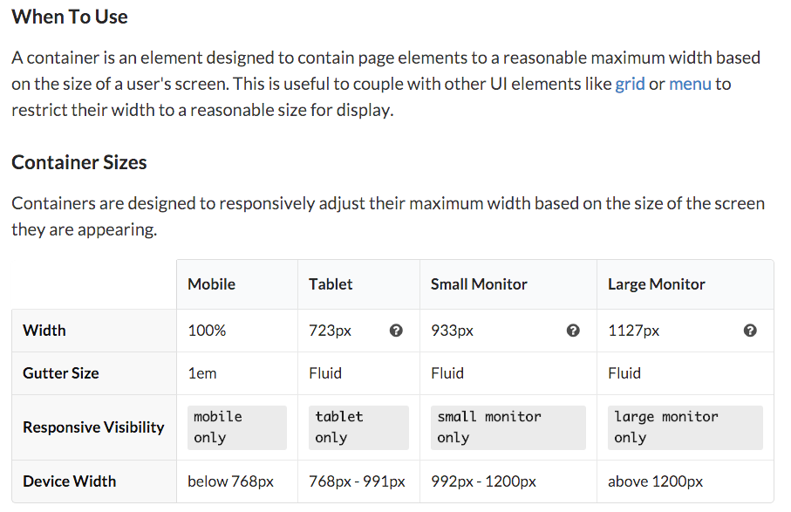
Container
http://semantic-ui.com/elements/container.html

Slide 9
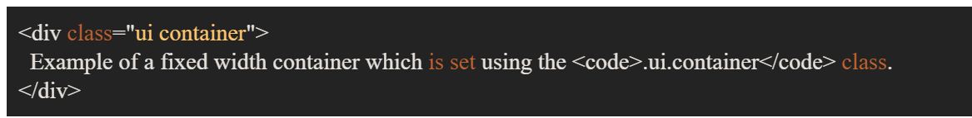
Container
As stated a container is a fixed width element that wraps your site's content. It remains a constant size and uses margin to center.
Containers are the simplest way to center page content inside a grid.

Slide 10
Grid
Grid systems enable you to create advanced layouts using rows and columns.
Semantic UI uses a 16 column grid, where each column is of equal width with spaces in between. These spaces are called gutters. The use of grids is by far the most popular method for dividing and utilizing space. Regardless of which framework you choose to develop with a solid understanding of the grid layout will allow you the most flexibility and control in your designs.

Slide 11
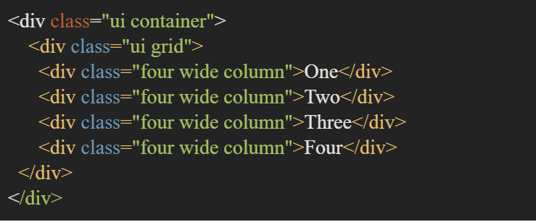
Grid - Columns
If you would like to divide your content into 4 sections across the page it's as simple as dividing the 16 total columns by 4, which equals 4. This means you'll need to specify that each column takes up a width of four in order to have four columns across the page.

Slide 12
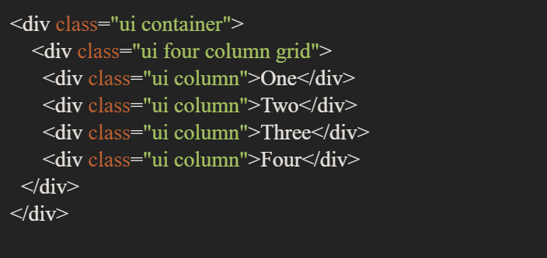
Grid - Columns
We could code the grid also as follows:

Slide 13
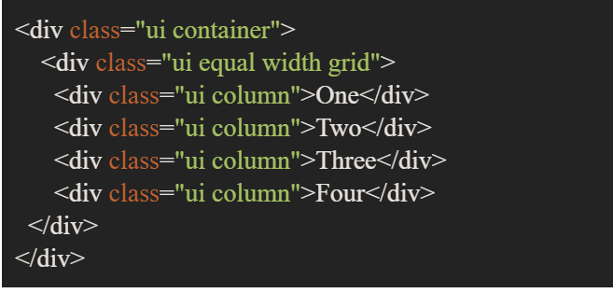
Grid - Columns
Alternatively, we could code the grid also as follows:

Slide 14
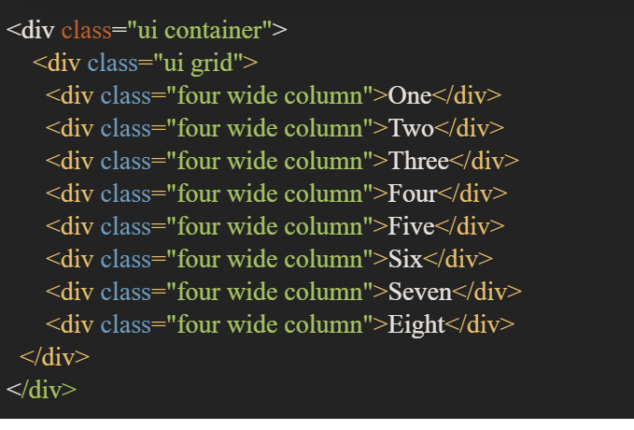
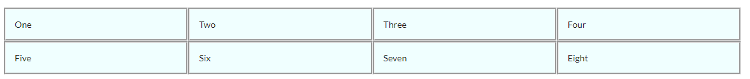
Grid - Rows
Rows are implicitly rendered if required but new rows may be explicitly specified.

Slide 15
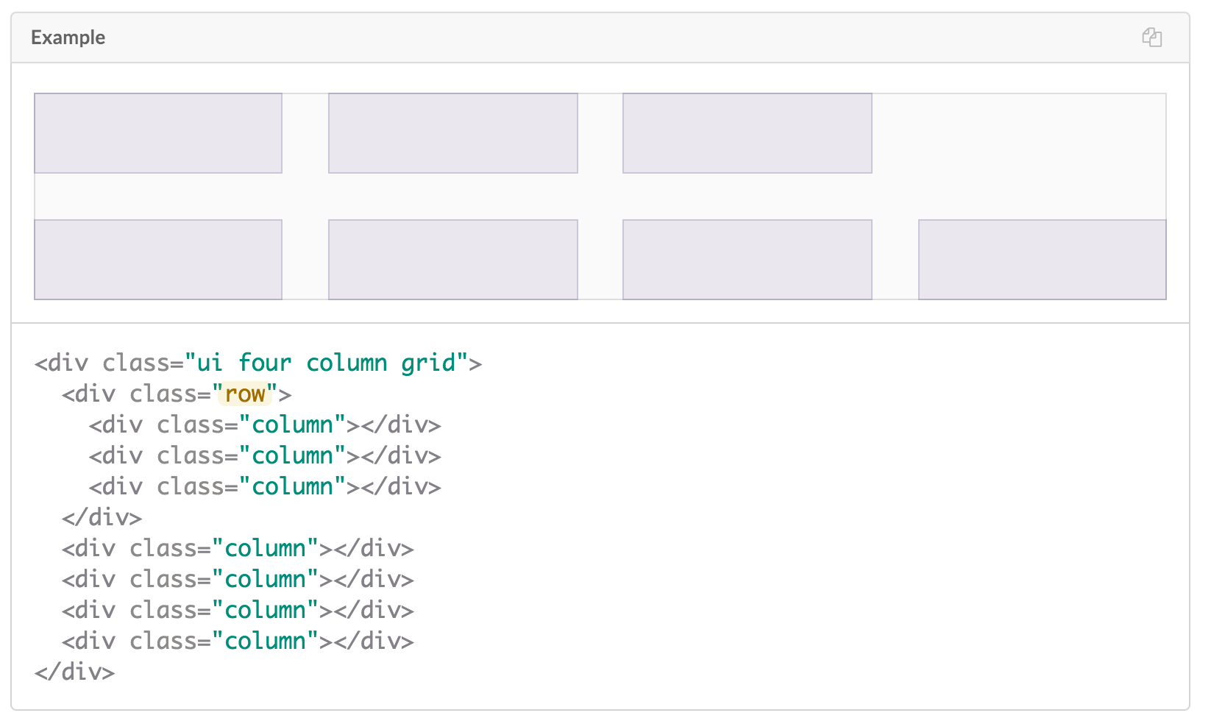
Grid - Rows

Slide 16
Grid
Grids may be nested:
Coloured:
Aligned and Floated:

Slide 17
Grid
We need to design for all viewports so what looks readable and usable on a computer may not look the same on small devices such as mobile.
There are various options available to change the look of a website depending on the viewport.

Slide 18
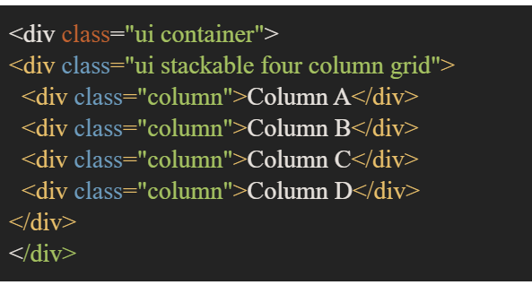
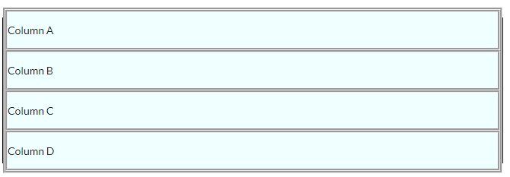
Grid
A stackable grid will automatically stack rows to a single columns on mobile devices.

Slide 19
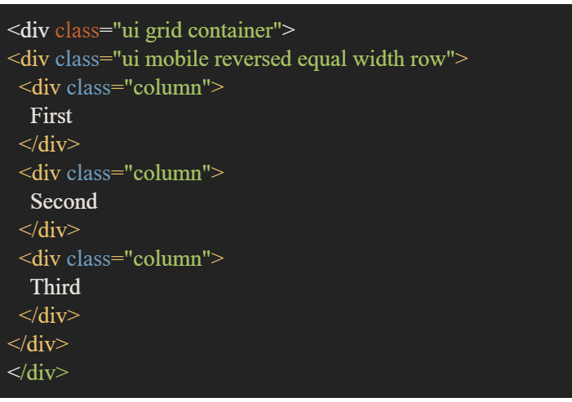
Grid
You can reverse the order of columns or rows by device.

Slide 20
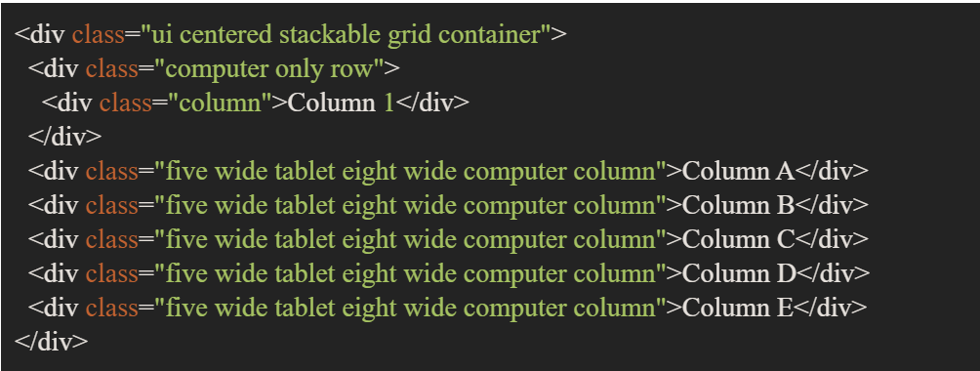
Grid
You can also manually tweak device presentation by specifying (x) wide device or device only columns or rows.

Slide 21
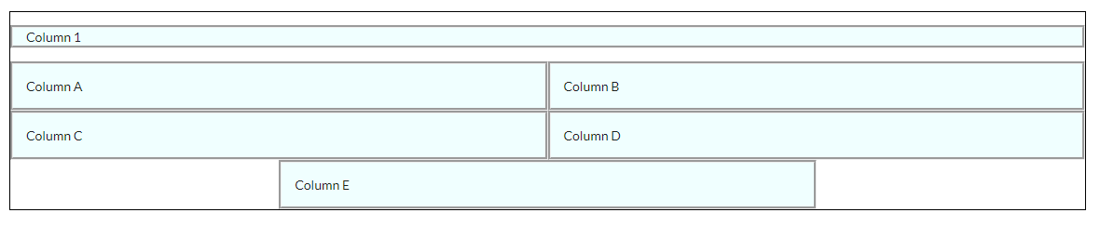
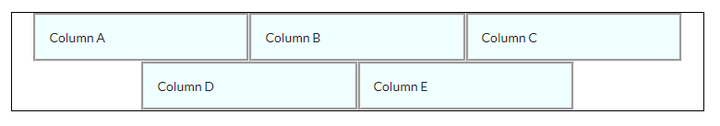
Grid
Computer viewports and larger:
Tablet viewport:

Slide 22
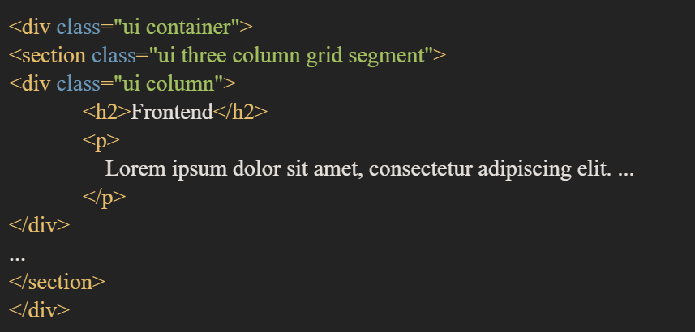
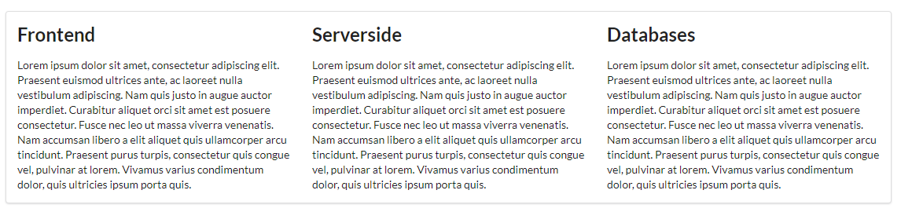
Segment
Use to group related content
Give the enclosing articles/sections the class
class="ui segment":

Slide 23
Segment
Variations of the segment include:
Raised
Piled
Stacked

Slide 24
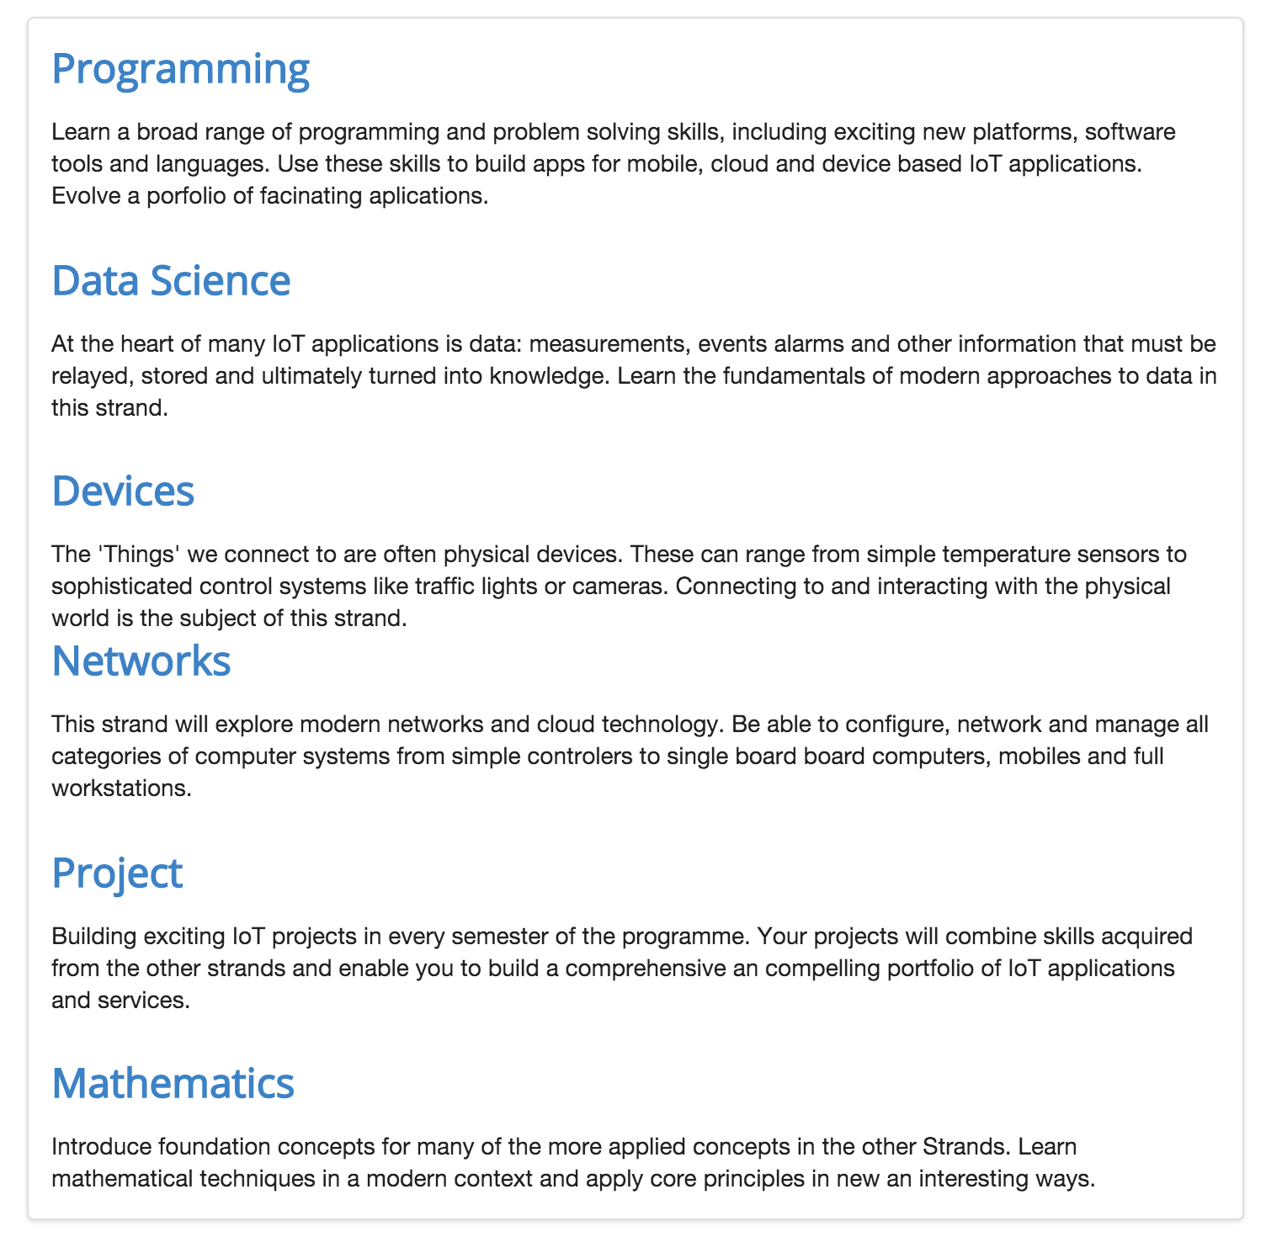
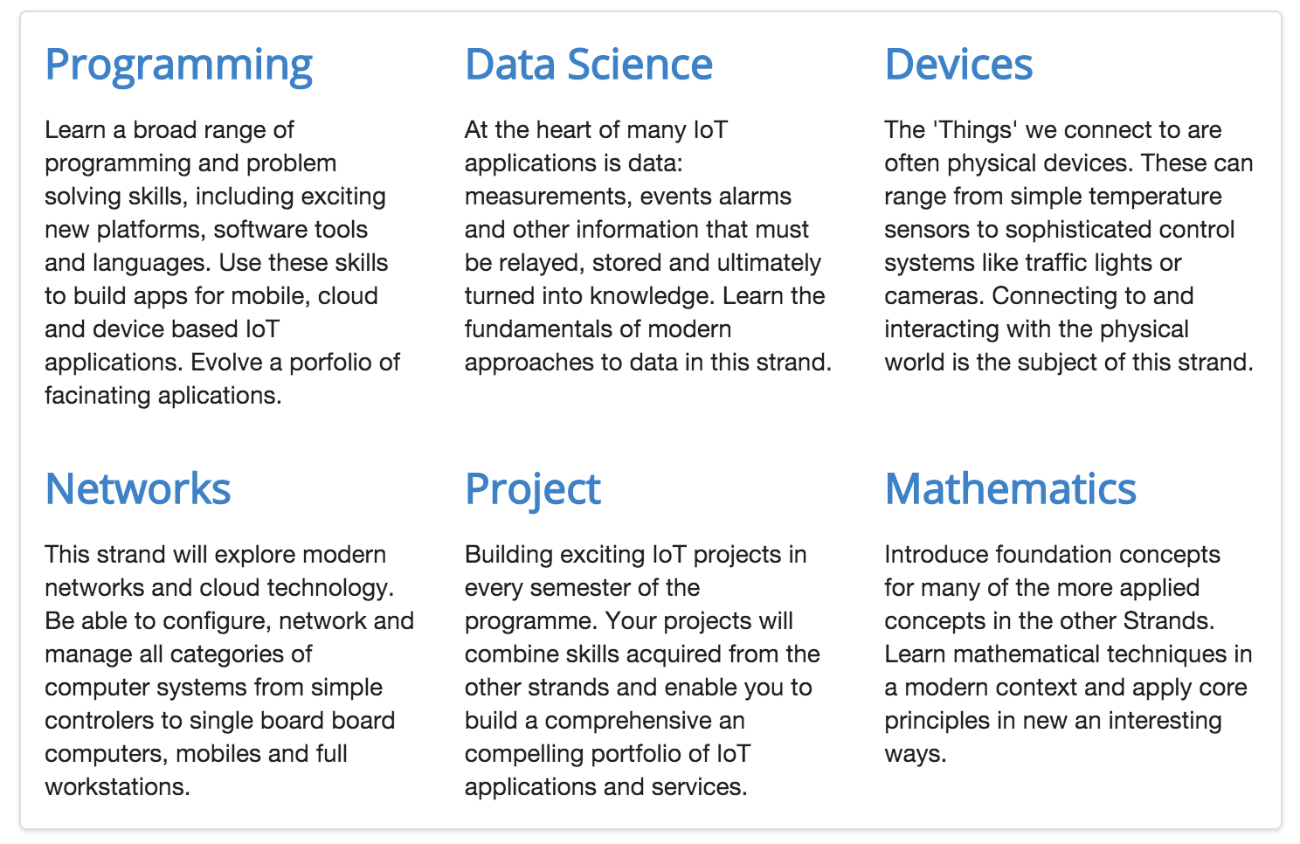
Grid Example

Slide 25
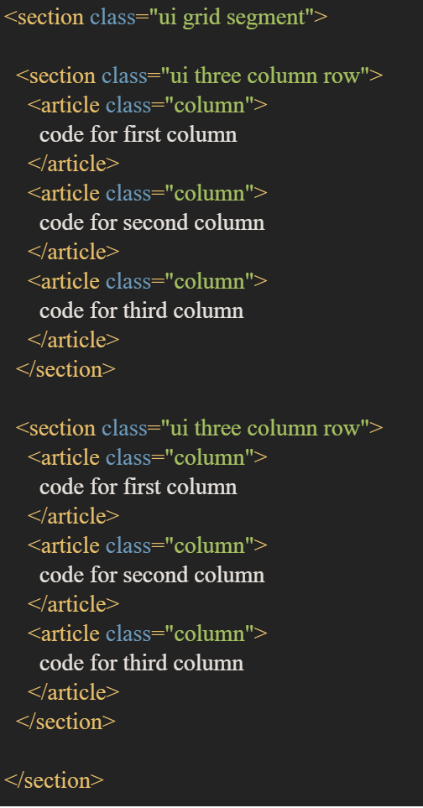
Two Rows
Row 1 - three columns
Row 2 - three columns

Slide 26
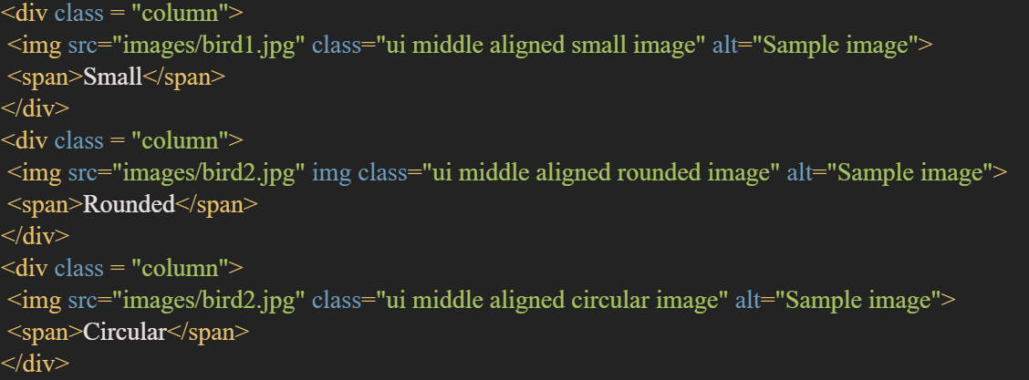

Image Element
The ui image class can be added to the <img> tag to add more options for images.

Slide 27
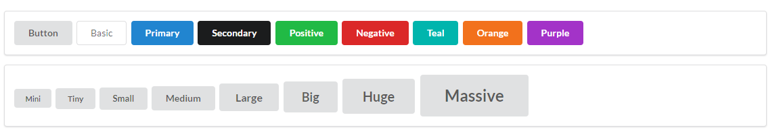
Button Element
Likewise, the ui button class can be added to the <button> tag to add more options for buttons.
Options include:
Size
Type
Colour
Inverted

Slide 28
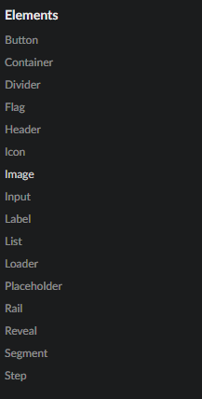
Elements
Information about Semantic UI elements can be found at:
https://semantic-ui.com

