Slide 1
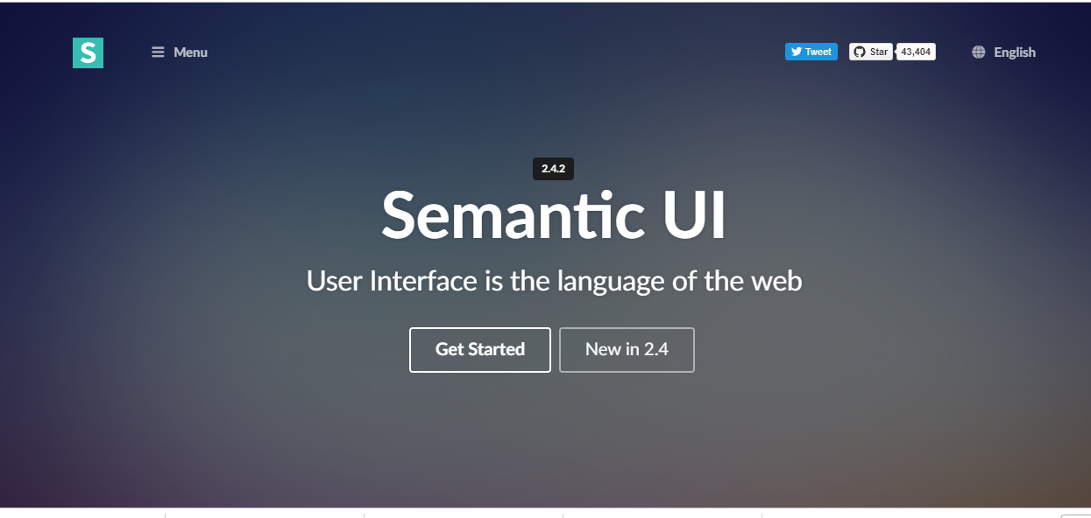
Semantic UI

Slide 2
Topic List
Table
Menu
Card

Slide 3
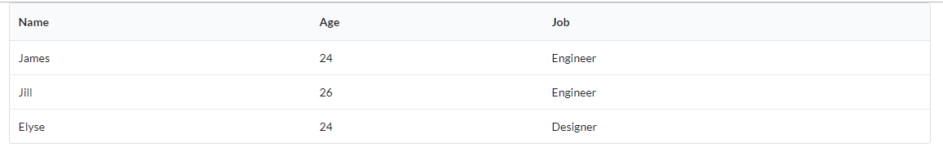
Table
The .ui.table class added to the <table> tag renders a standard table.

Slide 4
Table
The following classes can be added to the <table> tag (for layout):
Basic (No colour).
Celled (Add cell borders).
Padded (Add some padding).
Compact (Reduce top and bottom padding in cells).
Fixed (Each cell is the same size).
Collapsing (Reduce width of table).
Single Line (No word wrap).
Column Width (Specify column width of table columns).

Slide 5
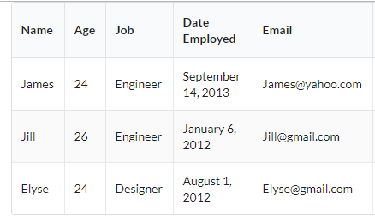
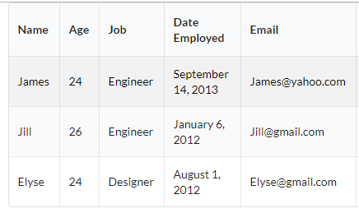
Table
The following classes can be added to the <table> tag (for colour and style):
Striped (Every second row has a background colour).
Selectable (Change background colour when mouse hovers over each row).

Slide 6
Modifying Semantic UI Classes
If you wish to change the colour or other style property, then make changes in your local .CSS file.
Copy the style rule from the semantic.css file.

Slide 7
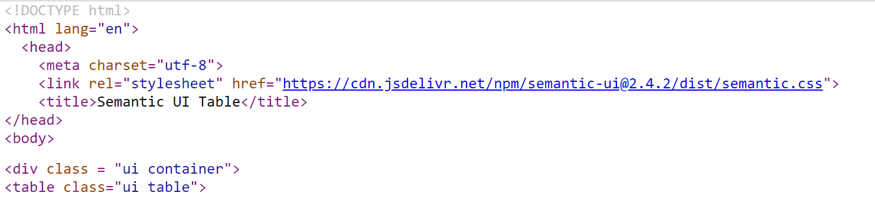
Modifying Semantic UI Classes
You can go to the semantic.css file by viewing the source of any of the example files. Click on the .css file link.

Slide 8
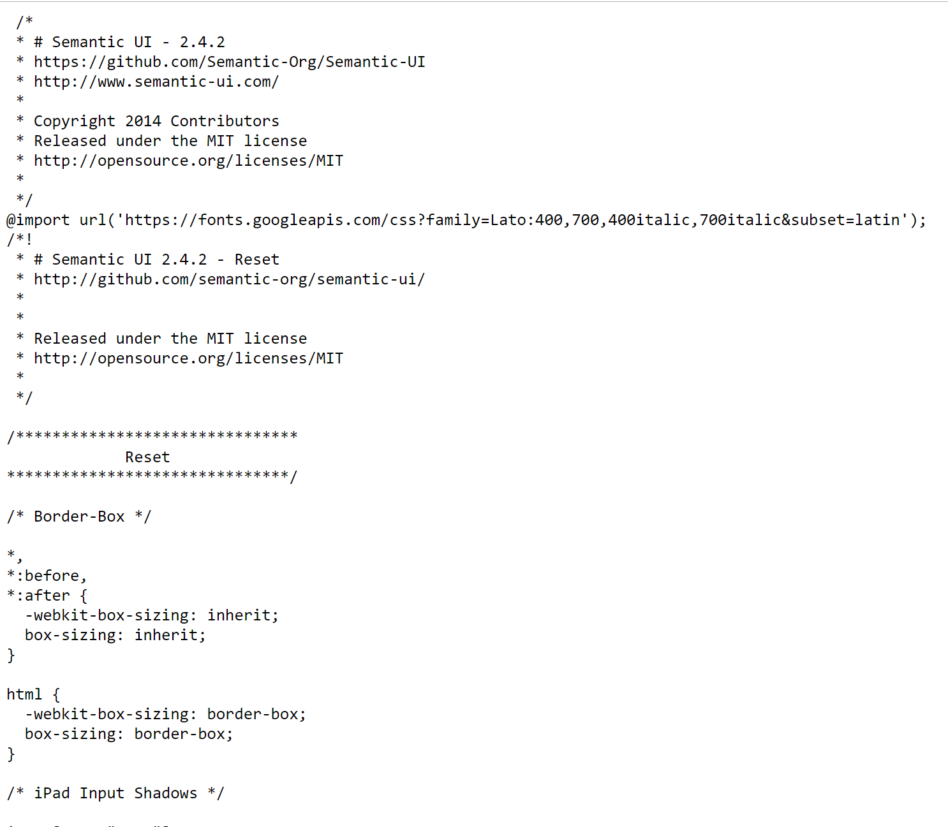
Modifying Semantic UI Classes

Slide 9
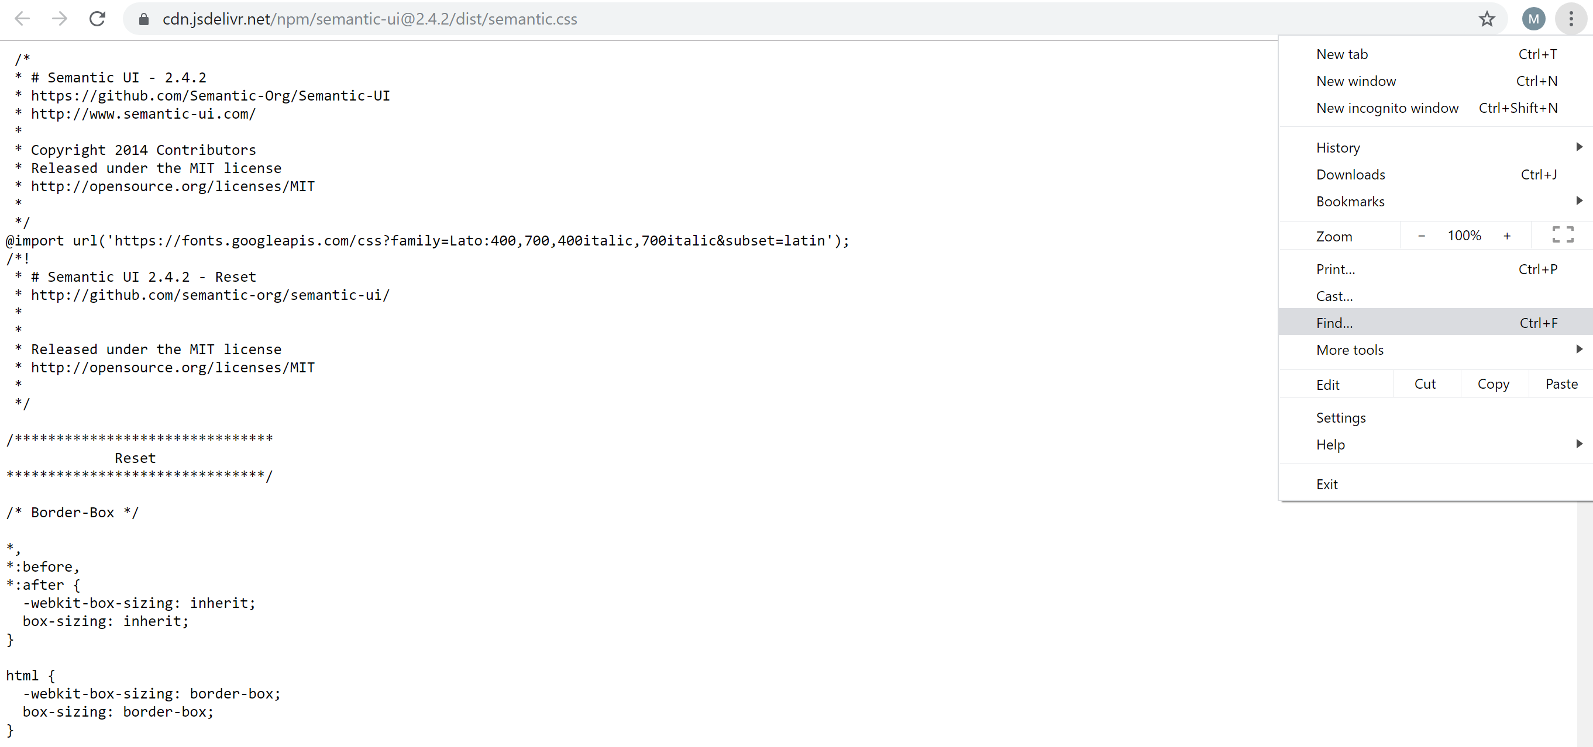
Modifying Semantic UI Classes
Locate the necessary rule by using the Find… facility.

Slide 10
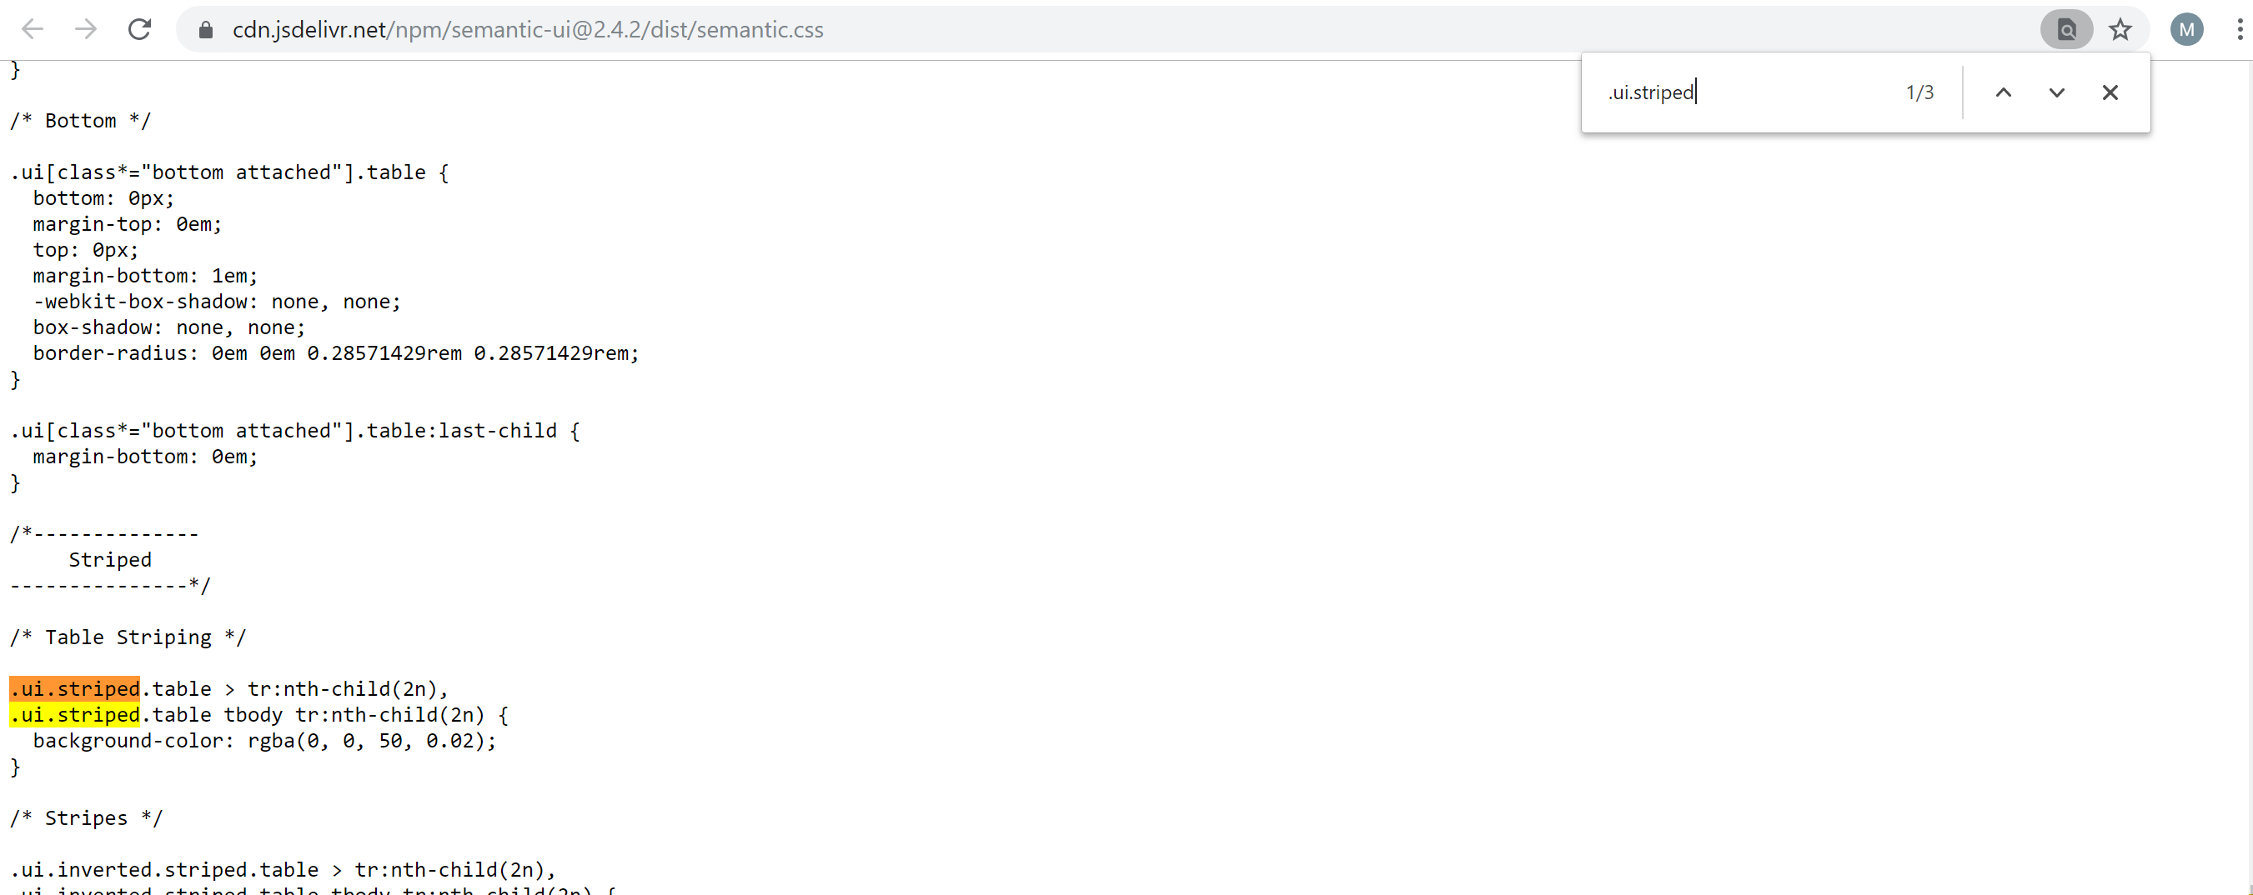
Modifying Semantic UI Classes

Slide 11
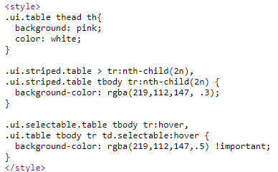
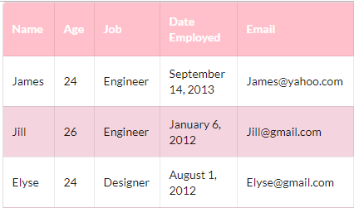
Modifying Semantic UI Classes

Slide 12
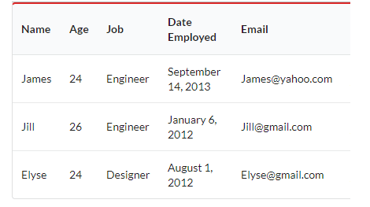

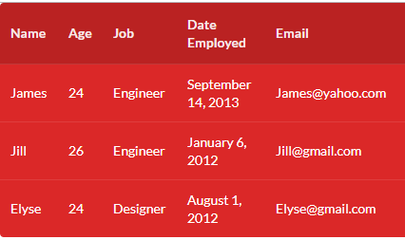

Add some colour

Slide 13
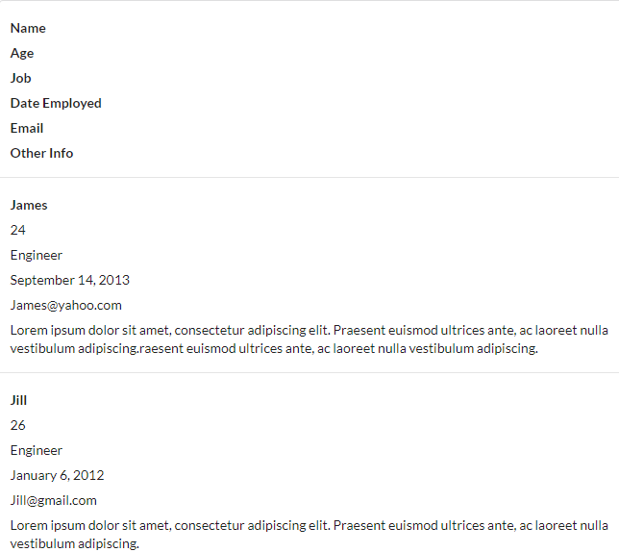
Responsive Tables
Tables automatically stack for mobile devices.
Other options include:
tablet stackable, and
unstackable.

Slide 14
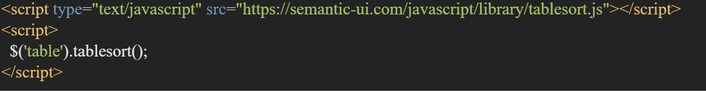
Sorting Tables
Extra script file required (tablesort.js), include it after the jquery and semantic.js <script> tags.
Add code, which will select the table and apply the tablesort function.
$('table').tablesort();

Slide 15
Topic List
Table
Menu
Card

Slide 16
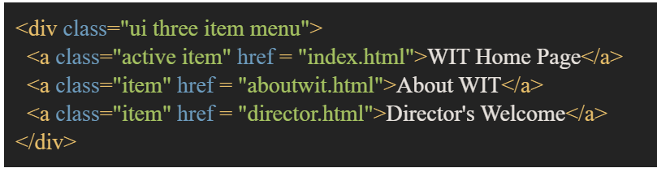
Menu
A simple menu can be created using the .ui.menu class.
For each menu item you add the .item class, and for the current (active) item, add the .active class.

Slide 17
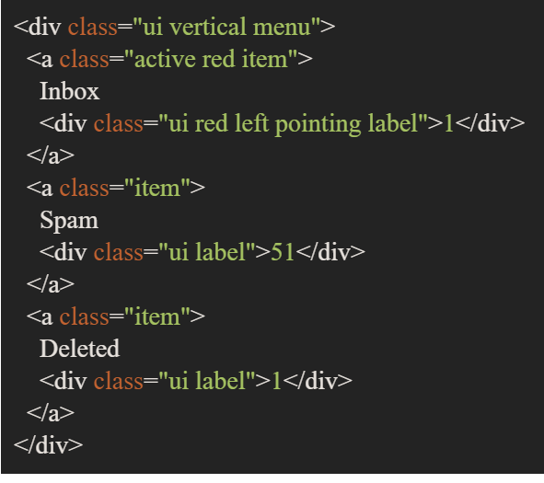
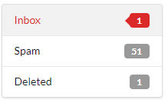
Menu
Variations on the simple menu include:
Vertical

Slide 18
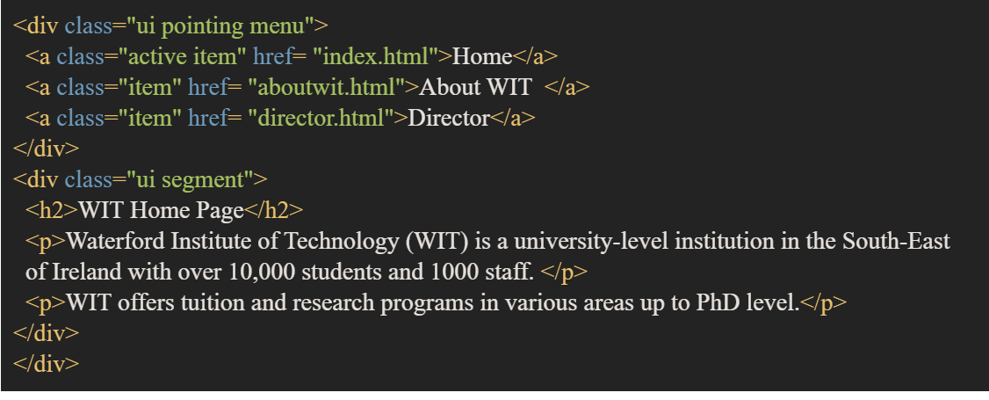

Menu
Pointing

Slide 19
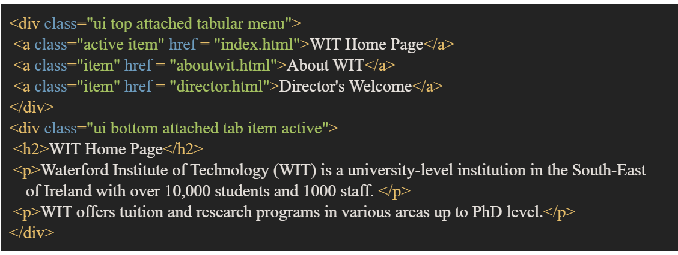

Menu
Tabular

Slide 20
Dropdown Menu
To create a dropdown menu we need to add some classes before the .menu and .item classes.
We will add .selection and .dropdown classes. We also add a hidden text box, icon and default text classes.
We also need to add some JavaScript code.

Slide 21
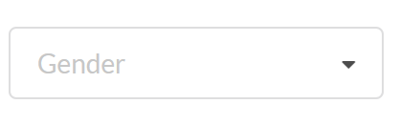
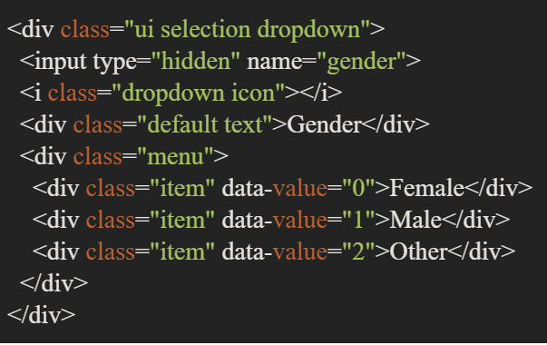
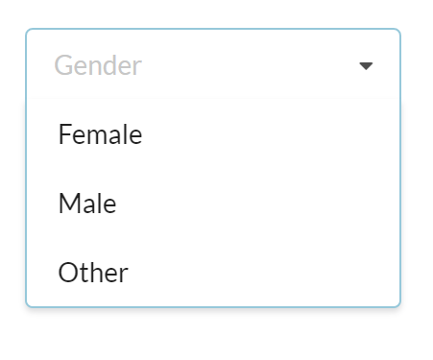
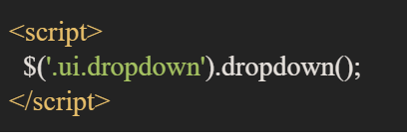
Dropdown Menu

Slide 22
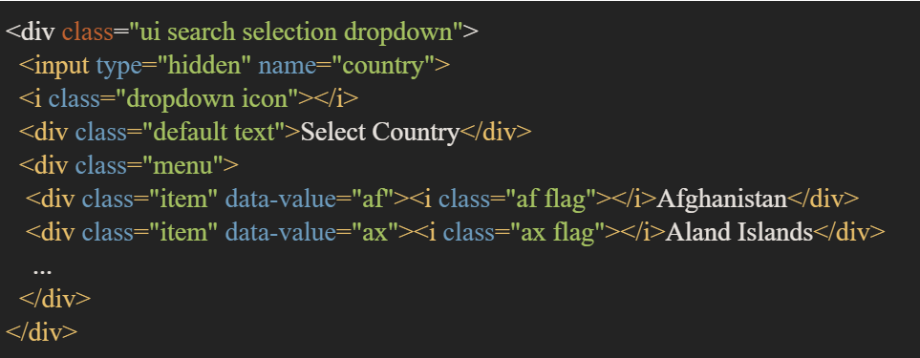
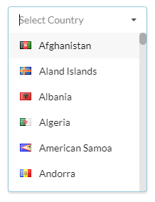

Dropdown Menu
Variations on the dropdown menu include:
Search

Slide 23
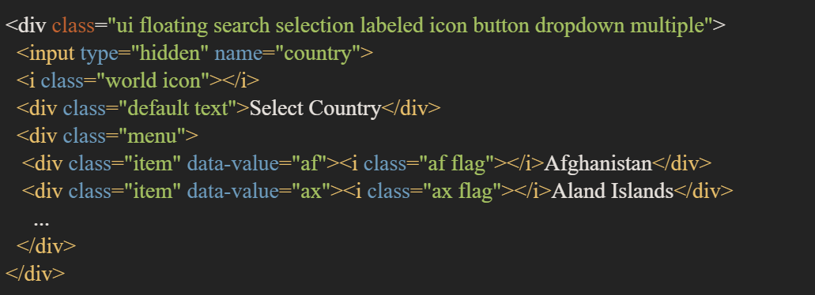
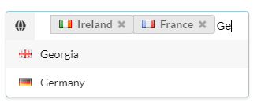
Dropdown Menu
Multiple

Slide 24
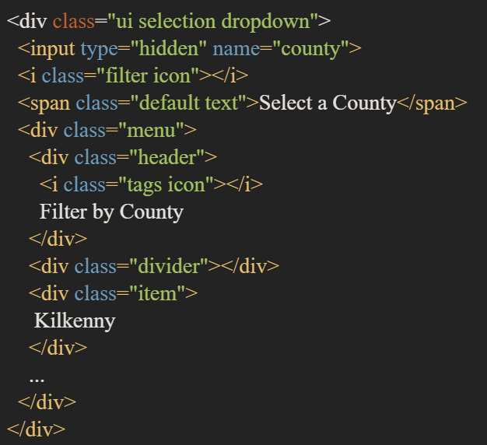
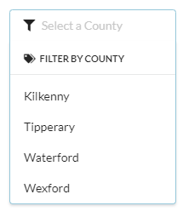
Dropdown Menu
We can add in a Header and Divider inside the menu.

Slide 25
Topic List
Table
Menu
Card

Slide 26
Card
A card displays site content in a manner similar to a playing card.
The class .ui.card creates a single card.
Adding a class .centered will center the card on the screen.

Slide 27
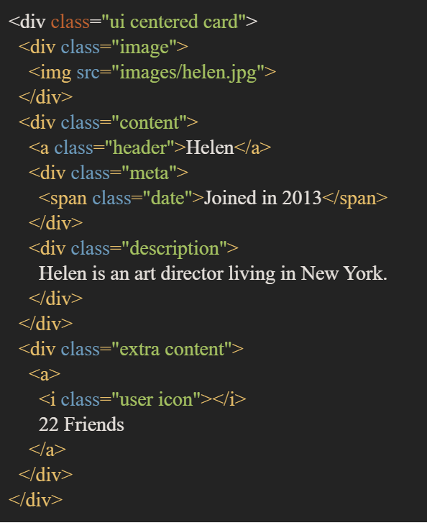

Card

Slide 28
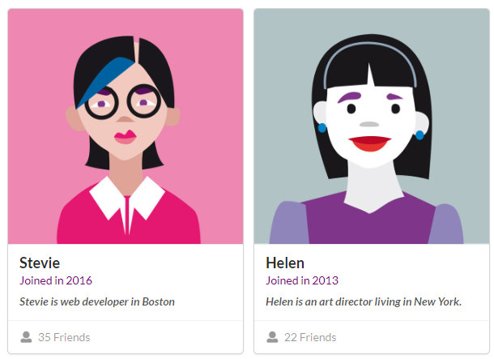
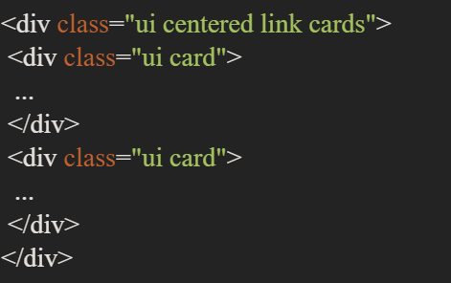
Cards
The class .ui.cards creates a group of cards.
Add the .link class to add some animation, letting the user know which card is selected.

