Slide 1
Forms

Slide 2

Overview of forms
Forms are used all over the Web to
Accept information.
Provide interactivity.
Types of forms:
Search form, Order form, Newsletter sign-up form, Survey form, Add to Cart form, and so on…

Slide 3
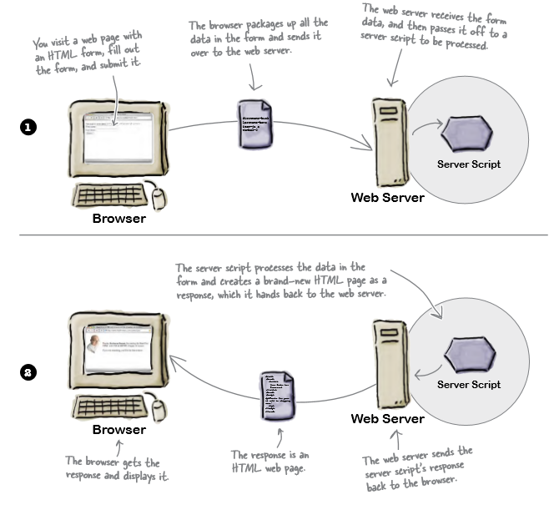
Server side

Slide 4
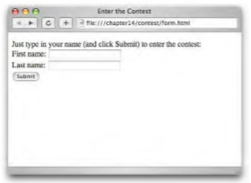
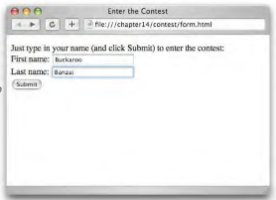
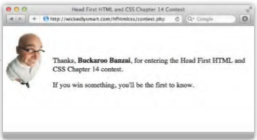
How forms work in the browser
The browser loads the page, it creates controls on the page that allow you to input various kinds of data.
You enter data, type a single line of text, click an option, checkbox control etc.
You submit the form by clicking a submit button.
The server responds by receiving the data and processing it and presenting a new html page.

Slide 5
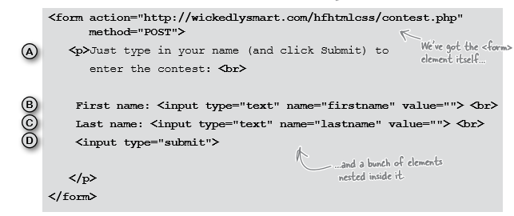
Form elements

Slide 6
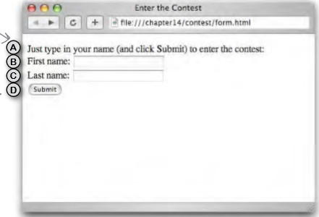
Form elements

Slide 7
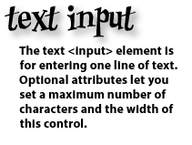
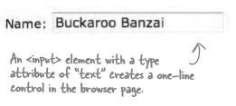

What can go on a form?
The password <input> element works just like the text <input> element except that the text is masked.

Slide 8
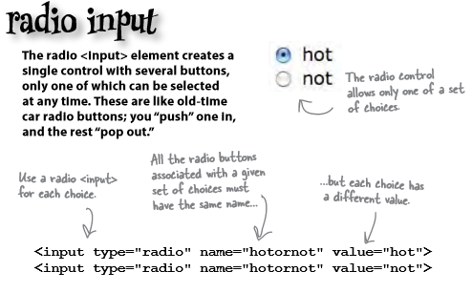
What can go on a form?
Radio buttons create a single control of several buttons of which only one can be chosen.

Slide 9
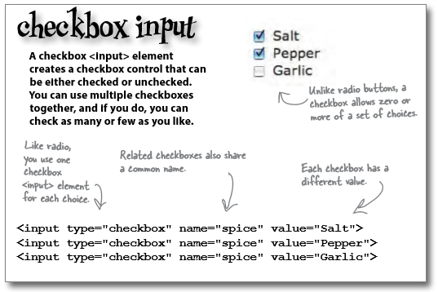
What can go on a form?

Slide 10
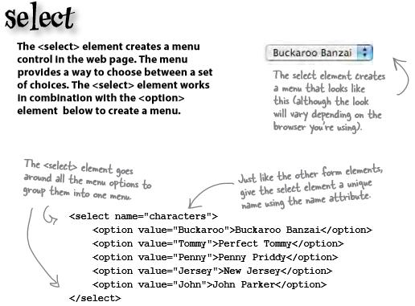
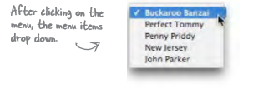
What can go on a form?

Slide 11
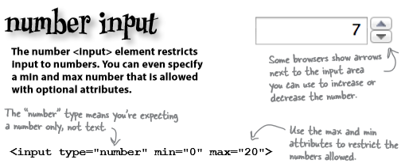
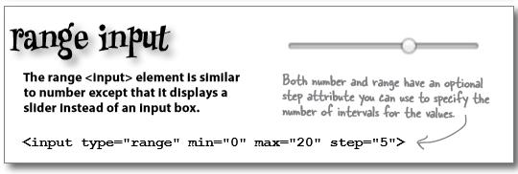
What can go on a form?
HTML5 adds more input types:

Slide 12
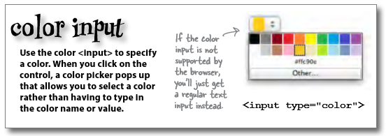
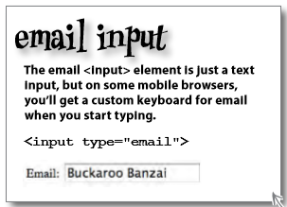
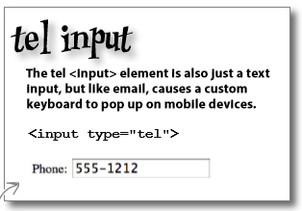
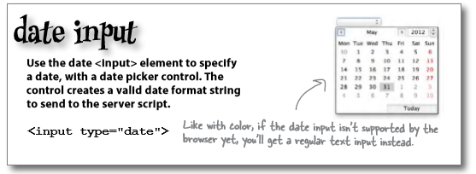
What can go on a form?

Slide 13
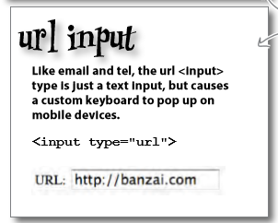
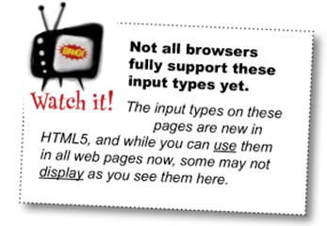
What can go on a form?
Even with these specialised types, it’s up to you to make sure you know what values the server script is expecting and use the right <input> type.

Slide 14
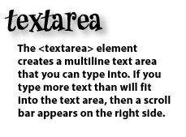
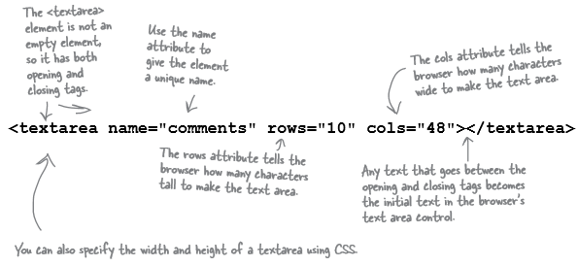
What can go on a form?
Not every form element is an <input> element there are some others for typing more than one line of text:

Slide 15
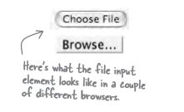
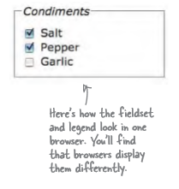
What more could go into a form?
If you need to send an entire file you can set the input type to “file”, this creates a control that allows you to choose a file and the contents when the form is submitted is sent to the server.
A <fieldset> element can be used to group together common elements.
It then can also make use of an element called <legend>.

Slide 16
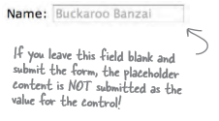

What more could go on a form?
The placeholder attribute can be used with most <input> types in a form, it gives a hint about the kind of content expected.
The required attribute forces the user to enter content. An error will show if the user leaves it blank.
If a form element includes the autofocus attribute then the cursor is in the form element when the form opens.

Slide 17
What more could go on a form?
We can also include a Pattern. This allows us to specify the type of data, and the format required.
pattern="[a-zA-Z0-9]": All alphanumeric characters.
pattern="[A-Za-z]{3}" : Three letter code.
pattern = "[A-Z][a-z]+( [A-Z][a-z]+)*": Name (with optional second name, and more names...).
pattern ="\S{6,}": At least 6 characters (excluding space, tab, newline, carriage return, form feed).
pattern="\d{4,8}": Matches at least 4 digits but no more than 8 digits.
Add a title attribute to add an error message and it is displayed when the cursor moves over the respective form element.

Slide 18
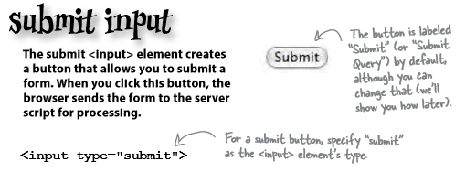

What more could go on a form?
The submit button will send the fields to the server script for processing, whereas the reset button will return all fields to their default values.

Slide 19
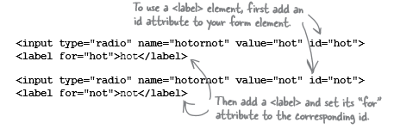
Accessibility
So far we have been labelling our form using text. We should really be using the <label> element to mark up these labels.
The <label> element provides further information about the structure of your page, allows you to style your labels using CSS more easily, and helps screen readers for the visually impaired to correctly identify form elements.
Labels don’t look any different from normal text. But they can make a big difference when it comes to accessibility.

Slide 20
Form layout
Add the form class to the <form> tag.
Enclose each combined/related label and text input with an element (such as a <div>) with the field class.
<div class="field">
<label for="firstname">First Name</label>
<input type="text" id="firstname"
name="firstname">
</div>

Slide 21
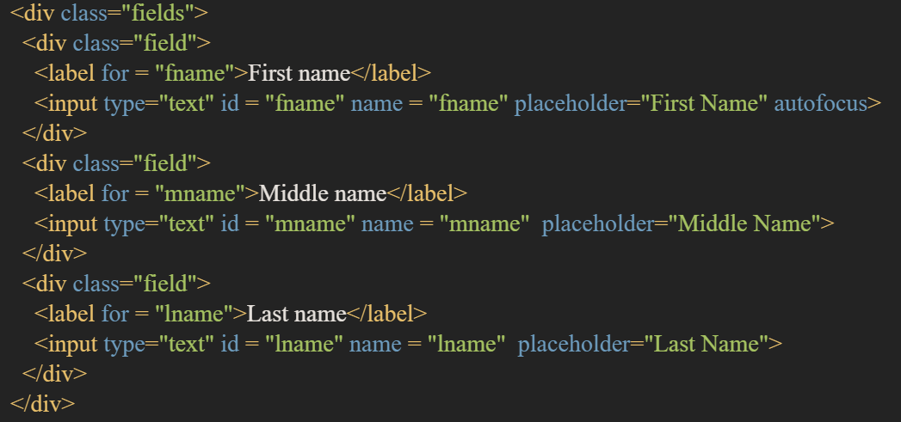

Form layout
Fields can be grouped together by enclosing the fields inside an element (such as a <div>) with the class fields.

Slide 22
Form layout
A horizontal form is a form with the label and input element on the same row/line.
You can use the inline fields or inline field classes to create horizontal forms.

Slide 23
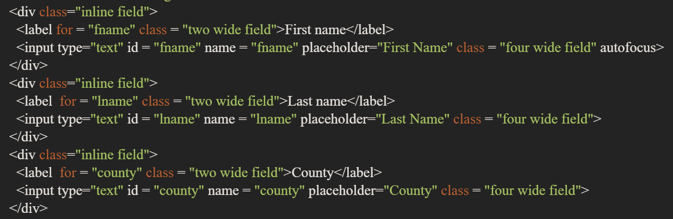
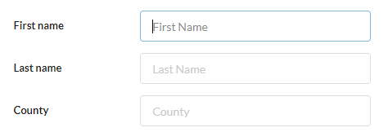
Form layout

Slide 24
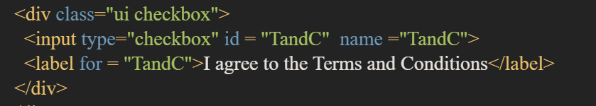



Form layout
To output checkboxes and radio buttons in a readable manner you can use the checkbox class, and add other classes to it as necessary.
Toggle
Slider

Slide 25
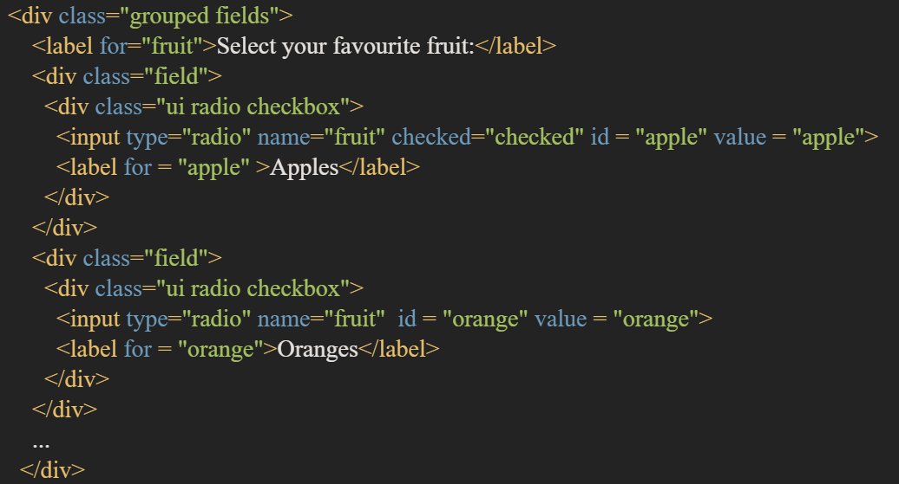
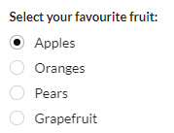
Form layout
Radio

Slide 26
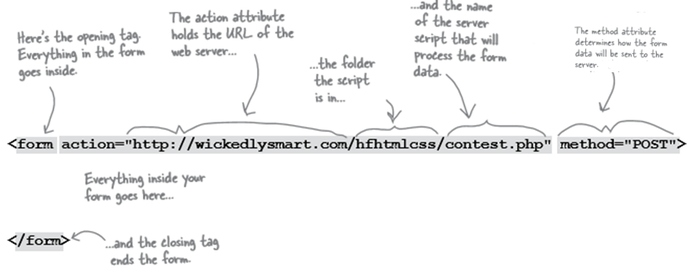
More on how the <form> element works

Slide 27
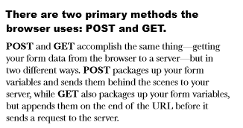
Sending the data to the server

Slide 28
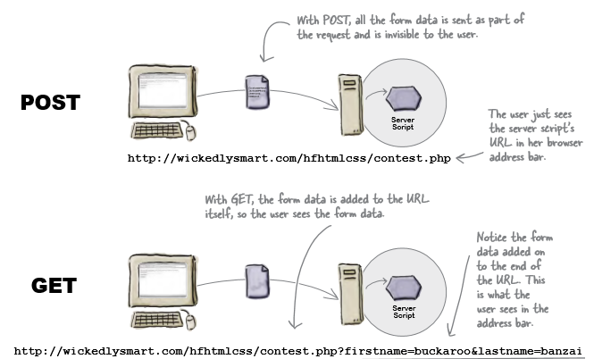
Sending the data to the server

