Slide 1
Applying Data Mining to Reveal Media Bias
A Comparison Between China Daily and The New York Times (2013-2015)
Sam Yuxiao Sun

Slide 2
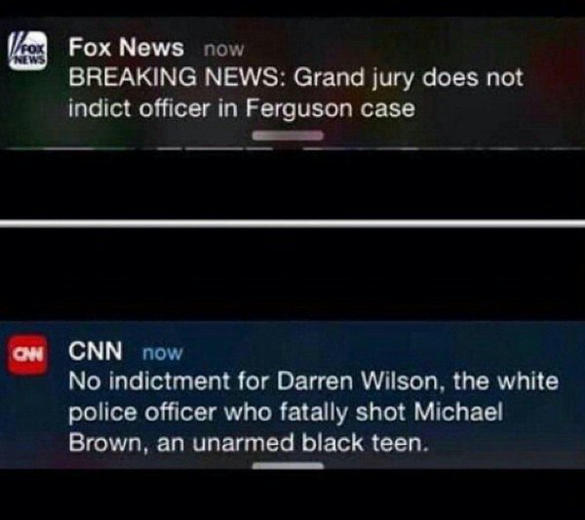
Media bias
Media bias is the bias of journalists and news producers within the mass media in the selection of events and stories that are reported and how they are covered.
Stefano Mario Rivolta:
gate keeping bias
coverage bias
statement bias
A Comparative Approach
Notes:
China Daily was established in June 1981 and has the widest print circulation of any English-language newspaper in China (over 200,000 copies per issue, of which a third are abroad)

Slide 3
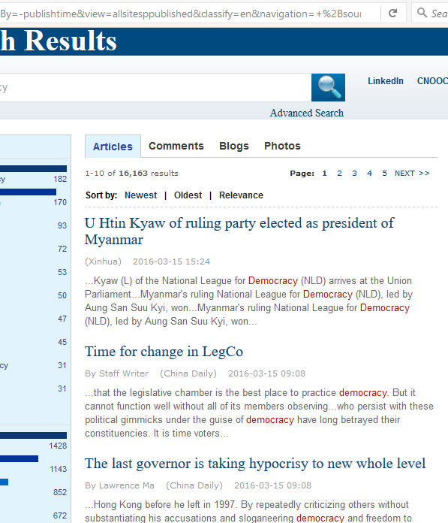
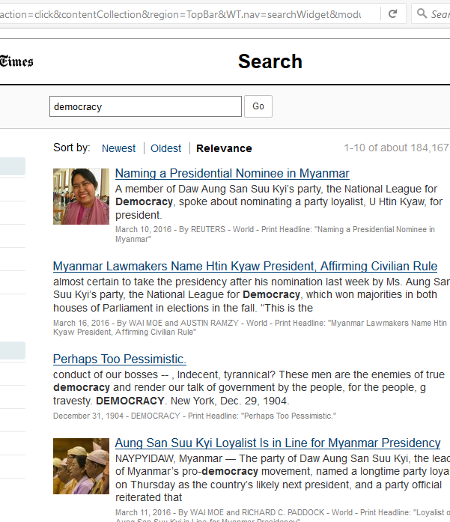

Slide 4
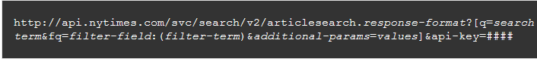
Web Scraping 1
http://searchen.chinadaily.com.cn/search?sortBy=-publishtime&view=allsitesppublished&classify=en&navigation=+&drillDown=&drillUp=&offset=2&query=democracy

Slide 5
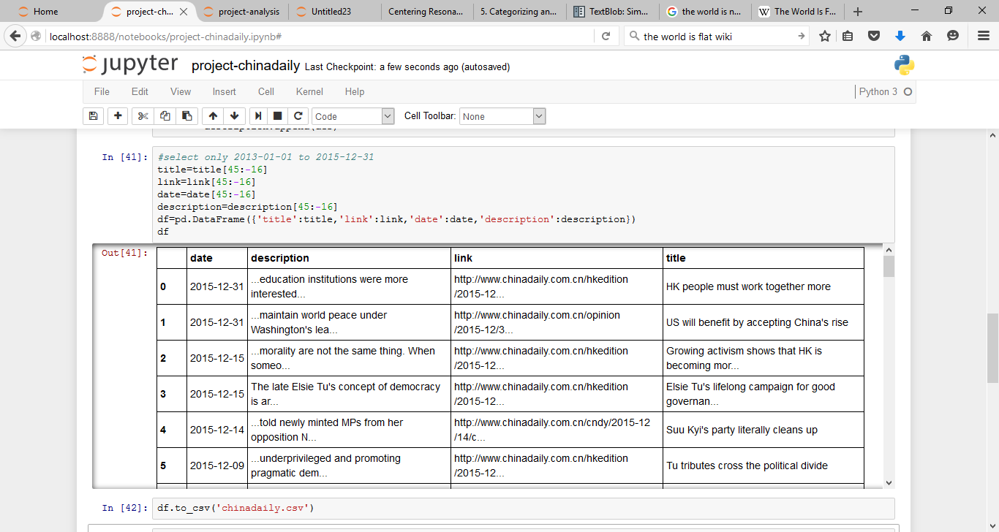

Slide 6
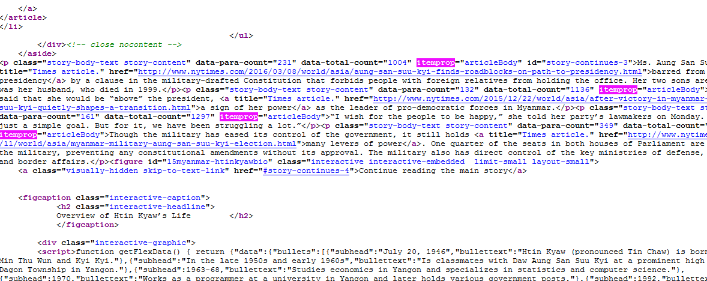
Web Scraping II

Slide 7
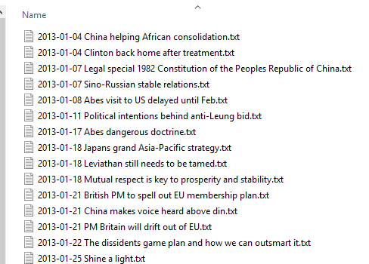
Corpus
China Daily: 1472
New York Times: 2534

Slide 8
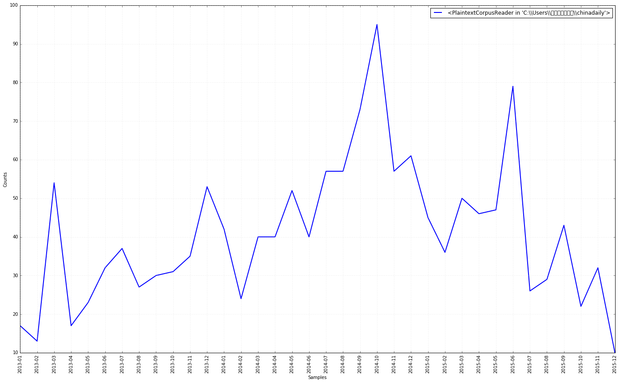
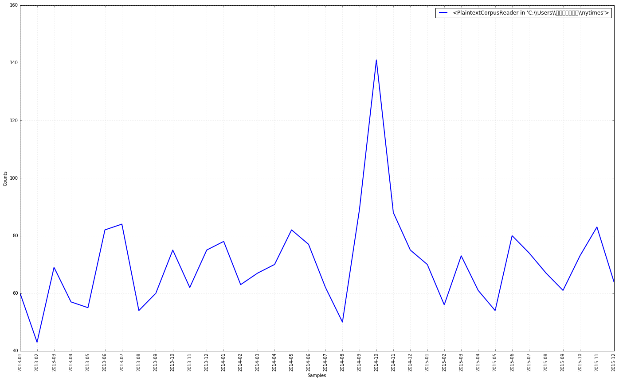
Gate Keeping I-general
Similarity: trend
Difference: two peak
China Daily
Nytimes

Slide 9
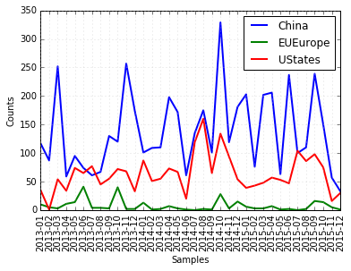
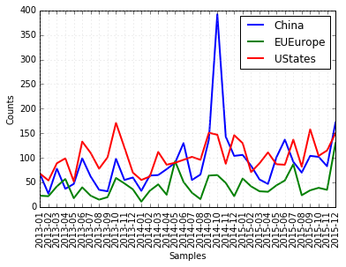
Gate keeping II-by country
Similarity: us-china target
Difference: China more domestic news
China Daily
Nytimes

Slide 10
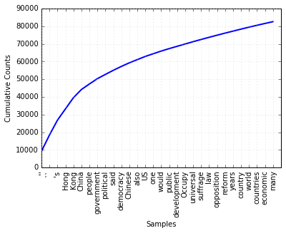
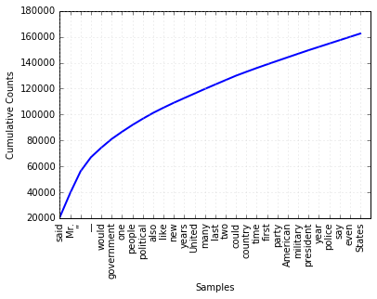
CoVERAGE i-frequency
Similarity: shape
Difference: word
Non-Stop words
China Daily
The New York Times

Slide 11
COVErage ii-tfidf
Nytimes | China Daily
Word: said, TF-IDF: 0.05228 | Word: Hong, TF-IDF: 0.05461
Word: Mr, TF-IDF: 0.04713 | Word: Kong, TF-IDF: 0.05449
Word: would, TF-IDF: 0.01861 | Word: China, TF-IDF: 0.03968
Word: government, TF-IDF: 0.01696 | Word: people, TF-IDF: 0.03291
Word: one, TF-IDF: 0.01513 | Word: government, TF-IDF: 0.0269
Word: new, TF-IDF: 0.01454 | Word: democracy, TF-IDF: 0.02181
Word: people, TF-IDF: 0.01351 | Word: political, TF-IDF: 0.02177
Word: political, TF-IDF: 0.0123 | Word: said, TF-IDF: 0.02007
Word: also, TF-IDF: 0.01142 | Word: law, TF-IDF: 0.01847
Word: president, TF-IDF: 0.01104 | Word: US, TF-IDF: 0.01815
Word: like, TF-IDF: 0.01031 | Word: one, TF-IDF: 0.01793
Word: party, TF-IDF: 0.01016 | Word: Chinese, TF-IDF: 0.01759
Word: many, TF-IDF: 0.00969 | Word: central, TF-IDF: 0.01693
Word: last, TF-IDF: 0.00914 | Word: also, TF-IDF: 0.01591
Word: United, TF-IDF: 0.0091 | Word: would, TF-IDF: 0.0132
Word: years, TF-IDF: 0.00903 | Word: public, TF-IDF: 0.01278
Word: two, TF-IDF: 0.00893 | Word: country, TF-IDF: 0.01269
Word: state, TF-IDF: 0.00886 | Word: development, TF-IDF: 0.01244
Word: could, TF-IDF: 0.0085 | Word: two, TF-IDF: 0.01162
Training: Reuters News Corpus (1000)
Testing: China Daily, Nytimes (100)
Top 25
Similarity: government, political
Difference:
China Daily higher TFIDF
Law, development, central

Slide 12
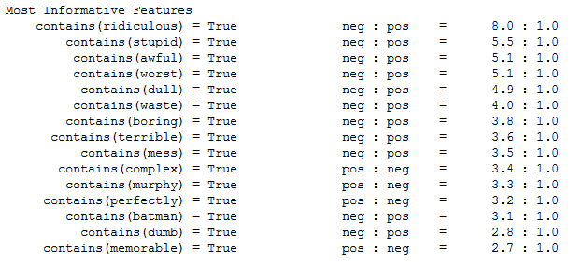
statement I-sentiment
Training: Ideally should train with my Corpus; use movie_review corpus from NLTK
Naïve Bayes: P(sentiment)--P(words)
Accuracy: 80.9% (out-of-sample)

Slide 13
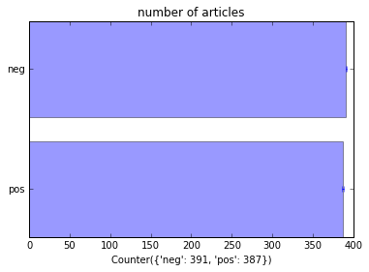
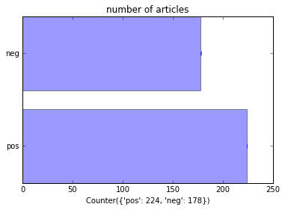
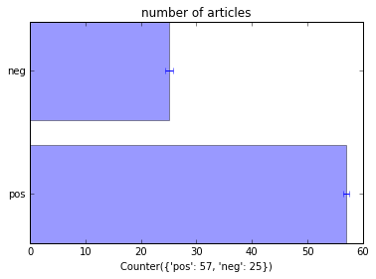
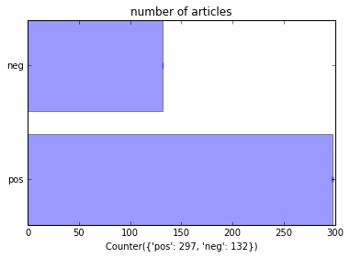
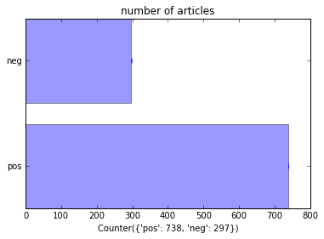
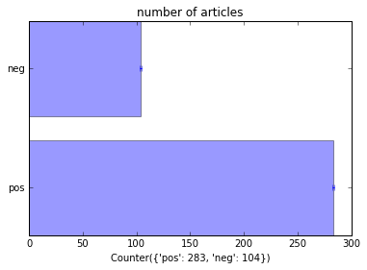
Similarity: EU
Difference: CN-CN, CN-US
Articles contain(‘China’) contain(‘US’/’States’) contain(‘Europe)-baseline
Negative
Negative
Negative
China Daily
Positive
Positive
Positive
Negative
Negative
Negative
Nytimes
Positive
Positive
Positive

Slide 14
Statement ii-network
Reveal how words (Nouns/Adjs) are connected in sentences from c
Case Studies: 2014 Hong Kong protest/umbrella movement
Sit-in street protests from 26 Sep to 15 Dec 2014
Data: related news in Oct 2014, China Daily (67), Nytimes (53)
Steps:
Filter words from sentences
Named Entity Recognition
Noun/Adjs relation within each sentence
NetworkX
Centrality Score
Computationally expensive!

Slide 15
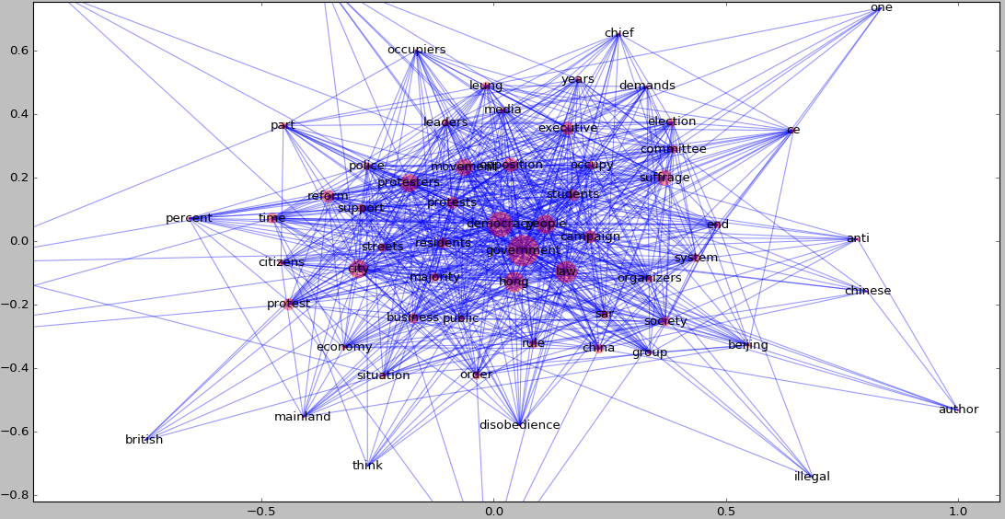
statement ii-network
China Daily, Nouns, 100 words resolution

Slide 16
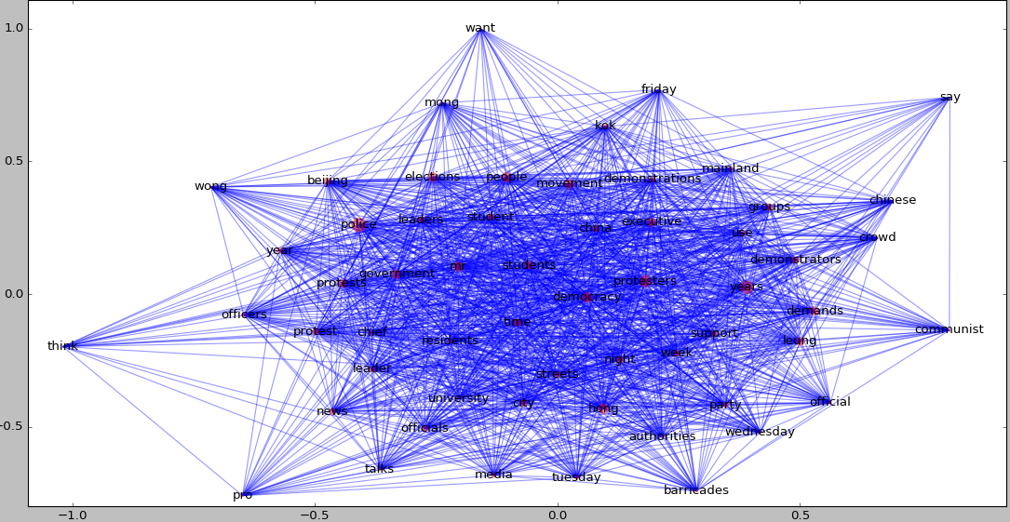
Nytimes, Nouns, 80 words resolution

Slide 17
Thank you!

