Slide 1
Applying Data Mining to Reveal Media Bias
A Comparison Between China Daily and The New York Times (2013-2015)
Sam Yuxiao Sun
Notes:
This project explores the public discourse of democracy from a media’s perspective. The hidden assumption is that media from a particular country carries the traits of the discourse
Database=articles that have the keyword “democracy”
Nytimes=2400
China Daily=1500

Slide 2

Media bias
Media bias is the bias bias of journalists and news producers within the mass media in the selection of events and stories that are reported and how they are covered.
Stefano Mario Rivolta:
gate keeping bias
coverage bias
statement bias
A Comparative Approach

Slide 3
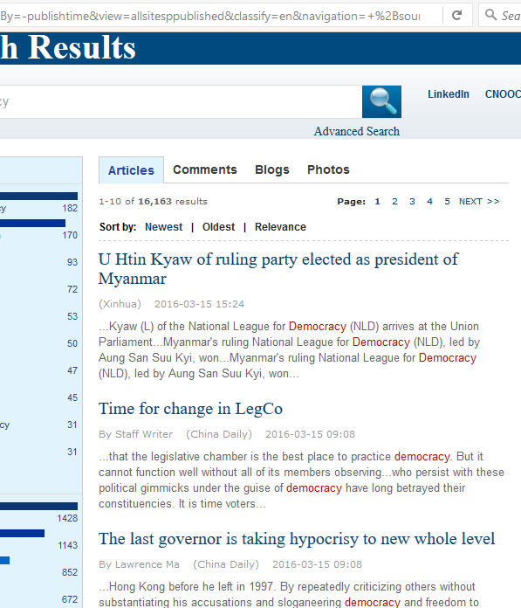
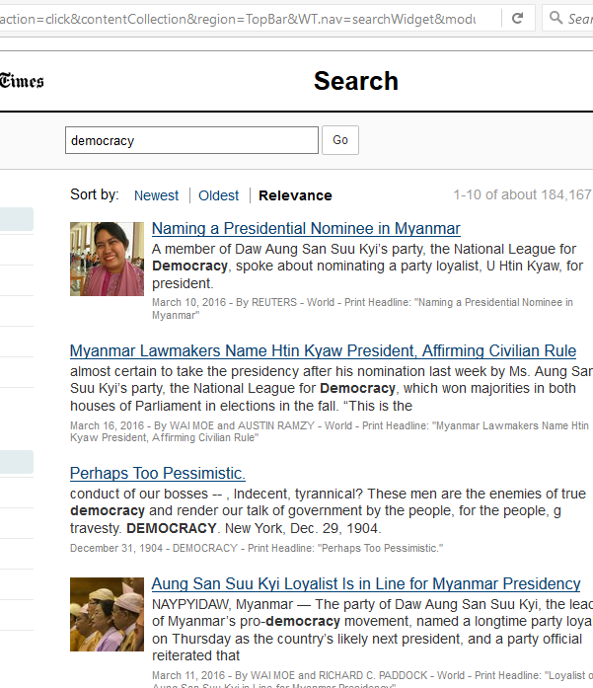

Slide 4
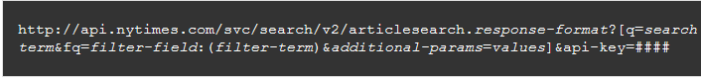
Web Scraping 1
http://searchen.chinadaily.com.cn/search?sortBy=-publishtime&view=allsitesppublished&classify=en&navigation=+&drillDown=&drillUp=&offset=2&query=democracy

Slide 5
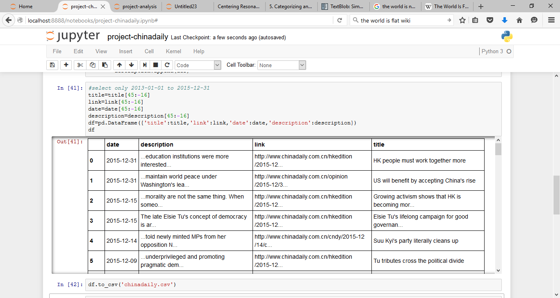

Slide 6
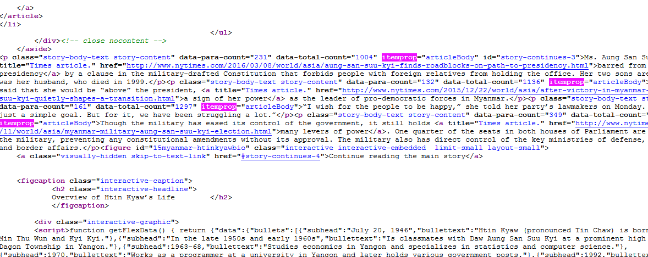
Web Scraping II

Slide 7
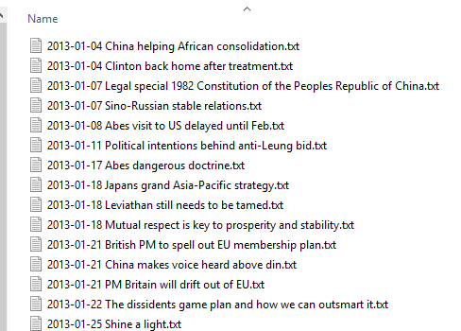
Corpus
China Daily: 1472
New York Times: 2534

Slide 8
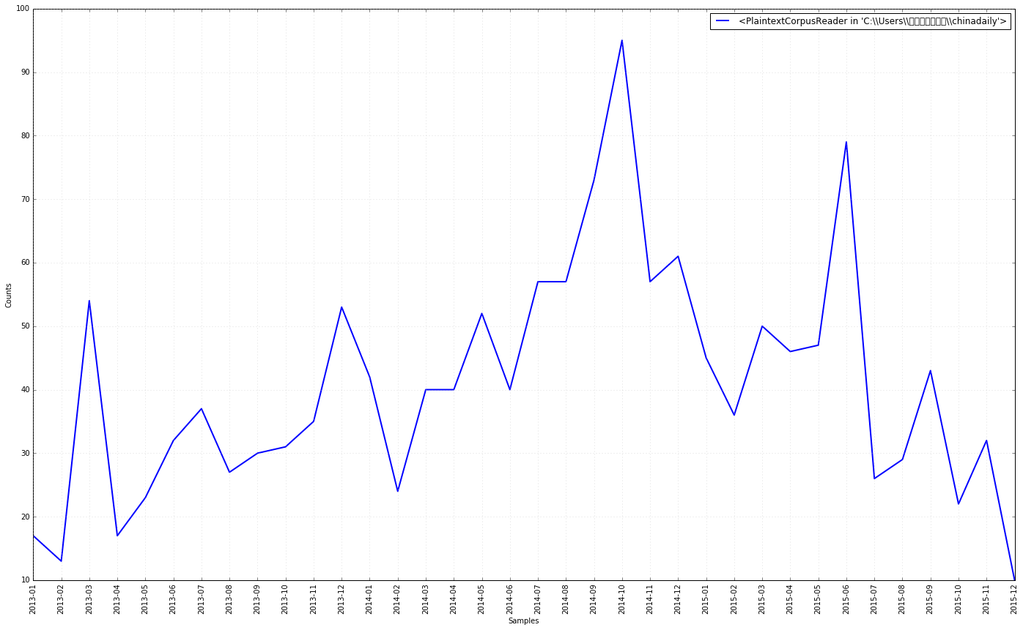
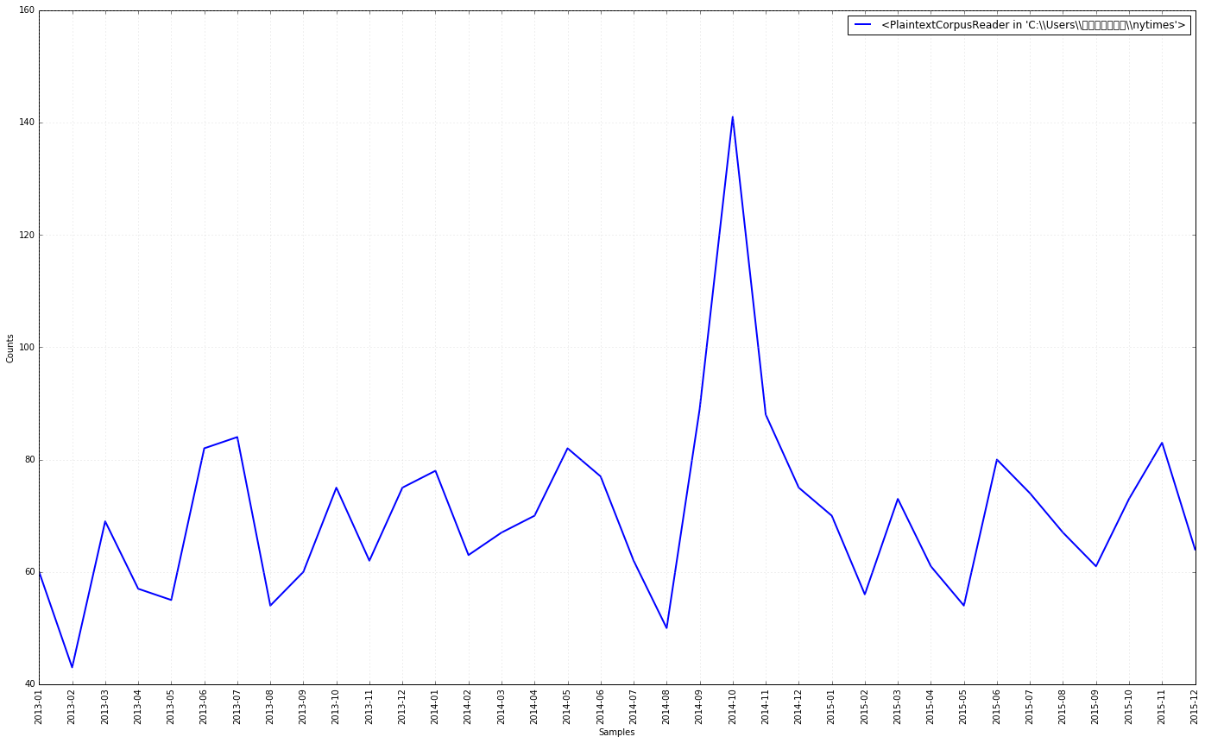
Gate Keeping I-general
China Daily
Nytimes

Slide 9
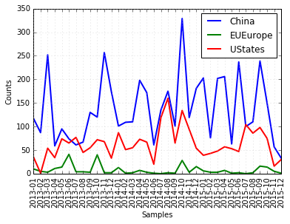
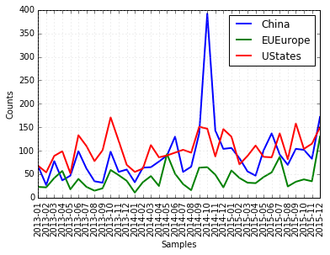
Gate keeping II-by country
Scrape Search Engine Results and Individual Pages
Write Files to a Corpus and Analyze with NLTK
Data Visualization and Output
China Daily
Nytimes
Notes:
Fluctuations are mainly due to breaking news: 2014-10 Hong Kong Protests (26 September to 15 December 2014) https://en.wikipedia.org/wiki/2014_Hong_Kong_protests
Both Countries seems to treat each other as important audience and targets, eu as reference
Chinese media coverage focus more on domestics

Slide 10
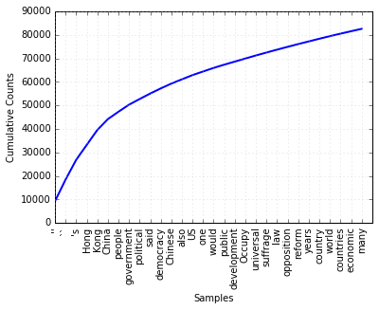
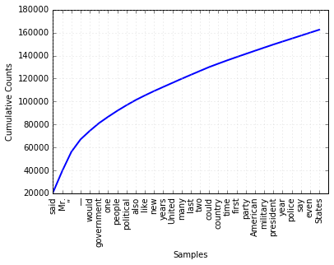
CoVERAGE i-frequency
Non-Stop words
China Daily
The New York Times
Notes:
Naïve attempt fail to recognize the fact that some words are used more in general for texts of this kind
So I use reutors corpus to train the data to find the normalization value for news data
Show the traits of political system (party, president vs central, Hong Kong); transition=(new, millitary); (law)

Slide 11
COVErage ii-tfidf
Nytimes | China Daily
Word: said, TF-IDF: 0.05228 | Word: Hong, TF-IDF: 0.05461
Word: Mr, TF-IDF: 0.04713 | Word: Kong, TF-IDF: 0.05449
Word: would, TF-IDF: 0.01861 | Word: China, TF-IDF: 0.03968
Word: government, TF-IDF: 0.01696 | Word: people, TF-IDF: 0.03291
Word: one, TF-IDF: 0.01513 | Word: government, TF-IDF: 0.0269
Word: new, TF-IDF: 0.01454 | Word: democracy, TF-IDF: 0.02181
Word: people, TF-IDF: 0.01351 | Word: political, TF-IDF: 0.02177
Word: political, TF-IDF: 0.0123 | Word: said, TF-IDF: 0.02007
Word: also, TF-IDF: 0.01142 | Word: law, TF-IDF: 0.01847
Word: president, TF-IDF: 0.01104 | Word: US, TF-IDF: 0.01815
Word: like, TF-IDF: 0.01031 | Word: one, TF-IDF: 0.01793
Word: party, TF-IDF: 0.01016 | Word: Chinese, TF-IDF: 0.01759
Word: many, TF-IDF: 0.00969 | Word: central, TF-IDF: 0.01693
Word: last, TF-IDF: 0.00914 | Word: also, TF-IDF: 0.01591
Word: United, TF-IDF: 0.0091 | Word: would, TF-IDF: 0.0132
Word: years, TF-IDF: 0.00903 | Word: public, TF-IDF: 0.01278
Word: two, TF-IDF: 0.00893 | Word: country, TF-IDF: 0.01269
Word: state, TF-IDF: 0.00886 | Word: development, TF-IDF: 0.01244
Word: could, TF-IDF: 0.0085 | Word: two, TF-IDF: 0.01162
Training: Reuters News Corpus (1000)
Testing: China Daily, Nytimes (100)
Top 25
Compare to Nytimes:
Hong Kong
Law
Development

Slide 12
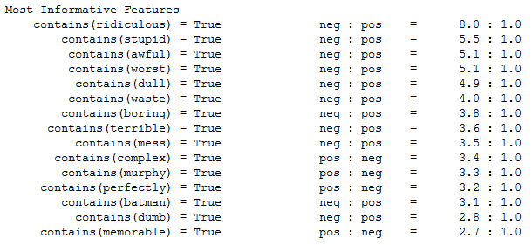
statement I-sentiment
Training: Ideally should train with my Corpus; use movie_review corpus from NLTK
Naïve Bayes: P(sentiment)--P(words)
Accuracy: 80.9% (out-of-sample)

Slide 13
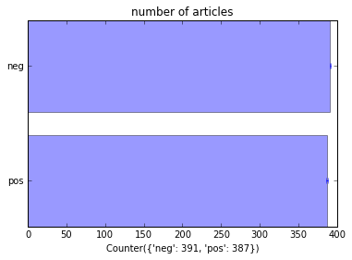
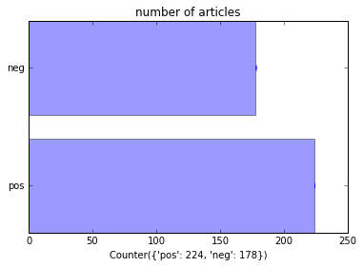
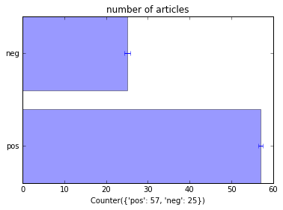
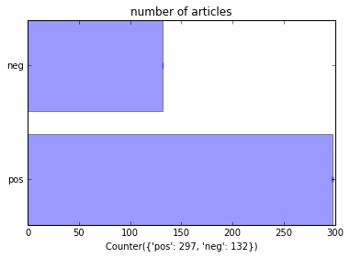
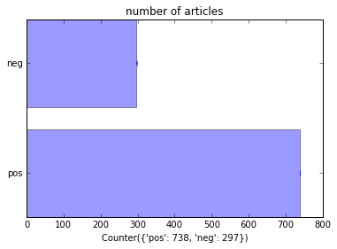
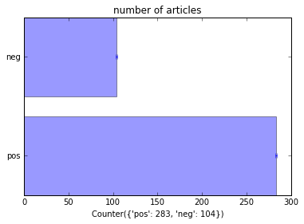
Articles contain(‘China’) contain(‘US’/’States’) contain(‘Europe)-baseline
Negative
Negative
Negative
China Daily
Positive
Positive
Positive
Negative
Negative
Negative
Nytimes
Positive
Positive
Positive
Notes:
Sentiment analysis
China express more negative attitudes towards democracy
This negative attitude is especially sensitive when it talks about democracy in its domestics context, followed by US.
US express more negative attitudes when it discusses democracy and China together

Slide 14
Statement ii-network
Reveal how words (Nouns/Adjs) are connected in sentences from c
Case Studies: 2014 Hong Kong protest/umbrella movement
Sit-in street protests from 26 Sep to 15 Dec 2014
Data: related news in Oct 2014, China Daily (67), Nytimes (53)
Steps:
Filter words from sentences
Named Entity Recognition
Noun/Adjs relation within each sentence
NetworkX
Centrality Score
Computationally expensive!

Slide 15
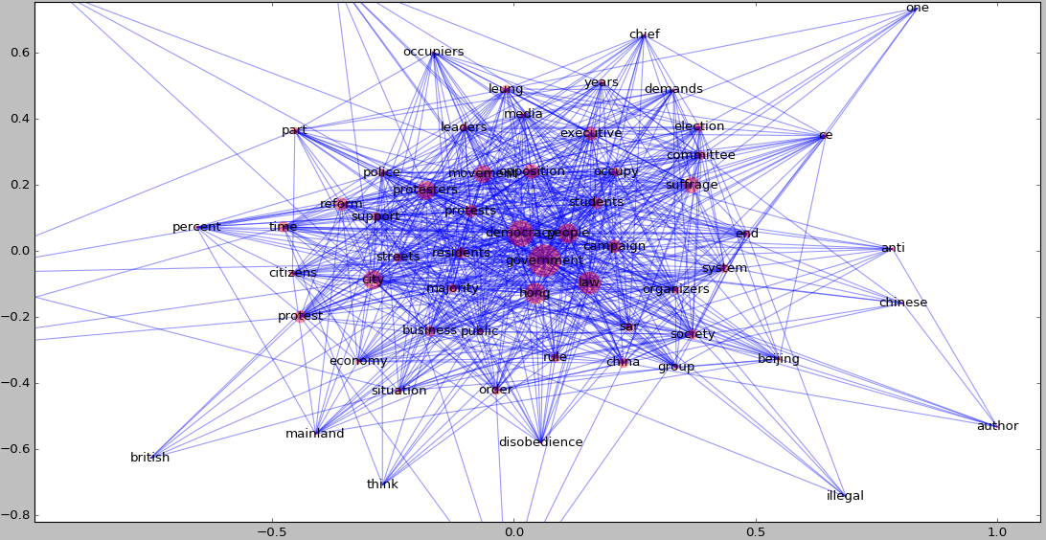
statement ii-network
China Daily, Nouns, 100 words resolution

Slide 16
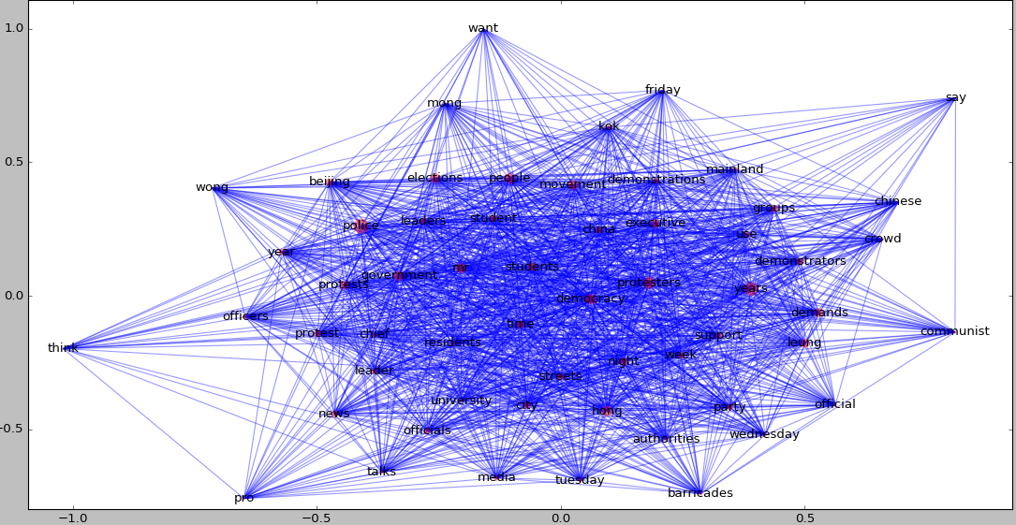
Nytimes, Nouns, 80 words resolution

Slide 17
Thank you!

