Slide 1
Applying Data Mining to Reveal Media Bias
A Comparison Between China Daily and The New York Times (2013-2015)
Sam Yuxiao Sun
Notes:
This project explores the public discourse of democracy from a media’s perspective. The hidden assumption is that media from a particular country carries the traits of the discourse
Database=articles that have the keyword “democracy”
Nytimes=2400
China Daily=1500

Slide 2
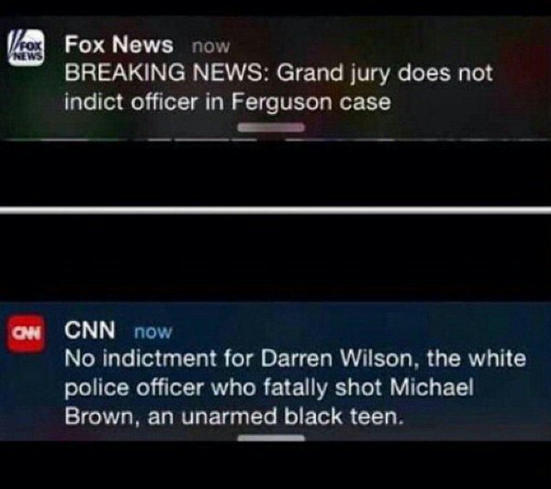
Media bias
Media bias is the bias bias of journalists and news producers within the mass media in the selection of events and stories that are reported and how they are covered.
Stefano Mario Rivolta:
gate keeping bias
coverage bias
statement bias
A Comparative Approach

Slide 3
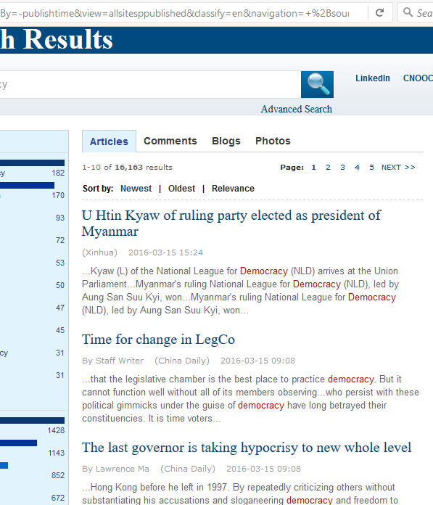
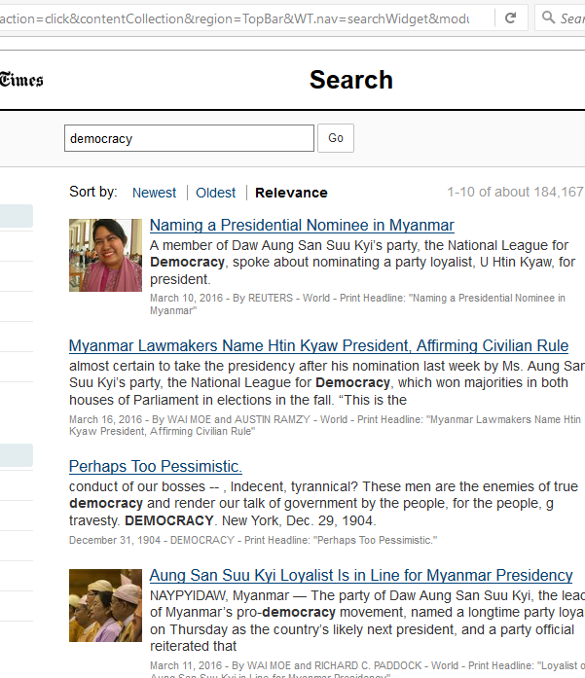

Slide 4
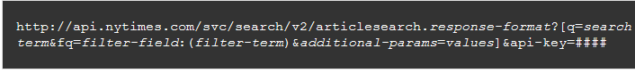
Web Scraping 1
http://searchen.chinadaily.com.cn/search?sortBy=-publishtime&view=allsitesppublished&classify=en&navigation=+&drillDown=&drillUp=&offset=2&query=democracy

Slide 5
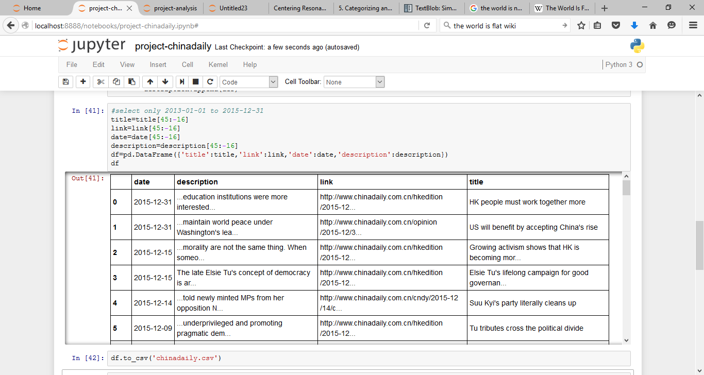

Slide 6
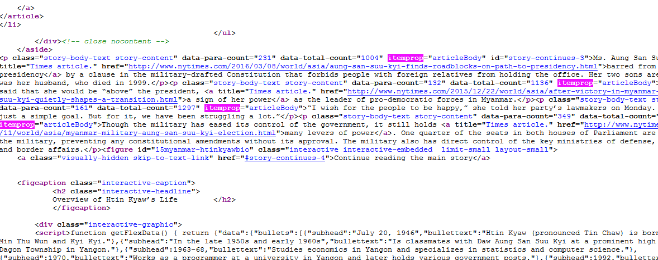
Web Scraping II

Slide 7
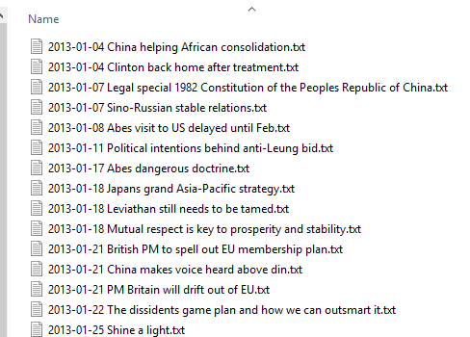
Corpus
China Daily: 1472
New York Times: 2534

Slide 8
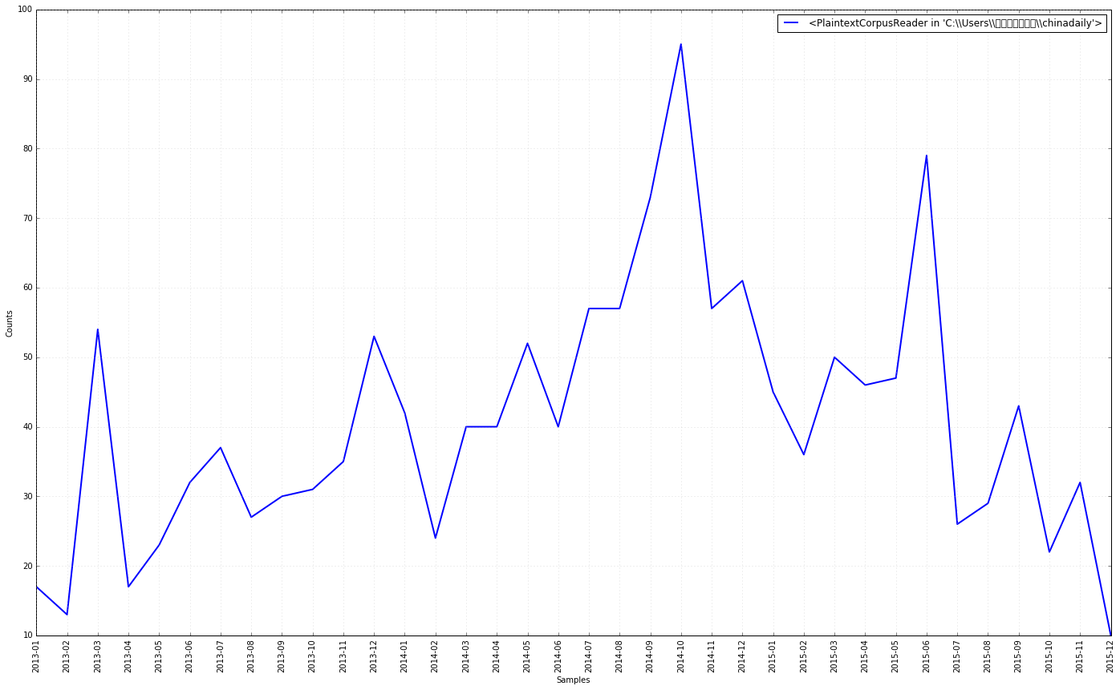
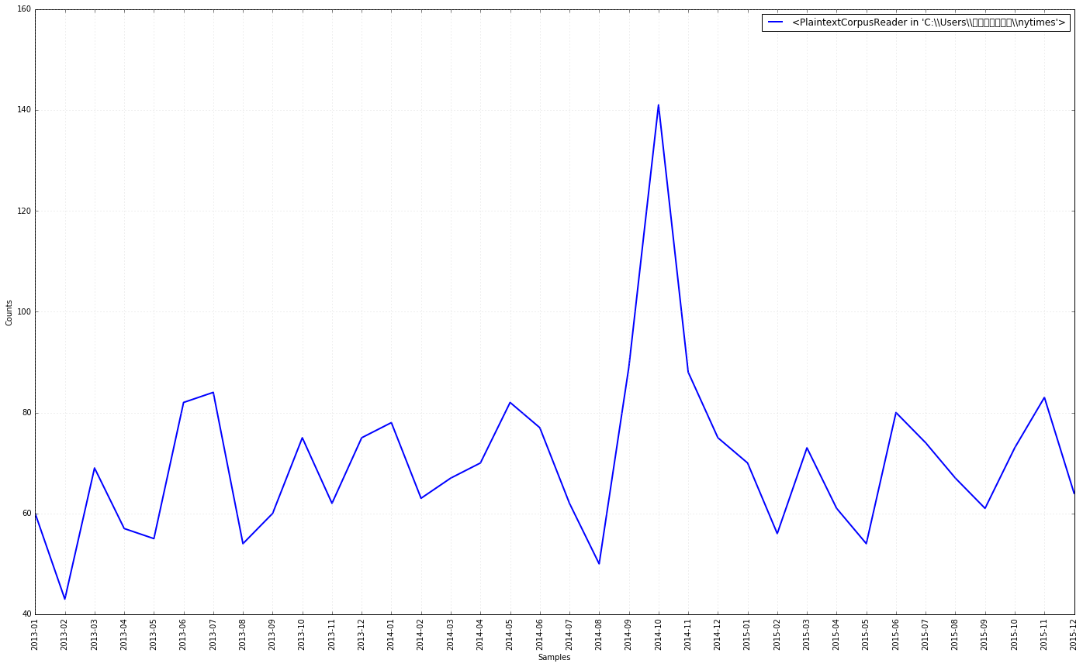
Gate Keeping I-general
China Daily
Nytimes

Slide 9
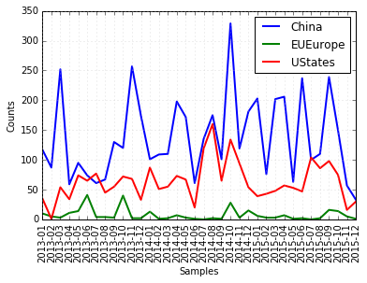
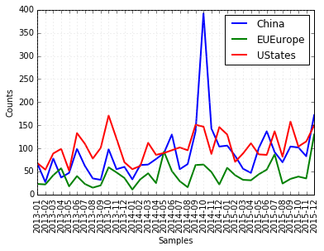
Gate keeping II-by country
Scrape Search Engine Results and Individual Pages
Write Files to a Corpus and Analyze with NLTK
Data Visualization and Output
China Daily
Nytimes
Notes:
Fluctuations are mainly due to breaking news: 2014-10 Hong Kong Protests (26 September to 15 December 2014) https://en.wikipedia.org/wiki/2014_Hong_Kong_protests
Both Countries seems to treat each other as important audience and targets, eu as reference
Chinese media coverage focus more on domestics

Slide 10
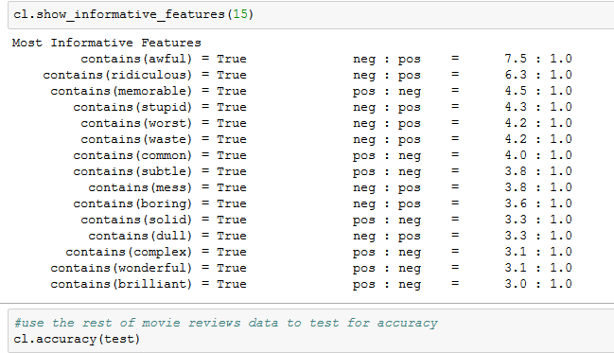
Coverage I-sentiment analysis
Training: Ideally should train with my Corpus; use Movie_Review from NLTK
Naïve Bayes Classifier
Accuracy: 79.3%

Slide 11
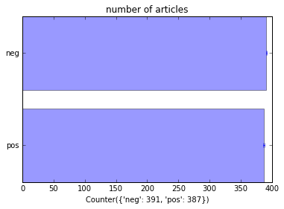
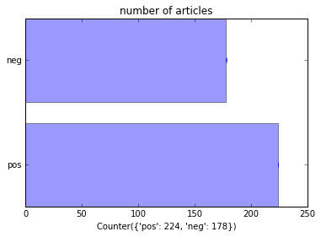
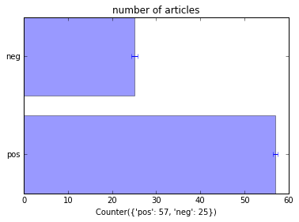
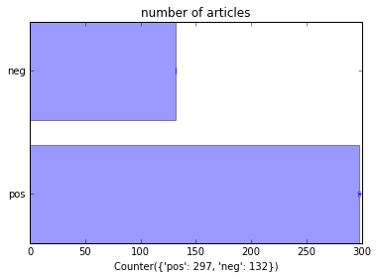
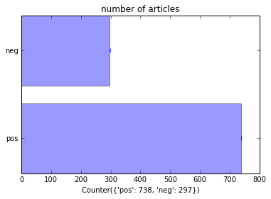
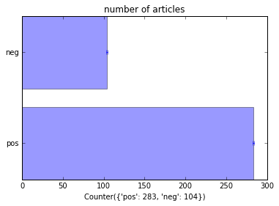
Articles contain(‘China’) contain(‘US’/’States’) contain(‘Europe)
Negative
Negative
Negative
Positive
Positive
Positive
Negative
Negative
Negative
Positive
Positive
Positive
Notes:
Sentiment analysis
China express more negative attitudes towards democracy
This negative attitude is especially sensitive when it talks about democracy in its domestics context, followed by US.
US express more negative attitudes when it discusses democracy and China together

Slide 12
Coverage ii-network
Reveal how words are connected in sentences from c
Case Studies (e.g Hong Kong protests)
Named Entity Recognition
Noun phrases extraction
NetworkX
Centrality Score
Computationally expensive!

Slide 13
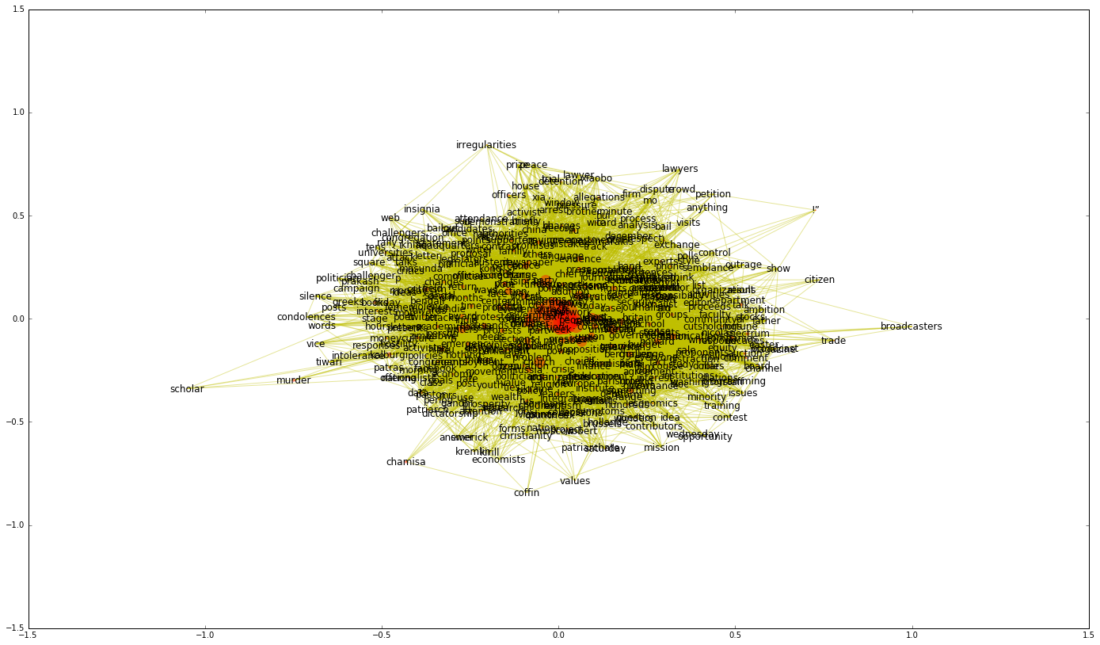
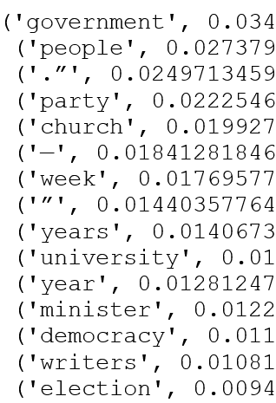
Coverage ii-network

Slide 14
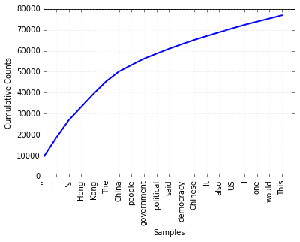
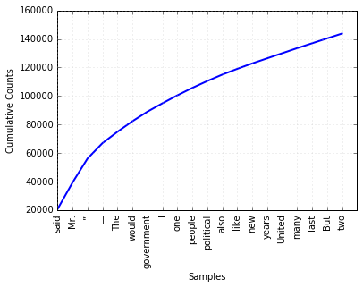
Statement i-frequency
China Daily
The New York Times
Notes:
Naïve attempt fail to recognize the fact that some words are used more in general for texts of this kind
So I use reutors corpus to train the data to find the normalization value for news data
Show the traits of political system (party, president vs central, Hong Kong); transition=(new, millitary); (law)

Slide 15
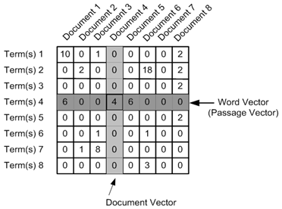
Statement ii-tfidf
Nytimes | China Daily
Word: Mr, TF-IDF: 0.03142 | Word: The, TF-IDF: 0.04942
Word: ”, TF-IDF: 0.02807 | Word: Hong, TF-IDF: 0.0364
Word: —, TF-IDF: 0.01806 | Word: Kong, TF-IDF: 0.03632
Word: political, TF-IDF: 0.00696 | Word: People, TF-IDF: 0.02194
Word: party, TF-IDF: 0.00678 | Word: China, TF-IDF: 0.02014
Word: Party, TF-IDF: 0.00678 | Word: In, TF-IDF: 0.01972
Word: government, TF-IDF: 0.00565 | Word: This, TF-IDF: 0.01587
Word: people, TF-IDF: 0.0055 | Word: democracy, TF-IDF: 0.01454
Word: New, TF-IDF: 0.00485 | Word: As, TF-IDF: 0.01394
Word: President, TF-IDF: 0.00479 | Word: people, TF-IDF: 0.0134
Word: democracy, TF-IDF: 0.00471 | Word: They, TF-IDF: 0.01326
Word: military, TF-IDF: 0.00459 | Word: political, TF-IDF: 0.01233
Word: police, TF-IDF: 0.00446 | Word: Chinese, TF-IDF: 0.01172
Word: Ms, TF-IDF: 0.00437 | Word: One, TF-IDF: 0.01015
Word: country, TF-IDF: 0.00427 | Word: Central, TF-IDF: 0.00959
Word: new, TF-IDF: 0.00414 | Word: It, TF-IDF: 0.00957
Word: would, TF-IDF: 0.00408 | Word: 's, TF-IDF: 0.00955
Word: president, TF-IDF: 0.00404 | Word: law, TF-IDF: 0.00938
Word: “The, TF-IDF: 0.00373 | Word: Law, TF-IDF: 0.00938
Word: former, TF-IDF: 0.00359 | Word: government, TF-IDF: 0.00897
Training: Reuters News Corpus
Top 20
Political system (party, president) vs (central, Hong Kong)
Ideologies (formal, new, millitary) vs (law)

Slide 16
Thank you!

