Slide 1
B조
Computer vision term project
HandCaptcha
Youngmin Jeon 202235116
Seungho Jung 202235119
Jihun Jung 202235123
Minseok Choi 202235134
Chaemin Lee 202334521

Slide 2
HANDCAPTCHA
01
02
03
04
05
06
07
Problem & Concept
Overall Pipeline
Generation & Difficulty Check
Hand Tracking & Answer Check
Liveness Detection & CNN
Demo Video
Lessons & Future Work
Contents

Slide 3
HANDCAPTCHA
Problem & Concept
Problem
  Improved AI image recognition makes traditional CAPTCHAs easier to solve automatically.
  We aim to verify real user interaction as well as image-answer correctness.
Our Solution
  HandCaptcha lets users point to the target object with their index finger in front of a camera.
  By combining image challenges, hand gestures, and video verification, we aim to admit humans and block bots.

Slide 4
HANDCAPTCHA
Pipeline
Answer Check
+
Liveness Check
(Human or Bot)
Generation
Difficulty Check
Hand Tracking
Pass or Fail

Slide 5
HANDCAPTCHA
Problem Generation
1 target + 2 distractors
  We composite three objects into a background image.
  The challenge image and a hint about the target are provided.
Difficulty via transformations, occlusion & blending
  Random scale and rotation changes, plus partial occlusion by nearby objects.
  Pyramid blending softens boundaries and reduces compositing clues.

Slide 6
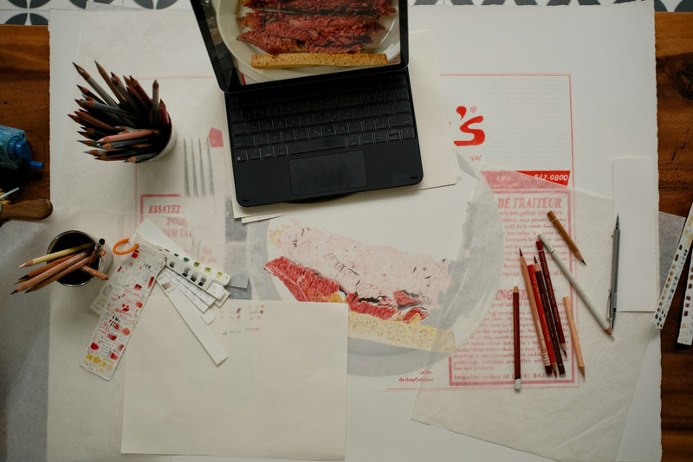
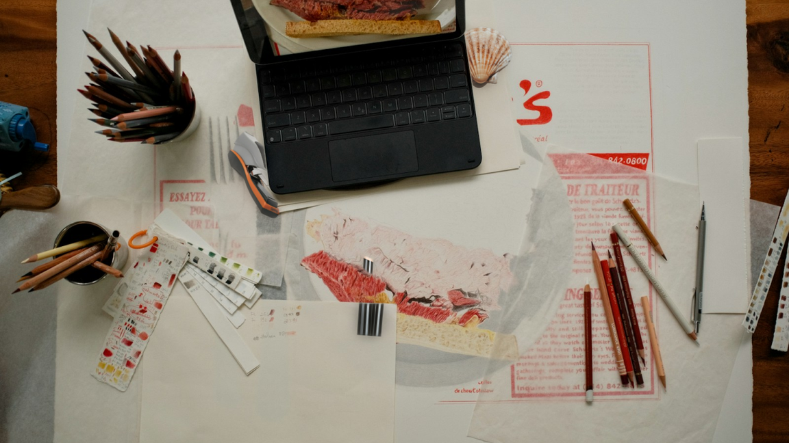
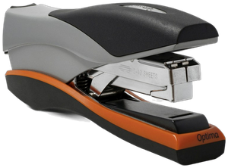
HANDCAPTCHA
Problem Generation
=>
+

Slide 7




HANDCAPTCHA
Difficulty check
ORB&SIFT Feature Matching
OWLv2 Feature Matching
Robust object detection across diverse categories through large-scale vision-language pretraining.
Match the challenge and target images to
estimate location without the answer.
Use robust features for rotation and scale
to attempt automatic solving.
Regenerate if Solved
Up to 5 Attempts
Regenerate if either ORB or SIFT
successfully finds the target.
Limit retries to prevent endless regeneration.
This does not guarantee that every
challenge is unsolvable.
Only challenges not solved by these CV methods are presented to users.

Slide 8
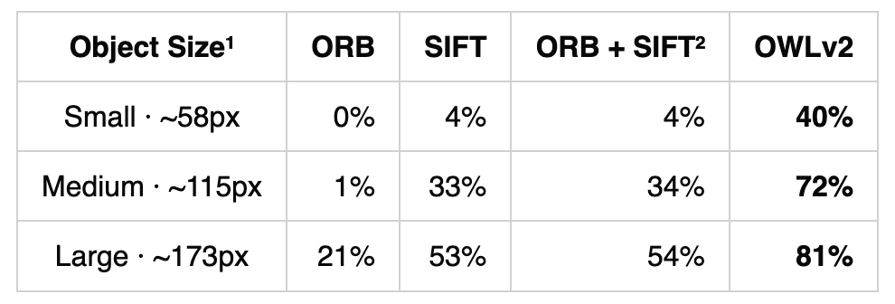
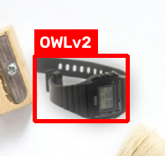
HANDCAPTCHA
Difficulty check performance

Slide 9
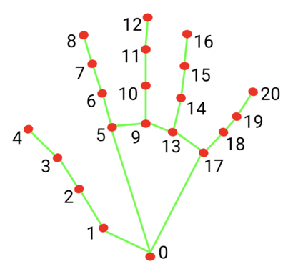
HANDCAPTCHA
Hand Tracking & Answer Check
STEP1
Detect hand
STEP3
Start Gesture
Move to target
Hold for 1 second to select
STEP5
Send Result
Hand/target IoU
at least 0.3:
correct answer
Map fingertip to image
Smooth with EMA
Detect 21 landmarks
with MediaPipe
Extend index finger
to start selection
Send selection box,
trajectory, fingertip video
STEP2
Map coordinates
STEP4
Select target
STEP6
Check Answer

Slide 10
HANDCAPTCHA
Liveness Detection
Liveness Detection Pipeline
Validation Results
Check subtle fingertip motion during pauses
104 / 104
01
Trajectory Test
Gaussian filter
40/40 coordinate bots + 64/64 video bots blocked
Measure independent finger motion and geometric error
Human min 0.33 vs. bot max 0.06 (strongest signal)
02
Video Test
94.8%
92%
Harris + pyramidal LK + geometric transform
CNN validation accuracy
Synthetic bots detected
03
CNN Test
Classify motion patterns across 10 frames
Average decision time: 0.1–0.3 s
Custom-designed HandNet
89 humans: 81 passed · 6 retry · 2 misclassified
Key insight | Real fingers move independently; a photo moves as one.

Slide 11
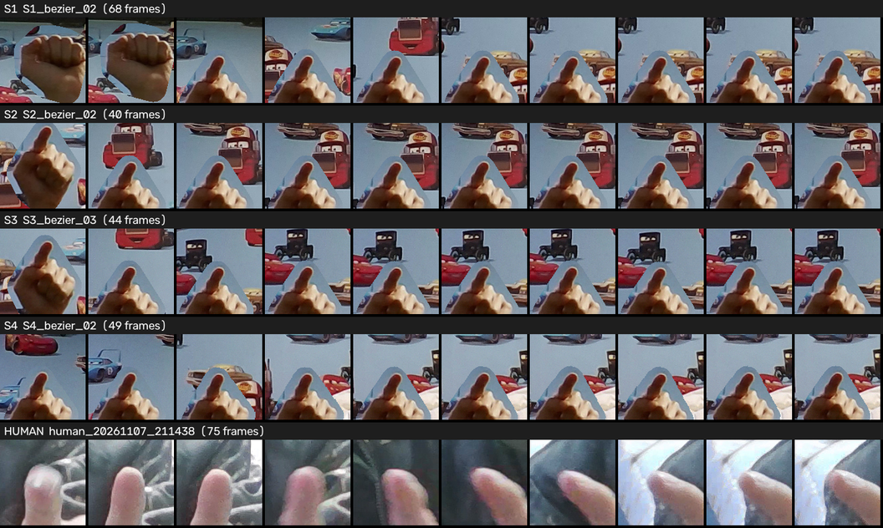
HANDCAPTCHA
Human vs Bot Hand Movement
Synthetic Bot
(S1–S4)
Relative finger positions and shapes stay nearly fixed
Real Human
Finger angles and shapes change continuously

Slide 12
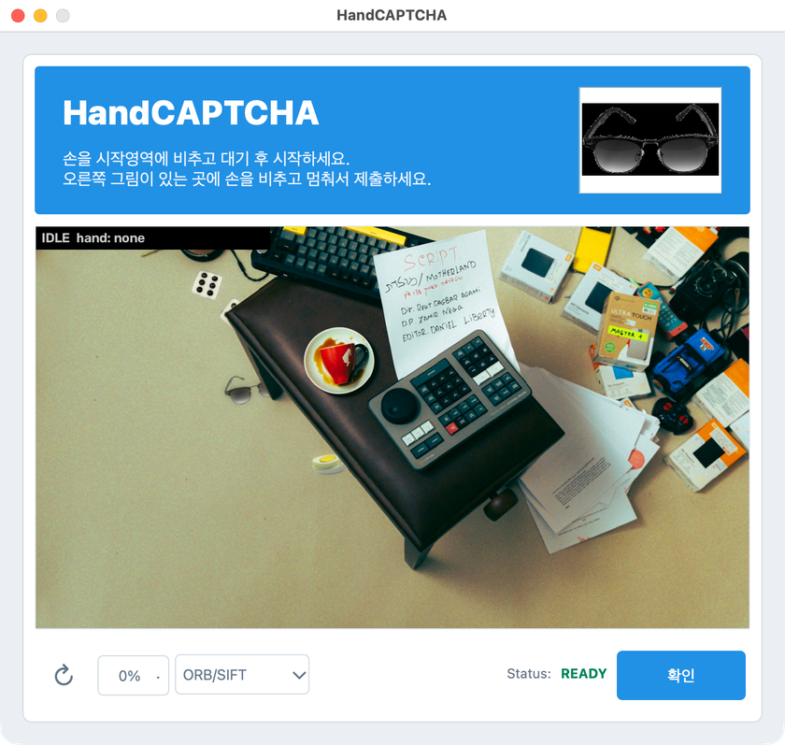

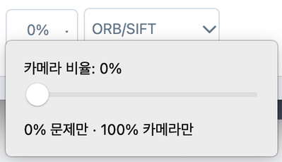
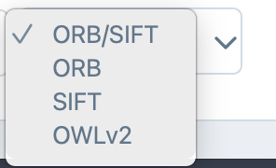
HANDCAPTCHA
GUI Feature (by PySide)
Reload: Create new captcha
Slide: Change camera Transparency
Dropbox: Change feature detection method

Slide 13
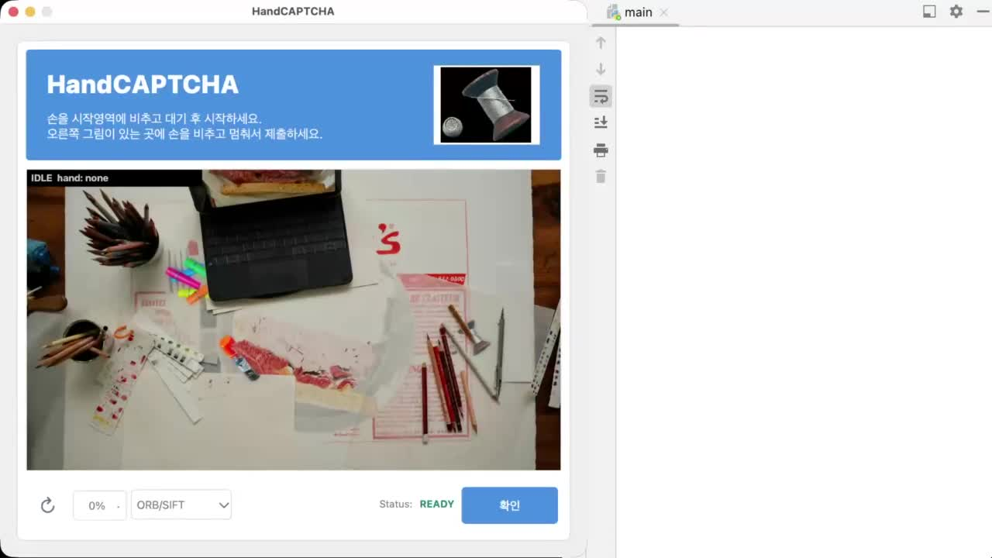
HANDCAPTCHA
DEMO Video

Slide 14
HANDCAPTCHA
Lessons Learned & Future Work
Lessons Learned
Future Work
  Camera, lighting, and hand angle affect real-world results. We tuned thresholds (1s hold, 15 px, IoU 0.3) empirically.
  CNNs may solve challenges that traditional CV (ORB/SIFT) cannot, highlighting the need for hand-motion verification.
  Agreeing on module input/output formats early made integration easier.
  Add a deep-learning difficulty validator
  Expand human data and refine thresholds
  Support web and mobile cameras

Slide 15
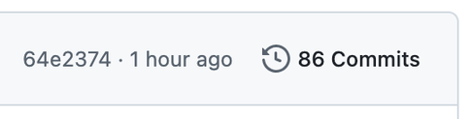
HANDCAPTCHA
Roles
이채민 : Feature Detection (ORB/SIFT)
전영민 : Captcha Problem Creation
정승호 : Hand Detection
정지훈 : Robot Detection
최민석 : GUI and Feature Integration / Feature Detection (OWLv2)
Co-work at github: https://github.com/waterlemon7z/HandCaptcha

Slide 16
Q&A
B조 · HandCaptcha

