Slide 1

CS 489/698: Introduction to Natural Language Processing Lecture 4: Classification
Instructor: Freda Shi
fhs@uwaterloo.ca
January 14th, 2026

Slide 2
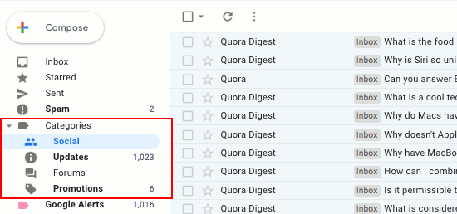
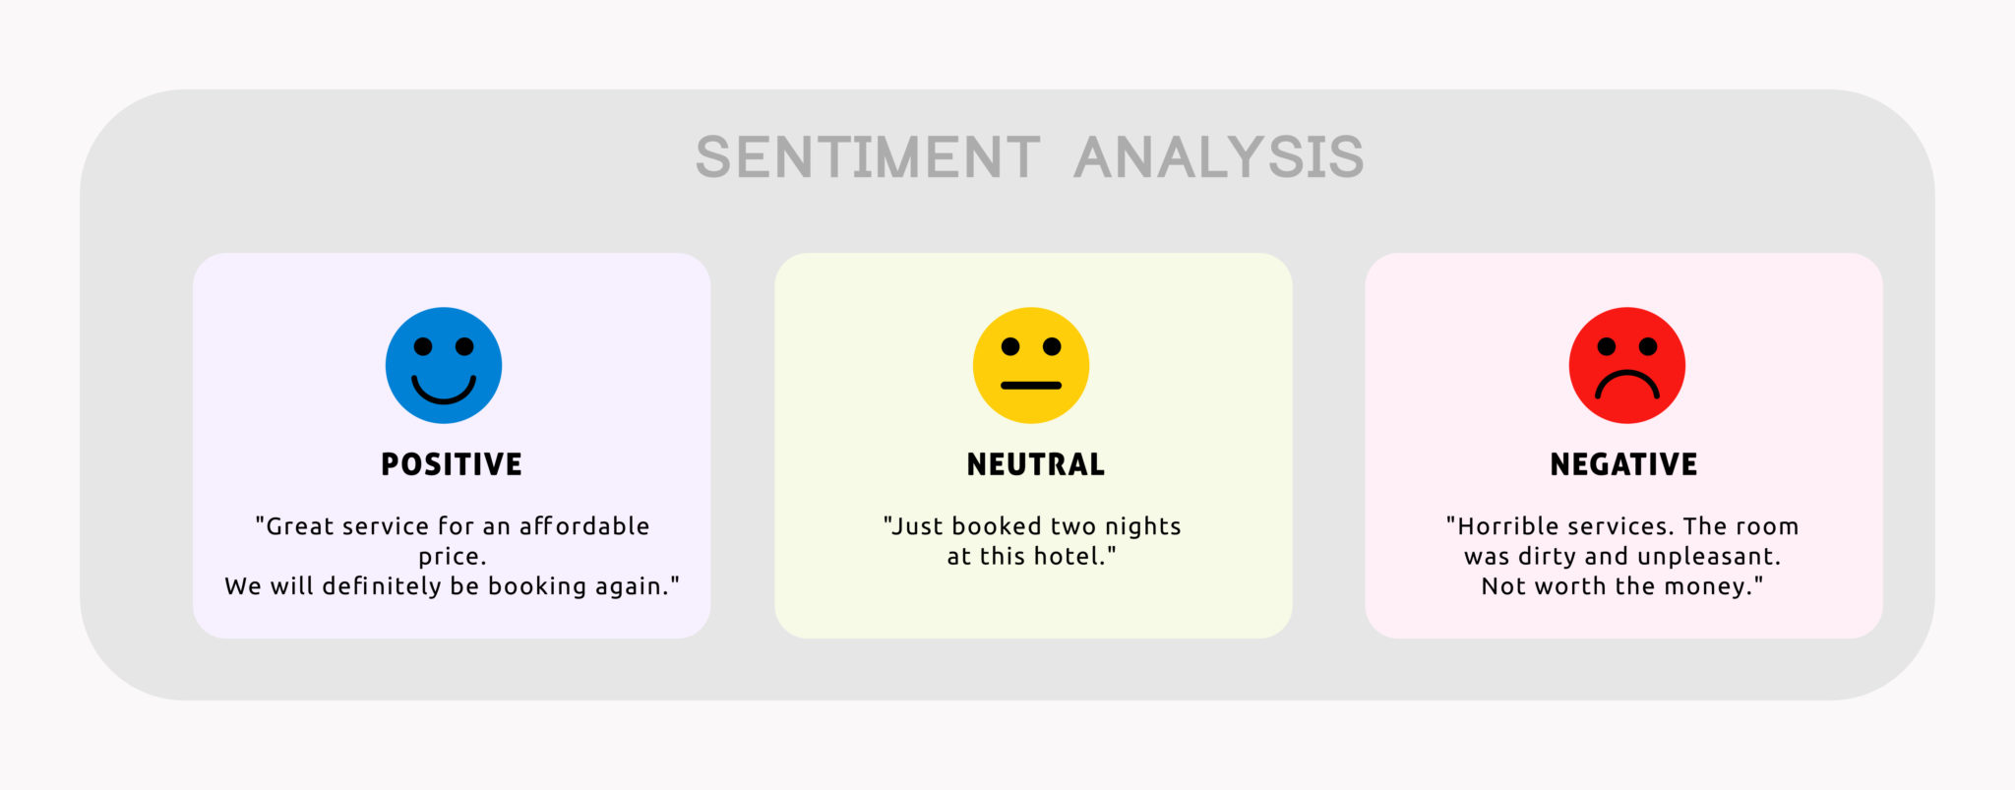
Classification
Simplest user facing NLP application
Text
Model
category

Slide 3
Outline of Today’s Lecture
Modeling approaches for classification
Rule-based classification
Naïve Bayes
Logistic regression
Neural networks

Slide 4


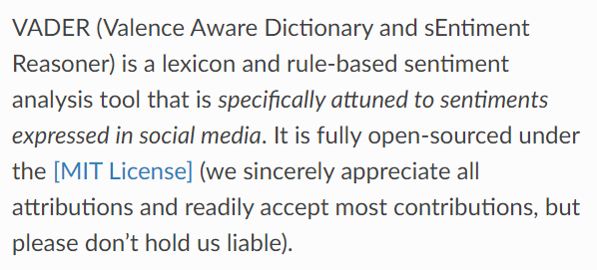

Rule-Based Classifier
Sentiment classification of sentence $s$ (classes: positive, negative)
If $s$ contains words in [good, excellent, extraordinary, …] return positive
If $s$ contains words in [bad, terrible, awful, …] return negative
Nice interpretability
Can be very accurate (with carefully refined rules)
Rules are difficult to define
System can be very complicated
Hardly generalizable

Slide 5
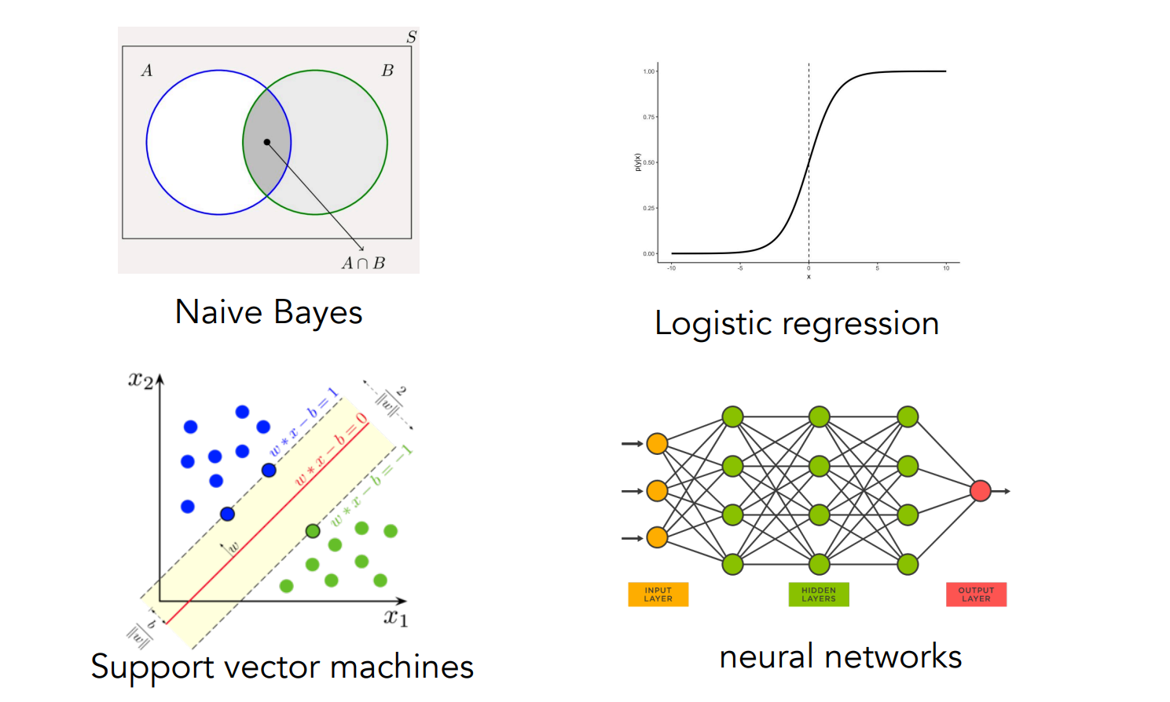
Statistical Classifiers
Naïve Bayes
Logistic Regression
Neural Networks

Slide 6
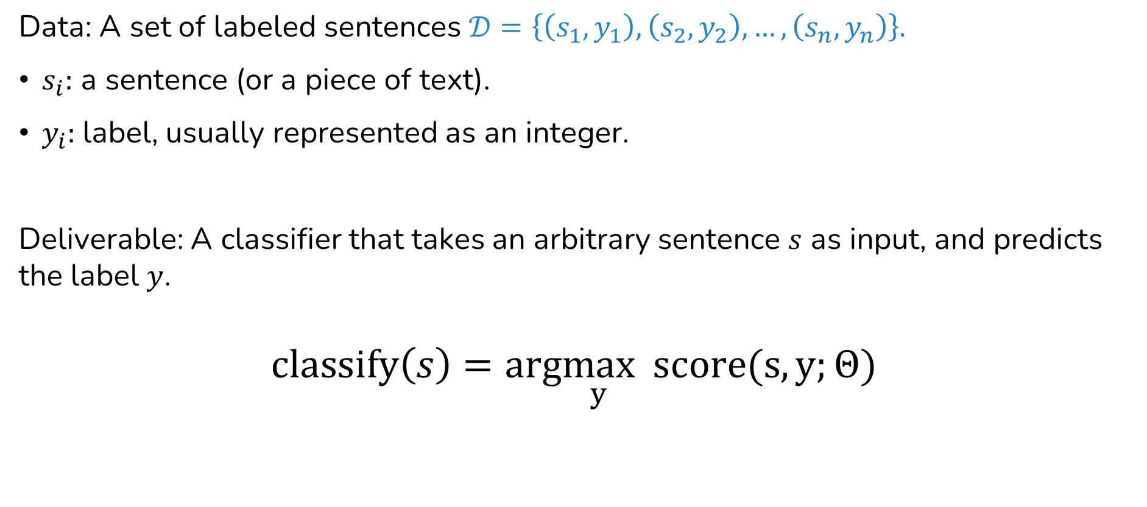
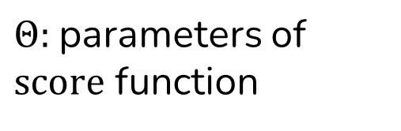
Statistical Classifiers: General Formulation
Data: A set of labeled sentences $𝒟=\left\{\left(s_{1},y_{1}\right), \left(s_{2},y_{2}\right), …,\left(s_{n}, y_{n}\right)\right\}.$
$s_{i}:$ a sentence (or a piece of text).
$y_{i}:$label, usually represented as an integer.
Deliverable: A classifier that takes an arbitrary sentence $s$ as input, and predicts the label $y$.
$$classify\left(s\right)=arg\max_{y} score(s, y;Θ)$$
$Θ:$parameters of $score$ function
Notes:
Nominal integers

Slide 7
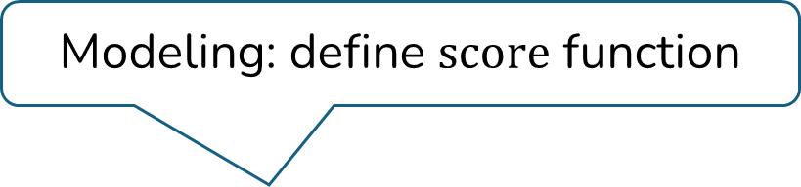

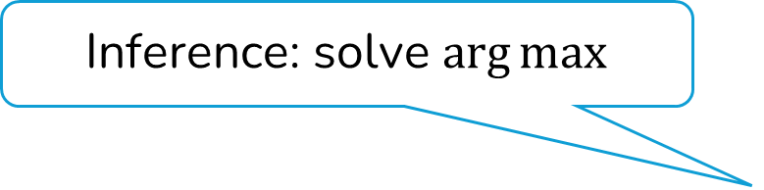
Modeling, Learning, and Inference
$$classify\left(s\right)=arg\max_{y} score(s, y;Θ)$$
Inference: solve $\arg{max}$
Modeling: define $score$ function
Learning: choose parameter

Slide 8
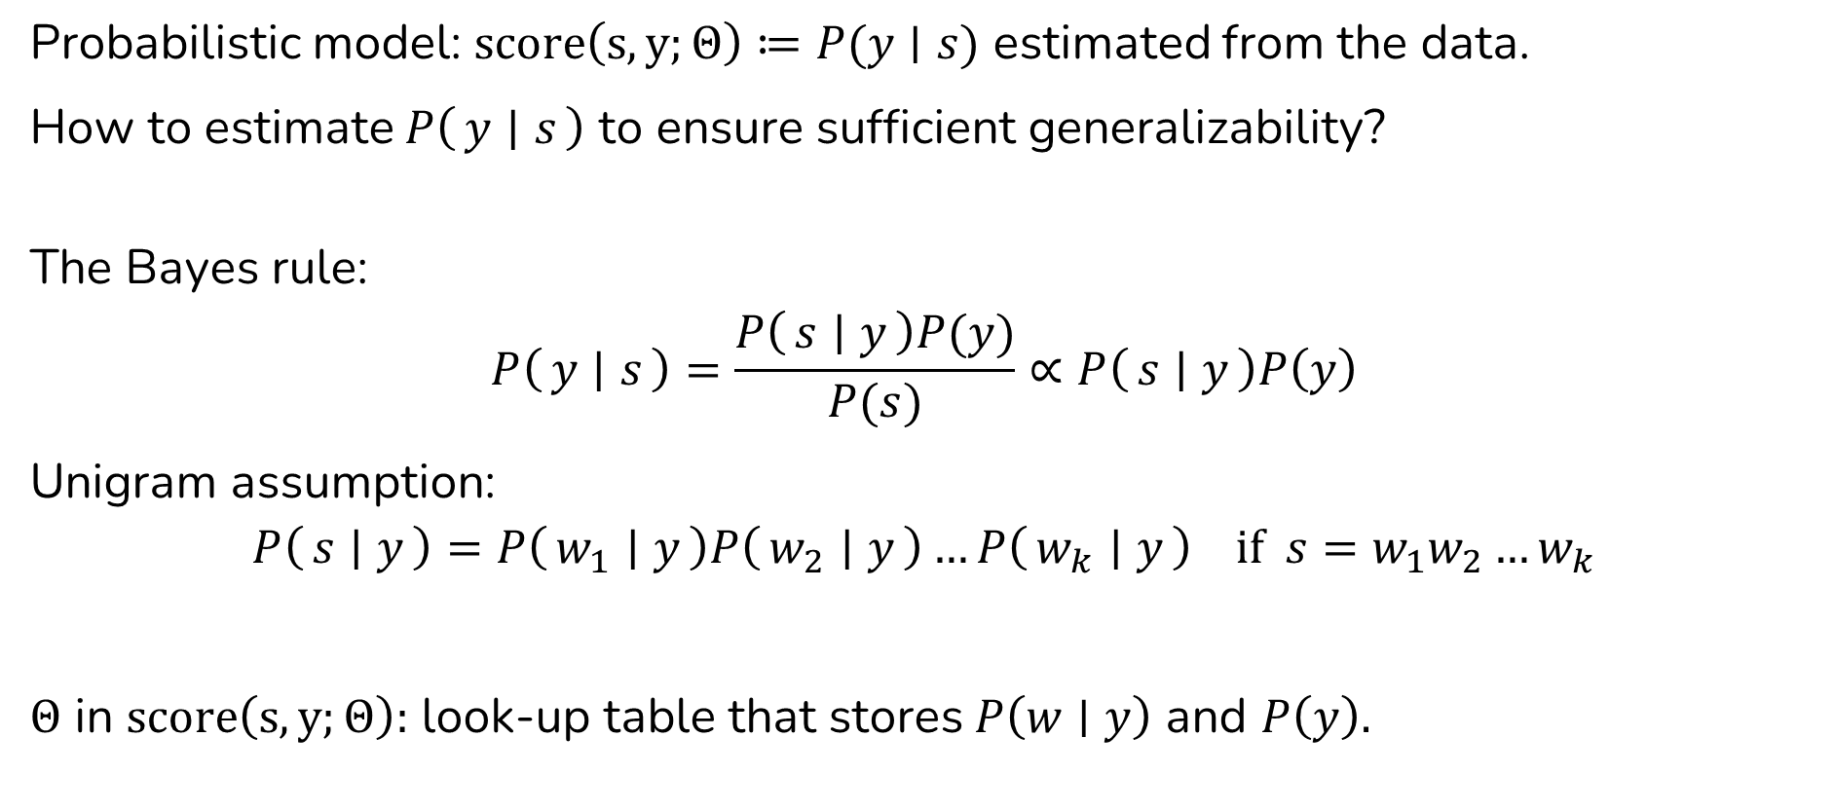
Naïve Bayes: Modeling
Probabilistic model: $score\left(s, y;Θ\right)≔P(y∣s)$ estimated from the data.
How to estimate $P\left(y ∣ s\right)$ to ensure sufficient generalizability?
The Bayes rule:
$$P\left(y ∣ s\right)=\frac{P\left(s ∣ y\right)P(y)}{P(s)}∝P\left(s ∣ y\right)P\left(y\right)$$
Unigram assumption:
$$P\left(s ∣ y\right)=P\left(w_{1} ∣ y\right)P\left(w_{2} ∣ y\right)…P\left(w_{k} ∣ y\right) if s=w_{1}w_{2}…w_{k}$$
$Θ$ in $score\left(s, y;Θ\right):$ look-up table that stores $P\left(w∣y\right)$ and $P\left(y\right).$

Slide 9
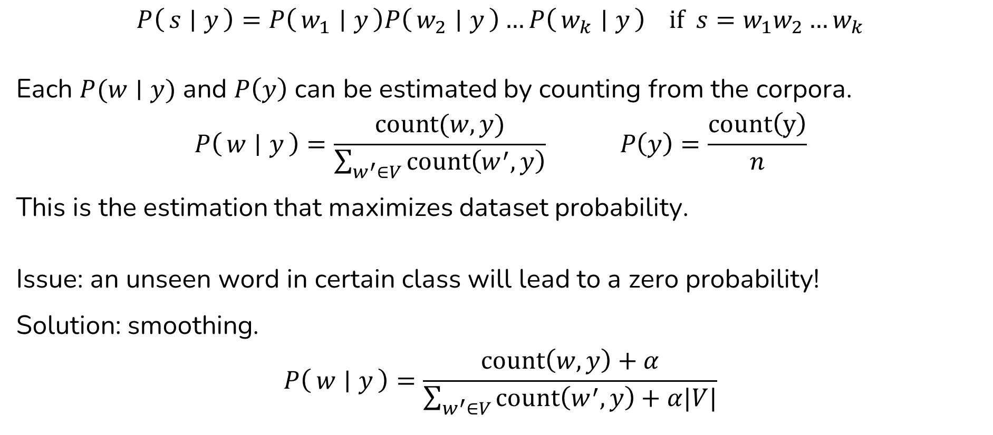
Naïve Bayes: Learning
$$P\left(s ∣ y\right)=P\left(w_{1} ∣ y\right)P\left(w_{2} ∣ y\right)…P\left(w_{k} ∣ y\right) if s=w_{1}w_{2}…w_{k}$$
Each $P(w∣y)$ and $P\left(y\right)$ can be estimated by counting from the corpora.
$$P\left(w ∣ y\right)=\frac{count(w, y)}{\sum_{w^{′}∈V}{count\left(w^{′}, y\right)}} P\left(y\right)=\frac{count\left(y\right)}{n}$$
This is the estimation that maximizes dataset probability.
Issue: an unseen word in certain class will lead to a zero probability!
Solution: smoothing.
$$P\left(w ∣ y\right)=\frac{count\left(w, y\right)+α}{\sum_{w^{′}∈V}{count\left(w^{′}, y\right)}+α|V|}$$

Slide 10

“Bag-of-words” Features
I love this movie! It's sweet, but with satirical humor. The dialogue is great and the adventure scenes are fun... It manages to be whimsical and romantic while laughing at the conventions of the fairy tale genre. I would recommend it to just about anyone. I've seen it several times, and I'm always happy to see it again whenever I have a friend who hasn't seen it yet!
it 6 I 5 the 4 to 3 and 3 seen 2 yet 1 would 1 sweet 1 genre 1 fairy 1 humor 1 have 1 great 1
…
love sweet humor
it are be it seen
and tale whimsical
and I’m I’ve it see
again friend it seen recommend fairy to anyone always have hasn’t genre humor…

Slide 11

Naïve Bayes: Inference
$$classify\left(s\right)=arg\max_{y} score\left(s, y;Θ\right)=arg\max_{y} P(y∣s)$$
$$P\left(y ∣ s\right)∝P\left(y\right) P\left(s ∣ y\right)=P\left(y\right)P\left(w_{1} ∣ y\right)P\left(w_{2} ∣ y\right)…P\left(w_{k} ∣ y\right)$$
Consult the look-up tables for values of $P\left(y\right)$ and $P\left(w ∣ y\right).$

Slide 12
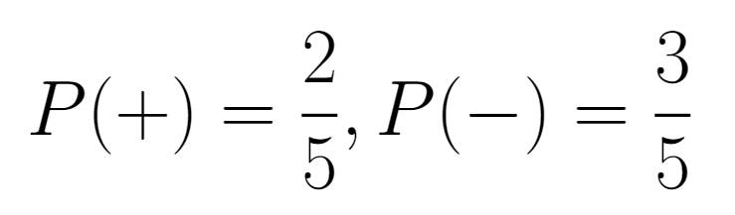
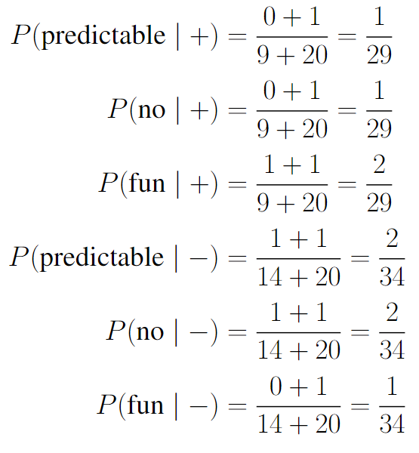
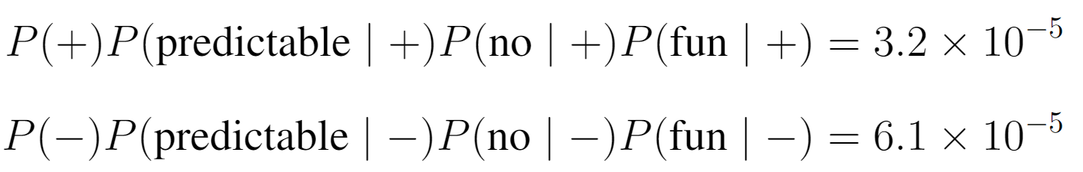

Naïve Bayes: Example
Type | Category | Sentence
Training | - | just plain boring
Training | - | entirely predictable and lacks energy
Training | - | no surprises and very few laughs
Training | + | very powerful
Training | + | the most fun film of the summer
Testing | ? | predictable with no fun
Prior from training set:
$\left|V\right|=20$ from training set
Conditional probabilities $(α=1)$:
Scoring the examples

Slide 13
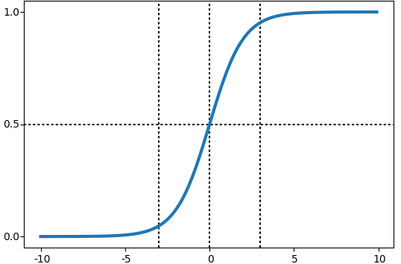

Recap: Logistic Function
Logistic function: $σ\left(x\right)=\frac{1}{1+e^{−x}}, σ:ℝ→\left(0, 1\right).$
“Native” for binary classification.

Slide 14
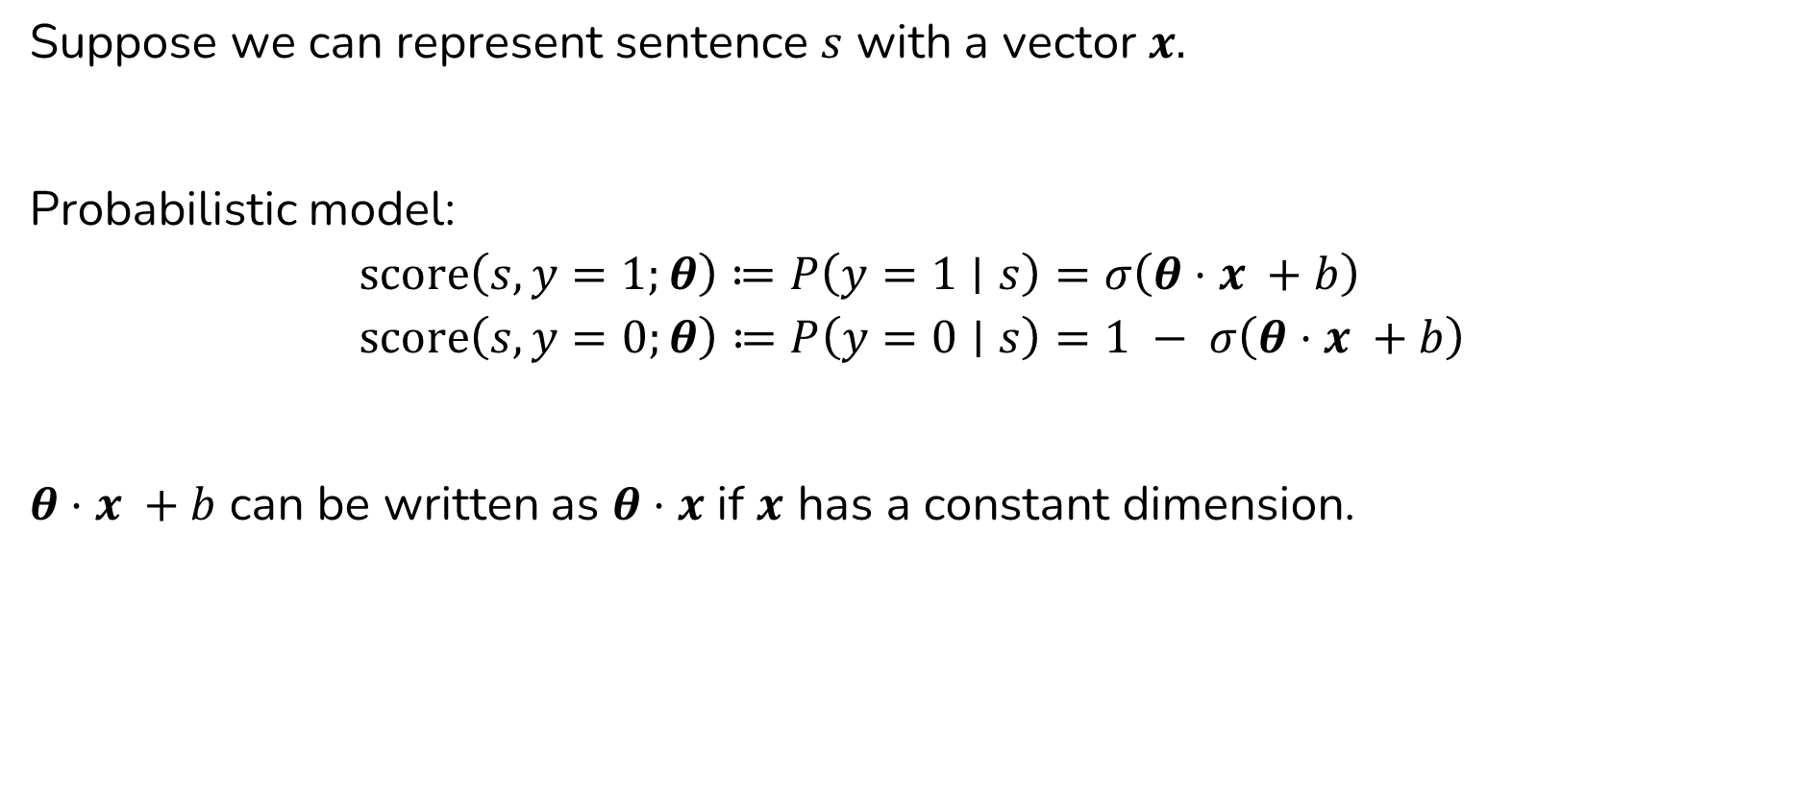
Logistic Regression: Modeling
Suppose we can represent sentence $s$ with a vector $x.$
Probabilistic model:
$$score\left(s, y=1;θ\right)≔P\left(y=1∣s\right)=σ\left(θ⋅x +b\right)$$
$$score\left(s, y=0;θ\right)≔P\left(y=0∣s\right)=1 − σ\left(θ⋅x +b\right)$$
$θ⋅x +b$ can be written as $θ⋅x$ if $x$ has a constant dimension.

Slide 15
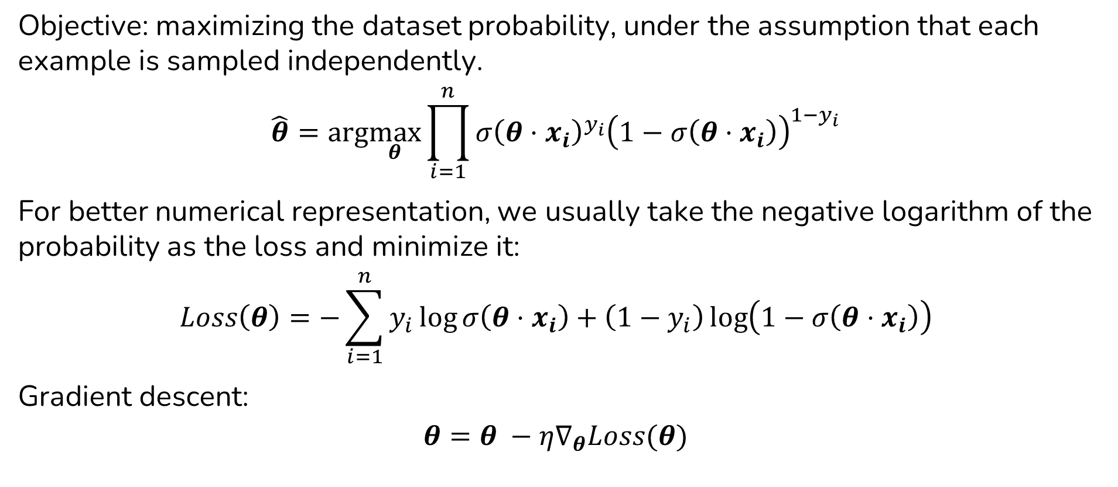
Logistic Regression: Learning
Objective: maximizing the dataset probability, under the assumption that each example is sampled independently.
$$\hat{θ}=arg\max_{θ}\prod_{i=1}^{n}{σ{\left(θ⋅x_{i}\right)}^{y_{i}}{\left(1−σ\left(θ⋅x_{i}\right)\right)}^{1−y_{i}}}$$
For better numerical representation, we usually take the negative logarithm of the probability as the loss and minimize it:
$$Loss\left(θ\right)=−\sum_{i=1}^{n}{y_{i}\log{σ\left(θ⋅x_{i}\right)}+\left(1−y_{i}\right)\log\left(1−σ\left(θ⋅x_{i}\right)\right)}$$
Gradient descent:
$$θ=θ −η∇_{θ}Loss(θ)$$

Slide 16
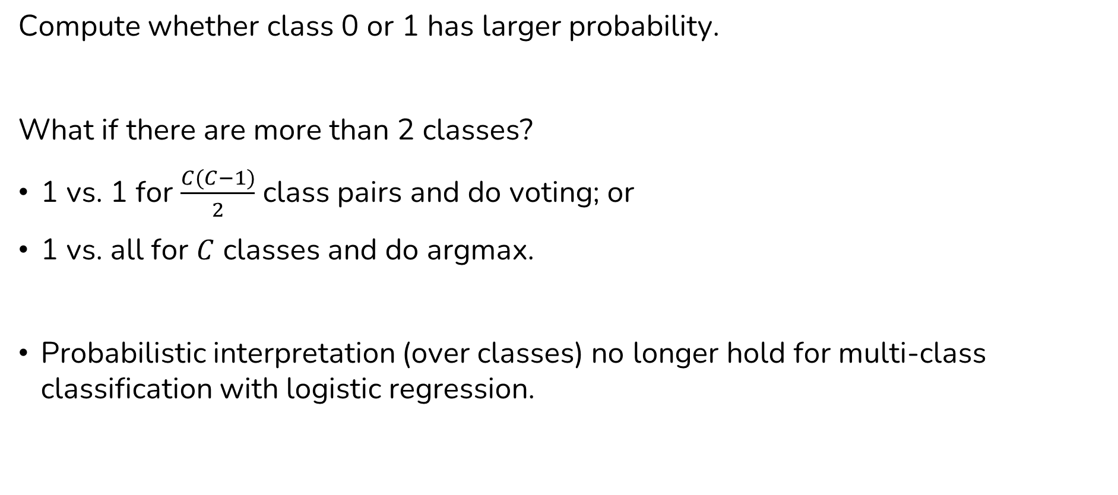
Logistic Regression: Inference
Compute whether class 0 or 1 has larger probability.
What if there are more than 2 classes?
1 vs. 1 for $\frac{C(C−1)}{2}$ class pairs and do voting; or
1 vs. all for $C$ classes and do argmax.
Probabilistic interpretation (over classes) no longer hold for multi-class classification with logistic regression.

Slide 17
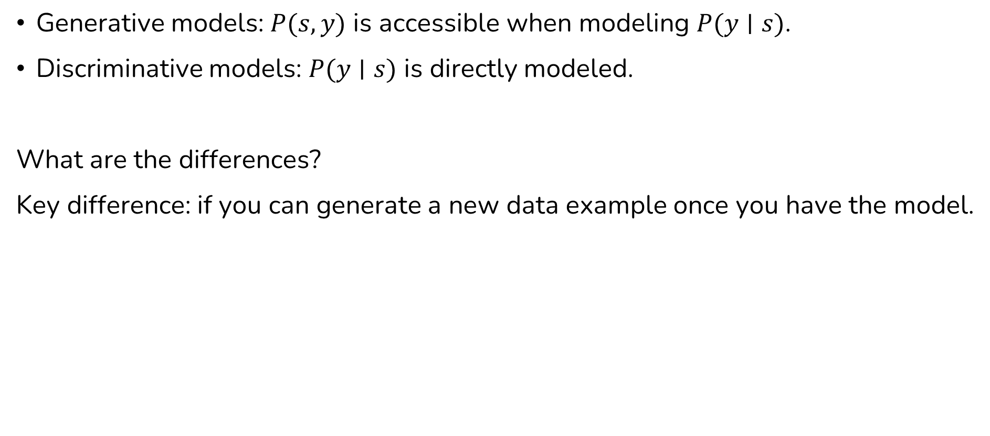
Generative vs. Discriminative Model for Classification
Generative models: $P(s, y)$ is accessible when modeling $P(y∣s)$.
Discriminative models: $P(y∣s)$ is directly modeled.
What are the differences?
Key difference: if you can generate a new data example once you have the model.

Slide 18
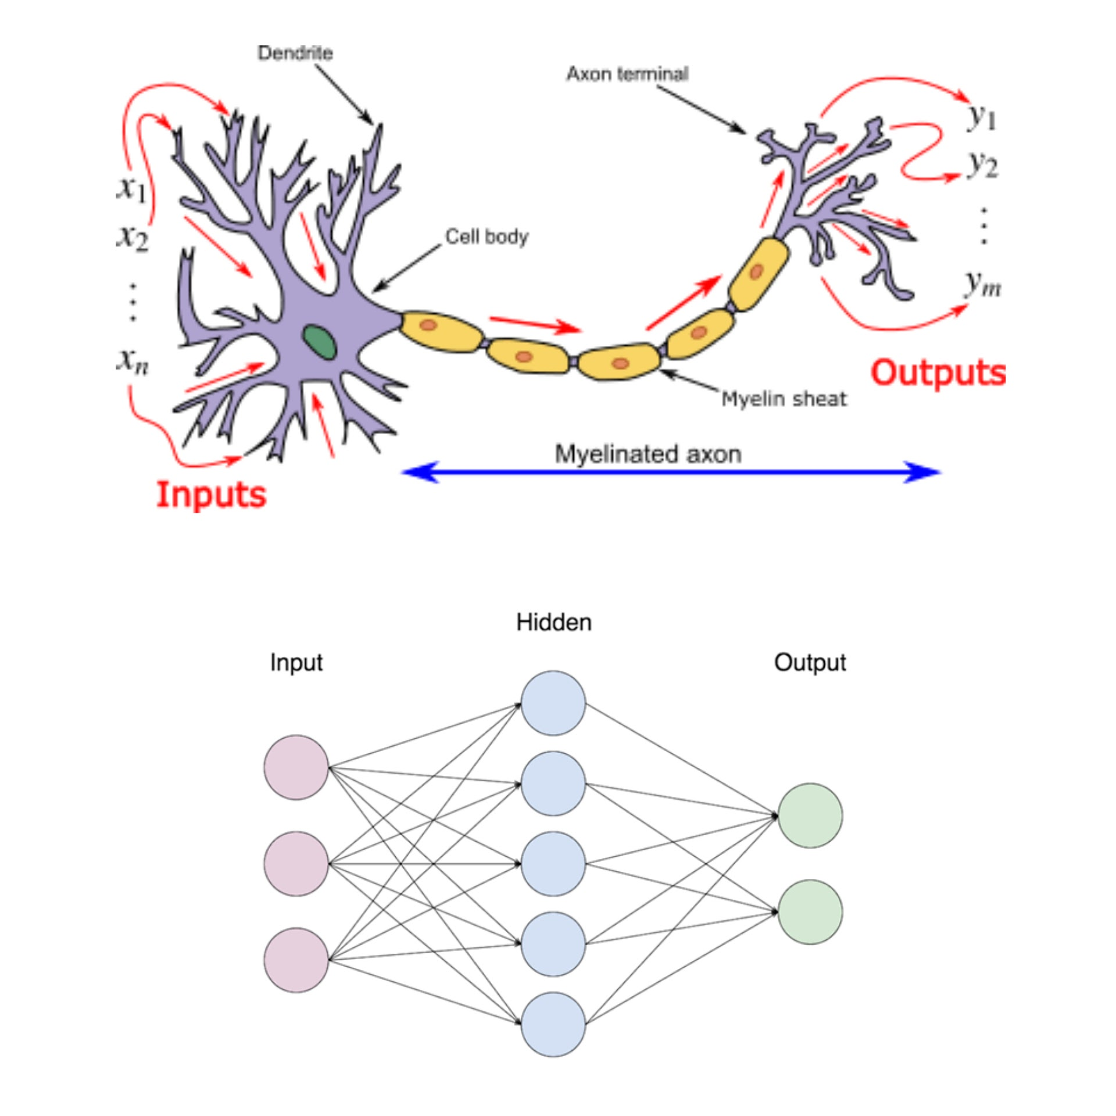
Neural-Network Classifier
A neural network is a function
It has inputs and outputs.
“Neural modeling” now is better thought of as dense representation learning.

Slide 19
Neural Implementation of Scoring Function
$$classify\left(s\right)=arg\max_{y} score(s, y;Θ)$$
Inference: solve $\arg{max}$
Modeling: define $score$ function
Learning: choose parameter
With a neural network--based function $f_{θ}$, we input $x$ and collects a vector $\hat{y}=f_{w}\left(x\right);$ $score(x,y;θ)$ is defined by selecting the corresponding entry in $\hat{y}.$

Slide 20
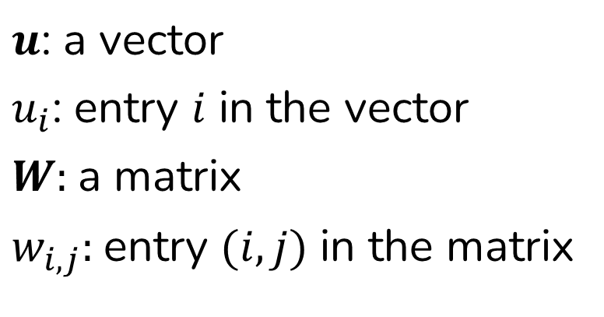
Common Neural Network Notations
$u$: a vector
$u_{i}$: entry $i$ in the vector
$W:$a matrix
$w_{i,j}:$entry $(i,j)$ in the matrix

Slide 21
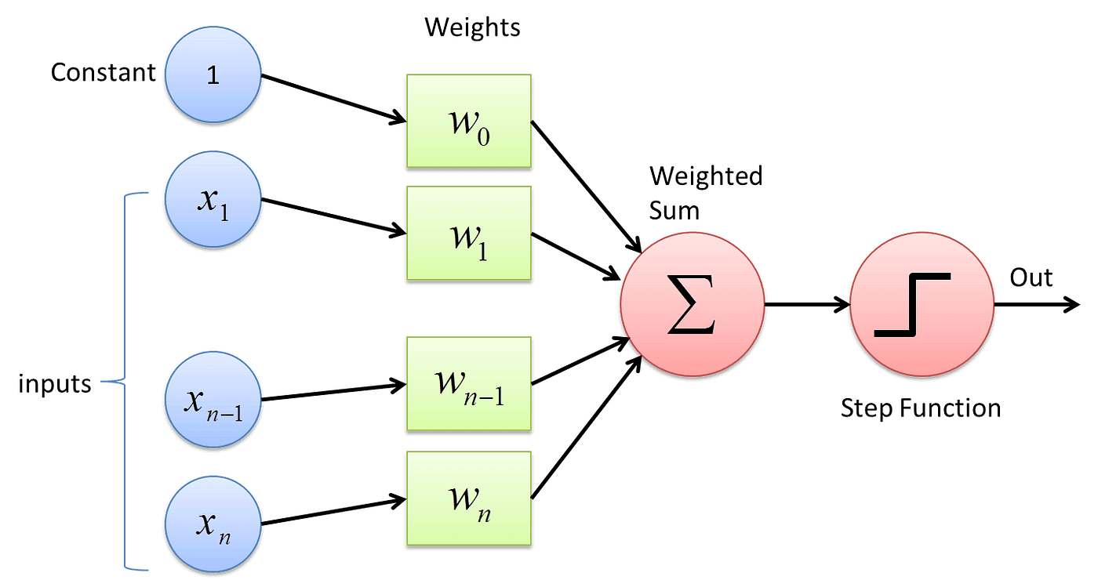
Perceptron
$$perceptron\left(x;θ\right)=step\left(θ^{T}x\right)$$
activation
function
affine transform

Slide 22
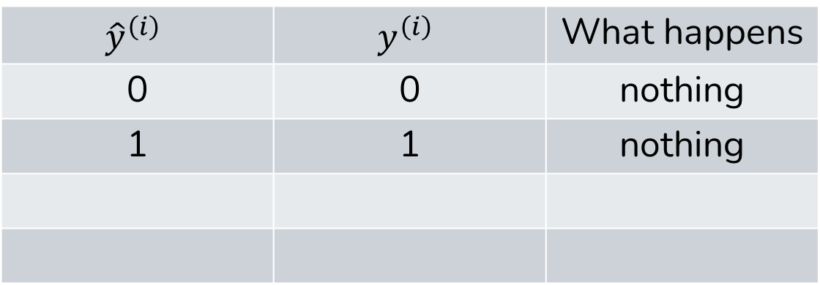
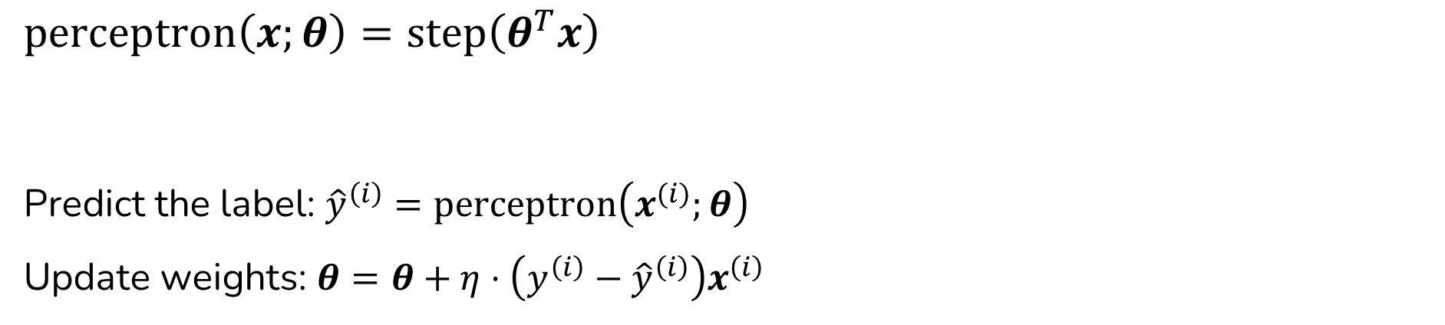
Perceptron: Learning
$$perceptron\left(x;θ\right)=step\left(θ^{T}x\right)$$
Predict the label: ${\hat{y}}^{\left(i\right)}=perceptron\left(x^{(i)};θ\right)$
Update weights: $θ=θ+η⋅\left(y^{\left(i\right)}−{\hat{y}}^{\left(i\right)}\right)x^{\left(i\right)}$
$${\hat{y}}^{\left(i\right)}$$ | $$y^{\left(i\right)}$$ | What happens
0 | 0 | nothing
1 | 1 | nothing

Slide 23
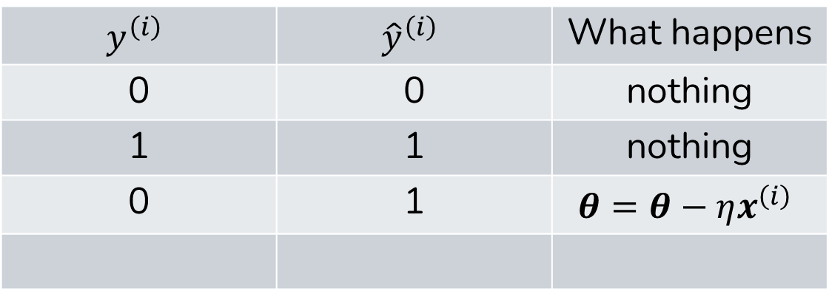
Perceptron: Learning
$$perceptron\left(x;θ\right)=step\left(θ^{T}x\right)$$
Predict the label: ${\hat{y}}^{\left(i\right)}=perceptron\left(x^{(i)};θ\right)$
Update weights: $θ=θ+η⋅\left(y^{\left(i\right)}−{\hat{y}}^{\left(i\right)}\right)x^{\left(i\right)}$
$$y^{\left(i\right)}$$ | $${\hat{y}}^{\left(i\right)}$$ | What happens
0 | 0 | nothing
1 | 1 | nothing
0 | 1 | $$θ=θ−ηx^{\left(i\right)}$$

Slide 24
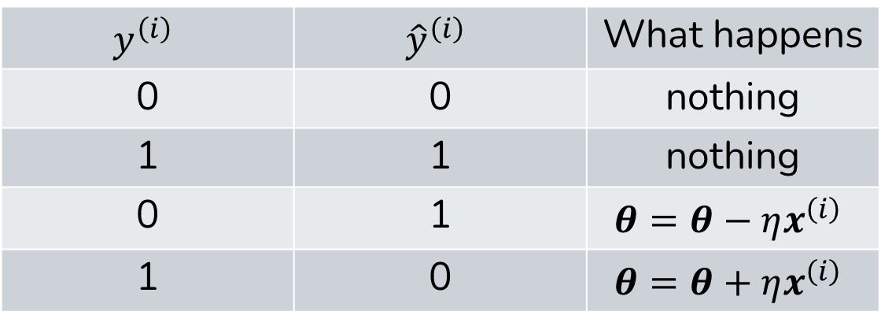
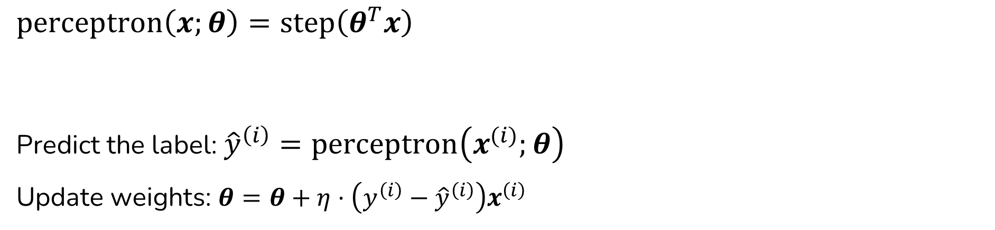
Perceptron: Learning
$$perceptron\left(x;θ\right)=step\left(θ^{T}x\right)$$
Predict the label: ${\hat{y}}^{\left(i\right)}=perceptron\left(x^{(i)};θ\right)$
Update weights: $θ=θ+η⋅\left(y^{\left(i\right)}−{\hat{y}}^{\left(i\right)}\right)x^{\left(i\right)}$
$$y^{\left(i\right)}$$ | $${\hat{y}}^{\left(i\right)}$$ | What happens
0 | 0 | nothing
1 | 1 | nothing
0 | 1 | $$θ=θ−ηx^{\left(i\right)}$$
1 | 0 | $$θ=θ+ηx^{\left(i\right)}$$

Slide 25

Neural Layer: Generalized Perceptron
A neural layer = affine transformation + nonlinearity
Output is a vector (results from multiple independent perceptrons).
Can have other activation functions for nonlinearity.
$$perceptron\left(x\right)=step\left(θ^{T}x+b\right)$$
$$neural_layer\left(x\right)=g\left(W^{T}x+b\right)$$
activation function
affine transform

Slide 26
Stacking Neural Layers
Multiple neural layers can be stacked together.
hidden units
layer index
…
…
…
Use output of one layer as input to the next
Feed-forward and/or fully-connected layers
Also called multi-layer perceptron (MLP)

Slide 27
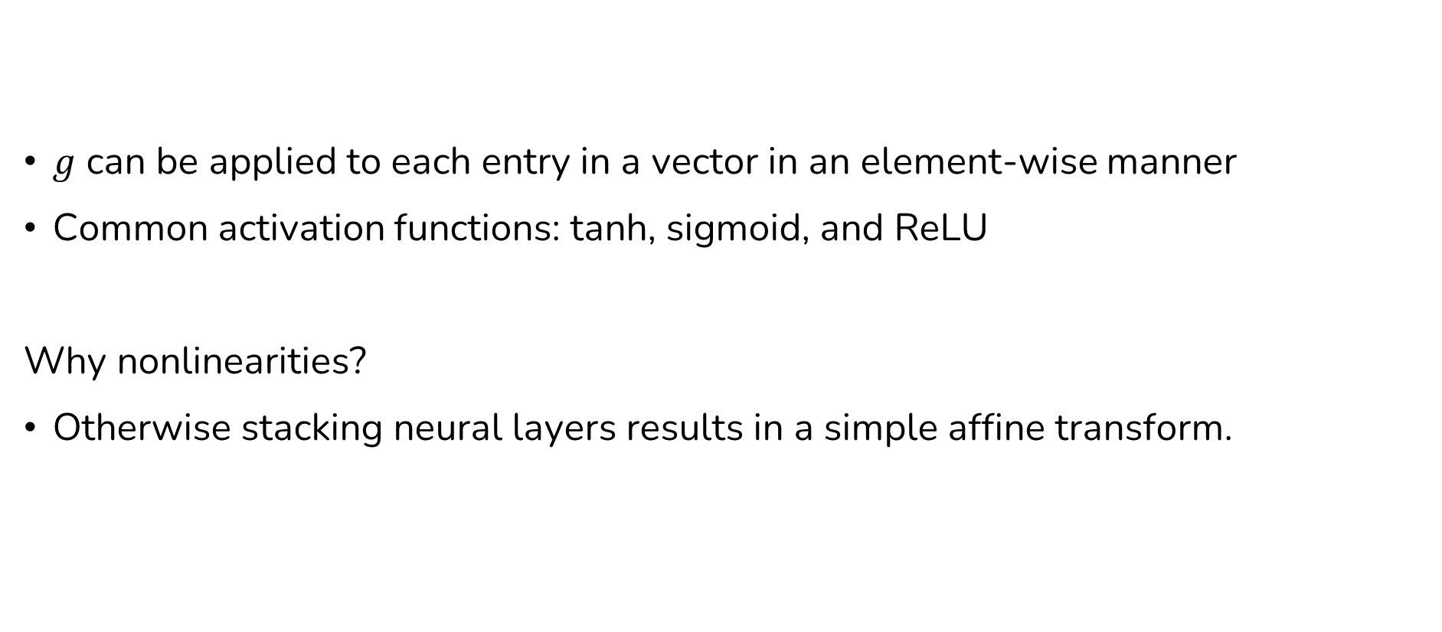
Nonlinearities (activation function)
$g$ can be applied to each entry in a vector in an element-wise manner
Common activation functions: tanh, sigmoid, and ReLU
Why nonlinearities?
Otherwise stacking neural layers results in a simple affine transform.

Slide 28
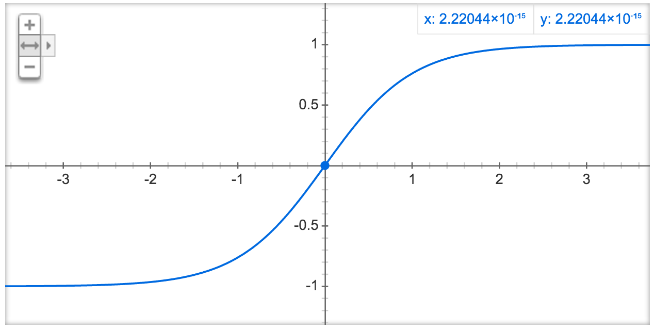
Nonlinearities: tanh

Slide 29
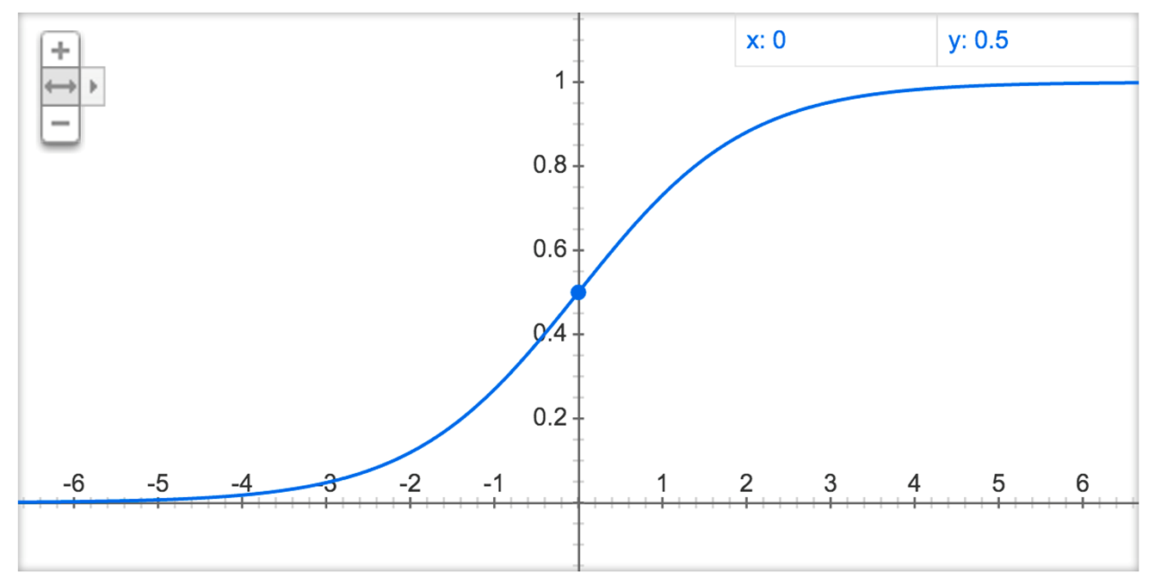
Nonlinearities: sigmoid

Slide 30
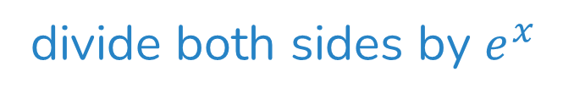
Sigmoid and tanh
divide both sides by $e^{x}$

Slide 31
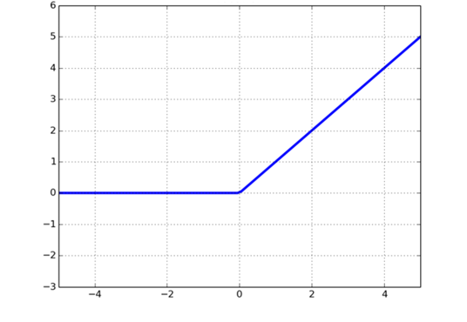
Nonlinearity: Rectified Linear Unit (ReLU)

Slide 32

Sentiment Classification with Neural Network
We empirically don’t pass the final layer into an activation function
How can we get $x$ for a sentence?
Average word embeddings
More complicated neural network structures

Slide 33

Neural Network: Training
Maximize the probability (minimize negative log probability) of gold standard label
Also called cross entropy (between $p$ and the 1-hot gold standard distribution) loss.

Slide 34
Backpropagation
Chain rule: suppose , then
Now we have , how should we update ?

Slide 35
Visualization of an Average Word Vector Classifier
…

Slide 36
Next
Common neural network architectures for NLP (for more powerful models).

Slide 37
Modeling
$$classify\left(s\right)=arg\max_{y} score(s, y;Θ)$$
Modeling: define $score$ function

Slide 38
Learning
$$classify\left(s\right)=arg\max_{y} score(s, y;Θ)$$
Learning: choose parameter

Slide 39
Modeling, Learning, and Inference
$$classify\left(s\right)=arg\max_{y} score(s, y;Θ)$$
Inference: solve $\arg{max}$

