Slide 1

CS 489/698: Introduction to Natural Language Processing Lecture 6.2: Language Modeling II
Instructor: Freda Shi
fhs@uwaterloo.ca
February 4th, 2026

Slide 2
Outline: Neural Language Modeling
Neural language modeling
Probing neural language models

Slide 3
Recap: Language Modeling as Classification
This is just a probabilistic classification problem!
We can use any tools from the previous lectures: linear model with features, neural networks, etc.

Slide 4
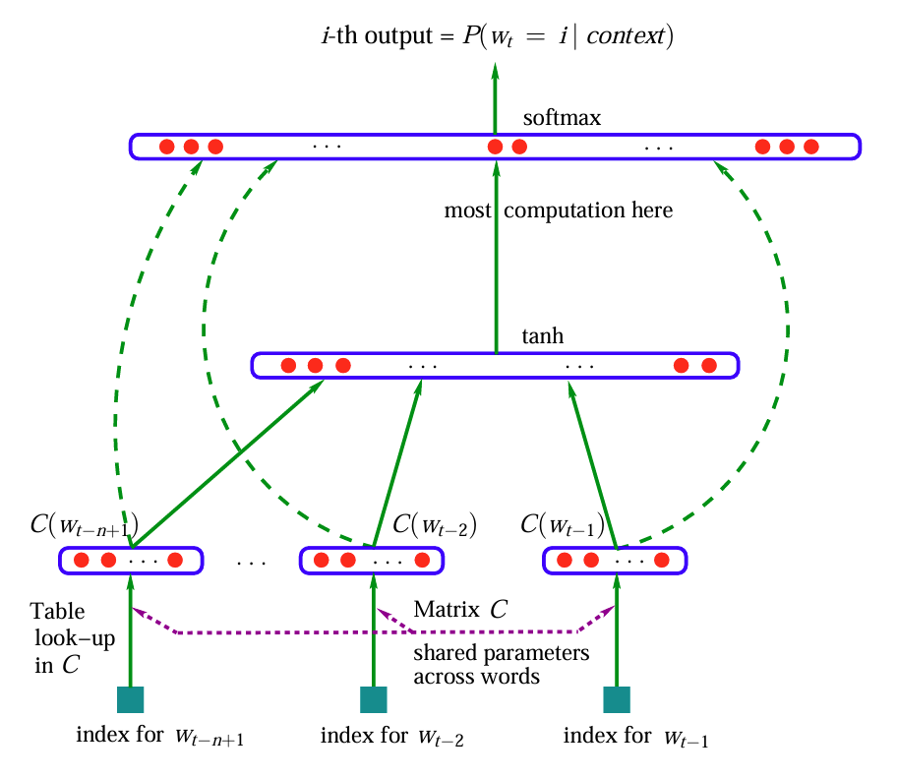
Neural N-Gram Language Models
[Src: Bengio et al., 2003]

Slide 5
Neural Trigram Language Model
Given two previous words, compute probability distribution over possible next words
Input is concatenation of vectors (embeddings) of previous two words:

Slide 6
Neural Trigram Language Model
Output is a vector containing probabilities of all possible next words:
…

Slide 7
Neural Trigram Language Model
To get , do matrix multiplication of parameter matrix and input, then “softmax” transformation
“fully-connected layer”

Slide 8

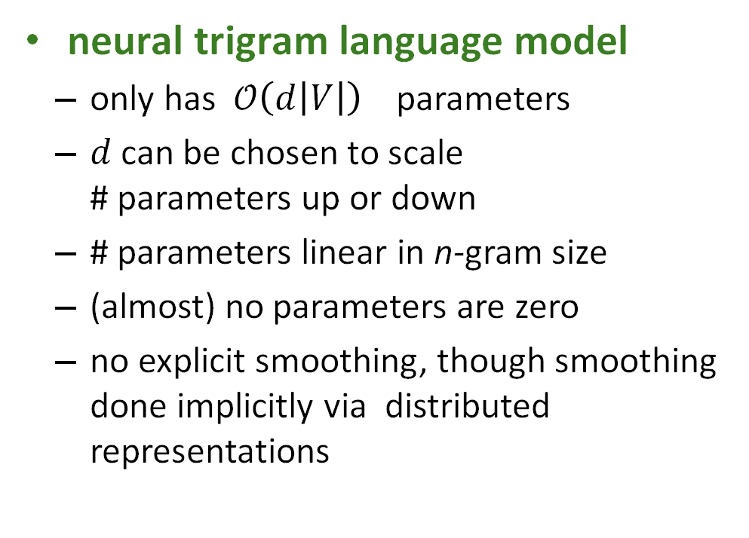
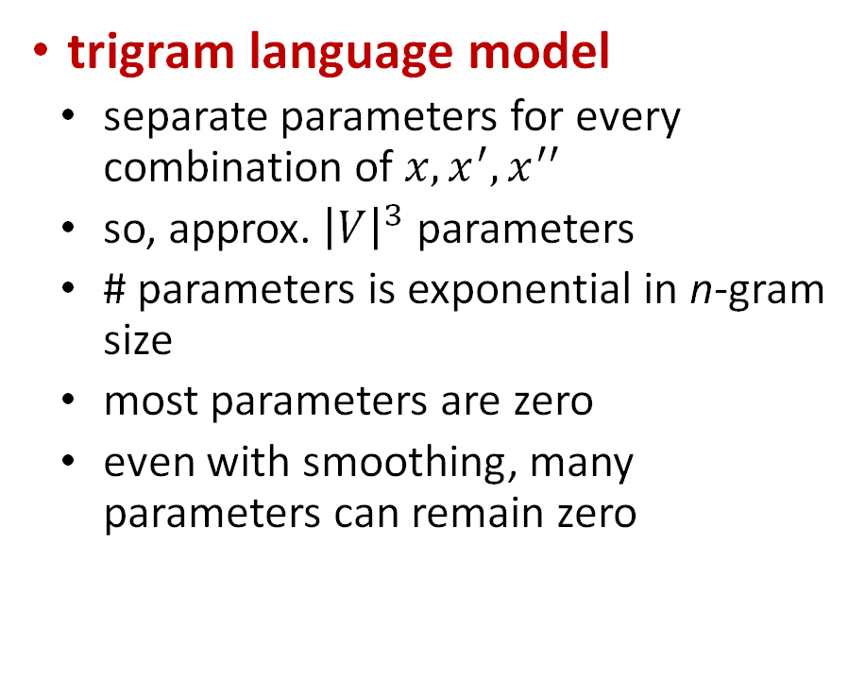
Trigram vs. Neural Trigram LMs $P\left(x ∣ x^{′},x^{′′}\right)$
trigram language model
separate parameters for every combination of $x, x^{′}, x^{′′}$
so, approx. ${\left|V\right|}^{3}$ parameters
# parameters is exponential in n-gram size
most parameters are zero
even with smoothing, many parameters can remain zero
neural trigram language model
only has $𝒪\left(d\left|V\right|\right)$ parameters
$d$can be chosen to scale # parameters up or down
# parameters linear in n-gram size
(almost) no parameters are zero
no explicit smoothing, though smoothing done implicitly via distributed representations

Slide 9
Removing N-Gram Constraints
[Src: Bengio et al., 2003]

Slide 10
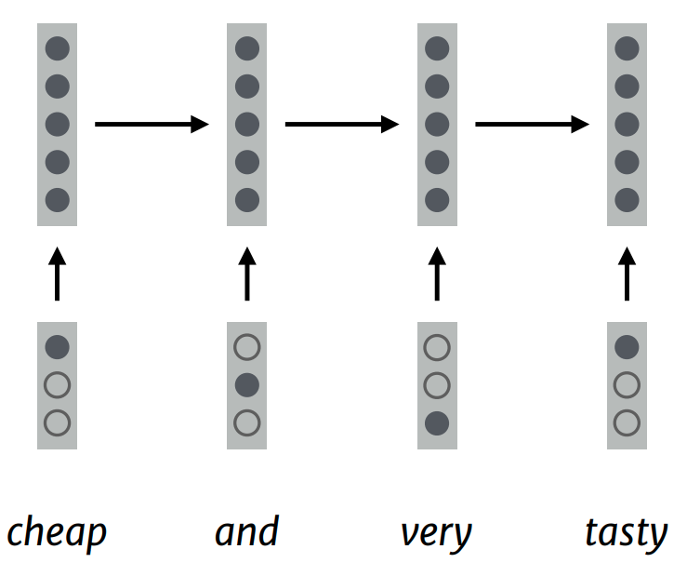

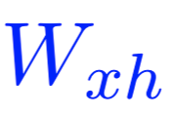
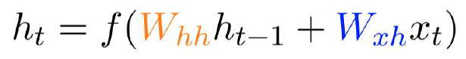
RNN Language Models
Hidden state is a function of previous hidden state and current input.
Same weights at each state.
I have a cat
No Markov assumption!

Slide 11
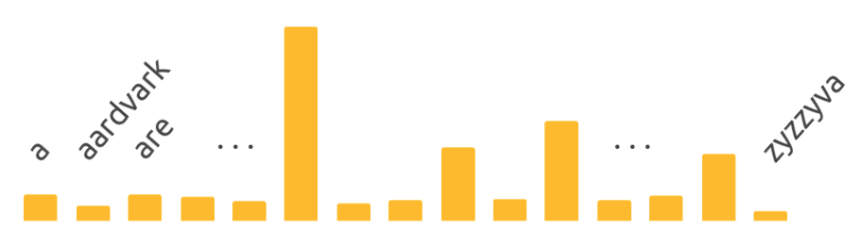



RNN Language Model
have a cat
$$W$$
$$W$$
$$W$$
I have a cat

Slide 12
Transformer Language Models

Slide 13
Next
Basic Syntax

