Slide 1

CS 489/698: Introduction to Natural Language Processing Lecture 5: Neural Networks – Common Architectures
Instructor: Freda Shi
fhs@uwaterloo.ca
January 19th, 2026

Slide 2
Recap: Multi-Layer Perceptron
…
…
…

Slide 3
Recap: Simple Neural Classifier with BoW Feature
…

Slide 4
This Lecture: Common Neural Architectures
Convolutional neural networks
Recurrent neural networks
Recursive neural networks
Transformers
Better features?
…

Slide 5
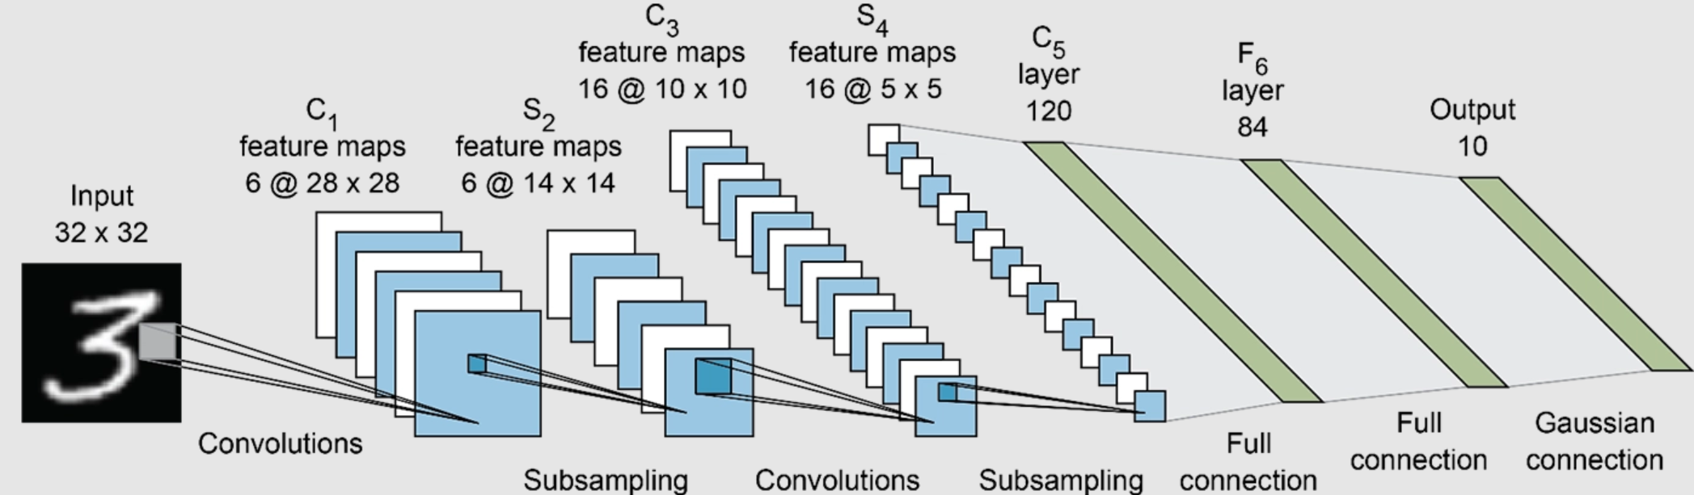
Convolutional Neural Networks
Introduced for vision tasks; also used in NLP to extract feature vectors.

Slide 6
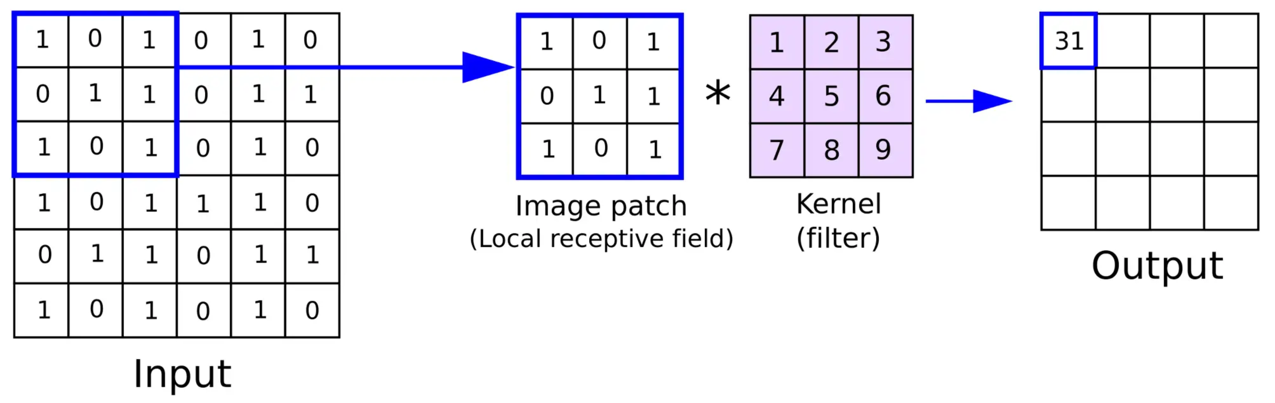

Convolutional Neural Networks
$$1+3+5+6+7+9 = 31$$

Slide 7
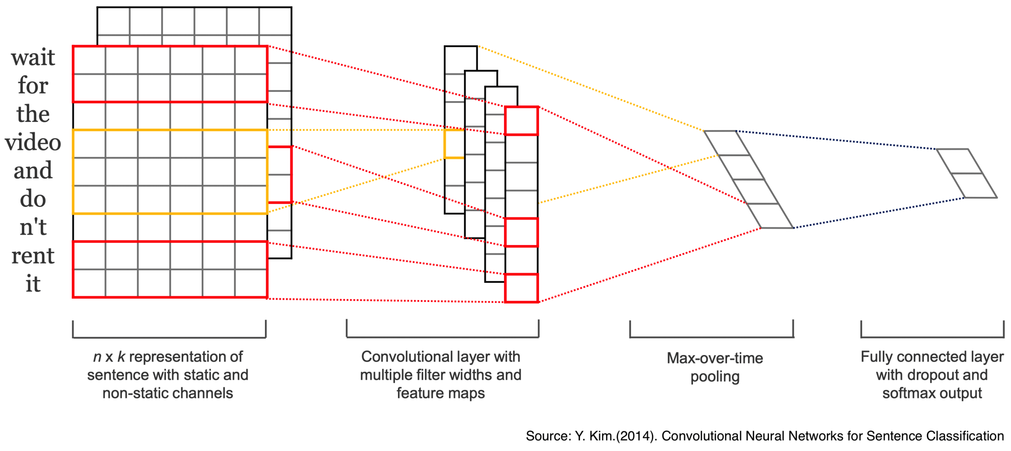
From 2D to 1D: Overview

Slide 8
Kernel/Filter
parameters/kernel
Start from word embeddings
Take dot product between filter and (stretched) word embeddings

Slide 9
Kernel/Filter
parameters/kernel
Start from word embeddings
Take dot product between filter and (stretched) word embeddings

Slide 10
Kernel/Filter
parameters/kernel
Start from word embeddings
Take dot product between filter and (stretched) word embeddings

Slide 11
Kernel/Filter
What about a kernel/filter with a different size?

Slide 12
Pooling
Each kernel/filter extracts one type of features
However, a kernel’s output size depends on sentence length A fixed dimensional vector is desirable for MLP inputs
Solution: mean pooling/max pooling converts a vector to a scalar
Final feature: concatenating pooling results of all filters
pooling

Slide 13
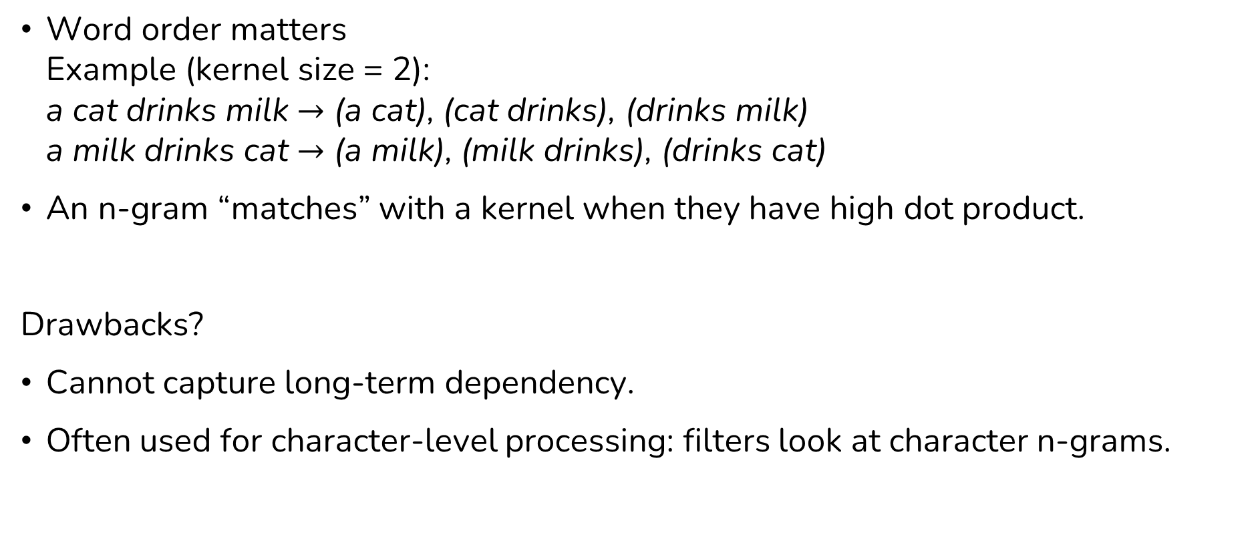
Summary: Convolutional Neural Networks for NLP
Word order matters Example (kernel size = 2): a cat drinks milk $→$ (a cat), (cat drinks), (drinks milk) a milk drinks cat $→$ (a milk), (milk drinks), (drinks cat)
An n-gram “matches” with a kernel when they have high dot product.
Drawbacks?
Cannot capture long-term dependency.
Often used for character-level processing: filters look at character n-grams.

Slide 14
Recurrent Neural Networks (RNNs)
Idea: apply the same transformation to tokens in time order

Slide 15
Recurrent Neural Networks
Gradient update for
Suppose is the representation passed to the classifier We can easily calculate
What about ?

Slide 16
An important issue of simple RNNs
Absolute value of entries grow/vanish exponentially w.r.t. sequence length.
This motivates the development of more advanced RNN architectures.

Slide 17
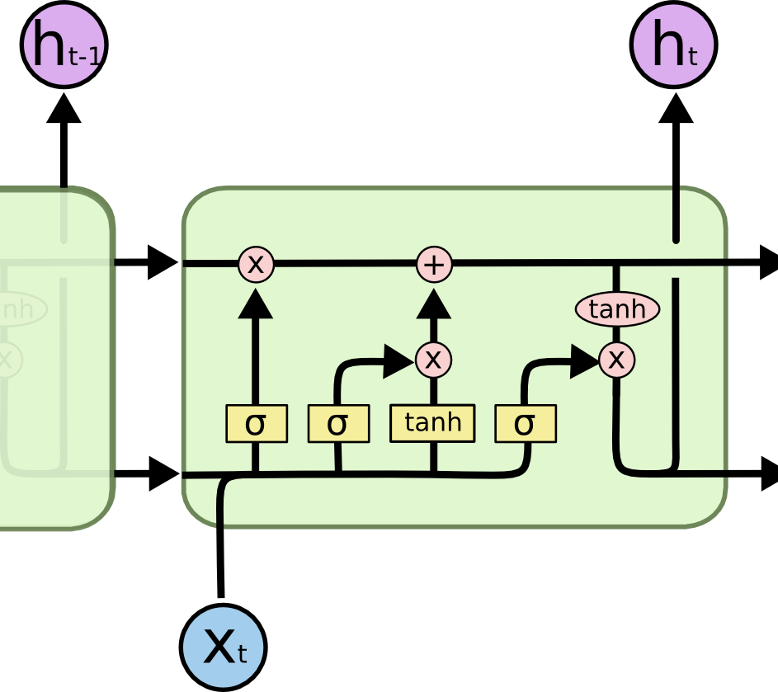
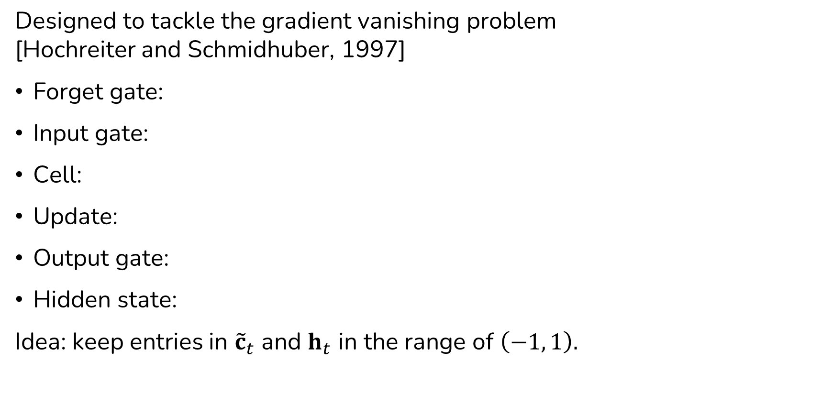
The Long Short-Term Memory Networks (LSTMs)
Designed to tackle the gradient vanishing problem [Hochreiter and Schmidhuber, 1997]
Forget gate:
Input gate:
Cell:
Update:
Output gate:
Hidden state:
Idea: keep entries in ${\tilde{c}}_{t}$ and $h_{t}$ in the range of $\left(−1, 1\right).$
[Figure credit: Chris Olah]

Slide 18
Gated Recurrent Units
Fewer parameters and generally works quite well.
Update gate:
Reset gate:

Slide 19
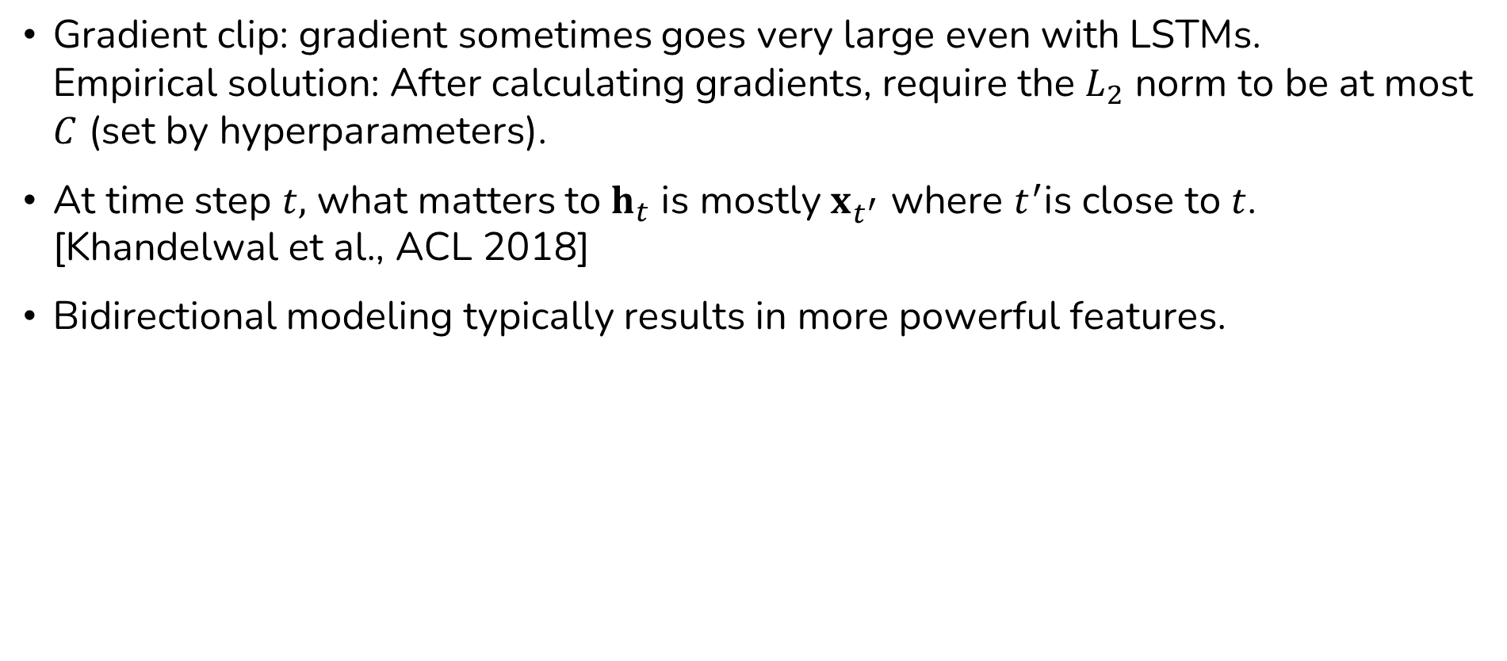
RNN: Practical Approaches
Gradient clip: gradient sometimes goes very large even with LSTMs. Empirical solution: After calculating gradients, require the $L_{2}$ norm to be at most $C$ (set by hyperparameters).
At time step $t,$ what matters to $h_{t}$ is mostly $x_{t^{′}}$ where $t^{′}$is close to $t$. [Khandelwal et al., ACL 2018]
Bidirectional modeling typically results in more powerful features.

Slide 20
Recursive Neural Networks
Run constituency parser on sentence, and construct vector recursively
All nodes share the same set of parameters [Socher et al., 2011&2013]

Slide 21
Recursive Neural Networks
Tree LSTMs typically work well. (slight modification of LSTM cells needed)

Slide 22
Recursive Neural Networks
Tree LSTMs typically work well. (slight modification of LSTM cells needed)
Recursive neural networks with left-branching trees are basically equivalent to recurrent neural networks.
Syntactically meaningful parse trees are not necessary for good representations: balanced trees work well (or even better) for most tasks. [Shi et al., EMNLP 2018]

Slide 23
Attention
Can be thought of as weighted sum; each token receives a weight
From (unweighted) bag of words to (weighted) bag of words
Each word receives a fixed weight
Normalize the weights with softmax

Slide 24
Parameterized Attention
Word tokens with the same word type should probably receive different weights in different sentences
Implement attention with an MLP (example below)

Slide 25

Self-Attentive RNNs
The last hidden state of RNN could be bad feature. Why?
At time step $t,$ what matters to $h_{t}$ is mostly $x_{t^{′}}$ where $t^{′}$is close to $t$ [Khandelwal et al., ACL 2018]
Caveat: attention weights over RNN hidden states could be bad indicators on which token is more important
Trainable parameters,
Jointly trained w/ RNN parameters

Slide 26
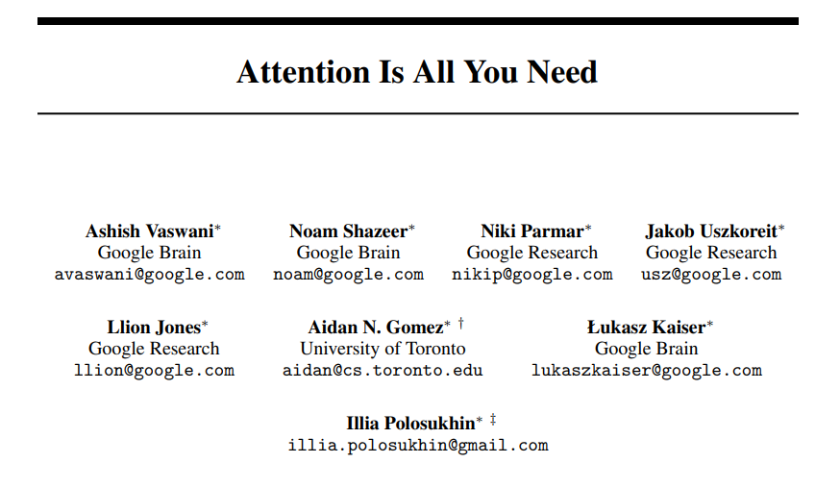
Transformers

Slide 27
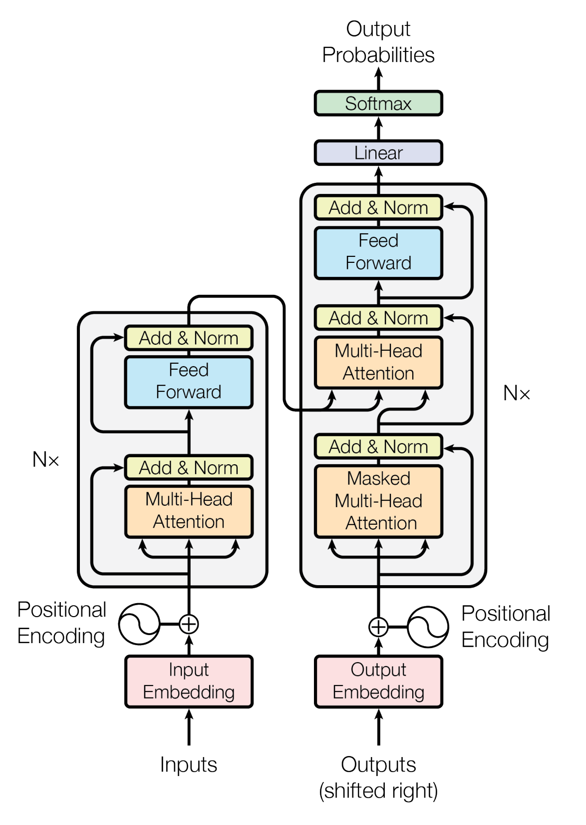
Transformer Encoder
Transformer: attention-based sentence encoding, and optionally, decoding.
Idea: every token has “attention” to every other token.
For sentence with tokens
Trainable parameters

Slide 28
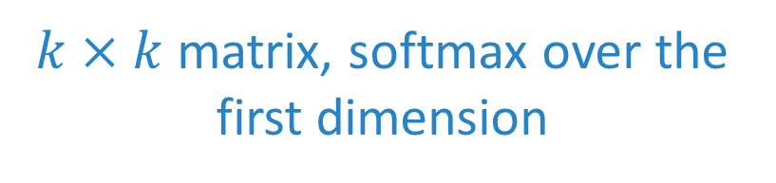
Transformer Encoder
$k×k$ matrix, softmax over the first dimension

Slide 29
Transformer Encoder

Slide 30


Transformer Encoder
$$⋅$$
$$=$$

Slide 31
Transformer Encoder

Slide 32
Transformer Encoder

Slide 33

Transformer Encoder
$$⋅$$
$$=$$

Slide 34

Transformer Encoder
$$⋯$$

Slide 35

Transformer Encoder
$$=$$

Slide 36
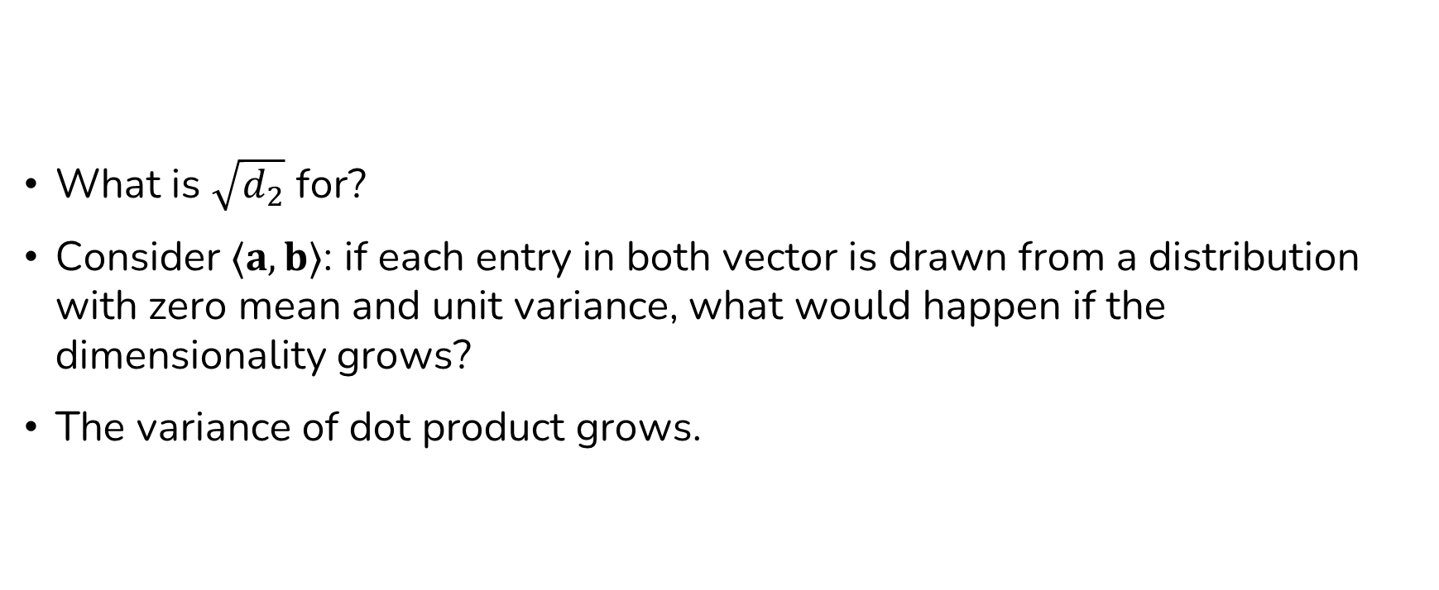
Transformer Encoder: Variance Preservation
What is $\sqrt{d_{2}}$ for?
Consider $⟨a,b⟩$: if each entry in both vector is drawn from a distribution with zero mean and unit variance, what would happen if the dimensionality grows?
The variance of dot product grows.

Slide 37
Recap: Variance and Covariance
For independent zero-mean, unit-variance random variables and

Slide 38

Recap: Variance and Covariance
For independent zero-mean, unit-variance random variables and
If we have $2n$ independent zero-mean, unit variance variables

Slide 39

Transformer Encoder
The application of $\sqrt{d_{2}}$ is theoretically motivated.
See also Xavier initialization: initialize a dot product parameter vector
with values drawn from

Slide 40
Positional Encoding
This is just complicated bag of words…
Columns of for “a cat”
= permutation of columns of for “cat a”

Slide 41
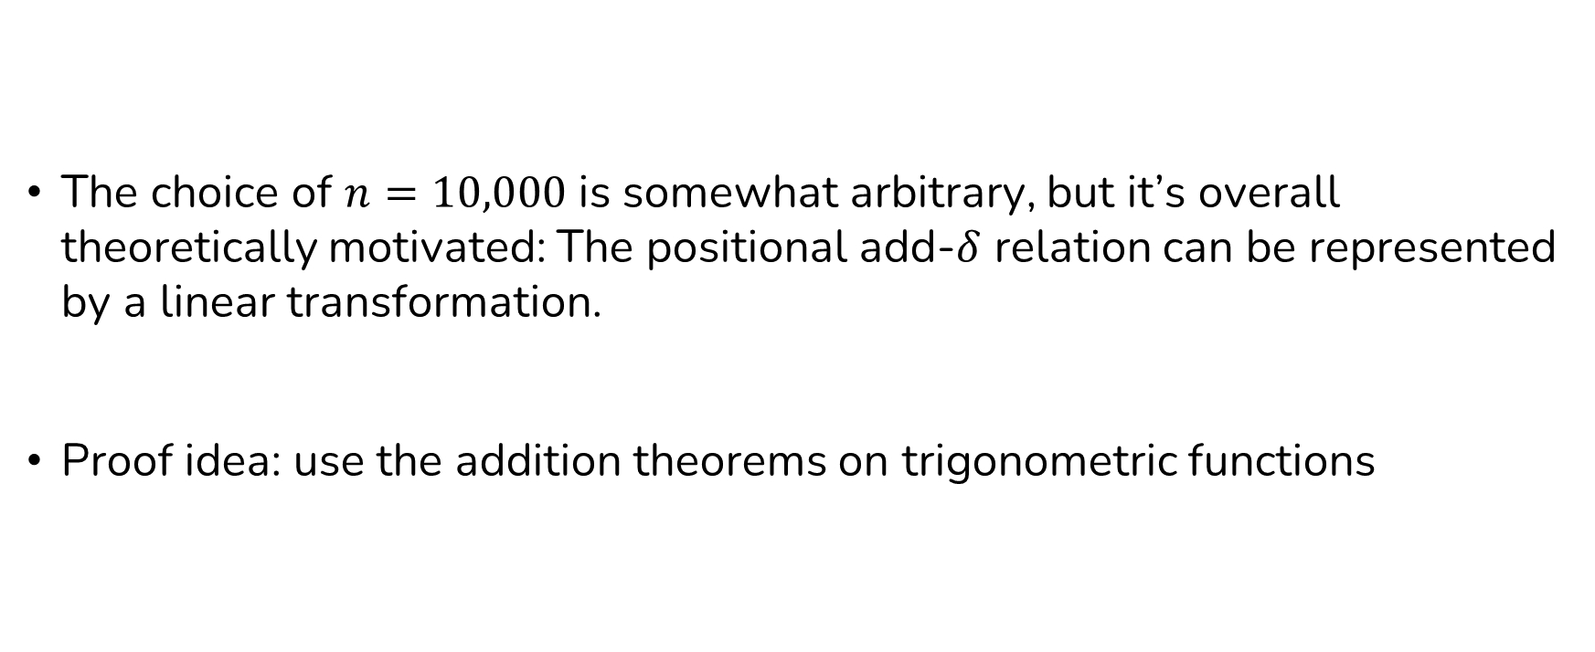
Positional Encoding
The choice of $n=10,000$ is somewhat arbitrary, but it’s overall theoretically motivated: The positional add-$δ$ relation can be represented by a linear transformation.
Proof idea: use the addition theorems on trigonometric functions

Slide 42
Applying Positional Encoding
Limitation: only fixed number of positions available
Another option: learnable positional encoding

Slide 43

Multi-Head Attention
We can parallelize multiple $W_{k},W_{q},W_{v}$ with different random initialization (and hope they learn different ways to attend tokens.

Slide 44
Stacking Transformer Layers

Slide 45
Residual Connection and Normalization
Earlier layers’ output are added to the “vector stream.”
Normalization: preserve variance.

Slide 46
Next
Language Modeling

