Slide 1

CS 489/698: Introduction to Natural Language Processing Lecture 8: Grounded Semantics & Multimodal Language Models
Instructor: Freda Shi
fhs@uwaterloo.ca
February 11th, 2026
Notes:
There are quite some philosophical discussions that are still under development, but my goal of this lecture is to give you an idea and a pointer.
This is a rather advanced topic, so I didn’t list all readings on syllabus, but you can find all pointers via citations on slides.

Slide 2
Outline
Grounded Semantics
The symbol grounding problem and what grounding is
Vision-language models (VLMs)
Visual-semantic embeddings and CLIP
Generative vision-language models
Tasks and limitations of VLMs

Slide 3

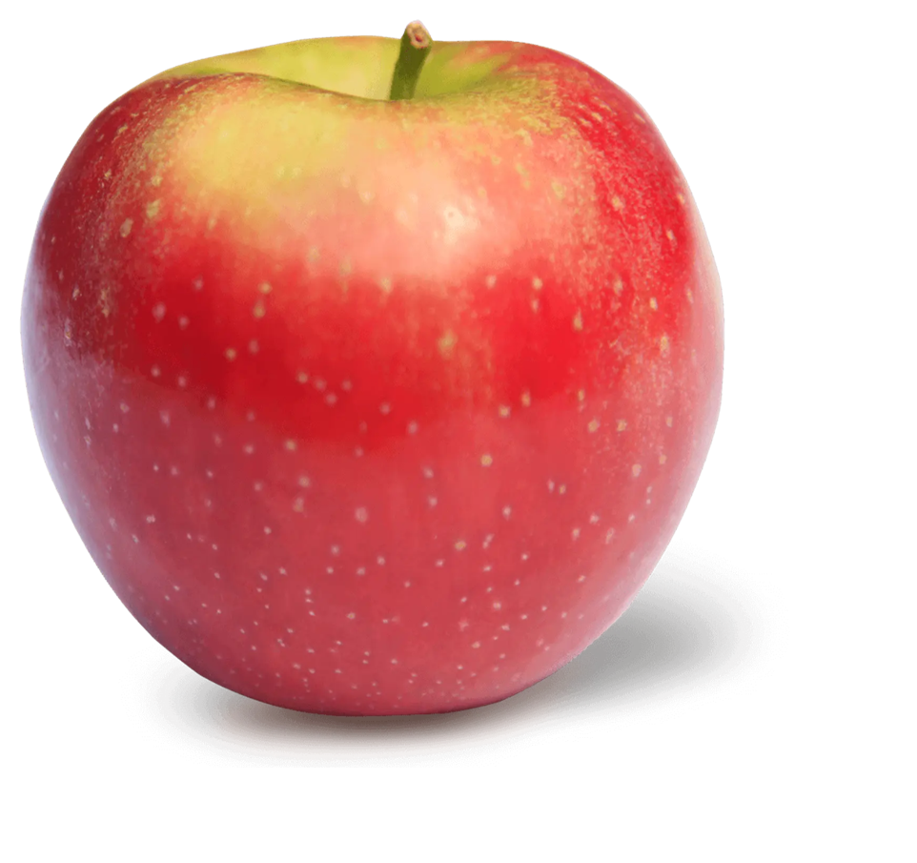

Meaning in the Real World
My favourite fruit is apple.

Slide 4



Experience Grounds Language
Bisk et al. (2020): We posit that the present success of representation learning approaches trained on large, text-only corpora requires the parallel tradition of research on the broader physical and social context of language to address the deeper questions of communication.
[Bisk et al. 2020. Experience Grounds Language. In: EMNLP]

Slide 5
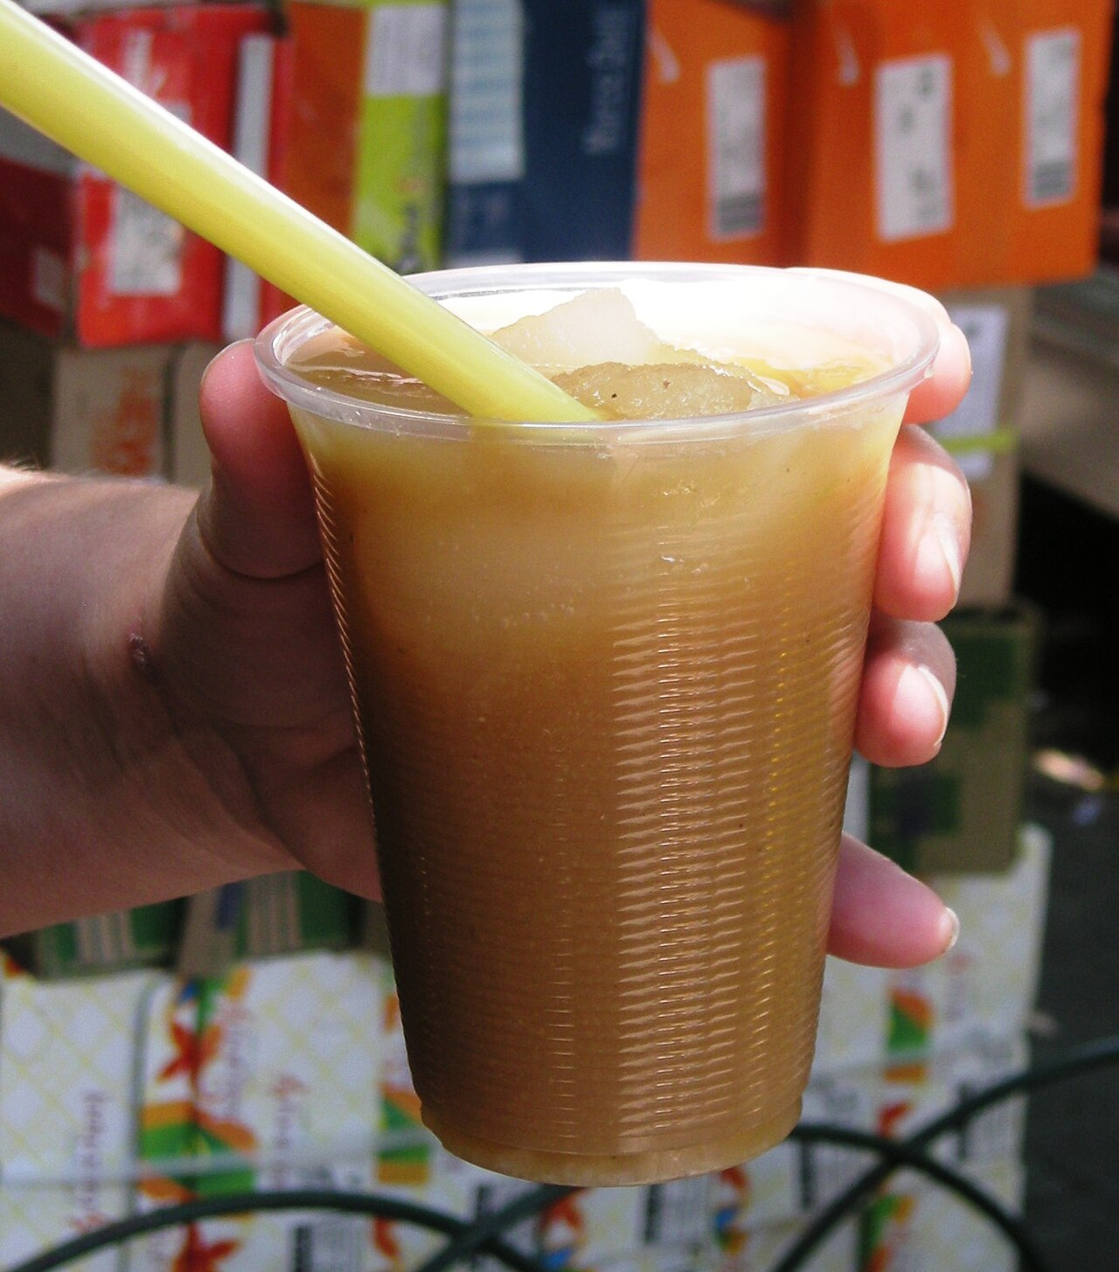
Grounded Semantics
Meanings demonstrated from other sources of data in addition to the language systems.
Distributional Semantics
A bottle of tezgüino is on the table.
Everybody likes tezgüino.
Don’t have tezgüino before you drive.
We make tezgüino out of corn.
Visually Grounded Semantics
tezgüino =
[Figure credit: Alejandro Linares Garcia]

Slide 6
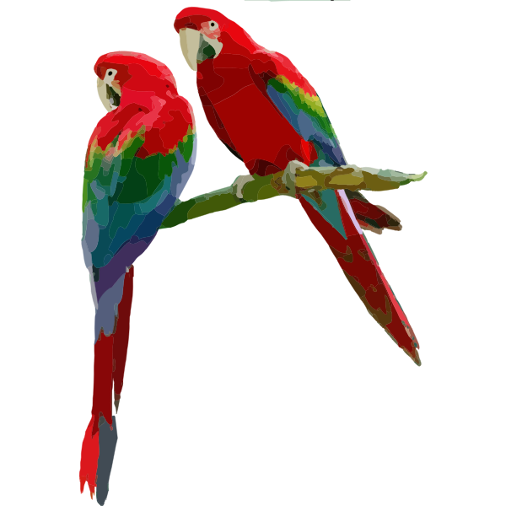

The Symbol Grounding Problem (Harnad, 1990)
Symbol $→$ meaning: how to make sense of symbols?
Practical implication: enable the reliably meaningful interaction between language models and humans/physical world.
Stochastic parrots or semantic comprehension?
Still under debate…
But we all agree -- external source of meaning (e.g., data from another modality) better implies comprehension.
[Bender et al. 2021. On the Dangers of Stochastic Parrots: Can Language Models Be Too Big? In: ACM FAccT; Figure source: https://freesvg.org]

Slide 7
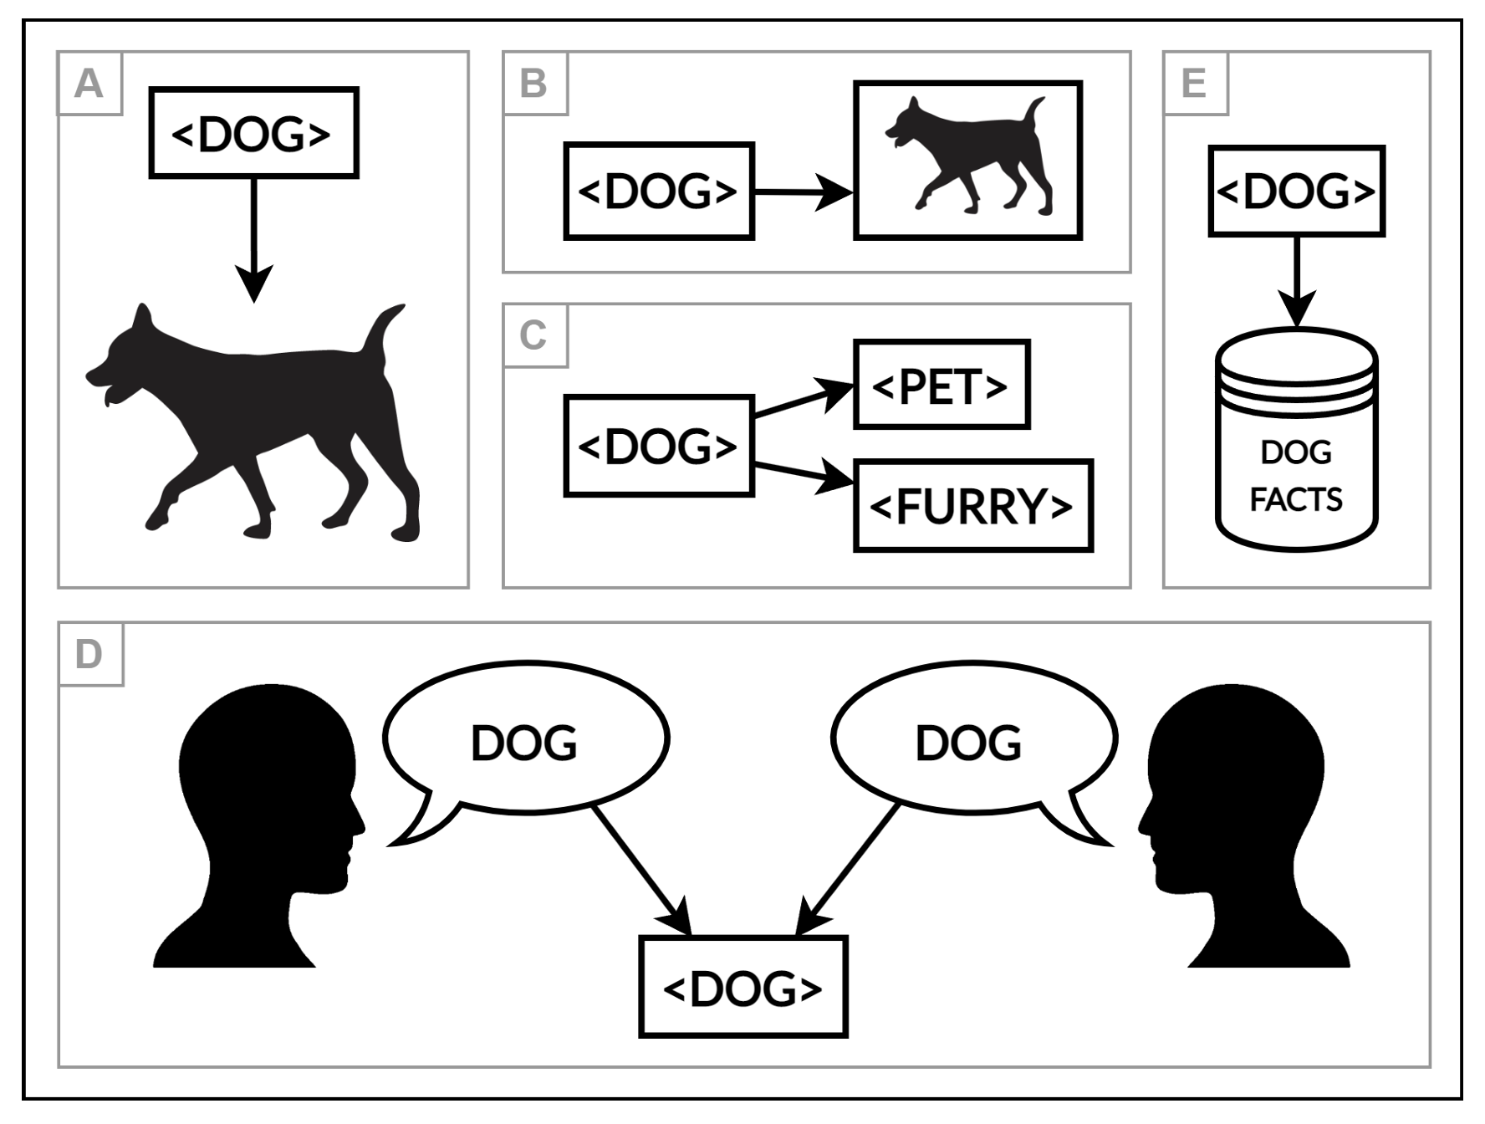
Taxonomy of Grounding
Grounding can be categorized into
A: referential grounding
B: sensorimotor grounding
C: relational grounding
D: communicative grounding
E: epistemic grounding
Chai et al. (2018)
A, B, C, E: semantic (static) grounding
D: communicative (dynamic) grounding
[Mollo and Millière. 2023. The Vector Grounding Problem]
Notes:
Our Goal: incorporate these grounding signals into language models.
Grounding is not necessarily vision, but there is a strong community engagement of using visual signals as source of grounding

Slide 8
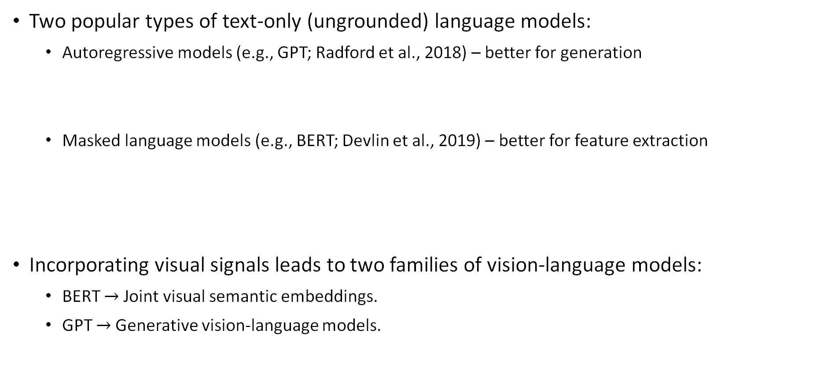
Recap: Text-Only Language Models
Two popular types of text-only (ungrounded) language models:
Autoregressive models (e.g., GPT; Radford et al., 2018) – better for generation
Masked language models (e.g., BERT; Devlin et al., 2019) – better for feature extraction
Incorporating visual signals leads to two families of vision-language models:
BERT $→$Joint visual semantic embeddings.
GPT $→$Generative vision-language models.
Notes:
Our goal is to incorporate visual and more broadly, multimodal signals to these text-only language models

Slide 9
Outline
Grounded Semantics
The symbol grounding problem and what grounding is
Vision-language models (VLMs)
Visual-semantic embeddings and CLIP
Generative vision-language models
Tasks and limitations of VLMs

Slide 10
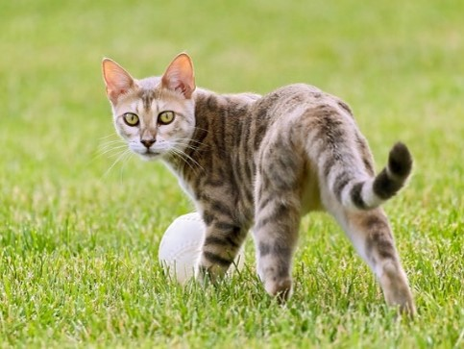
Joint Visual-Semantic Embedding Space
Idea: encode visual and textual information into a shared space.
Embedding: vector space.
Text Encoder
(Neural Network)
There is a cat.
Design a loss function to “align” the two vector spaces.
Image Encoder
(Neural Network)

Slide 11
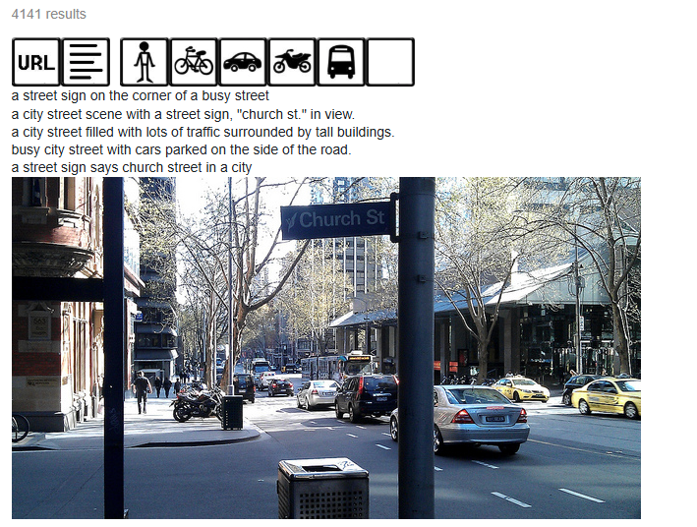
Joint Visual-Semantic Embedding Space: Dataset
Training data: images and their text descriptions.
Example: Microsoft COCO (Lin et al., 2014) collects 80K images of common objects and their captions.

Slide 12
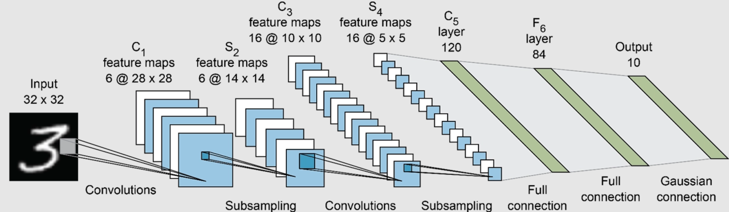
Visual Encoders
Convert an image to a fixed-dimensional vector representation.
Notes:
Vision transformers. CS 484 Computer vision class: 1/3 of that course is about how to build a better model

Slide 13

Joint Visual-Semantic Embedding Space: Objective
Core idea: Matched image-caption pair should be closer than mismatched pairs in the embedding space.
“Triplet-Based Hinge Loss”
There is a cat.
There is an apple.
model parameter
“margin”
enumerate over dataset
[Kiros et al. 2014. Unifying visual-semantic embeddings with multimodal neural language models.]

Slide 14
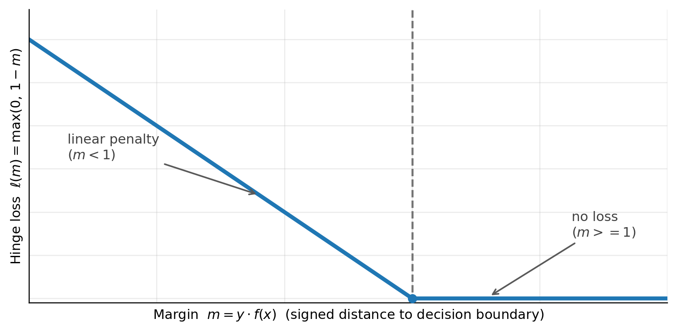

“Hinge” Loss

Slide 15
Properties of the Joint Space
Images and text are close in a good joint embedding space if they are semantically related.
Example applications:
Bidirectional image-caption retrieval, e.g., Google image search.
Image captioning
Text in the training data can be at any level of granularity (words, phrases, sentences, paragraph, documents, etc.).

Slide 16
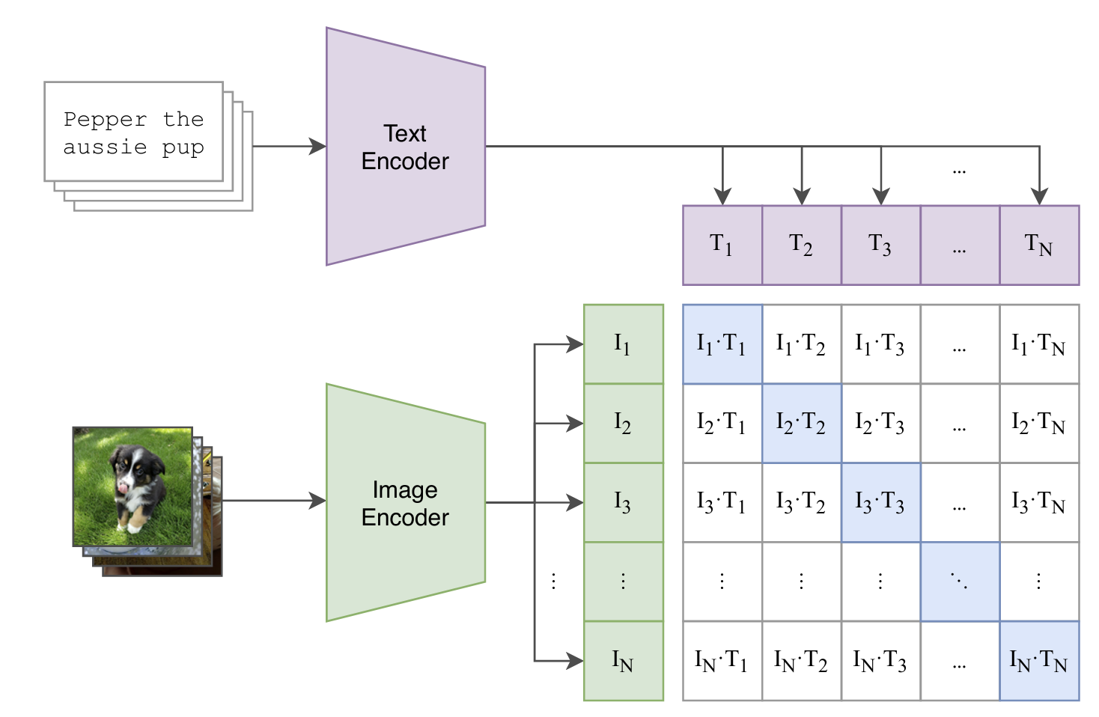
Contrastive Language-Image Pretraining (CLIP)
[Figure: Radford et al. 2021. Learning transferable visual models from natural language supervision]
Notes:
Contrastive Language-Image Pre-training

Slide 17

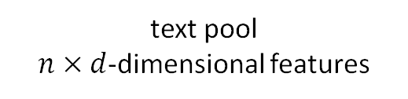
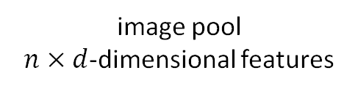
CLIP Objective: “Classifying for the True Label”
Image-to-text retrieval: given a pool of text, model the probability of choosing the correct text; and vice versa.
text pool
$n×d$-dimensional features
image pool
$n×d$-dimensional features
There is a cat. $\left(T_{i}\right)$
Notes:
In practice, this pool is implemented within a minibatch

Slide 18
Outline
Grounded Semantics
The symbol grounding problem and what grounding is
Vision-language models
Visual-semantic embeddings and CLIP
Generative vision-language models
Tasks and limitations of VLMs

Slide 19
Recap: Generative Autoregressive Language Models
Text-only language models: predicting the next token conditioned on the history.
cute/beautiful/naughty/…
The cat is very

Slide 20

Extending to Vision-Language Models (VLMs)
How about representing images as “tokens”?
cute
…
…
…
…
…
…
The cat is very
Visual “Tokens”
Textual Tokens
visual features: a continuous valued tensor
[Liu et al. 2023. Visual instruction tuning. In: NeurIPS.]
Notes:
An engineering-oriented approach

Slide 21
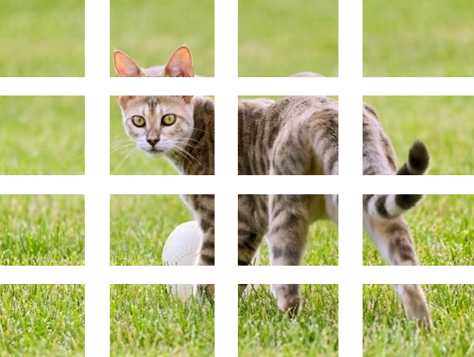
Generative VLM: Training Objective
Loss function only calculated on textual positions.
In practice, each visual token correspond to an image patch.
Visual encoders use patches to improve representation quality.
Training all involved parameters via backpropagation and gradient descent.

Slide 22
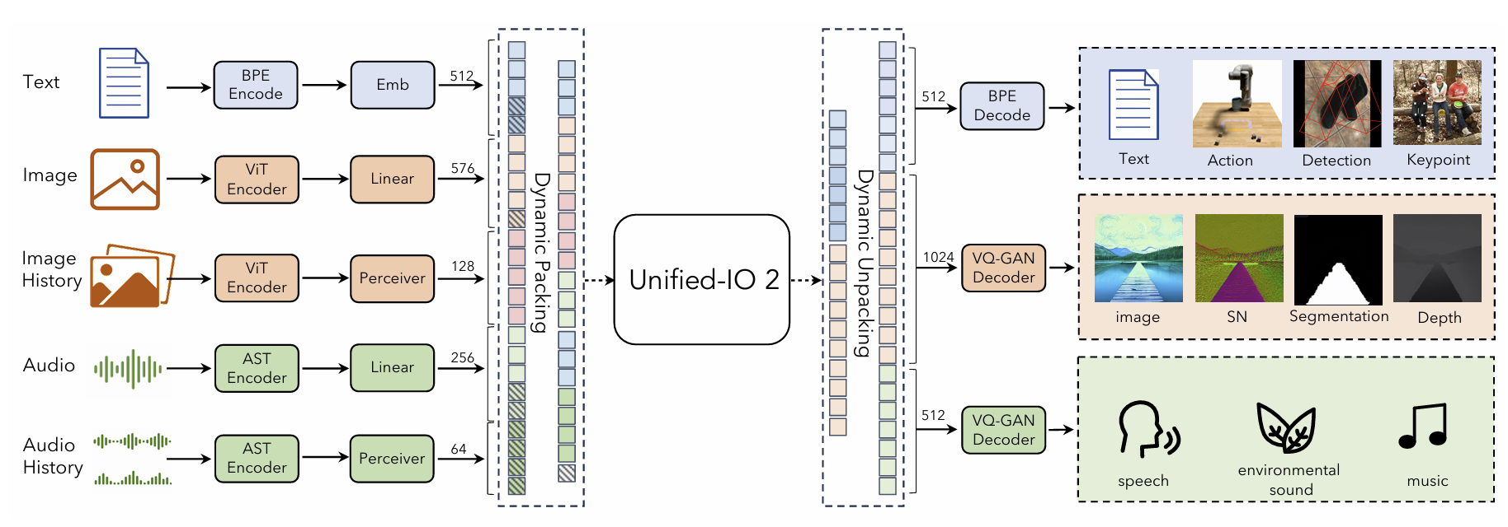
Towards Encoding Everything in the World
[Lu et al. 2024. Unified-IO 2: Scaling autoregressive multimodal models with vision, language audio and action. In: CVPR.]
Notes:
Vision is not the only modality of real world

Slide 23
Outline
Grounded Semantics
The symbol grounding problem and what grounding is
Vision-language models
Visual-semantic embeddings and CLIP
Generative vision-language models
Tasks and limitations of VLMs

Slide 24
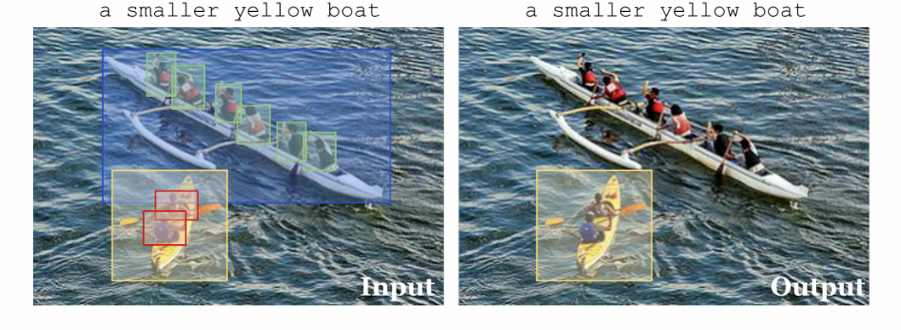
Finer-Grained Vision-Language Tasks
Object retrieval (assuming all objects’ bounding boxes are given).
Cognitive plausibility: recognizing objects are very easy for humans (in fact, 5-month-old infants; Baillargeon et al., 1985).

Slide 25
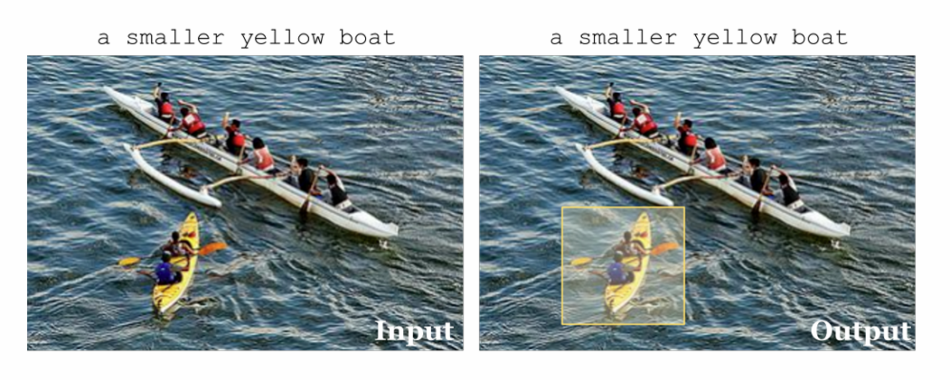
Finer-Grained Vision-Language Tasks
Multimodal coreference resolution (w/o assuming bounding boxes)

Slide 26
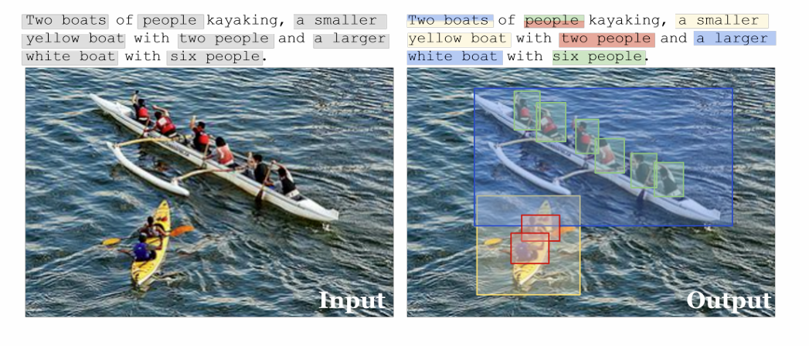
Finer-Grained Vision-Language Tasks
Phrase grounding: mapping phrases to objects in the image.
Dense captioning (reverse): write a short description for each detected object.

Slide 27
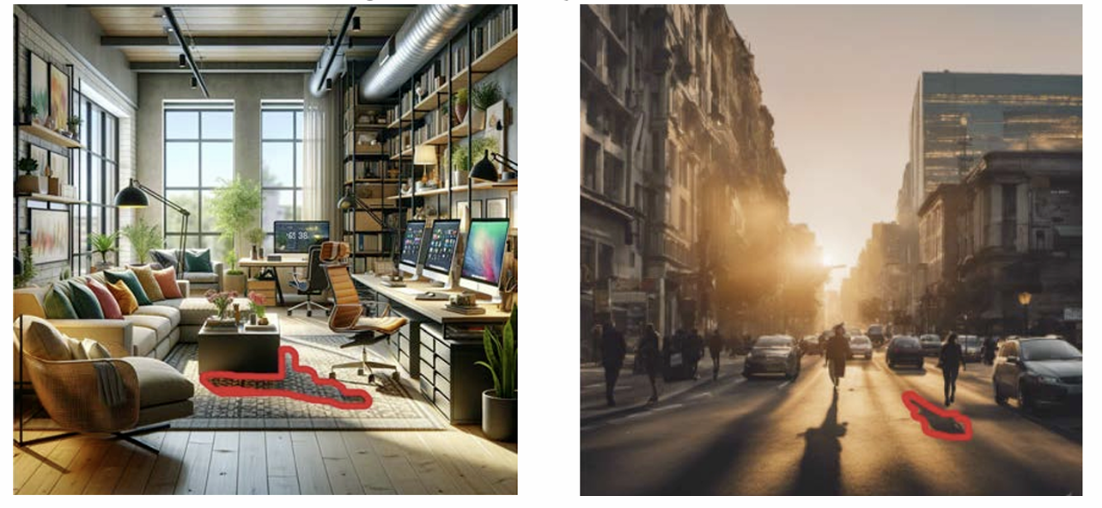
Limitations of Current VLMs
Lack of physical knowledge, and the neural architecture makes it hard to incorporate the knowledge.
[Sarkar et al. 2024. Shadows don’t lie and lines can’t bend! Generative models don’t know projective geometry… for now. In: CVPR.]

Slide 28
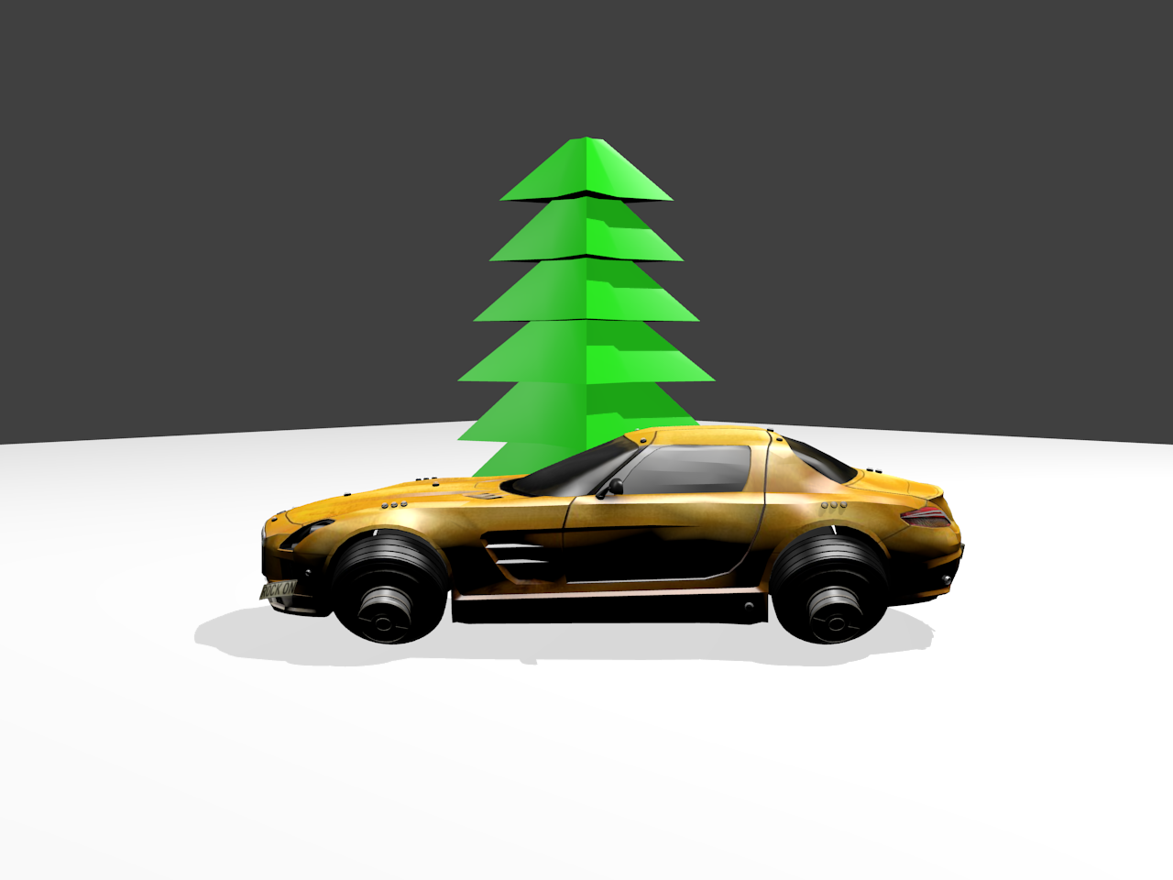
Limitations of Current VLMs
Poor in recognizing spatial relations.
The tree is behind the car.
The tree is to the right of the car.
The tree is in front of the car.
The car is to the left of the tree.
[Zhang et al. 2025. Do vision-language models represent space and how? Evaluating spatial frame of reference under ambiguities. In: ICLR]

Slide 29
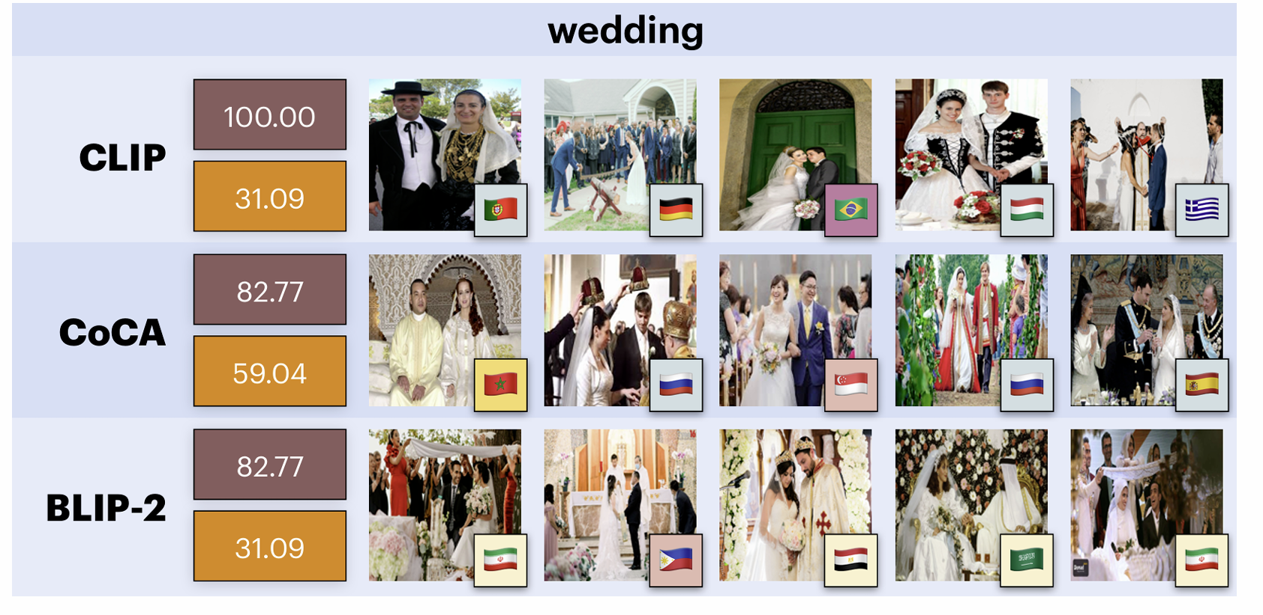
Limitations of Current VLMs
Lack of cultural diversity representation.
[Bhatia et al. 2024. From Local Concepts to Universals: Evaluating the Multicultural Understanding of Vision-Language Models. In: EMNLP]

Slide 30
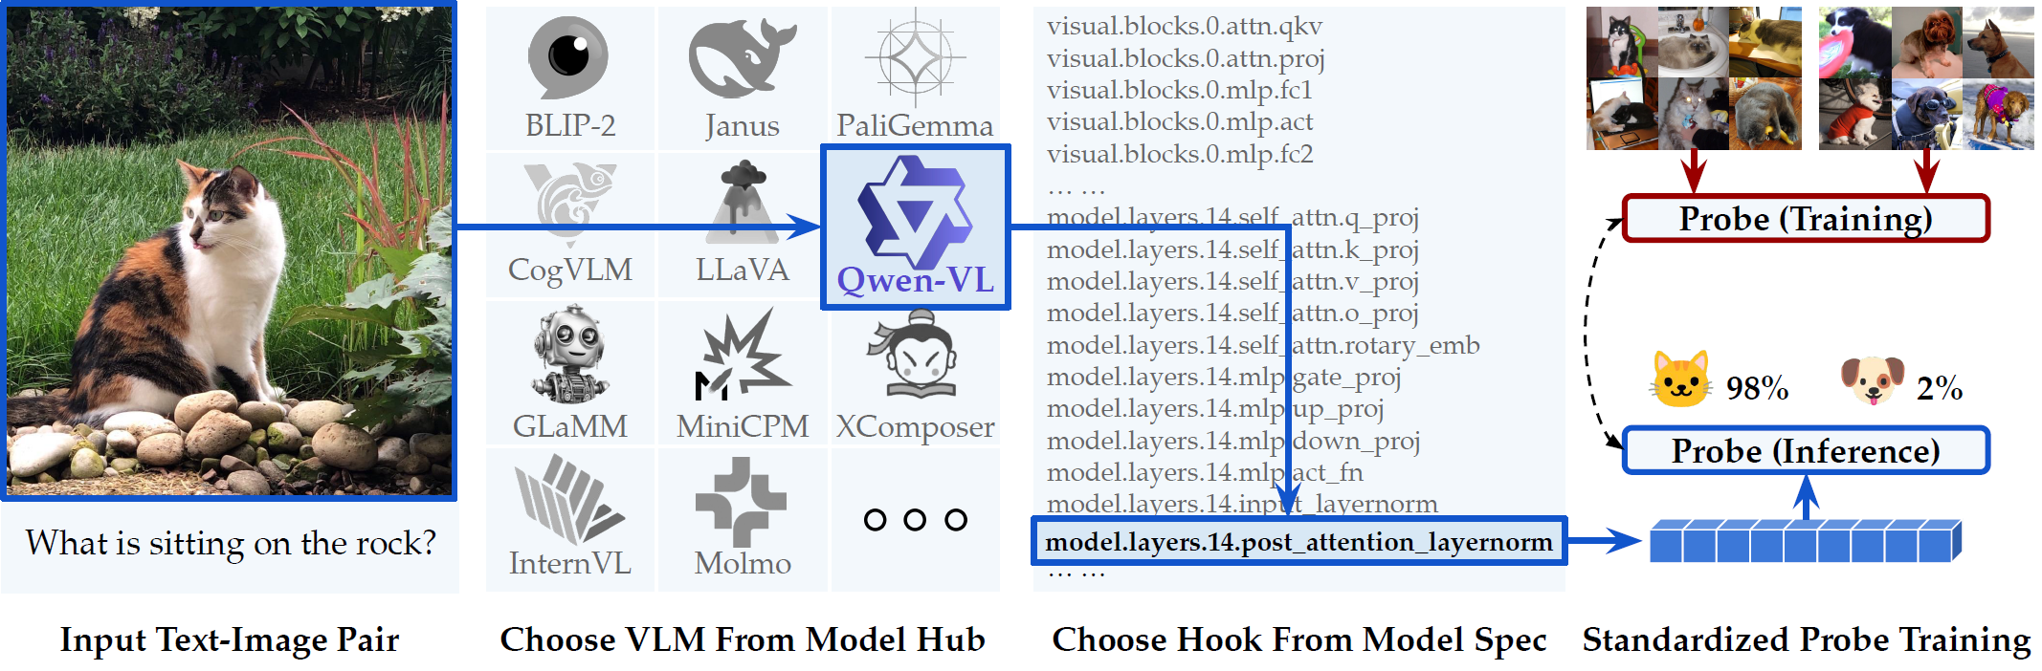
Analyzing Internals of VLMs
https://github.com/compling-wat/vlm-lens
[Sheta et al. 2025. From Behavioral Performance to Internal Competence: Interpreting Vision-Language Models with VLM-Lens. In: EMNLP Systems Demonstraton]

Slide 31
Next
Assignment 2 will be released on Friday
Victor takes over the lectures on pretraining language models

