Slide 1

CS 489/698: Introduction to Natural Language Processing Lecture 7: Syntax
Instructor: Freda Shi
fhs@uwaterloo.ca
February 9th, 2026

Slide 2
Outline
Constituency grammar
Constituency test
Context-free grammars and probabilistic context-free grammars
A pointer to dependency grammar

Slide 3
Phrase Structures/Constituency Grammar
Constituency grammars focus on the constituent relation.
Informally: Sentences have hierarchical structures.
A sentence is made up of two pieces:
Subject, typically a noun phrase (NP)
Predicate, typically a verb phrase (VP)
NPs and VPs are made up of pieces:
a cat = (a + cat)
walked to the park = (walk + (to + (the + school) ) )
Each parenthesized phrase is a constituent in the constituent parse.

Slide 4
What makes a group of words a constituent?
Constituent: a group of words that functions as a single unit.
Linguists (try to) determine constituents via constituency tests.
A constituency test follows some rules to construct a new sentence, focusing on the constituent candidate of interests.
If the constructed sentence looks good (to native speakers), we find some evidence about constituency.
Consider this sentence: Drunks could put off the customers.

Slide 5
Constituency Test: Coordination
Drunks could put off the customers.
Coordinate the candidate constituent with something else.
Drunks could [put off the customers] and sing.
Drunks could put off [the customers] and the neighbors.
Drunks [could] and [would] put off the customers.

Slide 6
Constituency Test: Topicalization
Drunks could put off the customers.
Moving the candidate constituent to the front. Modal adverbs can be added to improve naturalness.
… and [the customers], drunks certainly could put off.
* … and [customers], drunks could certainly put off the.

Slide 7
Constituency Test: Deletion
Drunks could put off the customers.
Delete the span of interest. Word orders can be changed to improve naturalness.
Drunks could put off the customers [in the bar].
* Drunks could put off the customers [in the] bar.

Slide 8
Constituency Test: Substitution
Drunks could put off the customers.
Substitute the candidate constituent with the appropriate proform (pronoun/proverb/etc.). Slight word order adjustment is allowed to improve naturalness.
Drunks could [do so = put off the customers].
Drunks could put [them = the customers] off.
* Drunks could put the [them = customers] off.

Slide 9
Constituency Parsing as Bracketing
Brackets: which spans of words are the constituents in a sentence?
Sentence: the man walked to the park
Bracketing: ((the man) (walked (to (the park))))
The brackets can be translated into trees
the man walked to the park

Slide 10
Labeled Bracketing / Tree
There are categories associated with constituents
(S (NP the man) (VP walked (PP to (NP the park))))
S
VP
Key:
S = sentence
NP = noun phrase
VP = verb phrase
PP = prepositional phrase
NP
PP
NP
the man walked to the park

Slide 11
Labeled Bracketing / Tree
S
VP
NP
nonterminals
PP
NP
DT
NN
VBD IN DT NN
preterminals
the man walked to the park
terminals

Slide 12
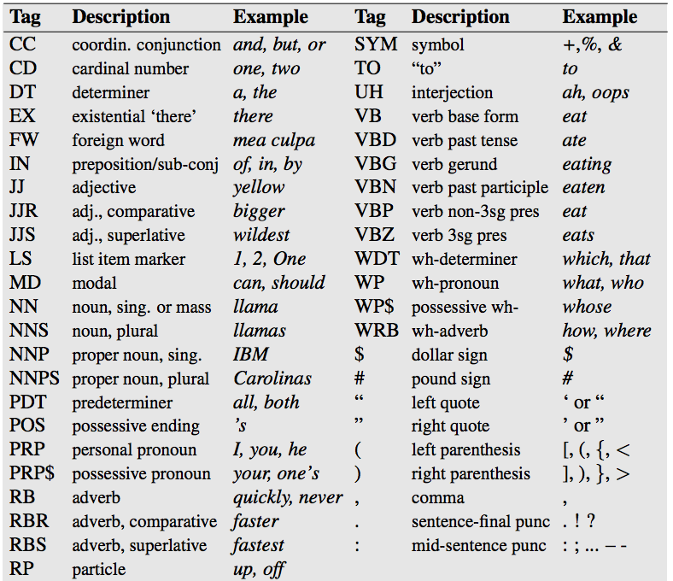
Penn Treebank Tagset (Pre-Terminals)
Marcus et al. (1993): 40K WSJ sentences annotated by linguistic experts.

Slide 13
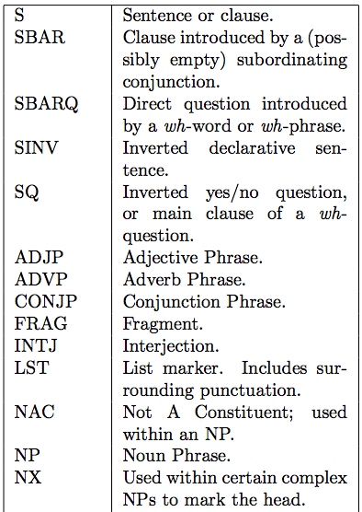
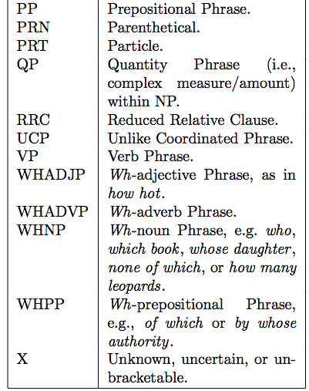
Penn Treebank Non-Terminal Set
Marcus et al. (1993): 40K WSJ sentences annotated by linguistic experts.

Slide 14
Head of a Constituent
Head of a constituent is the most responsible/important word for the constituent label
Which word makes the cat an NP?
Cat
Which word makes walked to the park a VP?
Walked
We’ll see how this connects to dependency grammar on the last slides.

Slide 15
Syntactic Ambiguities
Time flies like an arrow.
Fruit flies like a banana.

Slide 16
NLP Task: Constituency Parsing
Given a sentence, output its constituency parse.
Widely studies task with a rich history.
Most studies are based on the Penn Treebank. (Treebank = corpus of annotated parse trees)

Slide 17
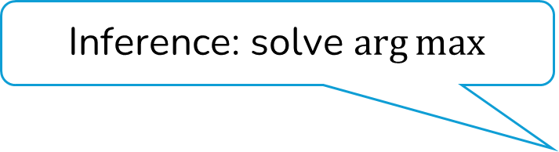
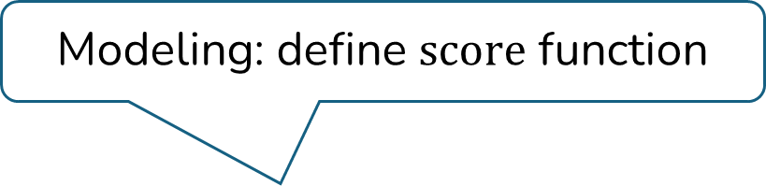
Constituency Parsing within General Formulation
Modeling: define $score$ function
: sentence
: constituent parse tree
Inference: solve $\arg{max}$
Learning: choose parameter

Slide 18

Constituency Parsing: Modeling
Modeling: define $score$ function
The score of a tree is defined by the sum of constituent scores

Slide 19
Constituency Parsing: Modeling and Learning
Each span score can be modeled with a neural network.
Training objective (Kitaev and Klein, 2018): let the collection of the true spans have the highest accumulated span scores among all parses.
How do we calculate this?

Slide 20
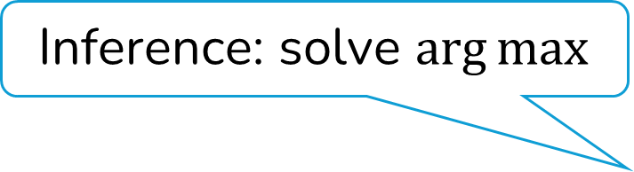
Constituency Parsing: Inference
Inference: solve $\arg{max}$
Let’s first assume is a binary unlabeled parse tree. (We’ll see any tree can be converted into binary without loss of geneality)
Each node is either a terminal node or the parent of two other nodes.
There is one root node.

Slide 21
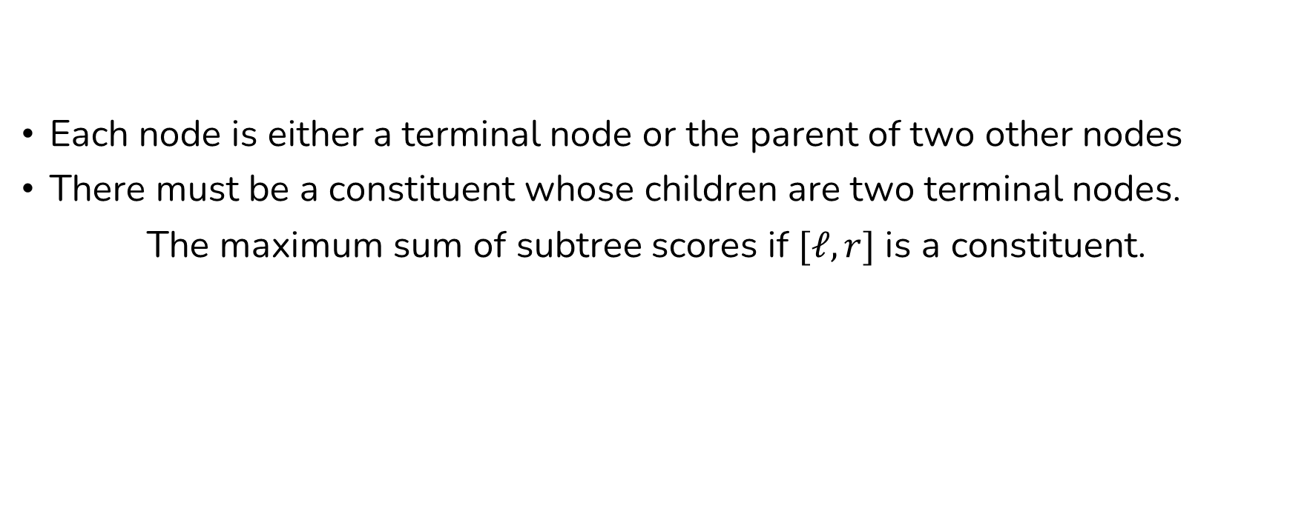
Constituency Parsing: Inference
Each node is either a terminal node or the parent of two other nodes
There must be a constituent whose children are two terminal nodes.
The maximum sum of subtree scores if $[ℓ, r]$ is a constituent.

Slide 22
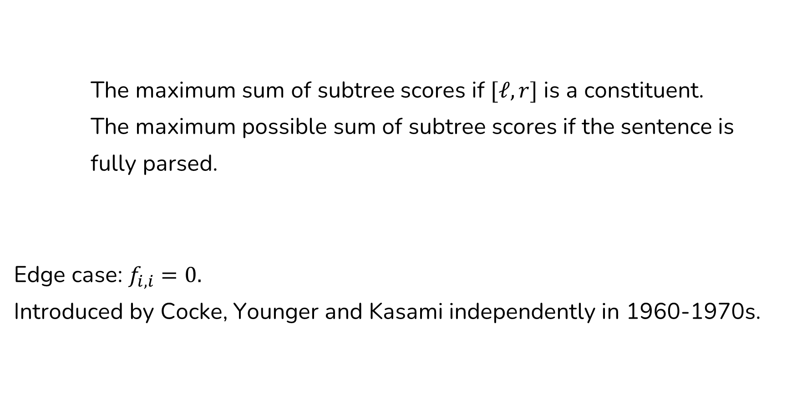
The (Simplified) CKY Algorithm
The maximum sum of subtree scores if $[ℓ, r]$ is a constituent.
The maximum possible sum of subtree scores if the sentence is
fully parsed.
Edge case: $f_{i,i}=0.$
Introduced by Cocke, Younger and Kasami independently in 1960-1970s.

Slide 23
Context-Free Grammar (CFG)
A generative way to describe constituency parsing.
A CFG defines some “rewrite rules” to rewrite nonterminals as other nonterminals or terminals
S → NP VP
“S goes to NP VP”
NP → DT NN
VP → VBD PP
PP → IN NP
NN → man
DT → the

Slide 24
Context-Free Grammar (CFG)
A sequence of rewrites corresponds to a bracketing (induces a hierarchical tree structure).
S
S → NP VP
VP
VP → VBD PP
NP
PP
NP → DT NN
NP
DT
NN
VBD IN DT NN
DT → the
the man walked to the park

Slide 25
Why Context-Free?
A rule to rewrite NP does not depend on the context of that NP.
The left-hand side (LHS) of a rule is only a single non-terminal (without any other context).
S
S → NP VP
VP
VP → VBD PP
NP
PP
NP → DT NN
NP
DT
NN
VBD IN DT NN
DT → the
the man walked to the park

Slide 26
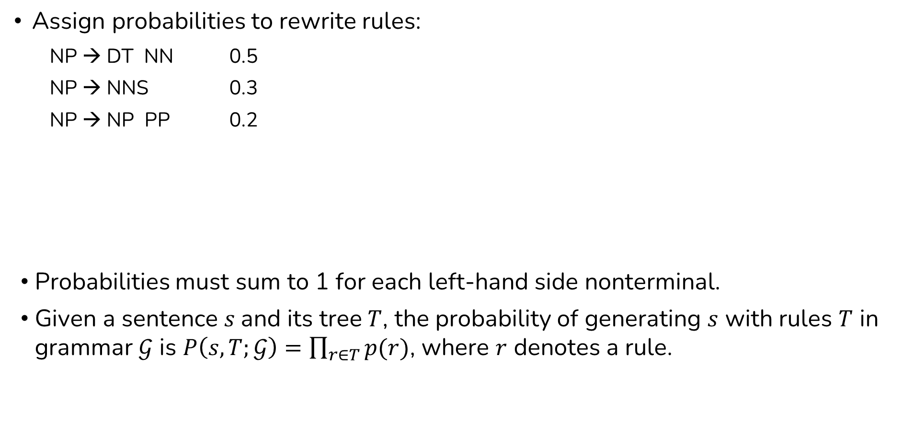
Probabilistic Context-Free Grammar (PCFG)
Assign probabilities to rewrite rules:
NP → DT NN 0.5
NP → NNS 0.3
NP → NP PP 0.2
Probabilities must sum to 1 for each left-hand side nonterminal.
Given a sentence $s$and its tree $T$, the probability of generating $s$ with rules $T$ in grammar $𝒢$ is $P\left(s, T;𝒢\right)=\prod_{r∈T}{p(r)}$, where $r$ denotes a rule.
same nonterminal can be on both left and right sides

Slide 27
PCFG: Learning
Given a treebank, what is the MAP estimation of the PCFG?
A PCFG assigns probabilities to
Sequences of rewrite operations that terminate in terminals---this sequence implies the natural-language “yield”.
Bracketings of sentences.

Slide 28
CKY with PCFG Formalism
Find the max-probability tree for a sentence
rules applied in generating the parse tree

Slide 29

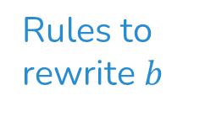
CKY with PCFG Formalism
: the maximum possible log probability that words within range $[ℓ, r]$ are the outcome of a nonterminal label $b$.
Edge case: set the appropriate $f_{i, i, ℓ}=0$ when word $i$ could have label $ℓ$, and otherwise $−∞$.
See SLP: Chapter 18 for a running example.
Rules to rewrite $b$
midpoint for splitting

Slide 30
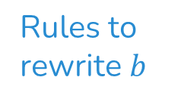
Inside Algorithm
Find the probability for generating a sequence from a certain non-terminal (counting all possible trees).
Rules to rewrite $b$
midpoint for splitting

Slide 31
The Chomsky Normal Form (CNF)
For any free-form PCFG, there exists an equivalent PCFG in which each nonterminal has zero or two nonterminal children, or it directly goes to a terminal.
Trees satisfying the latter conditions are said to be in the Chomsky normal form.
added dummy node
A → B C D 0.5
A → B C 0.5
A → B C-D 0.5
A → B C 0.5
C-D → C D 1.0

Slide 32
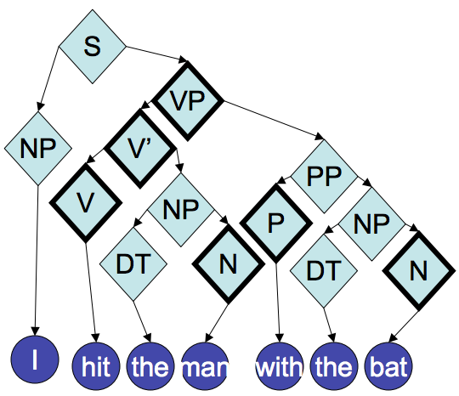
From Constituency to Dependency
heads have bold outline
e.g., VP is head of S -> NP VP
from Noah Smith

Slide 33
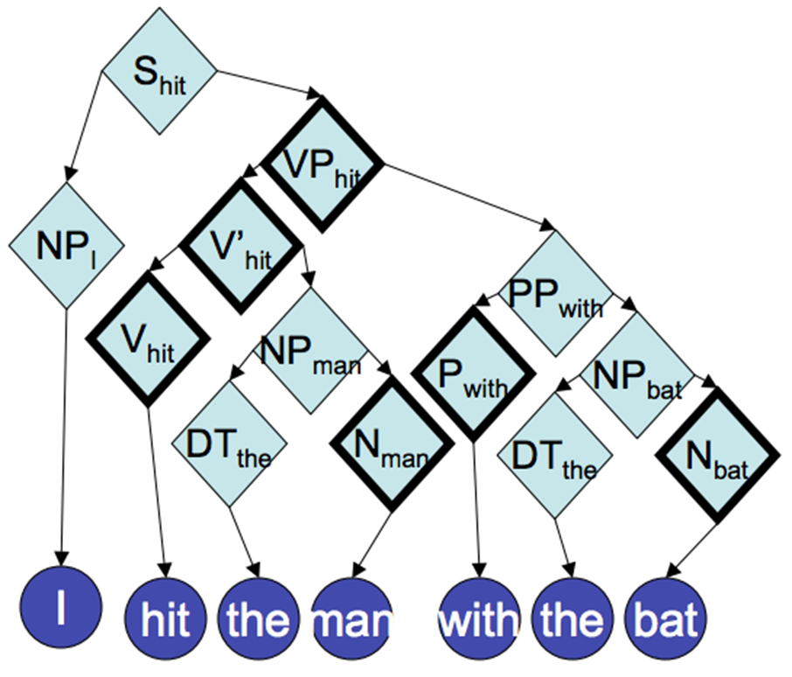
From Constituency to Dependency
Propagate lexical heads up the tree
from Noah Smith

Slide 34
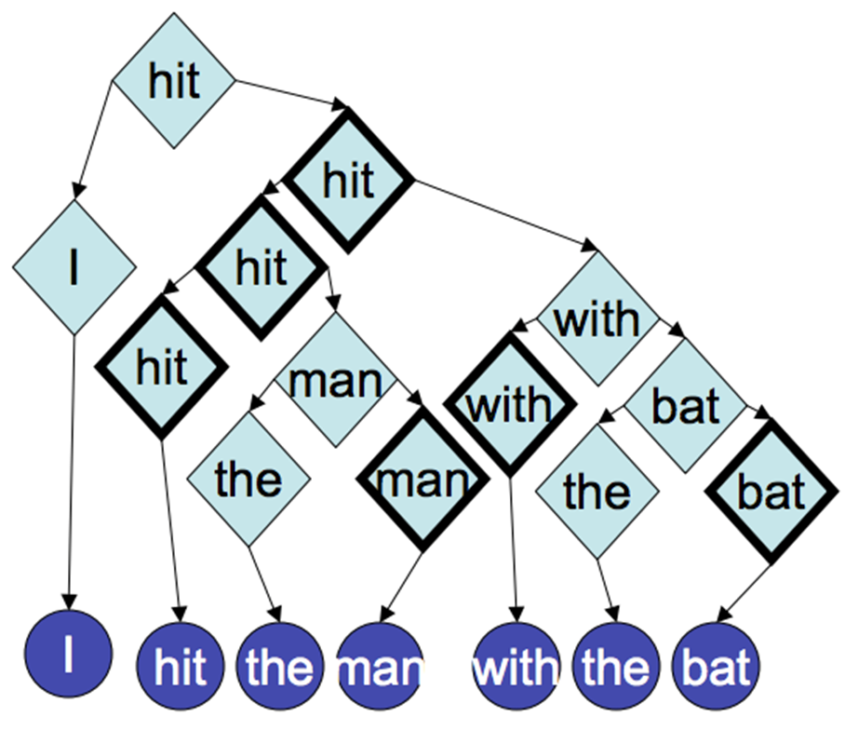
From Constituency to Dependency
Remove nonlexical parts
from Noah Smith

Slide 35
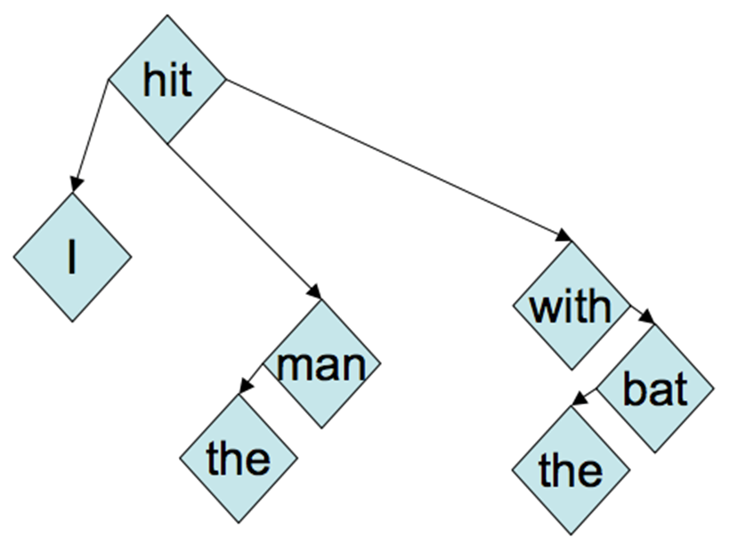
From Constituency to Dependency
Merge redundant nodes
This is the dependency parse tree
from Noah Smith

Slide 36
Dependency Parses
Directly model the relation between words.
See SLP: Chapter 19 for more details.

Slide 37
Next
Multimodal language models

