Slide 1

CS 489/698: Introduction to Natural Language Processing
Lecture 2: Words and Morphology
Instructor: Freda Shi
fhs@uwaterloo.ca
January 7th, 2026

Slide 2
What is a word?
Lexical Semantics
“A single distinct meaningful element of speech or writing, used with others (or sometimes alone) to form a sentence and typically shown with a space on either side when written or printed.”
[Source: Oxford Languages]

Slide 3
What is a word?
Things in dictionaries?
“One of the most prolific areas of change and variation in English is vocabulary; new words are constantly being coined to the name or describe new inventions or innovations, or to better identify aspects of our rapidly changing world... Most general English dictionaries are designed to include only those words that meet certain criteria of usage across wide areas and over extended periods of time...”
[Source: Merriam-Webster; https://www.merriam-webster.com]

Slide 4
What is a word?
Things between spaces and punctuation?
This is English: The cat is cute.
This is French: Le chat est mignon.
This is Spanish: El gato es lindo.
This is Chinese: 猫很可爱。
This is Japanese: 猫はかわいい。
This is Thai: แมวน่ารักจัง.

Slide 5
What is a word?
Smallest unit that can be uttered in isolation?
You could utter this word in isolation: unimpressively.
Also this one: impress.
Probably also these when you talk about morphology: un, ive, ly.
Are they all words?

Slide 6
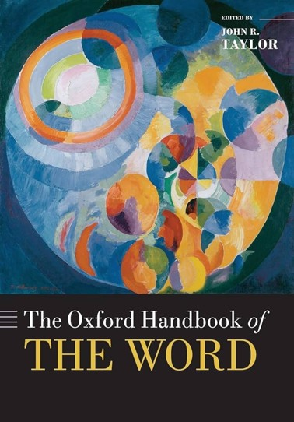
What is a word?
Each of the above points captures some, but very likely not all aspects of what a word is.
42 chapters.
Nearly 900 pages.
Covers a lot of aspects of what makes a word word, “to anyone who shares a fascination with words.”

Slide 7
Outline of Today’s Lecture
Linguistic morphology
  The study of internal structures of words.
Lexical semantics
  The study of meanings of words.
Word tokenization
  The process of splitting texts into “words” (tokens).

Slide 8

cold
re
game
er
play
ed
play
Notes:
Okay. Here are some simple examples of words.
If we are familiar with these words, we can find that many words (word types) have structure, which is often as simple as a concatenation of multiple units that each contribute some syntactic or semantic information, though for some languages the process can be much more complex.
Now let’s talk about that structure, which is called morphology.

Slide 9
cold
re
game
er
play
ed
play
Notes:
Now let’s talk about that structure, which is called morphology.

Slide 10

Morphology
The study of how words are built from smaller meaning-bearing units.
Types of morphemes:
  Stem: a core meaning-bearing unit.
  Affix: a piece that attaches to a stem, adding some function or meaning.
  Prefix: unhappy, predefine
  Suffix: cats, walked
  Infix: (Malay) Gigi (teeth) $→$ Gerigi (tooth blade)
  Circumfix: (German) mach (root of machen; to make) $→$ gemacht (made; past participle)
  Interfix: speedometer
[See more in Chap. 6.2 of Doner. The Linguistic analysis of word and sentences structures]

Slide 11
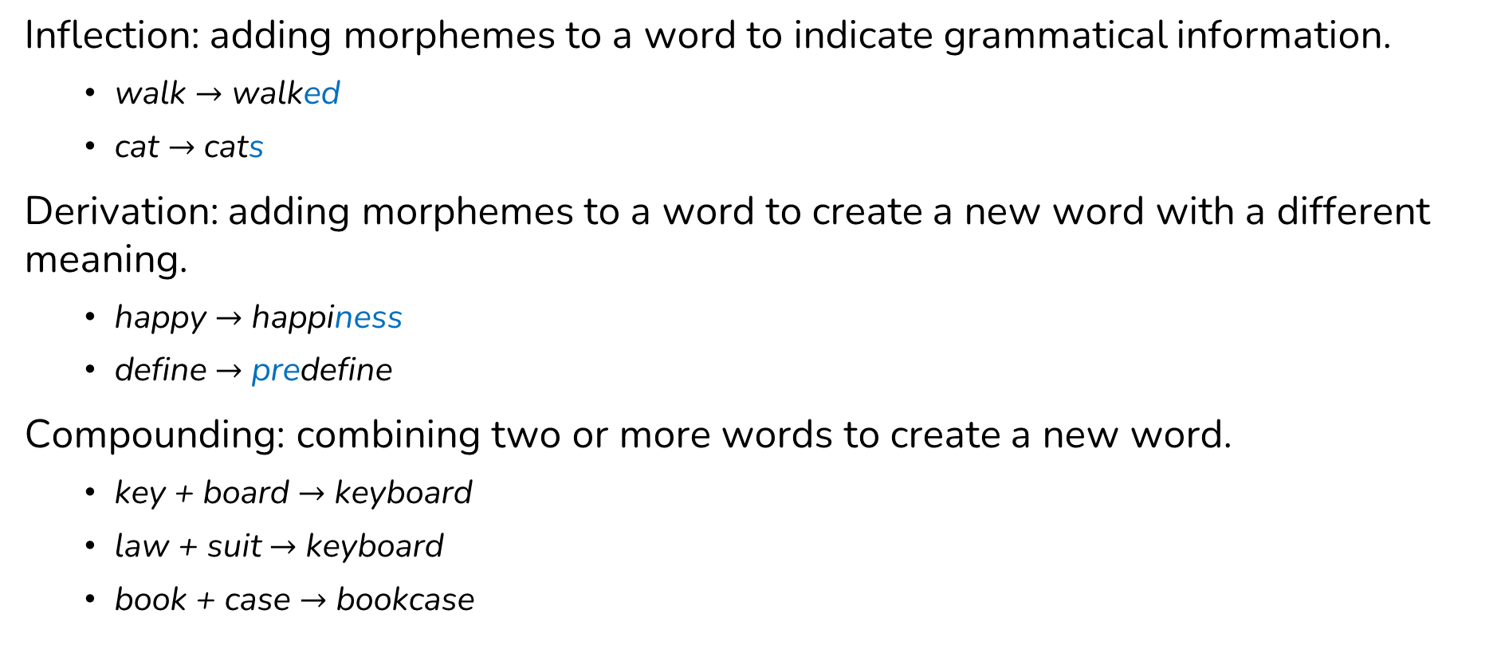
Types of Word Formation
Inflection: adding morphemes to a word to indicate grammatical information.
  walk $→$ walked
  cat $→$ cats
Derivation: adding morphemes to a word to create a new word with a different meaning.
  happy $→$ happiness
  define $→$ predefine
Compounding: combining two or more words to create a new word.
  key + board $→$ keyboard
  law + suit $→$ keyboard
  book + case $→$ bookcase

Slide 12
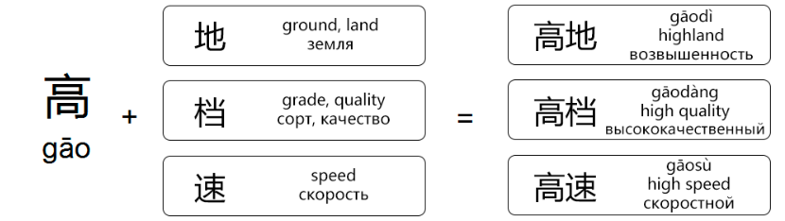
Isolating Language
In languages like Classical Chinese, Vietnamese, and Thai
Each word form typically consists of one single morpheme.
There is little morphology other than compounding.
Inflection
们： 我们， 你们， 他们
mén: wǒmén, nǐmén, tāmén
plural: we, you (pl.), they
Derivation
家: 艺术家
jiā: yì shù jiā, artist
Compound
Notes:
Chinese: up to 80% of Chinese words are compounds

Slide 13
Morphological Decomposition
Usually, morphological decomposition is simply splitting a word into its morphemes:
  walked = walk + ed
  greatness = great + ness
But it can actually be a hierarchical structure:
  unbreakable = un + (break + able)
  internationalization = (((inter + nation) + al) + iz[e]) + tion
There is ambiguity in hierarchical decomposition!
The door is unlockable.

Slide 14
Morphology in NLP
Individual tasks that address morphology:
Lemmatization: putting words/tokens in a standard format.
  Lemma: canonical/dictionary form of a word.
  Wordform: fully inflected or derived form of a word as it appears in text.
wordform | lemma
run | run
ran | run
running | run

Slide 15
Morphology in NLP
Individual tasks that address morphology:
Stemming: reducing words to their stems (approximately) by removing affixes.
More conventional engineering-oriented approach used in applications such as retrieval.
Caillou is an average, imaginative four-year-old boy with a love for forms of transportive machinery such as rocket ships and airplanes.
↓
Caillou is an averag imagin four year old boi with a love for form of transport machineri such as rocket ship and airplan

Slide 16




Lexical Semantics
bass
…
…

Slide 17
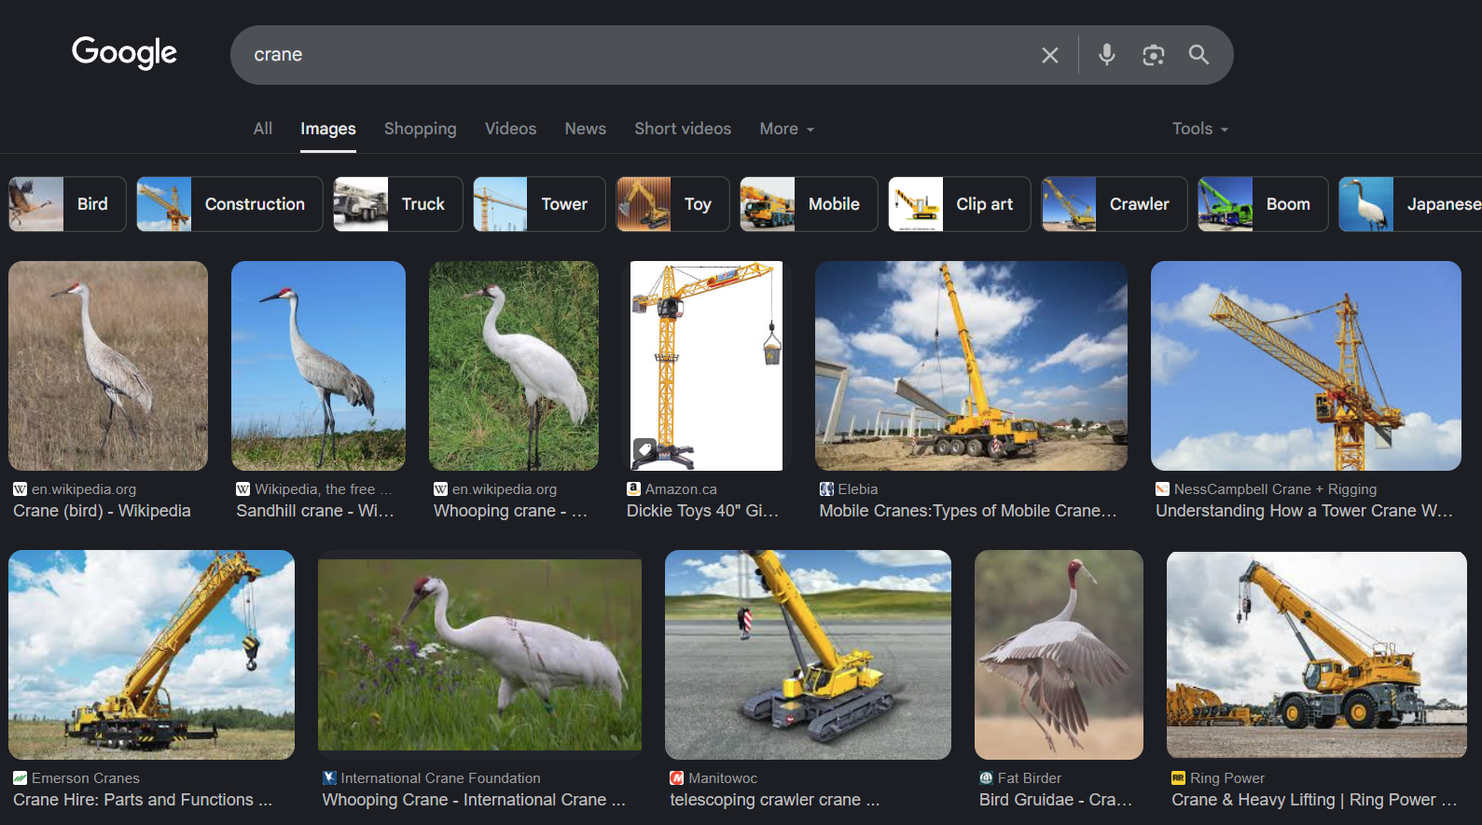
Variability and Ambiguity in Words
Lemmatization and stemming tackles the problem of variability---multiple forms could share the same or similar meanings.
On the other hand, one wordform could refer to multiple meanings.

Slide 18
Polysemy vs. Homonymy
Polysemy: a word has multiple related meanings.
  She is a star.
  (pointing to the sky) The star is shining.
Homonymy: a word has multiple meanings originated from different sources.
  I need to go to the bank as I don’t have enough cash.
  I am sitting on the bank of the river.
Question: which one do you think is the case for crane?
Notes:
Answer: polysemy – the machine looks like the bird.

Slide 19
Synonyms
Synonyms (informal definition): words that have the same meanings according to some criteria.
  couch vs. sofa
  big vs. large
  water vs. H₂O
There are very few (or no) examples of perfect synonymy.
Synonymy is a relation between senses rather than words.
How big is the plane?
How large is the plane?
Miss Nelson became a kind of big sister to Benjamin.
Miss Nelson became a kind of large sister to Benjamin. (*)

Slide 20
Antonyms
Antonyms: senses that are opposite with respect to (at least) one dimensionality of meaning.
dark and light
dark and bright
hot and cold
in and out

Slide 21
Hyponymy/Hypernymy, and Meronym/Holonym
Sense A is a hyponym of sense B if A is more specific, denoting a subclass of B.
Conversely, B is a hypernym of A.
  dog is a hyponym of animal
  corgi is a hyponym of dog
Sense A is a meronym of sense B if A is a part of B.
Conversely, B is a holonym of A.
  hand is a meronym of body
  Finger is a meronym of hand
The WordNet database: https://wordnet.princeton.edu

Slide 22
Word Sense Disambiguation
Word-Sense Disambiguation (WSD): the task of determining which sense of a word is used in a particular context, given a set of predefined possible senses.
Relatedly, word sense induction (WSI) requires clustering word usages into senses without predefined ground truths.
Default solution (as of 2026): encode the context of words with a pretrained model, and train a neural network to predict the sense.
Or… prompting a pretrained language model.

Slide 23
The Role of Word Senses
A practical question: We now have powerful neural language models, which do not distinguish word senses. Is WSD still a meaningful task?
A philosophical question in lexical semantics: Do discrete word senses even “exist”?
[Li. 2024. Semantic minimalism and the continuous nature of polysemy. Mind and Language]

Slide 24
Tokenization
Tokenization: the process that converts running text (i.e., a sequence of characters) into a sequence of tokens.
“Oh!” said Lydia stoutly, “I am not afraid; for though I _am_ the youngest, I’m the tallest.”
tokenizer
“ Oh ! ” said Lydia stoutly , “ I am not afraid ; for though I _ am _ the youngest , I ’m the tallest . ”

Slide 25
Conventions in Rule-Based Tokenizers
It is important to check and ensure consistency when comparing results across different tokenizers.
See nltk.tokenize, which also works for sentence tokenization.
Penn Treebank
Moses
don’t
aren’t
can’t
won’t
do n’t
are n’t
ca n’t
wo n’t
don ’t
aren ’t
can ’t
won ’t
[https://www.nltk.org/api/nltk.tokenize.html]

Slide 26
Tokenization across Languages
There is no explicit whitespace between words in some languages, and tokenization becomes highly nontrivial in these cases.
姚明 进入 总决赛
“YaoMing reaches finals”
姚 明 进入 总 决赛
“Yao Ming reaches overall finals”
Chinese Treebank
Peking University

Slide 27
Word Types vs. Word Tokens
“ oh ! ” said lydia stoutly , “ i am not afraid ; for though i _ am _ the youngest , i ’m the tallest . ”
3 i
2 ,
2 _
2 am
2 the
2 “
2 ”
1 !
1 .
1 ;
1 afraid
1 for
1 lydia
1 not
1 oh
1 said
1 stoutly
1 tallest
1 though
1 youngest
1 ’m

Slide 28
Word Types vs. Word Tokens
3 i
2 ,
2 _
2 am
2 the
2 “
2 ”
1 !
1 .
1 ;
1 afraid
1 for
1 lydia
1 not
1 oh
1 said
1 stoutly
1 tallest
1 though
1 youngest
1 ’m
Type: a unique word (an entry in a vocabulary or dictionary) – 21 types.
Token: an instance of a type in the text – 29 tokens.

Slide 29

Type/Token Ratio
How does the type/token ratio change when adding more data?
type/token ratio
# tokens
Notes:
Words don’t appear out of nowhere ---
corpus (plural corpora): a computer-readable collection of text or speech.

Slide 30

Type/Token Ratio: Wikipedia vs. Twitter
How do the type/token ratio curves compare between Wikipedia and Twitter?
vs.

Slide 31
Type/Token Ratio: Wikipedia vs. Twitter
How do the type/token ratio curves compare between Wikipedia and Twitter?
type/token ratio
# tokens

Slide 32
224571 really
1189 rly
1119 realy
731 rlly
590 reallly
234 realllly
216 reallyy
156 relly
146 reallllly
132 rily
104 reallyyy
89 realllllly
89 reeeally
84 reaaally
82 reaally
72 reeeeally
65 reaaaally
57 reallyyyy
53 rilly
50 reallllllly
48 reeeeeally
41 reeally
38 really2
37 reaaaaally
35 reallyyyyy
31 reely
30 realllyyy
27 reaaly
27 realllyy
26 realllyyyy
25 realllllllly
22 reaaallly
21 really-
19 reeaally
18 reallllyyy
16 reaaaallly
15 reaallly
15 reallllllllly
15 reallllyy
15 reallyreally
15 realyy
14 reallllyyyy
14 reeeeeeally
13 reeeaaally
12 reaaaaaally
12 rreally
11 reaallyy
11 realllllyyy
11 reeeallly
11 reeeeallly
10 reaaaly
10 reallyreallyreally
9 r)eally
9 really-really
9 reallys
9 reeeeeeeally
8 realky
8 reallyyyyyy
8 reallyyyyyyy
8 reeeaally
7 r3ally
7 raelly
7 reaaaaaaally
7 realllllllllllly
7 reallllllyyy
7 reeeeaaally
Notes:
why is this? well i think one reason is because twitter shows an enormous amount of variation in word forms, for example for the word really

Slide 33
7 reeeealy
7 reeeeeeeeeally
7 relaly
6 r-e-a-l-l-y
6 r-really
6 reaaaaaallly
6 realllllllllly
6 realllyyyyy
6 realyl
6 reeeaaaally
6 reeeaaallly
6 reeeaaalllyyy
5 reaaaaallly
5 reaaaalllly
5 reaalllyy
5 reallllllllllllly
5 reallllllllllly
5 reeallyyy
5 reeeeaaallly
5 reeeeaally
5 reeeeeeeeally
5 rellly
5 rrly
5 rrrreally
4 reaaaaly
4 reaaalllly
4 reaaalllyy
4 reaalllly
4 reaalllyyy
4 realllllllyyyy
4 realllllyyyy
4 reeaaaally
4 reeealy
4 reeeeeeeeeeally
4 rllly
3 r34lly
3 r]eally
3 reaaaaaaaally
3 reaaaaaly
3 reaaaallllly
3 reaaaallyy
3 reaaallyy
3 reaallllly
3 reaallyyyy
3 realiy
3 realllllllllllllllly
3 reallllllyy
3 reallllllyyyy
3 reallllllyyyyyyy
3 reallllyyyyy
3 realluy
3 really)
3 reallyl
3 reallyyyyyyyyy
3 reeaaallly
3 reeaalllly
3 reeaalllyyy
3 reeaaly
3 reeallly
3 reealy
3 reeeaaallllyyy
3 reeeaallly
3 reeeeaaaaally
3 reeeealllly
3 reeeeealllly
2 reaaaaaaaaaally

Slide 34
2 reaaaaaaaaally
2 reaaaaaaaallly
2 reaaaaaalllllyyy
2 reaaaaallllly
2 reaaaaalllly
2 reaaalllllyyy
2 reaaallllyyy
2 reaaalllyyy
2 reaallllyy
2 reaallllyyy
2 reaallyyy
2 reaalyy
2 reallllllllllllllllly
2 reallllllllllllllly
2 realllllllyy
2 realllllllyyyyy
2 reallllllyyyyy
2 realllllyy
2 realllllyyyyyy
2 reallllyyyyyy
2 realllyyyyyy
2 really*
2 really/
2 reallyyyyyyyy
2 reallyyyyyyyyyyyy
2 realyyy
2 reaqlly
2 reeaaally
2 reeaallly
2 reeaalllyy
2 reeaallyy
2 reeallyy
2 reeeallyy
2 reeeeaaaalllyyy
2 reeeeaaaally
2 reeeeaaalllly
2 reeeeaaallllyyyy
2 reeeeallllyyy
2 reeeeallyyy
2 reeeeeaaallllly
2 reeeeeaaally
2 reeeeeaally
2 reeeeeallly
2 reeeeeealy
2 reeely
2 rellys
2 rellyy
2 reqally
2 rlyyy
2 rlyyyy
2 rreeaallyy
2 rrreally
1 r-r-r-really
1 r3aly
1 r3ly
1 raaahhhlllaaayyyy
1 raeally
1 re-e-e-eally
1 re-eaaaaaaaly
1 re-he-he-he-ealy
1 re-he-he-heeeeally
1 re3ally
1 rea(l)ly
1 reaaaaaaaaaaaaaaaaaaally
1 reaaaaaaaaaaaaaaaally
1 reaaaaaaaaaaaaaaallllly

Slide 35
1 reaaaaaaaaaaaaaally
1 reaaaaaaaaaaaally
1 reaaaaaaaaaaallllly
1 reaaaaaaaaaaalllly
1 reaaaaaaaaaaally
1 reaaaaaaaaaalllllllyyyyyyyyy
1 reaaaaaaaaallly
1 reaaaaaaaallllllyyyyy
1 reaaaaaaaalllly
1 reaaaaaaaallllyyyy
1 reaaaaaalllly
1 reaaaaaalllyyyy
1 reaaaaalllllllyyyy
1 reaaaaalllllyyy
1 reaaaaalllllyyyy
1 reaaaaalllllyyyyy
1 reaaaaalllllyyyyyyy
1 reaaaaallllyy
1 reaaaaallllyyyyy
1 reaaaaallyy
1 reaaaalllllly
1 reaaaallllllyy
1 reaaaalllllyyy
1 reaaaalllllyyyyy
1 reaaaallllyyy
1 reaaaallllyyyyy
1 reaaaalllyy
1 reaaaalllyyy
1 reaaaalllyyyy
1 reaaaallyyy
1 reaaallllllly
1 reaaalllllllyyy
1 reaaallllly
1 reaaalllllyyyy
1 reaaalllllyyyyy
1 reaaalllyyyyy
1 reaaallyyy
1 reaaallyyyy
1 reaalllllly
1 reaalllllyyyy
1 reaallllyyyy
1 reaalllyyyy
1 reaalllyyyyy
1 reaalllyyyyyy
1 real(ly
1 realaaay
1 realkly
1 reall(y
1 reallhy
1 reallllllllllllllllllllllllllllllllll
lllllllllllllllllllllllllllllllllly
1 reallllllllllllllllllllllllllllllllll
llllllllllllllllllllly
1 reallllllllllllllllllllllllllllllllll
llllllllllly
1 reallllllllllllllllllllllllllllllllly
1 realllllllllllllllllllllllllllly
1 reallllllllllllllllllllllllllly
1 reallllllllllllllllllllllyyyyy
1 reallllllllllllllllllllly
1 reallllllllllllllllllly
1 reallllllllllllyyyyyy
1 reallllllllllyyyyy
1 realllllllllyyy
1 realllllllllyyyy
1 realllllllllyyyyy
1 realllllllllyyyyyy
1 reallllllllyyyy
1 reallllllllyyyyyyy
1 reallllllllyz
1 realllllyly
1 realllllyyyyy
1 reallllyyyyyyy
1 reallllyyyyyyyyy
1 realllylyyy
1 realllyyyyyyy
1 realllyyyyyyyyy
1 really(really
1 really//
1 really/really/really
1 really100
1 really2x
1 really:')
1 really^^
1 really_
1 reallyii
1 reallyreallyreallyreallyreallyr33lly
1 reallyreallyreallyreallyreallyreally
reallyreallyreallyreallyreallyreally
reallyreallyreallyreallyreally

Slide 36
1 reallyyyyyyyyyyy
1 really😒
1 realoly
1 realys
1 realyyyyy
1 real•ly
1 reawly
1 ree-hee-heally
1 reeaaaaaaaaaaaaaaaaalllllllllyyy
1 reeaaaaaaaalllllllly
1 reeaaaaalllllly
1 reeaaaallly
1 reeaaalllly
1 reeaaallllyyy
1 reeaaallyyy
1 reeaaaly
1 reeaalllllyyy
1 reeaallllyyy
1 reeaallyyy
1 reealllly
1 reealllyyy
1 reealllyyyyy
1 reeeaaaaaaaly
1 reeeaaaaally
1 reeeaaaallllly
1 reeeaaaallllyyy
1 reeeaaaallllyyyy
1 reeeaaaallly
1 reeeaaaalllyyy
1 reeeaaaaly
1 reeeaaalllllyyyy
1 reeeaaallllyyyy
1 reeeaaallyy
1 reeeaaallyyy
1 reeeaaaly
1 reeeaalllly
1 reeeaallyy
1 reeeaallyyy
1 reeeallllly
1 reeealllly
1 reeeallllyy
1 reeeallllyyy
1 reeeallllyyyy
1 reeealllyyy
1 reeealllyyyy
1 reeeallys
1 reeeeaaaaaaallllllyyyyyyy
1 reeeeaaaaaallllllyyyyy
1 reeeeaaaaallllllly
1 reeeeaaaaalllly
1 reeeeaaaaallly
1 reeeeaaaaalllyyy
1 reeeeaaaalllly
1 reeeeaaaallllyyyyyy
1 reeeeaaallllyy
1 reeeeaaalllyy
1 reeeeaaallyyy
1 reeeeaaaly
1 reeeeaallly
1 reeeeaalllyy
1 reeeeaaly
1 reeeeallllly
1 reeeeallllyy
1 reeeealllyy
1 reeeealllyyy
1 reeeealllyyyy
1 reeeeeaaaaallllllly
1 reeeeeaaaaally
1 reeeeeaaalllly
1 reeeeeaaallllyyy
1 reeeeeaaallly
1 reeeeeallllyyy
1 reeeeealy
1 reeeeeeaaaaaally
1 reeeeeeaaaaalllllyyyy
1 reeeeeeaaaaally
1 reeeeeeaaaalllly
1 reeeeeeaally
1 reeeeeeaaly
1 reeeeeeallllly
1 reeeeeealllyyyy
1 reeeeeeeaaaallly
1 reeeeeeeaally
1 reeeeeeeallyy
1 reeeeeeealy
1 reeeeeeeeaaaaaaaalllllyyyyyy
1 reeeeeeeeeaaaaaaaaalllllllllyyyyyyyy
1 reeeeeeeeeaaaaaaallllllllyyyyyyyy
1 reeeeeeeeeaaaaaalllyyy
1 reeeeeeeeeaaally
1 reeeeeeeeeaally
1 reeeeeeeeeallllly
1 reeeeeeeeeeaaally

Slide 37
1 reeeeeeeeeeaally
1 reeeeeeeeeeeally
1 reeeeeeeeeeeeally
1 reeeeeeeeeeeeeaaally
1 reeeeeeeeeeeeeeeaaaallly
1 reeeeeeeeeeeeeeeeally
1 reeeeeeeeeeeeeeeeeeeeeesalllllllllllllllllllllllllly
1 reeeeeeelly
1 reeeeeely
1 reeeeelly
1 reeeeely
1 reeeelllllyyy
1 reeellllyy
1 reellly
1 reelllyy
1 reheheally
1 relally
1 rellllllly
1 relllly
1 rellyrell
1 rellzy
1 rieeely
1 rlllllly
1 rllllllyy
1 rlllly
1 rllyrlly
1 rllyy
1 rllyyy
1 rlyrlyrly
1 rlyy
1 rraarreellyy
1 rreaalllyyy
1 rreaally
1 rreeaaallllyyyy
1 rreeaallllyy
1 rreeaallyyy
1 rreealy
1 rreeeaaaaallllyyyy
1 rreeeaaallllyyy
1 rreeeeeeaaaaallllllllyyyyyy
1 rreeeeeeallly
1 rreeeeeely
1 rrreallyyy
1 rrreeeaaalllyyy
1 rrreeealllyyy
1 rrreeeeaalllllyy
1 rrreeeeallly
1 rrrlyyy
1 rrrreeeally
1 rrrreeeeeeaaaaallllllllyyyyyy
1 rrrrreeeeaaalllly
1 rrrrreeeeaaalllyy
1 rrrrrreally
1 rrrrrrealy
1 rrrrrrreeeeeeaaaalllllyyyyyyy
1 rrrrrrrrrreally
1 rrrrrrrrrrrrrrrreeeeeeeeeeeaaaaaaalllllllyyyyyy

Slide 38
How are words distributed?
224571 really
1189 rly
1119 realy
731 rlly
590 reallly
234 realllly
216 reallyy
156 relly
146 reallllly
132 rily
104 reallyyy
89 realllllly
89 reeeally
84 reaaally
82 reaally
72 reeeeally
65 reaaaally
…
1 rreeeeeeaaaaallllllllyyyyyy
1 rreeeeeeallly
1 rreeeeeely
1 rrreallyyy
1 rrreeeaaalllyyy
1 rrreeealllyyy
1 rrreeeeaalllllyy
1 rrreeeeallly
1 rrrlyyy
1 rrrreeeally
1 rrrreeeeeeaaaaallllllllyyyyyy
1 rrrrreeeeaaalllly
1 rrrrreeeeaaalllyy
1 rrrrrreally
1 rrrrrrealy
1 rrrrrrreeeeeeaaaalllllyyyyyyy
1 rrrrrrrrrreally
1 rrrrrrrrrrrrrrrreeeeeeeeeeeaaaaaaalllllllyyyyyy

Slide 39
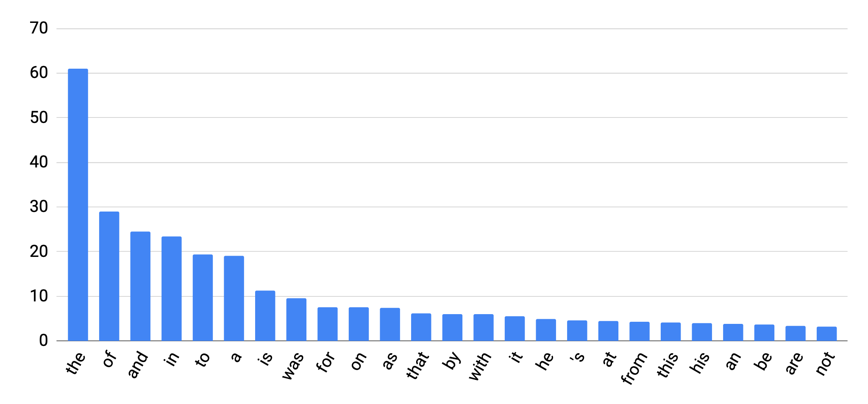
Zipf’s Law
Frequency of a word is (roughly) inversely proportional to its rank in the word frequency list.
count (in millions)
“long tail”
rank 1
rank 5
rank 10
…

Slide 40
Tokenization in Modern NLP Systems
There are so many word types, but the words have shared internal structures and meanings (recall what we’ve talked about in morphology).
Modern NLP systems always convert tokens into numerical indices for further processing. Can we do better than assigning each word a unique index?
Raw text input
tokenizer
…
NLP model
…
detokenizer
Raw text output

Slide 41
Data-Driven Subword-Based Tokenizers
Data-driven tokenizers offer an option that learns the tokenization rules from data, tokenizing texts into subword units (a.k.a, wordpieces) using statistics of character sequences in the dataset.
Two most popular methods:
Byte Pair Encoding (BPE): Gage (1994), Sennrich et al. (2016).
SentencePiece: Kudo (2018).
[Gage, P. (1994). A new algorithm for data compression. The C Users Journal, 12(2), 23-38.]
[Sennrich, R., Haddow, B., & Birch, A. (2016). Neural machine translation of rare words with subword units. In Proceedings of ACL (pp. 1715-1725).]
[Kudo, T. (2018). Subword Regularization: Improving Neural Network Translation Models with Multiple Subword Candidates. In Proceedings of ACL (pp. 66-75).]

Slide 42
Byte Pair Encoding
Originally introduced by Gage (1994) for data compression, and later adapted (and revived) by Sennrich et al. (2016) for NLP.
Key idea: merge symbols with a greedy algorithm.
Initialize the vocabulary with the set of characters, and iteratively merge the most frequent pair of symbols to extend the vocabulary.
Training Corpus
c a t
c a t s
c o n c a t e n a t i o n
c a t e g o r i z a t i o n

Slide 43
Byte Pair Encoding
Training Corpus
c a t
c a t s
c o n c a t e n a t i o n
c a t e g o r i z a t i o n
Initial Vocabulary
a c e g i n o r s t z
Count Symbol-Pair Frequencies
<a t>: 6, <c a>: 4, <o n>: 3, …
Update Vocabulary
a c e g i n o r s t z at

Slide 44
Byte Pair Encoding
Training Corpus
c a t
c a t s
c o n c a t e n a t i o n
c a t e g o r i z a t i o n
Current Vocabulary
a c e g i n o r s t z at
Count Symbol-Pair Frequencies
<c at>: 4, <o n>: 3, …
Update Vocabulary
a c e g i n o r s t z at cat
Repeat this process until the vocabulary reaches the desired size.

Slide 45
Byte Pair Encoding
The BPE proposal is not optimal in terms of compression rate under the same vocabulary size.
Terminate Vocabulary
a c e g i n o r s t z at cat
Training Corpus
c a t
c a t s
c o n c a t e n a t i o n
c a t e g o r i z a t i o n
A Better Vocabulary
a c e g i n o r s t z cat on
Notes:
However, due to simplicity, it’s widely adapted.
Open problem: no optimal compression rate proved.

Slide 46

Apply Trained BPE to New Corpus
In addition to having the tokens, we will also need to know the “merge rules.”
Starting from individual characters, and merge following the rules.
If there is unknown character, add a new term (unlikely in real practice).
Terminate Vocabulary
a c e g i n o r s t z at cat
Merge Rules
a t $→$ at
c at $→$ cat
Word to be tokenized
c a t e g o r y
Result
cat e g o r y

Slide 47
SentencePiece Tokenization
Kudo (2018): find the vocabulary for a unigram language model that maximizes the likelihood of the training corpus.
The Google command-line toolkit that implements this algorithm and some others (including BPE): https://github.com/google/sentencepiece

Slide 48
Byte-Level BPE
A practical question: How do large language models tokenize texts from different languages, with a unified tokenizer and fixed vocabulary size?
That’s great 👍
54 68 61 74 2019 73 20 67 72 65 61 74 20 1F44D
All in hexadecimal!
Prepend zeros to fix the length of tokens (to ensure the unique decoding), and do BPE on the bit/multi-bit level.

Slide 49
Next
Word Embeddings

