Slide 1

CS 489/698: Introduction to Natural Language Processing Lecture 6.1: Language Modeling I
Instructor: Freda Shi
fhs@uwaterloo.ca
January 26th , 2026

Slide 2
Announcements
Assignment 1 should be submitted via LEARN to be properly graded.
Added one DP encoder that is more suitable with SentencePiece-like algorithms.
Your final mark will be based on the better compression ratio applying to both algorithms.
CS698: Two projects with different dues
Project 1 (shared with CS489, 25%): The Interstellar Autocomplete Challenge
Initial proposal due: Feb 2nd
Midterm check-in due: Feb 23rd
Final submission: Final exam weeks
Details at https://github.com/waterloo-nlp/intro-to-nlp-project
Project 2 (NLP-related research project at your own choice; 25%)
Proposal/midterm check-in due Feb 23rd: 1-page PDF
Final submission: Final exam weeks

Slide 3
Reminder
Kaggle public leaderboard (training set) performance does (usually positively) correlate with but not guarantee the performance on held-out data.
Example (sentiment classification):
if sentence in training set:
return label of sentence in training set
else:
return random label in {0, 1}
Don’t optimize too hard on the training set, otherwise your model might overfit.
Suggestion: reserve some training examples to estimate the performance on the held-out data.

Slide 4
Outline: Language Modeling
Language modeling
General approach
Length Modeling
Formulation
Example: N-gram language models
Evaluation
Autoregressive language models
Masked language models

Slide 5
Recap: Distributional Semantics
You shall know a word by the company it keeps.
-- J. R. Firth, 1957
A bottle of tezgüino is on the table.
Everybody likes tezgüino.
Don’t have tezgüino before you drive.
We make tezgüino out of corn.
A bottle of _____ is on the table.
Everybody likes _____.
Don’t have _____ before you drive.
We make _____ out of corn.

Slide 6
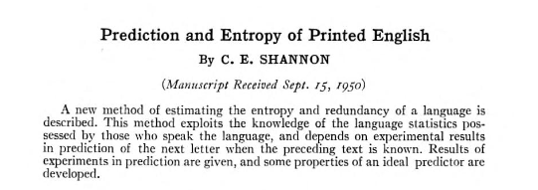
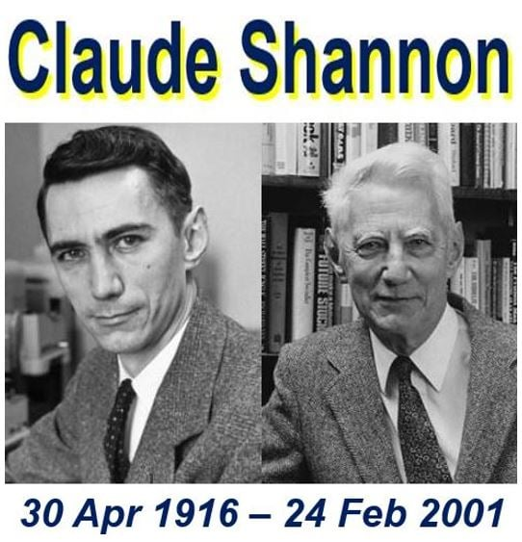
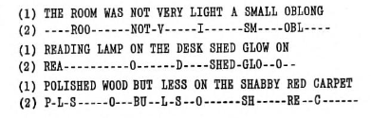
The Shannon Game
The Shannon game [Shannon 1951]:
How well can you predict the next letter?

Slide 7
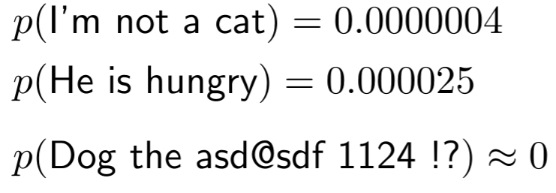

Language Models: General Formulation
Language model computes a probability distribution over strings in a language:
$x$: A string with tokens $x_{1},x_{2},…x_{n}$.

Slide 8




Language Models: General Formulation
Language model computes a probability distribution over strings in a language:

Slide 9

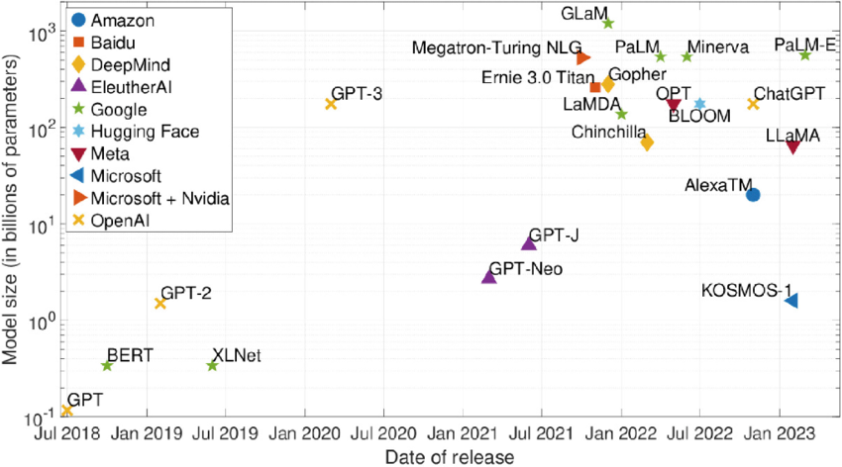
Nowadays: large language models
Figure credit: Kath et al. (2023)
Notes:
Image sources:
https://www.google.com/search?q=large+language+models+model+sizes&tbm=isch&ved=2ahUKEwievKL-xY-CAxVWKd4AHTt8ABUQ2-cCegQIABAA&oq=large+language+models+model+sizes&gs_lcp=CgNpbWcQAzoNCAAQigUQsQMQgwEQQzoHCAAQGBCABDoECAAQHlDbBVj0EWDwEmgAcAB4AIABU4gBpAeSAQIxM5gBAKABAaoBC2d3cy13aXotaW1nwAEB&sclient=img&ei=KCw4ZZ6IDdbS-LYPu_iBqAE&bih=883&biw=1728&rlz=1C5CHFA_enUS1080#imgrc=fuOrSa4WC7hxBM
https://www.google.com/search?q=large+language+models+model+sizes&tbm=isch&ved=2ahUKEwievKL-xY-CAxVWKd4AHTt8ABUQ2-cCegQIABAA&oq=large+language+models+model+sizes&gs_lcp=CgNpbWcQAzoNCAAQigUQsQMQgwEQQzoHCAAQGBCABDoECAAQHlDbBVj0EWDwEmgAcAB4AIABU4gBpAeSAQIxM5gBAKABAaoBC2d3cy13aXotaW1nwAEB&sclient=img&ei=KCw4ZZ6IDdbS-LYPu_iBqAE&bih=883&biw=1728&rlz=1C5CHFA_enUS1080#imgrc=BYZ2hrO9BDjFhM

Slide 10
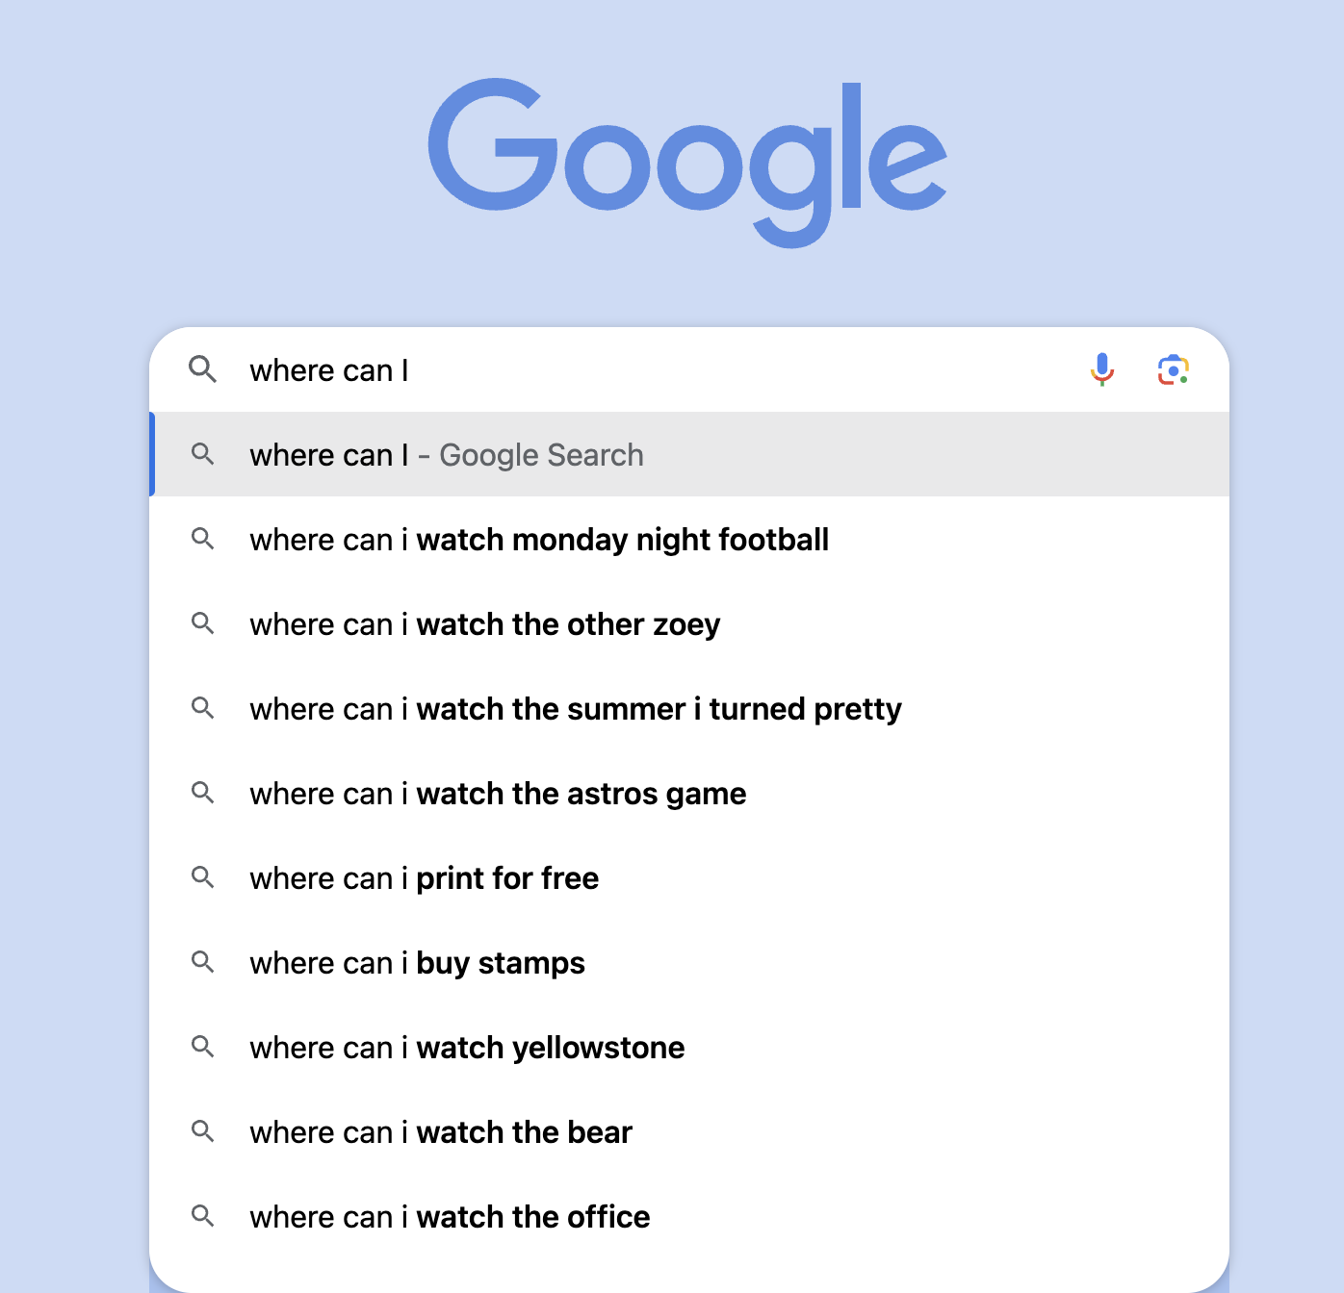
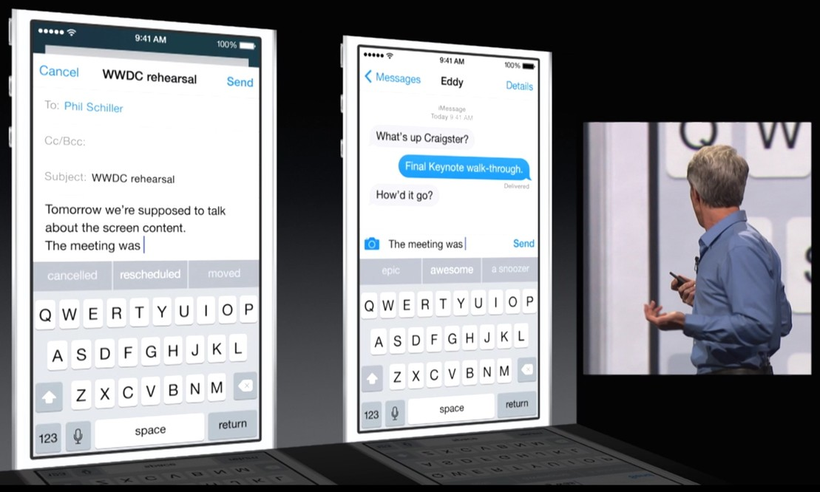
Languages models are now everywhere!

Slide 11
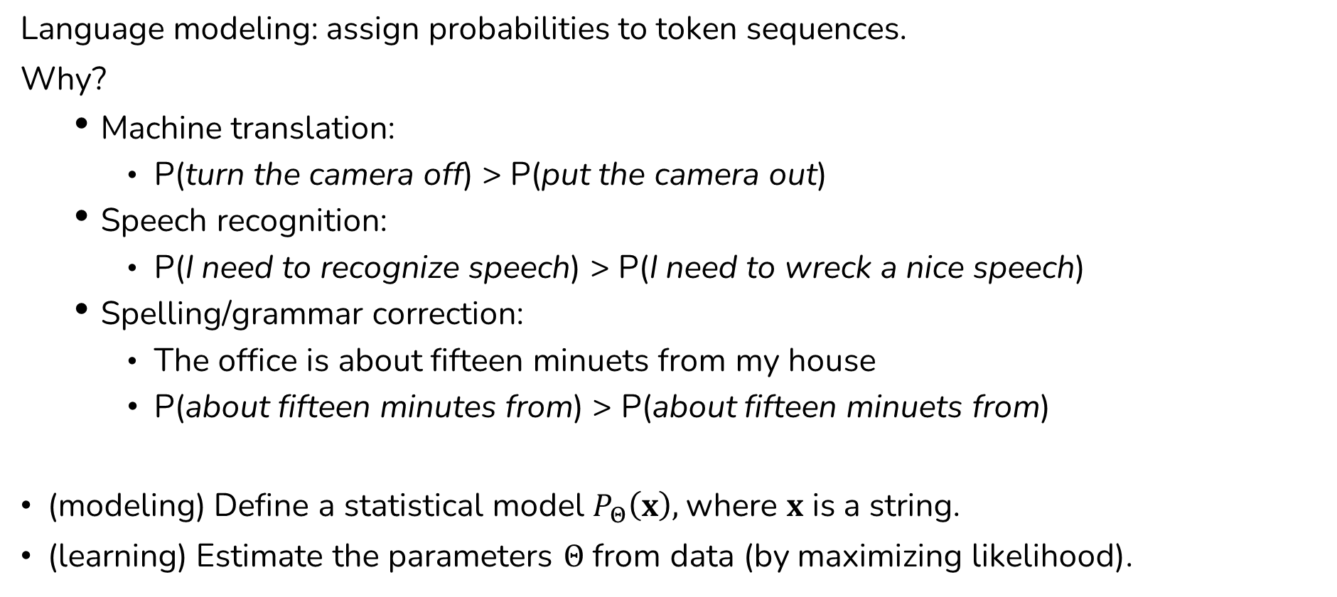
Language Models: General Formulation
Language modeling: assign probabilities to token sequences.
Why?
Machine translation:
P(turn the camera off) > P(put the camera out)
Speech recognition:
P(I need to recognize speech) > P(I need to wreck a nice speech)
Spelling/grammar correction:
The office is about fifteen minuets from my house
P(about fifteen minutes from) > P(about fifteen minuets from)
(modeling) Define a statistical model $P_{Θ}\left(x\right),$where $x$ is a string.
(learning) Estimate the parameters $Θ$ from data (by maximizing likelihood).

Slide 12
Language Modeling
Goal – Compute the probability of a sequence of words:
Relatedly, modeling probability of the next word:
Relatedly, modeling the probability of a masked word given its context:
A model that computes any of the above is called a language model.
A good language model will assign higher probabilities to sentences that are more likely to appear.

Slide 13
Language Modeling
How do we model this?
Recap: the chain rule of probability.
We haven’t yet made any independence assumptions!

Slide 14
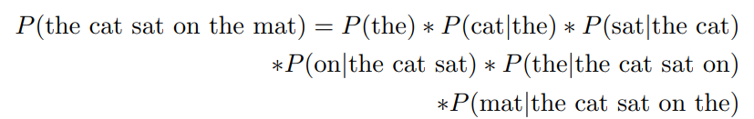
Autoregressive Language Modeling

Slide 15
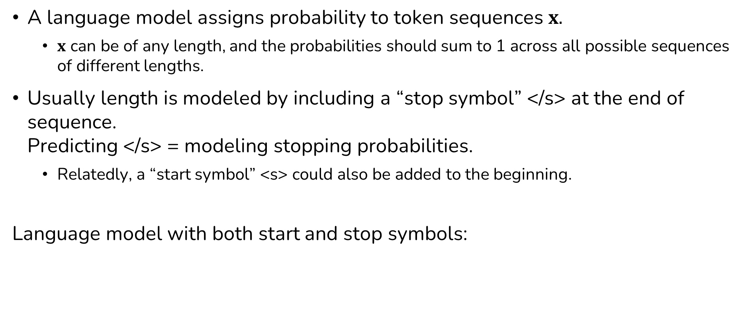
Important Detail: Modeling Length
A language model assigns probability to token sequences $x.$
$x$ can be of any length, and the probabilities should sum to 1 across all possible sequences of different lengths.
Usually length is modeled by including a “stop symbol” </s> at the end of sequence. Predicting </s> = modeling stopping probabilities.
Relatedly, a “start symbol” <s> could also be added to the beginning.
Language model with both start and stop symbols:

Slide 16
Why Stopping Probability?
Our language model:
We need to ensure:
Consider removing stopping probabilities:

Slide 17
What happens if we don’t model stropping probability?
Recall that we need:
Sums of probabilities for all possible length-1 and length-2 sequences:

Slide 18
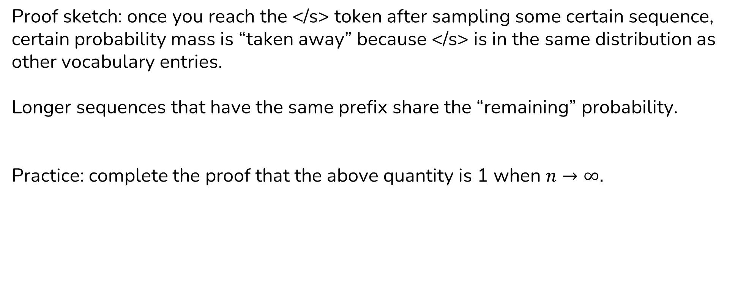
With the stop symbol…
Proof sketch: once you reach the </s> token after sampling some certain sequence, certain probability mass is “taken away” because </s> is in the same distribution as other vocabulary entries.
Longer sequences that have the same prefix share the “remaining” probability.
Practice: complete the proof that the above quantity is 1 when $n→∞.$

Slide 19
Other Ways of Modeling Length
Alternatively, we can model the length n explicitly (e.g., using a zero-truncated Poisson distribution):

Slide 20

Estimating Language Model Probabilities
<s> I do not like green eggs and ham </s>
Let’s use maximum likelihood estimation (MLE):
Problem: we’ll never have enough data!

Slide 21
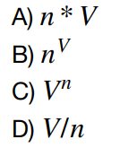
Estimating Language Model Probabilities
Suppose we have a vocabulary of size V, how many sequences of length n do we have?
Typical English vocabulary ~ 40k words
Even sentences of length <= 11 results in more than 4 * 10^50 sequences. Too many to count! (# of atoms in the earth ~ 10^50)

Slide 22
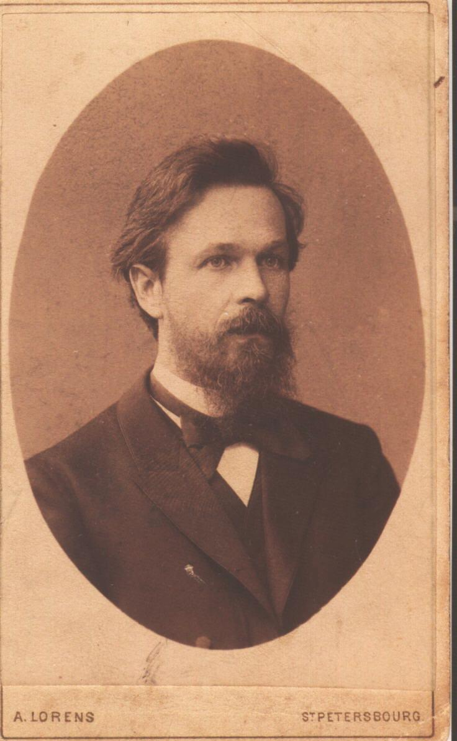
Markov Assumption
Independence assumption: the next word only depends on the most recent past.
Reduces the number of estimated parameters in exchange for modeling capacity
Most recent k words
Andrey Markov
1st order Markov: k = 1
2nd order Markov: k = 2

Slide 23

N-Gram Language Models
$n=1:$ Unigram language model
$n=2$: Bigram language model
$n=3:$Trigram language model

Slide 24
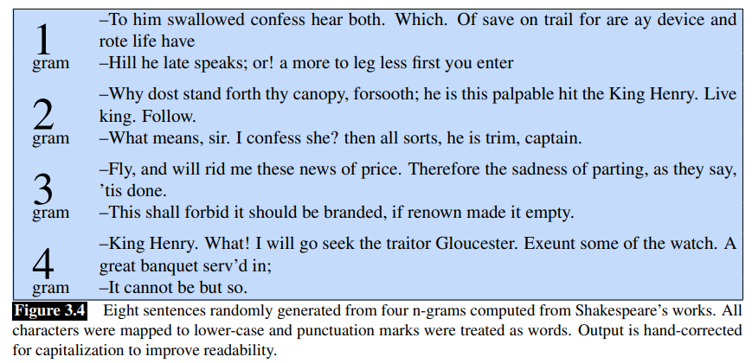
Example Sentences from N-Gram Models
[SLP3: Chapter 3]

Slide 25
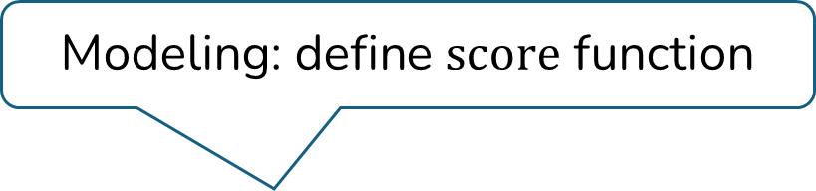

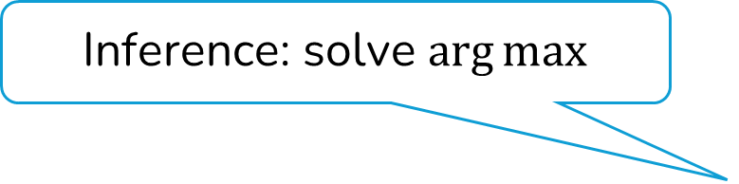
Recap: Modeling, Learning, and Inference in Classification
$$classify\left(s\right)=arg\max_{y} score(s, y;Θ)$$
Inference: solve $\arg{max}$
Modeling: define $score$ function
Learning: choose parameter

Slide 26
General Formulation: Language Models as Classifiers
Sentiment Classifier
It’s a cute cat!
positive
Next-Word Predictor
It’s a cute
cat
[Mask] Token Predictor
It’s a [mask] cat
cute

Slide 27

Modeling, Learning, and Inference
$$nextword\left(s\right)=arg\max_{y} score(s, y;Θ)$$
Inference: solve $\arg{max}$
Modeling: define $score$ function
Learning: choose parameter

Slide 28
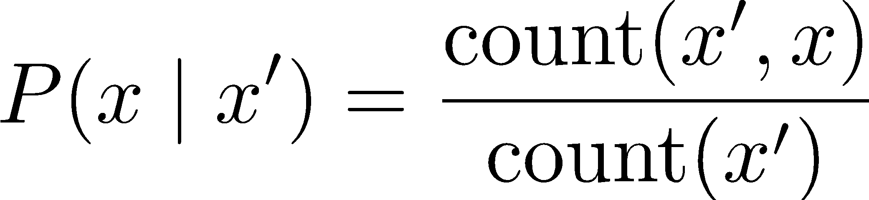
Estimating N-Gram Probabilities
Maximum likelihood estimate (MLE)
Notes:
Could be derived from writing down the log corpus probability as objective, and take the partial derivative of the objective with respect to each parameter to zero.

Slide 29
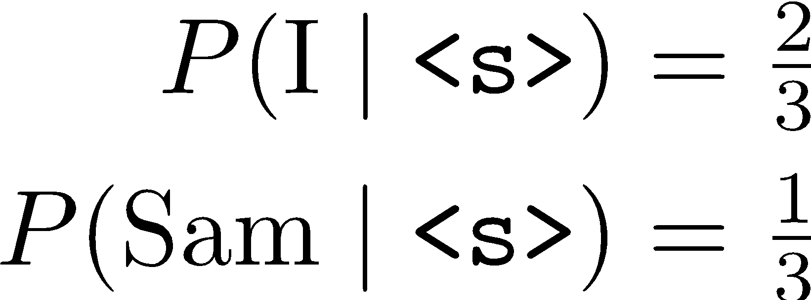
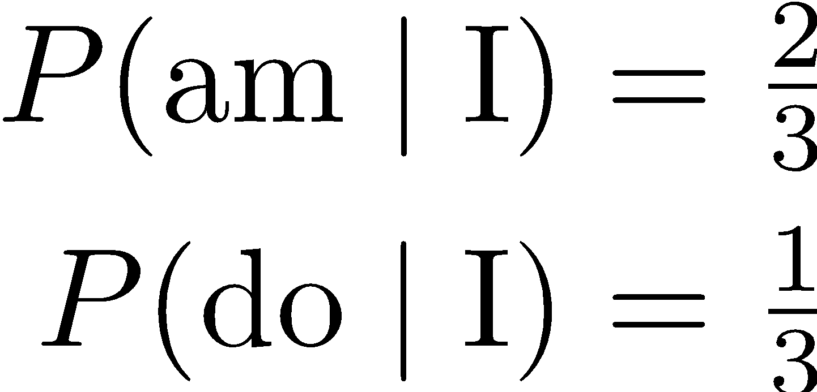
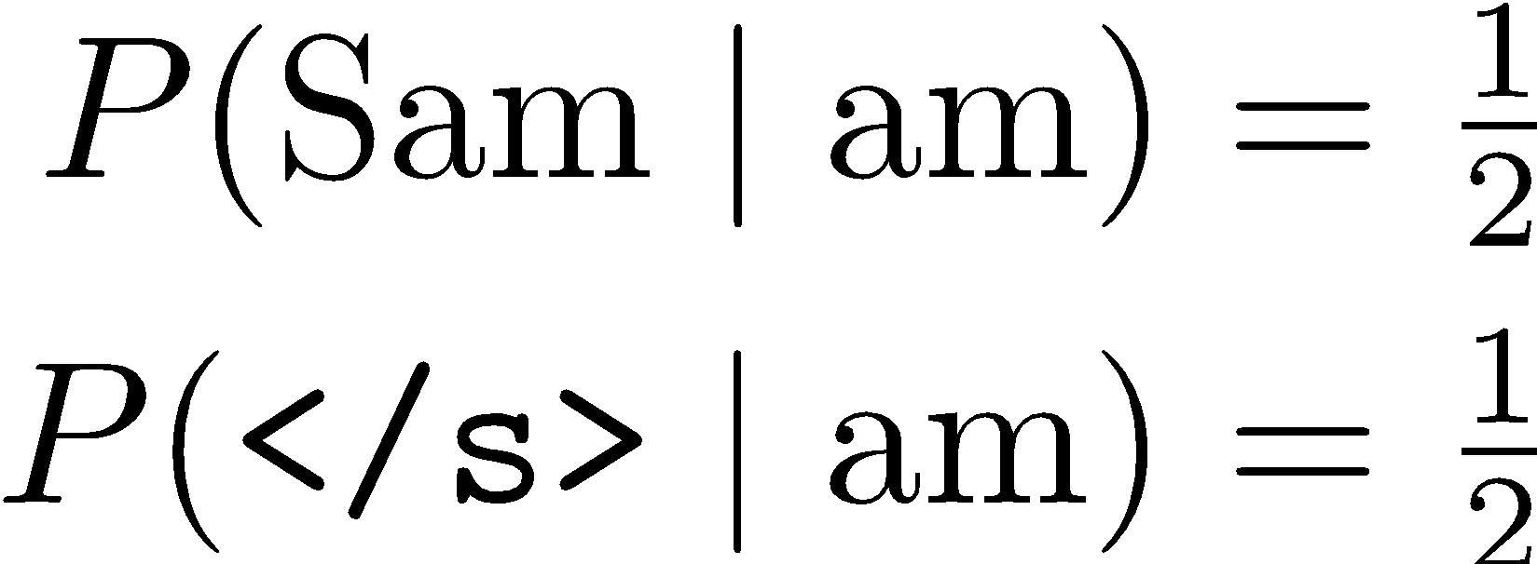
Estimating N-Gram Probabilities
Training data:
MLE estimator:
<s> I am Sam </s>
<s> Sam I am </s>
<s> I do not like green eggs and ham </s>
A few estimated bigram probabilities:
[SLP3: Chapter 3]

Slide 30
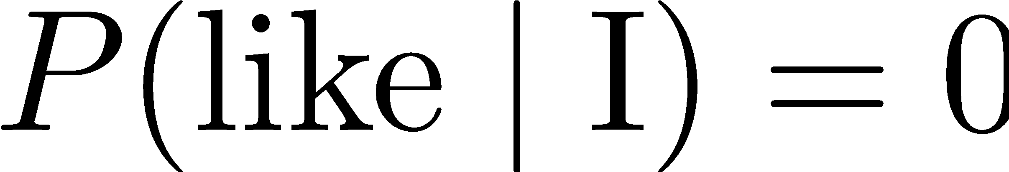
Smoothing in N-Gram LMs
Training data:
<s> I am Sam </s>
<s> Sam I am </s>
<s> I do not like green eggs and ham </s>
Test data:
<s> I like green eggs and ham </s>
Problem: !

Slide 31
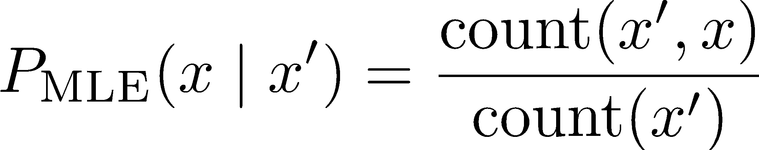
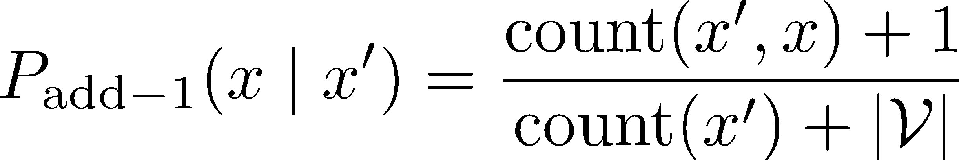
Add-1 Estimation
Just add 1 to all counts!
Also called Laplace smoothing
MLE estimate:
Add-1 estimate:
Simple and avoids zeros, and there are many advanced “smoothing” methods.
vocabulary size
[SLP3: Chapter 3]

Slide 32

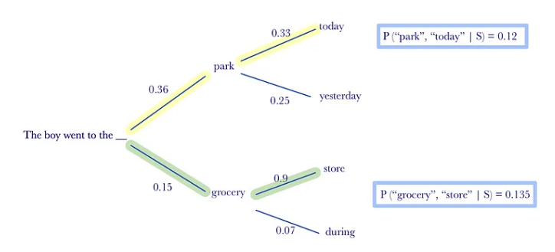

Generating from a Language Model
Greedy search: choose the most likely word at every step
To predict the next word given the previous two words $w_{1}, w_{2}$

Slide 33



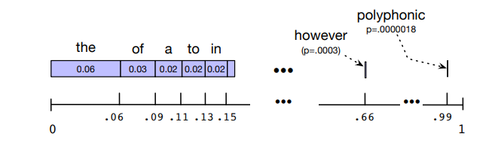
Generating from a Language Model
Bigram model
Generate the first word
Generate the second word
Generate the third word
…
Sampling
[SLP3: Chapter 3]

Slide 34
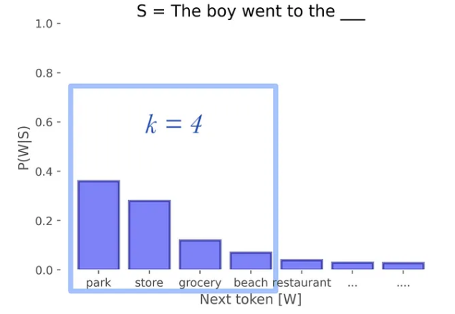
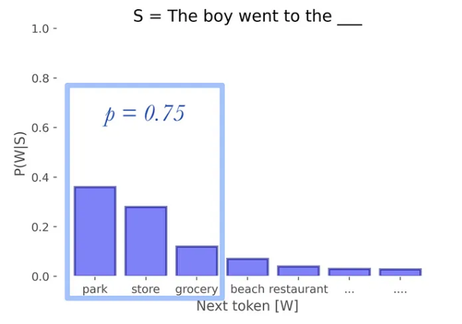
Generating from a Language Model
Two effective sampling strategies: excluding the possibility for tokens with very-low probabilities.
Top-k vs. top-p sampling
Top-k sampling
Top-p sampling
[Holtzman et al., 2020]

Slide 35
Evaluating Language Models
A good language model will assign higher probabilities to sentences that are more likely to appear.
Compute probability on held-out data.
Standard metric: perplexity.
Caveat: these metrics correlate with but do not necessitate good downstream performance.

Slide 36
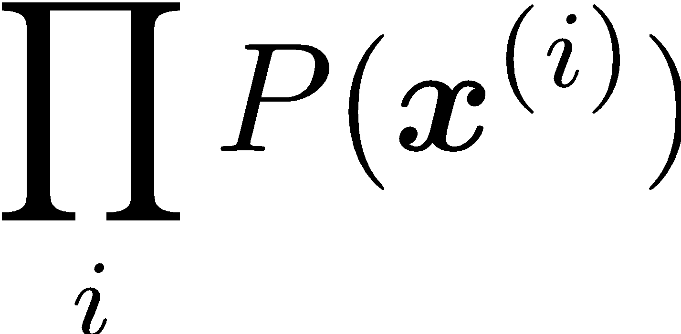
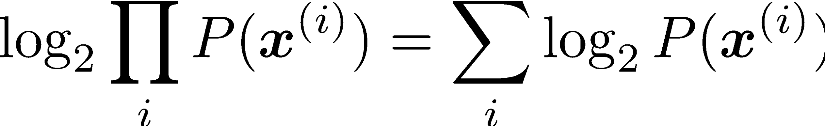
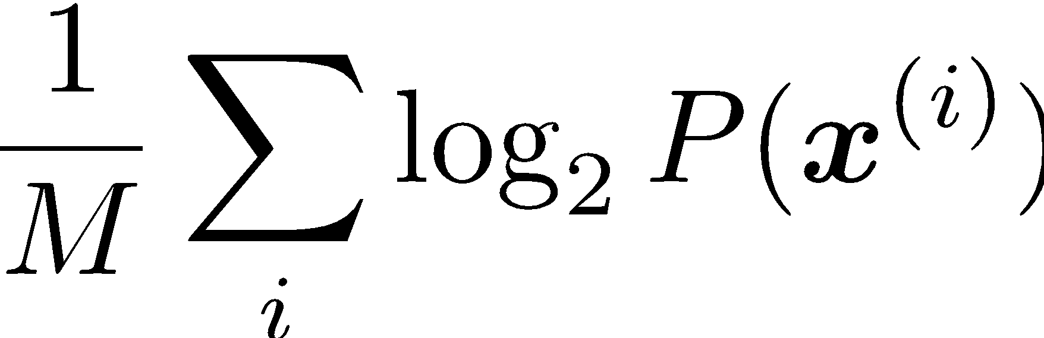
Held-Out Probability
Probability of held-out sentences:
Let’s work with log-probabilities:
Divide by number of words M (including stop symbols) in held-out sentences:

Slide 37
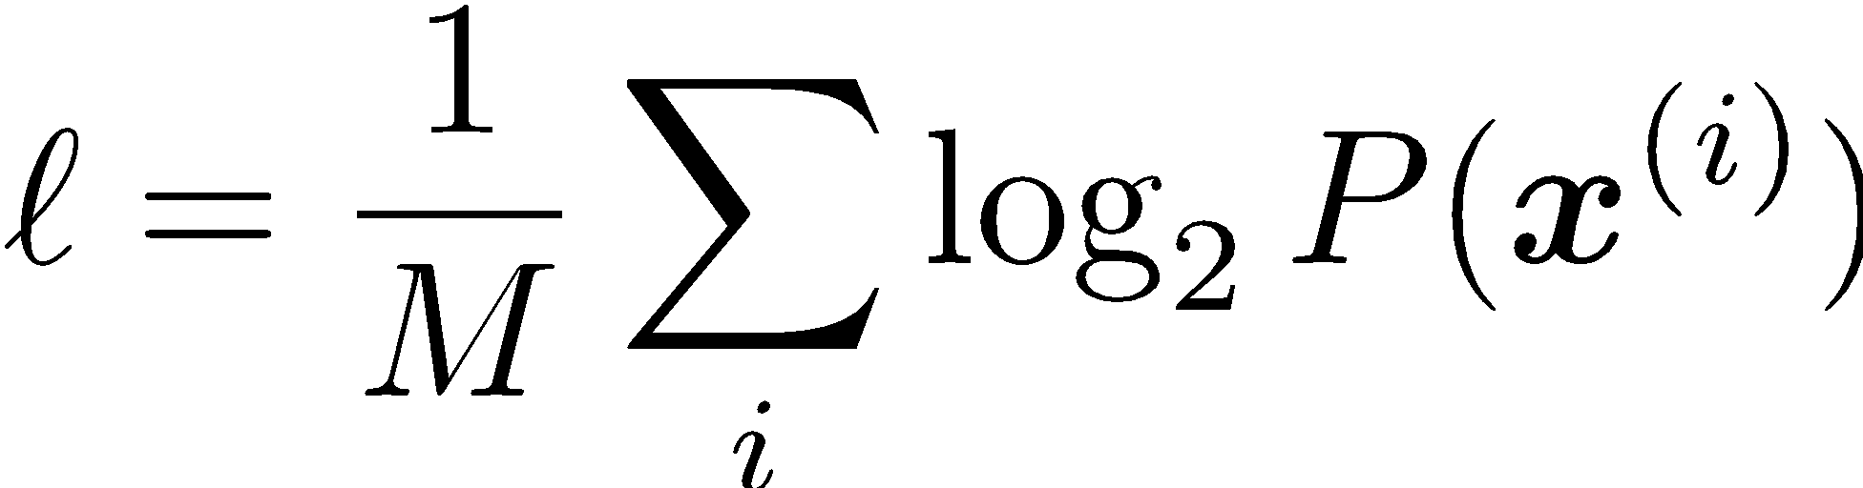
Probability → Perplexity
Average token log-probability of held-out data:
Perplexity:
The lower the perplexity, the better the model.
????
Cross entropy

Slide 38
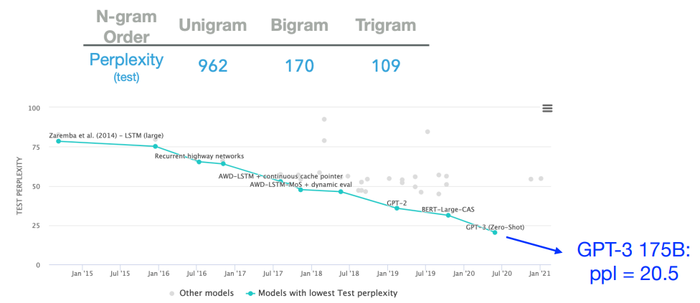
Perplexity of Models
[Src: https://paperswithcode.com/sota/language-modelling-on-penn-treebank-word]

Slide 39
Next
Constituency syntax and context-free grammars
Probing syntactic knowledge in neural language models

