Slide 1
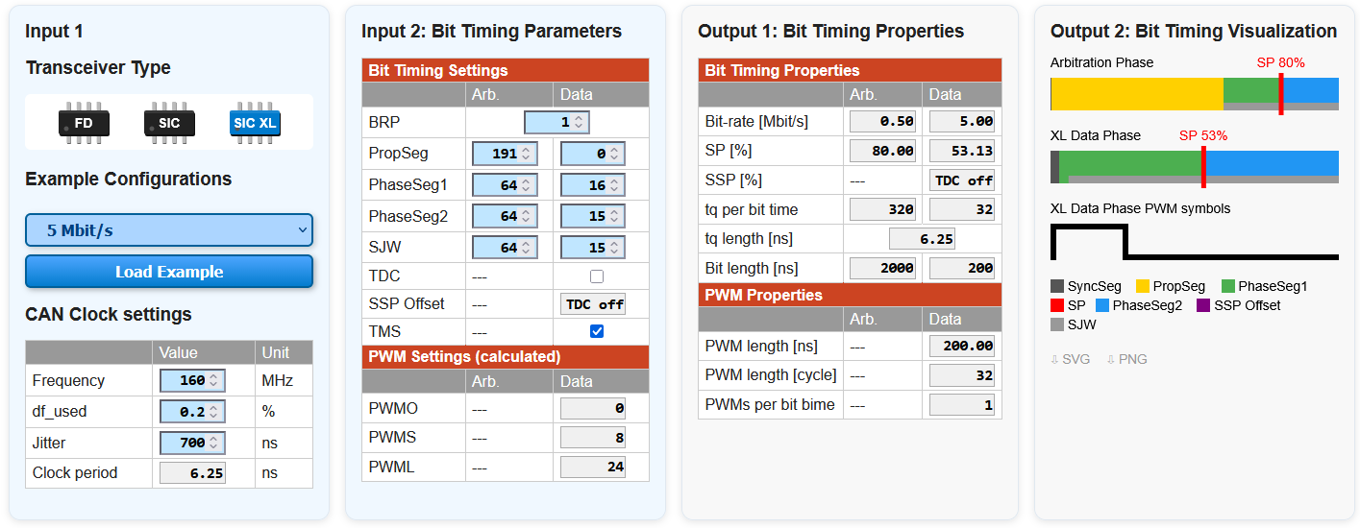
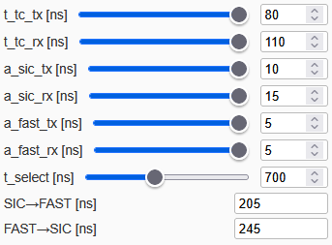

Setup
Node 1
Sonst gleich wie Node 1.
Node 2
delay transmission start by [ns]
400
Layout
Webseite
df
+0,2%
Arb. [kbit/s]
500
CAN
Controller (CC)
Data. [Mbit/s]
12,3
t_cc_tx_tx
t_tc_cc_rx
15 ns
20 ns
Arb. [kbit/s]
500
TXD
RXD
Data. [Mbit/s]
12,3
t_tc_tx
t_tc_rx
80 ns
SIC XL
110 ns
CAN bus
T
T
t_cable:
20 ns
Configuration View: hide / unhide
Node 1 Configuration
Input 3: Transceiver Parameters
Input 4: Channel Parameter
Node 2 Configuration: same as for Node 1. [BUTTON: Copy values from Node 1]
Simulation Result

Slide 2
ALTE FOLIEN ab hier

Slide 3
Node 1
Node 2
TX delays
CC
RX delays
both nodes:
- same delays
- same asymmetry
CC
TX transceiver asymmetry
a_sic_tx: +10ns
t_cc_tc_tx = 15ns
t_cc_tc_rx = 20ns
a_sic_rx: +15ns
min
max
TXD
RXD
min
max
TXD
RXD
a_fast_tx: +5ns
t_tc_tx = 80ns
SIC XL
t_tc_rx = 110ns
a_fast_rx: +5ns
SIC XL
min
max
min
max
min
max
min
max
T
T
t_cable: 20ns
CAN bus

Slide 4
Node 1
Transceiver
State
SIC mode
CAN Controller
State
transmitter
arbitration phase
SOF
arbitration field
SOF
ID 28
ID 28
ID 28
SS
Prop
PS1
PS2
TX_CC
SP
TX_bus
RX_CC
Node 2
Transceiver
State
SIC mode
CAN Controller
State
transmitter
arbitration phase
SOF
arbitration field
SOF
ID 28
ID 28
ID 28
SS
Prop
PS1
PS2
TX_CC
SP
TX_bus
RX_CC

