Slide 1

EatYourFill Project
Brought by Team GoogleColab

Slide 2
TABLE OF CONTENTS
01
02
03
04
05
06
Introduction
Stakeholders
Live Demo
Potential Impact
Budget Calc
Existing Solution

Slide 3
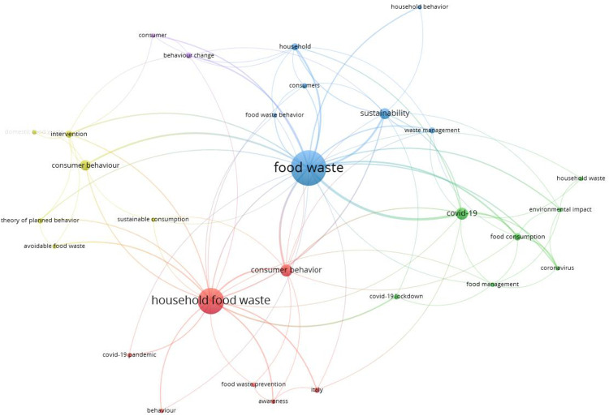
Introduction
Image source: https://www.ncbi.nlm.nih.gov/pmc/articles/PMC10381066/
Notes:
Based on this figure from an article listed by National Library of Medicine, the team has identified a significant waste source which is brought by the household. Through two days of dedication, the team has come up with a coding prototype to address the food insecurities issues.

Slide 4
Stakeholders Identification
Platform Providers
Technological Partners
E.g. Google Play and Apple Apple Store. Security and malware reviews must be approved before apps become publicly accessible.
Utilizing coding architectures based on Golang and our prompt tool, Gemini, Changes in the framework could affect the generator results.
Merchant/Distributors
Food-deprived masses
Users who do not purchase food in response to irrational hunger will reduce over-purchsing. This may lead to decreased profits and increased inventory for business owners.
This group may benefit from reduced prices resulting from decreased demand from the app users.

Slide 5
Live demo
Assumptions
The user is employed in one position.
The user possess a functioning biometric collector; heartbeat and blood level readings are obtained from an Apple Watch. Given time constraints, we used the global average for all adults as input for our model.
The user is aware of the energy consumptions from all activities participated during the week and all the information filled-in is correct.
Average energy consumption rate is applied to activities with defined lower and upper bound.
If the material price data is absent from the generator, average of all entries in the retail prices column are used from Stats Canada.

Slide 6
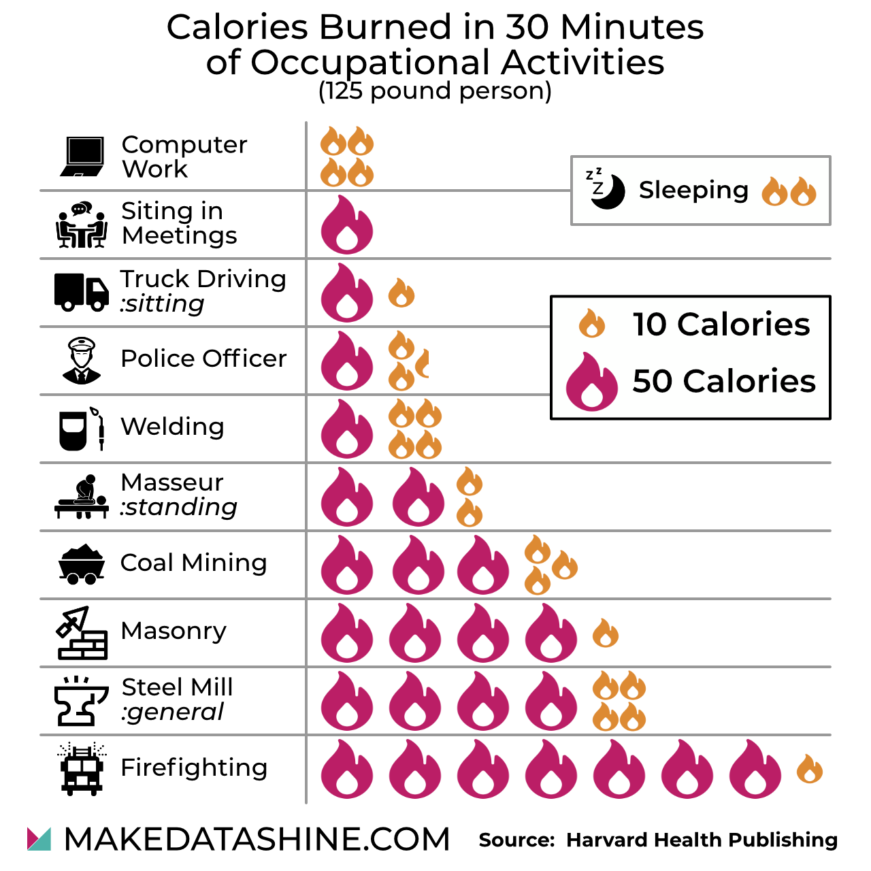
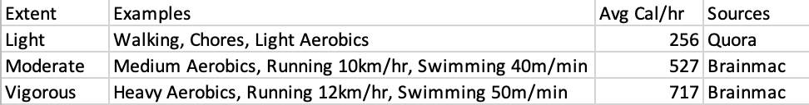

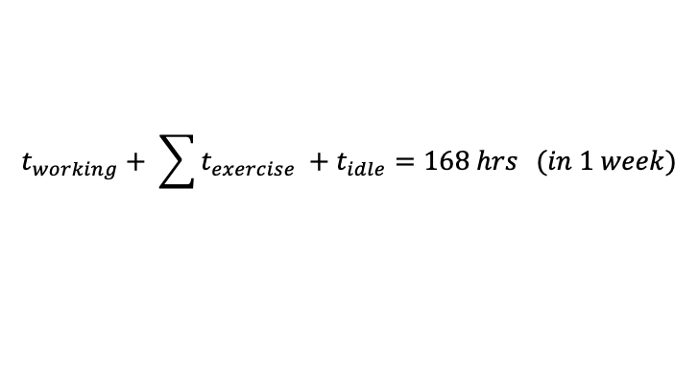
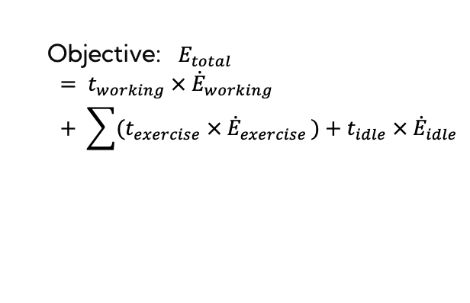
Live demo
Energy Equations behind
Objective: $E_{total}$
$$= t_{working} × {\dot{E}}_{working}+ \sum{{(t}_{exercise} × {\dot{E}}_{exercise })+t_{idle} × {\dot{E}}_{idle}}$$
$$t_{working}+ \sum{t_{exercise} +t_{idle}=168 hrs } (in 1 week)$$
$${\dot{E}}_{idle}=46 cal/hr$$
[1] [2]
Image Source: Reddit https://www.reddit.com/r/dataisbeautiful/comments/8ymt7m/oc_calories_burned_in_30_minutes_of_various/
Sources: [3] [4]

Slide 7
Potential Impacts
User economics
Environmental benefits
We expect the primary users to be individuals or members in a family unit. The predicted ingredient list will specify the exact amount of materials pending purchase, the users will spend their expenditure more wisely, giving them economical savings.
Given less organic garbage that could be hedged, this app could help the treatment plants due to less energy spent for garbage processing. This will indirectly mitigate overconsumption of fossil fuels and further global warming.

Slide 8
$313
$65
Project Budget Costs
per month using a cloud server [5]
Estimated price for the model [6]

Slide 9
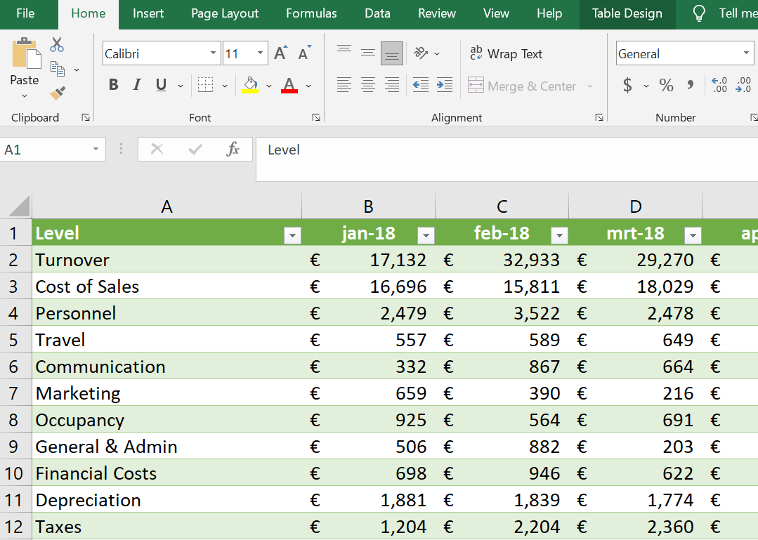
One Existing Solution
Manual Budget Planning for shopping list using worksheet and Microsoft Excel
Lacks the scientific measurements to precisely calculate calroies required and environmental awareness for possible food wastes
EatYourFill App
Our app returned combined multiple features (e.g. recipes, ingredient list and sustainability scores) based on wider rage of inputs
It not only saves the user’s expenses but also standing in environmental’s perspective to shield it
Image source: https://beebole.com/blog/budget-vs-actuals-template-microsoft-excel/

Slide 10
References
[1] Harvard Health Publishing. “Burning calories without exercise.” Harvard Medical School. Accessed: May 5, 2024. [Online]. Available: https://www.health.harvard.edu/staying-healthy/burning-calories-without-exercise#:~:text=This%20is%20your%20body%20on%20idle&text=It%27s%20true%3A%20just%20sitting%20on,up%20watching%20TV%20or%20reading.
[2] Healthline. “How Many Calories Do You Burn While You’re Asleep?” Accessed: May 5, 2024. [Online]. Available: https://www.healthline.com/health/calories-burned-sleeping
[3] Nirvana Ayruveda Liver and Kidney. “How many calories can be burned in an hour of light home exercise?” Quora. Accessed: May 5, 2024. [Online]. Available: https://www.quora.com/How-many-calories-can-be-burned-in-an-hour-of-light-home-exercise/answer/NIRVANA-AYRUVEDA-LIVER-AND-KIDNEY?ch=10&oid=1477743677624003&share=8f5cce3e&srid=hiDy9Y&target_type=answer
[4] Brainmac Sports Coach. “Energy Expenditure.” Accessed: May 5, 2024. [Online]. Available: https://www.brianmac.co.uk/energyexp.htm
[5] Sirius. “How much does a cloud server cost for a small business?” Accessed: May 5, 2024. [Online]. Available: https://siriusofficesolutions.com/cloud-server-price/#:~:text=What%20is%20the%20price%20of,on%20your%20IT%20infrastructure%20costs
[6] Jon Reiley, “Cost of AI in 2024: Estimating Development & Deployment Expenses.” Akkio. Accessed: May 5, 2024. [Online]. Available: https://www.akkio.com/post/cost-of-ai#:~:text=From%20%245%20to%20over%20%24100%2C000,widely%20based%20on%20required%20performance.&text=Custom%2Dbuilt%20for%20specific%20tasks,performance%20for%20complex%20AI%20applications

Slide 11
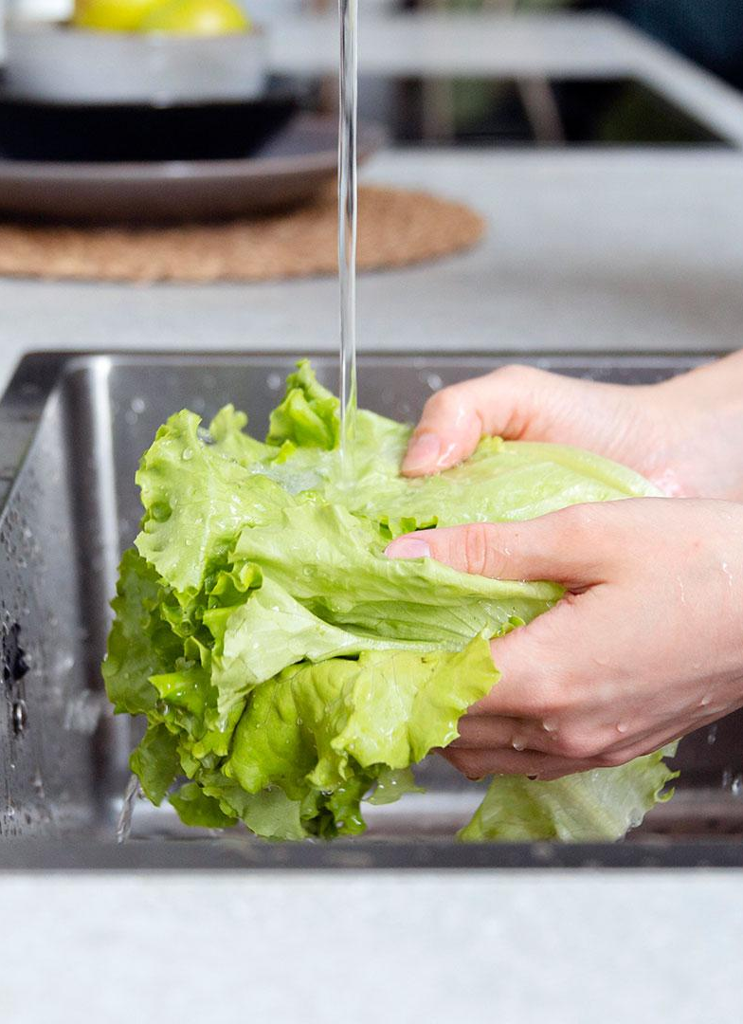
THANKS
Do you have any questions?
Brought you by Vidha, Thomas, Eric and Mack
Please keep this slide for attribution

