Slide 1
MH6805 MACHINE LEARNING IN FINANCE | GROUP 7
Do scheduled token unlocks help forecast crypto volatility?
Walk-forward evidence from 176 tokens and five machine-learning models
[Member 1] [Member 2] [Member 3]
[Presentation date]
Notes:
Speaker: [Member 1]
Introduce the group and the question in one sentence: crypto tokens publish their unlock calendars in advance; we test whether that calendar helps forecast how volatile a token will be over the next two weeks, beyond what its recent volatility already tells us.

Slide 2
MOTIVATION
Unlocks are widely watched as volatility events
1
2
3
4
Supply is locked
Schedule is public
Narrative: more sellers
But volatility persists
Team, investor and ecosystem allocations vest over months or years
Unlock dates and sizes are published in advance (Tokenomist tracks 176 of our tokens)
New supply reaches holders who may sell, so traders expect price swings
Recent volatility is already a strong forecast, so the bar for a new feature is high
Our question: does the unlock calendar add forecasting power for 14-day forward volatility beyond volatility persistence and the market regime?
MH6805 Group 7 | Token unlocks and forward volatility
2
Notes:
Speaker: [Member 1]
Explain vesting: most of a token's supply is locked at launch and released on a published schedule. The market narrative is that unlocks bring new sellers and so more volatility. Because the schedule is public in advance it is a legitimate forward-looking input, which is rare in forecasting. But volatility is very persistent, so any new feature has a high bar to clear.

Slide 3
RESEARCH DESIGN
One paired comparison answers the question
CONTROLS (9)
+ UNLOCK & STATIC (23)
Δ R²
Trailing volatility 7, 14, 30d
Trailing return 7, 30d
BTC and ETH volatility (regime)
Log market cap, token age
Share of float unlocking in next 7, 30, 90 days
Days to and size of next cliff
30d unlocks by recipient (team, investors, community ...)
Allocation shares, data-quality flags
FULL minus CONTROLS, per fold, same model, same data
Target: log of annualized realized volatility over the next 14 days. Metric: R² out-of-sample vs the persistence forecast (0 = ties “next 14 days look like the last 14”).
MH6805 Group 7 | Token unlocks and forward volatility
3
Notes:
Speaker: [Member 1]
Every model is trained twice with the same rows, folds and tuning grid: once on the nine controls and once with the 23 unlock and static features added. The difference in out-of-sample R squared is the finding. We decided up front that a null result is a valid result and we did not tune to change it.

Slide 4
DATASET
A daily panel of 176 tokens over two years
176
101,393
32
5
tokens
token-days
features
walk-forward folds
with a Tokenomist schedule and a Binance USDT pair
2024-09-14 to 2026-08-15, median 701 days per token
9 controls, 13 emission, 10 static; no missing values after cleaning
90-day test windows after a 30-day embargo; rows never shuffled
Prices: Binance spot daily klines (open, high, low, close). Unlocks: Tokenomist API daily emission, unlock events and allocations, pulled 2026-09-14.
Weekly panel (14,623 rows) used as a robustness check because daily 14-day targets overlap.
MH6805 Group 7 | Token unlocks and forward volatility
4
Notes:
Speaker: [Member 1]
Two real sources: Binance daily candles for prices and Tokenomist for unlock schedules and allocations. One row per token per day from September 2024 to August 2026. Every feature is known at the close of the day; the only forward-looking inputs are the published schedule columns. One caveat: schedules are the version curated on our pull date, so later revisions are back-filled.

Slide 5
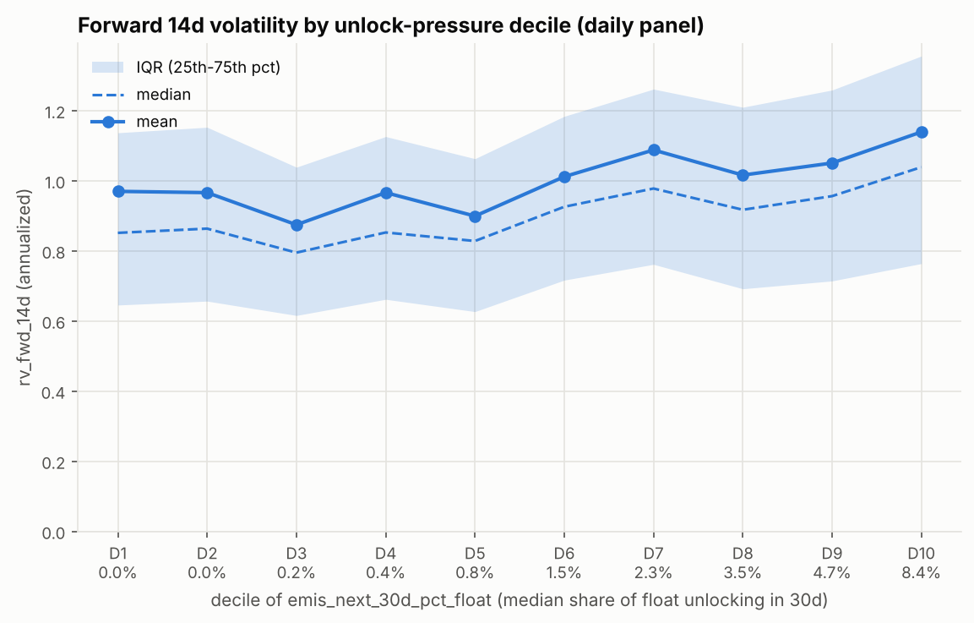
EXPLORATORY ANALYSIS
In the raw data, volatility does rise with unlocks
0.14
pooled Spearman ρ between 30-day unlock pressure and forward volatility
74%
of tokens show a positive correlation (per-token median ρ = 0.22)
But: heavy-unlock tokens are young and already volatile. Is this just persistence in disguise?
MH6805 Group 7 | Token unlocks and forward volatility
5
Notes:
Speaker: [Member 1]
This is the hook: unconditionally, there is a relationship. Forward volatility climbs from about 0.97 in the lowest unlock decile to 1.14 in the highest, and the correlation is positive for three quarters of tokens. But heavy-unlock tokens are young, small and already volatile, so the question is whether this survives once trailing volatility is in the model.

Slide 6
PROTOCOL
Walk-forward validation: never shuffle, never peek
Fold 1
Fold 2
Fold 3
Fold 4
Fold 5
2024-09
2025-06
2026-01
2026-08
Train
Validation (last 90d of train, for tuning)
30-day embargo
Test (90 days, scored once)
Candidates (pre-processing + model + settings) are compared on validation only; the winner is refit and the test window is scored once, never used to change a model.
MH6805 Group 7 | Token unlocks and forward volatility
6
Notes:
Speaker: [Member 2]
Five folds cut by calendar date, all tokens pooled. Training expands; a 30-day embargo separates train from test because the target looks 14 days ahead. Inside each fold the last 90 days of training are the validation slice used for tuning; the winner is refit on all training data and scored once on the next 90 days. Scalers live inside the sklearn pipeline, so nothing is fit on test data.

Slide 7
METHODS
Five models, one shared harness
REGRESSION
REGRESSION
REGRESSION
REGRESSION
CLASSIFICATION
KNN
Random Forest
Ridge
Elastic Net
Logistic
Quantile-scaled distance; k from 5 to 250
400 trees, depth × leaf × features grid
L2 penalty; α from 0.1 to 10⁷
L1 + L2, α × l1_ratio grid
L2; C from 10⁻⁵ to 10, log-loss tuning
Tuned: k = 100–250
Tuned: leaves of 50–100 rows
Tuned: α = 10⁴–10⁷
Tuned: all-zero in 2 of 5 folds
Events: top-20% vol, 1.5× spike
MH6805 Group 7 | Token unlocks and forward volatility
7
Notes:
Speaker: [Member 2]
Each model sees identical rows, folds and features. KNN tests a local, similarity-based view; Random Forest can find non-linear effects and interactions, for example unlocks mattering only in calm markets; Ridge and Elastic Net are strong linear benchmarks, and Elastic Net can drop features entirely; logistic regression re-asks the question as classifying high-volatility events. Note what tuning chose: very large neighbourhoods, large leaves and strong penalties, all signs of a noisy target.

Slide 8
RESULT 1
All models beat the benchmarks on controls alone
Out-of-sample R² vs persistence
daily panel, 5 test folds, same test rows for every forecast
0.17
training-mean benchmark: every model is above it
+0.001 to +0.006
gain from adding 23 unlock and static features
MH6805 Group 7 | Token unlocks and forward volatility
8
Notes:
Speaker: [Member 2]
Read the chart pair by pair: blue is controls only, orange adds the unlock and static features. Every model clears the training-mean benchmark of 0.17 and the persistence benchmark of zero. But within each pair the bars are almost identical. Ridge on controls alone is as good as anything we built.

Slide 9
RESULT 2
The small gain is noise: it flips sign across folds
Δ R²oos = FULL − CONTROLS
per test fold, in calendar order
2 of 5
folds where FULL beats CONTROLS (RF and KNN); 3 of 5 for the linear models
±0.15
fold-to-fold s.d. of R²oos itself, 25× the largest mean gain
MH6805 Group 7 | Token unlocks and forward volatility
9
Notes:
Speaker: [Member 2]
This is the per-fold paired difference. For the Random Forest the unlock block helps in the two oldest folds and hurts in the three most recent, which are trained on the most data. KNN swings even more. Linear models barely move because they shrink the unlock coefficients to almost zero. Meanwhile R squared itself varies by about 0.15 from fold to fold, so a difference of 0.006 is far inside the noise.

Slide 10
WHICH MISTAKES REMAIN?
Unlock features do not help even where unlocks are big
Change in test RMSE from adding unlock features (positive = worse), by 30-day unlock share of float
18% → 12%
forecasts off by more than 2×: persistence vs Ridge. The real gain is fewer large misses
62%
of remaining 2× misses are over-forecasts: volatility collapsed. The rest are spikes no feature sees
MH6805 Group 7 | Token unlocks and forward volatility
10
Notes:
Speaker: [Member 3]
We pool all test rows and ask where the errors are. If unlock features carried signal, FULL should beat CONTROLS where more than 5% of the float unlocks, or where a cliff is two weeks away. The opposite happens: positive bars mean adding unlock features made the forecast worse. What remains is regression to the mean: too high for tokens that turn calm, too low for tokens that spike. The models' real gain over persistence is fewer large misses.

Slide 11
INTERPRETATION
Inside the models, unlock features barely register
Random Forest: test-RMSE increase when a feature group is shuffled
COEFFICIENTS
Ridge / Elastic Net
Largest unlock coefficient +0.008 vs +0.040 for trailing 30d vol; EN drops every feature in 2 of 5 folds
A TREE
Depth-3 tree, all 32 features
Splits only on trailing vol, BTC/ETH vol, token age and 30d return
NEIGHBOURS
KNN, most unlock-heavy row
Top 5 features are all controls: trailing 30d, 14d, 7d vol, 30d return, token age. Partial dependence on unlock pressure is flat across BTC regimes.
104% of float unlocking; neighbours' median 12.5%. Forecast 0.78, realized 0.55
MH6805 Group 7 | Token unlocks and forward volatility
11
Notes:
Speaker: [Member 3]
We explain each model with the tool that suits it. Random Forest permutation importance: shuffling all controls costs three times more test RMSE than shuffling all 13 emission features, and partial dependence on unlock pressure is flat. Coefficients: the largest unlock coefficient is positive, as the narrative says, but five times smaller than trailing volatility, and Elastic Net drops everything in two folds. A shallow tree never splits on an unlock feature. Neighbours: for the most unlock-heavy token-day there is no comparable history, so KNN falls back on trailing volatility.

Slide 12
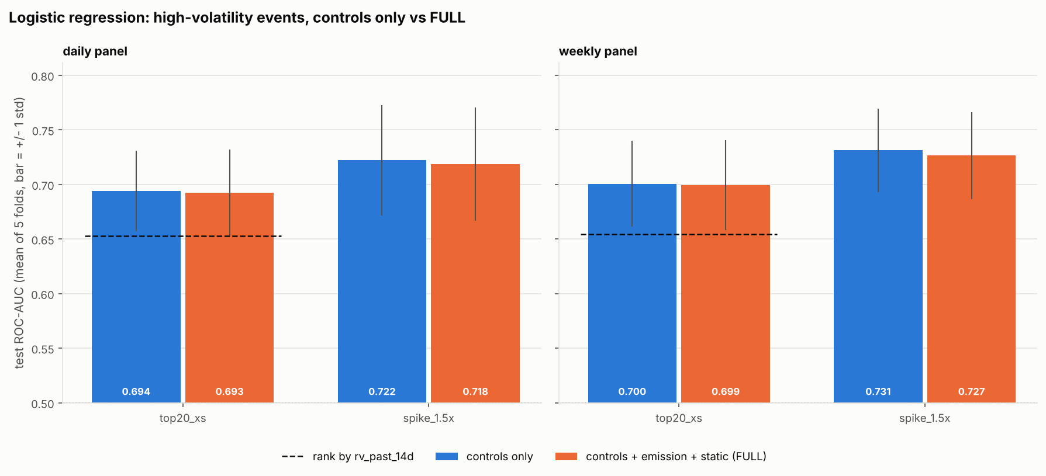
RESULT 3
Classification view: unlock features slightly hurt
Event | Base rate | Naive AUC | AUC controls | AUC + unlocks | Δ AUC
Top 20% most volatile tokens on the date | 20% | 0.653 | 0.694 | 0.693 | -0.002
Vol jumps above 1.5× own 30d level | 14% | – | 0.722 | 0.718 | -0.004
Daily panel, mean of 5 folds. PR-AUC and Brier skill fall too, on both panels. Unlock schedules do not help pick the most volatile tokens, nor anticipate a token's own volatility jump.
MH6805 Group 7 | Token unlocks and forward volatility
12
Notes:
Speaker: [Member 3]
Same question as classification. The model on controls does pick out high-volatility tokens better than just ranking by recent volatility, AUC 0.69 against 0.65. Adding unlock features lowers AUC, PR-AUC and the Brier skill score for both events, on both panels.

Slide 13
ROBUSTNESS
The null result survives every robustness check
Specification | KNN | Random Forest | Ridge | Elastic Net
Daily panel (main) | +0.001 | +0.006 | +0.001 | +0.001
Weekly panel | -0.008 | +0.007 | +0.014 | +0.002
Hand-curated tokens only | – | +0.017 | +0.005 | 0.000
Target: 7-day vol | – | – | +0.004 | +0.002
Target: 30-day vol | – | – | +0.003 | +0.003
Target: Parkinson 14-day | – | – | +0.011 | +0.001
+0.017
largest gain anywhere (RF, curated tokens)
0.15
typical fold-to-fold s.d. of R²oos
Cells: mean Δ R²oos (FULL − CONTROLS) over 5 folds. – = controls-only run not done for that specification.
MH6805 Group 7 | Token unlocks and forward volatility
13
Notes:
Speaker: [Member 3]
We re-ran the comparison on the weekly panel, on three alternative volatility targets and on the tokens Tokenomist curates by hand, where schedules should be most accurate. The largest gain anywhere is +0.017, for the Random Forest on the curated subsample, still about a tenth of the fold-to-fold spread. Ridge on the Parkinson target is the only case that wins all five folds, by 0.011.

Slide 14
PRACTICAL RELEVANCE
Is any improvement useful for the decision?
0.27
median absolute error, annualized-vol points (32% of the level)
Still needs human review
1
Tokens entering a spike (listings, delistings, hacks): the forecast is too low
41%
of forecasts within 25% of realized (persistence 41%)
2
Tokens whose volatility is collapsing: most remaining 2× misses are over-forecasts
3
New listings with under 30 days of history: the model cannot score them
None
useful gain from unlock features, at the cost of a data subscription and upkeep
4
Regime shifts not seen in 2024–26 training data
MH6805 Group 7 | Token unlocks and forward volatility
14
Notes:
Speaker: [Member 3]
Translate the errors into volatility points. The typical error is large for every forecast, and on the median the model is no better than persistence. What it does buy is fewer forecasts that are off by a factor of two, which is what matters for margin and position limits. Unlock features add nothing to that and cost a data subscription and a maintenance pipeline, so our recommendation to a risk desk is not to pay for them as a volatility input, and to keep a human in the loop for the cases on the right.

Slide 15
CONCLUSION
Unlocks are not a reliable incremental volatility signal
1
Raw link is real, not incremental
2
Five model families agree
Heavy-unlock tokens are young and already volatile; trailing volatility absorbs the effect.
Regressors gain only +0.001 to +0.006 R², with unstable sign; logistic AUC falls slightly.
3
Best forecaster: Ridge on controls
4
Consistent with an efficient market
Best RMSE and rank correlation, seconds to train, interpretable. RF close second.
Schedules are public months ahead, so any predictable effect is likely priced before the date.
A null result is a valid result: nothing was tuned to make it disappear.
Notes:
Speaker: [Member 3]
State the answer plainly: once you know a token's recent volatility and the market regime, its unlock calendar does not help forecast the next two weeks. Give the interpretation: the unconditional correlation comes from young, volatile tokens having big unlocks. Practical takeaway: do not bump a volatility forecast just because an unlock is coming.

Slide 16
DISCUSSION
Limitations and next steps
Limitations
Next steps
1
One calm-to-moderate regime (2024-09 to 2026-08), no 2022-style stress
1
Event study around the largest cliff unlocks
2
Schedules as curated on 2026-09-14: revisions are back-filled (biases toward finding an effect)
2
Intraday data for the hours around each unlock
3
Allocation and listing data are snapshots
3
Interact unlocks with liquidity, depth and funding rates
4
176 Binance-listed tokens: larger, more liquid names
4
Point-in-time schedule snapshots; boosted trees and HAR models
MH6805 Group 7 | Token unlocks and forward volatility
16
Notes:
Speaker: [Member 3]
Be upfront: one regime, and schedule revisions are back-filled, which if anything flatters the unlock features and so makes our null stronger. The natural next study is an event study around the largest cliff unlocks with intraday data, where an effect, if any, would be concentrated.

Slide 17
Thank you. Questions?
Code, per-fold results and figures: github.com/watersalamander/MH6805A-Project-Group7
CONTRIBUTIONS
[Member 1]: [part / %] [Member 2]: [part / %] [Member 3]: [part / %]
Notes:
All members: take questions. Each member should be ready to answer on the model they built.

