Slide 1
Ordered List of Plots
UV Flowrate vs. Permeate Flowrate
Specific Energy Consumption of RO vs. Permeate Flow (Train 1 Only)
Total Feed Flowrate vs. Time
Total Power Consumption vs Total Feed Flowrate

Slide 2
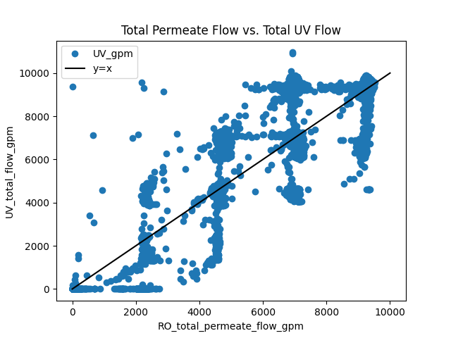

Slide 3
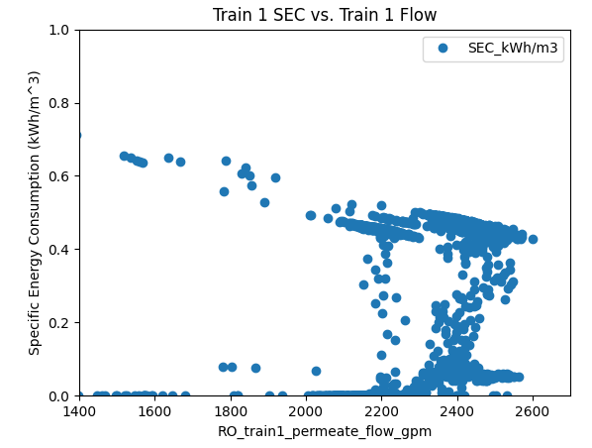

Slide 4
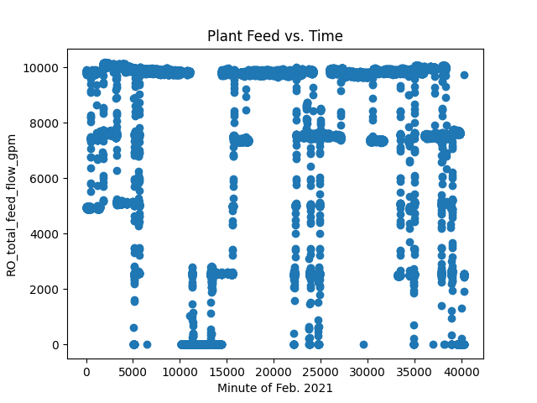

Slide 5
