Slide 1
GitHub 101 for WaterTAP Academy
Principles and Best Practices
WaterTAP Academy 2025

Slide 2


Outline
GitHub Basics
What is GitHub and Git?
Terminology & common commands
Git Basics:
Downloading the latest material
Tracking and sharing file changes
Working on a local branch

Slide 3

What is GitHub and Git
GitHub - Collaborative Development
Git - Version Control
Cloud-based code hosting service
Helps manage git repositories
Provides a convenient review process
Users can report bugs by opening issues
Version control for source code
No need to create multiple copies locally
Easy to work on independent projects
without tampering source code

Slide 4
GitHub/Git Terminology
Term | Meaning
Repository or repo | Project folder
Issue | Bug report or feature request
Pull Request or PR | Request to merge your contribution to the project
Branch | Name given to a set of changes to the repo
Main* | By convention, the name of the default branch
Fork | Copy of repo on your GitHub account
Merge | Means to bring changes from one branch into another
Clone | Get a local copy of a repository
* - Also called master but main is the recommended name by GitHub

Slide 5
Common Commands
Command | Function
git clone <link> | Clone a repo locally
git status | Displays the status of the current branch you are in
git branch | Displays all the current branches on your local machine
git remote -v | Displays where your remotes are pointed to on GitHub
git merge <branch name> | Merge current local branch with another branch
git checkout <branch name> | Move from current branch to other NOTE: Git complains unless all changes have been committed in the current branch
git pull <remote name> <branch name> | Pulls from a particular branch on a remote.
git push <remote name> <branch name you want to push>:<new name> | Push a particular local working branch to a remote.
git config --global core.editor "nano" | Sets Nano as your default text editor for Git commands that require user input; "vim" can be used in place of "nano" but is less intuitive.

Slide 6
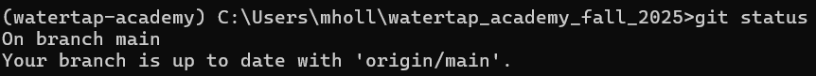
Downloading the Latest Material
To ensure your version of the WaterTAP Academy repo is up to date, go through the following steps:
Verify that you are on the main branch:
git status → will display “On branch main”
If you are not on the main branch, switch to it and check the status:
git checkout main → git status
If your branch is up to date, you should see:
“Your branch is up to date with origin/main”
If your branch is not up to date:
“This branch is behind origin/main by X commits and can be fast-forwarded”
git pull origin main → will update your branch to be in-line with the public repository
NOTE: You may need to commit changes to your current local branch before switching

Slide 7
Tracking and Sharing File Changes
Step 1: Create a local working branch
git branch <branch name>
Step 2: Checkout to your local working branch
git checkout <branch name>
Step 3: Check the status (always recommended)
git status → will tell you that you are now on branch <branch name>
Step 4: Make changes to files
git add <filepath> → Git will track and save all the changes to this file
Step 5: Commit the changes and summarize with a message
git commit –m <message> → Commit messages will be publicly displayed on the PR
Step 6: Push the changes to the main branch
git push myfork-academy <branch name> → creates a link for a public PR
Pro-tip: Combine steps 1 & 2:
git checkout –b <branch name>
Pro-tip: git status will display all the modified files

Slide 8
Working on a Local Branch
Assume you have a new file → new.py that you want to commit
On your local working branch:
git status → should show “new.py” in untracked files
Add the file to be tracked by Git:
git add new.py (Note: you should be in that folder)
Carefully, check and add each file and do not add all files at once.
Do a check on what was added
git status
Commit the file
git commit –m “your commit message”
Check the status again:
git status → should tell you “nothing to commit, working directory clean”
If you made multiple changes, you will see multiple files listed under untracked files
NOTE: Never execute git add --all. Always add one file and know which file is being added.

Slide 9
Helpful GitHub Resources
Simple tutorial from GitHub: https://guides.github.com/activities/hello-world/
GitHub workflow explained: https://guides.github.com/introduction/flow/
Forking projects: https://guides.github.com/activities/forking/
GitHub Docs: https://docs.github.com/en
Git handbook: https://guides.github.com/introduction/git-handbook/
GitHub’s official YouTube channel for video guides:
https://www.youtube.com/githubguides
Highly recommended tutorials:
https://www.atlassian.com/git/tutorials

Slide 10
Thank you
This material is based upon work supported by the National Alliance for Water Innovation (NAWI), funded by the U.S. Department of Energy, Office of Energy Efficiency and Renewable Energy (EERE), Industrial Technologies Office (ITO), under Funding Opportunity Announcement DE-FOA-0001905.
National Energy Technology Laboratory: Adam Atia, Elmira Shamlou, Hunter Barber, Marcus Holly, Chenyu Wang, Alejandro Garciadiego, Maojian Wang, Carolina Tristan
Lawrence Berkeley National Laboratory: Dan Gunter, Keith Beattie, Ludovico Bianchi, Xiangyu Bi, Oluwamayowa Amusat, Michael Pesce
National Renewable Energy Laboratory: Kurby Sitterley, Kinshuk Panda, Zach Binger, Mukta Hardikar, Ben Knueven
Oak Ridge National Laboratory: Johnson Dhanasekaran, Fahim Abdullah, Kris Villez, Srikanth Allu
SLAC National Accelerator Laboratory: Alex Dudchenko
Disclaimer: This presentation was prepared as an account of work sponsored by an agency of the United States Government. Neither the United States Government, nor any agency thereof, nor any of their employees, nor any of their contractors, subcontractors, or their employees, make any warranty, express or implied, or assumes any legal liability or responsibility for the accuracy, completeness, or usefulness of any information, apparatus, product, or process disclosed, or represents that its use would not infringe privately owned rights. Reference herein to any specific commercial product, process, or service by trade name, trademark, manufacturer, or otherwise does not necessarily constitute or imply its endorsement, recommendation, or favoring by the United States Government, any agency thereof, or any of their contractors or subcontractors. The views and opinions of authors expressed herein do not necessarily state or reflect those of the United States Government, any agency thereof, or any of their contractors. Sandia National Laboratories is a multimission laboratory managed and operated by National Technology and Engineering Solutions of Sandia, LLC., a wholly owned subsidiary of Honeywell International, Inc., for the U.S. Department of Energy's National Nuclear Security Administration under contract DE-NA-0003525.

Slide 11
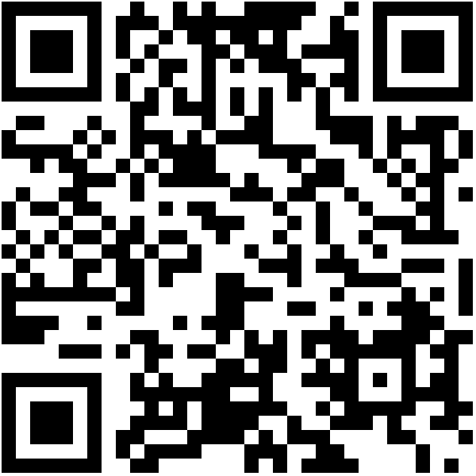
Contact Us!
For general inquiries, collaborations, etc.:
watertap-contact@lbl.gov
For user support on WaterTAP:
watertap-support@lbl.gov
WaterTAP software is publicly released each quarter on GitHub: https://github.com/watertap-org/watertap
WaterTAP Documentation and tutorials: https://watertap.readthedocs.io/en/stable/

