Slide 1
An Overview of Meros
μεροσ
Trilinos User’s Group
Wednesday, November 2, 2005
Victoria Howle
Computational Sciences and Mathematics Research Department (8962)
Sandia is a multiprogram laboratory operated by Sandia Corporation, a Lockheed Martin Company,
for the United States Department of Energy under contract DE-AC04-94AL85000.

Slide 2
Outline
What is Meros?
Motivation & background
  Incompressible Navier–Stokes
  Block preconditioners
Some preconditioners being developed in Meros
A few results from these methods
Code example: user level
Code example: inside Meros
Release plans, etc.
References

Slide 3
What is Meros?
Segregated preconditioner package in Trilinos
Scalable block preconditioning for problems that couple simultaneous solution variables
Initial focus is on (incompressible) Navier-Stokes
Release version in progress
  Updating (from old TSF) to Thyra interface
  Plan to release next Fall ‘06
Team
  Ray Tuminaro
  1414, Computational Mathematics & Algorithms
  Robert Shuttleworth
  Univ. of Maryland, Summer Student Intern 2003, 2004, 2005
Other collaborators
  Howard Elman, University of Maryland
  Jacob Schroder, University of Illinois, Summer Intern 2005
  John Shadid, Sandia, NM
  David Silvester, Manchester Univerity

Slide 4






Where is Meros in The Big Picture
Analyst or Designer
The speed, scalability, and robustness of an application can be heavily dependent on the speed, scalability, and robustness of the linear solvers
Linear algebra often accounts for >80% of the computational time in many applications
Iterative linear solvers are essential in ASC-scale problems
Preconditioning is the key to iterative solver performance
Optimization Code
(e.g., APPSPACK, MOOCHO, Opt++, Split)
Simulation Code
(e.g., MPSalsa, Sierra, Sundance)
Nonlinear Solver
(e.g., NOX)
Linear Solver
(e.g., AZTECOO, Belos)
Preconditioner
(e.g., IFPACK, Meros, ML)
Linear Algebra Kernel
(e.g., Epetra)

Slide 5
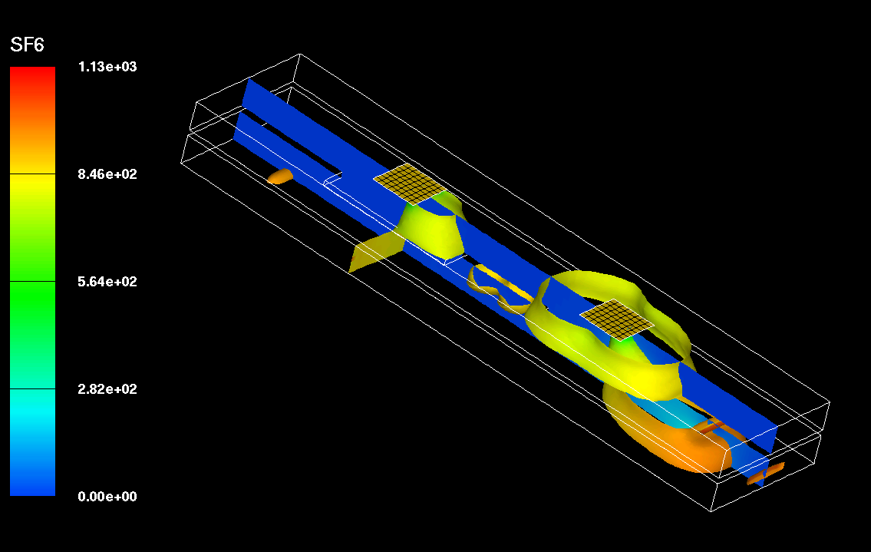
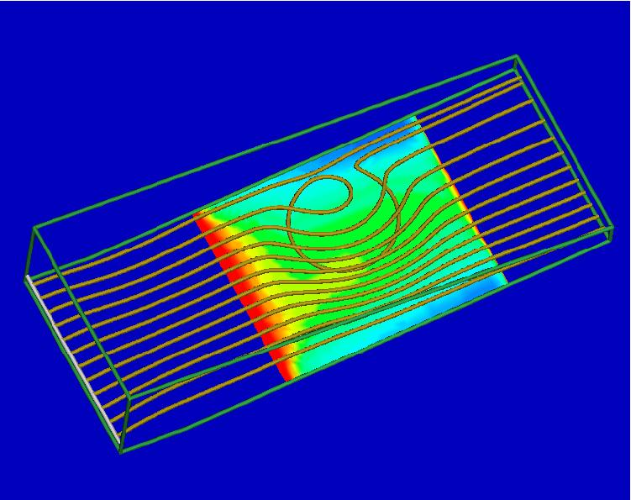
Incompressible Navier–Stokes
Examples of incompressible flow problems
  Airflow in an airport; e.g., transport of an airborne toxin
  Chemical Vapor Deposition
Goal: efficient and robust solution of steady and transient chemically reacting flow applications
Current testbed application: MPSalsa
Early user: Sundance
Related Sandia applications:
  Charon
  ARIA
  Fuego
  …
Airport source detection problem
CVD Reactor

Slide 6
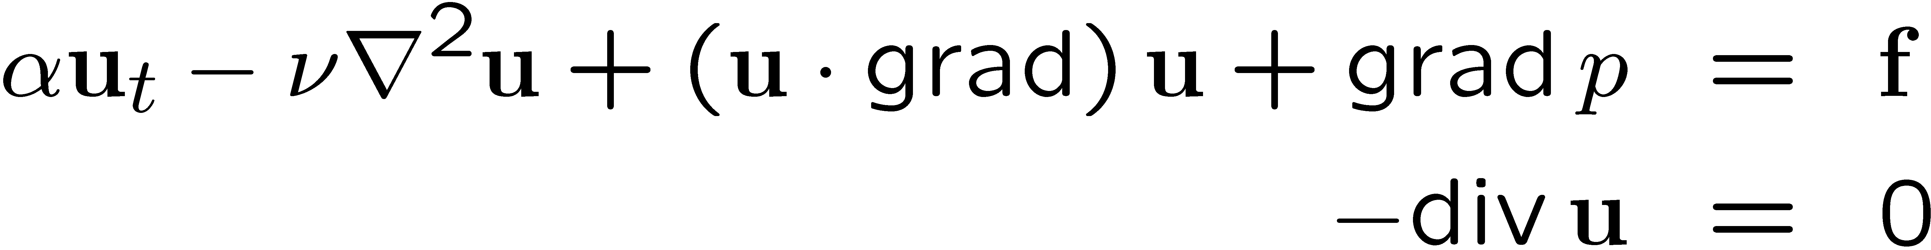
Incompressible Navier–Stokes
α = 0 ) steady state, α = 1 ) transient
(2,2)-block = 0 (unstabilized) or
= C (stabilized)
Incompressibility constraint ) difficult for linear solvers
Chemically reactive flow ⇒ multiphysics; even harder
Indefinite, strongly coupled, nonlinear, nonsymmetric systems

Slide 7
Block preconditioners
Want the scalability of multigrid (mesh-independence)
Difficult to apply multigrid to the whole system
Solution:
  Segregate blocks and apply multigrid separately to subproblems
Consider the following class of preconditioners:
is an optimal (right) preconditioner when is the Schur complement,
(Assuming C = 0)
Notes:
Recent class of promising methods
Focus on Schur complement issues

Slide 8
Choosing (Kay & Loghin, F_{p})
Key is choosing a good Schur complement approximation
to
Motivation: move F⁻¹ so that it does not appear between G^{T} and G
Suppose we have an F_{p} such that
Then
And
Giving
(Kay, Loghin, & Wathen; Silvester, Elman, Kay & Wathen)
(A_{p} is pressure Poisson)

Slide 9
Other Choices for
Kay & Loghin F_{p} method works well, but…
  F_{p} is not a standard operator for apps
  (pressure convection–diffusion)
  Can be difficult for many applications to provide
  Even if they can provide it, they don’t really want to
Other options for :
Algebraic pressure convection–diffusion methods:
  Sparse Approximate Commutator (SPAC)
  Least Squares Commutator (LSC)
Algebraically determine an operator F_{p} such that

Slide 10
Algebraic Commutators
Build F_{p} column by column via ideas similar to sparse approximate inverses (e.g., Grote & Huckle) ) Sparse Approximate Commutators (SPAC)
  F_{p} is no longer a pressure convection-diffusion operator
Minimize via normal equations ) Least Squares Commutators (LSC)
The tilde’s are hiding an issue of algebraic vs. differential commuting

Slide 11
Stabilized LSC (C ≠ 0)
Certain discretizations require stabilization
Stabilization term C
For certain discretizations (G^{T}G) is unstable
  Blows up on high frequencies
  C built to stabilize
Preconditioner
also needs stabilization
  In 3 places
  Use C for preconditioner stabilization, too

Slide 12

F_{p} vs. DD results:
Flow over a diamond in MPSalsa
Linear solve timings
Steady state (harder than transient
for linear algebra)
Parallel (on Sandia’s ICC)
Re = 25
Using development version of Meros hooked into MPSalsa through NOX
Unknowns (Procs) | DD (seconds) | F_{p} (seconds)
62K (1) | 199 | 368
256K (4) | 1583 | 736
1M (16) | 7632 | 1428
4M (64) | failed | 5532
Notes:
Figure out what the picture really is showing.
Mention DD fails (but Fp converges) on med size parallel problem for LDC
Mention transient results

Slide 13
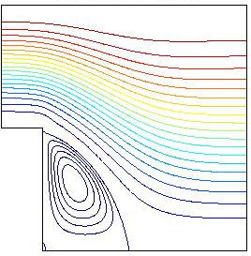
(Matlab) Results: F_{p}, LSC, and SPAC
Linear iterations for backward facing step problem on underlying 64x192 grid, Q₂-Q₁ (stable) discretization.
Linear iterations for backward facing step problem on underlying 128x384 grid, Q₂-Q₁ (stable) discretization.
Results from ifiss
  Academic software package that incorporates our new methods and a few other methods (Elman, Silvester, Ramage)
Re | F_{p} | LSC | SPAC
10 | 30 | 19 | 23
100 | 42 | 21 | 30
200 | 47 | 22 | 41
Re | F_{p} | LSC | SPAC
10 | 33 | 23 | 32
100 | 58 | 29 | 39
200 | 63 | 29 | 60

Slide 14
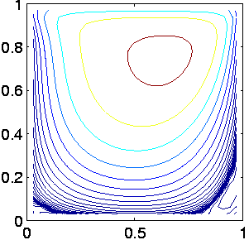
(Matlab) Results: F_{p}, LSC, Stabilized LSC
Linear iterations for lid driven cavity problem on 32x32 grid,
Q₁-Q₁ (needs stabilization) discretization.
Results from ifiss
Re | F_{p} | LSC | Stabilized LSC
100 | 27 | 151 | 16
500 | 57 | 197 | 29
1000 | 80 | 228 | 44
5000 | 130 | 320 | 83

Slide 15
Transition promising academic methods into methods for ASC applications
Promising methods have been developed
We have extended these methods mathematically to suit more realistic needs
  Removing need for nonstandard operators
  Stabilization
Currently, software for these methods is mostly in academic (Matlab) codes
Now need to develop software to make them available to more real-world apps through Trilinos

Slide 16
Meros
Initial focus is on preconditioners for Navier-Stokes
A number of solvers are being incorporated:
  Pressure convection-diffusion preconditioners
  (today’s focus)
    F_{p} (Kay & Loghin)
    LSC (and stabilized LSC)
    (SPAC?)
  Pressure-projection methods
  E.g., SIMPLE (SIMPLEC, SIMPLER, etc.)

Slide 17



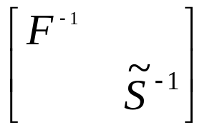
Trilinos packages in an MPSalsa example
Time Loop
Component
Methods
Package
Nonlinear
Loop
MPSalsa
Finite Element
Epetra
Linear
Solver
Nonlinear
Solver
Newton-Krylov
Methods
NOX
Block
Precond
Linear
Solver
GMRESR
Aztec00
(Epetra, Thyra)
block
preconditioner
Meros
(Thyra)
End NonLin
Loop
End Time
Loop
F⁻¹ : GMRES/AMG
Ŝ⁻¹ : CG/AMG
Aztec00, ML
Epetra

Slide 18
Meros & Trilinos
Meros is a package within Trilinos
Meros is also a user of many other Trilinos packages
Depends on:
  Thyra
  Teuchos
  (Epetra)
Currently uses:
  AztecOO
  IFPACK
  ML
Could use:
  Belos
  Amesos
  …

Slide 19
Example preconditioner:
First set up abstract solvers for inner solves
// WARNING: Assuming TSF-style handles and assuming I have typedeffed
// to hide the Templating
// WARNING: Examples include functionality that is not yet available in Thyra
// Meros builds a PreconditionerFactory so we can pass it to an abstract linear solver
// E.g., K & L preconditioner needs the saddlepoint matrix A, plus F_{p} and A_{p},
// and choices of solvers for F and A_{p}
// Inner F solver options:
Teuchos::ParameterList FParams;
FParams.set(“Solver”, “GMRES”);
FParams.set(“Preconditioner”, “ML”);
FParams.set(“Max Iters”, 200);
FParams.set(“Tolerance”, 1.0e-8); // etc
LinearSolver FSolver = new AztecSolver(FParams);
// Inner Ap solver options:
ApParams.set(“Solver”, “PCG”);
ApParams.set(“Preconditioner”, “ML”); // etc
LinearSolver ApSolver = new AztecSolver(ApParams);

Slide 20
Next set up Schur complement approx. and build the preconditioner
// Set up Schur complement approx factory (with solvers if necessary)
SchurFactory sfac = new KayLoghinSchurFactory(ApSolver);
// Build preconditioner factory with these choices
PreconditionerFactory pfac = new KayLoghinFactory(outerMaxIters,
outerTol, FSolver, sfac, …)
// Group operators that are needed by preconditioner
OperatorSource opSrc = new KayLoghinOperatorSource(saddleA, Fp, Ap);
// Use preconditioner factory directly in an abstract solver
outerParams.set(“Solver”,”GMRESR”); // etc
LinearSolver solver = new AztecSolver(outerParams);
SolverState solverstate = solver.solve(pfac, opSrc, rhs, soln);

Slide 21
Example (cont.)
// Get Thyra Preconditioner from factory for a particular set of ops
Preconditioner Pinv = pfac.createPreconditioner(opSrc);
// Get Thyra LinearOpWithSolve to use precond op more directly
LinearOperator Minv = Pinv.right();
outerParams.set(“Solver”,”GMRESR”);
LinearSolver solver = new AztecSolver(outerParams);
SolverState solverstate = solver.solve(A*Minv, rhs, intermediateSoln);
soln = Minv * intermediateSoln;
// Simple constructors will make intelligent choices of defaults:
PreconditionerFactory pfac = new KayLoghinFactory(maxIters, Tol);
// Still need the appropriate operators for the chosen method
// (some can be built algebraically by default if not given, e.g., SPAC)
OperatorSource opSrc = new OperatorSource(A, Fp, Ap);

Slide 22
Inside createPreconditioner()
// Build the preconditioner given 2x2 block matrix (etc.)
Preconditioner KayLoghinFactory::createPreconditioner(…)
{
// Get F, G, G^{T} blocks from the block operators
LinearOperator F = A.getBlock(1,1);
LinearOperator G = A.getBlock(1,2);
LinearOperator Gt = A.getBlock(2,1);
// LinearOperators Ap and Fp built here or gotten from OpSrc
// Set up F solve (given solver and parameters or build with defaults)
LinearOpWithSolve Finv = F.inverse(FSolver);

Slide 23
createPreconditioner() (cont.)
// Setup Schur complement approximation and solver
// (given by user or build using defaults)
LinearOpWithSolve Apinv = Ap.inverse(ApSolver);
LinearOperator Sinv = -Fp * Apinv;
// Or if we were building an LSC preconditioner
LinearOperator GtG = Gt * G;
LinearOpWithSolve GtGinv = Ap.inverse(ApSolver);
LinearOperator Sinv = -GtGinv * Gt * F * G * GtGinv;

Slide 24
createPreconditioner() (cont.)
LinearOperator Iv = IdentityOperator(F.domain()); // velocity space
LinearOperator Ip = IdentityOperator(G.domain()); // pressure space
// Domain and range of A are Thyra product spaces, velocity x pressure
LinearOperator P1 = new BlockLinearOp(A.domain(),A.range());
LinearOperator P2 = new BlockLinearOp(A.domain(),A.range());
LinearOperator P3 = new BlockLinearOp(A.domain(),A.range());
P1.setBlock(1,1,Finv);
P1.setBlock(2,2,Ip);
P2.setBlock(1,1,Iv);
P2.setBlock(2,2,Ip);
P2.setBlock(1,2,G);
P3.setBlock(1,1,Iv);
P3.setBlock(2,2,Sinv);
return new GenericRightPreconditioner(P1*P2*P3);
}

Slide 25
Plans & Info
Planning to release Meros 1.0 in Fall ’06
(with closest major Trilinos release)
Initial block preconditioner selection should include:
  Pressure Convection-Diffusion
    Kay & Loghin (F_{p})
    Least Squares Commutator (LSC)
    SPAC?
  Pressure Projection
    SIMPLE
    SIMPLEC, SIMPLER?
Web page: software.sandia.gov/Trilinos/packages/meros/index.html
Mailing lists: Meros-Announce, Meros-Users, etc.
vehowle@sandia.gov

Slide 26
References
Elman, Silvester, and Wathen, Performance and analysis of saddle point preconditioners for the discrete steady-state Navier-Stokes equations, Numer. Math., 90 (2002), pp. 665-688.
Kay, Loghin, and Wathen, A preconditioner for the steady-state Navier-Stokes equations, SIAM J. Sci. Comput., 2002.
Elman, H., Shadid, and Tuminaro, A Parallel Block Multi-level Preconditioner for the 3D Incompressible Navier-Stokes Equations, J. Comput. Phys, Vol. 187, pp. 504-523, May 2003.
Elman, H., Shadid, Shuttleworth, and Tuminaro, Block Preconditioners Based on Approximate Commutators, to appear in SIAM J. Sci. Comput., Copper Mountain Special Issue, 2005.
Elman, H., Shadid, and Tuminaro, Least Squares Preconditioners for Stabilized Discretizations of the Navier-Stokes Equations, in progress.

