Slide 1
AUTOSAR-CAN DRIVER MODULE
UIT Training - 2019

Slide 2
Contents
1. CAN Protocol
2. CAN Driver Module
3. Functional Specification
4. Configurations & Generation Tool
5. Functional Testing
6. Q&A

Slide 3
1. CAN Protocol

Slide 4
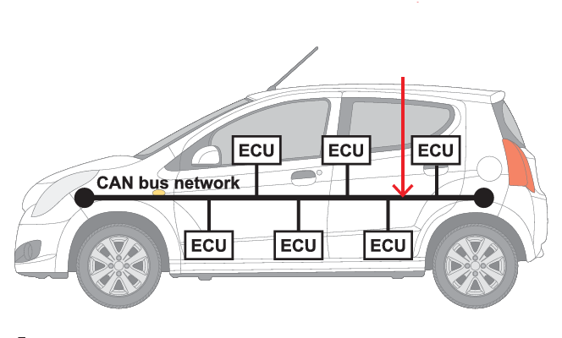
1.1. What is CAN?
Controller Area Network (CAN): is a robust vehicle bus standard designed to allow ECUs in vehicle to communicate with each other without a host computer. So called multi-master communication.
It is a message-based protocol and Asynchronous communication.
Two wires base (CAN-H, CAN-L)
Notes:
Question: Any one know about CAN protocol?

Slide 5
1.2. History Briefly
1983: CAN bus Development started at Robert Bosch GmbH.
1991: Bosch published several versions of the CAN spec, at least two are published:
CAN 2.0A: standard format with an 11-bit identifier.
CAN 2.0B: extended format with an 29-bit identifier.
Notes:
What is ISO?

Slide 6
1.2. History Briefly
1993: the ISO released the CAN standard ISO 11898:
ISO 11898-1: covers the data link layer.
ISO 11898-2: covers the CAN physical layer for high-speed CAN.
ISO 11898-3: covers the CAN physical layer for low-speed/fault-tolerant CAN.

Slide 7
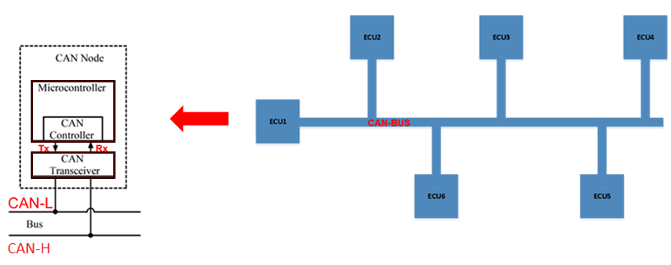
1.3. CAN Physical Layers – Basic
Notes:
Reference: https://en.wikipedia.org/wiki/CAN_bus

Slide 8
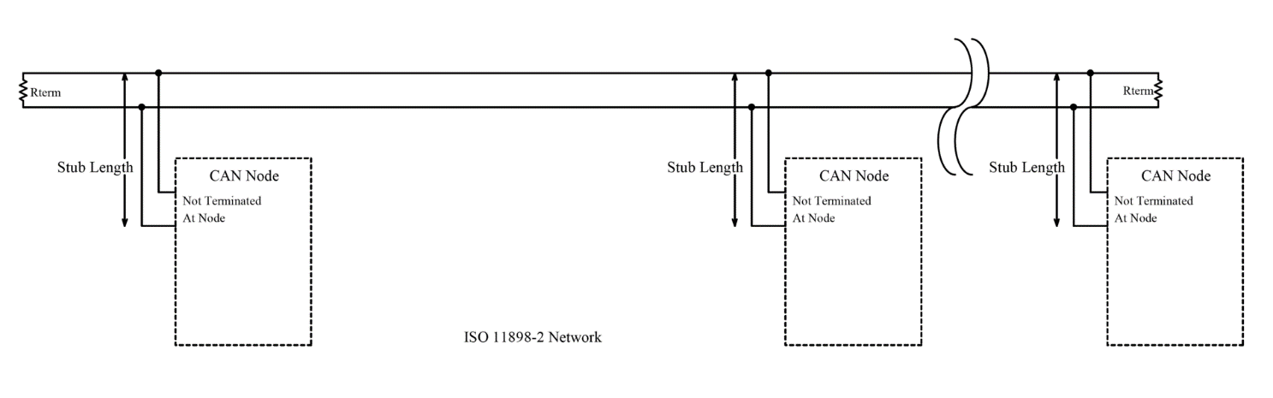
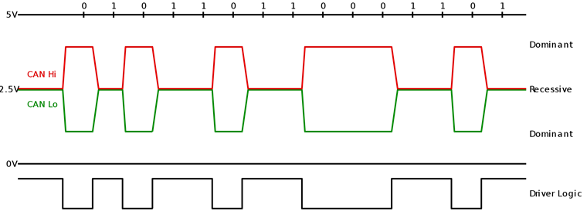
1.4. CAN Physical Layers – 11898-2
Terminated by
120 Ohm resister
CAN-H/CAN-L
Tx/Rx Pin
Notes:
Note:
Reference: https://en.wikipedia.org/wiki/CAN_bus
ISO 11898-2, also called high speed CAN (bit speeds up to 1Mb/s on CAN, 5Mb/s on CAN-FD), uses a linear bus terminated at each end with 120 Ω resistors.
Dominant (0) : The dominant differential voltage is a nominal 2 V.
Recessive (1) : The recessive differential voltage is a nominal 0 V.
Question: Dominant and Recessive?

Slide 9
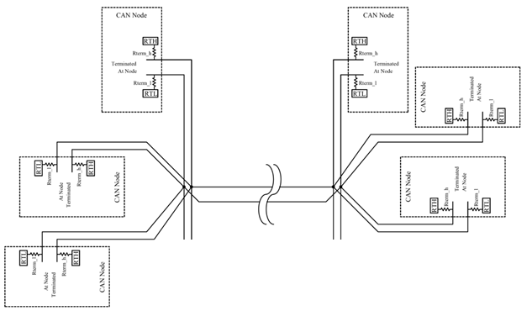
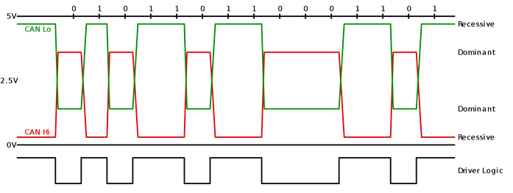
1.5. CAN Physical Layers – 11898-3
Terminated by 100 Ohm resister
CAN-L
CAN-H
Tx/Rx pin
Notes:
Note:
Reference: https://en.wikipedia.org/wiki/CAN_bus
ISO 11898-3, also called low speed or fault tolerant CAN (up to 125 Kbps), uses a linear bus, star bus or multiple star buses connected by a linear bus and is terminated at each node by a fraction of the overall termination resistance. The overall termination resistance should be about 100 Ω, but not less than 100 Ω.
The dominant differential voltage must be greater than 2.3 V (with a 5 V Vcc)
The recessive differential voltage must be less than 0.6 V

Slide 10
Question?
What are main differences between High-speed and Low speed?
When do we use high-speed network? Or Low speed network?
How does it impact to network distance?

Slide 11
1.6. CAN Terminologies (FRAME TYPES)
There are 4 Frame types:
Data Frame: a frame containing node data for transmission
Remote Frame: a frame requesting the transmission of a specific identifier
Error Frame: a frame transmitted by any node detecting an error
Overload Frame: a frame to inject a delay between data or remote frame
Notes:
Note:
Reference: https://en.wikipedia.org/wiki/CAN_bus
For AUTOSAR Spec: Only support transmit Can Data Frame
Error frame:
The error frame consists of two different fields:
The first field is given by the superposition of ERROR FLAGS (6–12 dominant/recessive bits) contributed from different stations.
The following second field is the ERROR DELIMITER (8 recessive bits).
There are two types of error flags:
Active Error Flag six dominant bits – Transmitted by a node detecting an error on the network that is in error state "error active".
Passive Error Flag six recessive bits – Transmitted by a node detecting an active error frame on the network that is in error state "error passive".
There are two error counters in CAN:
Transmit error counter (TEC)
Receive error counter (REC)
Error state when:
When TEC or REC is greater than 127 and lesser than 255, a Passive Error frame will be transmitted on the bus.
When TEC and REC is lesser than 128, an Active Error frame will be transmitted on the bus.
When TEC is greater than 255, then the node enters into Bus Off state, where no frames will be transmitted.

Slide 12
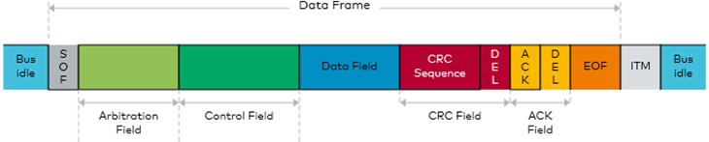
1.7. CAN Terminologies-DATA FRAME
CLASSIC CAN and CAN-FD
Classic CAN: support transmission up to 8 data bytes and Speed is up to 1Mbps
CAN-FD: supports transmission up to 64 data bytes and Speed is up to 8Mbps
Standard CAN Identifier and Extended CAN Identifier
Standard ID: 11 bits ID
Extended ID: 29 bits ID
Notes:
Refer: D:\00_Generic\00_Slide_Sharing_Training\01_AIS\02_CAN_DRIVER\Ref\CAN_DATA_FRAME.xlsx

Slide 13
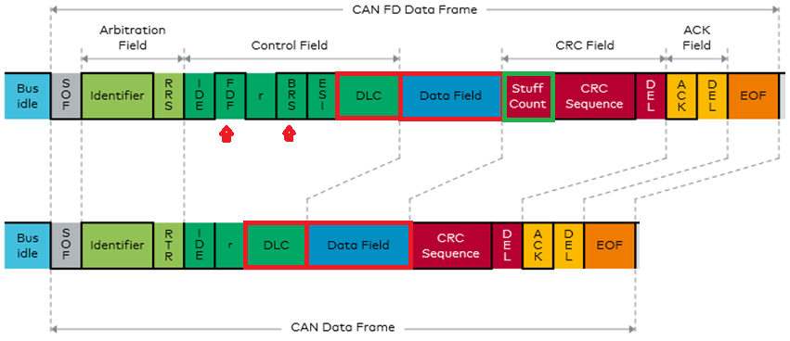
1.7.1 CAN-FD vs CLASSIC CAN
Notes:
Classic CAN: support transmission up to 8 data bytes and Speed is up to 1Mbps
CAN-FD: supports transmission up to 64 data bytes and Speed is up to 8Mbps

Slide 14
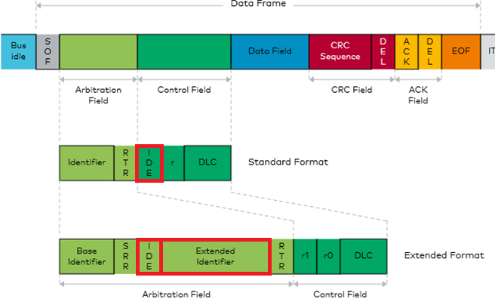
1.7.2 Standard ID vs Extended ID

Slide 15
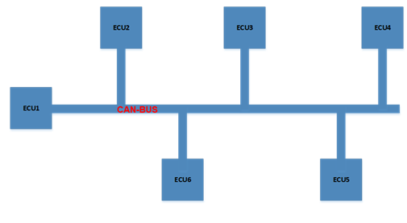
1.8. How CAN Communication works?
Principle of Bus Arbitration
SUFFING BIT

Slide 16
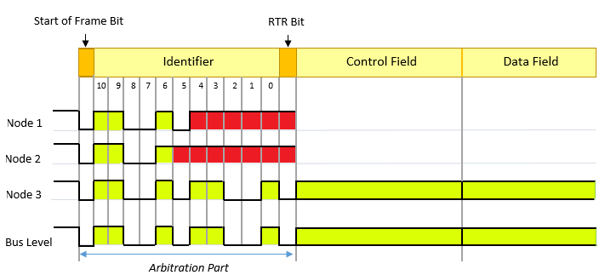
1.8.1. Bus Arbitration
Notes:
Note:
Message IDs must be unique on a single CAN bus, otherwise two nodes would continue transmission beyond the end of the arbitration field (ID) causing an error.
Node has smaller ID it will have higher priority for transmit data on bus

Slide 17
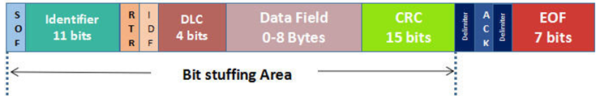
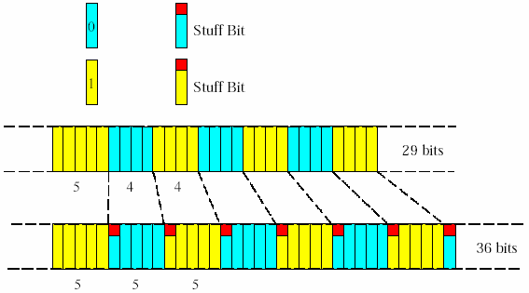
1.8.2. SUFFING BIT
Notes:
Note:
- To ensure enough transitions to maintain synchronization, a bit of opposite polarity is inserted after five consecutive bits of the same polarity. This practice is called bit stuffing, and is necessary due to the non-return to zero (NRZ) coding used with CAN. The stuffed data frames are destuffed by the receiver.
- All fields in the frame are stuffed with the exception of the CRC delimiter, ACK field and end of frame which are a fixed size and are not stuffed. In the fields where bit stuffing is used, six consecutive bits of the same polarity (111111 or 000000) are considered an error. An active error flag can be transmitted by a node when an error has been detected. The active error flag consists of six consecutive dominant bits and violates the rule of bit stuffing.

Slide 18
2. AUTOSAR CAN DRIVER

Slide 19
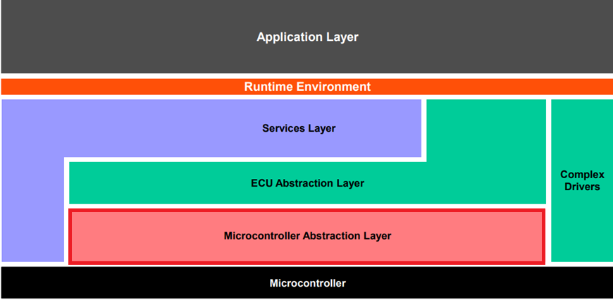
2.1. CAN-DRIVER (AUTOSAR-MCAL)
Notes:
Refer: AUTOSAR_EXP_LayeredSoftwareArchitecture..pdf

Slide 20
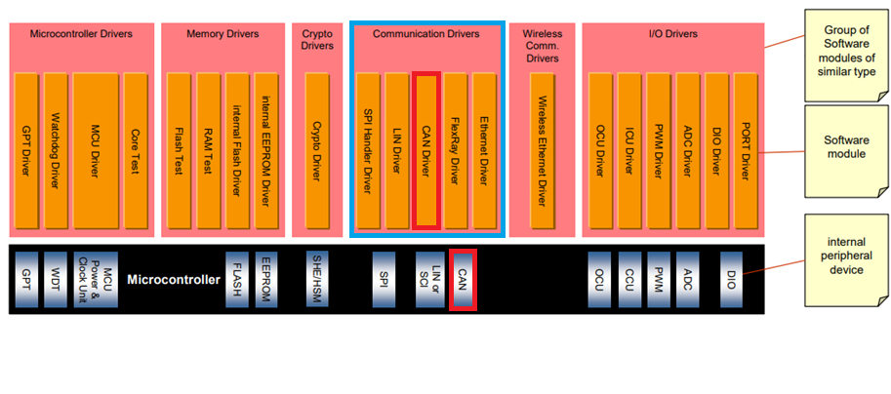
2.1. CAN-DRIVER (Communication)
Notes:
Refer: AUTOSAR_EXP_LayeredSoftwareArchitecture..pdf

Slide 21
2.2. CAN-DRIVER (CAN-COM STACK)

Slide 22
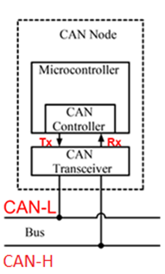
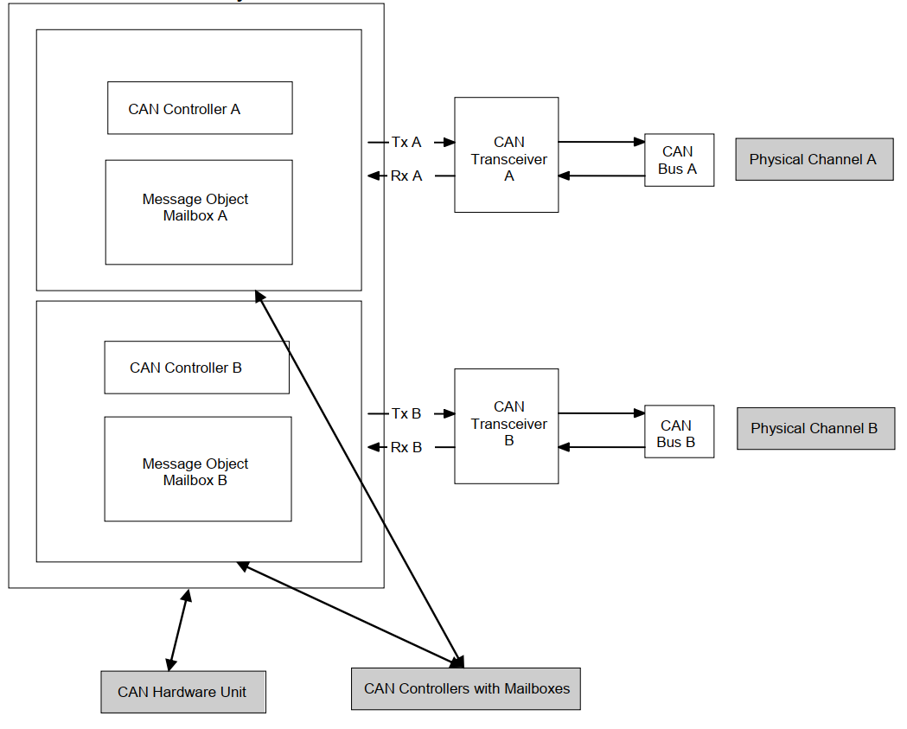
2.3. CAN DRIVER-SCOPE

Slide 23
2.3. How to investigate (SRS/SWS)
https://www.autosar.org/standards/classic-platform/
AUTOSAR_SRS_CAN
AUTOSAR_SWS_CANDriver

Slide 24
2.3.1. AUTOSAR_SRS_CAN
Requirements on CAN-Stack
Functional Requirements:
Initialization
Normal Operation
Fault Operation
…
Non-Functional Requirements:
Timing Requirements
Resource Usage
…
Refer: AUTOSAR_SRS_CAN.pdf

Slide 25
2.3.2 AUTOSAR_SWS_CANDriver
Driver Source Code:
Provided services
Type Definitions
APIs Specifications
Configuration:
CanGeneral
CanConfigSet
Refer: AUTOSAR_SWS_CANDriver
Notes:
Link: D:\00_Generic\03_Autosar\4.3.0\Software-Architecture_Communication-Stack\standard\AUTOSAR_SWS_CANDriver.pdf

Slide 26
3. Functional Specification

Slide 27
3.1. INTERACT/DEPEND MODULES

Slide 28
3.1.1 MCU/PORT/INTC
MCU will init clock that will be used for CAN hardware
PORT will configure Tx/Rx pin for CAN driver
INTC will handle disable/enable interrupt that was generated by CAN hardware

Slide 29
3.1.2 CAN-IF, EcuM, OS, SchM
CAN-IF: main user of CAN-Driver
EcuM: Init Can driver at start up time. Also validate wake-up event from CAN bus.
OS: provide OsCounter service that was used inside Can Driver for counting timeout
SchM: process event for related Can MainFunction and protection share resource of internally Can module.

Slide 30
3.1.3 DET, DEM
CAN-DRV will report Development Errors to DET (DefaultErrorTracer)
CAN-DRV will report Production Errors to DEM (DiagnosticEventManager)
Refer:
AUTOSAR_SWS_DefaultErrorTracer
AUTOSAR_SWS_DiagnosticEventManager
Notes:
What is Development Error and Production Error?

Slide 31
3.2. Provided Services
De-Initialize/Initialize CAN Hardware Unit
Get Module Version Info
Set/Get Controller State
Transmit/Receive L-PDU frame
Sleep and Wake up over CAN bus
Change Baud-rate during run-time
Bus-error monitoring (Error active/passive, bus-off)
Disable/Enable Can Controller Interrupts
Active/De-active Pretended Networking

Slide 32
3.2.1 Init/DeInit & State Machine
De-Initialize/Initialize CAN Hardware Unit (Controller, Buffer, Filter)
Managing Controller State
N.o | Api | Description
1 | Can_Init | This function initializes the module.
2 | Can_DeInit | This function de-initializes the module.
N.o | Api | Description
1 | Can_SetControllerMode | This function performs software triggered state transitions of the CAN controller State machine.
2 | Can_GetControllerMode | This service reports about the current status of the requested CAN controller.

Slide 33
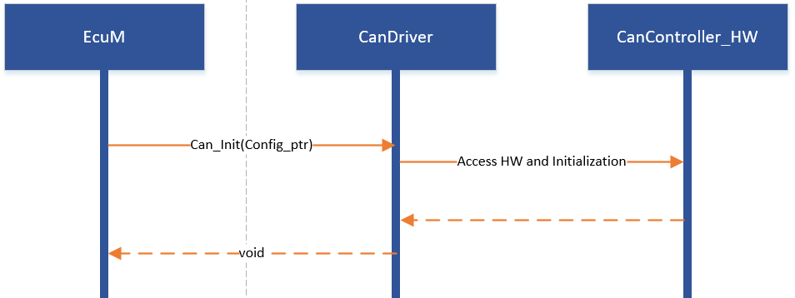
3.2.1.1 Init/DeInit
Normally, Can_Init will be called be EcuM module once.
Depends on specific HW, Follow chart can be customized.

Slide 34
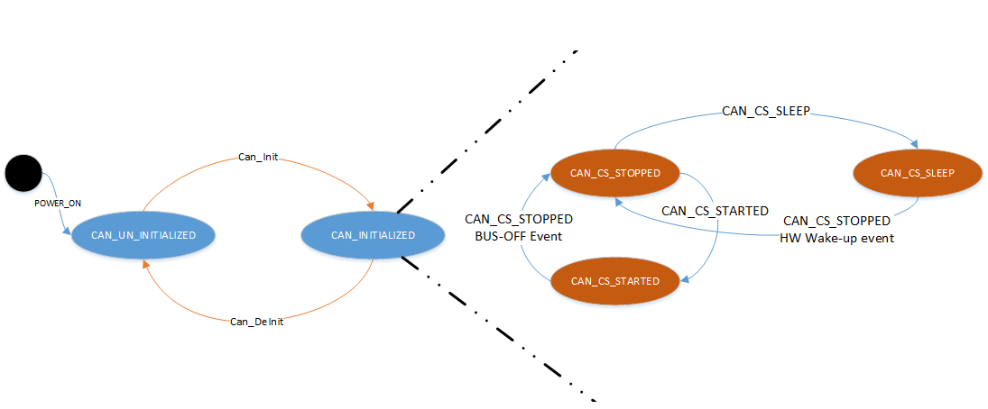
3.2.1.2 State Machine
CanDriver State
CanController State

Slide 35
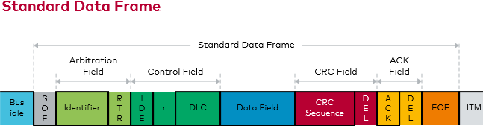
3.2.2 Transmission/Reception
Question: Which part of CAN-Data frame will “Can Driver module” handle?
Notes:
Note: Question
Which part of frame

Slide 36
3.2.2.1 Transmission
Transmit request
Transmit Checking and Notification
N.o | Api | Description
1 | Can_Write | This function is called by CanIf to pass a CAN message to CanDrv for transmission.
N.o | Api | Description
1 | Can_MainFunction_Write | This function performs the polling of TX confirmation when CAN_TX_PROCESSING is set to POLLING
Notes:
Note:
Question:
POLLING vs INTERRUPT mode
OS Task

Slide 37
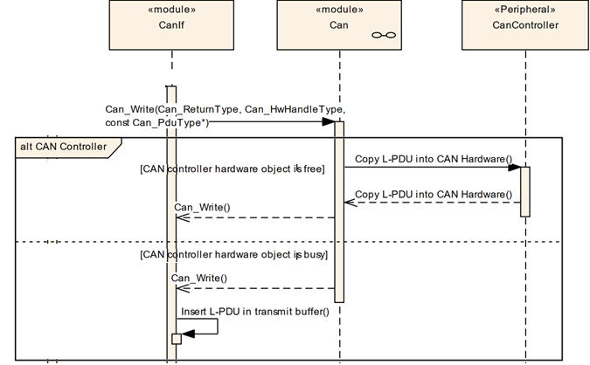
3.2.2.2 Transmit request
Notes:
Refer: 9.1 Transmit request in CanIf SWS.

Slide 38
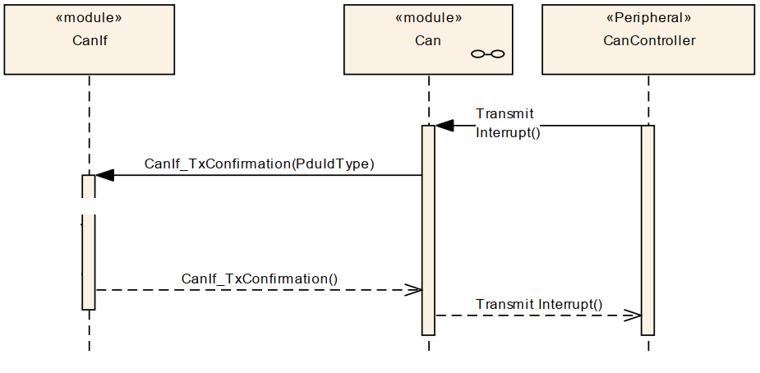
3.2.2.3 Transmit confirm (Interrupt)
Notes:
Refer: 9.3 Transmit confirmation (interrupt mode) in CANIF SWS

Slide 39
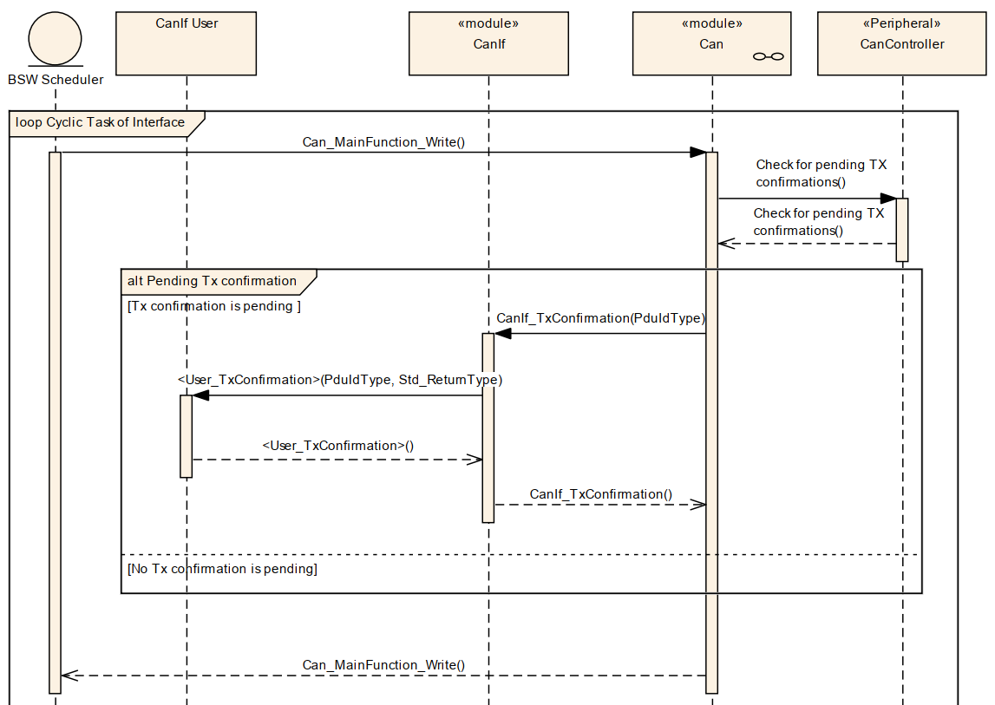
3.2.2.4 Transmit confirm (Polling)
Notes:
Refer: 9.4 Transmit confirmation (polling mode) in SWS CAN-IF

Slide 40
3.2.2.5 Reception
Transmit Checking and Notification
N.o | Api | Description
1 | Can_MainFunction_Read | This function performs the polling of TX confirmation when CAN_TX_PROCESSING is set to POLLING
Notes:
Note:
Question:
POLLING vs INTERRUPT mode
OS Task

Slide 41
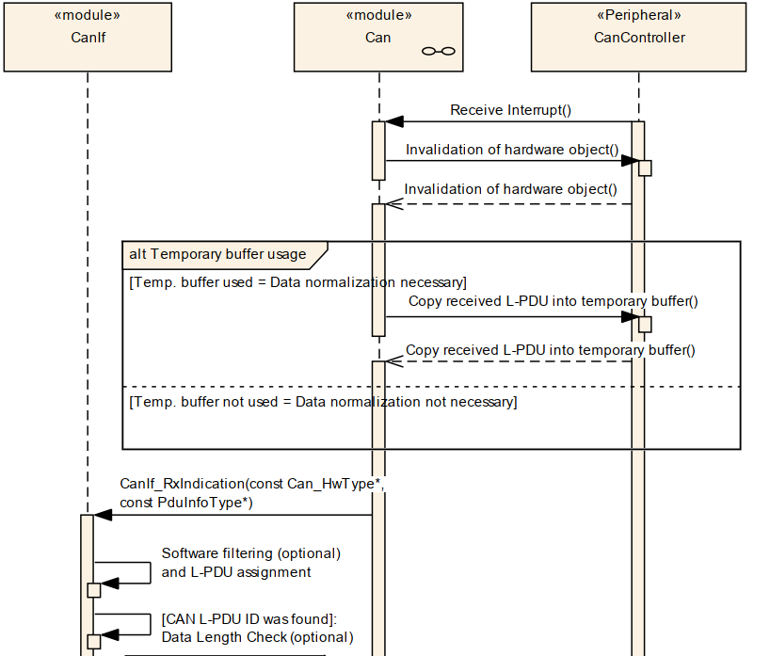
3.2.2.6 Reception-Indication Interrupt
Notes:
Note:
Question:
POLLING vs INTERRUPT mode
OS Task

Slide 42
3.2.2.7 Reception-Indication Polling
Refer: 9.9 Receive indication (polling mode)

Slide 43
3.2.3 Sleep and Wake-up
Refer 9.2.3 CAN Wakeup Sequences in EcuM module
Supports POLLING MODE and INTERRUPT MODE
N.o | Api | Description
1 | Can_MainFunction_Wakeup | This function performs the polling of wake-up events that are configured statically as 'to be polled'.

Slide 44
3.2.4 Change Baud-rate
N.o | Api | Description
1 | Can_SetBaudrate | This service shall set the baud rate configuration of the CAN controller. Depending on necessary baud rate modifications the controller might have to reset.

Slide 45
3.2.5 Bus-error monitoring
N.o | Api | Description
1 | Can_MainFunction_BusOff | This function performs the polling of bus-off events that are configured statically as 'to be polled'.

Slide 46
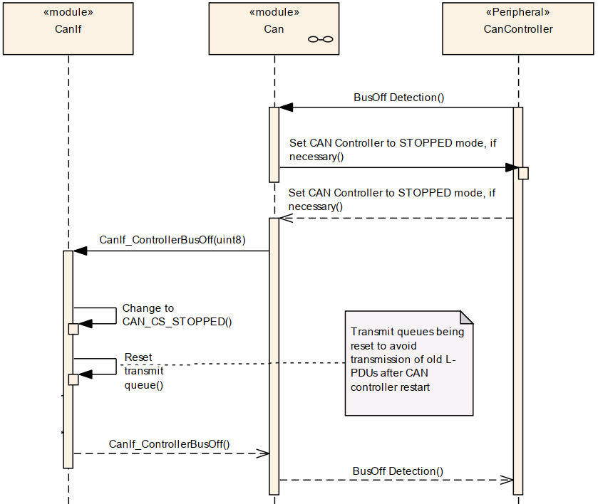
3.2.5 Bus-error monitoring

Slide 47
3.2.6 Disable/Enable Interrupts
N.o | Api | Description
1 | Can_DisableControllerInterrupts | This function disables all interrupts for this CAN controller.
2 | Can_EnableControllerInterrupts | This function enables all allowed interrupts

Slide 48
3.2.8 Pretended Networking
Pretended Networking and Partial Networking
Refer: AUTOSAR_EXP_LayeredSoftwareArchitecture.pdf
N.o | Api | Description
1 | Can_SetIcomConfiguration | This service shall change the Icom Configuration of a CAN controller to the requested one.

Slide 49
4. Configurations & Generation Tool

Slide 50
6.1. Configuration
Introducing by CAN driver Design:
“PDF Excel File”

Slide 51
5. Functional Testing (IT)

Slide 52
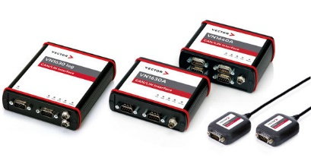
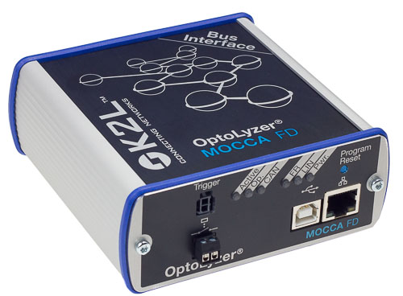
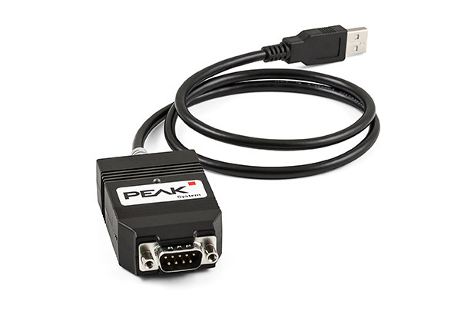
7.1. Supported Testing Tool/Devices

Slide 53
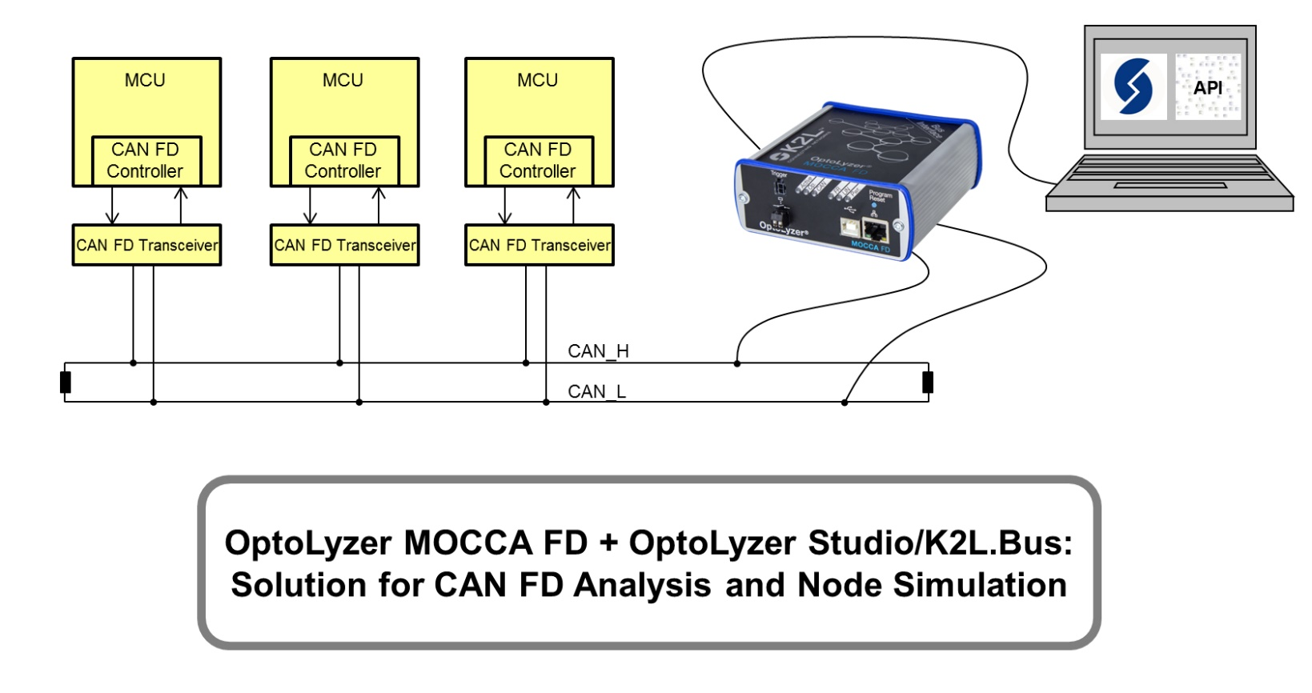
7.1. Supported Testing Tool/Devices

