Slide 1
Khóa 3 (IoT) - Buổi II Câu lạc bộ lập trình nhúng CEEC

Slide 2
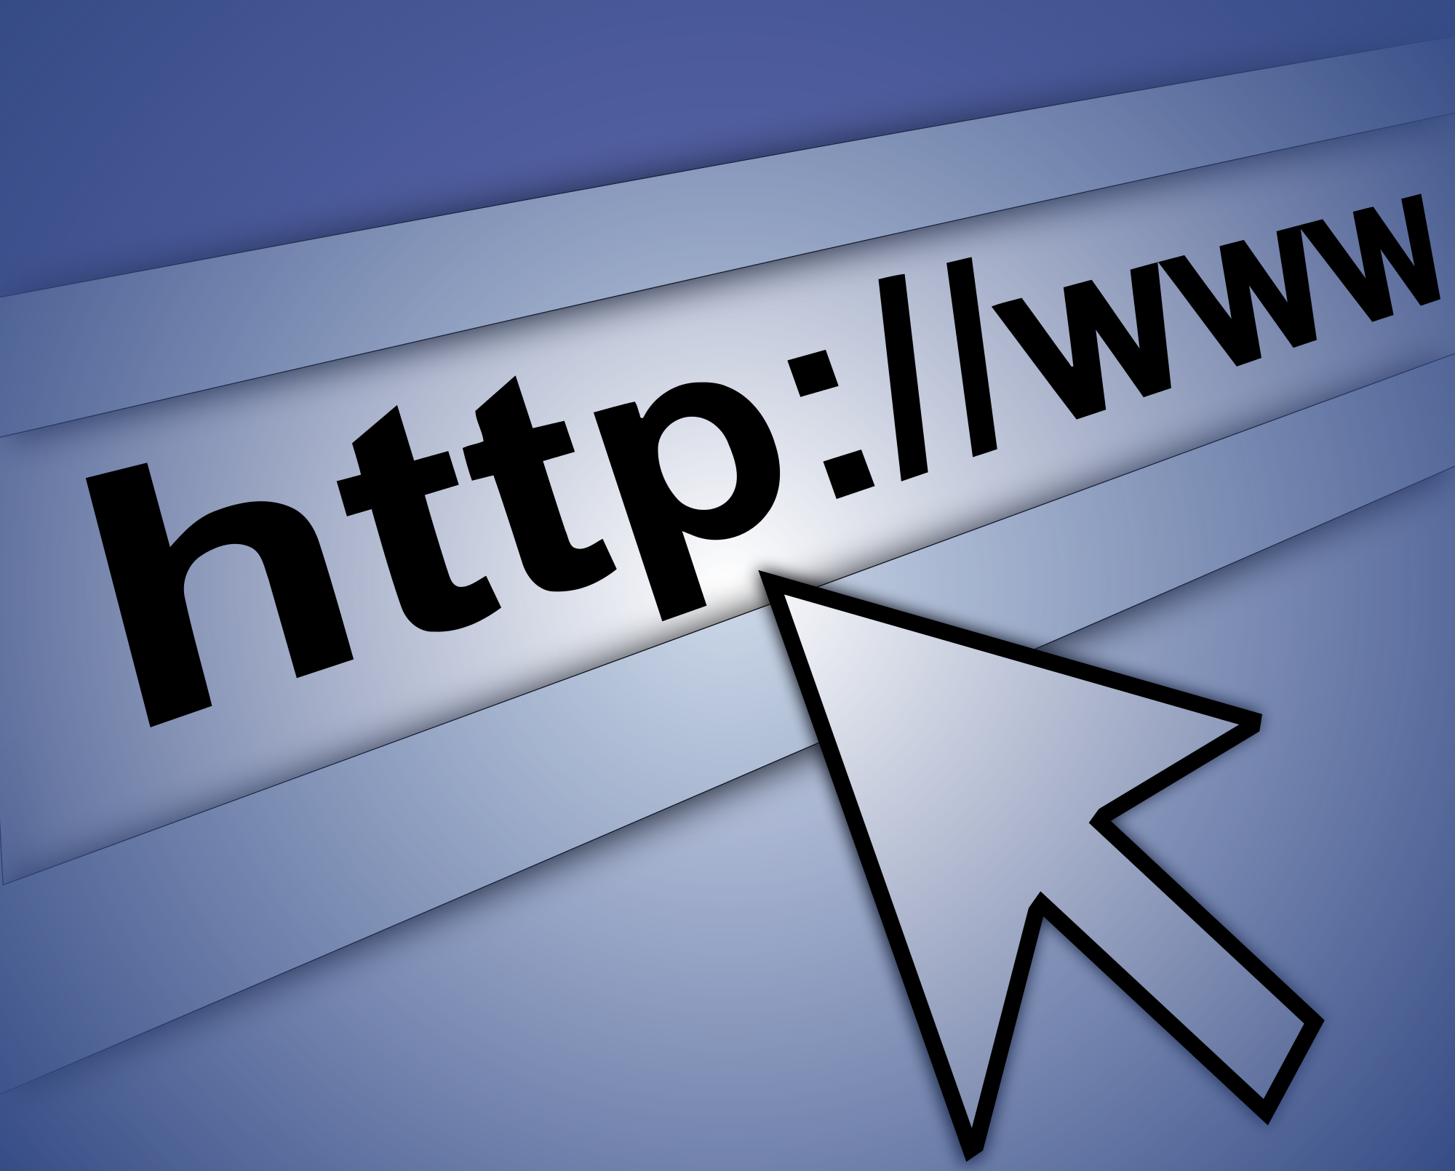
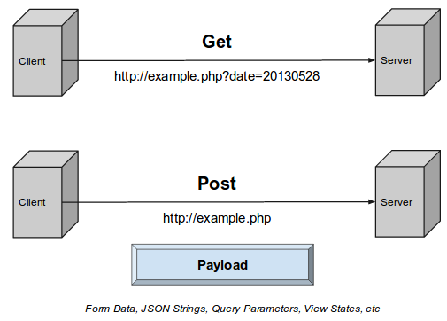
Instructions
HTTP
GET-POST Request
More info about them
https://vi.wikipedia.org/wiki/Hypertext_Transfer_Protocol
https://www.w3.org/Protocols/rfc2616/rfc2616-sec5.html
<number>

Slide 3
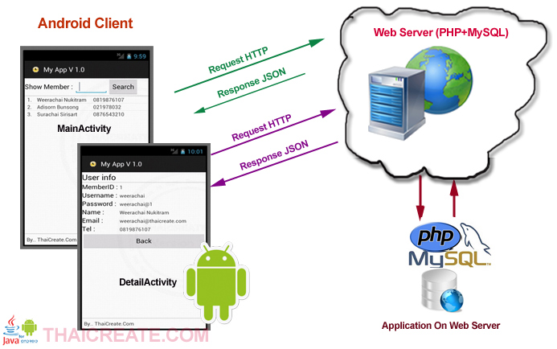
What I can do?
<number>

Slide 4
1
GET-POST
Let’s start with the first step of things

Slide 5
Mục tiêu:
Send request đến Webserver
Handle dữ liệu bằng Webserver
Nhận và in ra dữ liệu
<number>

Slide 6
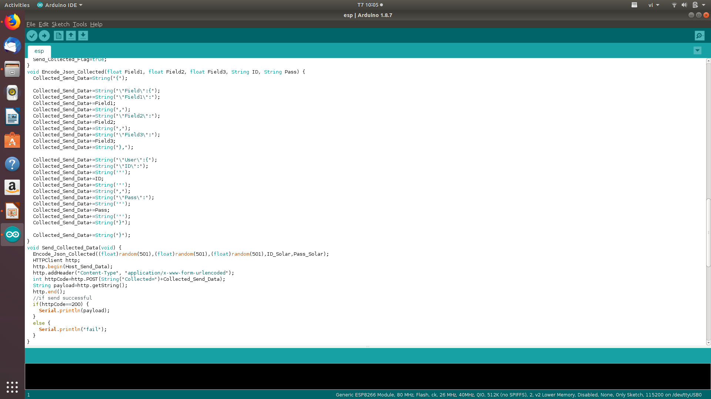
<number>

Slide 7
1. Thu thập dữ liệu
2. Gửi request lên Webserver
3. Webserver nhận dữ liệu và xử lí
4. Webserver gửi dữ liệu về cho ESP
5. ESP nhận dữ liệu và xử lí
<number>

Slide 8
More
Làm việc với Database
<number>

Slide 9
Mục tiêu:
Gửi dữ liệu để thay đổi database
Nhận dữ liệu từ database và xử lí
<number>

Slide 10
You can do anything!
our office
<number>

Slide 11
The End

Slide 12
You can also split your content
White
Is the color of milk and fresh snow, the color produced by the combination of all the colors of the visible spectrum.
Black
Is the color of coal, ebony, and of outer space. It is the darkest color, the result of the absence of or complete absorption of light.
<number>

Slide 13
In two or three columns
Yellow
Is the color of gold, butter and ripe lemons. In the spectrum of visible light, yellow is found between green and orange.
Blue
Is the colour of the clear sky and the deep sea. It is located between violet and green on the optical spectrum.
Red
Is the color of blood, and because of this it has historically been associated with sacrifice, danger and courage.
<number>

Slide 14
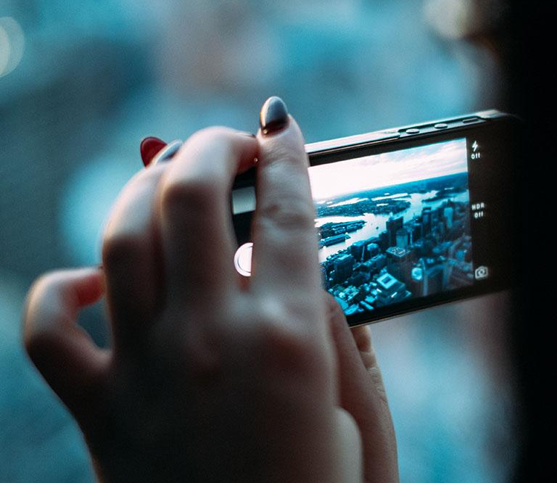
A picture is worth a thousand words
A complex idea can be conveyed with just a single still image, namely making it possible to absorb large amounts of data quickly.
<number>

Slide 15
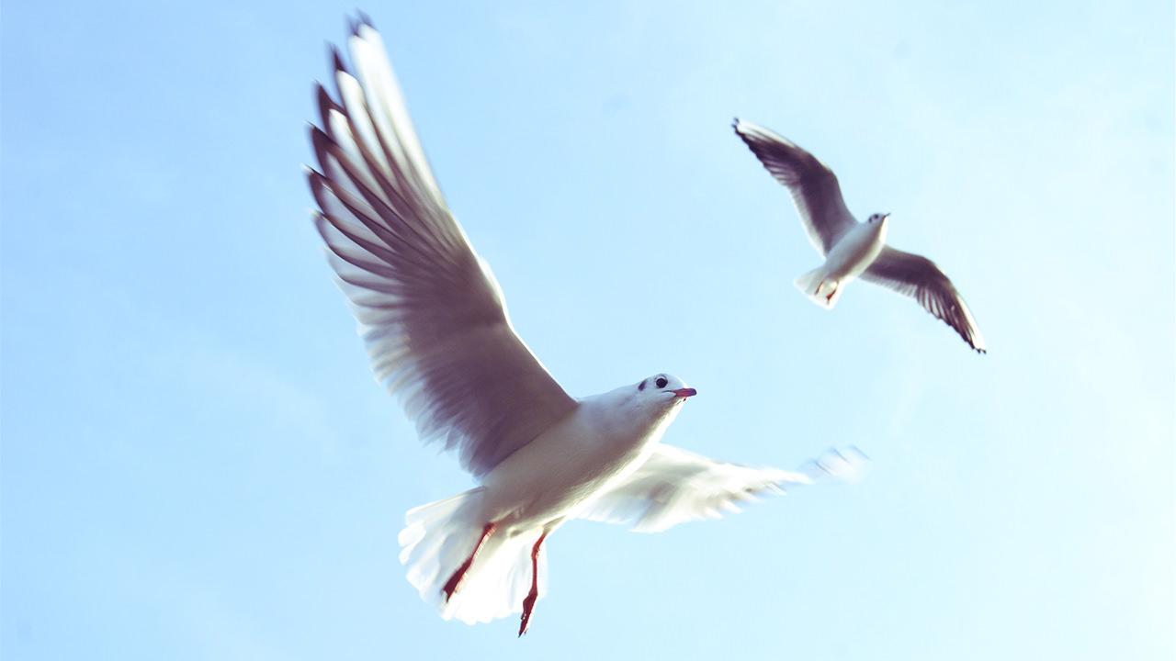
Want big impact? Use big image.
<number>

Slide 16
Use charts to explain your ideas
White
Gray
Black
<number>

Slide 17
And tables to compare data
 | A | B | C
Yellow | 10 | 20 | 7
Blue | 30 | 15 | 10
Orange | 5 | 24 | 16
<number>

Slide 18
89,526,124 Whoa! That’s a big number, aren’t you proud?
<number>

Slide 19
89,526,124$
That’s a lot of money
185,244 users
And a lot of users
100%
Total success!
<number>

Slide 20
Our process is easy
first
second
last
<number>

Slide 21
Our sales funnel
20%
40%
60%
80%
Diagram featured by http://slidemodel.com
100%
<number>

Slide 22
Let’s review some concepts
Yellow
Is the color of gold, butter and ripe lemons. In the spectrum of visible light, yellow is found between green and orange.
Blue
Is the colour of the clear sky and the deep sea. It is located between violet and green on the optical spectrum.
Red
Is the color of blood, and because of this it has historically been associated with sacrifice, danger and courage.
Yellow
Is the color of gold, butter and ripe lemons. In the spectrum of visible light, yellow is found between green and orange.
Blue
Is the colour of the clear sky and the deep sea. It is located between violet and green on the optical spectrum.
Red
Is the color of blood, and because of this it has historically been associated with sacrifice, danger and courage.
<number>

Slide 23
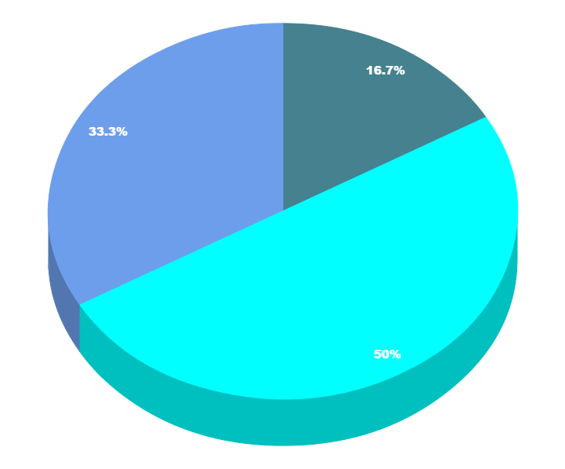
You can copy&paste graphs from Google Sheets
<number>

Slide 24
Place your screenshot here
Android project
Show and explain your web, app or software projects using these gadget templates.
<number>

Slide 25
Place your screenshot here
iPhone project
Show and explain your web, app or software projects using these gadget templates.
<number>

Slide 26
Place your screenshot here
Tablet project
Show and explain your web, app or software projects using these gadget templates.
<number>

Slide 27
Place your screenshot here
Desktop project
Show and explain your web, app or software projects using these gadget templates.
<number>

Slide 28
Thanks!
Any questions?
You can find me at:
@username
user@mail.me
<number>

Slide 29
Credits
Special thanks to all the people who made and released these awesome resources for free:
Presentation template by SlidesCarnival
Photographs by Unsplash
<number>

Slide 30
Presentation design
This presentation uses the following typographies and colors:
Titles: Nixie One
Body copy: Muli
You can download the fonts on this page:
https://www.fontsquirrel.com/fonts/nixie-one
https://www.fontsquirrel.com/fonts/muli
Aquamarina #00e1c6 / Turquoise #19bbd5 / Skyblue #2c9dde /
Light gray #c6daec / Dark blue #0e293c
You don’t need to keep this slide in your presentation. It’s only here to serve you as a design guide if you need to create new slides or download the fonts to edit the presentation in PowerPoint®
<number>

Slide 31
SlidesCarnival icons are editable shapes.
This means that you can:
Resize them without losing quality.
Change fill color and opacity.
Change line color, width and style.
Isn’t that nice? :)
Examples:
<number>

Slide 32
😉
Now you can use any emoji as an icon!
And of course it resizes without losing quality and you can change the color.
How? Follow Google instructions https://twitter.com/googledocs/status/730087240156643328
✋👆👉👍👤👦👧👨👩👪💃🏃💑❤😂😉😋😒😭👶😸🐟🍒🍔💣📌📖🔨🎃🎈🎨🏈🏰🌏🔌🔑 and many more...
<number>

