Slide 1

Scripting for Testers
bret@pettichord.com
www.pettichord.com
A One-Day Tutorial
May 2004
Copyright © 2004 Bret Pettichord. Permission granted to reproduce with attribution.

Slide 2
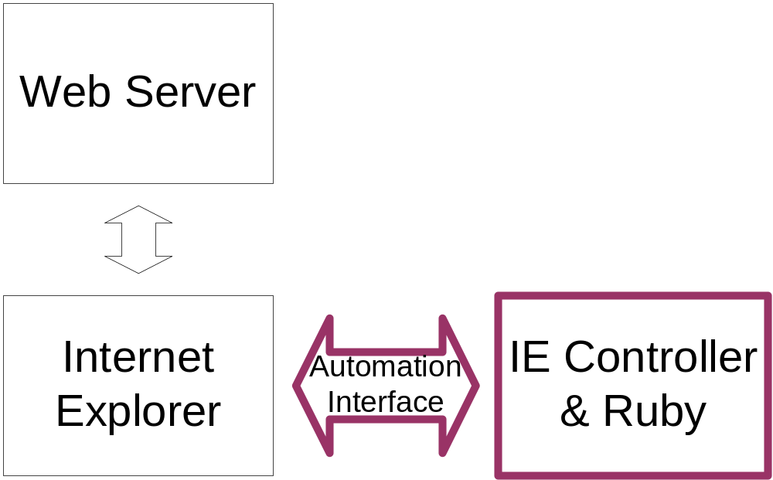
Browser Automation
Use the COM Automation interface to Internet Explorer
Tests drive the browser

Slide 3
A snippet
require 'toolkit'
start_ie 'http://localhost:8080'
forms[0].name = 'matz'
forms[0].submit
This starts a browser at the given URL and then enters a name in the user name field.
Notes:
A longer example: start_stop.rb

Slide 4
DOM
“Document Object Model”
A non-proprietary standard for representing elements of a web page.
Often used by client-side JavaScript.
Supported by IE and Netscape and other browsers.
IE provides access to the DOM via OLE.

Slide 5
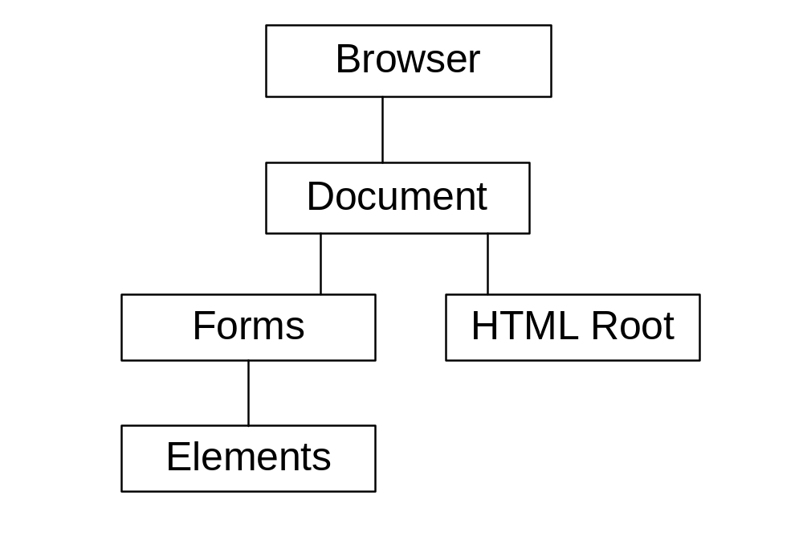
DOM

Slide 6
IE Controller
Wiki
  http://www.clabs.org/wtr/
Mailing List
  http://rubyforge.org/projects/wtr/
Overview
  http://www.rubygarden.org/ruby?IeController

Slide 7
Building Your Own
Any decent language can call Internet Explorer’s COM Automation interface.
Many applications built with Microsoft technology have COM Automation interfaces.
There are equivalent interface mechanisms for other technologies.

Slide 8
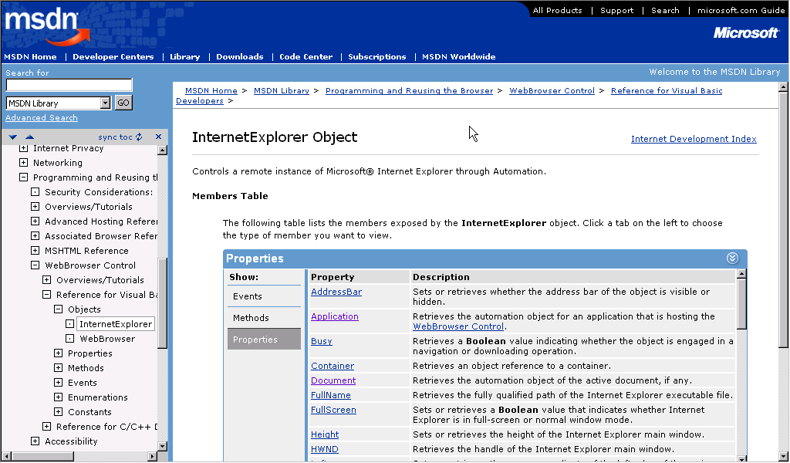
IE Automation Reference
http://msdn.microsoft.com/workshop/browser/webbrowser/reference/Objects/InternetExplorer.asp

