Slide 1
The Watir Community
Scripting Web Tests
A One-Day Tutorial
July 2005
Copyright © 2004-2005 Bret Pettichord. Permission granted to reproduce with attribution.
Notes:
Present this slide deck after completing Lab 4

Slide 2
Web Testing with Ruby
2002 – Wasserman creates Samie
  A Perl COM/DOM driver
  Creates it in frustration when refused a WinRunner license
  http://www.perl.com/pub/a/2005/04/21/win32ole.html
early 2003 – Morris creates IEC
  A Ruby COM/DOM Driver, inspired by Samie
May 2003 – Marick & Pettichord
  First teach Scripting for Testers, using Ruby
  IEC is very popular with students
  Continue to teach this class publicly, adapting IEC to student reactions
Oct 2003 – Web Testing with Ruby project founded
  Includes both IEC and the Scripting class materials
  Rogers contributes another Ruby COM/DOM driver
Aug 2004 – Watir launched by Pettichord & Rogers
  A new Ruby COM/DOM Driver based on Test-Driven Development
Jan 2005 – Watir 1.0 released

Slide 3
Projects Using Watir
Calgary
Bangalore
Montreal
Los Angeles
Pune, India
Turkey
Bay Area
Washington State
http://wtr.rubyforge.org/wiki/wiki.pl?WatirUsers
Toronto
Madison, Wisconsin
London
Melbourne
Job Listings
Bay Area
Australia

Slide 4
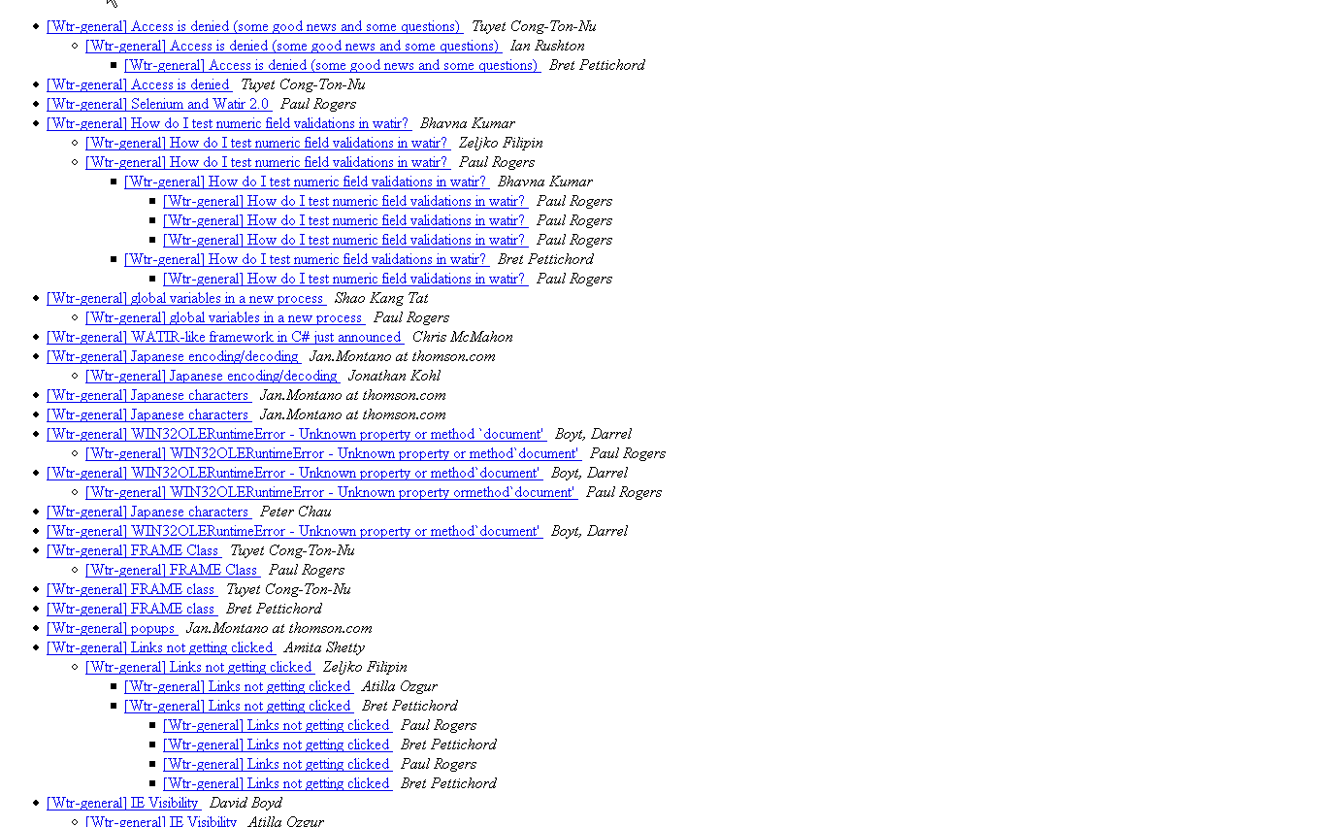
Mailing List

