Slide 1
Beyond Watir
Scripting Web Tests
A One-Day Tutorial
July 2005
Copyright © 2004-2005 Bret Pettichord. Permission granted to reproduce with attribution.
Notes:
Concluding Slide Deck

Slide 2
Other COM/DOM Drivers
Samie – Perl
  http://samie.sourceforge.net
Win32-IE-Mechanize – Perl
  http://search.cpan.org/dist/Win32-IE-Mechanize/
Jiffie – Java
  http://jiffie.sourceforge.net
Pamie – Python
  http://pamie.sourceforge.net
IEUnit – JavaScript
  http://ieunit.sourceforge.net
IETest – C#
  http://ietest.sourceforge.net

Slide 3
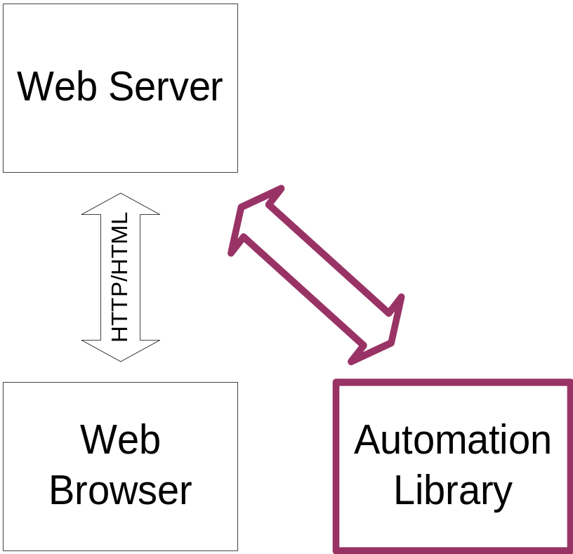
Protocol Drivers
Simulate a Web Browser
HttpUnit – Java
  http://httpunit.sf.net
jWebUnit – Java
  http://jwebunit.sf.net
HTMLUnit – Java
  http://htmlunit.sf.net
WWW-Mechanize – Perl
  http://search.cpan.org/dist/WWW-Mechanize/
All open-source and commercial load/performance testing tools are protocol drivers
Technology is limited for functional testing because of inability to test JavaScript and browser compatibility
Tests execute directly against the server

Slide 4
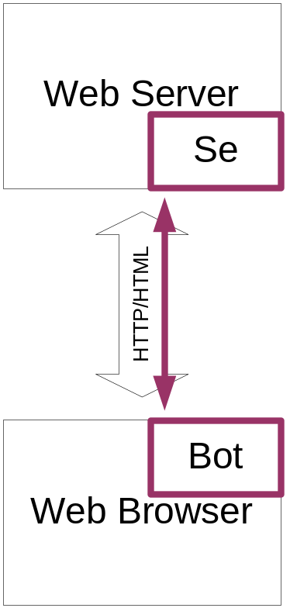
Selenium
Driver Browser using implanted Bot
Selenium installed on Server
Works with most platforms and browsers
Supports tests in
  HTML
  Java
  .Net
  Ruby
  Python
http://selenium.thoughtworks.com
Tests execute in browser

Slide 5
Commercial Web Tools
Some use COM/DOM drivers
Most modify browser DLL’s to include testability hooks
Also send GUI events to the browser

Slide 6
Windows GUI Testing
Win32 GUIs
Win32-GuiTest – Perl
  http://triumvir.org/prog/perl/guitest/
AutoIt
  Library delivered as ActiveX (COM/OLE) component, thus can be used from most languages
  http://www.autoitscript.com/
.Net GUI Testing
Effective GUI Test Automation, Li & Wu
  How to build your own tool
“Build Quick and Easy UI Test Automation Suites with Visual Studio .NET,” James McCaffrey
  http://msdn.microsoft.com/msdnmag/issues/03/01/UITestAutomation/default.aspx
“Automating Tests for .NET Applications in C#,” Elisabeth Hendrickson
  http://qualitytree.com/autotest/dotnetgui.htm

Slide 7
Java GUI Testing
Abbot
  http://abbot.sourceforge.net/
  Testing Java with Java
Marathon
  http://marathonman.sourceforge.net/
  Testing Java with Python

Slide 8
Command Line Testing
Expect, Don Libes
  Automates Unix terminals
  Uses Tcl or [incr Tcl]
  Long-established.
  Exploring Expect, Don Libes
  http://expect.nist.gov/
  http://wiki.tcl.tk/expect
  http://www.csc.calpoly.edu/~dbutler/tutorials/winter96/expect/
Pexpect,
  Expect for Python
  http://pexpect.sourceforge.net/
Expect.pm
  Expect for Perl
  http://sourceforge.net/projects/expectperl/
Notes:
From Exploring Expect:
3Com does software quality assurance with Expect. Silicon Graphics uses it to do network measurements such as echo response time using telnet. The World Bank uses it to automate file transfers and updates. IBM uses it as part of a tape backup production environment. HP uses it to automate queries to multiple heterogeneous commercial online databases. Sun uses it to sweep across their in-house network testing computer security. Martin Marietta uses it to control and extract usage statistics from network routers. Tektronix uses it to test software simulations of test instruments. The National Cancer Institute uses it to administer accounts across multiple platforms. Cisco uses it for network control and testing. Xerox uses it for researcher collaboration. Motorola uses it to control and backup multiple commercial databases. Data General uses it for software quality engineering. The Baha'i World Centre uses it to automate and coordinate data collection and storage from different telephone exchange locations. Amdahl uses it to automatically retrieve stock prices. CenterLine Software uses it for software quality assurance. Encore Computer uses it to simulate 500 users logging into one system at the same time. AT&T uses it to copy files between internal hosts through a firewall to and from external Internet hosts. Sandia National Laboratories uses it to control unreliable processes that need to be watched constantly. Schlumberger uses it to manage a network environment including routers, repeaters, bridges, and terminal servers all from different manufacturers. ComputerVision built an automated testbed using it.

Slide 9
Homebrew Test Automation
A full-day seminar on how to build your own testing frameworks
Covers most types of applications
Full seminar notes online
  http://www.io.com/~wazmo/papers/homebrew_test_automation_200409.pdf

