Slide 1
How Watir Works
Scripting Web Tests
A One-Day Tutorial
July 2005
Copyright © 2004-2005 Bret Pettichord. Permission granted to reproduce with attribution.
Notes:
Present this slide deck after completing Lab 3

Slide 2
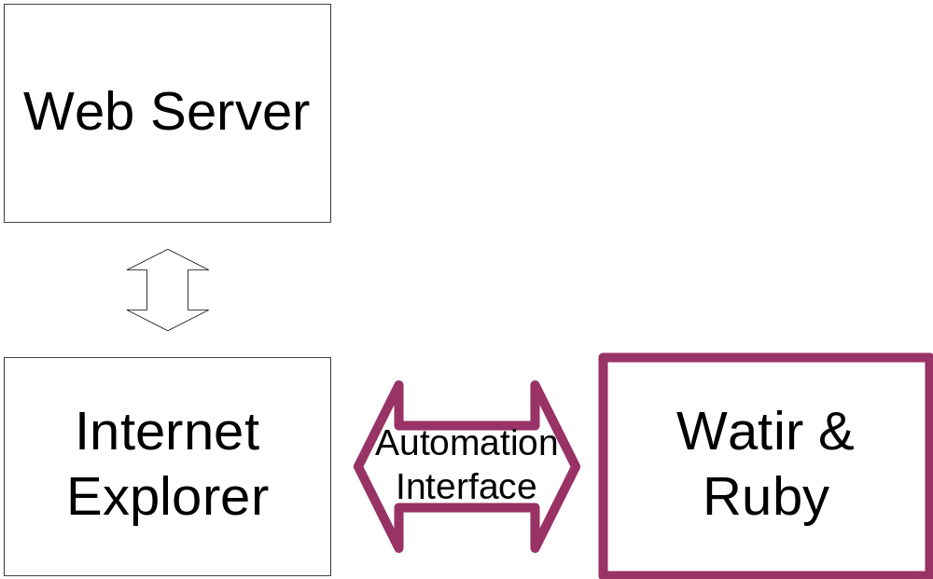
Browser Automation
Use the OLE/COM Automation interface to Internet Explorer
Tests drive the browser

Slide 3
Document Object Model
"DOM"
A standard model for elements of a web page
Used by client-side JavaScript
Supported by IE, Mozilla, FireFox and other browsers
IE also provides access to the DOM via OLE/COM

Slide 4
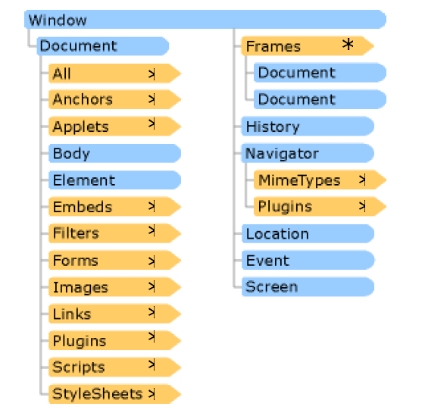
Document Object Model
Notes:
Slide Courtesy of Dion Johnson

Slide 5
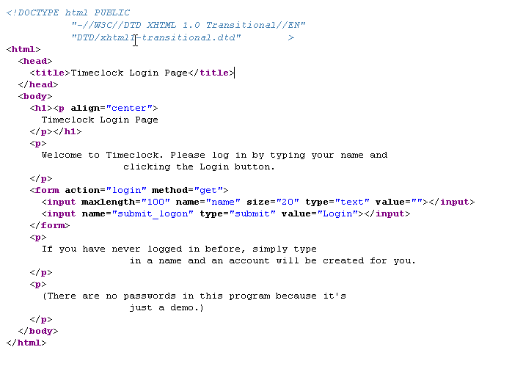
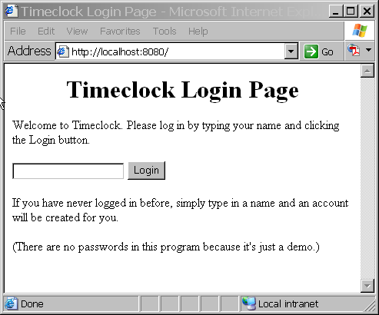
The DOM in Action

Slide 6
How are tests created?
View Source
Watir's show methods in IRB
DOM Inspector such as SpySmith

Slide 7
Building Your Own
Any decent language can use Internet Explorer’s OLE/COM Automation interface
There are equivalent interface mechanisms for other technologies

