Slide 1
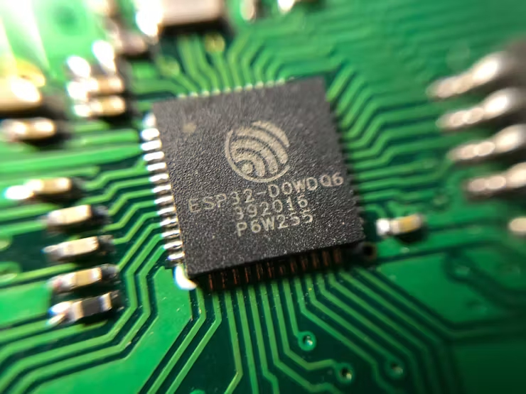
Arduino Workshop (ESP32 Advanced Level) ดร. วาธิส ลีลาภัทร ภาควิชาวิศวกรรมคอมพิวเตอร์ คณะวิศวกรรมศาสตร์ มหาวิทยาลัยขอนแก่น

Slide 2
Agenda
Content
ESP32 Wi-Fi Communications
ESP32 Simple Web Server
Internet of Things (IoT) using Blynk Platform
Hardware interrupt
LCD Custom font
Prerequisite:
1. Basic C/C++ programming language (Arduino IDE)
2. Basic and intermediate ESP32 courses
3. Electronics (not required, but will be advantageous)

Slide 3
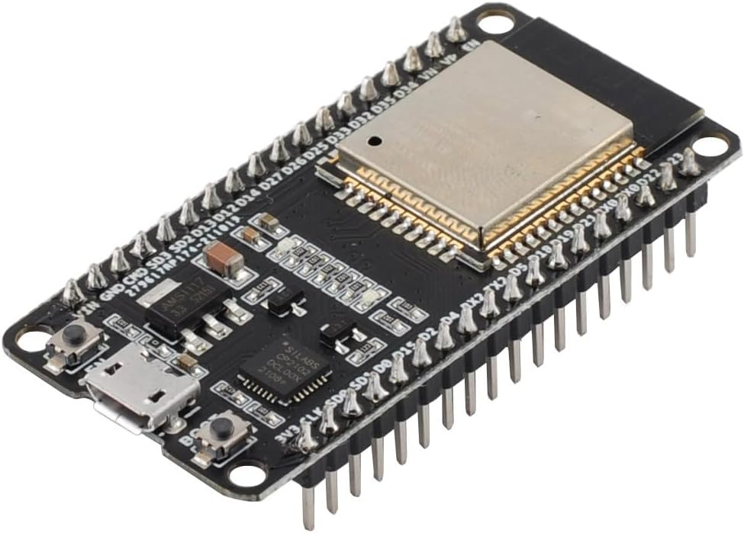
ESP32 DEVKIT
ESP-WROOM-32 DevKit
utilizes ESP32 chip, 240MHz, RAM 512KB, 4MB flash memory
Wi-Fi 2.4GHz / Bluetooth

Slide 4
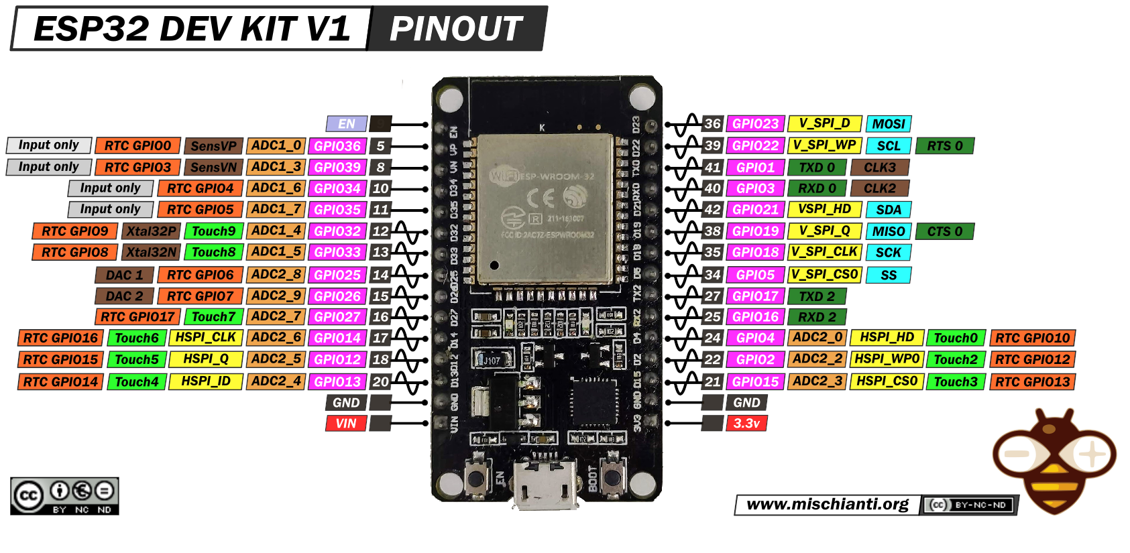
ESP32 DEVKIT Pinout
Micro USB Port

Slide 5
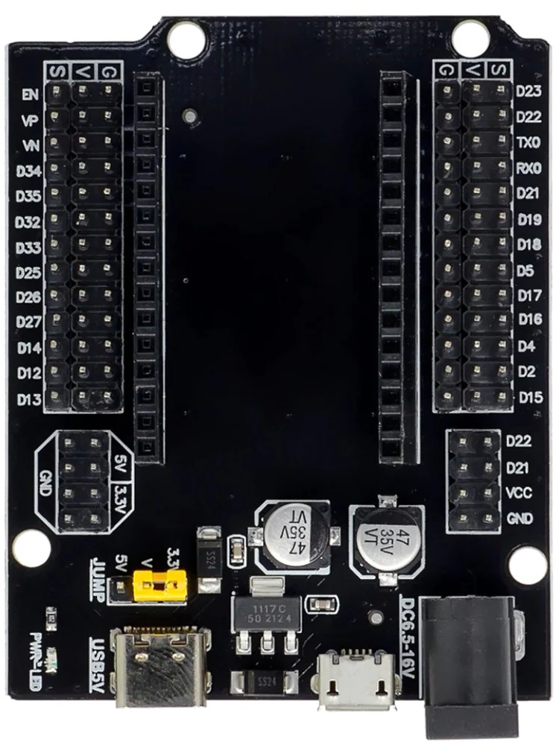
ESP32 Extension Board
Pins extension
External power supply
S (Signal) Pins
V (3V Power supply) Pins
G (Ground) Pins

Slide 6
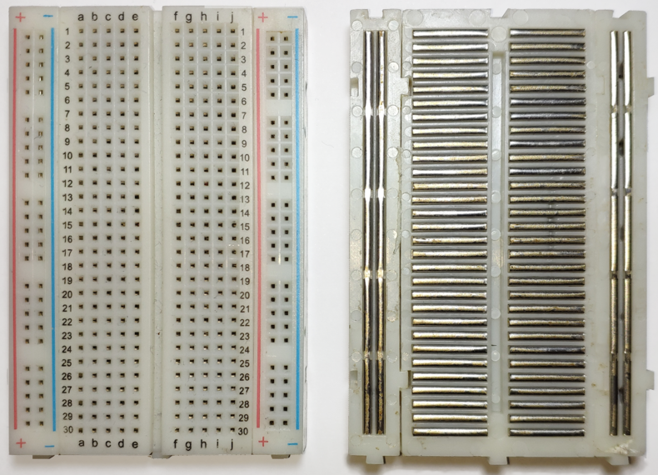
Circuit Construction
Prototyping board
Pre-connected conductor stripes
Horizontal stripes on 2 top rows and 2 bottom rows
Vertical stripes in the middle

Slide 7
Arduino Reference Sheet
https://kku.world/e664b0

Slide 8
Hardware Interrupt
Interrupt is a mechanism in microcontroller to handle event triggered
by software or internal/external hardware
Interrupt can reduce processor load significantly when monitoring
signal from hardware
Main loop
I/O Polling
Read GPIO 1
Routine for GPIO 1
Advantages:
Implemented in software only
Disadvantages:
Use more CPU time to execute
Slow response
Cannot be used during sleep mode
Read GPIO 2
Routine for GPIO 2
I/O Scan
Read GPIO n
Routine for GPIO n
Next statements

Slide 9
Hardware Interrupt
Interrupt is a mechanism in microcontroller to handle event triggered
by software or internal/external hardware
Interrupt can reduce processor load significantly when monitoring
signal from hardware
Interrupt
Advantages:
Fast response
Free CPU for another task
Can be used during sleep mode
Disadvantages:
Require hardware support
Main loop
Interrupt signal
Statement 1
Statement 2
Statement 3
Interrupt Service Routine (ISR)
Go to
Routing for GPIO1 if signal is from GPIO1
Routine for GPIO2 if signal is from GPIO1
Routine for GPIO n if signal is from GPIO n
Statement n
This process is
handled by hardware

Slide 10
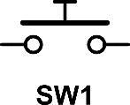
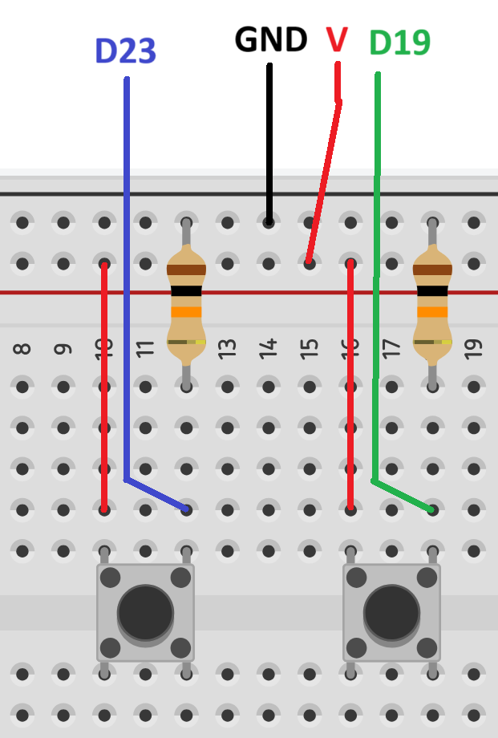

Hardware Interrupt
ESP32
V
V
Push-button
Switch
Push-button
Switch
D19
D23
10K Ohm
10K Ohm
GND
GND

Slide 11
Hardware Interrupt
I/O polling example: BasicTwoButton.ino
Open serial monitor to see result
#define Up 17 //Increase value
#define Down 16 //Decrease value
int Counter = 0;
void setup() {
Serial.begin(9600);
pinMode(Up, OUTPUT);
pinMode(Down, OUTPUT);
}
void loop() {
Serial.println(Counter);
if(digitalRead(Up) == 1) Counter++; if(digitalRead(Down) == 1) Counter--;
delay(100);
}

Slide 12
Hardware Interrupt
I/O polling example: InterruptTwoButton.ino
Open serial monitor to see result
#define Up 17 //Increase value
#define Down 16 //Decrease value
int Counter = 0;
void IRAM_ATTR Up_isr(){
Counter++;
}
void IRAM_ATTR Down_isr(){
Counter--;
}
void setup() {
Serial.begin(9600);
pinMode(Up, OUTPUT);
pinMode(Down, OUTPUT);
attachInterrupt(Up, Up_isr, RISING); attachInterrupt(Down, Down_isr, RISING);
}
void loop() {
Serial.println(Counter);
delay(100);
}
Rising Edge
Falling Edge

Slide 13
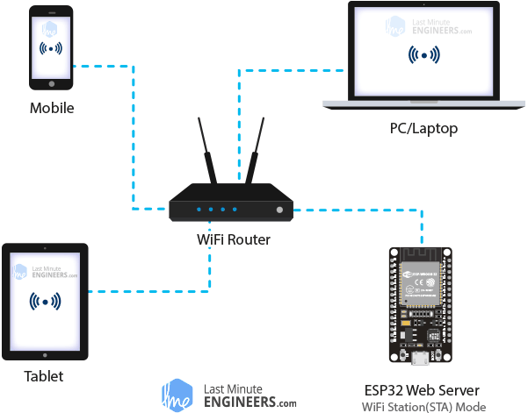
ESP32 Wi-Fi Operating Modes
ESP32 can operate in 2 different modes:
Station mode
Soft Access Point mode
2.4 GHz. band only

Slide 14
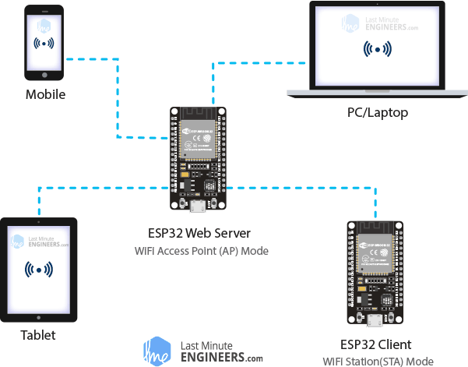
ESP32 Wi-Fi Operating Modes
ESP32 can operate in three different modes:
Station mode
Soft Access Point mode
2.4 GHz. band only

Slide 15
Example 1 : Wi-Fi Scanner
This example scans available Wi-Fi access points and displays
AP information.
Go to File → Examples → WiFi → WiFiScan
void setup() {
…
WiFi.mode(WIFI_STA); // Set WiFi to station mode
WiFi.disconnect(); // Disconnect from AP if it was previously connected
…

Slide 16
Example 1 : Wi-Fi Scanner
// WiFi.scanNetworks will return the number of networks found
int n = WiFi.scanNetworks();
Serial.println("scan done");
if (n == 0) {
Serial.println("no networks found");
} else {
Serial.print(n);
Serial.println(" networks found");
for (int i = 0; i < n; ++i) {
// Print SSID and RSSI (Received Signal Strength Indicator) for each network found
Serial.print(i + 1);
Serial.print(": ");
Serial.print(WiFi.SSID(i)); //WiFi.SSID() → access point name
Serial.print(" (");
Serial.print(WiFi.RSSI(i)); //WiFi.RSSI() → access point signal

Slide 17
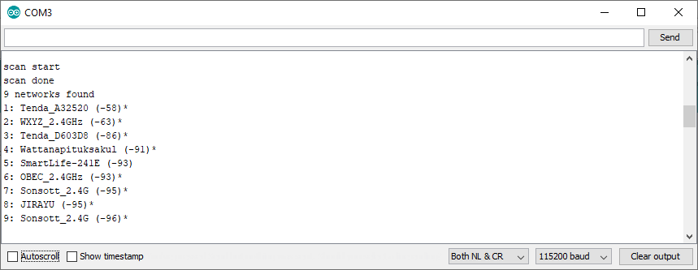
Example 1 : Wi-Fi Scanner
AP name
Signal Strength (dB)
1: Tenda_A32520 (-58)*
2: WXYZ_2.4GHz (-63)*
Authentication required

Slide 18
Example 2 : Hello Server
This example setups very simple web server on ESP32
Go to File → Examples → WebServer → HelloServer
const char* ssid = “……….."; //AP name
const char* password = “………."; //Password
const char* ssid = “Note7"; //AP name
const char* password = “qwerty1234"; //Password

Slide 19
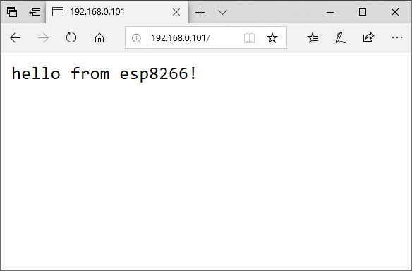
Example 2 : Hello Server
Connected to Tenda_A32520
IP address: 192.168.0.101
MDNS responder started
HTTP server started
IP Address of ESP32
hello from esp32!
Open your browser and type above IP address in address bar

Slide 20
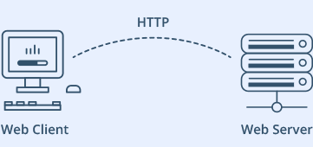
Example 2 : Hello Server
What is a Web server and how it works?
Web server stores, processes and delivers web pages to Web clients.
Web client is nothing but a web browser
The communication between client and server takes place using a protocol called Hypertext Transfer Protocol (HTTP).
Browser (user) ESP32

Slide 21
HTTP Protocol

Slide 22
HTTP Protocol
Client (browser) sends HTTP request to server
method
URL
protocol version
GET /index.html HTTP/1.1
Host: www.example.com
User-Agent: Mozilla/5.0
Accept: text/html, */*
Accept-Language: en-us
Accept-Charset: ISO-8859-1,utf-8
Connection: keep-alive
blank line
Header
Body
(optional)

Slide 23
HTTP Protocol
HTTP Methods (Verbs)
● GET - Fetch a URL
● HEAD - Fetch information about a URL
● PUT - Store to an URL
● POST - Send form data to a URL and get a response back
● DELETE - Delete a URL
GET and POST (forms) are commonly used.
REST APIs used GET, PUT, POST, and DELETE

Slide 24
Example 2 : Hello Server
HTTP Response from web server to client (browser)
protocol version
status status message
HTTP/1.1 200 OK
Date: Thu, 24 Jul 2008 17:36:27 GMT
Server: Apache-Coyote/1.1
Content-Type: text/html;charset=UTF-8
Content-Length: 1846
blank line
<?xml ... >
<!DOCTYPE html ... >
<html ... >
...
</html>
Header
Body
(html)

Slide 25
HTTP Protocol
Common HTTP Response Status Codes
200 OK Success
307 Temporary Redirect Redirection - Browser retries using Location header
404 Not Found Famous one
503 Service Unavailable Something crashed on the server
500 Internal Server Error Something is messed up on the server
501 Not Implemented Coming
400 Bad Request Use if web app sends bogus request
401 Unauthorized Use if user isn't logged in
403 Forbidden Use if even logging in wouldn't help
550 Permission denied Not allow to perform request

Slide 26
Example 3 : Advanced Web Server
This example setups more complicated web server on ESP32
Go to File → Examples → WebServer → AdvancedWebServer
const char* ssid = “……….."; //AP name
const char* password = “………."; //Password
const char* ssid = “Note7"; //AP name
const char* password = “qwerty1234"; //Password

Slide 27
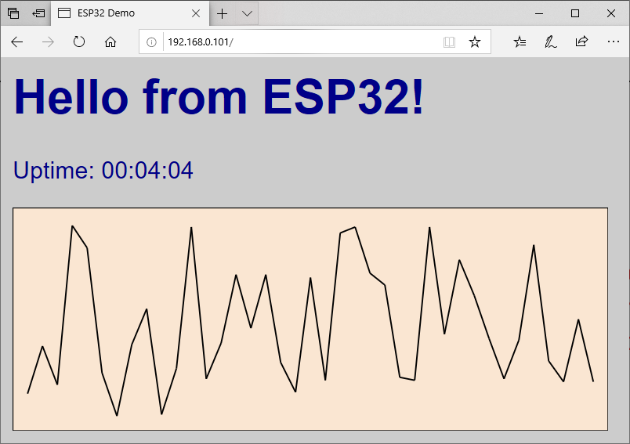
Example 3 : Advanced Web Server
Connected to Tenda_A32520
IP address: 192.168.0.101
MDNS responder started
HTTP server started
IP Address of ESP32
Open your browser and type above IP address in address bar

Slide 28
Example 3 : Advanced Web Server
Concept
Connect to AP and get IP address
Setup web server
Create web content
Text message & up timer
Random numbers and graphic plot
Timer
Create connection handling
Start web server & wait for connection

Slide 29
Example 4 : Web Server Controlled LED
This example shows how to control LED from web browser
Go to File → Examples → WiFi → SimpleWiFiServer
const char* ssid = “……….."; //AP name
const char* password = “………."; //Password
const char* ssid = “Note7"; //AP name
const char* password = “qwerty1234"; //Password

Slide 30
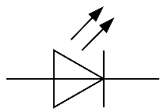

Example 4 : Simple Wi-Fi Server
Hardware setup
ESP32
1K Ohm
D5
GND

Slide 31
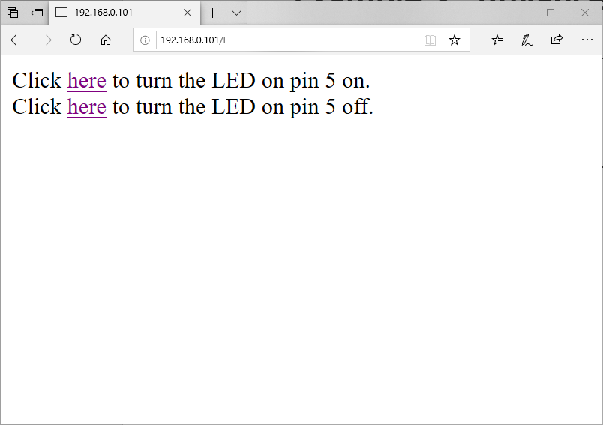
Example 4 : Simple Wi-Fi Server
Connected to Tenda_A32520
IP address: 192.168.0.101
MDNS responder started
HTTP server started
IP Address of ESP32
Open your browser and type above IP address in address bar

Slide 32
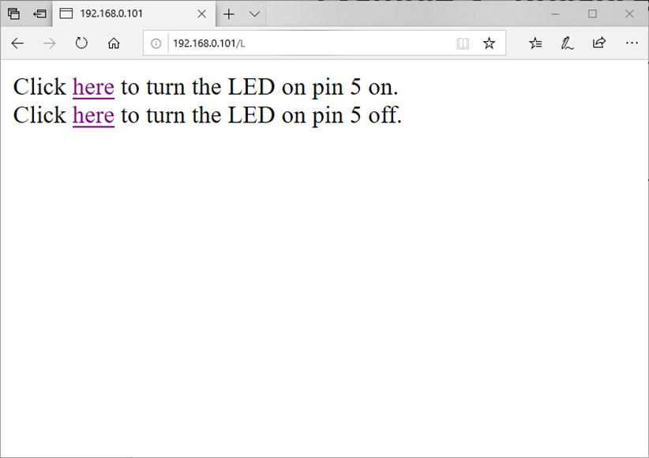


Example 4 : Simple Wi-Fi Server
Hardware setup

Slide 33
Example 4 : Simple Wi-Fi Server
Concept
Connect to AP and get IP address
Setup web server
Create web content
Create connection handling
Start web server & wait for connection
If request is “GET /H” then Pin5 → “1”
If request is “GET /L” then Pin5 → “0”

Slide 34
Example 5 : Switch Status Server
Hardware setup
This example shows how to use web server to display switch status
Open example file: InputSW-WebServer.ino
ESP32
V
1K Ohm
Push-button Switch
D13
D17
10K Ohm
GND
GND

Slide 35
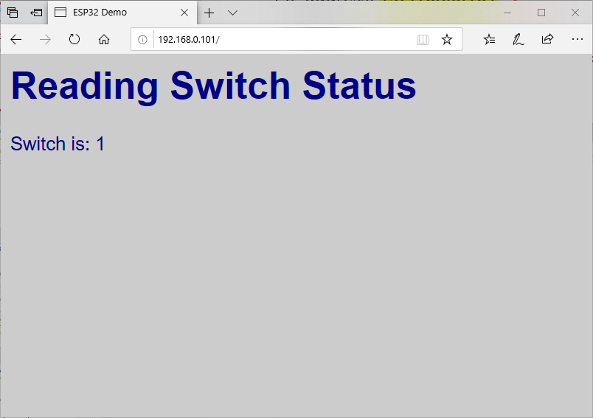
Example 5 : Switch Status Server
Connected to Tenda_A32520
IP address: 192.168.0.101
MDNS responder started
HTTP server started
IP Address of ESP32
Open your browser and type above IP address in address bar

Slide 36
Example 5 : Switch Status Server
Concept
Connect to AP and get IP address
Setup web server
Create web content
Create connection handling
Start web server & wait for connection
Keep scanning the input pin and update web content

Slide 37
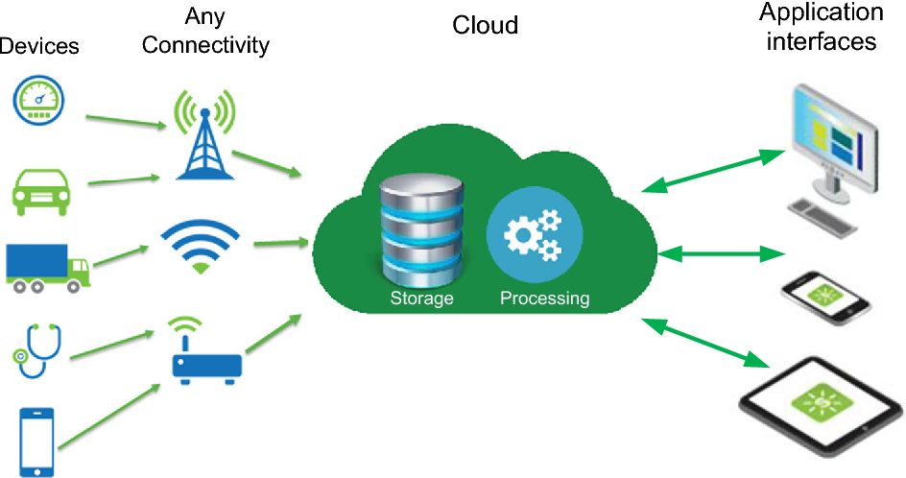
Architecture of IoT
IoT platform

Slide 38
Basic IoT application development
IoT applications require a lot of customized HW and SW
Common parts in IoT applications are user interface
There are available platform for creating simple IoT apps
Blynk
NetPie (by NECTEC)
ThingWorx

Slide 39
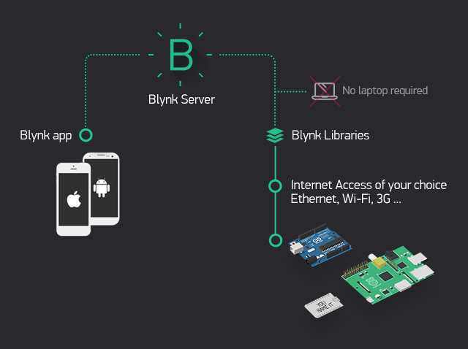
IoT Applications Development using Blynk
Blynk is an IoT Application development platform consisting of:
User interface for desktop and mobile devices (Android/iPhone)
Connection library for various IoT hardware platforms

Slide 40
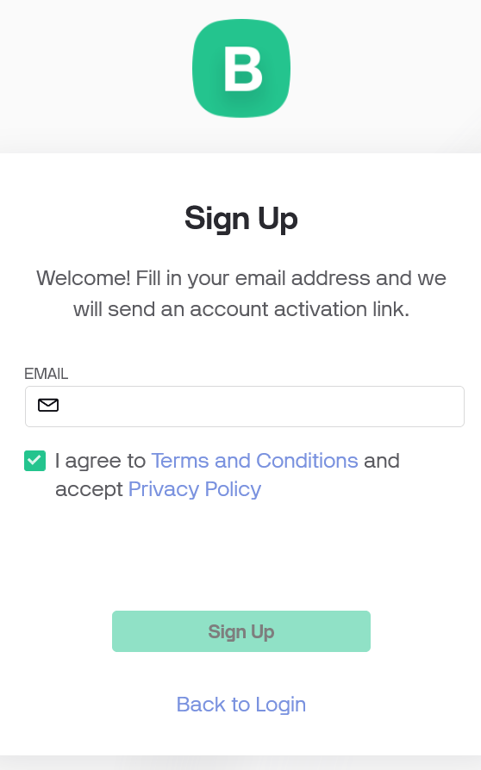
Blynk Applications Development
Signup for Blynk by going to: http://blynk.io
Type your email address to proceed to the next step

Slide 41
Blynk Applications Development
Open your email, then set a new password
Go back to main screen, log in using your new password
Once you log in, you will see Blynk Console
Steps to create a Blynk application are as follows:
Create new template in Blynk console
Create device for your template
Create user interface in Blynk mobile app
Build your circuit and write code for ESP32

Slide 42
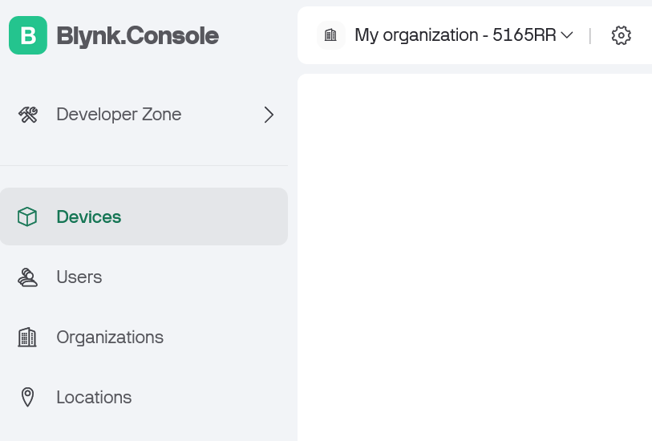
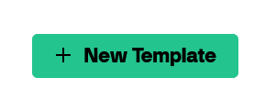
Creating a new template in Blynk Console
Click on Developer Zone on the left menu to go to template
Then click on New template

Slide 43
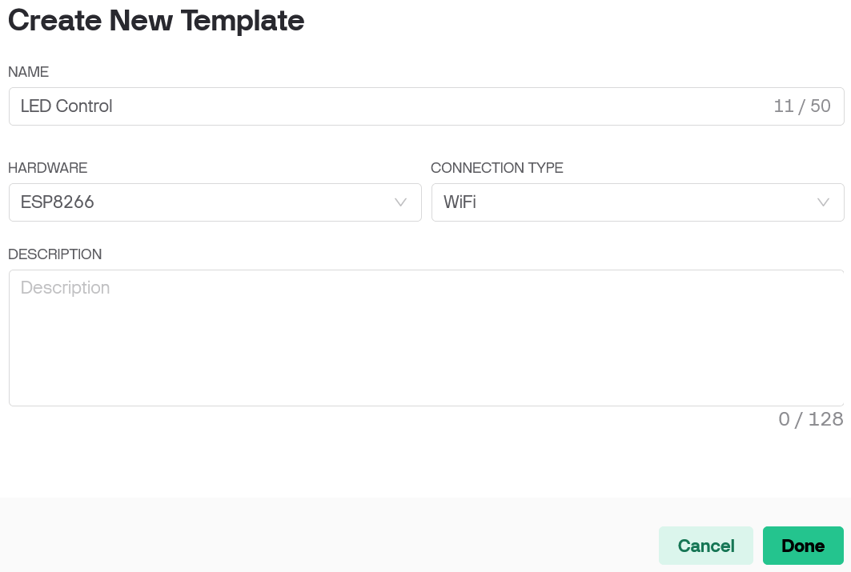
Creating a new template in Blynk Console
Under Name, type “LED Control” then select EPS32 and WiFi
Click on Done button
ESP32

Slide 44
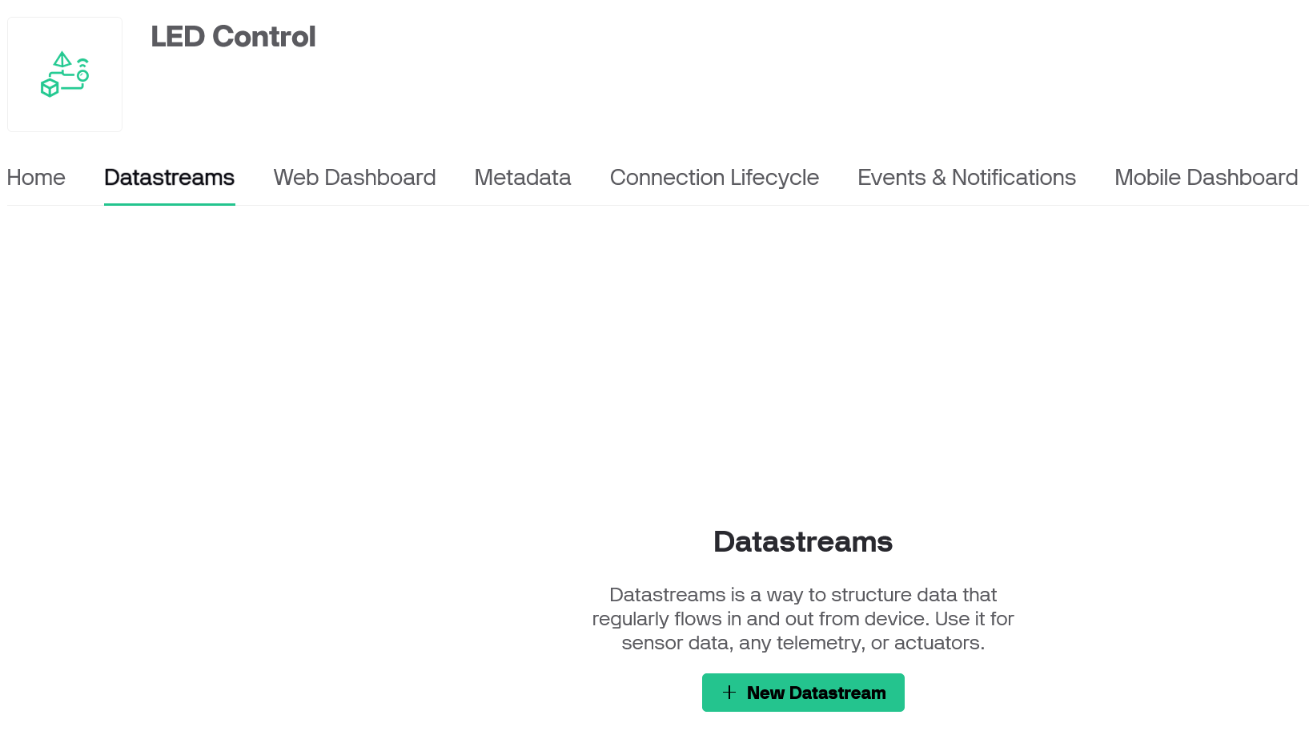
Creating a new template in Blynk Console
The next step is to create new datastream by clicking on
Datastreams tab and then New datastream button

Slide 45
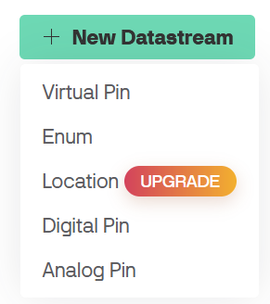
Creating a new template in Blynk Console
After new datastream is created, choose Virtual Pin

Slide 46
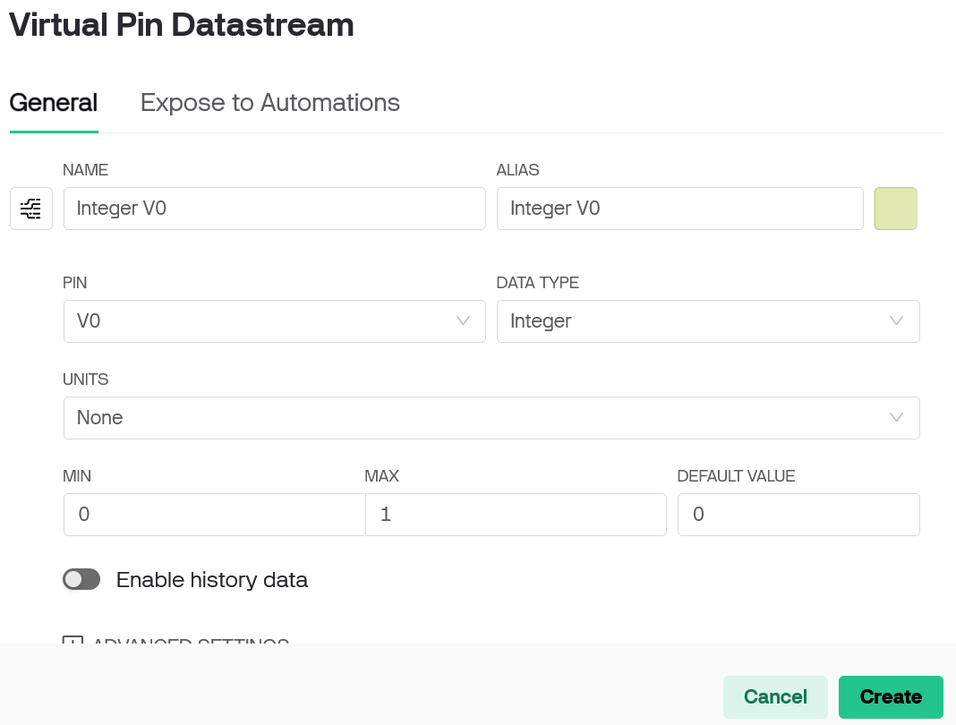
Creating a new template in Blynk Console
At the bottom of Virtual Pin Datastream setup screen, click on Create button

Slide 47
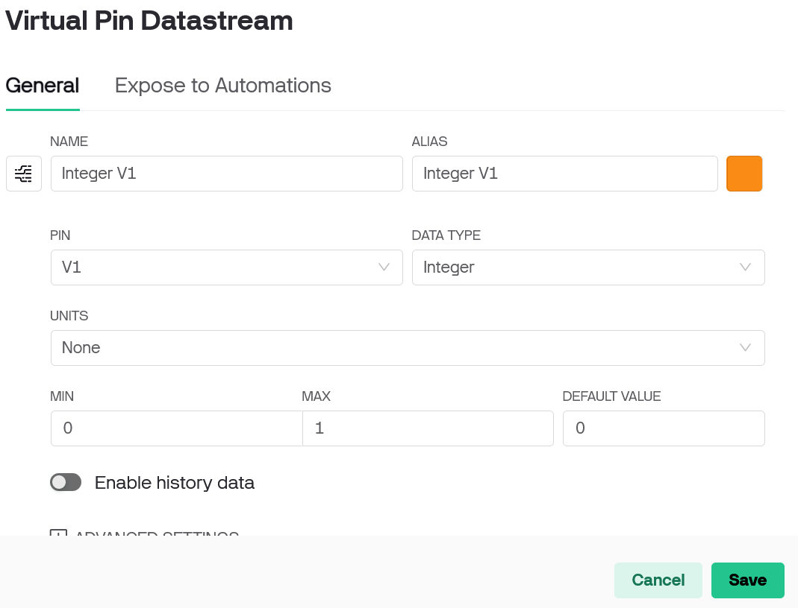
Creating a new template in Blynk Console
Repeat creating Virtual Pin Datastream again by clicking at New datastream

Slide 48
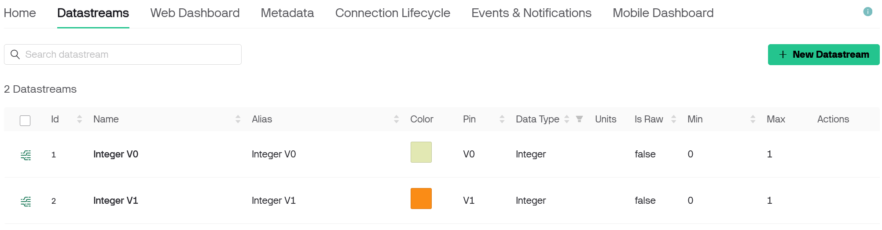
Creating a new template in Blynk Console
Now Datastreams tab should look like this:

Slide 49
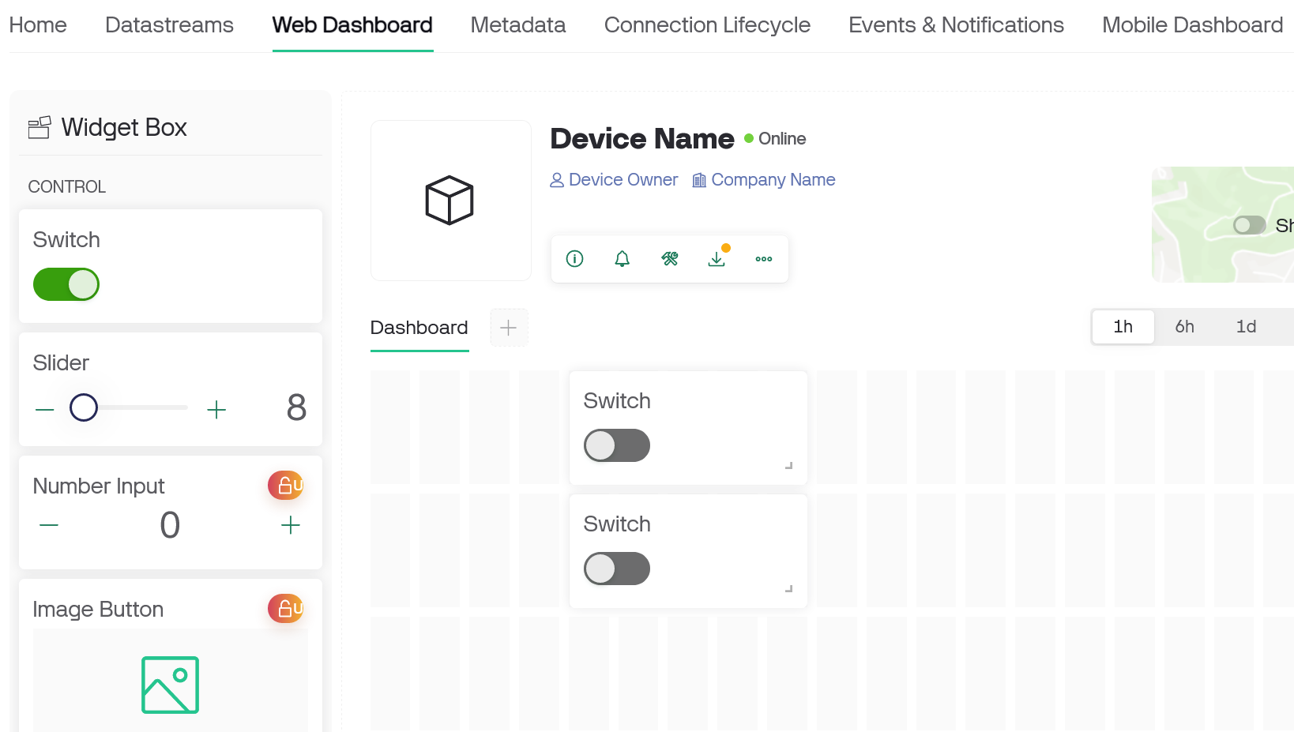
Creating a new template in Blynk Console
Go to Web Dashboard then drag Switch from widget box and place on the Dashboard

Slide 50
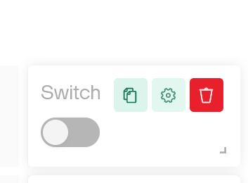
Creating a new template in Blynk Console
Move mouse pointer over Switch widget, then click on setting icon

Slide 51
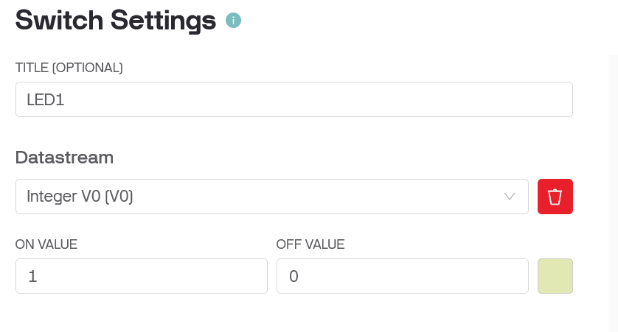
Creating a new template in Blynk Console
Under Title, type LED1, then set Datastream to Integer V0 [V0]
then click on Save

Slide 52
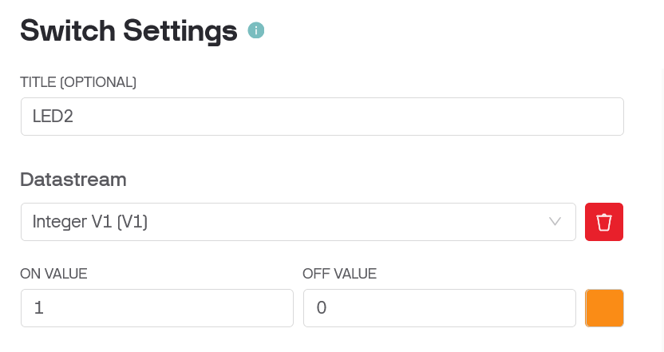
Creating a new template in Blynk Console
Repeat this process for setting the other Switch
Click on Save when finish

Slide 53
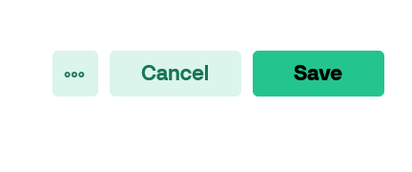
Creating a new template in Blynk Console
Finally, click on Save button on the right

Slide 54
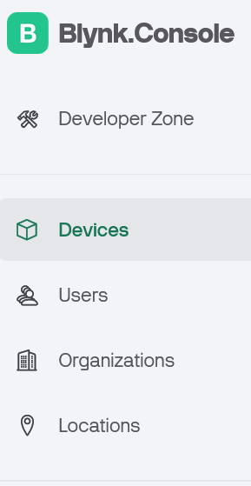
Creating device in Blynk Console
Next, choose Devices from menu on the left
Then, click on + New Device

Slide 55
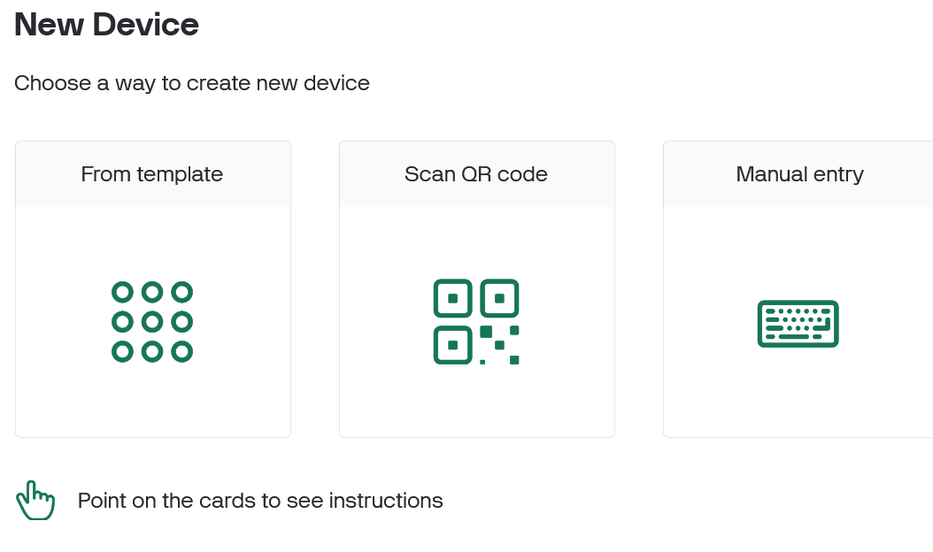
Creating device in Blynk Console
Choose From template

Slide 56
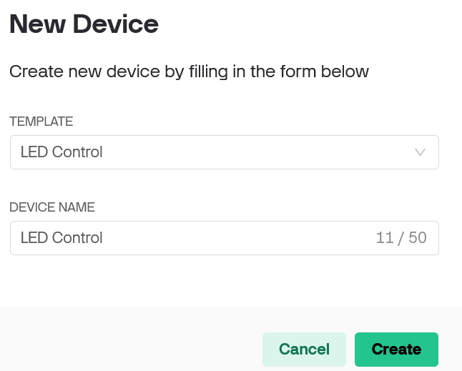
Creating device in Blynk Console
Choose the template we have created
Choose LED Control, then click on Create

Slide 57
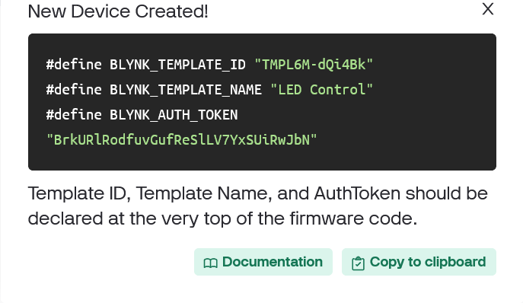
Creating device in Blynk Console
New Device Created! message will be displayed
We need to copy the Template ID, Name and AuthToken into our sketch

Slide 58
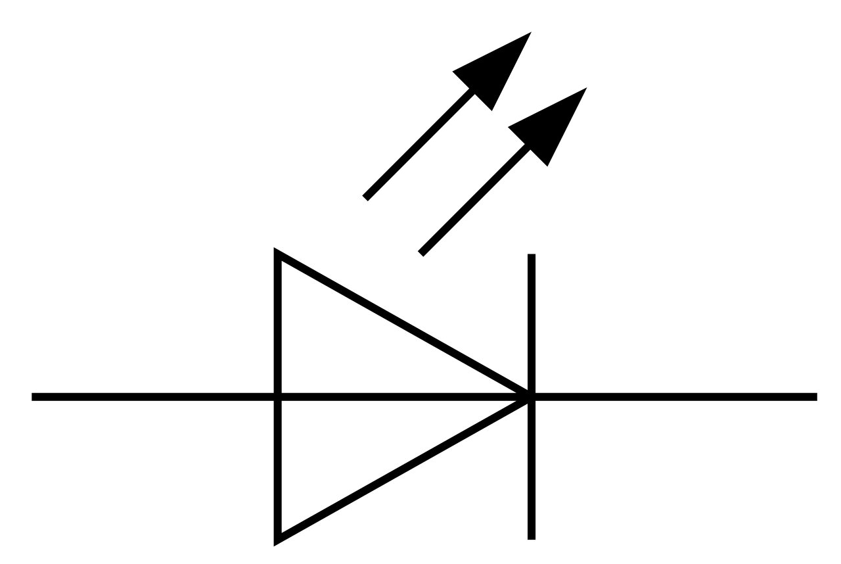

Test circuit for Blynk Application
ESP32
GPIO23
680 Ohm
680 Ohm
GPIO19
GND

Slide 59
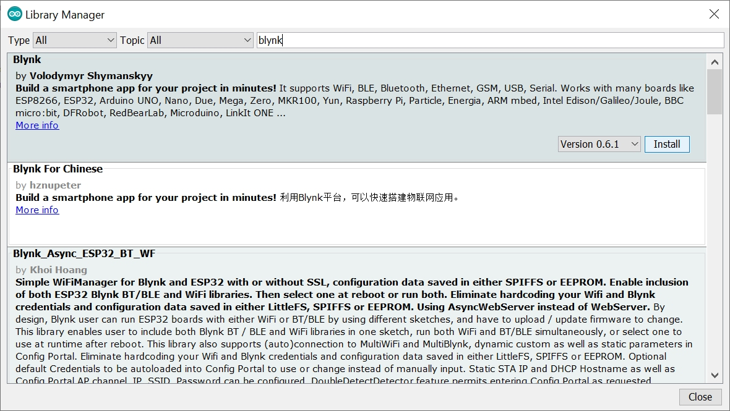
Install Blynk Library in Arduino IDE
Go to menu Tools → Manage Libraries…
Type Blynk in search box
Click install on Blynk library
Version 1.3.2

Slide 60

Blynk sketch for ESP32
Download Blynk_LED_ESP32.ino sketch from
https://github.com/watisleelapatra/Arduino
Open the sketch in Arduino IDE
Paste the following lines in the sketch
#define BLYNK_TEMPLATE_ID " "
#define BLYNK_TEMPLATE_NAME " "
#define BLYNK_AUTH_TOKEN " "
Information from
Blynk Console
Example

Slide 61
Blynk sketch for ESP32
Add your WiFi AP and password in the sketch
char ssid[] = " ";
char pass[] = " ";
Wi-Fi AP name
Password for Wi-Fi AP
Then download the sketch

Slide 62
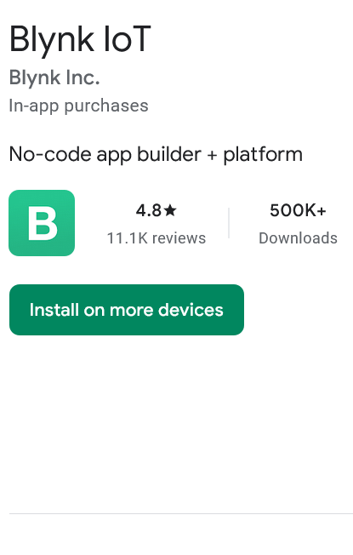
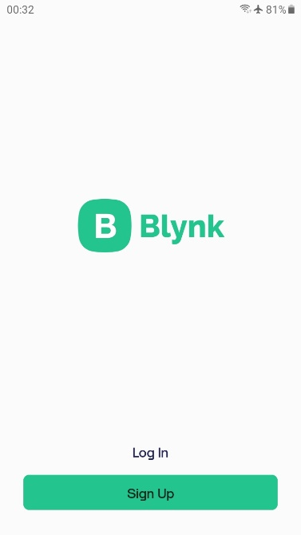
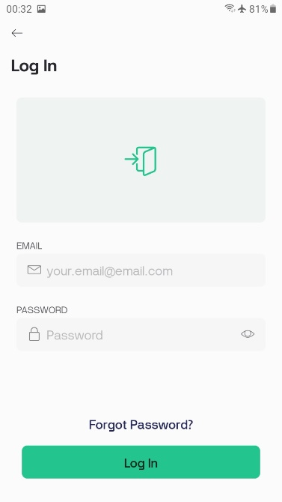
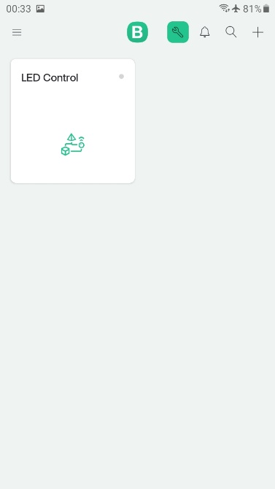
Install Blynk IoT Mobile Application
Go to App Store (iPhone) or Google Play (Android)
Search and install Blynk IoT on your mobile phone
After installation, Login using email you for signing up
There will be the created Template, Choose LED Control
1
2
3
4

Slide 63
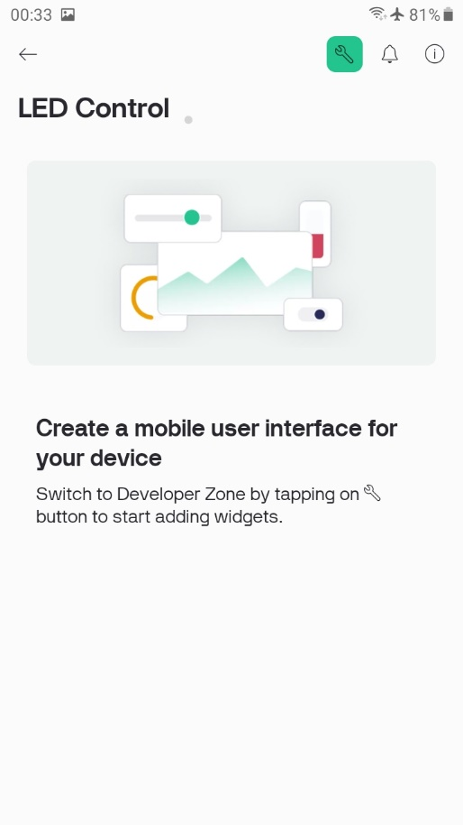
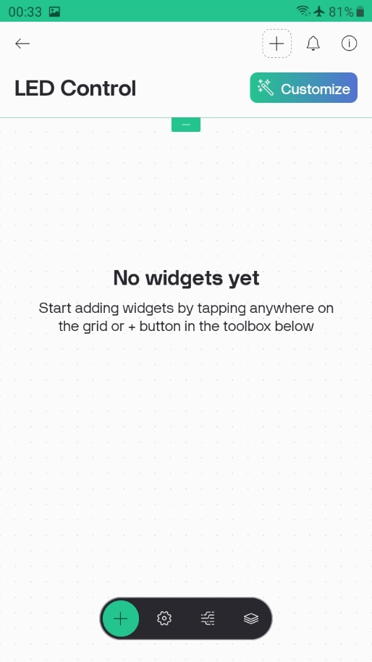
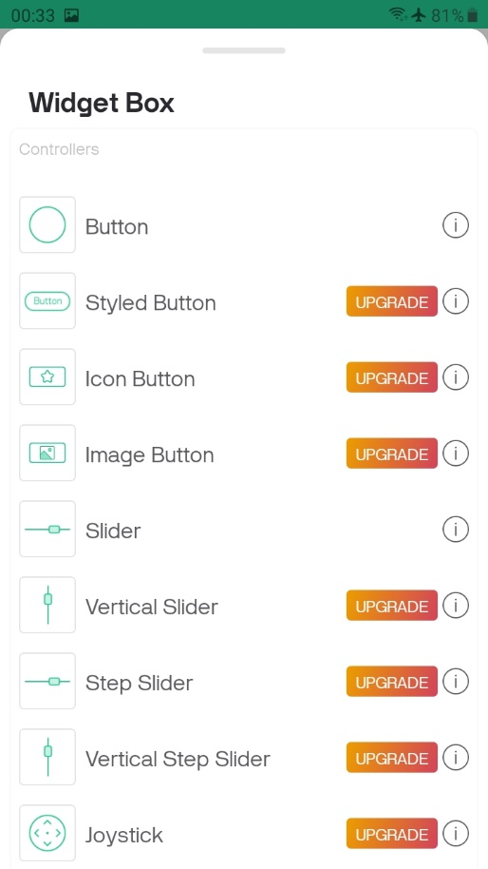
Creating Mobile Application
After choosing LED Control template, click on the wrench icon
Add widget by tapping ⊕ icon
Then choose Button

Slide 64
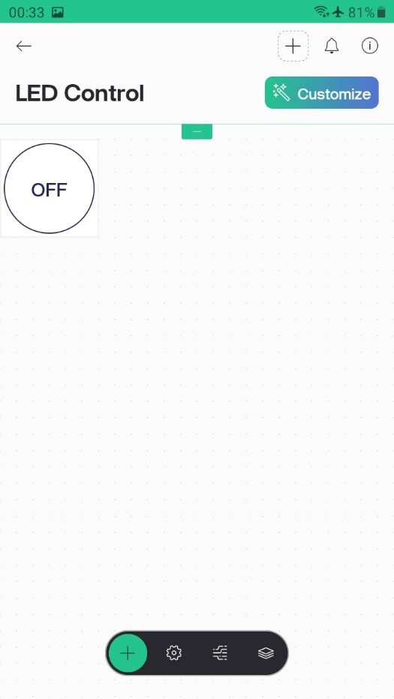
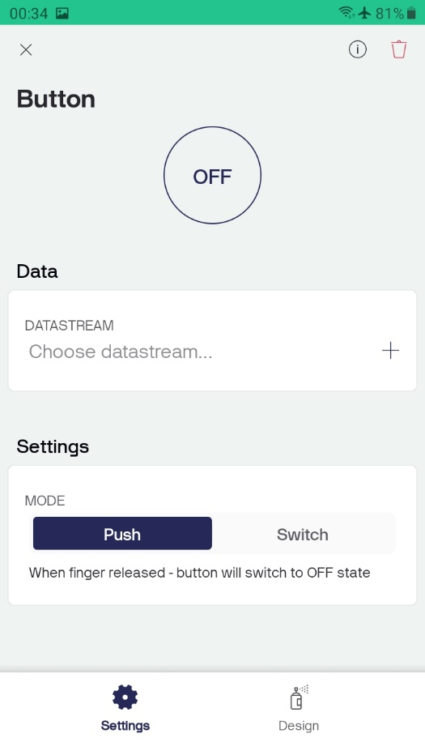
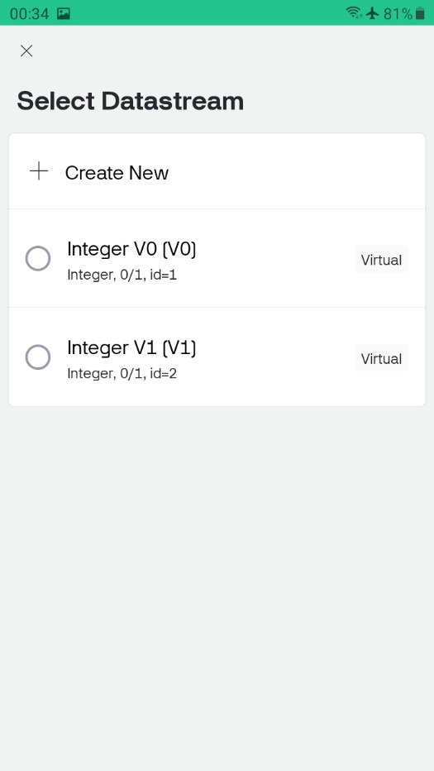
Creating Mobile Application
A button will be shown, then tap on the button
Change MODE from Push to Switch
Then set DATASTREAM to Integer V0 [V0]

Slide 65
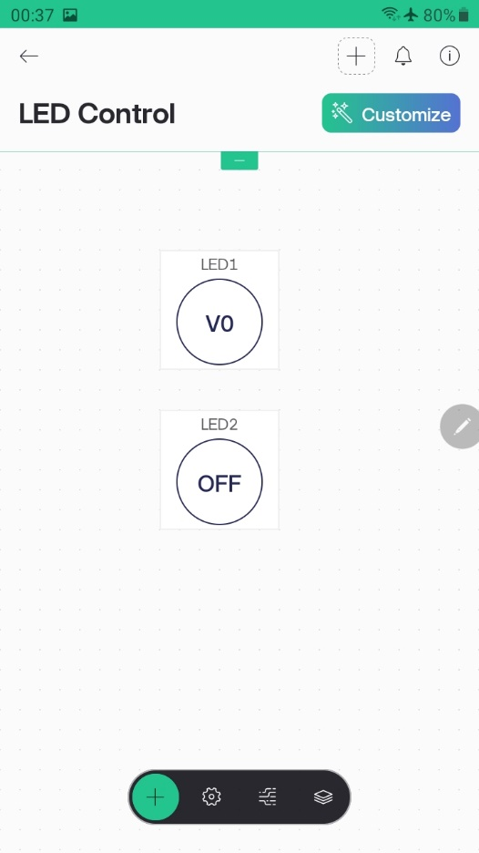


Creating Mobile Application
Repeat the process, tap on ⊕ then choose Button
Change Mode to Switch and set DATASTREAM to Integer V1 [V1]
Tap ← icon (top left of the screen) to go back to Application main screen

Slide 66

Sending DHT11 data to Blynk IoT App
Create a new template in Blynk Console, go to Developer zone and click on
New template
Type DHT11 under Name, choose ESP32 for Hardware and WiFi for Connection Type
ESP32

Slide 67

Sending DHT11 data to Blynk IoT App
Add Virtual Pin for DATASTREAM and set other parameters as follow:

Slide 68

Sending DHT11 data to Blynk IoT App
Add 2nd DATASTREAM by choosing Virtual Pin and set parameters as follow:

Slide 69

Sending DHT11 data to Blynk IoT App
Finally, click on Save And Apply

Slide 70

Sending DHT11 data to Blynk IoT App
Next, go to Devices menu and click on +New Device
Click on From template

Slide 71

Sending DHT11 data to Blynk IoT App
Choose DHT11 for Template , then click Create

Slide 72

Sending DHT11 data to Blynk IoT App
Template ID, Template Name and Token will be generated
Click on Copy to clipboard, then paste these information in your sketch

Slide 73

Sending DHT11 data to Blynk IoT App
Build the following circuit on breadboard
Download Blynk_DHT11_ESP32.ino sketch from https://github.com/watisleelapatra/Arduino
ESP32
D13
3V
GND

Slide 74

Sending DHT11 data to Blynk IoT App
Add Template ID, Name and AuthToken from Blynk console in your sketch
Add Wi-Fi AP name and Password, then download sketch to ESP32

Slide 75


Sending DHT11 data to Blynk IoT App
Open Blynk IoT App on mobile phone
Choose DHT11 Display template
Add Gauge Widget and rename to Temperature and set DATASTREAM to Integer V0 [V0]

Slide 76


Sending DHT11 data to Blynk IoT App
Add the 2nd Gauge, rename it to Humidity, set DATASTREAM to Integer V1 [V1]
Tap on X to close current screen, then tap on ← to go back to main screen

Slide 77

Sending DHT11 data to Blynk IoT App
Data from DHT11 will be displayed and updated every 5 seconds

Slide 78

Alphanumeric LCD (revisited)
Inter-Integrated Circuit (IIC or I²C) is used to simplified communication
between LCD module and ESP32
I²C uses only 2 I/O lines for communication
ESP32
Contrast adjust
D22
D21
5V
GND
GND
Vcc
LCD
SDA
SCL
I²C controller board

Slide 79

Alphanumeric LCD
Floating point numbers can be printed with specified number of fraction
Run test code: I2C_LCD_Numbers.ino
LCD display contain preloaded special characters:
To print these characters,
use (char) x inside lcd.print()
For example:
lcd.print((char) 247); // print π

Slide 80

LCD Custom Font Display
Some applications, we might need special symbols that
are not available in LCD character ROM
It is possible to customize fonts and display them on LCD

Slide 81

LCD Custom Font Display
Each character in LCD fonts are contained in 5x8 pixel grid
We consider dark pixel as "1" and light pixel as "0"
In the example below, we can write binary number for each row as:
#include <Wire.h>
#include <LiquidCrystal_I2C.h>
LiquidCrystal_I2C lcd(0x3F, 16, 2);
byte customChar[] = {
B00001, B11001, B11001, B01001,
B01001, B01001, B01001, B01111
};
void setup() { // Initialize the LCD
lcd.init();
for (int i = 0; i < 8; i++) { // Create custom characters
lcd.createChar(i, thaiChars[i]);
}
lcd.clear();
displayThaiCharacters(); // Display the Thai characters
}
00001
11001
11001
01001
01001
01001
01001
01111

Slide 82

LCD Custom Font Display
There is an online tool to help design custom fonts:
https://maxpromer.github.io/LCD-Character-Creator/

Slide 83
LCD Custom Font Display
The Liquid_Crystal_I2C library provides function to install
custom fonts into available LCD character memory
Example: ThaiCharDemo.ino

