Slide 1
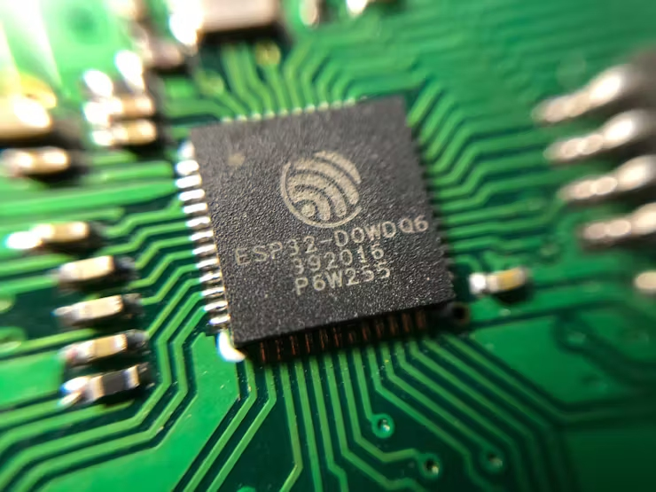
Arduino Workshop (ESP32 Basic Level) ดร. วาธิส ลีลาภัทร ภาควิชาวิศวกรรมคอมพิวเตอร์ คณะวิศวกรรมศาสตร์ มหาวิทยาลัยขอนแก่น

Slide 2
Hardware : ESP32
ESP32 Key Features
Xtensa® Dual-Core 32-bit LX6 microprocessors, up to 600 DMIPS
Integrated 520 KB SRAM
Integrated 802.11BGN HT40 Wi-Fi transceiver, baseband, stack and LWIP
Integrated dual mode Bluetooth (classic and BLE)
4 MByte flash (32Mbit)

Slide 3
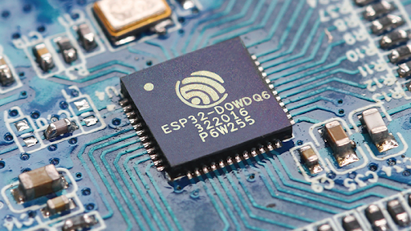
Hardware : ESP32
ESP32 Key Features
Xtensa® Dual-Core 32-bit LX6 microprocessors, up to 600 DMIPS
Integrated 520 KB SRAM
Integrated 802.11BGN HT40 Wi-Fi transceiver, baseband, stack and LWIP
Integrated dual mode Bluetooth (classic and BLE)
4 MByte flash (32Mbit)

Slide 4
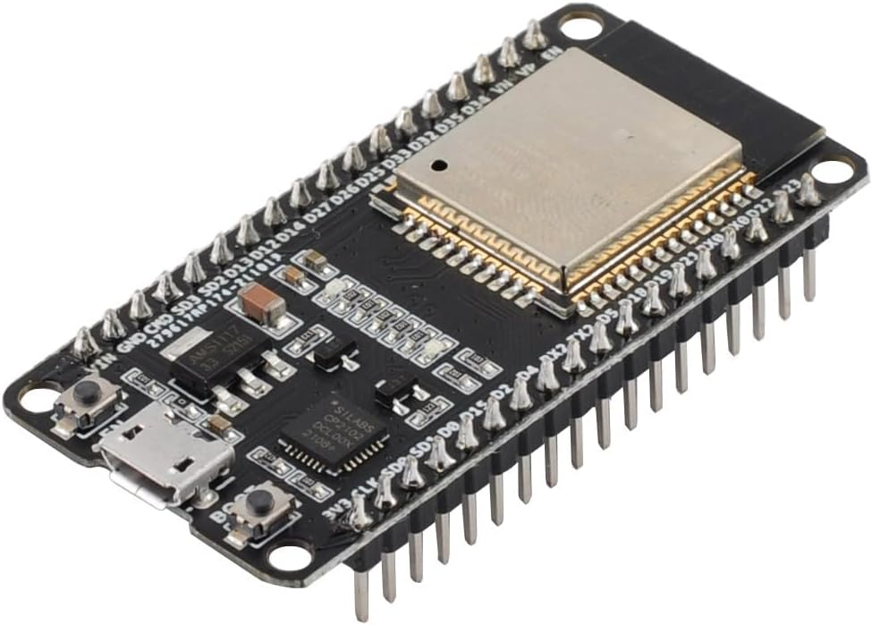
ESP32 DEVKIT
ESP-WROOM-32 DevKit
utilizes ESP32 chip, 240MHz, RAM 512KB, 4MB flash memory
WiFi 2.4GHz / Bluetooth

Slide 5
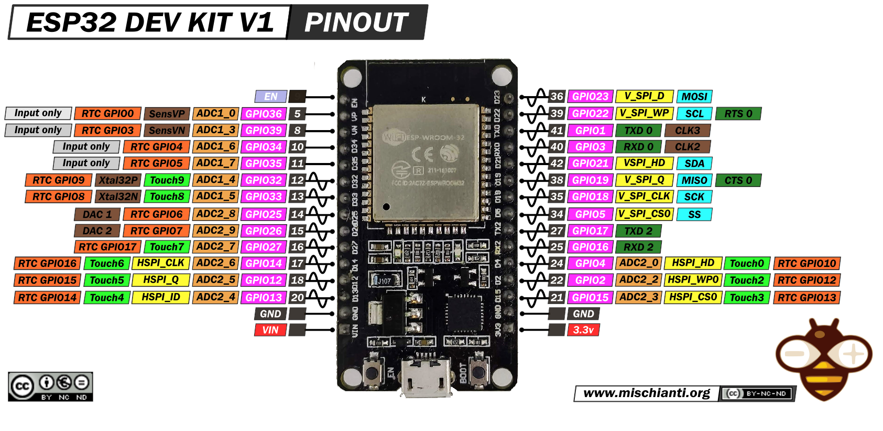
ESP32 DEVKIT
Micro USB Port

Slide 6
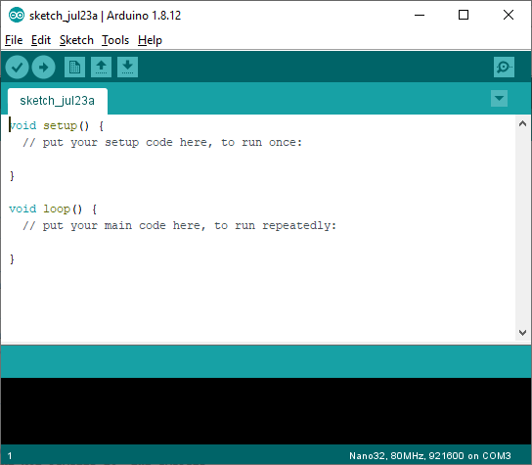
Software
Arduino IDE
Use for writing, compiling and downloading code into ESP32 board.
Go to arduino.cc/en/Main/Software, download & install on your PC.

Slide 7
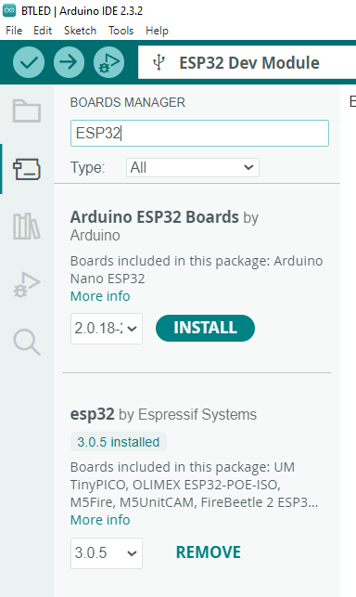

Add ESP32 Board Support
Click on Board icon on Arduino IDE, type ESP32 in search box
Look for esp32 by Espressif Systems, then click on INSTALL
2
1
3

Slide 8
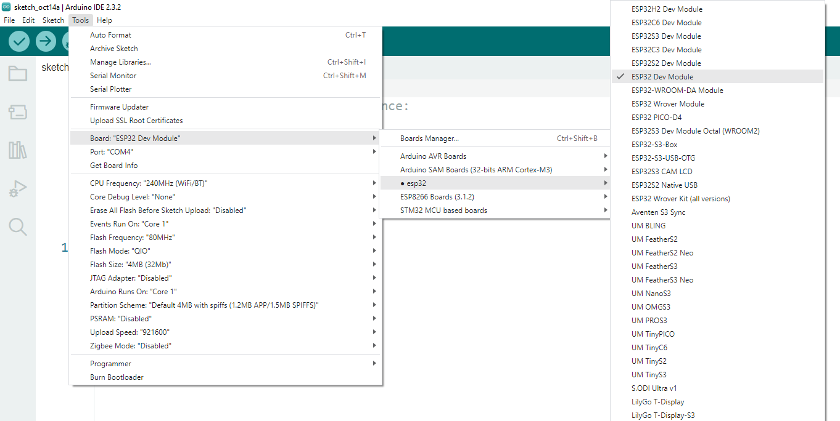
Add ESP32 Board Support
Go to Tools → Board: → esp32 → ESP32 Dev Module
Go to Tools → Port: → COMxx (xx is a number shown on your PC)

Slide 9
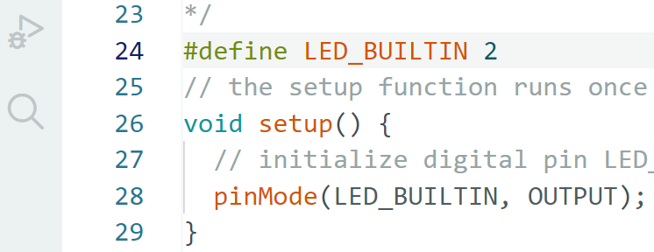
Test ESP32 Board
To test installation:
- Go to: File → Examples → 01.Basics → Blink
- At line 24, type:
# define LED_BUILTIN 2
- Click on download icon
- You should see the Blue LED blinking on ESP32 Board

Slide 10
Arduino Programming
Software for Arduino boards is developed on Arduino IDE
Arduino source code is called ‘sketch’
Sketch utilizes C programming language syntax
Initial structure of sketch:
void setup() {
// put your setup code here, to run once:
}
void loop() {
// put your main code here, to run repeatedly:
}

Slide 11
Arduino Programming
Example
// the setup function runs once when you press reset or power the board
void setup() {
// initialize digital pin LED_BUILTIN as an output.
pinMode(LED_BUILTIN, OUTPUT);
}
// the loop function runs over and over again forever
void loop() {
digitalWrite(LED_BUILTIN, HIGH); // turn the LED on (HIGH is the voltage level)
delay(1000); // wait for a second
digitalWrite(LED_BUILTIN, LOW); // turn the LED off by making the voltage LOW
delay(1000); // wait for a second
}

Slide 12
Digital I/O Port
pinMode()
Description
Configures the specified pin either as an input or an output.
Syntax
pinMode(pin, mode)
Parameters
pin: the number of the pin whose mode you wish to set
mode: INPUT, OUTPUT
Returns
None
ESP32
Data
OUTPUT
Data
INPUT

Slide 13
Digital I/O Port
Example: pinMode()
setup () {
pinMode(2, OUTPUT); // GPIO2 is output
SWPin = 17; // assign value 17 to variable SWPin
pinMode(SWPin, INPUT); // now GPIO 17 is input
}
ESP32
Data
GPIO2
Data
GPIO17

Slide 14
Digital I/O Port
digitalWrite()
Description
Write a HIGH or a LOW value to a digital pin. If the pin has been configured as an OUTPUT with pinMode()
Syntax
digitalWrite(pin, value)
Parameters
pin: the pin number
value: HIGH or LOW
Returns
none
ESP32
1
0
Data =
OUTPUT
Volt
High
High
3.3V
1
1
Low
Low
0
0
Time

Slide 15

Digital I/O Port
Example: digitalWrite()
setup () {
pinMode(2, OUTPUT); // GPIO2 is output
digitalWrite(2, HIGH); // Supply 3.3 Volt to GPIO2
delay(1000); // Suspend for 1000 milisecond
digitalWrite(2, LOW); // Supply 0 Volt to GPIO2
}
ESP32
ESP32
Data = 0
Data = 1
GPIO2
GPIO2
Data = LOW
Data = HIGH
GPIO17
GPIO17

Slide 16
Digital I/O Port
digitalRead()
Description
Reads the value from a specified digital pin, either HIGH or LOW.
Syntax
digitalRead(pin)
Parameters
pin: the pin number
Returns
HIGH or LOW.

Slide 17
Digital I/O Port
Example
Read status of input pin 7 and display on pin 13.
int ledPin = 13; // LED connected to digital pin 13 int inPin = 7; // pushbutton connected to digital pin 7 int val = 0; // variable to store the read value void setup() { pinMode(ledPin, OUTPUT); // sets the digital pin 13 as output pinMode(inPin, INPUT); // sets the digital pin 7 as input } void loop() { val = digitalRead(inPin); // read the input pin digitalWrite(ledPin, val); // sets the LED to the button's value }

Slide 18
Programming Structures
for
Description
The for statement is used to repeat a block of statements enclosed in curly braces. An increment counter is usually used to increment and terminate the loop. The for statement is useful for any repetitive operation
Syntax
for (initialization; condition; increment) {
// statement(s);
}
Example
int count = 0; // initialize variable
void setup() {
Serial.begin(9600);
}
void loop() {
for (int i = 0; i <= 255; i++) {
count = Count+2;
Serial.println(Count);
}
}

Slide 19
Programming Structures
if
Description
The if statement checks for a condition and executes the proceeding statement or set of statements if the condition is 'true'.
Syntax
if (condition) {
// statement(s);
}
Example
int a, b, c;
int b, c;
if (a > 0) {
c = a + b;
} else if (a == 0) {
c = b;
} else { //a must be less than zero
c = a);
}
if (condition1) {
// do statement group A
}
else if (condition2) {
// do statement group B
}
else {
// do statement group C
}

Slide 20
Programming Structures
while
Description
A while loop will loop continuously, and infinitely, until the expression inside the parenthesis, () becomes false.
Syntax
while (condition) {
// statement(s);
}
Example
var = 0;
while (var < 200) {
// do something repetitive 200 times
var++;
Serial.println(var);
}

Slide 21
Data types
boolean ‘true’, ‘false’
char 8-bit value from -128 to 127
unsigned char 8-bit value from 0 to 255
byte same as unsigned char
int 16-bit value from -32,768 to 32,767
unsigned int 16-bit value from 0 to 65535
word same as unsigned int
long 32-bit value from -2,147,483,648 to 2,147,483,647
unsigned long 32-bit value from 0 to 4,294,967,295
short same as int
float 32-bit value -3.4028235E+38 to 3.4028235E+38
double same as float
string array of character

Slide 22
Built-in functions
Digital I/O
pinMode()
digitalWrite()
digitalRead()
Analog I/O
analogReference()
analogRead()
analogWrite() - PWM
Advanced I/O
tone()
noTone()
shiftOut()
shiftIn()
pulseIn()
Time
millis()
micros()
delay()
delayMicroseconds()
Math
min()
max()
abs()
constrain()
map()
pow()
sqrt()
Communication
Serial
Stream

Slide 23
Serial Print
Serial.print() & println()
Description
Prints data to the serial port as human-readable ASCII text followed by a carriage return character (ASCII 13, or '\r') and a newline character (ASCII 10, or '\n'). These commands are useful for communication with PC and debugging.
Syntax
Serial.println(val)
Serial.println(val, format)
Example
int analogValue = 0; // variable to hold the analog value
void setup() {
Serial.begin(9600); // open the serial port at 9600 bps:
}
void loop() {
analogValue = analogRead(0); // read the analog input on pin 0:
// print it out in many formats:
Serial.println(analogValue); // print as an ASCII-encoded decimal
Serial.println(analogValue, DEC); // print as an ASCII-encoded decimal
Serial.println(analogValue, HEX); // print as an ASCII-encoded hexadecimal
Serial.println(analogValue, BIN); // print as an ASCII-encoded binary
}

Slide 24
Serial Print
- Open serial port monitor (Menu Tools→Serial Monitor)
- Run the following sketch
void setup()
{
Serial.begin(9600);
Serial.println("Hello World");
}
void loop()
{
}

Slide 25
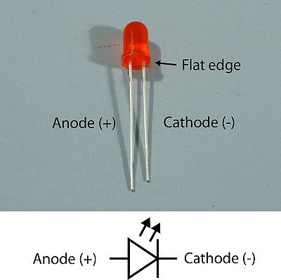
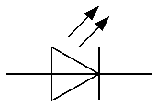

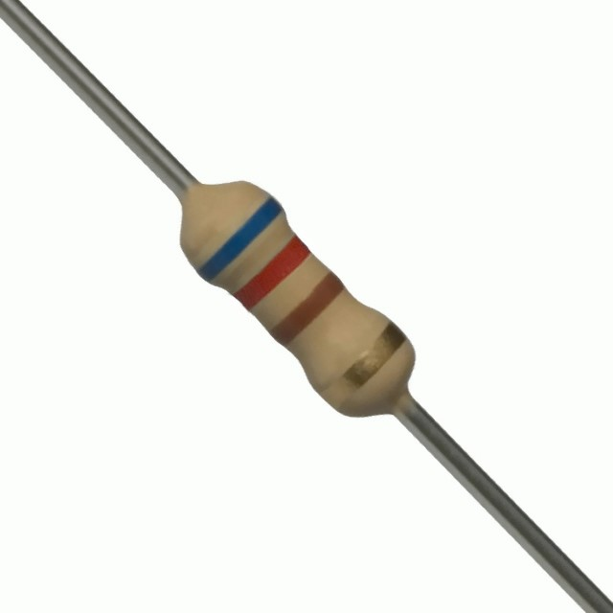
ESP32 Input/Output
Example 1: Blinking external LED
Open blink example: File → Examples → 01. Basics → Blink
Replace LED_BUILTIN with number 23
Connect resistor and LED to ESP32 at Pin D23
ESP32
620 Ohm
D23
GND
Resistor 620 Ohm

Slide 26
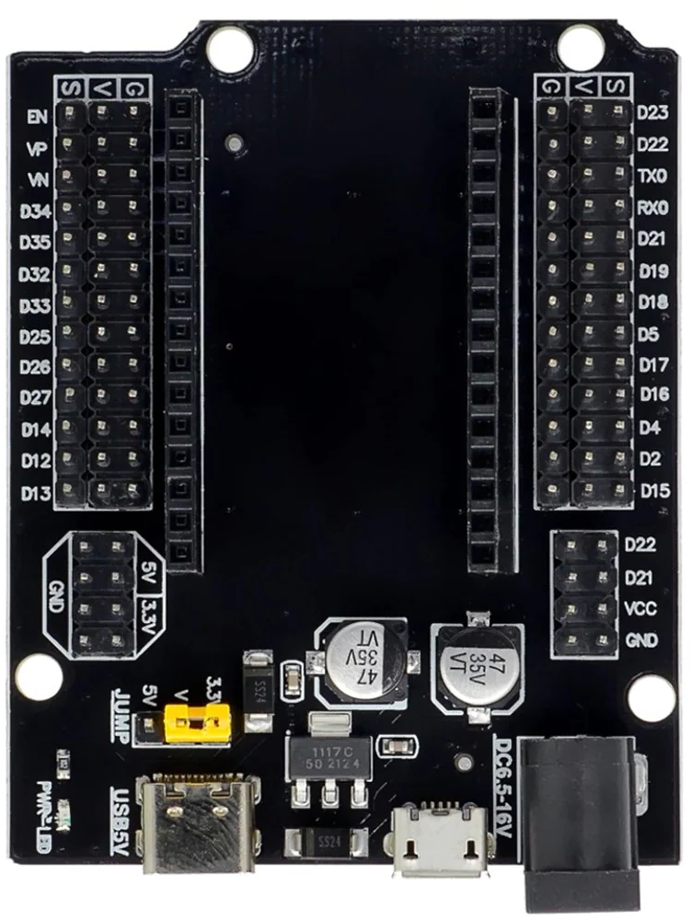
ESP32 Extension Board
Pins extension
External power supply
S (Signal) Pins
V (3V Power supply) Pins
G (Ground) Pins

Slide 27
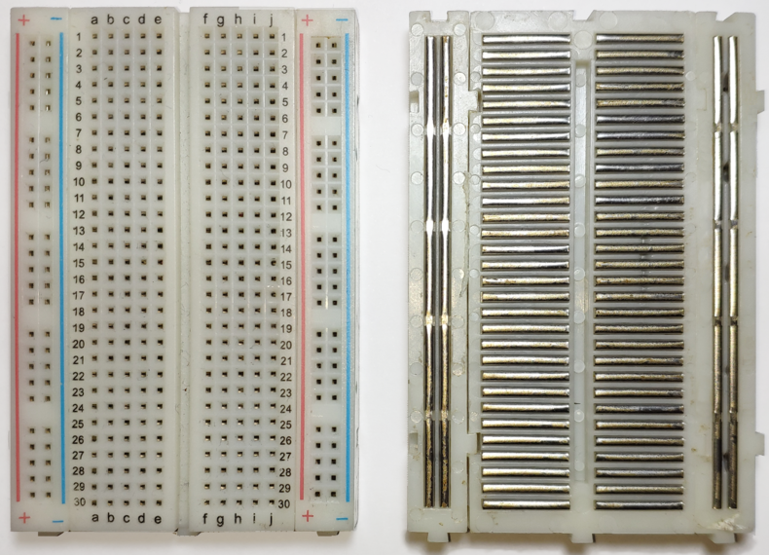
Circuit Construction
Prototyping board
Pre-connected conductor stripes
Horizontal stripes on 2 top rows and 2 bottom rows
Vertical stripes in the middle

Slide 28
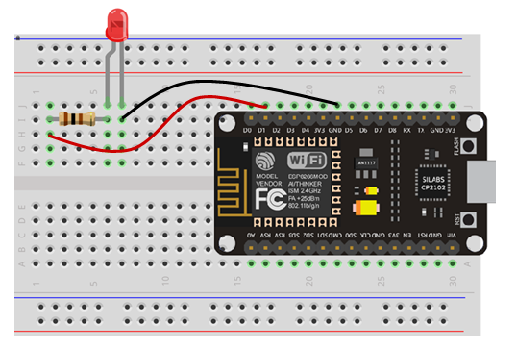
Circuit Construction
Prototyping board
Pre-connected conductor stripes
Horizontal stripes on 2 top rows and 2 bottom rows
Vertical stripes in the middle

Slide 29
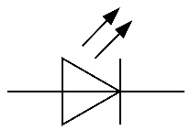

ESP32 Input/Output
Exercise 1: Blinking 3 external LEDs
ESP32
620 Ohm
D23
620 Ohm
D22
620 Ohm
D21
GND

Slide 30
ESP32 Input/Output
Exercise 2: Chasing LEDs
Modify your sketch to make chasing LEDs
ESP32
620 Ohm
D23
620 Ohm
D22
620 Ohm
D21
GND

Slide 31
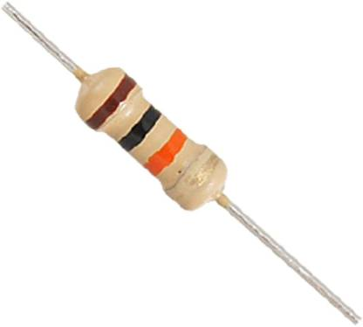
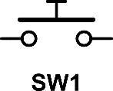
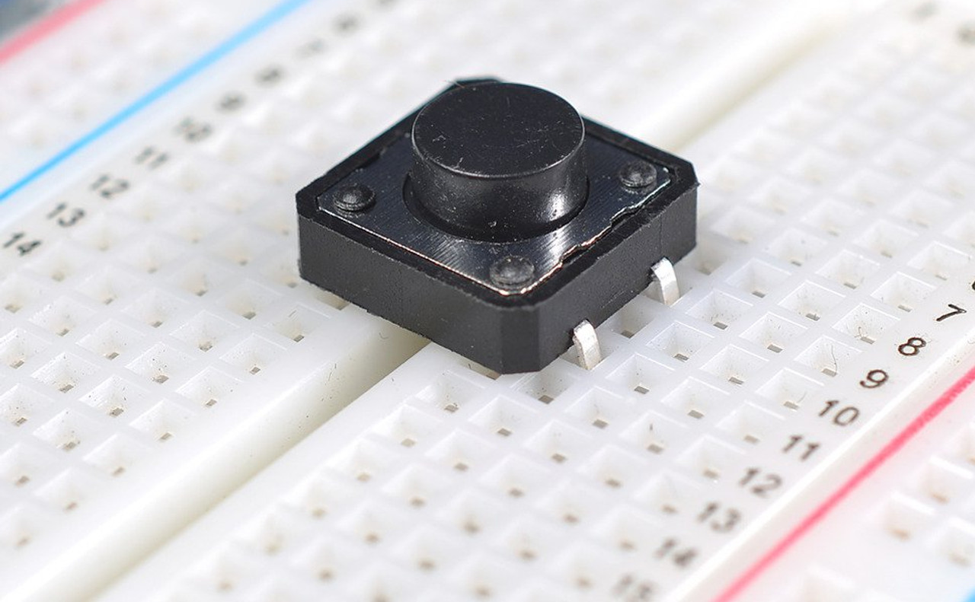

ESP32 Input/Output
Example 2: Reading digital input
Open example: File → Examples → 01. Basics → DigitalReadSerial
Change int pushButton = 2 to int pushButton = 19
Change delay value in delay(1) to delay(10)
10K Ohm
ESP32
V
620 Ohm
D23
620 Ohm
Push-button
Switch
D22
D19
620 Ohm
D21
10K Ohm
GND
GND

Slide 32
ESP32 Input/Output
Exercise 3 : Combine input & output
LED is on when button is pressed and off when button is released
LED if off when button is pressed and on when button is released
LED blinks 5 times when button is pressed
Reverse chasing direction when button is pressed
ESP32
V
620 Ohm
D23
620 Ohm
Push-button
Switch
D22
D19
620 Ohm
D21
10K Ohm
GND
GND

Slide 33
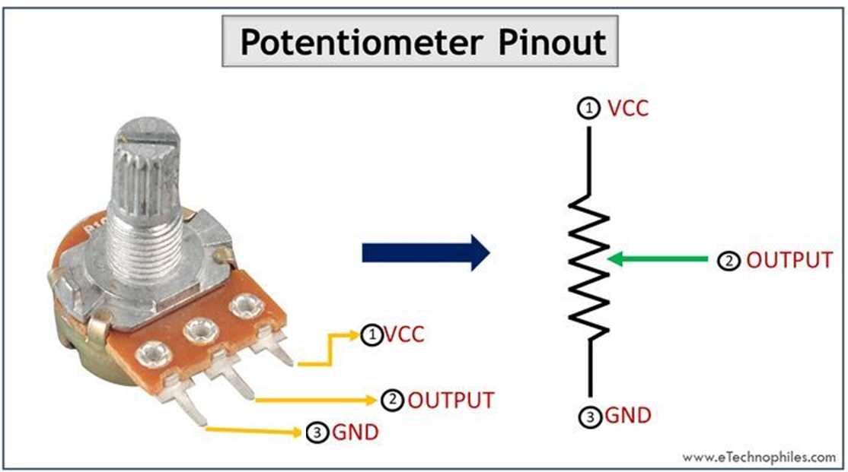
ESP32 Analog Input
Simple analog input
Potentiometer is used as analog voltage source
Analog voltage is converted to number ranging from 0 – 1023 (0 – 3.3v)

Slide 34
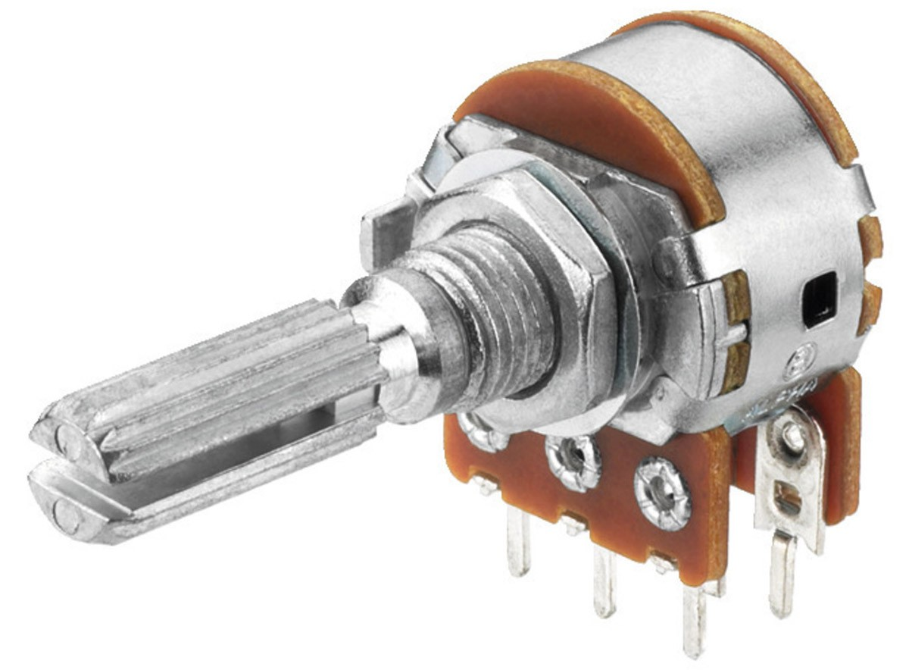
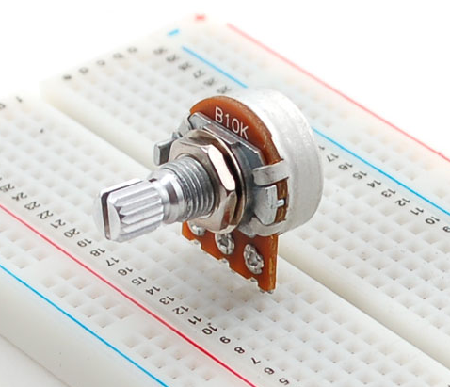

ESP32 Analog Input
Example 3 : Simple analog input
Potentiometer is used as analog voltage source
Analog voltage is converted to number ranging from 0 – 1023 (0 – 3.3v)
ESP32
620 Ohm
V
D23
620 Ohm
Push-button
Switch
D22
D19
620 Ohm
3
D21
2
1
10K Ohm
GND
1
GND
2
VP (ADC1-0)
3
Potentiometer
GND

Slide 35
ESP32 Analog Input
int POT = 36; // select the input pin for the potentiometer
int analogValue = 0; // variable to store the value coming from the sensor
void setup() {
Serial.begin(9600);
}
void loop() {
analogValue = analogRead(POT); // read the value from the sensor:
Serial.println(analogValue);
delay(500);
}

Slide 36
ESP32 Analog Input
Example 4
Open default blink example: File → Examples → 03. Analog → AnalogInput
Change int sensorPin = A0 to int sensorPin = 36
Make D23, D22, D1 to output
Adjust potentiometer to change blinking frequency
ESP32
620 Ohm
V
D23
620 Ohm
Push-button
Switch
D22
D19
620 Ohm
D21
10K Ohm
GND
1
GND
2
VP (ADC1-0)
3
Potentiometer
GND

Slide 37
ESP32 Analog Input
Exercise 4: Combine analog & digital inputs
Modify your chasing LEDs sketch to make it:
- chasing speed controllable using potentiometer
- chasing direction switchable using push-button

Slide 38
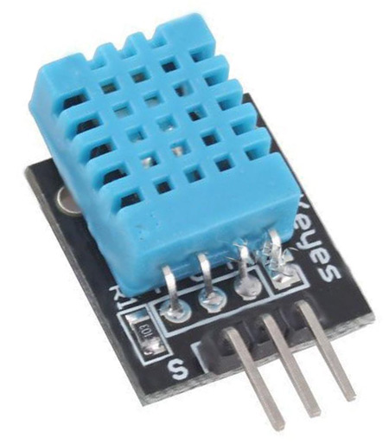
DHT11 Digital Temperature & Humidity Sensor
Specifications:
Temperature 0-50ºC
Humidity 20-80%
GND
Signal
3V

Slide 39
DHT11 Digital Temperature & Humidity Sensor
Blinking 3 external LEDs
ESP32
620 Ohm
D23
620 Ohm
D22
620 Ohm
D21
GND

