Slide 1


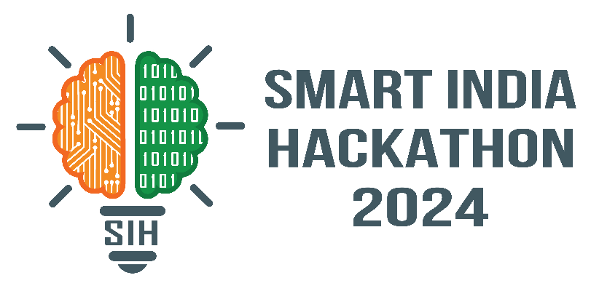

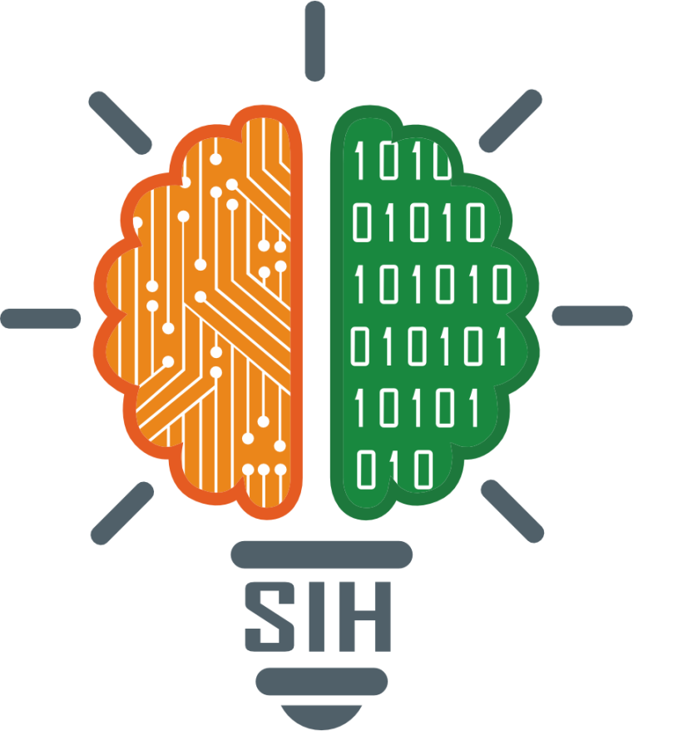
VITISH 2024 (SIH Internal Hackathon)
Problem Statement ID – SIH1540
Problem Statement Title – Student Innovation
Theme - Smart Automation
PS Category - Hardware
Team ID - VIT068
Team Name - OmniVRse

Slide 2
MULTIPURPOSE HAND GLOVE
Leverages multiple gyroscopes for precise hand gesture detection, enabling versatile application across various platforms.
Optimized for AR/VR, gaming, presentations, providing an interactive, immersive experience.
Facilitates communication and application control for physically challenged individuals, enhancing their independence.
Offers a high-tech solution at a fraction of the cost of similar products, making advanced technology accessible to a wider audience.
OmniVRse

Slide 3
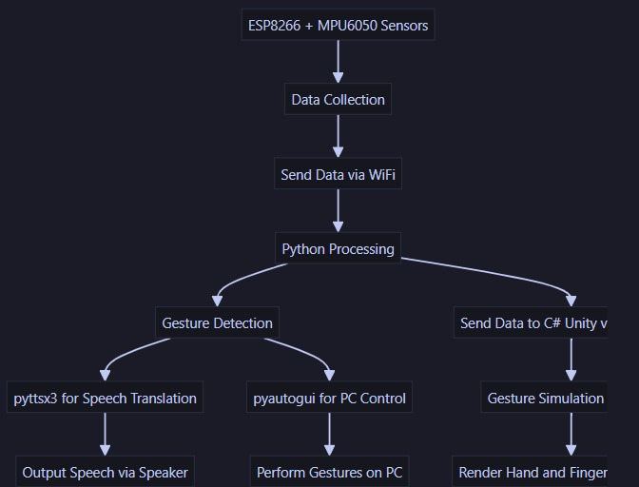
TECHNICAL APPROACH
ESP8266
MPU6050
Python
C
C#
Unity
OmniVRse

Slide 4
FEASIBILITY AND VIABILITY
Despite limited resources and time constraints, we were able to develop a fully working prototype with minimal capital.
With further development, this product has the potential to become an affordable, effective, and locally-produced solution
While we encountered challenges related to comfort, user learning curve, and sensor sensitivity, these are solvable through dedicated R&D efforts.
By dedicating more time and resources, we aim to enhance the design using Machine Learning for smarter gesture recognition and improve user experience by developing interactive tutorials for easier adoption..
OmniVRse

Slide 5
IMPACT AND BENEFITS
Our product significantly improves the lives of physically challenged individuals, gamers, lecturers, business professionals, and tech enthusiasts, offering a versatile solution for various needs.
The glove enables physically challenged users to communicate more effectively, breaking down barriers and enhancing their independence.
By making the product affordable, we are able to fuel mass adoption of VR and haptic navigation devices amidst the general populace, making their lives easier, as well as promoting innovation in this technology.
OmniVRse

Slide 6
RESEARCH AND REFERENCES
A haptic direction indicator using the gyro effect - https://www.researchgate.net/publication/221012072_A_haptic_direction_indicator_using_the_gyro_effect
Algorithm of roll, pitch and yaw angular velocity for three-axis gyroscope - https://ieeexplore.ieee.org/document/5567328
Virtual Reality Learning Environment with Haptic Gloves - https://dl.acm.org/doi/10.1145/3528137.3528142
OmniVRse

