Slide 1
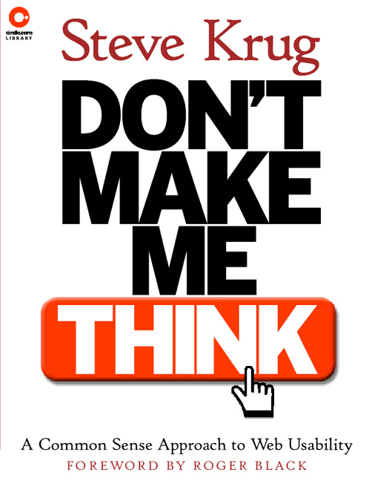
Real-Life Accessibility or
How I Should Have Spent my
Summer Vacation
Steve Krug
Boston-IA
Jan. 26, 2006

Slide 2
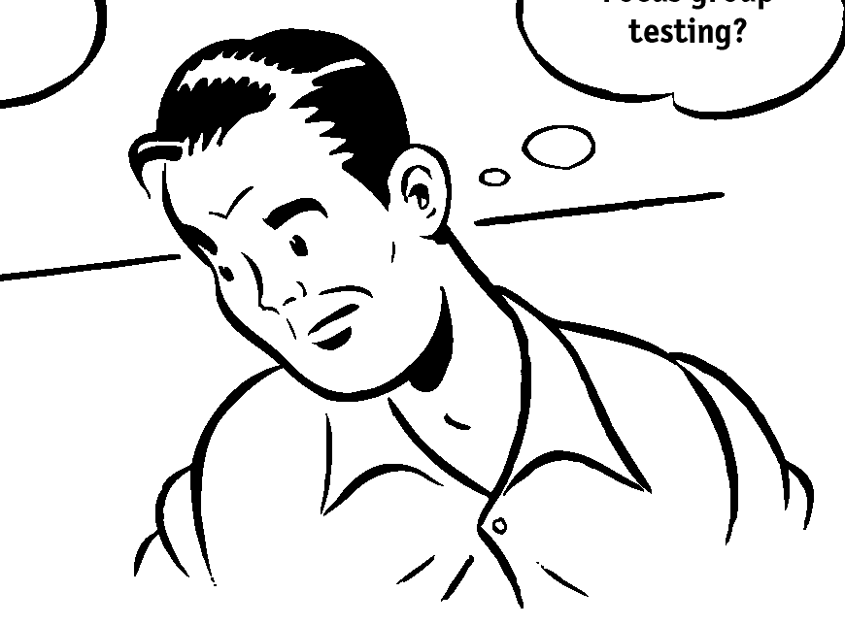
Who is this guy, anyway?
Steve Krug (steev kroog) (noun) 1. Son, husband, father 2. Resident of Brookline, Massachusetts
3. Usability consultant, author

Slide 3
This evening
Apologia
How/why I got myself into this mess
A walk through the chapter
My report card
A brief history of my site
Before and after: Conversation with Boston-IA's P.J. Gardner (and you)
A few closing thoughts

Slide 4
Apologia
Like to apologize in advance to anyone I might offend
Not a bad person, really (I think)
Political Correctness makes me edgy, sometimes escalating to irascible
Again, my apologies

Slide 5
Apologia, continued
I don’t like engaging in debates
  Inveterate lurker on listserv’s
  Not a bum; contribute in off-list e-mail
Debates usually seem more heat than light
  It all feels like Fox News to me
Life is too short
So please don’t e-mail me to debate
But I’m happy to discuss (even heatedly) face-to-face (e.g., here tonight)
  Ask questions as we go along

Slide 6
Hoist by my own petard
Been asking myself: How did I end up here?
For 'tis the sport to have the enginer Hoist with his owne petar
  Hamlet, Act III, Scene iv
This Is Your Bed, You Made It, Now Lie In It
  Bob Goulding and Ray Elliot

Slide 7
How I got into this mess
I really never intended to talk about accessibility
NOT an accessibility expert
  Don’t even play one on TV
Most of you may know much more about accessibility than I do
I don’t plan on becoming an expert
  Sherlock Holmes got it right
  That’s why we have books, Google, and...
  P.J. Gardner!

Slide 8
So why a chapter?
Figured accessibility was the right thing
  As in “doing the right thing”
But they weren’t selling me, somehow
And I should have been an easy sell
Most small sites are dancing as fast as they can even without thinking about accessibility
Interested whether there was a real conflict
Is accessibility the enemy of design?
  Do buttered cats really exist?

Slide 9
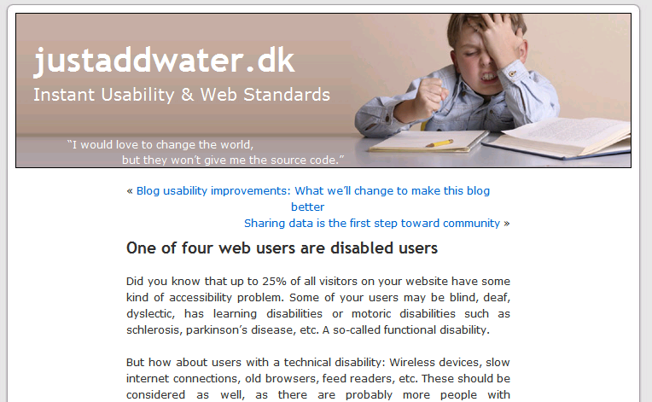
Some advocates cite 50%
and higher!
(Loses credibility...)

Slide 10
A walk through the chapter
Added to the second edition of Don't Make Me Think
“Accessibility, Cascading Style Sheets, and you”
Download it (for your personal use)
  http://www.sensible.com/Downloads/DMMT2Ch11-NotForDistribution.pdf

Slide 11
A walk through the chapter
#1. Fix the usability problems that confuse everyone
#2. Read an article
  “Guidelines for accessible and usable web sites: Observing users who work with screen readers”
    Ginny Redish and Mary Theofanos
    http://www.redish.net/content/papers.html
#3. Read a book
#4. Start using Cascading Style Sheets
#5. Go for the low-hanging fruit

Slide 12
A brief history of sensible.com
A modest site, even now (see site map)
1996-2000: Happy as a clam with my one-pager
2000: Book needed its own page
2001: Workshops needed some pages
Homegrown in Dreamweaver
  Always asking people not to look under the hood
  Cobbler's kids
But I always had alt text!
  God bless The Wayback Machine
  http://www.archive.org/web/web.php

Slide 13
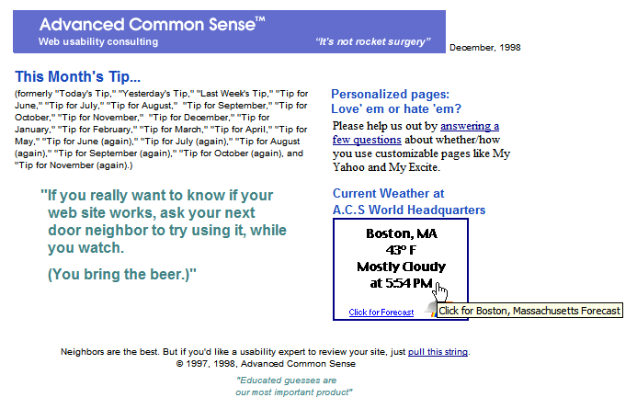

Slide 14
My report card
#1. Make it usable
  8
  A 10 would require real work
  “good enough” usability
#2. Read an article
  10
#3. Read a book
  7
  Read most of one, parts of four or five, but retained little
  Figured to go back to several of them while doing my site

Slide 15
My report card
#4. Start using CSS
  Average 5
  Hired Eric Meyer = 10
  Didn’t follow through = 1
#5. Go for the low-hanging fruit
  7
  Did some myself
  Hired P.J.

Slide 16
Before and after
Conversation with P.J.

Slide 17
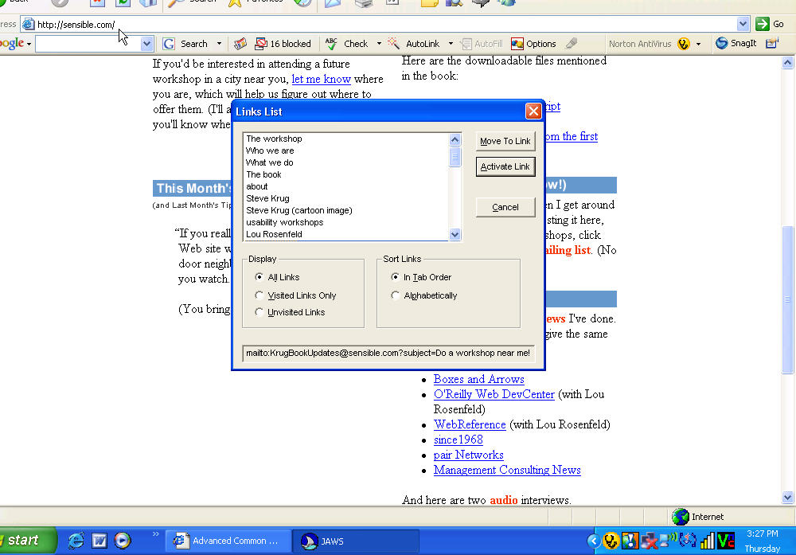
Links on my home page, as read by JAWS
(1 of 4, BEFORE)

Slide 18
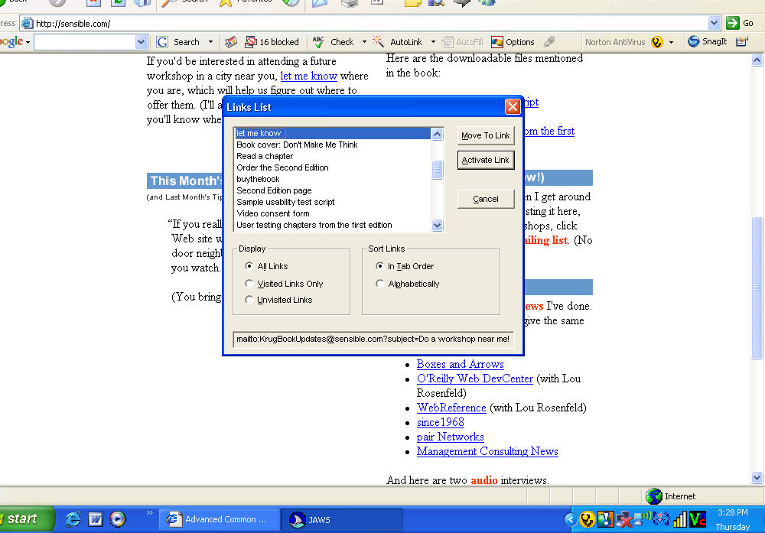
Bad!
Bad!
Links on my home page, as read by JAWS
(2 of 4, BEFORE)

Slide 19
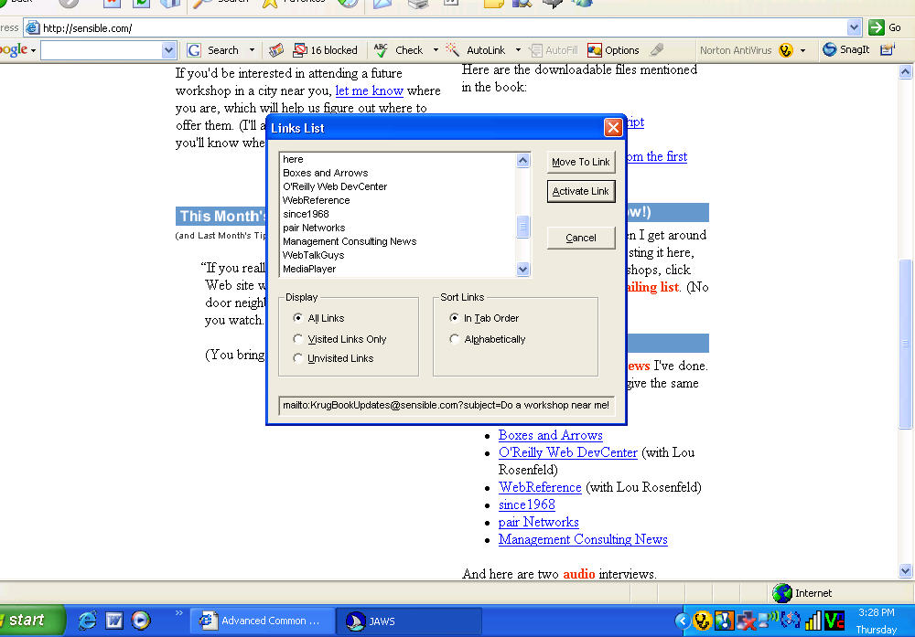
Bad!
Links on my home page, as read by JAWS
(3 of 4, BEFORE)

Slide 20
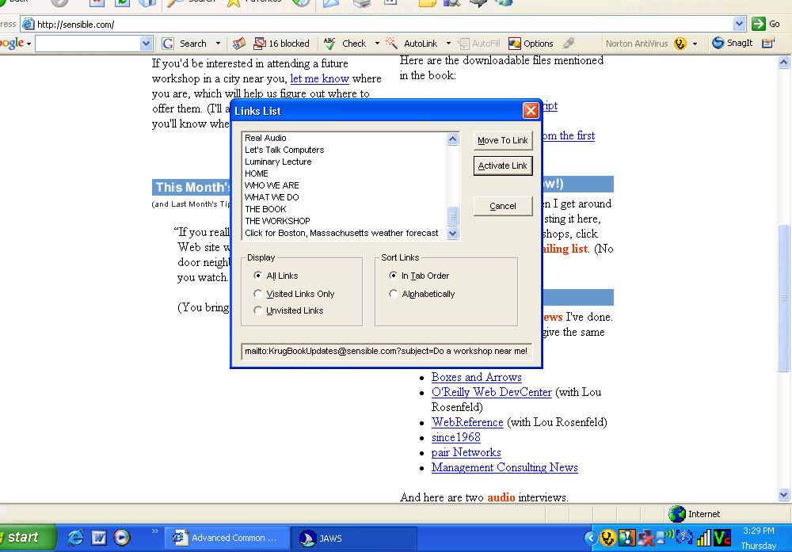
Links on my home page, as read by JAWS
(4 of 4, BEFORE)

Slide 21
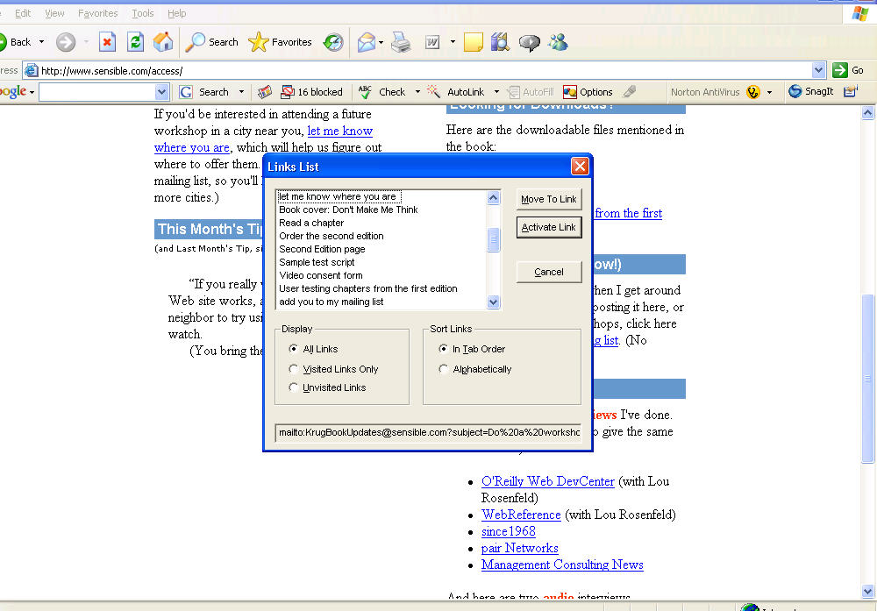
Better?
Better?
Link on my home page, as edited by P.J. (AFTER)

Slide 22
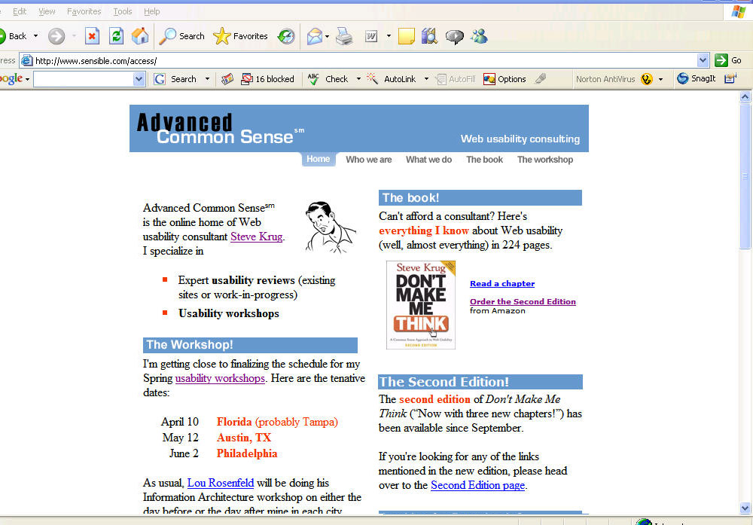
No headings found...
Headings on my home page, as read by JAWS (BEFORE)

Slide 23
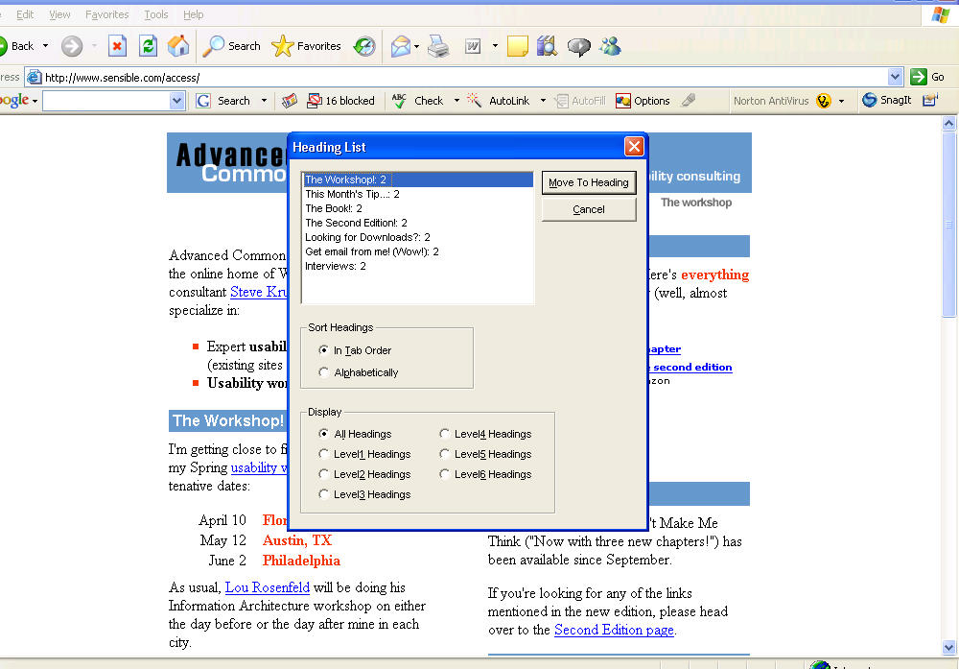
Headings on my home page, as read by JAWS (AFTER)

Slide 24
Thoughts
Should you wait for your next redesign to make the site accessible?
Avoid duplicating effort
  Why clean up things that may be going away?
My experience: might be better to decouple them
  Hmm. Before I convert to CSS, I should probably rethink the IA like I’ve been meaning to for years now. And I really should edit that text. And it really make sense to insulate the attic first, too...
The sense that it’s overwhelming becomes one more reason not to “just do it”

Slide 25
Thoughts
It’s not about guidelines
Guidelines are a means to an end
  The end: people being able to use it
  Not satisfying guidelines
Sounds a lot like usability ?
The problem: in this case, we’re terrible surrogates for our audience
  They’re diverse
  We don’t know them
  We have a hard time pretending to be them
    In part, because we don’t want to imagine being like them

Slide 26
Thoughts
Why don’t we all just do it?
Not sure how hard it is
Not sure how much we need to learn
Once you start reading, experts disagree
Unlike the visible UI, out of sight, out of mind
  Imitation/copying is one of the main reasons the Web has improved so much so soon
  Hard to actually tell which sites are accessible

Slide 27
Thanks a lot (@%^!$!)
Now I can’t look at comps from clients anymore without thinking “What about accessability?”

Slide 28
Thanks for all the fish
Lingering questions, gripes, etc.
  skrug@sensible.com

Slide 29
© 2006 Steve Krug

