Slide 1

Telescope
R0
(raw low-level)
R1 Calibration,
Gain Selection
OES
R1
(raw common)
Data Volume Reduction
DL0
(raw archived)
Charge Extraction
DL1a
(processed)
DPPS
Hillas Parameterisation
DL1b
(processed)
Shower Reconstruction
DL2
(reconstructed)
Grouping of Events +
IRF Generation
DL3
(reduced)
SUSS
Science Processing
﻿(spectra, sky maps, light curves, fit results)
DL4
(science)
Survey Mapping & Cataloguing
DL5
(high-level)

Slide 3
1) R0 Sample Storage
2) R0 Readout, Calibration, and R1 Storage
3) R1 Sample Readout
Camera Server
R0 File | 0 | 0 | 0 | 0 | 1 | 0 | 1 | 0
 | 0 | 1 | 1 | 0 | 0 | 1 | 1 | 1
 | 0 | 0 | 0 | 1 | 0 | 0 | 1 | 0
 | 1 | 0 | 0 | 0 | 0 | 0 | 0 | 1
 | 0 | 0 | 1 | 0 | 0 | 0 | 1 | 1
R1 File | 0 | 0 | 1 | 1 | 0 | 0 | 0 | 0
 | 0 | 1 | 0 | 0 | 0 | 0 | 1 | 1
 | 0 | 0 | 1 | 0 | 1 | 0 | 0 | 1
 | 0 | 0 | 0 | 0 | 0 | 0 | 1 | 0
 | 0 | 0 | 0 | 0 | 1 | 1 | 1 | 1
1 | 0 | 0 | 0 | 0 | 0 | 0 | 1
0 | 0 | 0 | 1 | 0 | 0 | 1 | 0
0 | 1 | 1 | 0 | 0 | 1 | 1 | 1
0 | 0 | 0 | 0 | 0 | 0 | 1 | 0 | 1 | 0 | 0 | 0 | 0 | 0 | 0 | 1
0 | 0 | 1 | 0 | 1 | 0 | 0 | 1 | 0 | 0 | 0 | 0 | 0 | 0 | 1 | 0
0 | 0 | 0 | 0 | 1 | 0 | 1 | 0
0 | 0 | 0 | 0 | 1 | 0 | 1 | 0 | 0 | 1 | 1 | 0 | 0 | 1 | 1 | 1
0 | 0 | 1 | 1 | 0 | 0 | 0 | 0 | 0 | 1 | 0 | 0 | 0 | 0 | 1 | 1
R0 File | 0 | 0 | 0 | 0 | 1 | 0 | 1 | 0
 | 0 | 1 | 1 | 0 | 0 | 1 | 1 | 1
 | 0 | 0 | 0 | 1 | 0 | 0 | 1 | 0
 | 1 | 0 | 0 | 0 | 0 | 0 | 0 | 1
 | 0 | 0 | 1 | 0 | 0 | 0 | 1 | 1
Calibrate
Add OFFSET to the resulting floating-point value and divide by SCALE to fit into uint16
Multiply by SCALE and subtract OFFSET to return R1-calibrated floating-point value
Waveform Reduction Tool
0 | 0 | 1 | 0 | 1 | 0 | 0 | 1 | 0 | 0 | 0 | 0 | 0 | 0 | 1 | 0
0 | 0 | 1 | 1 | 0 | 0 | 0 | 0 | 0 | 1 | 0 | 0 | 0 | 0 | 1 | 1
R1 File | 0 | 0 | 1 | 1 | 0 | 0 | 0 | 0
 | 0 | 1 | 0 | 0 | 0 | 0 | 1 | 1
 | 0 | 0 | 1 | 0 | 1 | 0 | 0 | 1
 | 0 | 0 | 0 | 0 | 0 | 0 | 1 | 0
 | 0 | 0 | 0 | 0 | 1 | 1 | 1 | 1

Slide 4
Light source
θ
d_{z}
d_{c}
β
Pixel
d₁
Camera Focal Surface
α
x
θ
r
d₂
α
Centre of Camera Circle

Slide 5
Telescope 2
Telescope 1
Shower Core Location
Telescope 3
Telescope 4

Slide 6
Image 2
Shower
Source Position
Image 1
Image 3
Image 4
Centre of FOV

Slide 7
Width
α
Length
Primary Image Axis
Distance
Shower Source
Position
Centre of FOV

Slide 8
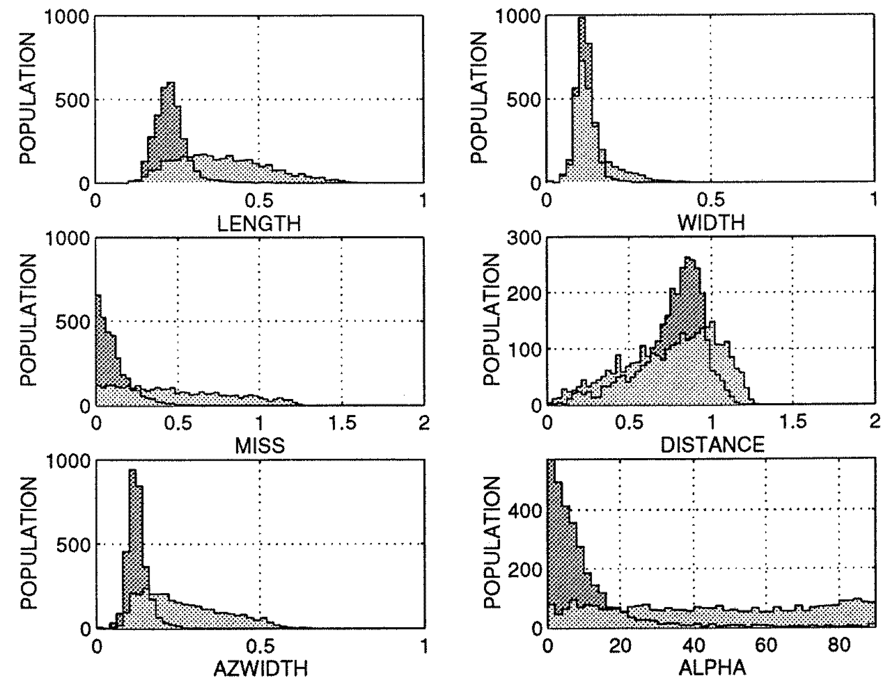

Slide 9
ctapipe.io.containers.DataContainer:
r0.*: Raw Data
r1.*: R1 Calibrated Data
dl0.*: DL0 Data Volume Reduced Data
dl1.*: DL1 Calibrated image
dl2.*: Reconstructed Shower Information
mc.*: Monte-Carlo data
mcheader.*: Monte-Carlo run header data
trig.*: Central trigger information
count: Number of events processed
inst.*: Instrumental information (deprecated)
pointing[*]: Telescope pointing positions

Slide 10
EventSource
Inheritance
Returns
Dependencies
HESSIOEventSource
pyhessio
SST1MEventSource
protozfits
TargetIOEventSource
TargetIO
…
DataContainer

Slide 11
Factory
+ EventSource
Inheritance
Returns
Method
EventSourceFactory
input_url + EventSource.is_compatible
HESSIOEventSource
Check first 4 bytes
SST1MEventSource
Check fits header
TargetIOEventSource
Check filename ends with .tio
…

Slide 12
R1
DL0
DL1
EventSource
CameraR1CalibratorFactory
Inheritance
Returns
Input
Execution
NullR1Calibrator
HESSIOR1Calirator
TargetIOR1Calibrator
…
CameraR1Calibrator.calibrate(DataContainer)
No data-volume reduction methods have been implemented into ctapipe yet.
CameraDL0Reducer.reduce(DataContainer)
(user choice)
ChargeExtractorFactory
(user choice)
WaveformCleanerFactory
LocalPeakIntegrator
NeighbourPeakIntegrator
…
…
CameraDL1Calibrator
CameraDL1Calibrator.calibrate(DataContainer)

Slide 13
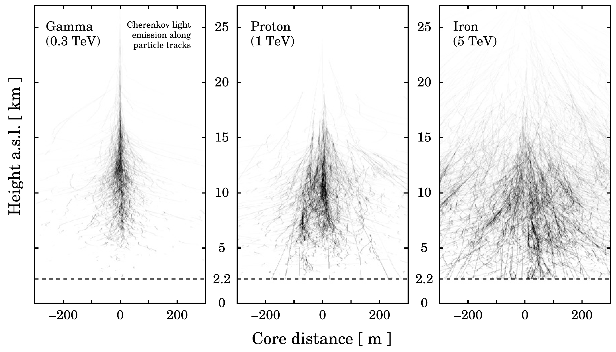

Slide 14
