Slide 1
Color Representations and Image Filtering

Slide 2
BRIEF OVERVIEW OF COLOR REPRESENTATIONS

Slide 3
Color models
Abstract mathematical model describing the way colors can be represented as tuples of numbers.

Slide 4
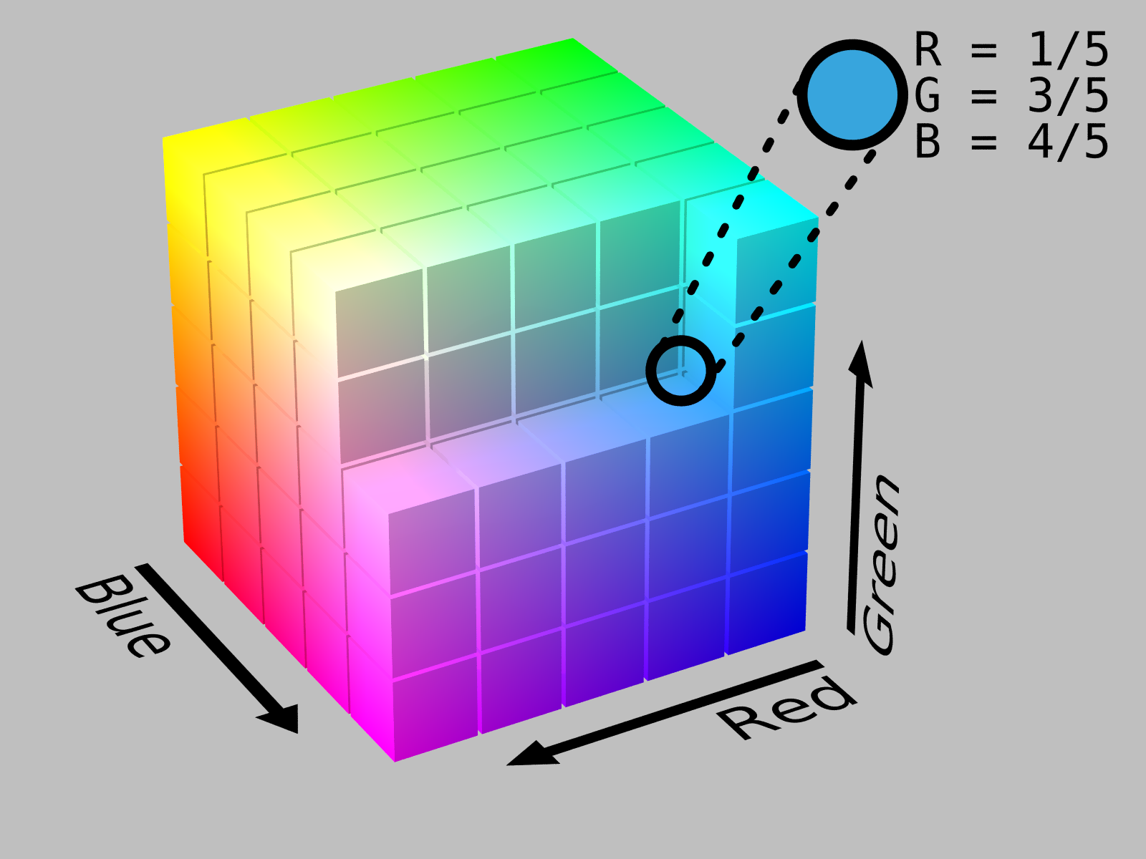
RGB color space
Additive color space.
A particular color can be represented as a point in the RGB space.
"RGB Cube Show lowgamma cutout b" by RGB_farbwuerfel.jpg: Horst FrankRGB_color_solid_cube.png: SharkDderivative work: SharkD Talk - RGB_farbwuerfel.jpgRGB_color_solid_cube.png. Licensed under CC BY-SA 3.0 via Wikimedia Commons - http://commons.wikimedia.org/wiki/File:RGB_Cube_Show_lowgamma_cutout_b.png#/media/File:RGB_Cube_Show_lowgamma_cutout_b.png

Slide 5
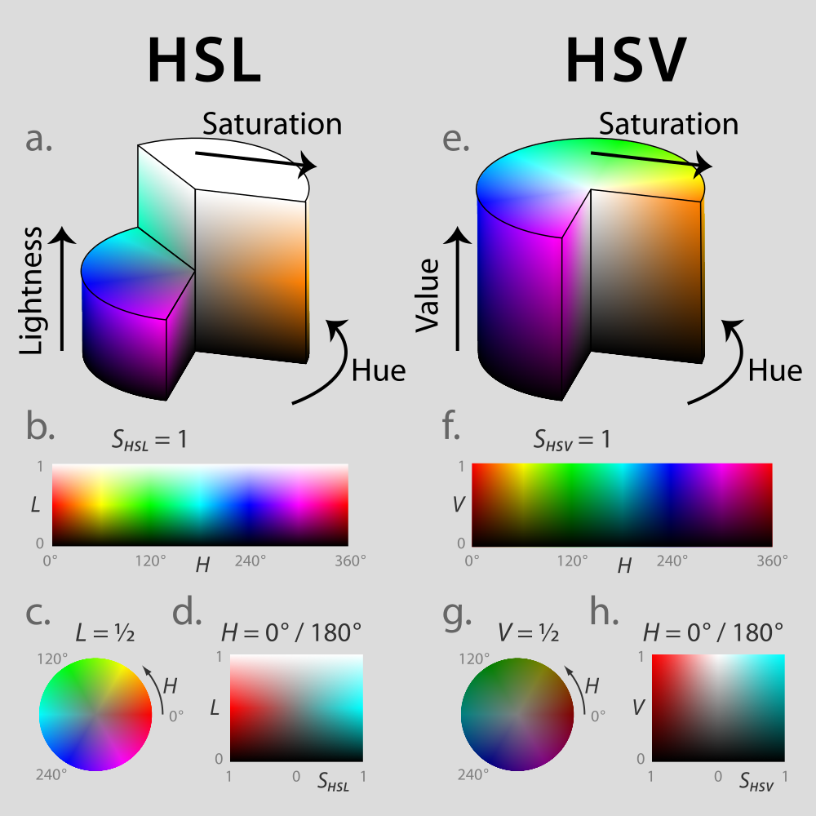
Other color models
HSV & HSL representations
"Hsl-hsv models" by Jacob Rus - Own work. Licensed under CC BY-SA 3.0 via Wikimedia Commons - http://commons.wikimedia.org/wiki/File:Hsl-hsv_models.svg#/media/File:Hsl-hsv_models.svg

Slide 6
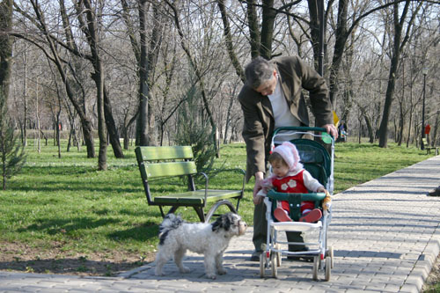
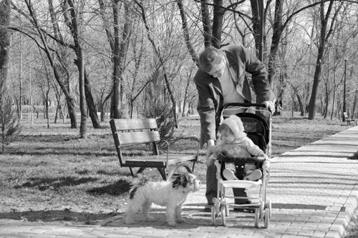
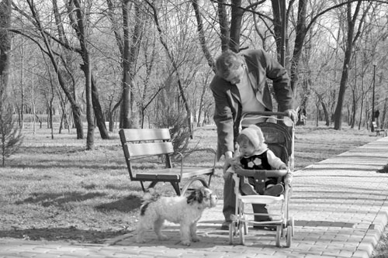
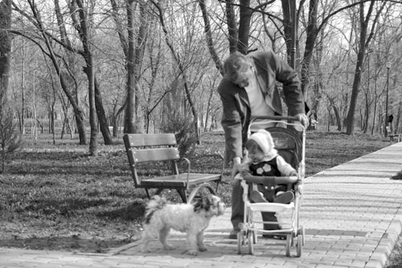
RGB Images
3 channels:
I(u, v) = [Red value, Green value, Blue value]
Red Channel
Green Channel
Blue Channel

Slide 7
Grayscale Images
We obtain the grayscale value for every pixel from its RGB values.
The conversion is a weighted sum of the RGB values, e.g., OpenCV’s RGB to grayscale conversion is:
Grayscale
value
Red
value
Green
value
Blue
value

Slide 8
IMAGE FILTERING

Slide 9
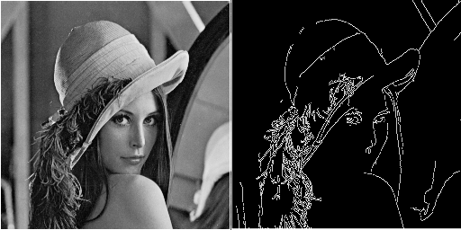
Convolution
Image processing technique to extract information
from an image (e.g., edges).

Slide 10
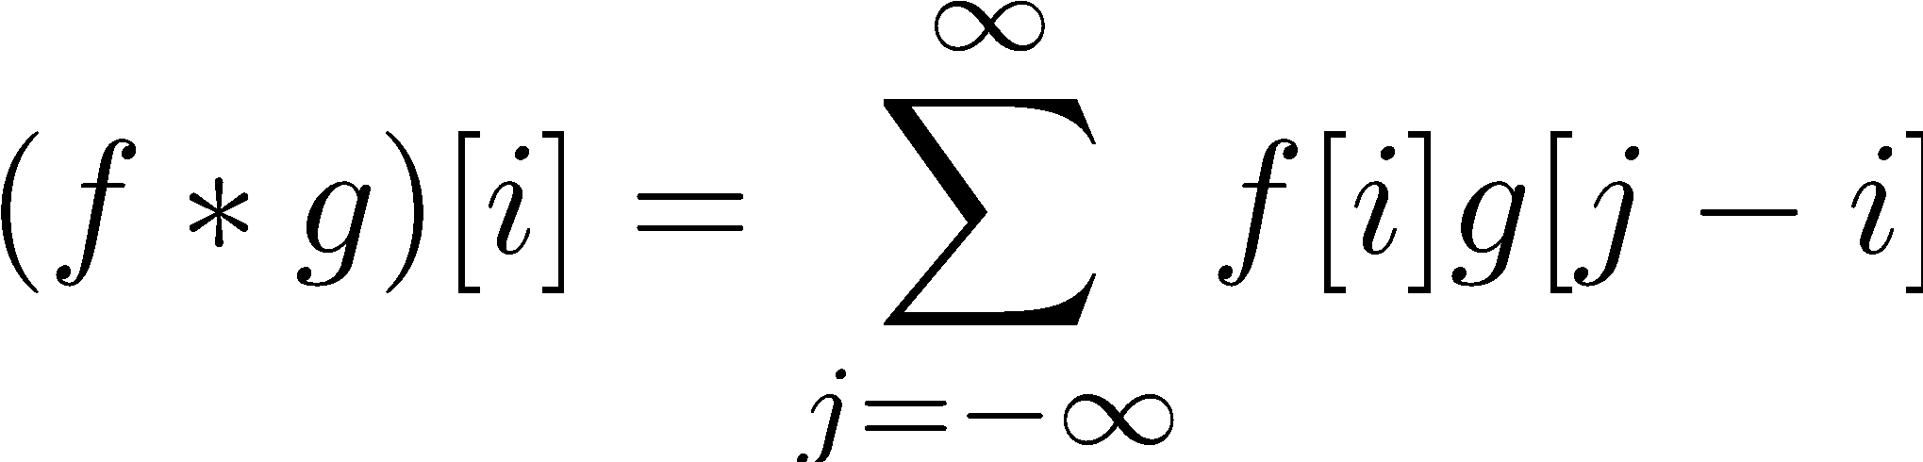
1D Discrete Convolution
Convolution operator
i-th sample

Slide 11
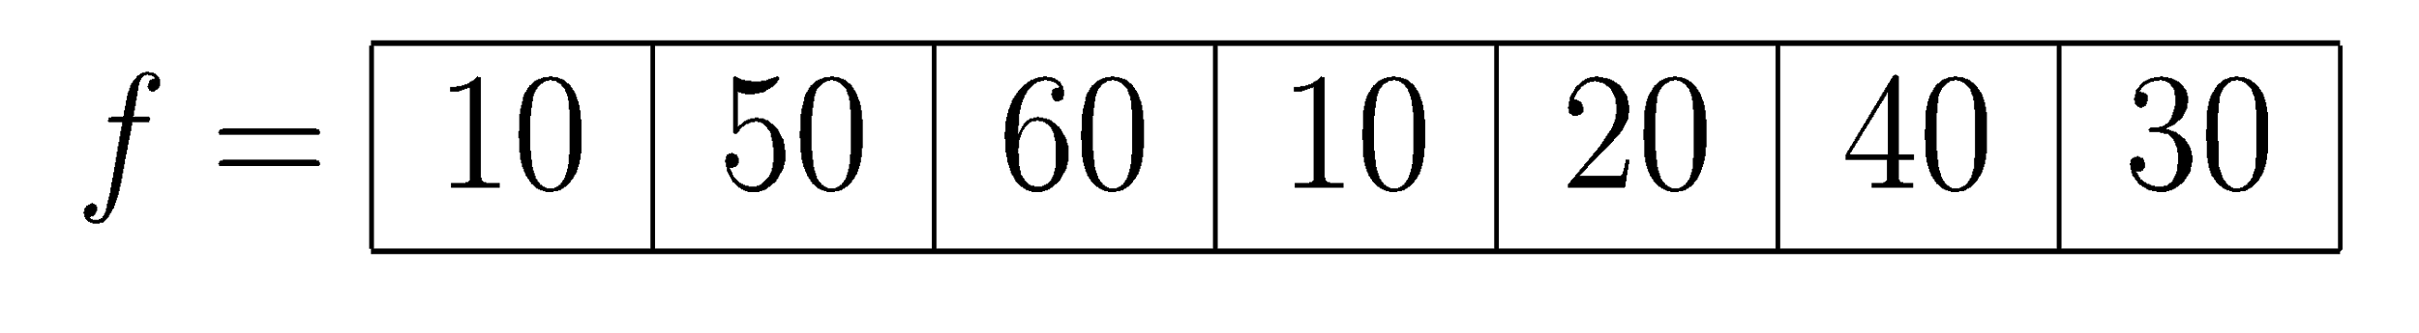
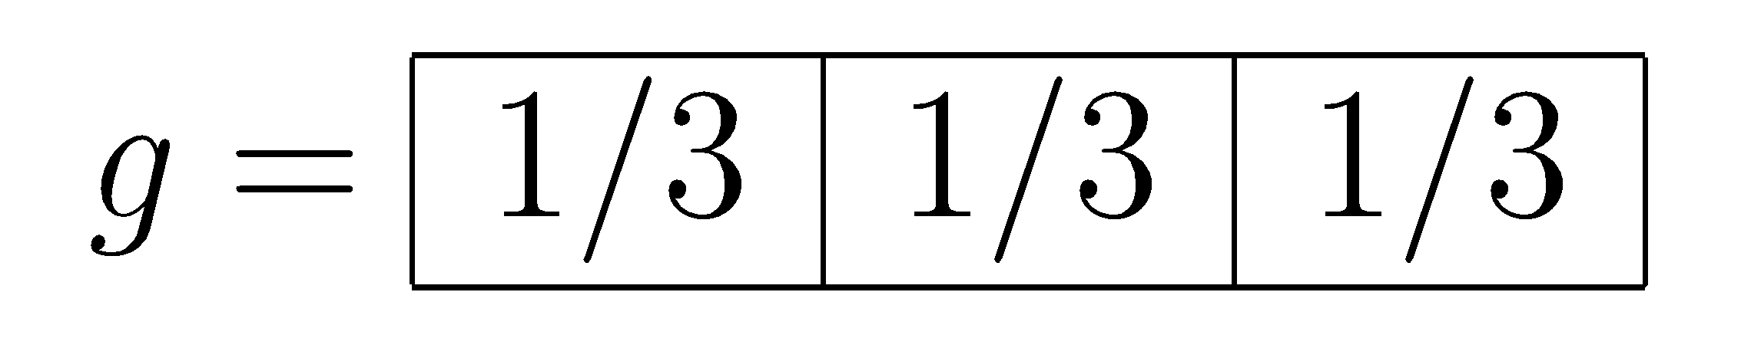
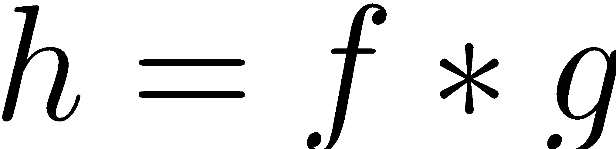
1D convolution example
We are given:
n
1D-Signal
Filter
m
We want:

Slide 12
1D convolution example (cont’d)
0
1
2
3
5
6
7
-1
0
1
Flip kernel!

Slide 13
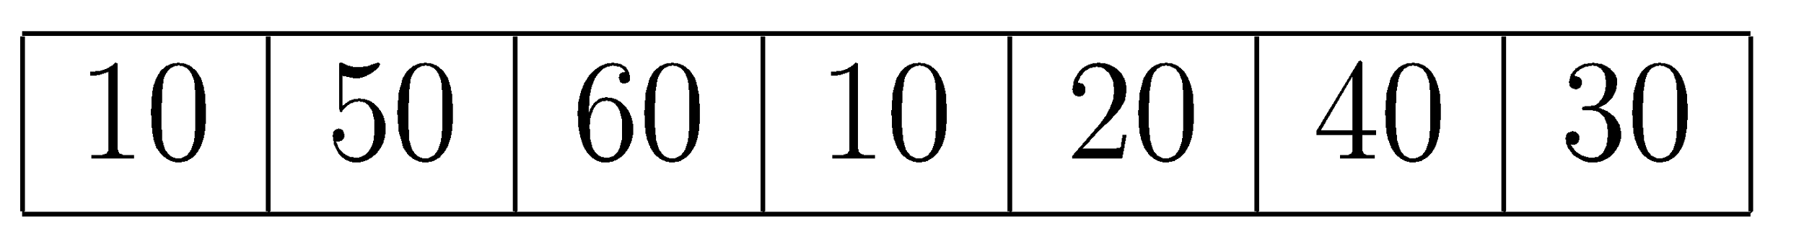
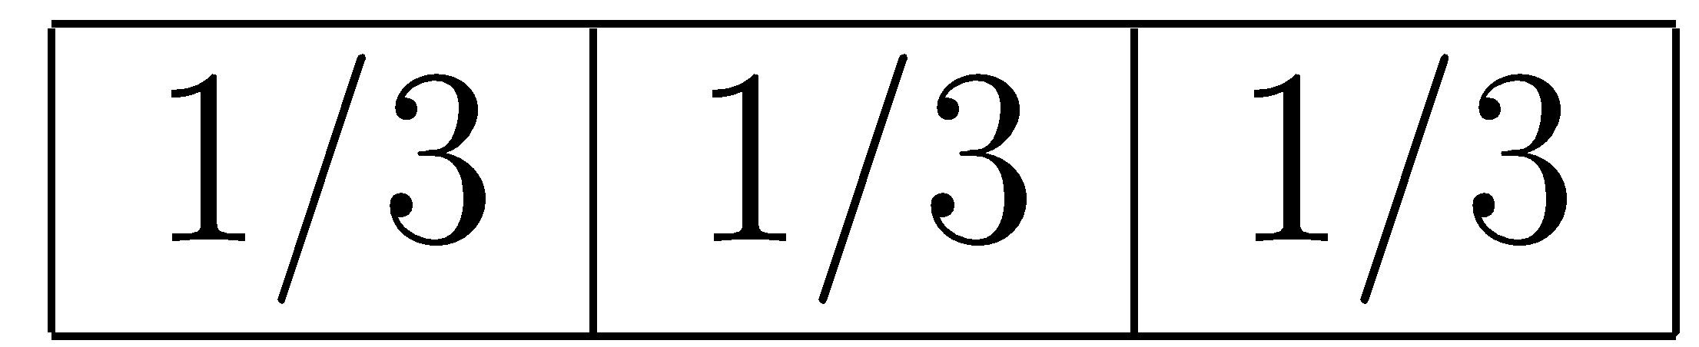
1D convolution example (cont’d)
Flip filter and “slide” it to the right.
*
Result = 1/3 * 10 + 1/3 * 0 + 1/3 * 0
10/3

Slide 14
1D convolution example (cont’d)
*
*
Result = 1/3 * 50 + 1/3 * 10 + 1/3 * 0
10/3 | 20

Slide 15
1D convolution example (cont’d)
*
*
Result = 1/3 * 0 + 1/3 * 30 + 1/3 * 40
10/3 | 20 | 40 | 40 | 30 | 70/3 | 30 | 70/3

Slide 16
1D convolution example (cont’d)
*
Result = 1/3 * 0 + 1/3 * 0 + 1/3 * 30
10/3 | 20 | 40 | 40 | 30 | 70/3 | 30 | 70/3 | 10

Slide 17
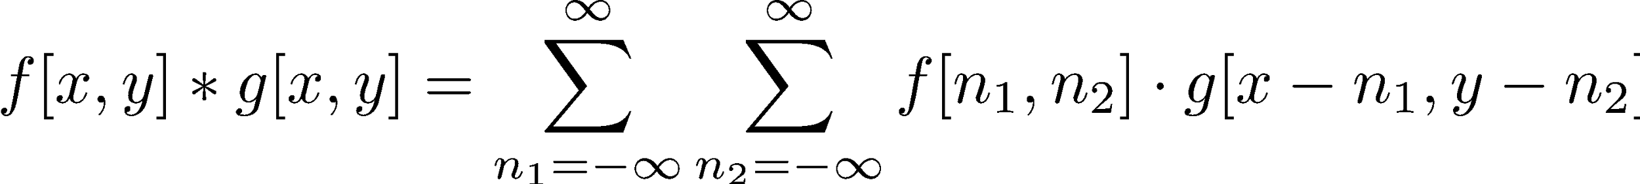
2D Convolution

Slide 18
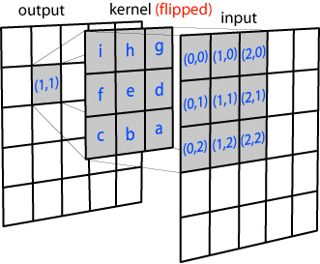
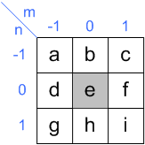
2D convolution example
Filter/Kernel
From http://www.songho.ca/dsp/convolution/convolution.html

Slide 19
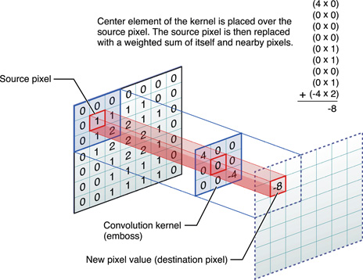
2D convolution example
From https://developer.apple.com/library/ios/documentation/Performance/Conceptual/vImage/Art/kernel_convolution.jpg

Slide 20
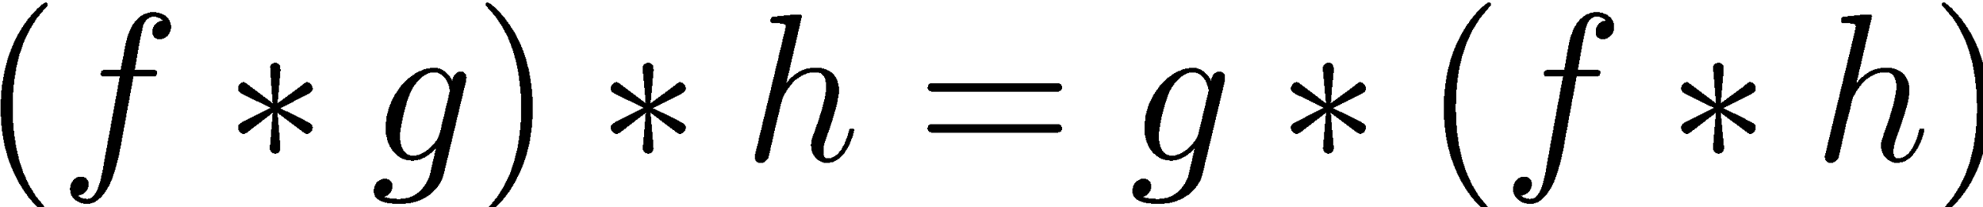
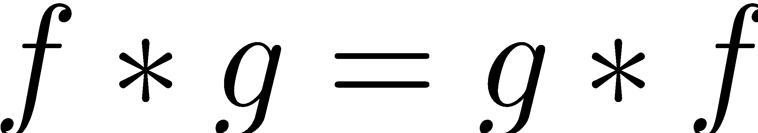
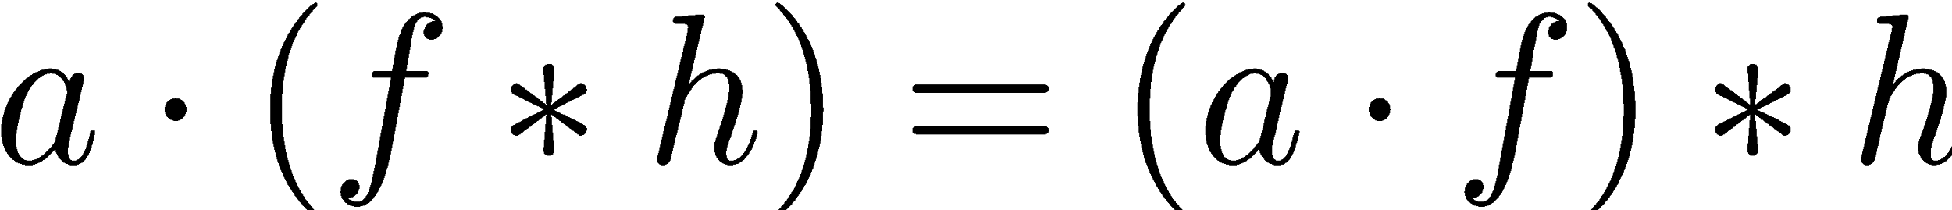
Convolution properties
Associativity
Commutativity
Distributivity
Associativity with scalar multiplication

Slide 21

Spatial filtering
A spatial filter is an image operation where each pixel value I(u, v) is changed by a function of the intensities of pixels in a neighborhood of (u, v).
From http://www.coe.utah.edu/~cs4640/

Slide 22
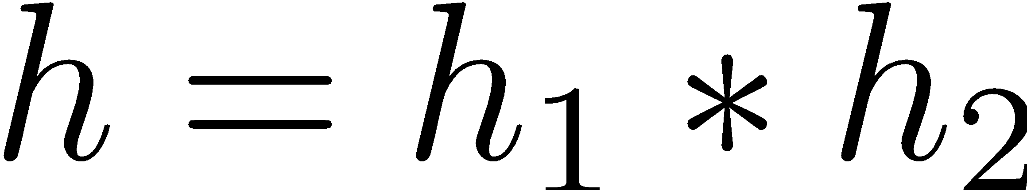
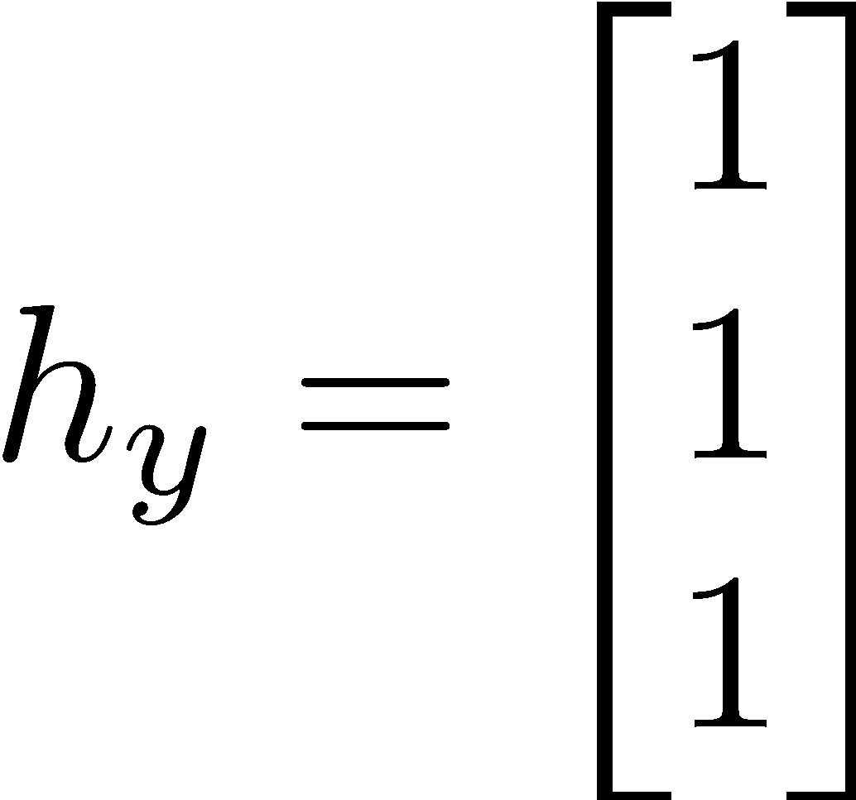
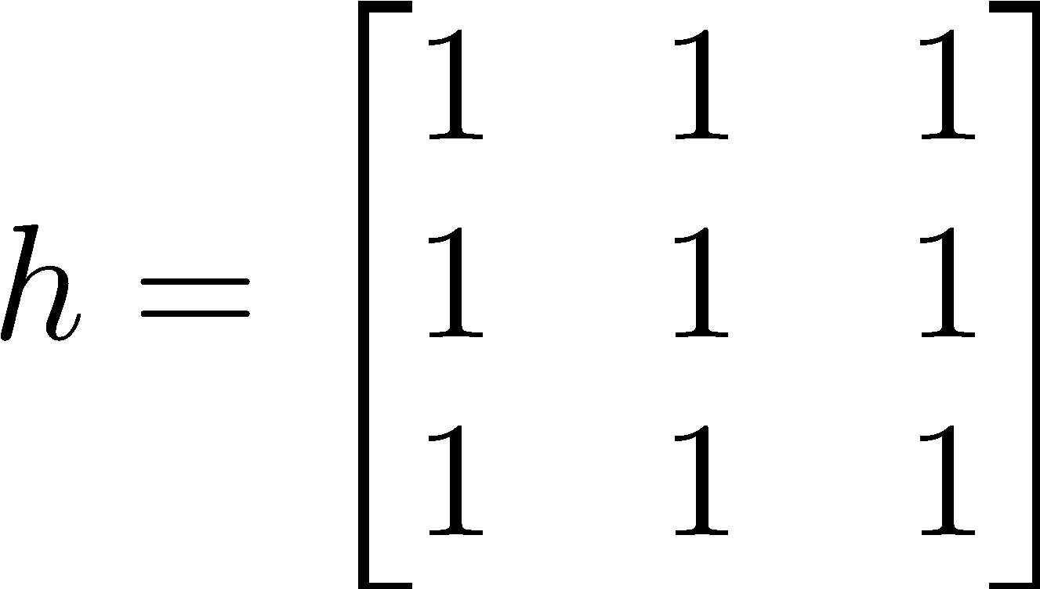
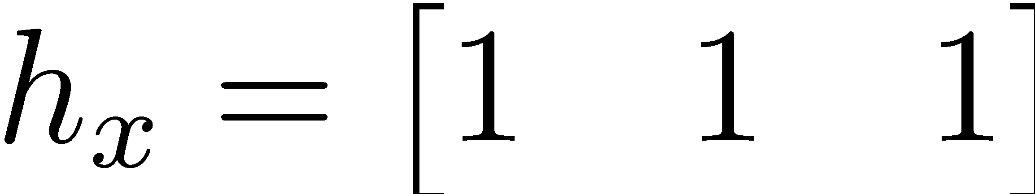
Separable filters
A kernel h is separable if it can be broken down into the convolution of two kernels:
Sometimes we can separate into two 1D kernels, e.g.,

Slide 23
Benefit of separable filters
Number of operations per pixel in a 2D convolution (assuming an MxM kernel) is O(M²).
Number of operations per pixel in a 1D convolution (filter with M entries) is O(M).
Therefore, the number of operations per pixel of a 2D convolution using a separable filter can be O(M).

Slide 24
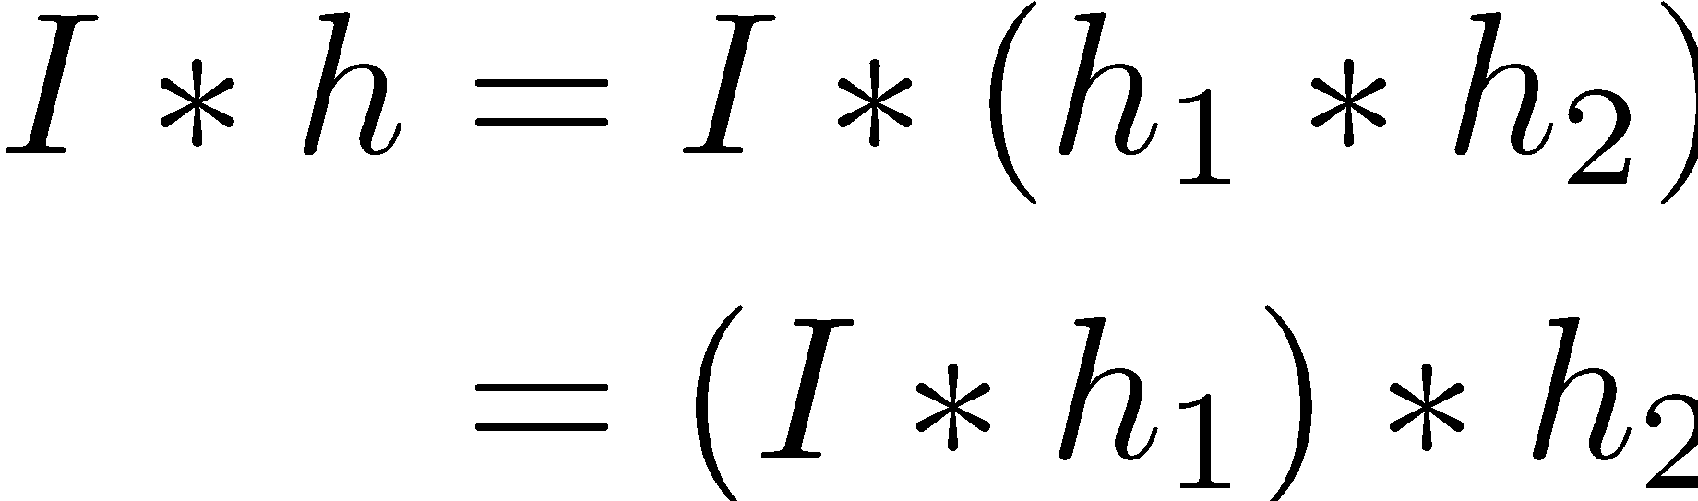
Saving computation with separable filters
Using the associativity property:
Convolving image I with the separable 1D kernels (h₁ & h₂) is much cheaper than convolving with h.

Slide 25
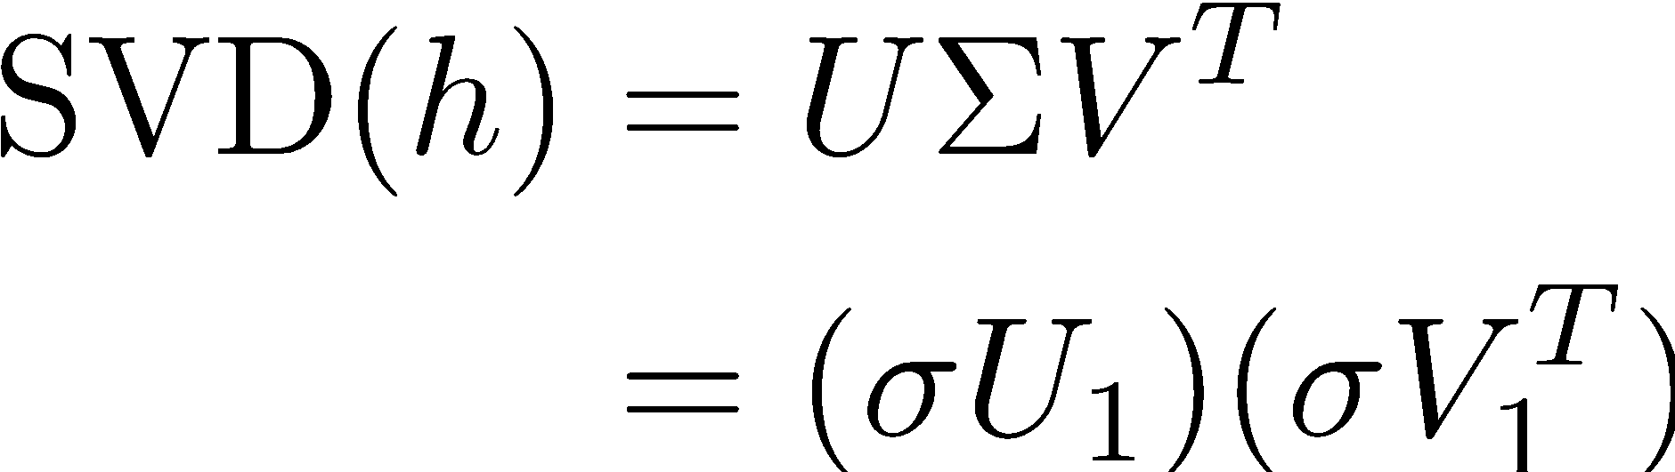
Separating a 2D kernel into two 1D filters
A 2D kernel is separable if its rank is 1.
This means that there is only one non-zero singular value (using SVD).
h₁
h₂

Slide 26
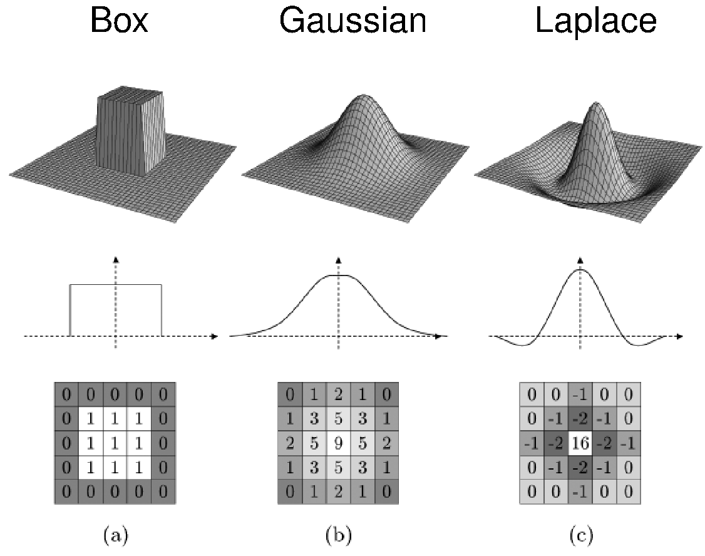
Spatial filter examples
From http://www.coe.utah.edu/~cs4640/

Slide 27
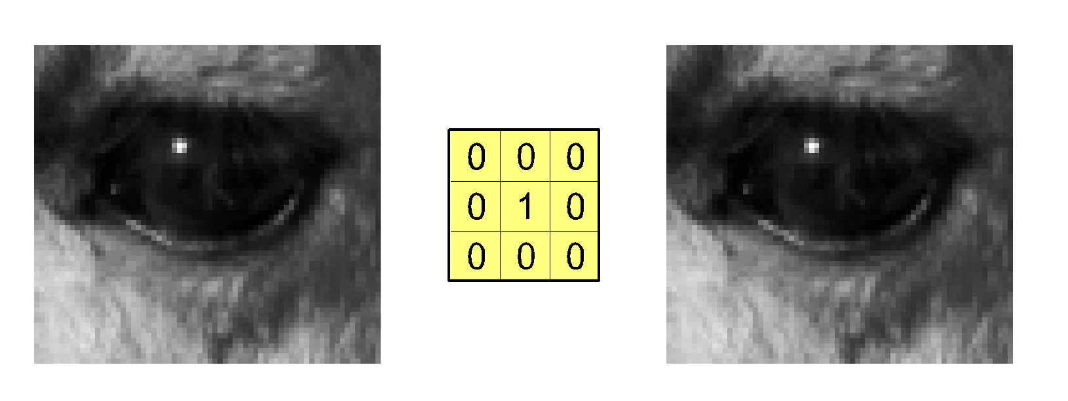
What does this filter do?
*
=
Identity filter
From http://www.coe.utah.edu/~cs4640/

Slide 28
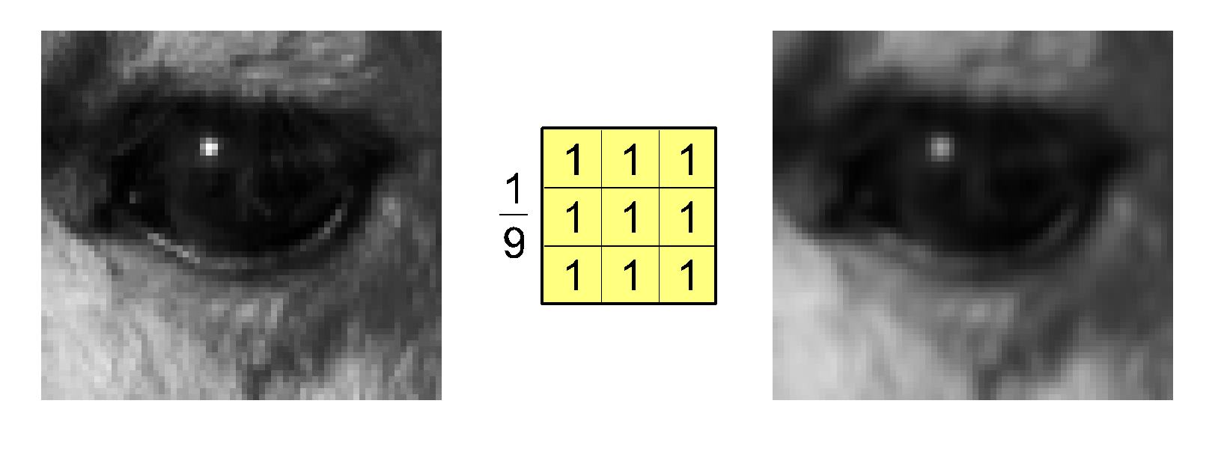
What does this filter do?
*
=
Mean filter
From http://www.coe.utah.edu/~cs4640/

Slide 29
SMOOTHING IMAGES

Slide 30
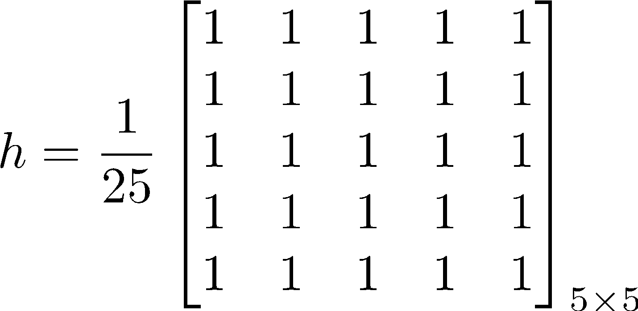
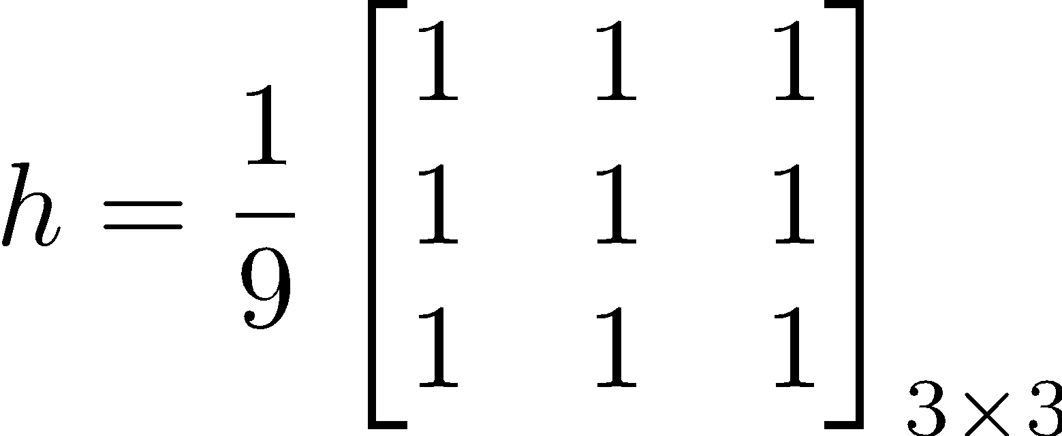
Average/Mean/Box filter

Slide 31
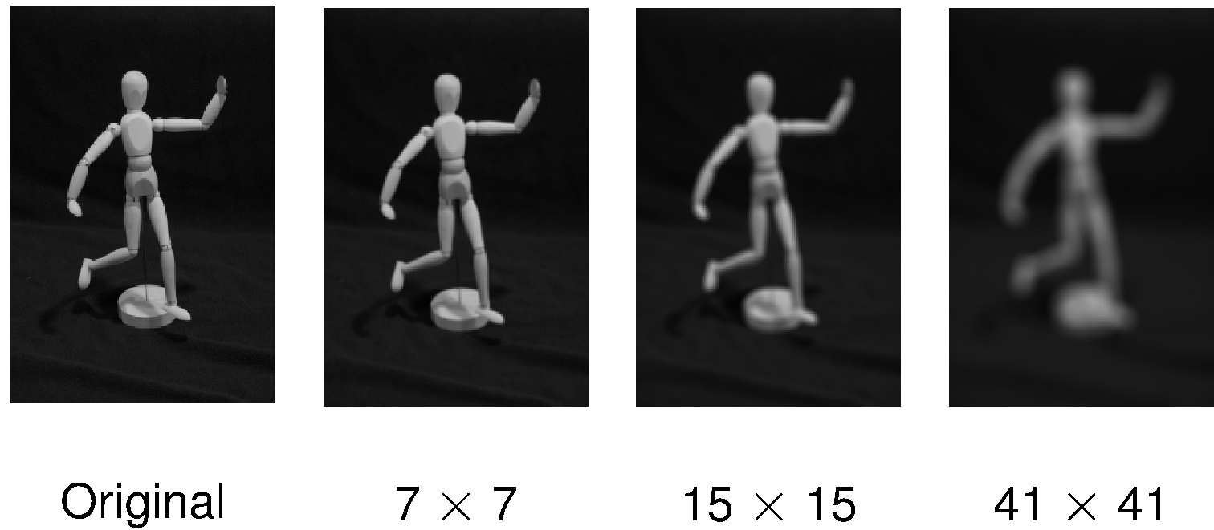
Smoothing/Blurring with box filters
The larger the size of the filter the blurry the output image.
From http://www.coe.utah.edu/~cs4640/
Notes:
Ask about ideas on how to improve this, or make this faster.

Slide 32
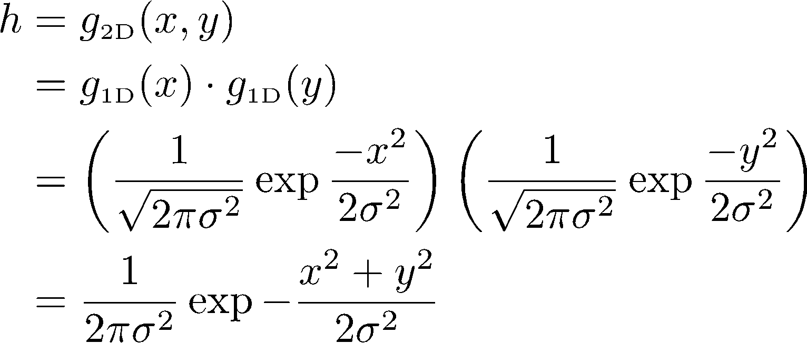
Gaussian Filter

Slide 33
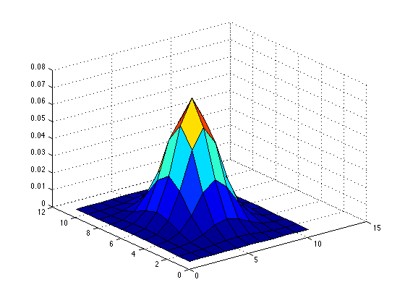
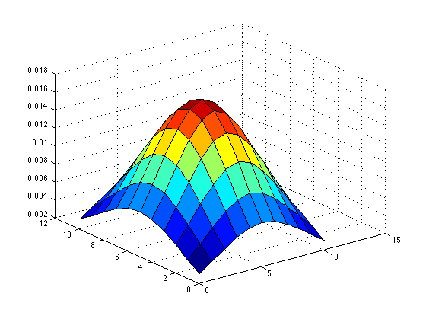
Visualization of a Gaussian filter
Sigma = 1.5
Sigma = 3.5

Slide 34

Convolving with a Gaussian filter efficiently
We can exploit the separability of the Gaussian filter.
Convolve (1D)
horizontally
Convolve (1D)
vertically

Slide 35


Gaussian Filtering
Pick a and a radius
Compute a 1D kernel with Gaussian values
Normalize the array so that it sums up to 1
Convolve horizontally
Convolve output with the vertical kernel

Slide 36
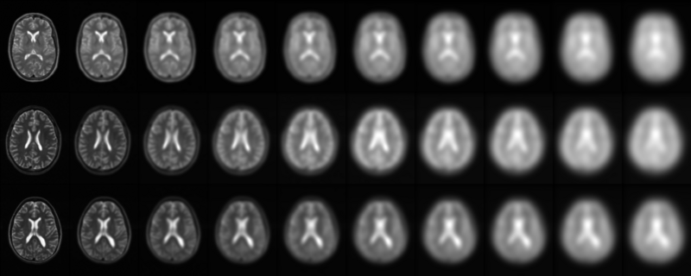
The larger the sigma the more blurry the image.
Sigma

Slide 37
Derivatives of an Image

Slide 38
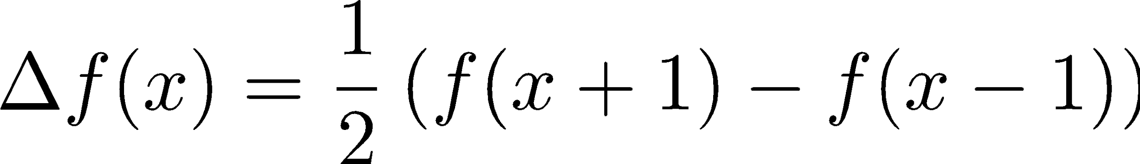
Finite Differences
Forward Difference:
Backward Difference:
Central Difference:
Finite differences approximate derivatives.

Slide 39

Forward difference
Forward Difference:
Kernel: H = [-1 1]
(We flip the kernel when convolving)

Slide 40

Backward difference
Backward Difference:
Kernel: H = [1 -1]

Slide 41

Central difference
Central Difference:
Kernel: H = [1 0 -1]

Slide 42

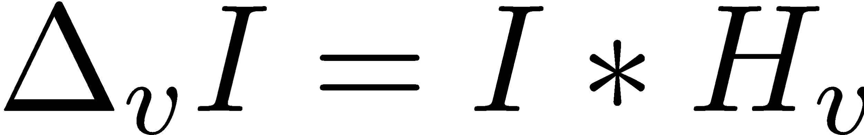
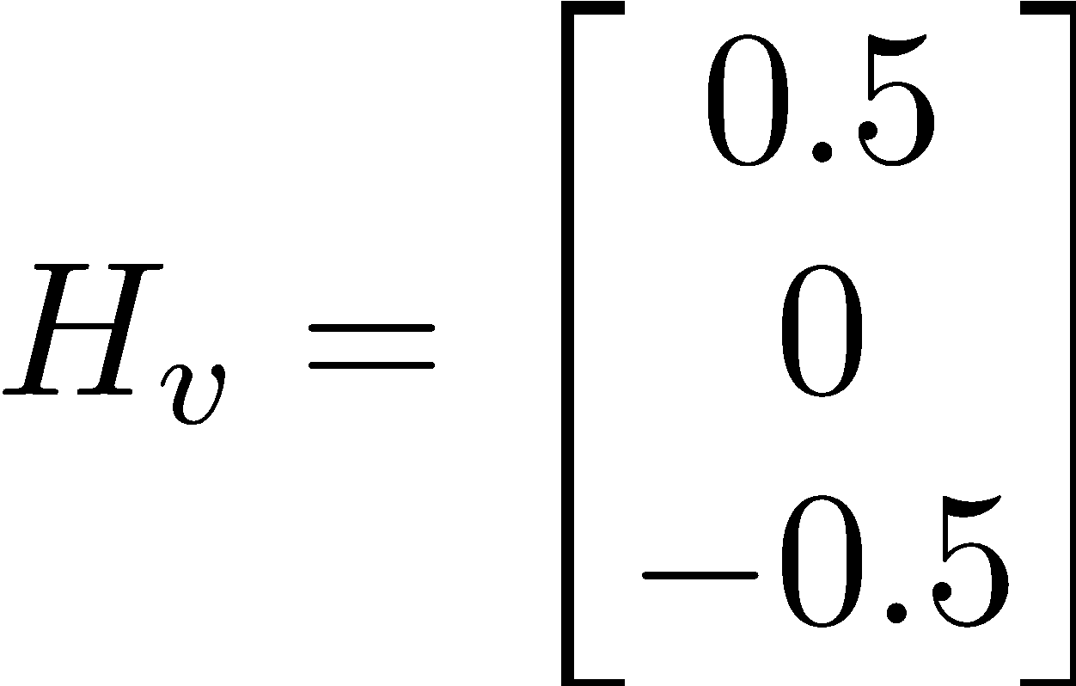
Derivatives of an Image
We can compute derivatives by using the finite differences:

Slide 43
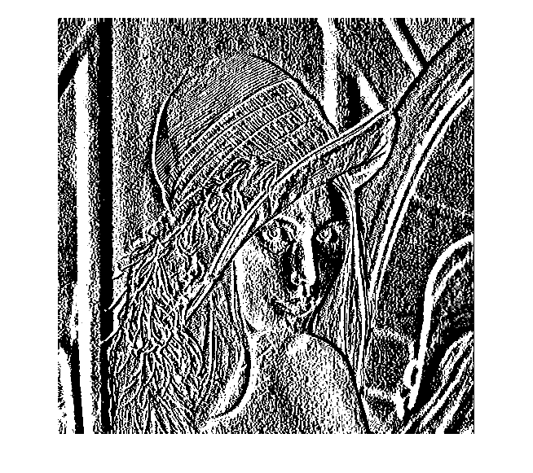
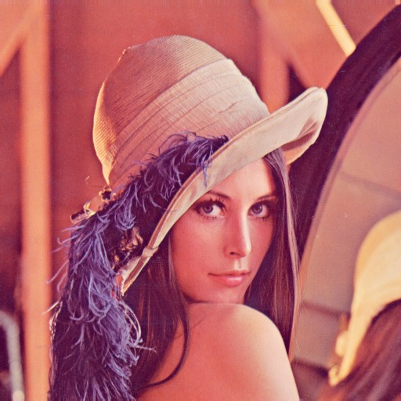
Examples of Derivatives
Horizontal direction

Slide 44
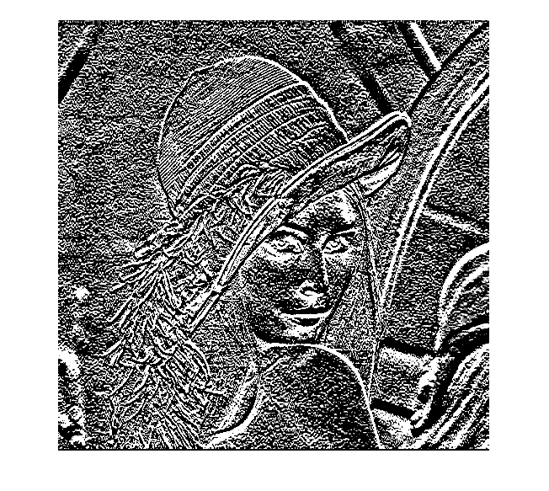
Examples of Derivatives
Vertical direction

Slide 45
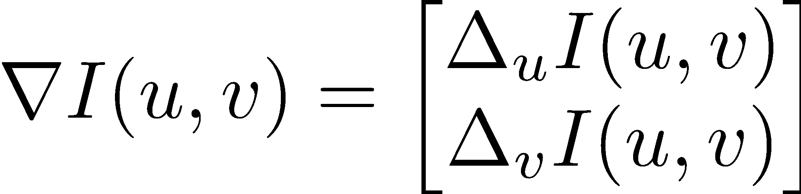
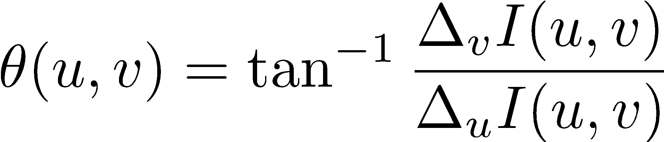
Image Gradient
The discrete image gradient is the 2D vector:
The norm of the gradient is:
The angle of the gradient is:

Slide 46
Averaging with finite differences
The differences operators are sensitive to noise.
We can make this robust if we average (smooth) first the image.

Slide 47
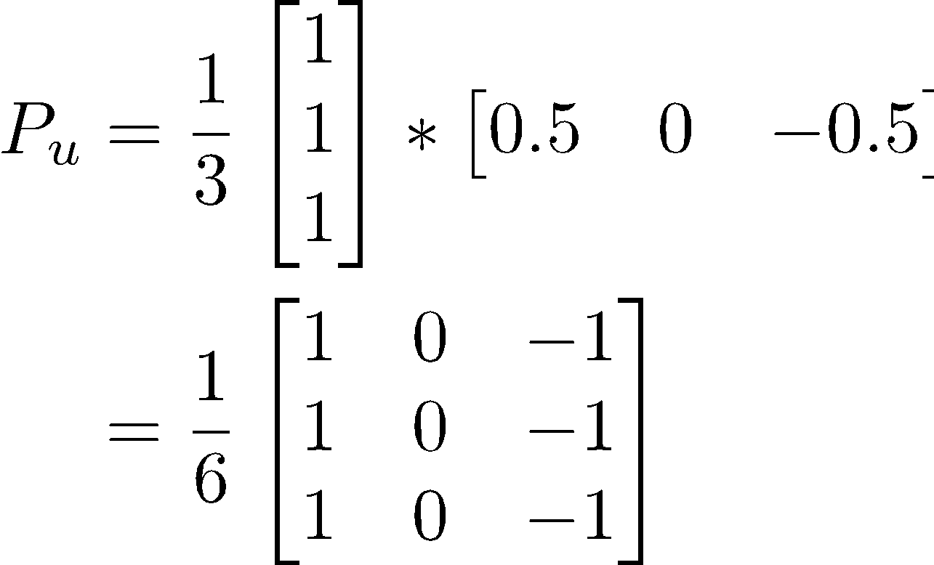
Prewitt Filter
Average
Derivative

Slide 48
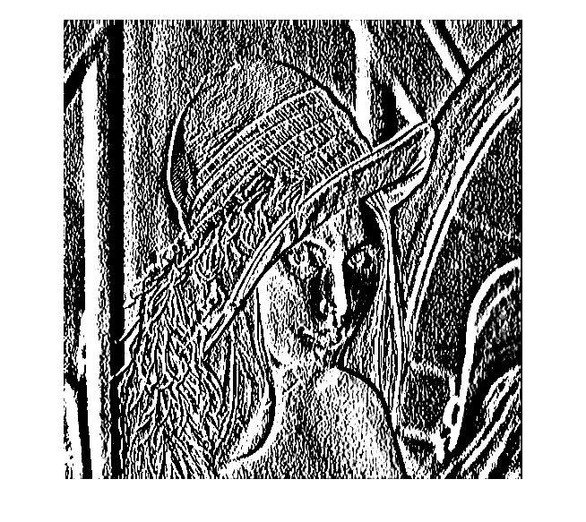
Example Prewitt

Slide 49
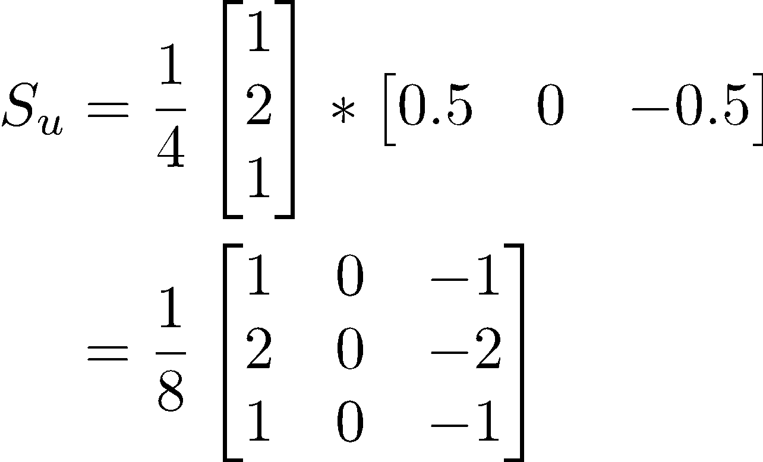
Sobel filter
Average
Derivative

Slide 50
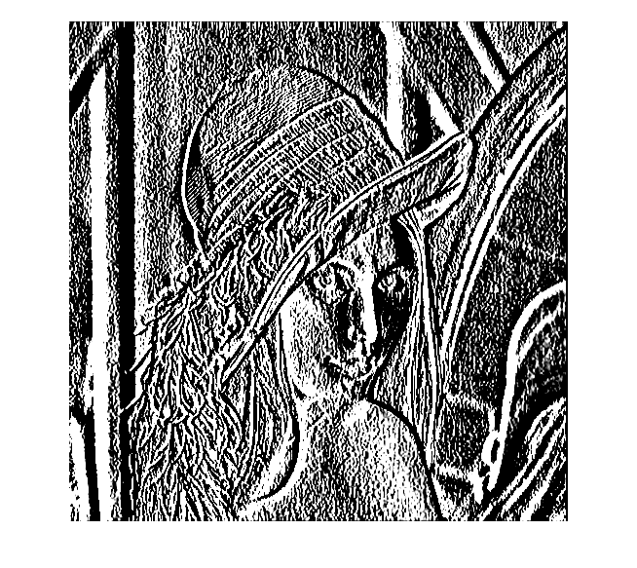
Example Sobel

Slide 51
Useful Matlab commands
The fspecial function creates several filters.
Convolution function on images conv2.

Slide 52
Useful functions in OpenCV
OpenCV has the image processing API
http://docs.opencv.org/modules/imgproc/doc/imgproc.html

