Slide 1
3D Computer Vision
CS 591B
Fall 2017
Victor Fragoso
victor.fragoso@mail.wvu.edu

Slide 2
Administrative

Slide 3
Grading
Homework assignments - 30%
Final project - 40%
Paper presentation - 20%
Participation - 10%
We will have a fair amount of coding.
We may have quizzes as part of participation.
Depends on how active the group is.

Slide 4
Website
http://vfragoso.com/teaching.html
Announcements
General information
Schedule
e-campus:
Announcements
Resources
Forums

Slide 5
Team for the final project
Team size
At most 2 persons
At least 1 persons
Start thinking ASAP about a project
Create a write-up.
Instructor must approve the project.
Aim to investigate novel ideas.

Slide 6
Recommended Textbooks
Richard Hartley and Andrew Zisserman. “Multiple View Geometry in Computer Vision.” Cambridge University Press.
Yi Ma, Stefano Soatto, Jana Kosecka, and S. Shankar Sastry. “An invitation to 3-d vision: from images to geometric models.” Vol. 26. Springer Science & Business Media, 2012

Slide 7
Topics to review carefully
Linear Algebra
Matrix multiplications
Matrix factorizations (e.g., SVD)
Dot products and outer products
Image Processing
2D Filtering - Convolution
Programming
C++, Python, or MATLAB

Slide 8
Online Resources
Review of Linear Algebra: http://cs229.stanford.edu/section/cs229-linalg.pdf
Open source vision libraries:
OpenCV: http://opencv.org/
VlFeat: http://www.vlfeat.org/
Theia: http://www.theia-sfm.org/
Visual SfM: http://ccwu.me/vsfm/
Proceedings of Top Conferences in Computer Vision
CVPR, ICCV: http://www.cv-foundation.org/openaccess/menu.py
ECCV (accessible only from the WVU network)
BMVC
Top Journals in Computer Vision (accessible only from the WVU network)
TPAMI
IJCV

Slide 9
Introduction

Slide 10
What is the goal of 3D Computer Vision?
The goal of Computer Vision is to understand the world from images
3D Computer Vision aims to
Reconstruct the world from flat images
Recognize objects using reconstructions (i.e., 3D models)
We will focus on the reconstruction
We will see recognition in 3D-vision at the end of the class since it is still an active area of research

Slide 11
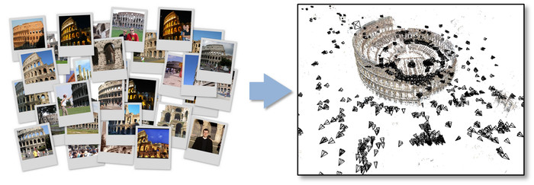
What is the goal of Reconstruction?
Input
Output
Flickr, Picassa
3D Model, and Camera poses
Image from: http://www.cs.cornell.edu/~snavely/bundler/

Slide 12
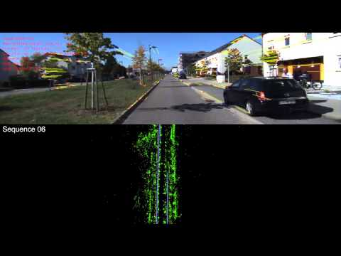
Example of Reconstruction: Visual SLAM

Slide 13
Taxonomy of a reconstruction pipeline
Collection of
Images
Reconstruction
Algorithms
3D Model &
Camera poses

Slide 14
What can we do with the 3D reconstructions?

Slide 15
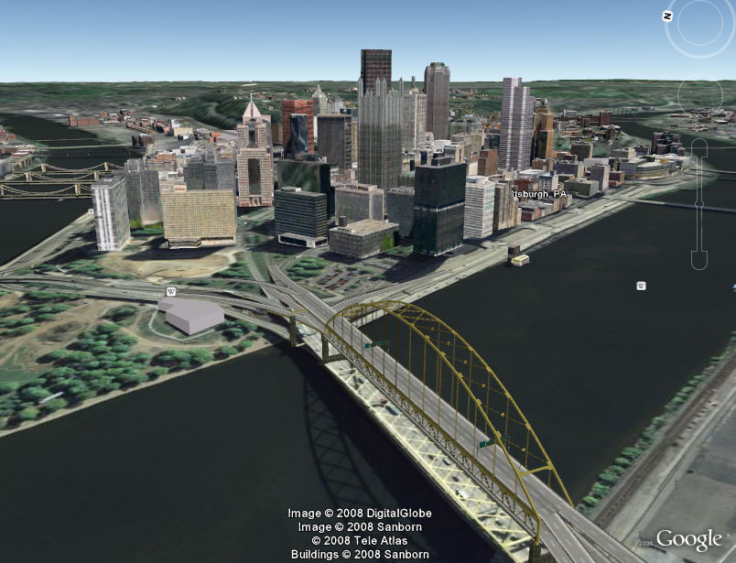
3d Models for Navigation and Gaming

Slide 16
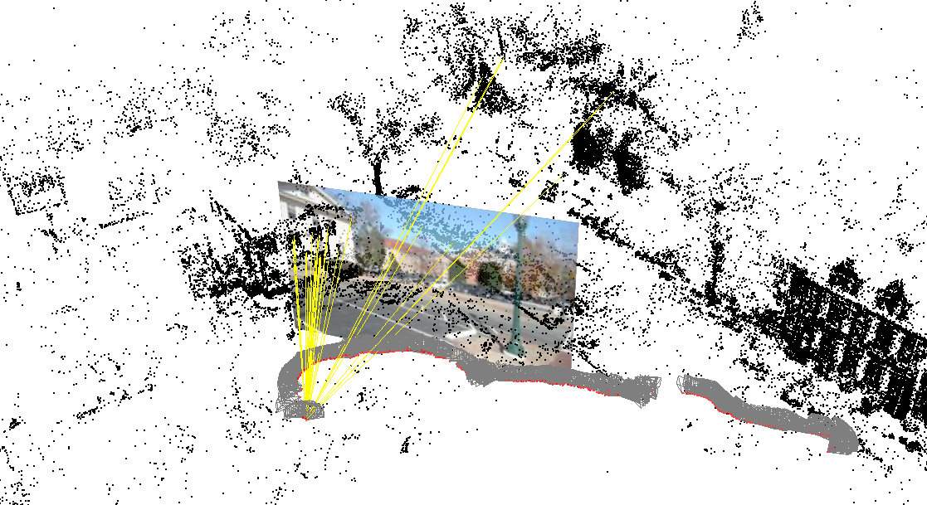
Localizing a Navigating Agent

Slide 17
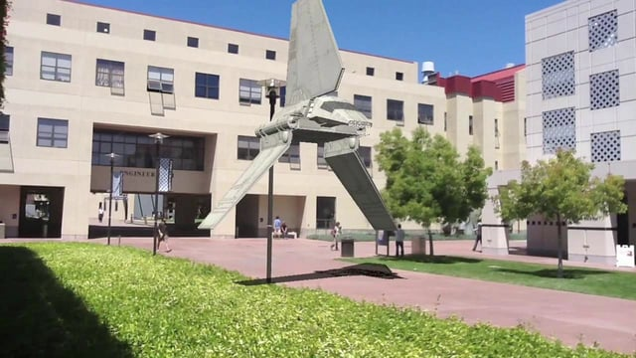
Augmented Reality

Slide 18
The objectives of the class
Learn reconstruction algorithms
Sparse Reconstructions
Dense Reconstructions
Reconstruction types
Structure-from-motion: Reconstruct an environment given a bunch of images of it
SLAM: Reconstruction using a video sequence of an environment
Get familiar with Recognition in 3D vision

Slide 19
Overview of the class
Fundamentals
Linear algebra
Feature detection and description
Image matching (Image Correspondence)
Multiple view geometry
Reconstruction
Triangulation
Bundle adjustment
Dense reconstruction
Point cloud registration and compression
3. Research review of recognition approaches to 3D vision.

Slide 20
Software for programming assignments
Preferably, C++, Python, or Java.
MATLAB is acceptable
Make sure you have the Image Processing Toolkit
OpenCV works in C++, Python, and Java
VlFeat works in C++ and MATLAB
Please prepare your environment for the programming assignments.

Slide 21
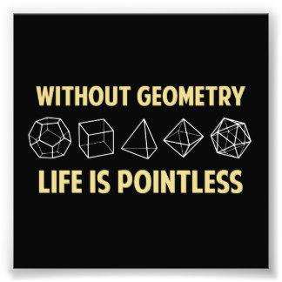
Questions?

