Slide 1
Review of Linear Algebra

Slide 2
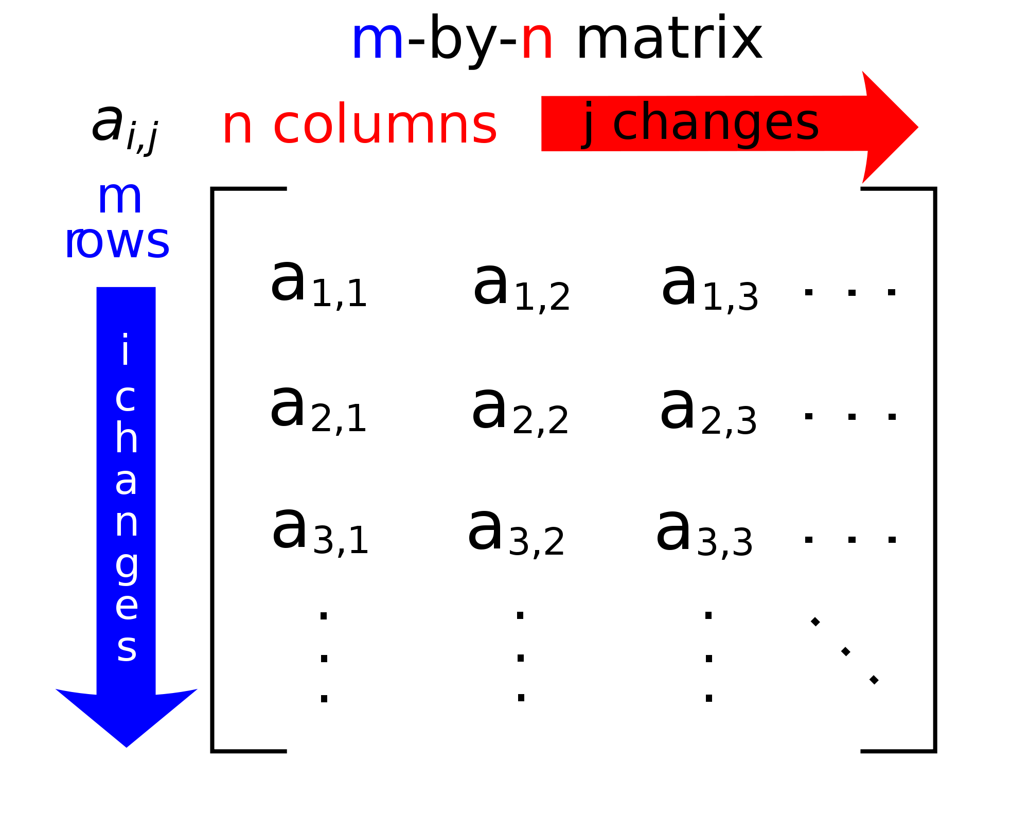
Matrix
A matrix is 2D array of numbers.
Image source: Wikipedia

Slide 3


Basic Notation
Num. Columns
Denotes a matrix with m rows and n columns. The matrix contains real numbers.
Num. Rows
Denotes a vector with n entries. The vector contains real numbers.
Notes
1. A vector is a matrix with m rows and a single column.
2. Typically, a vector is denoted with a bold letter.
Num. Entries

Slide 4
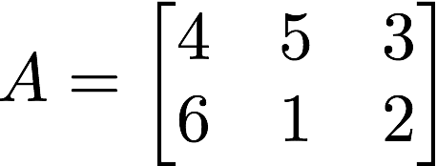
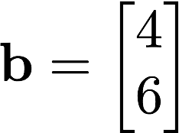
Examples of Matrices and Vectors
Matrix with:
Vector with:
2 rows
3 columns
2 rows

Slide 5

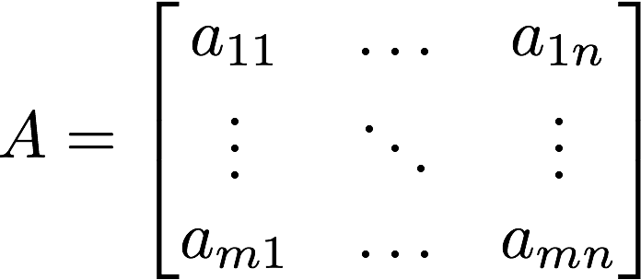

Examples
Entries of a matrix:
Example:

Slide 6
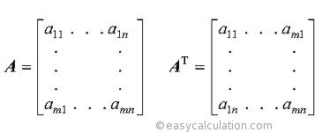
Transposition of a Matrix
Transposition: Rows become columns and columns becomes rows.
Note the superscript letter T that indicates transposition.

Slide 7
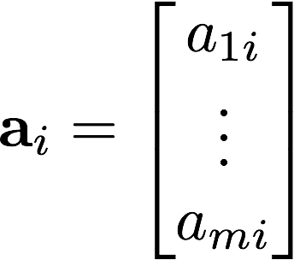

Matrix as a list of vectors
Columns of matrices as vectors:
Vector
Vector

Slide 8
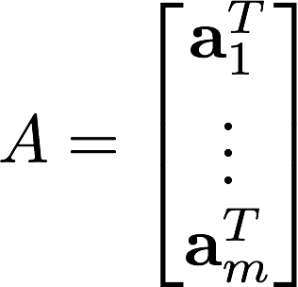

Matrix as a stack of transposed vectors
Rows of matrices as transposed vectors:
Transposed
Vector
Transposed
Vector

Slide 9
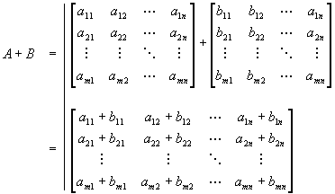
Matrix Addition
Entrywise Summation
Matrices must have same size
Image Credit: Richard Gilbert

Slide 10
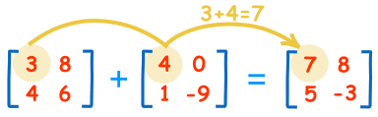
Matrix Addition Example
Image Source: http://www.mathsisfun.com

Slide 11
Properties of Matrix Addition
Commutative: A + B = B + A
Associative: A + (B + C) = (A + B) + C
Additive Identity: A + O = A (i.e., a zero matrix)
Additive Inverse: A + B = O -> B = -A

Slide 12

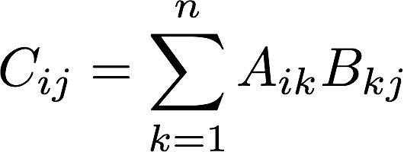

Matrix Multiplication
The product of two Matrices and is defined as:
This means that

Slide 13
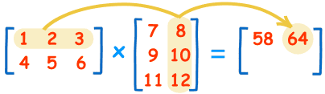
Matrix Multiplication Example
(1 x 8) + (2 x 10) + (3 x 12) = 64
Image Source: http://www.mathsisfun.com

Slide 14
Properties of Multiplication
It is not commutative (most of the time): AB != BA
Be careful with the order!
Associative: A(BC) = (AB)C
Distributive properties: A(B + C) = AB + AC
Scalar and matrix multiplication: r A B = (rA)B = A(rB)

Slide 15

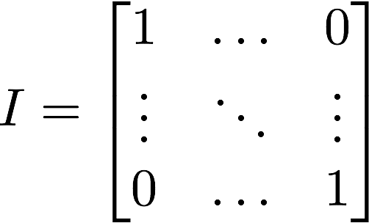
Identity Matrix
There exist a matrix I such that

Slide 16
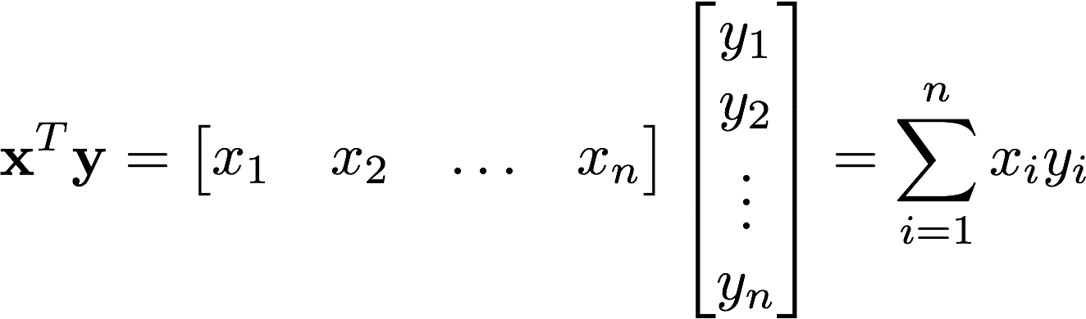
Vector-Vector Multiplication (Dot product)
The dot product returns a scalar (i.e., a single number)

Slide 17
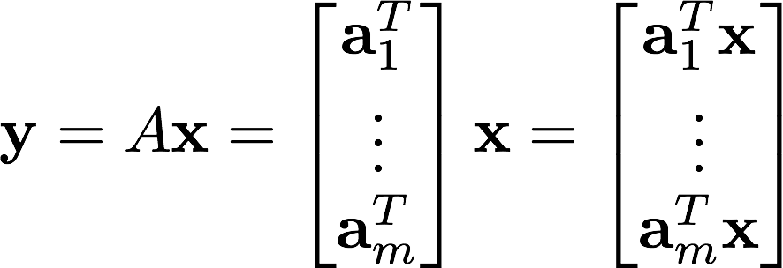
Matrix-Vector Multiplication
For every row, compute the dot product of the vector and the current row

Slide 18
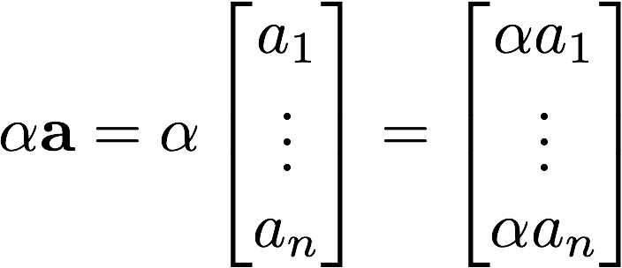
Matrix-Vector Multiplication (Alternative view)
For every column, scale the column vector using the i-th entry of the vector
Scaling a vector:

Slide 19


What are matrices good for?
Matrices are mappings/transformations
It takes a vector transforms it to return another one.
This can be rewritten as a function as follows:
What are the dimensions of vector x and y?

Slide 20

Inverse of a transformation/matrix
We denote the inverse of a matrix as follows:
Sometimes, the inverse of a matrix does not exist. In plain words, it is not possible to undo the transformation.

Slide 21
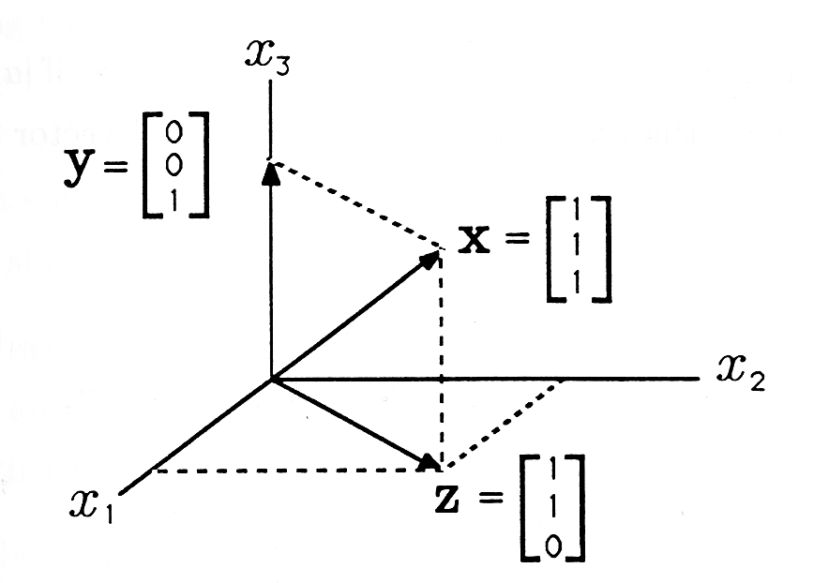
Why do we care about vectors?
They help us represent points in space
They encode a direction and a length
Image Source: cnx.org

Slide 22
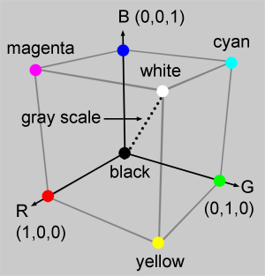
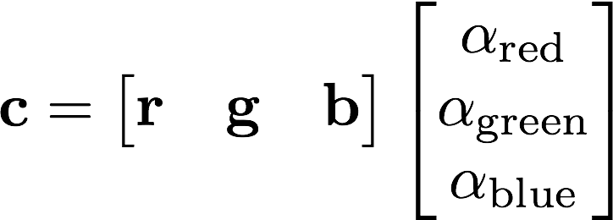
RGB Space: Example of the use of vectors
We represent colors using vectors
Color (output)
Basis
Image Source: Scratch a pixel

Slide 23
Basis
A basis of a space is the minimal set of linearly independent vectors that are required to generate the entire space when we linearly combine them.
For example, the RGB space only requires three vectors: red, green, and blue.
We can span the entire space by setting the alpha coefficients

Slide 24

Composition of Transformations
Sometimes we need to concatenate operations:
When written as functions:

Slide 25

Range and Null Space of a Matrix
Range (aka Column space) is the set of all possible linear combinations of its column vectors.
In plain words, it is the space that the column vectors can generate when we linearly combine them.
Null space is the set of vectors that when we apply the transformation it returns the 0-vector.

Slide 26
Next class
We will use matrices to represent rotations
We will use matrices to represent translations
We will see coordinate transformations
We are interested in representing how the camera moves and the structure of the scene.

