Slide 1
Pinhole Camera Model

Slide 2



How does the camera work?
Light
Rays
Reflect
Camera
Scene

Slide 3
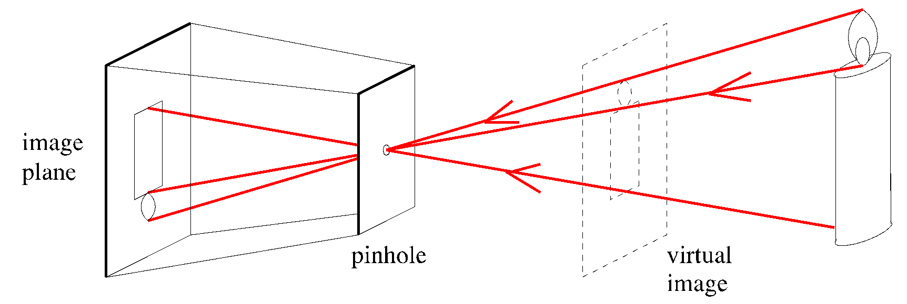
Pinhole imaging model
Light rays
The pinhole perspective projection model is mathematically convenient.
Provides good approximations of the real imaging process.

Slide 4
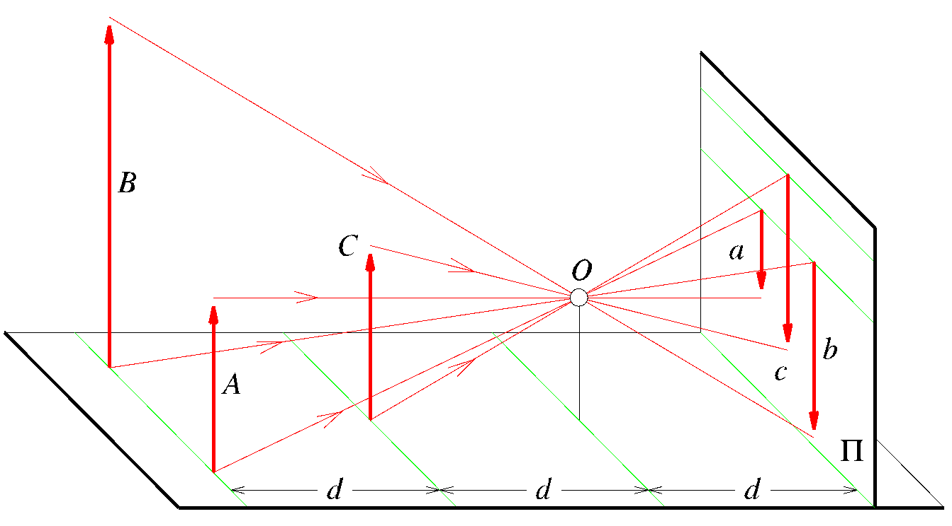
Perspective projection effects
Image
Plane
Points in
a scene
Pinhole
Far objects can appear smaller than close ones.
In some sense, we loose the sense of scale.

Slide 5

Far objects can appear smaller than close ones

Slide 6
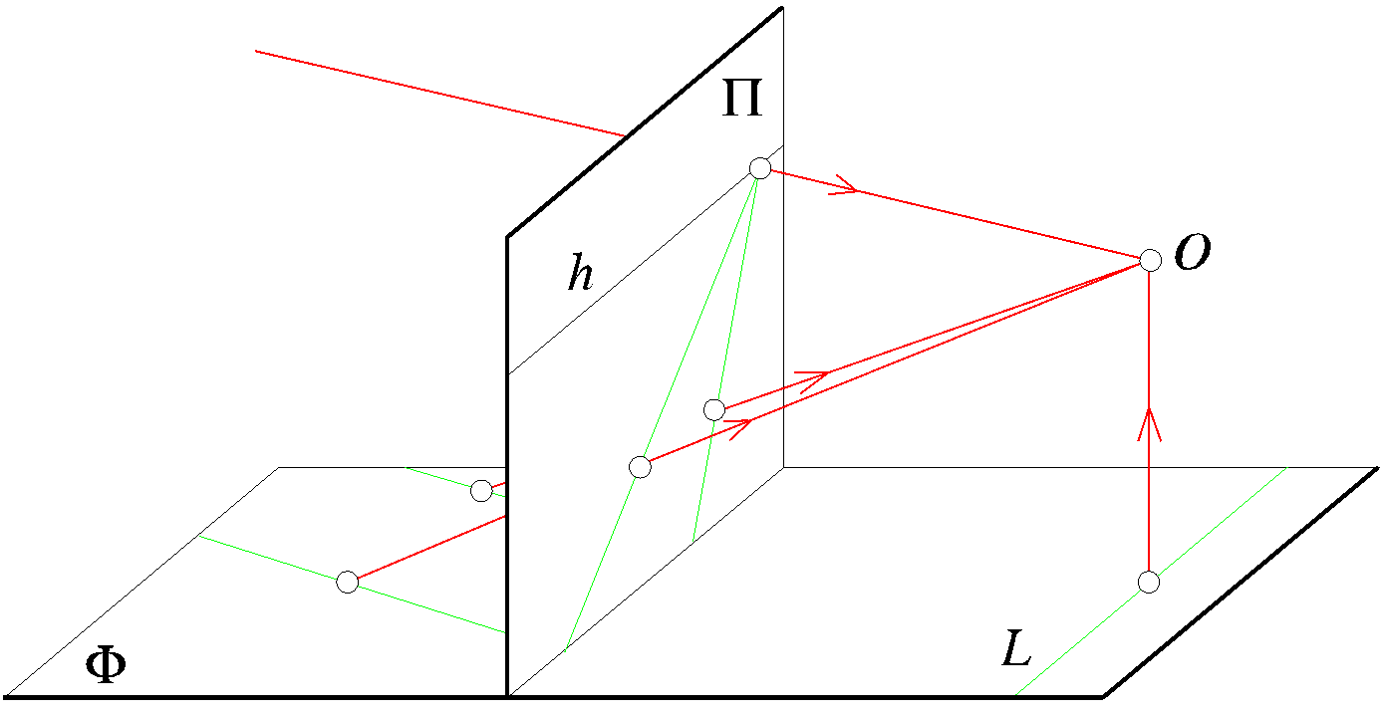
Perspective projection effects
Virtual image
Parallel lines
The images of parallel lines intersect at the horizon.

Slide 7
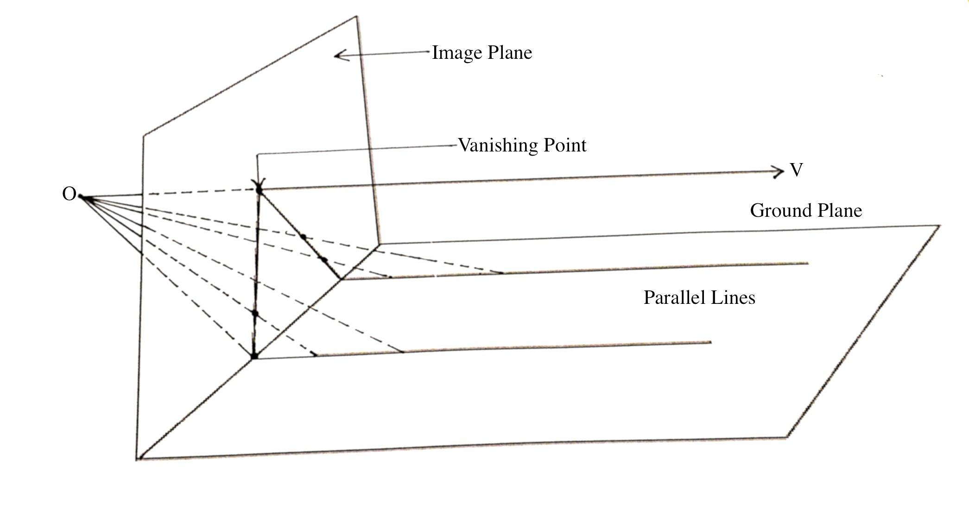
Parallel lines intersect!
"Vanishing Point" by Niharikamaheshwari - Own work. Licensed under CC BY-SA 4.0 via Wikimedia Commons - https://commons.wikimedia.org/wiki/File:Vanishing_Point.jpg#/media/File:Vanishing_Point.jpg

Slide 8
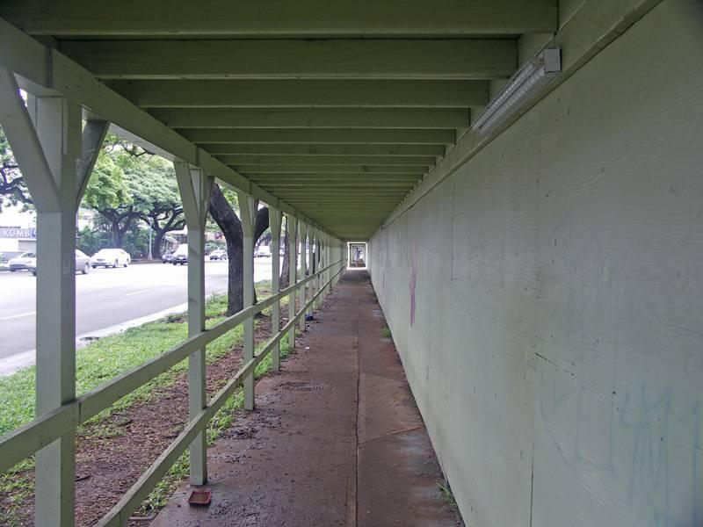
Example of projected parallel lines

Slide 9

Vanishing Point
The vanishing point of a straight line under perspective projection is that point in the image beyond which the projection of the straight line can not extend.
I.e., if the straight line were infinitely long in space, the line would appear to vanish at its vanishing point in the image.
The vanishing point of a line depends ONLY on its orientation in space, and not on its position.
Thus, parallel lines in space appear to meet at their vanishing point in image.

Slide 10
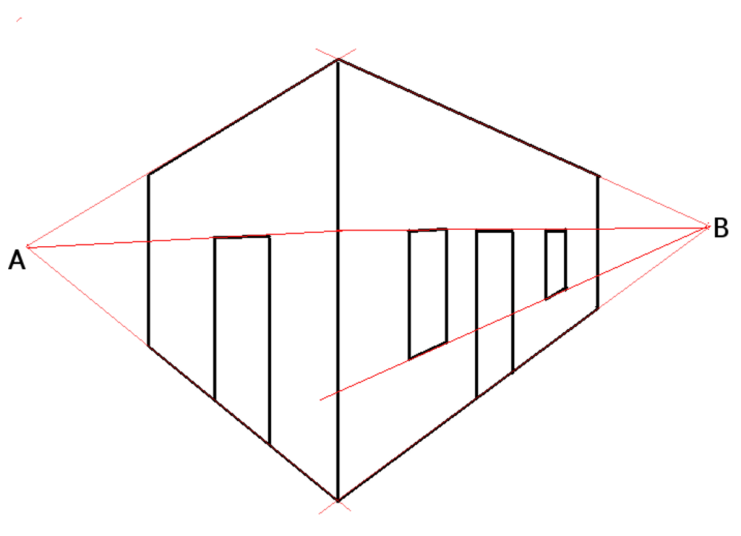
Vanishing point (cont’d)
"TwoPointPerspective" by Mmroberts - Own work. Licensed under CC BY 3.0 via Wikimedia Commons - https://commons.wikimedia.org/wiki/File:TwoPointPerspective.png#/media/File:TwoPointPerspective.png

Slide 11
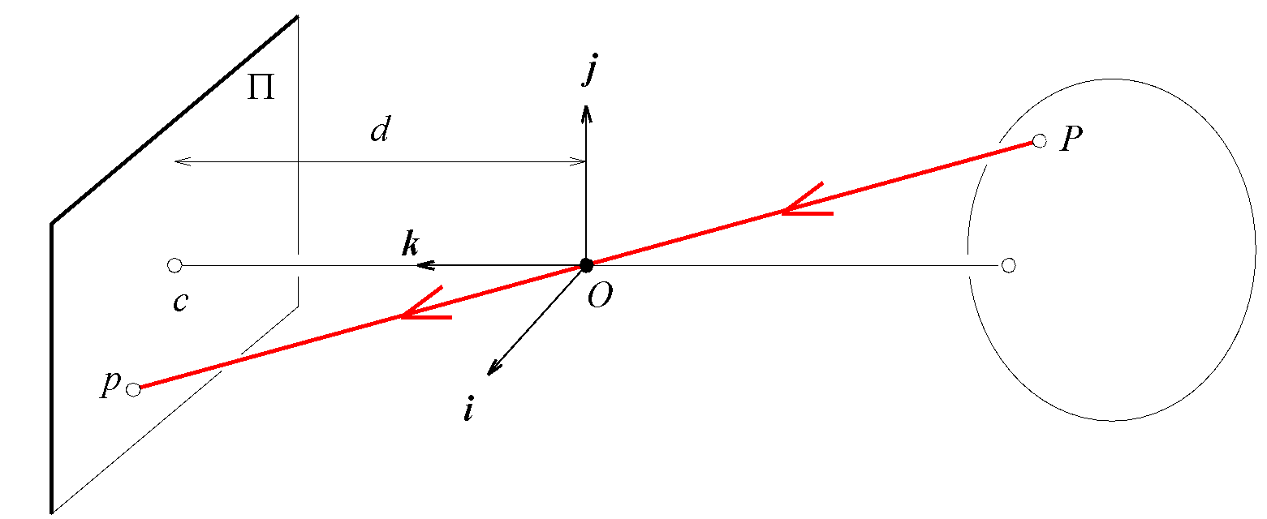
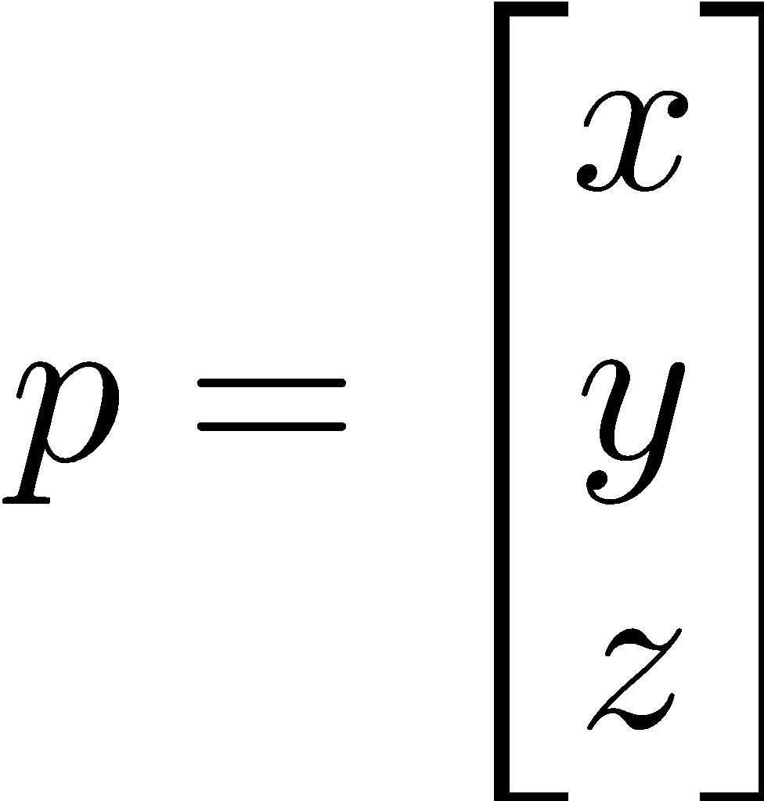
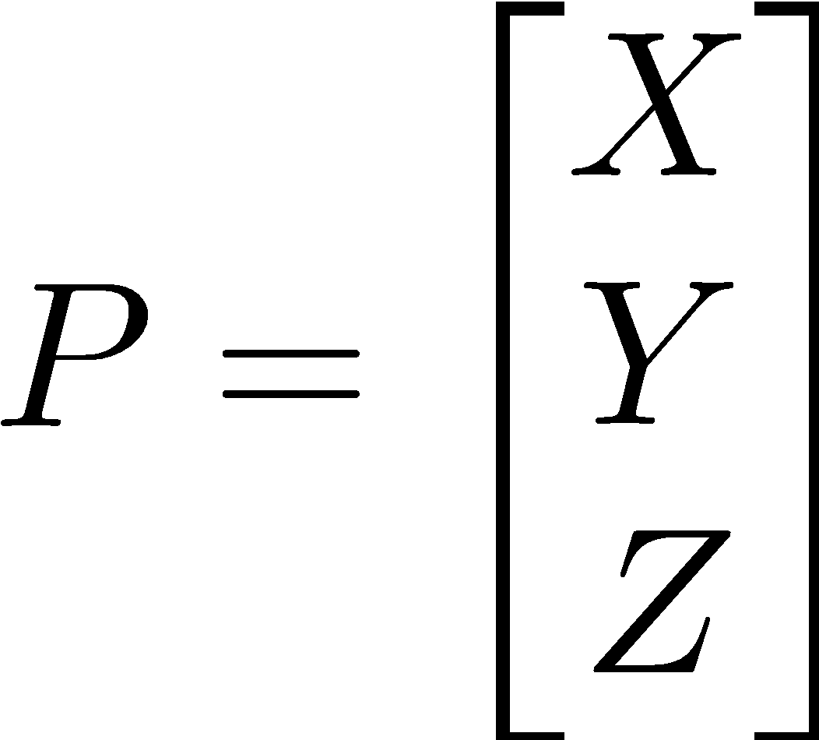
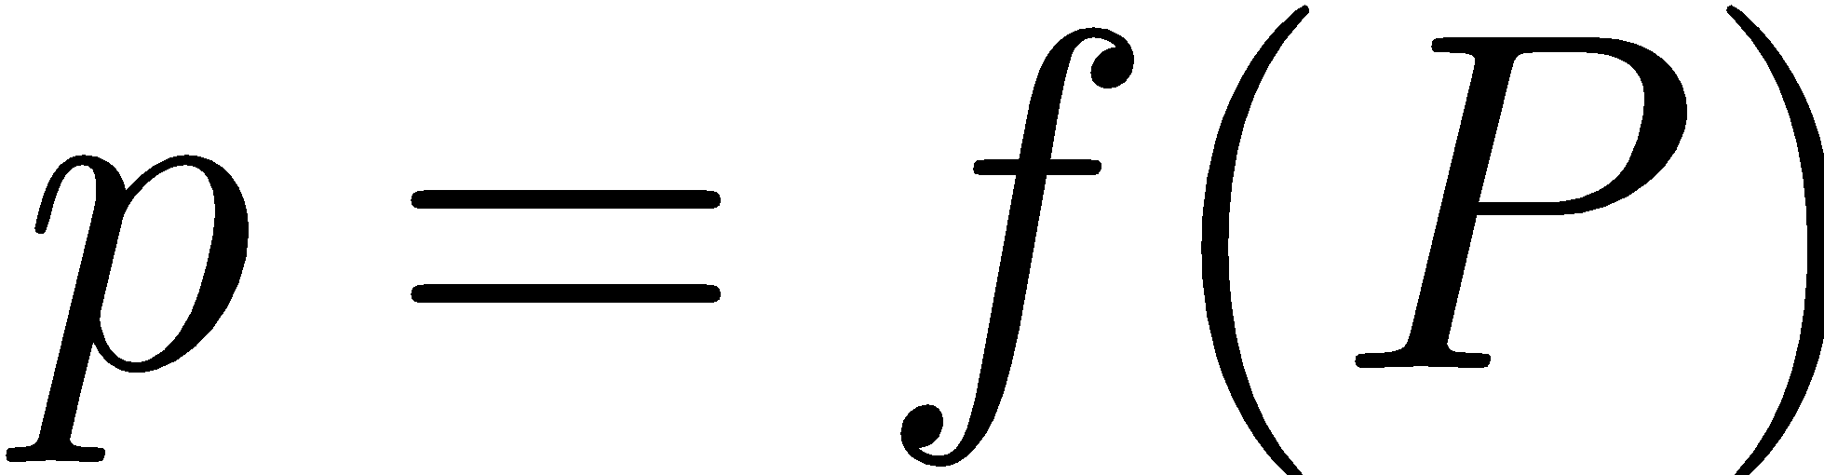
Perspective projection model
Image
Plane
{i, j, k} = {x, y, z}
Point in
The scene
Image
center
Projection
Optical axis
Center of
camera
What is the projection function f?

Slide 12
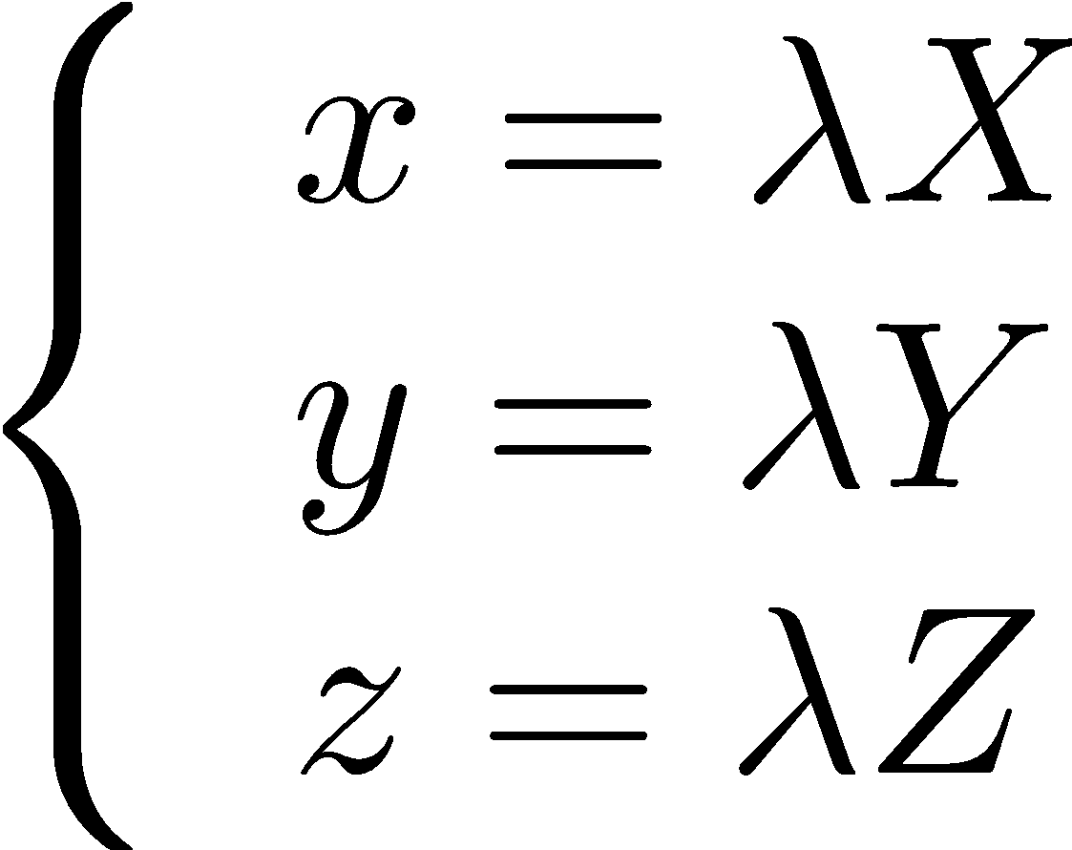
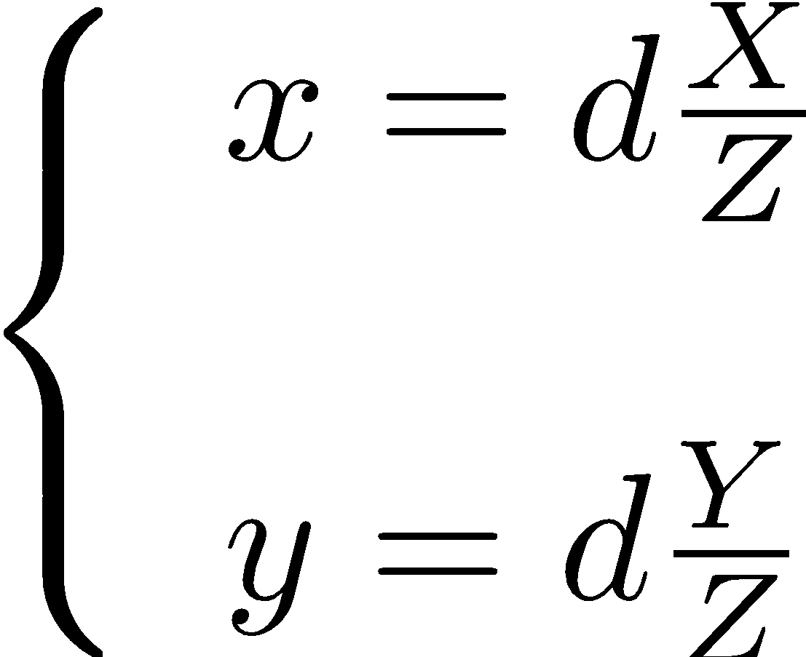
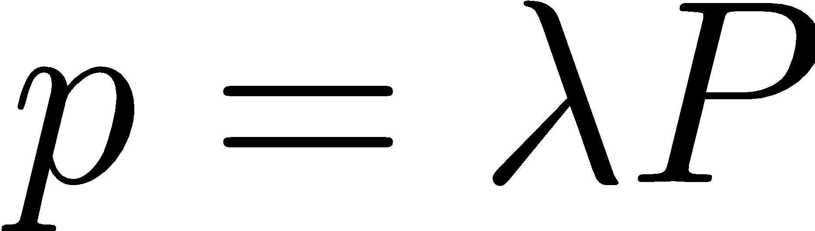

Perspective projection model (cont’d)
Collinear points

Slide 13
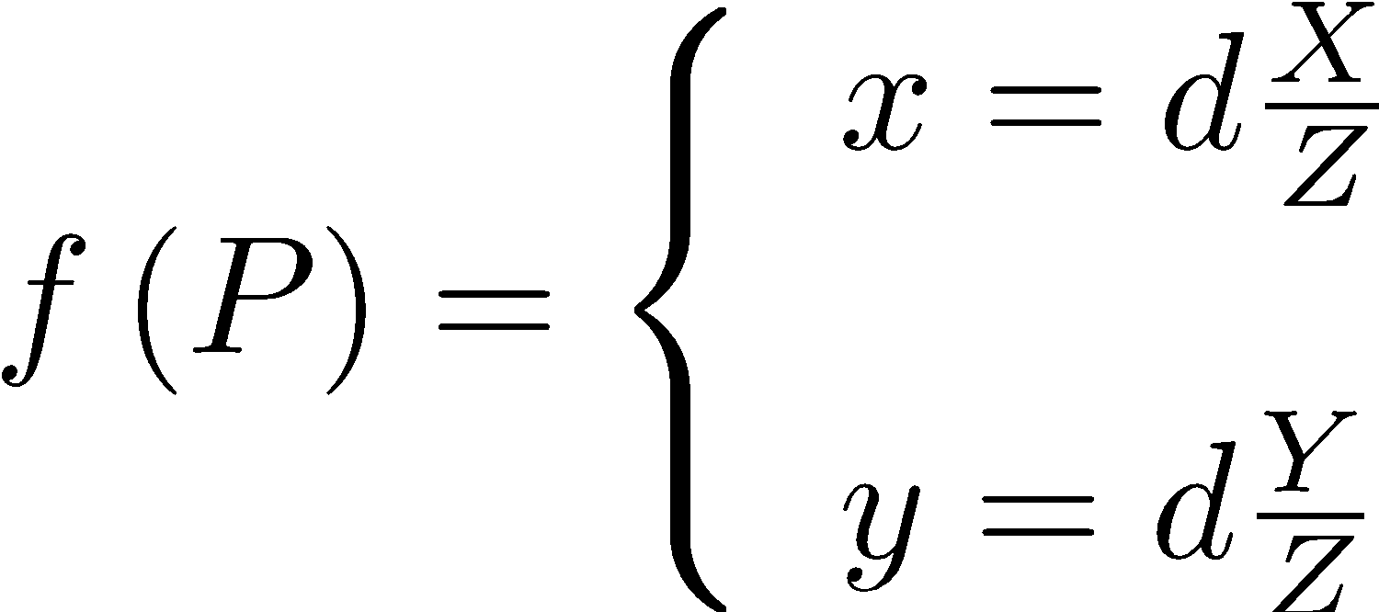
The pinhole projection model

Slide 14
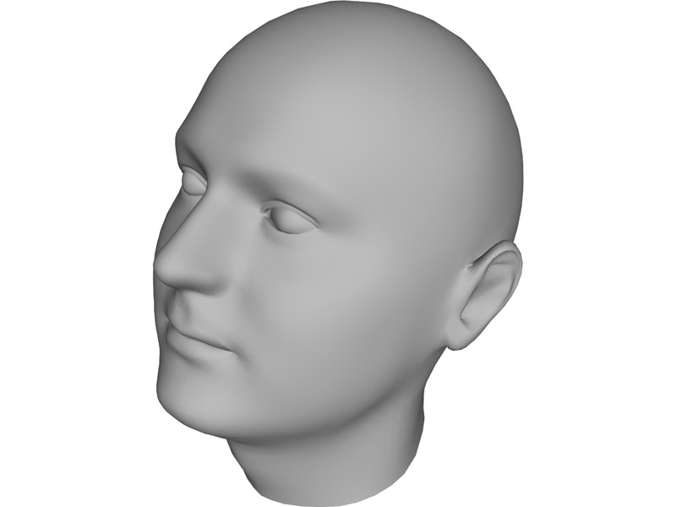
Virtual plane for convenience
c
x
z
Observer
O
y
Virtual
Plane
Camera
x=i, y=j, k=z

Slide 15
Virtual image plane seen as the observer
Virtual
Plane
c
x
y
z-axis is coming out of the plane

Slide 16
Cameras with lenses
Image formation is achieved with a lens system integrated with optical elements which alter light, such as prisms and mirrors.
Lens – a transparent element, usually made of glass
Surfaces are usually spherically ground and polished
Refraction at surfaces “bends” the light rays and focuses them
The refracting power of a lens is related to its focal point

Slide 17
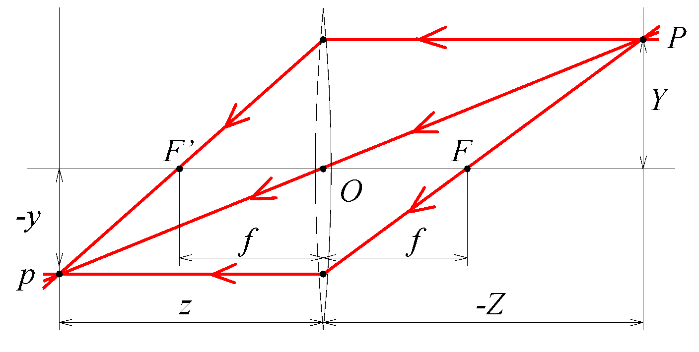
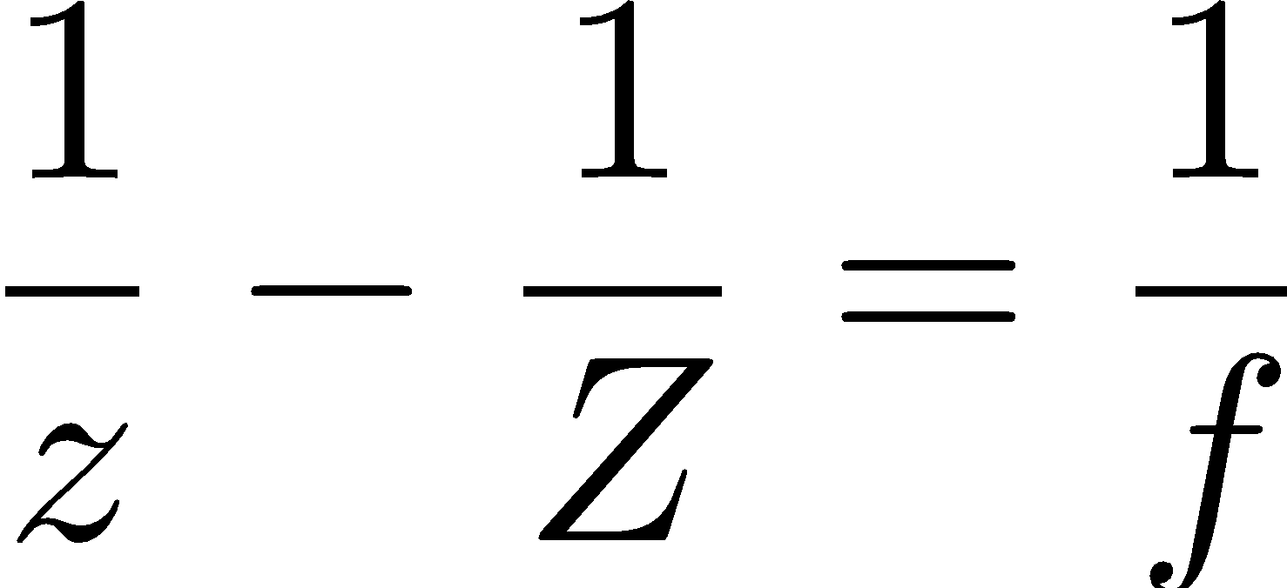
Thin lens equation
Lens
Point in
the scene
Image plane
Focal point
Optical
Axis
Point in the image plane
Focal length
Beware of signs!

Slide 18
Thin lens equation (cont’d)
The pinhole projection model still works for point P and p (of course iff d = z).
Points located exactly at a distance Z away from O will be in sharp focus only if the image plane is at a distance z.
Objects within a range of distances (called depth of field) will be in acceptable focus.
The depth of field increases with the f-number of the lens.

Slide 19
What if Z = -∞? If Z = -f ?
Point at infinity
Focus at f
f
k
z
-Z
Point between f and infinity
Focus between f and infinity
-Z
z
Point at f
Focus at infinity
z
-Z

Slide 20
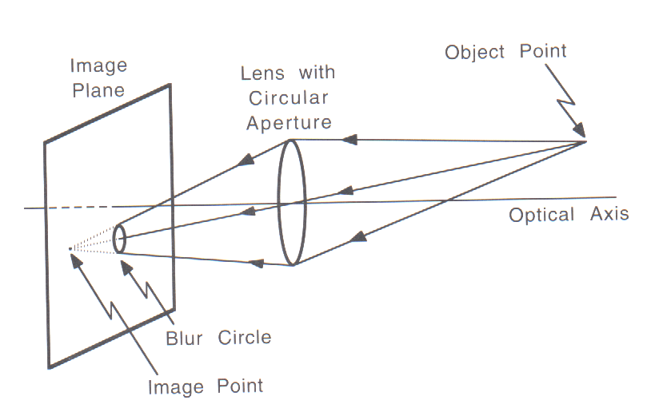
Misfocus Blur
P
p
/Disk

