Slide 1
Rigid Transformations

Slide 2
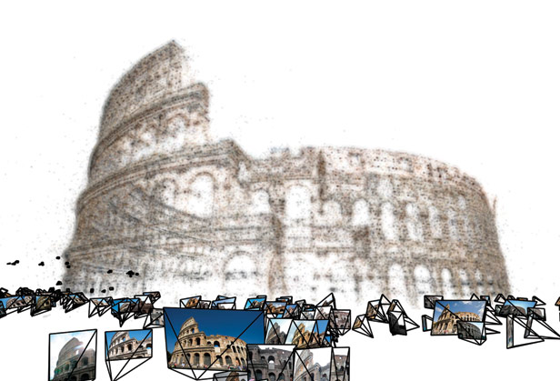
Rigid transformations
Useful for camera calibration and manipulating projective geometry.

Slide 3
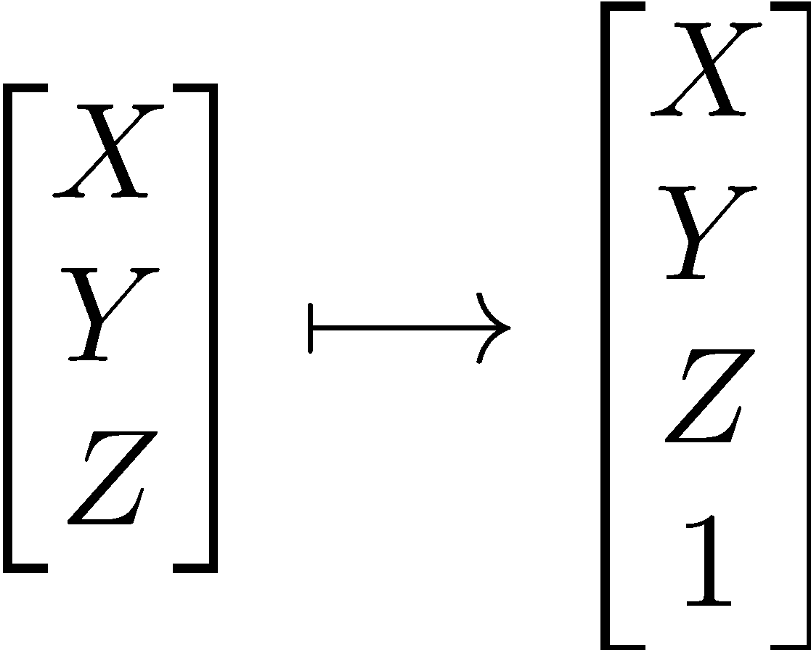
Homogeneous Coordinates
Useful for representing various geometric transformations as simple matrix products.

Slide 4
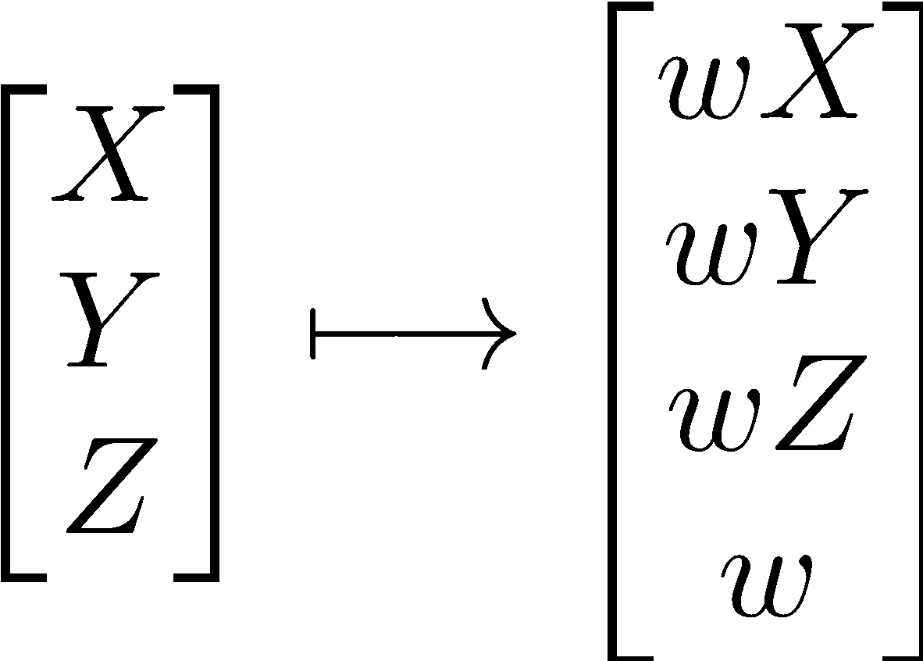
Homogeneous Coordinates (cont’d)
More generally, points in homogeneous coordinates require a scalar w.

Slide 5

Rigid transformations
y
z’
y’
O
x
O’
x’
z
The goal is to find the transformation between frame O and O’.
It is called rigid because we do not deform anything (distances and angles are preserved).

Slide 6

Rigid transformations (cont’d)
y
z’
z
y’
y
x
O’
x’
O
z
First, we align the axes by rotating the frame O around x.

Slide 7
Rigid transformations (cont’d)
z
Rotated
frame
z’
y’
y
translate
O
x
O’
x’
Now, we translate the frame O to O’.
At the end of the day, we align the two coordinate frames.

Slide 8
2D examples
y’
y
y’
y
x’
x
x’
x
Rot
Trans
y’
P
y
x’
x
Trans+Rot

Slide 9
Rigid transformations (cont’d)
Rigid transformations thus have a rotation and a translation operations.
Rotation can be computed using a rotation matrix, angle-axis vector, and quaternions.
Translation can be calculated by adding an offset vector (i.e., an offset at each entry of a vector).
Rigid transformations preserve distances and angles.

Slide 10


Rigid transformations (cont’d)
Point w.r.t.
frame O’
Rotation
matrix
Point w.r.t.
frame O.
Translation
vector

Slide 11

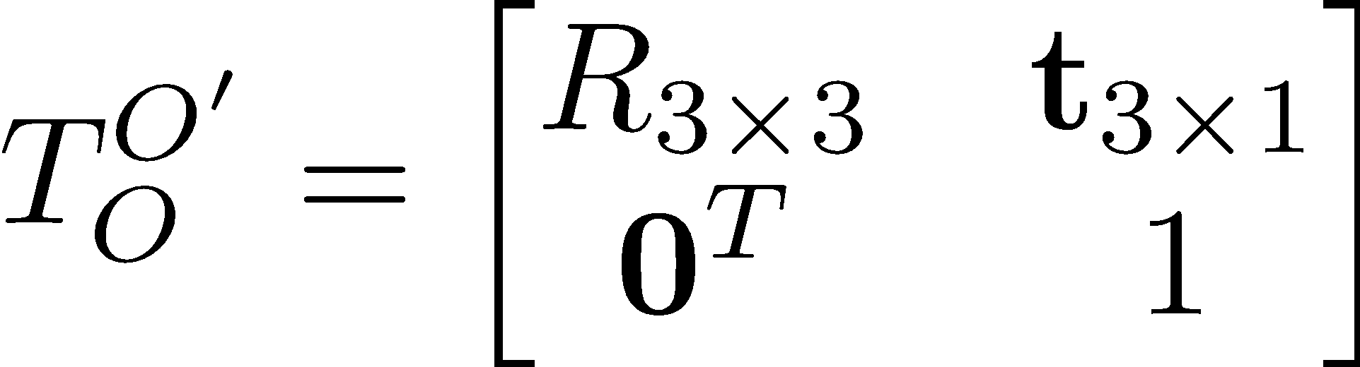
Rigid transformations (cont’d)
Using homogeneous coordinates, the rigid transform is simply a matrix-vector product.

Slide 12

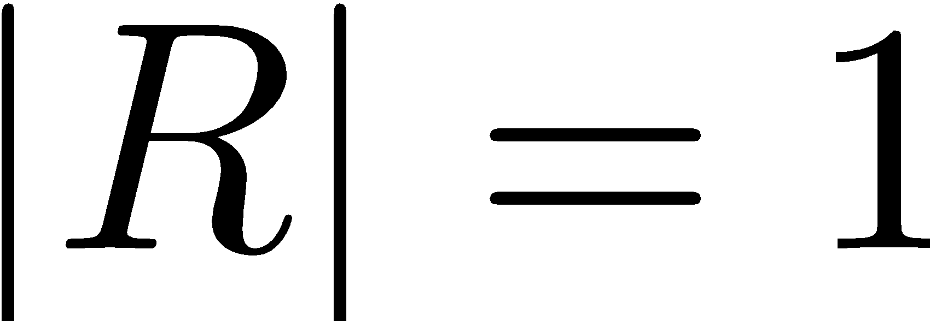
Properties of a rotation matrix
Orthonormal matrices
Inverse is just the transpose.
Its determinant is 1

Slide 13

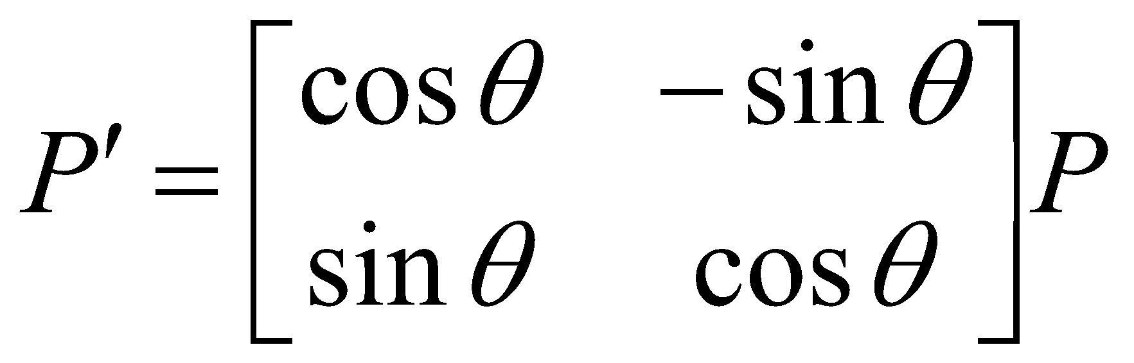
2D rotation matrix
Rotate θ counterclockwise
What is the transformation R?
y
p'
p
θ
x

Slide 14

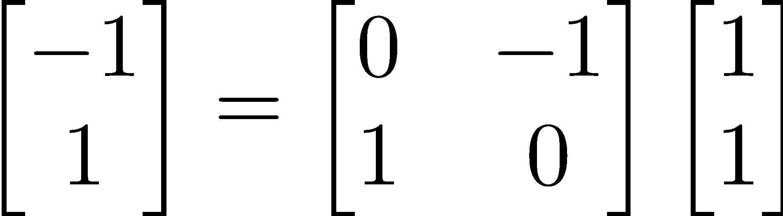
2D rotation example
Suppose I want to rotate a point 90 degrees.
y
(-1, 1)
(1, 1)
x

Slide 15
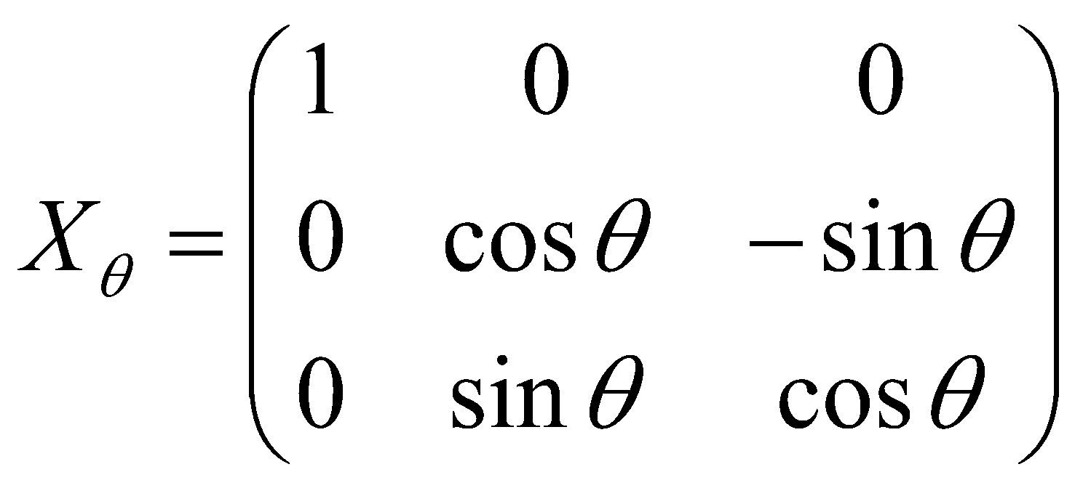
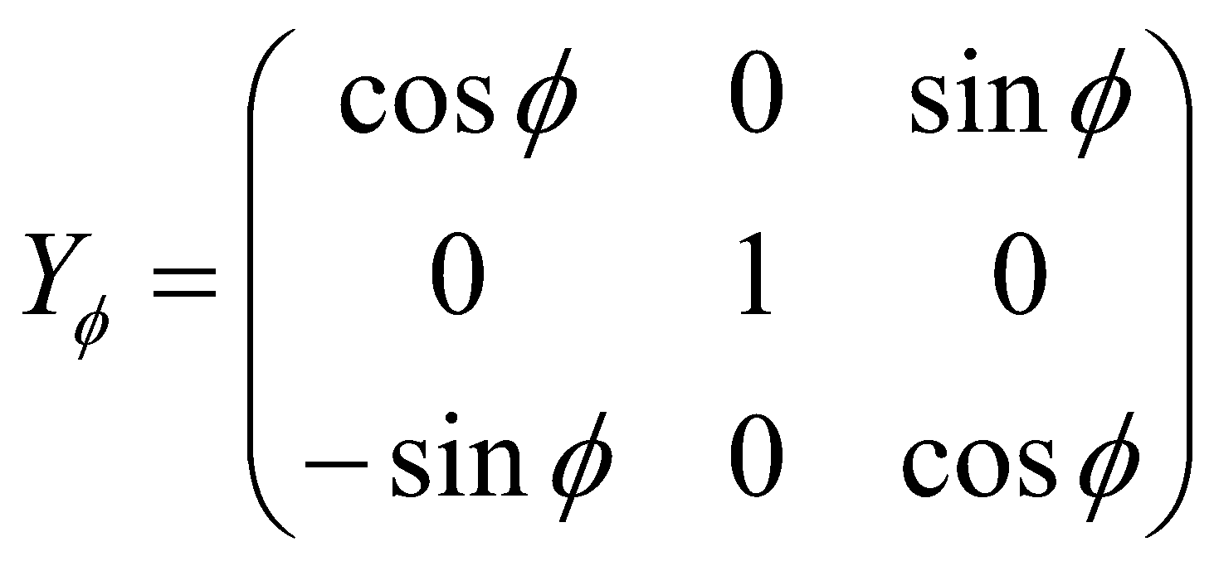
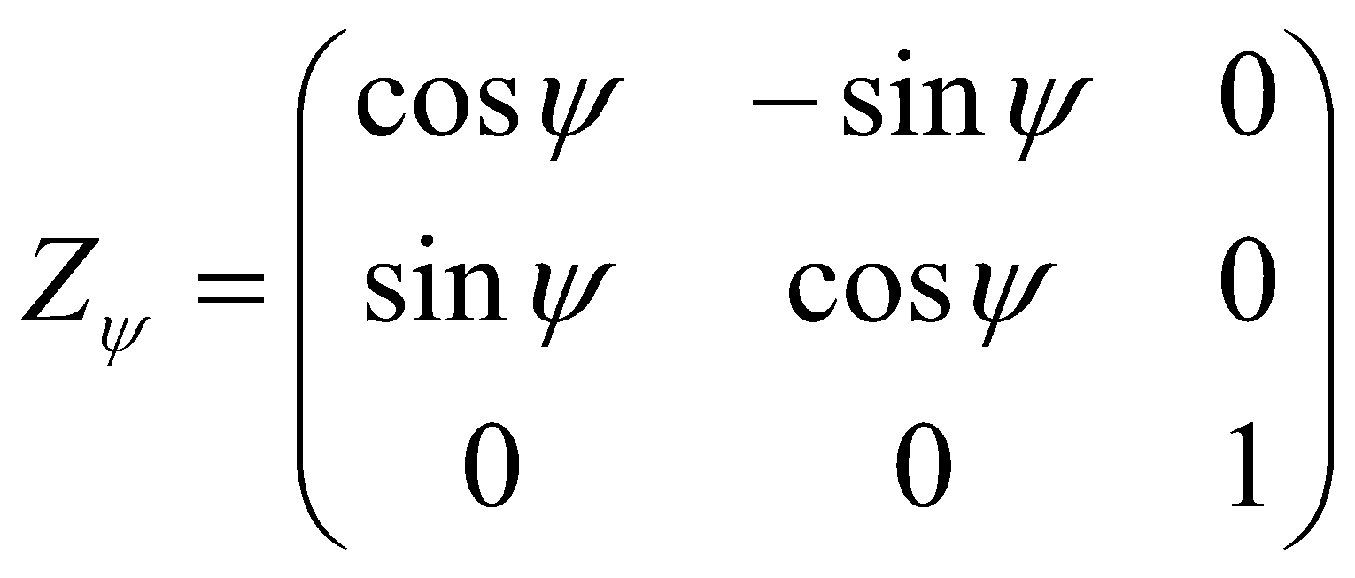
3D rotation matrices
Rotate θ about x axis, φ about y axis, and ψ about z axis
Notes:
‹#›

Slide 16

Composition of rotation matrices
Yaw
Pitch
Roll
The product represents a rotation whose yaw, pitch, and roll angles are α, β and γ, respectively.

Slide 17
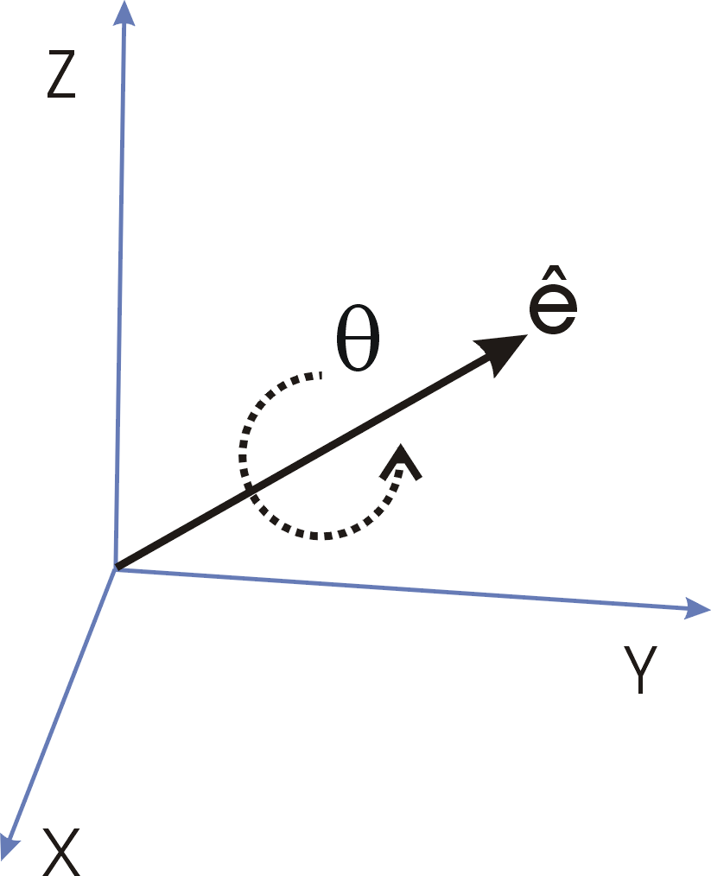

Angle-axis representation
Axis of rotation
(unit vector)
Angle
Rodrigues rotation formula

Slide 18
Rotation using quaternions
Another mathematical tool for rotations.
Used in computer graphics.

Slide 19
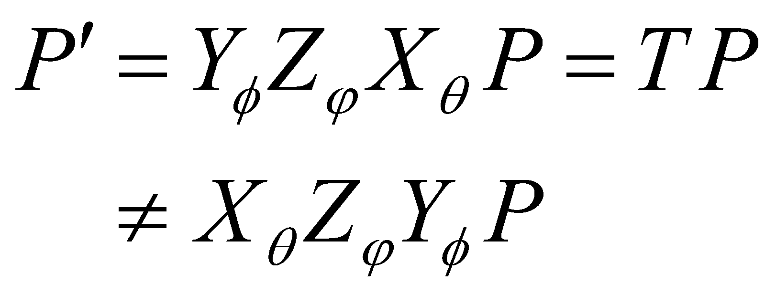
Combining rotations
To combine rotations, apply trans. matrices right to left
Rotate about x, then about z, then about y
Order matters!
The same is true for homogeneous transformations in general – and, therefore, for rigid transformations (rotation and translation)
Notes:
‹#›

Slide 20


Order of transformation matters
Order of the matrix products defines the composition of the transformations.

Slide 21
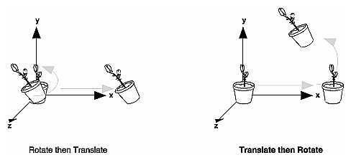
Order of Transformation Matters!

Slide 22
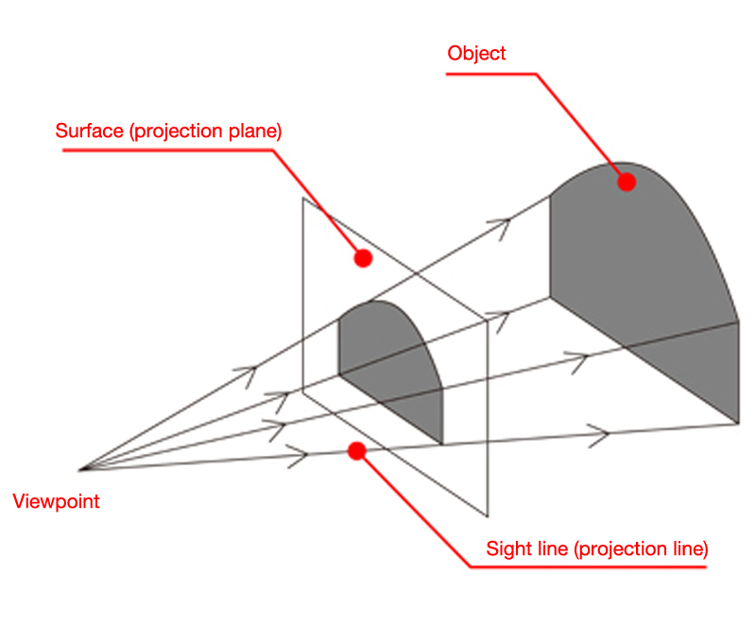
Perspective Projection

Slide 23
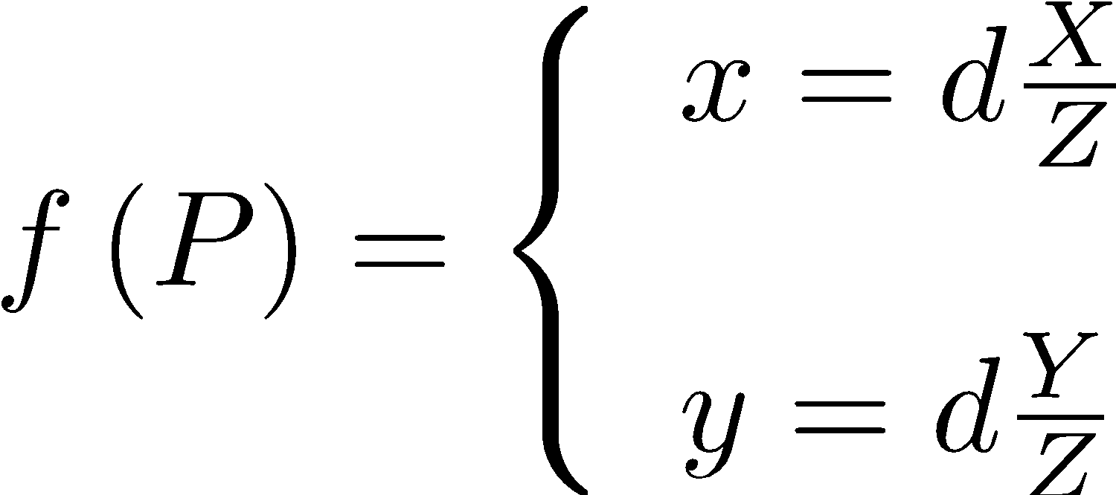
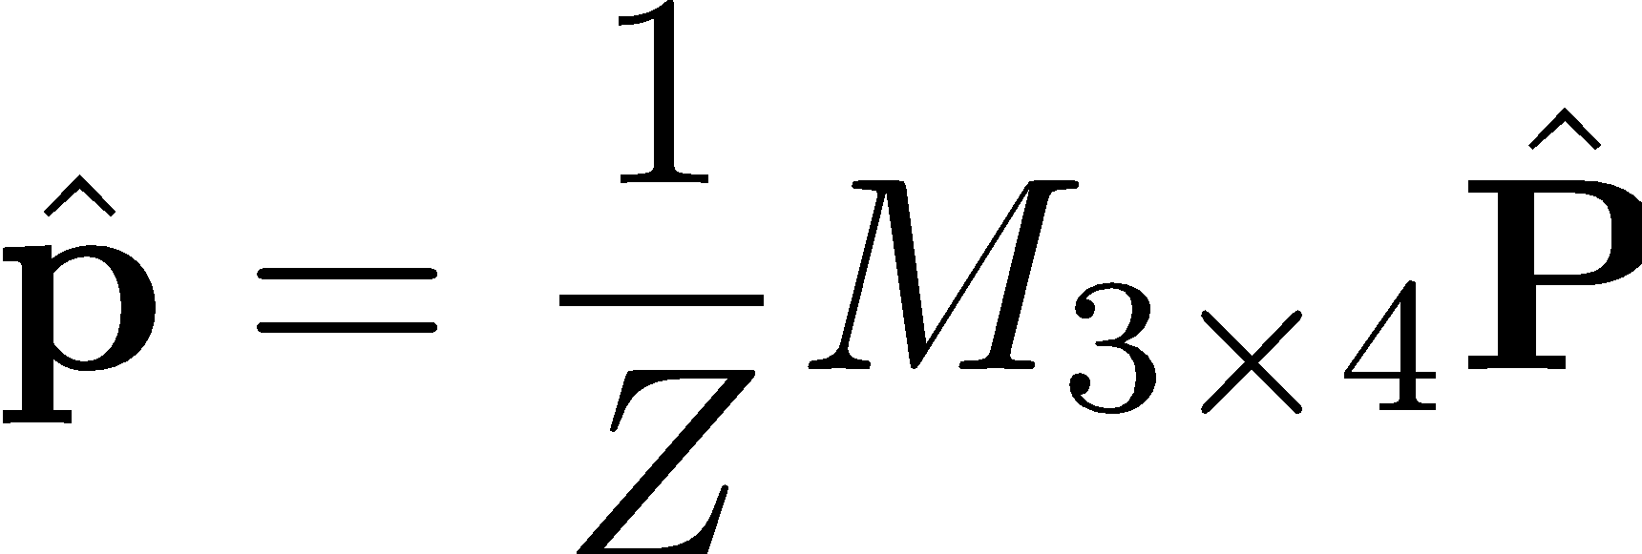
Perspective projection model
Written in matrix form and using homogeneous coordinates:
Point in the scene
(homogeneous)
Point on the image plane
(homogeneous)
Camera
matrix

Slide 24
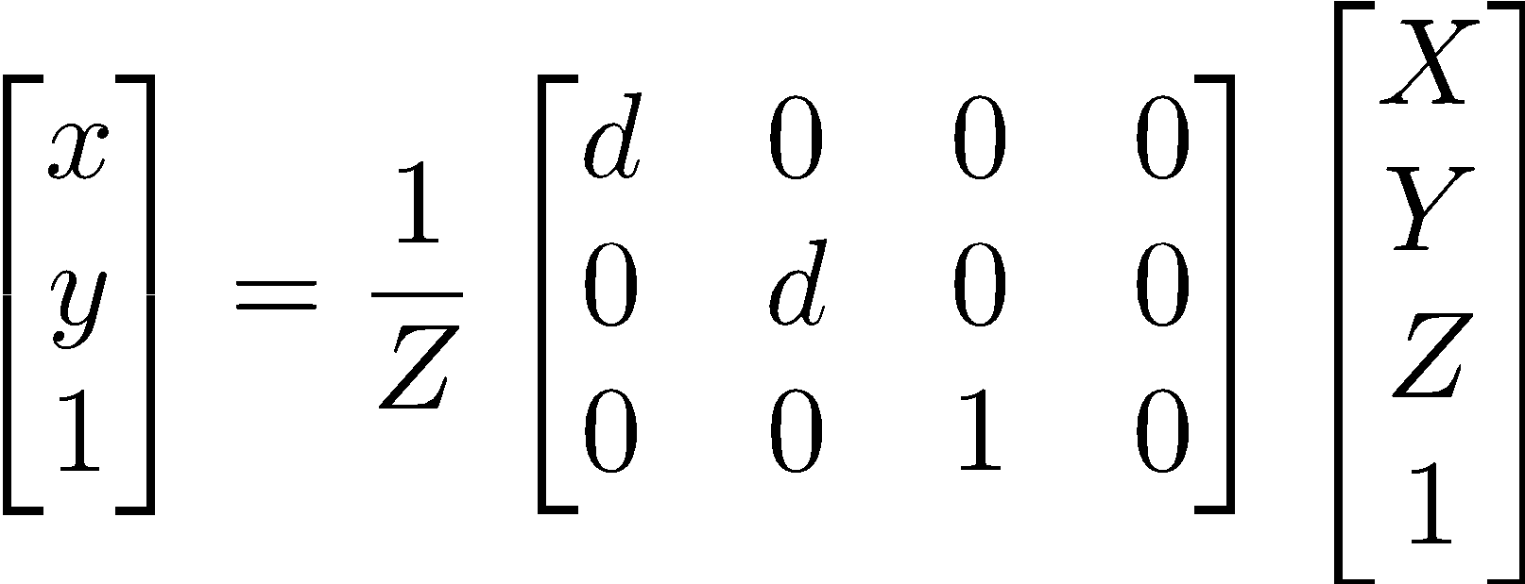
Perspective projection model (cont’d)

Slide 25
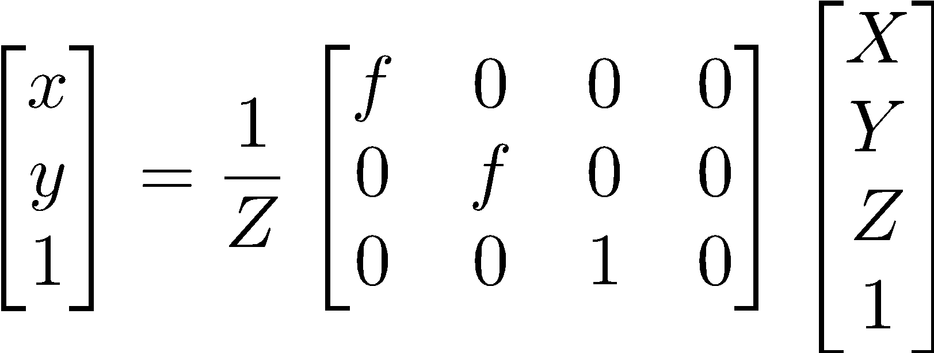
Perspective projection model (cont’d)
Assume we have a camera focused at infinity.
Point at infinity
Focus at f
f
k
z
-Z

Slide 26
Perspective projection model (cont’d)
Previous transformation maps a point in the scene to a plane with a camera focused at infinity.
Digital cameras have pixels:
u
Pixel
v
c
x
y

Slide 27
Perspective projection model (cont’d)
u
1 / k meters
v
Offset
c
x
1 / l
y
meters
f is a distance (e.g., expressed in meters)
Pixels can be rectangular
We want the projected point in pixels not meters, thus:
Scale width factor: k = pixel / meter
Scale height factor: l = pixel / meter
We need an offset to get pixel coordinates

Slide 28
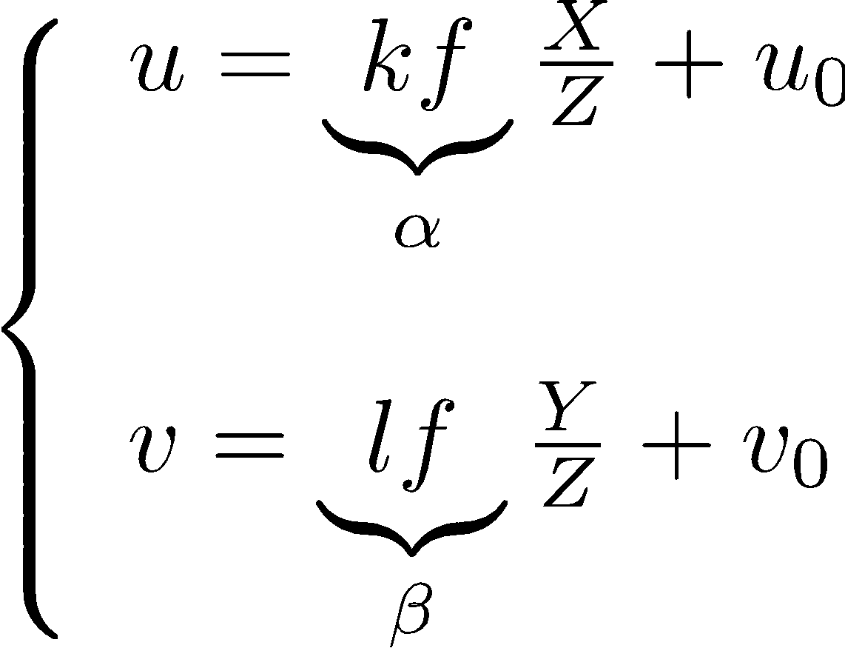
Perspective projection model (cont’d)
Pixel coordinates
Offset

Slide 29
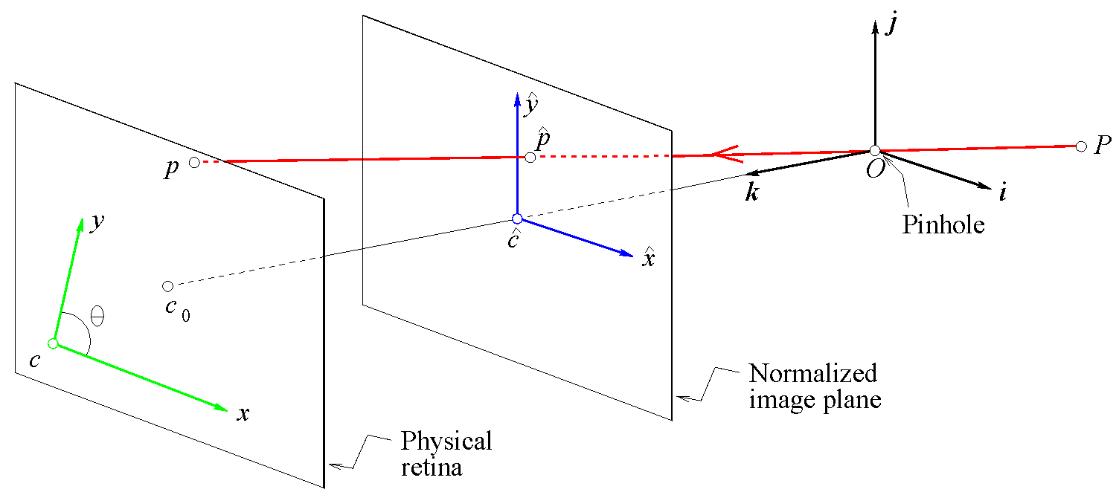
Perspective projection model (cont’d)
Due to manufacturing errors in the sensor, the real coordinate system is a bit skewed.

Slide 30
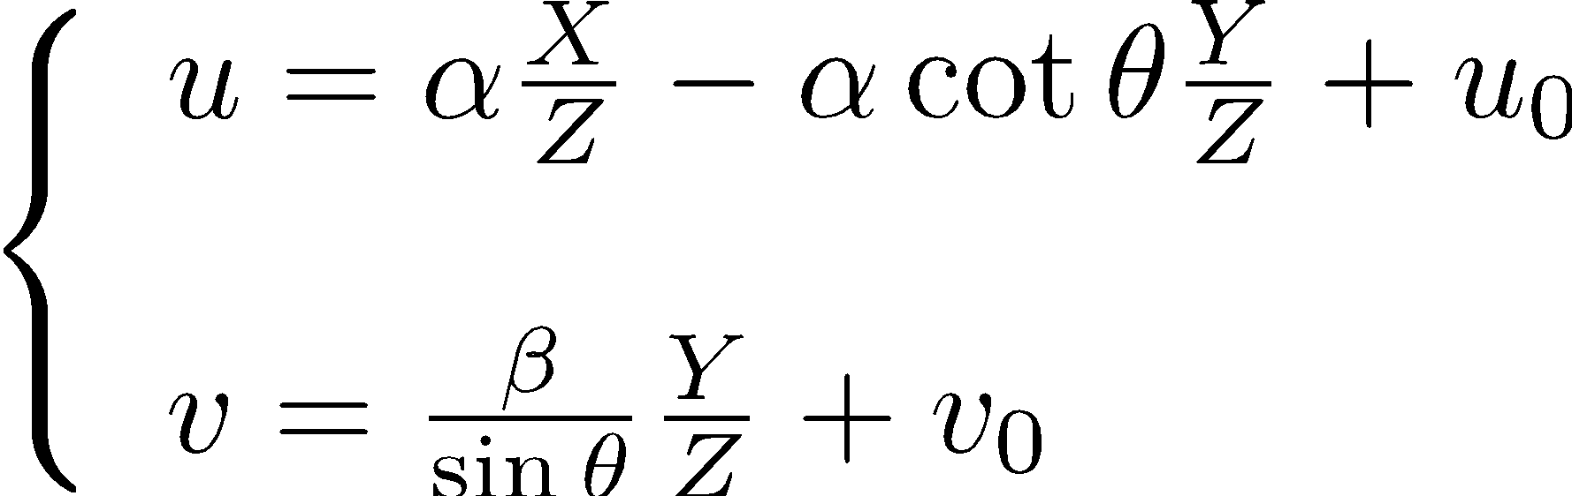
Perspective projection model (cont’d)
Skew compensation

Slide 31
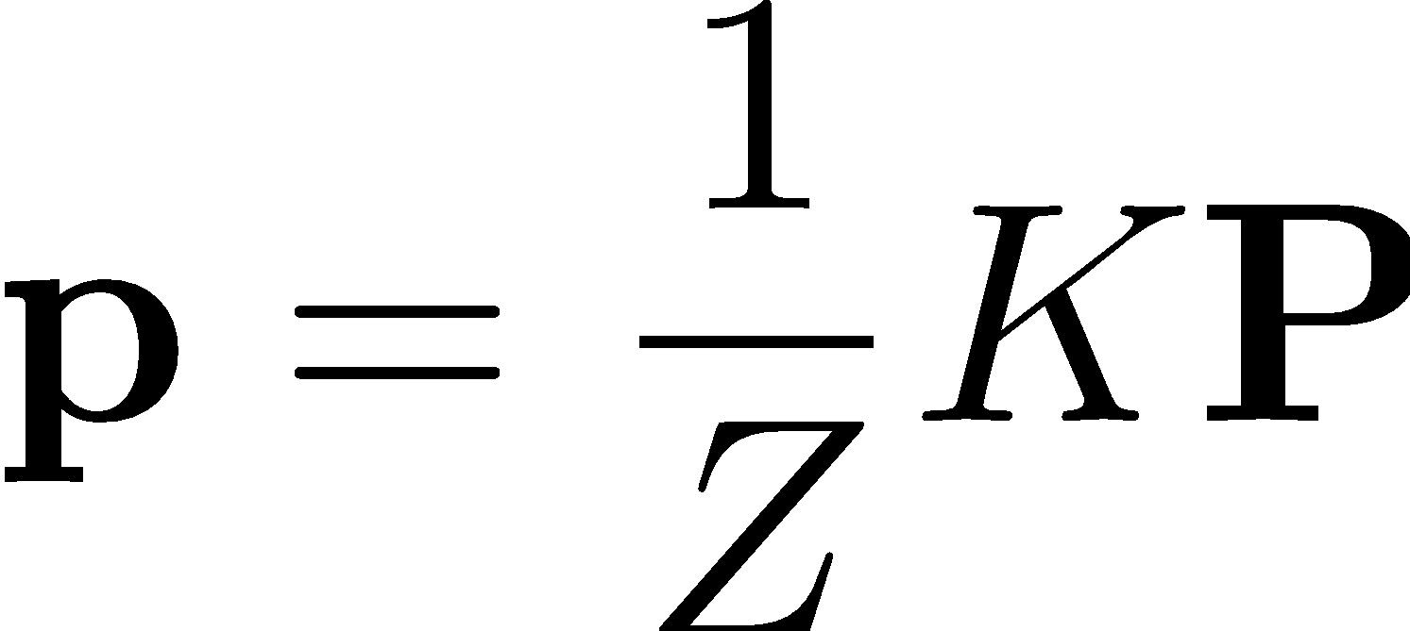
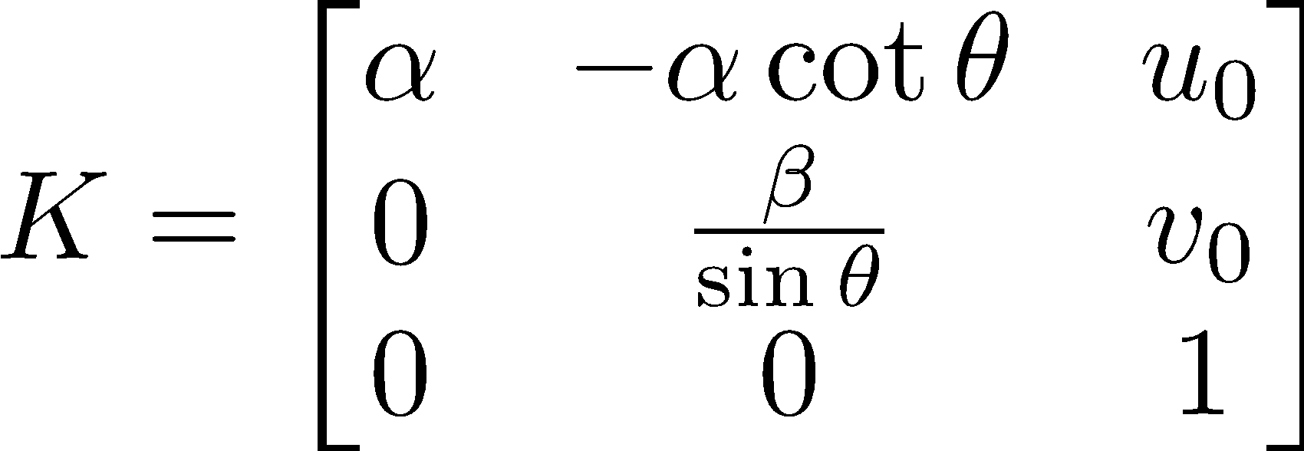
Calibration matrix / Intrinsic parameters
Point on the
Image plane
(non-homogeneous)
Point in the scene
(non homogeneous)
Intrinsic parameters / calibration matrix

Slide 32
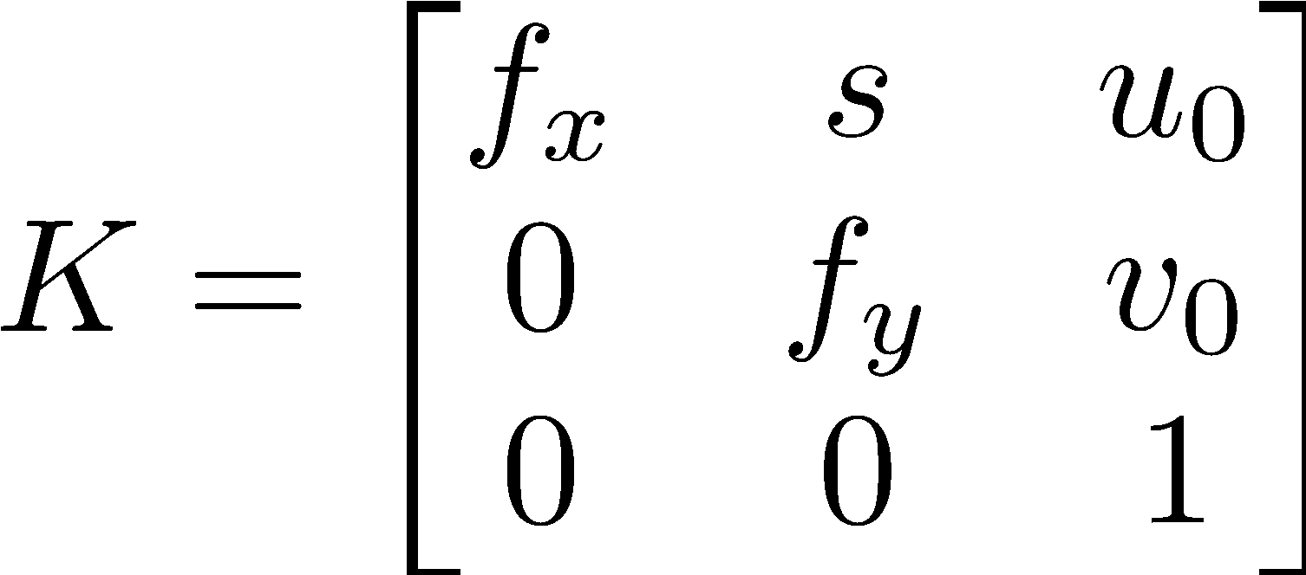
Simplified notation
In practice, when estimating the matrix it is assumed that s = 0.

Slide 33
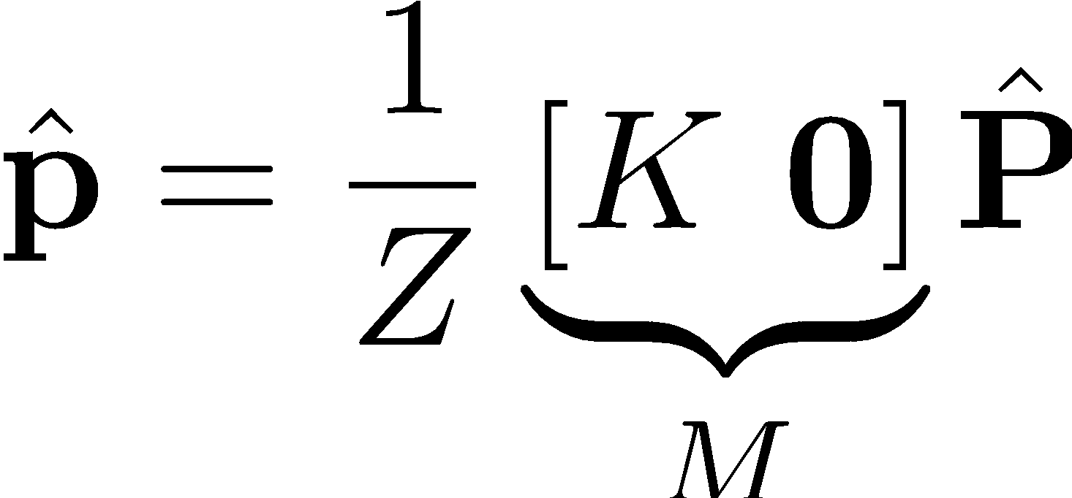
The camera matrix thus far
Point on the image plane
(homogeneous)
Point in the scene
(homogeneous)
Camera matrix

Slide 34
Let’s recapitulate
So far the point in the scene (P) has been described with respect to the camera frame system.
What If we have P described w.r.t. some other frame?

Slide 35
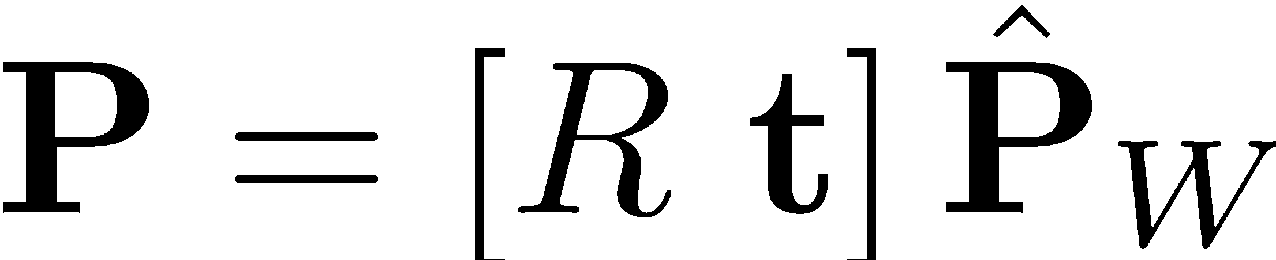
Extrinsic Parameters
We can use a rigid transform to compute the coordinates of P w.r.t. the camera frame system.

Slide 36

Extrinsic Parameters
Point
z
z’
x
O
W
x’
y
y’
Extrinsic parameters
The extrinsic parameters tells us how the camera is oriented and positioned w.r.t. the frame W.

Slide 37
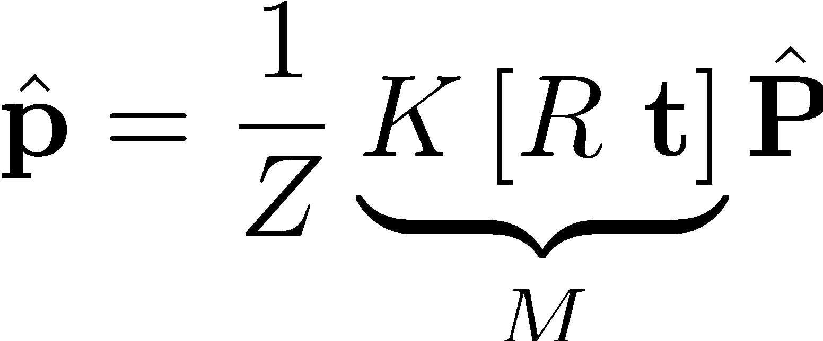
Perspective projection in matrix form
Intrinsic parameters
Extrinsic
parameters
Point in the scene
(homogeneous)
Point on
the image plane
Camera matrix

Slide 38
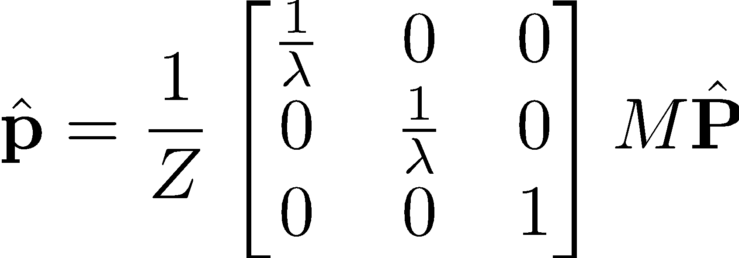
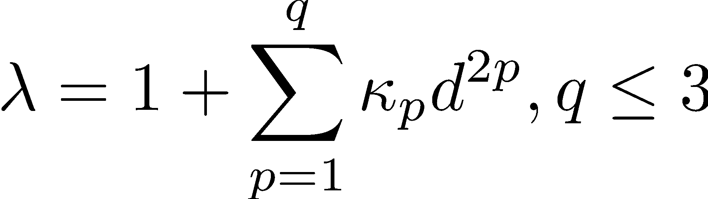
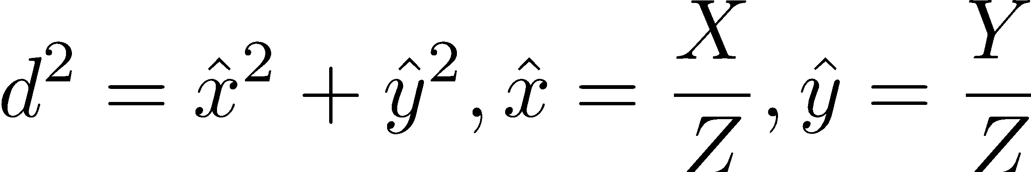
Radial distortion

Slide 39
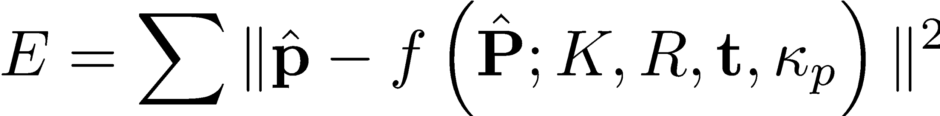
Solving for camera matrix + radial distortion coefficients
{
Projection model
Unknowns
Point on image plane
(observations)
Point in the scene
(observation)
We solve this problem using a non-linear least squares.

Slide 40


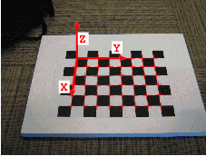


Camera calibration
How do we estimate the calibration matrix and the extrinsic parameters for a camera?
Observation
Observation

Slide 41
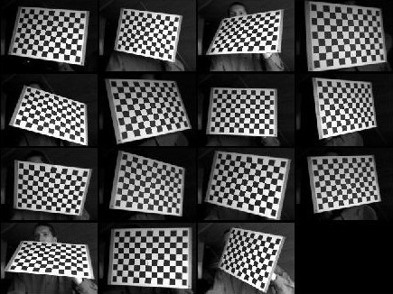
Camera calibration (cont’d)
M images
Calibration
K
radial distortion coeff.,
Tangential distortion coeff.,
Extrinsic1, …, ExtrinsicM

Slide 42
Software for calibration
Matlab: http://www.vision.caltech.edu/bouguetj/calib_doc/
OpenCV: http://docs.opencv.org/modules/calib3d/doc/calib3d.html

