Slide 1
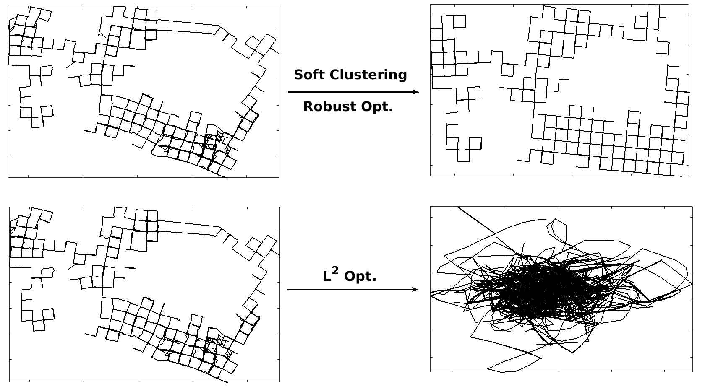
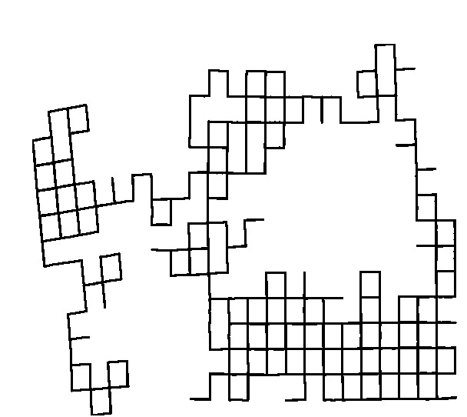
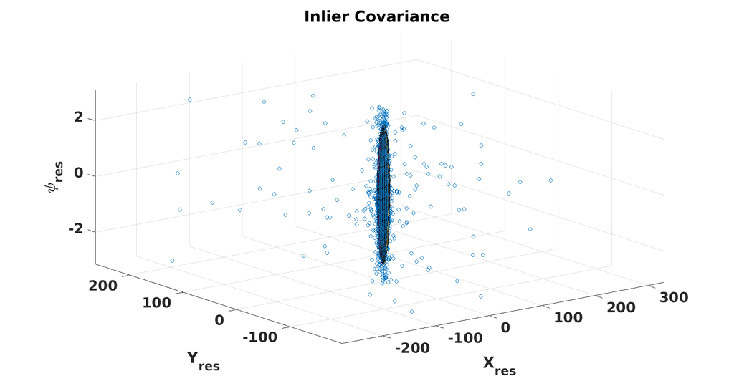
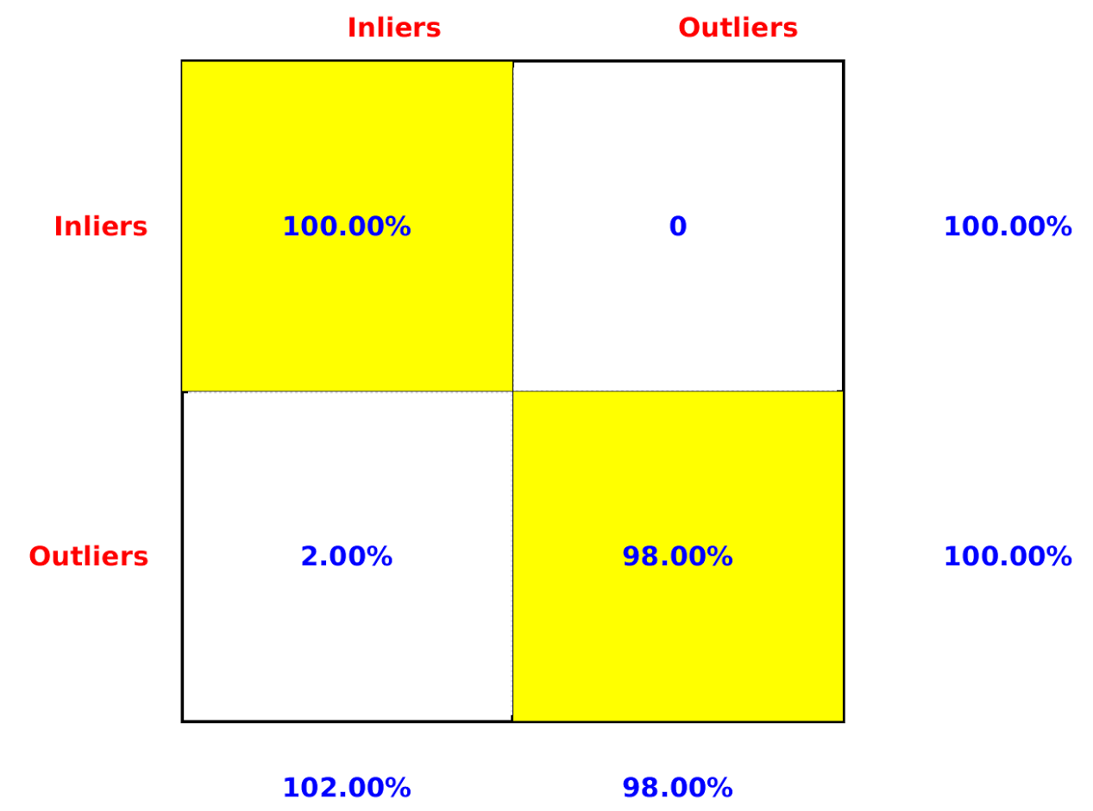
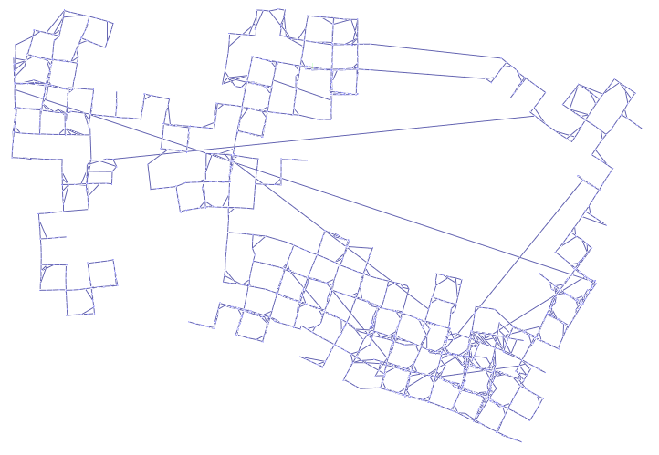
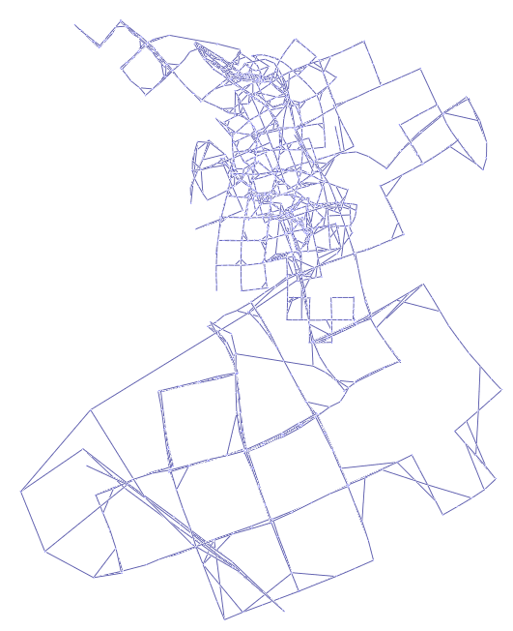
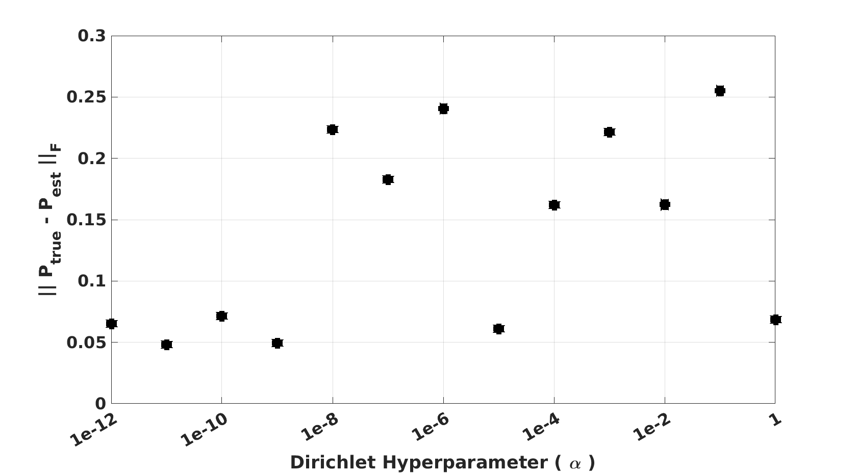
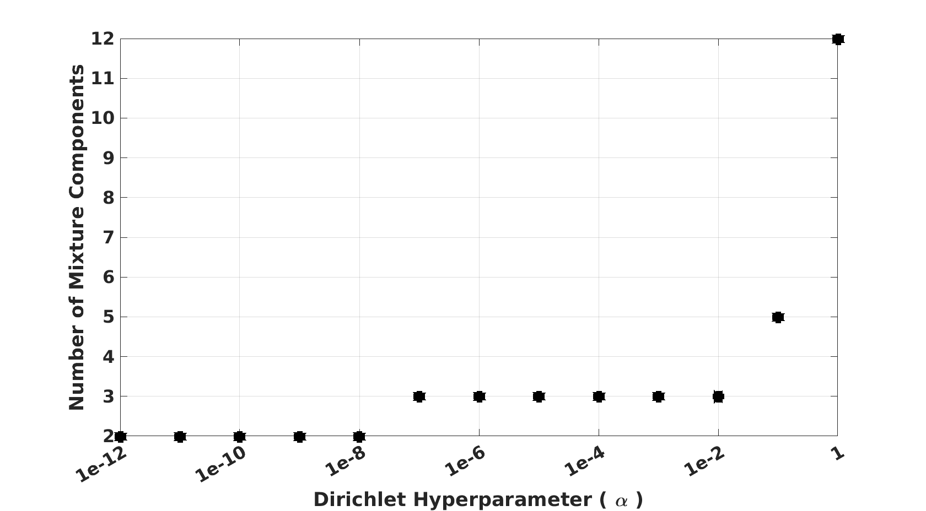
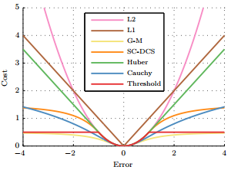
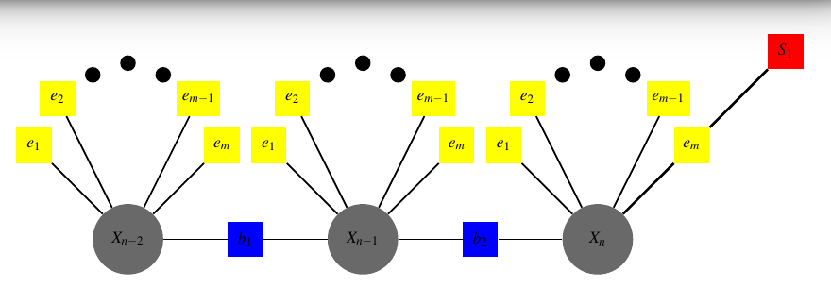
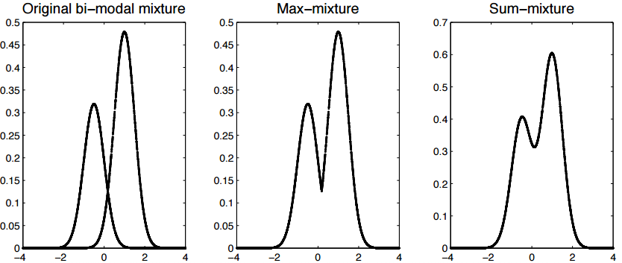
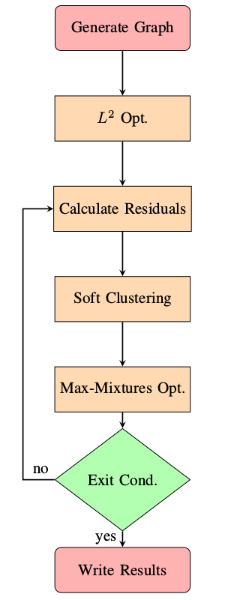
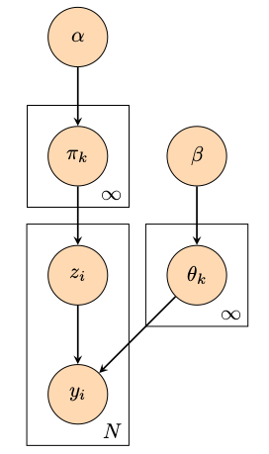
Robust Pose Graph Optimization Without An Accurate Measurement Covariance Model
Ryan Watson (West Virginia University, Ph. D Student)
Mentors: Robert C. Leishman (AFIT), Clark N. Taylor (AFRL)
Motivation
The factor graph provides a popular way to represent the navigation state estimation problem. Methods for optimizing factor graphs work well when the Gaussian assumption holds and the measurement model is known a priori. However, robust models aimed at addresses graph optimization when the above mentioned assumptions do not hold fall short on several fronts.
Results
Robust to false constraints
Accurate Covariance
Insensitivity to Hyper-parameters
Introduction
The factor graph provides a convenient tool for factorizing a function of many variables into a product of smaller subsets
What happens when the Gaussian assumption is not valid?
Current Methods of robust graph optimization.
These methods works well when the input measurement covariance is known. However, that is not always a safe assumption. Additionally, these methods are sensitive to hyper-parameters
M-Estimator Switch Factors Max-Mixtures
Contribution
We’ve provided a method of robust factor graph optimization that handle erroneous constraints and provides a reliable estimate of the inlier measurement covariance, while not being sensitive to hyper-parameters.
Technical Approach
                Utilize collapsed Gibb’s Sampling to estimate a infinite Gaussian Mixture Model (G.M.M) to characterize the measurement covariance matrix.
                Now, we have an n-component mixture model that characterizes the measurement covariance.
                Now, all constraints are iteratively tested against the model, which allows the information and Jacobian matrices to be scaled accordingly.
Future Work
We would like to advance this method on two fronts:
Reduce run-time
  The method discussed in this poster utilizes collapsed Gibb’s sampling to approximate the posterior distribution.
  We can make the current method faster by moving from a sampling approach to a closed form solution. Specifically, we can apply variational inference to approximate the true posterior distribution in closed form.
  Additionally, we can store the measurement residuals in a kd-tree to efficiently access them during inference.
Scale the final covariance estimate proportional to its likelihood of being a false positive.
  Utilize the Neyman-Pearson lemma.
Define and in such a way that we can analytically integrate out latent variables ( ) and only sample the component assignments.

