Slide 1
Robust Factor Graph Optimization Using Expectation Maximization
ATR Center Summer Workshop
9,10 August 2017
Ryan Watson, West Virginia University
Mentors: Robert C. Leishman, Clark N. Taylor

Slide 2
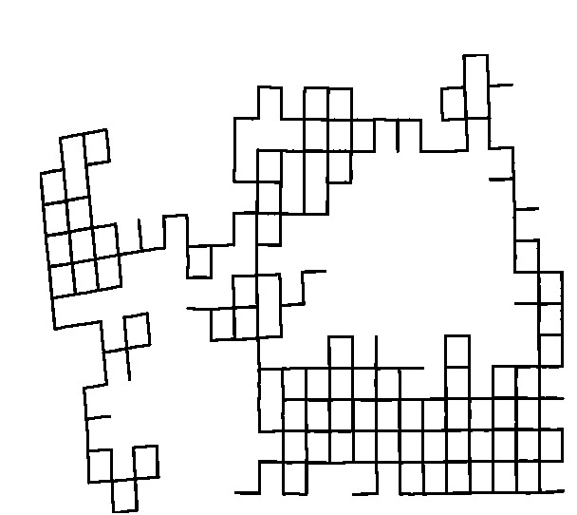
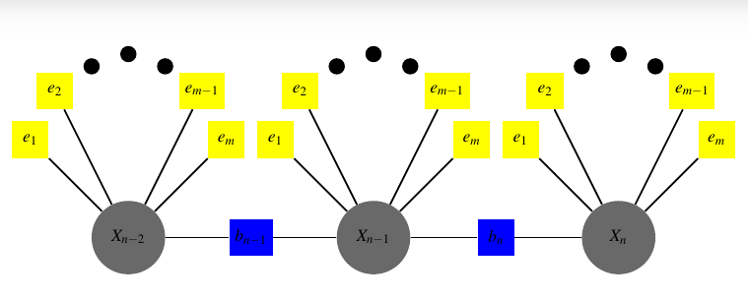
Introduction: What is a F.G.
What is a factor graph?
Tool to factorize a function of many variables into a product of smaller subsets
Factorization represented as a bipartite graph G=(F,X,E)
Can be applied to MAP estimation

Slide 3
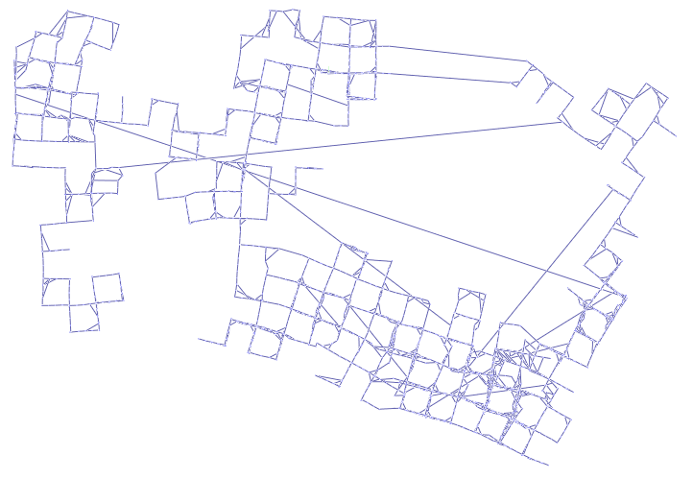
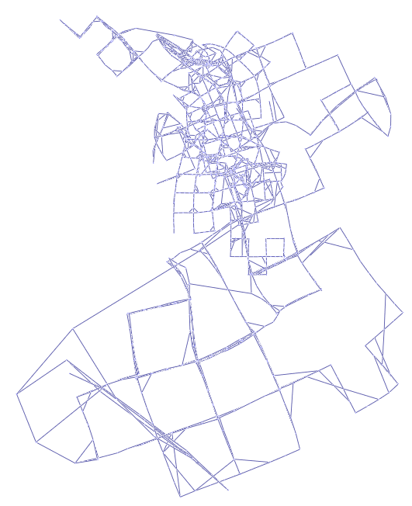
Introduction: Solving a F.G.
When The Gaussian Assumption Holds ::
When The Gaussian Assumption Does Not Hold ::

Slide 4
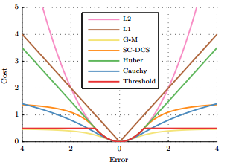
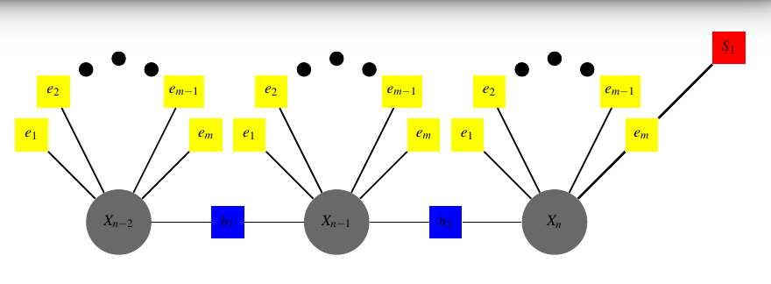
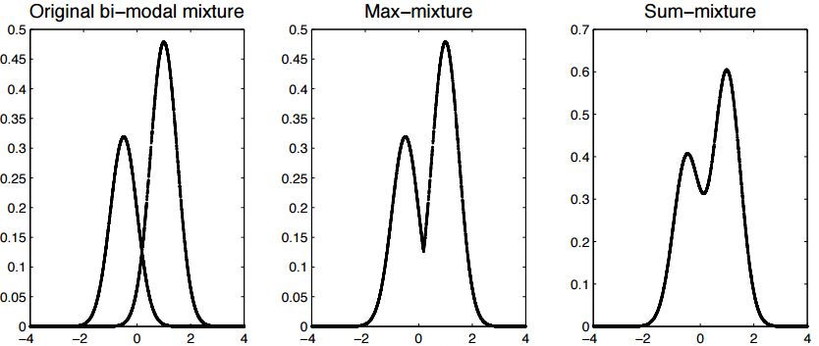
Previous Robust Methods
M-Estimator
Replace the traditional cost
with a modified cost function
Switchable Constraints
The topology of the pose graph
should be subject to the optimization.
Max-Mixtures
Allows for the adoption of more
realistic noise models through the
max operator

Slide 5
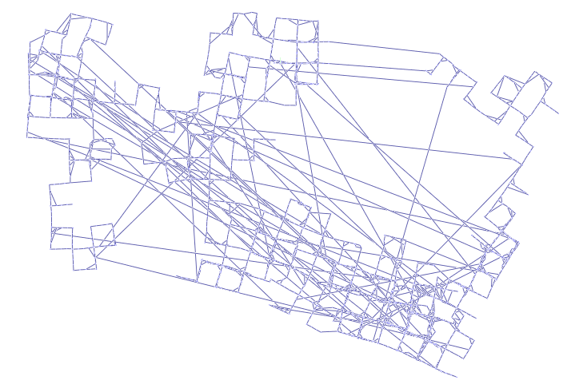
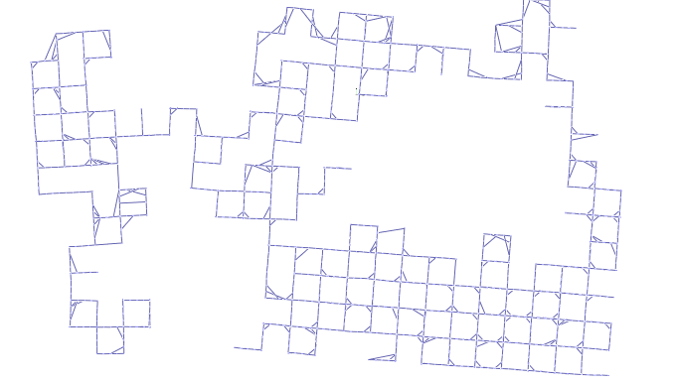
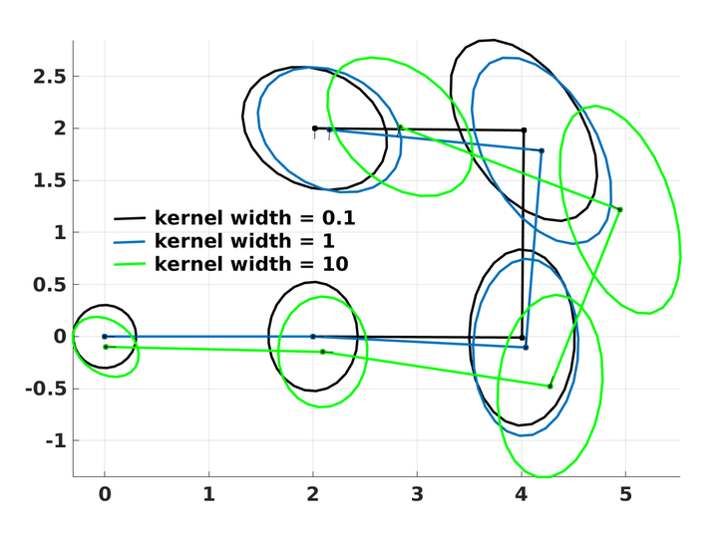
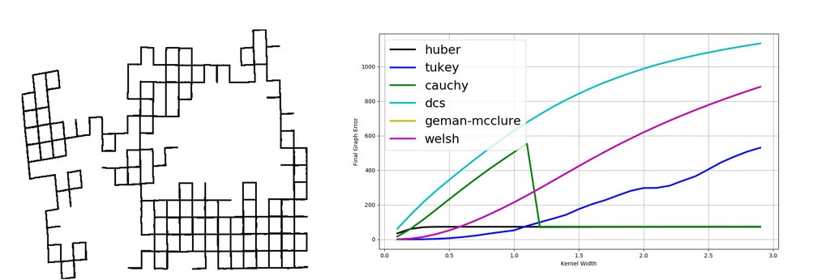
Motivation / Problem Statement
Robust
Accurate Covariance
Insensitive to Hyper-
Parameter

Slide 6
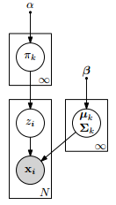
Our Approach
Extension to Max-Mixtures
Using E.M. to estimate Gaussian Mixture Model.
This provides us with an n-component mixture that characterizes our measurement covariance.
Now, all constraints are iteratively tested against the model, which allows the information and Jacobian matrices to be scaled accordingly.
Define and in such a way that we can analytically integrate out latent variables and only sample parameters of interest through collapsed Gibbs sampling

Slide 7
Results :: Robust

Slide 8
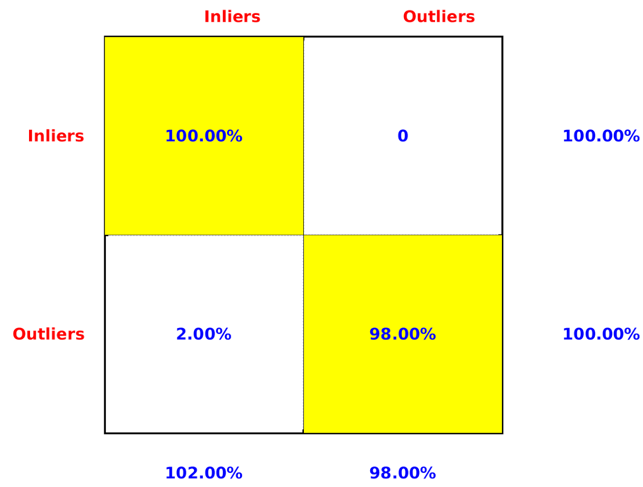
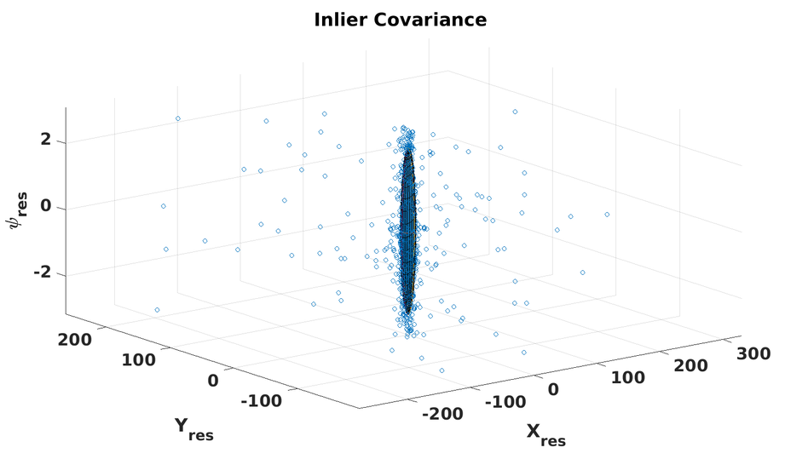
Results :: Accurate Covariance

Slide 9
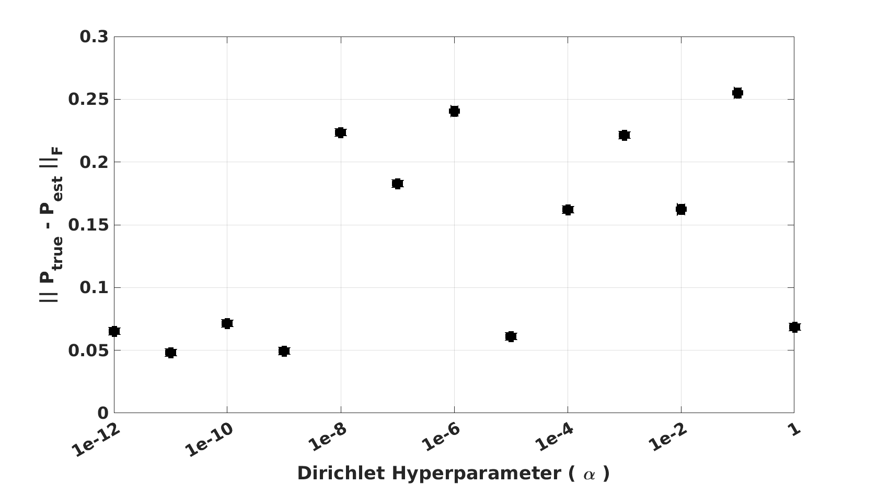
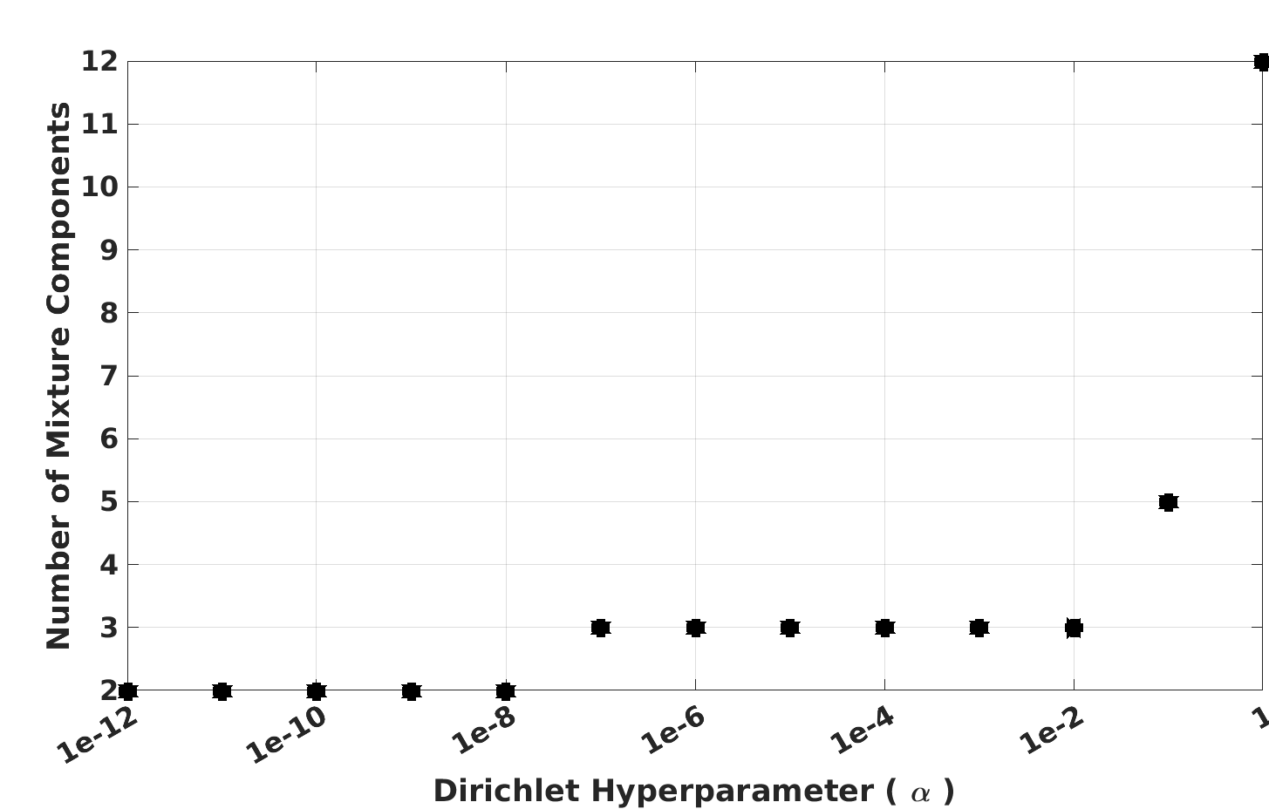
Results :: Hyper-parameter

Slide 10
Contributions, Future Work
Contributions:
Provided a robust pose-graph optimization routine that provides a reliable estimate of the inlier measurement covariance
Future work:
Reduce run-time
Store residuals in a kd-tree
Replace compressed Gibbs Sampling with variational inference.
Scale final covariance using Nyman-Pearson lemma.

